Slide 1
Double Hash Table
Group members:
Fatema Akter
Id: 2020-1-60-115
Abdullah al Tamim
Id: 2020-1-60-127

Slide 2

Introduction to Hashing and Double Hashing
Hashing is an important data structure designed to solve the problem of efficiently finding and storing data in an array. It is done for faster access to elements.
Linear searching → O(n)
Binary searching → O(log n)
Hashing → O(1)
A secondary function is used as well as the first modulus function during double hashing to avoid collision.

Slide 3

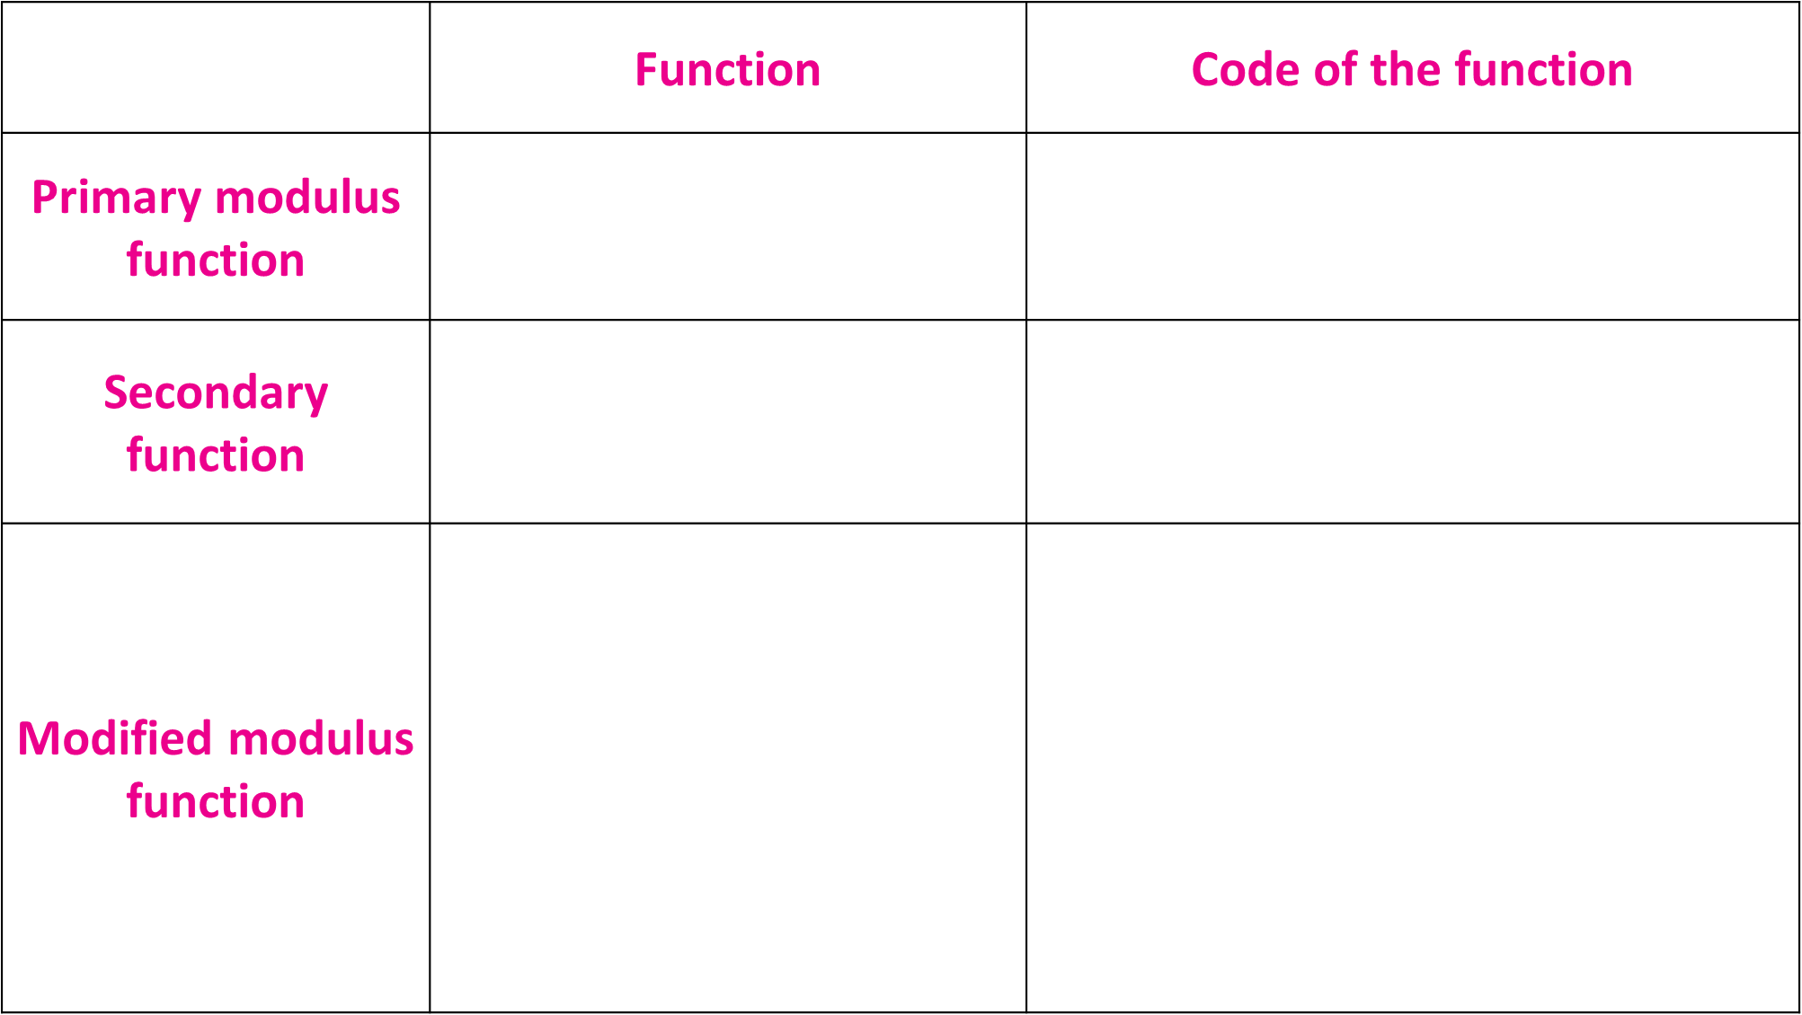
 | Function | Code of the function
Primary modulus function | H1(x) = element % size | int hash1(int element) { return element % size; }
Secondary function | H2(x) = r – (element % r) | int hash2(int element) { return prime - (element % prime); }
Modified modulus function | H1$′$(x) = [H1(x) + i * H2(x)] % size | int modified_hash1(int element) { int i = 1; while (array[(hash1(element) + (i * hash2(element))) % size] != 0 && i < size) { i++; } return (hash1(element) + (i * hash2(element))) % size; }

Slide 4
Insertion:
void insert()
{
int element;
printf("Enter the element: ");
scanf("%d", &element);
int index = hash1(element, size);
if (array[index] == 0)
{
array[index] = element;
}
else if (array[index] != 0)
{
index = modified_hash1(array, element, size);
array[index] = element;
}
}

Slide 5
Searching:
void search()
{
int key;
printf("Enter the value to search: ");
scanf("%d", &key);
int i = 0;
while (array[(hash1(key, size) + (i * hash2(key, size))) % size] != key && i < size)
{
i++;
}
if (i == size)
{
printf("%d is NOT FOUND in the hash table.\n", key);
}
else
{
printf("%d is FOUND after %d cycle/s at index %d.\n", key, i, (hash1(key, size) + (i * hash2(key, size))) % size);
}
}

Slide 6
Deletion:
int delete ()
{
int key;
printf("Enter the value to delete: ");
scanf("%d", &key);
int i = 0;
while (array[(hash1(key, size) + (i * hash2(key, size))) % size] != key && i < size)
{
i++;
}
if (i == size)
{
printf("%d is NOT FOUND in the hash table.\n", key);
return 0;
}
else
{
printf("%d is deleted.\n", key);
array[(hash1(key, size) + (i * hash2(key, size))) % size] = 0;
return 1;
}
}

