Slide 1

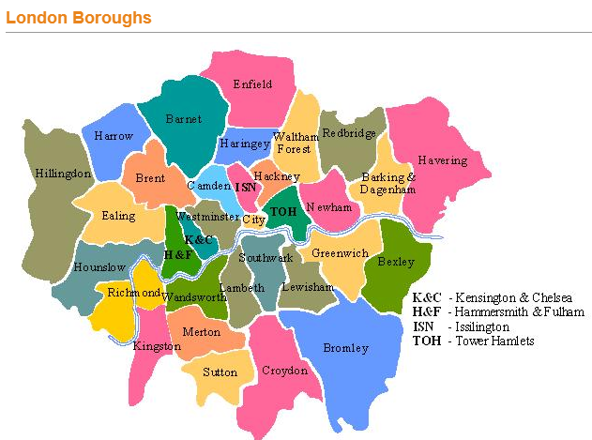
The London boroughs
which boroughs of London have seen the greatest increase in housing prices, on average, over the last two decades?

Slide 2
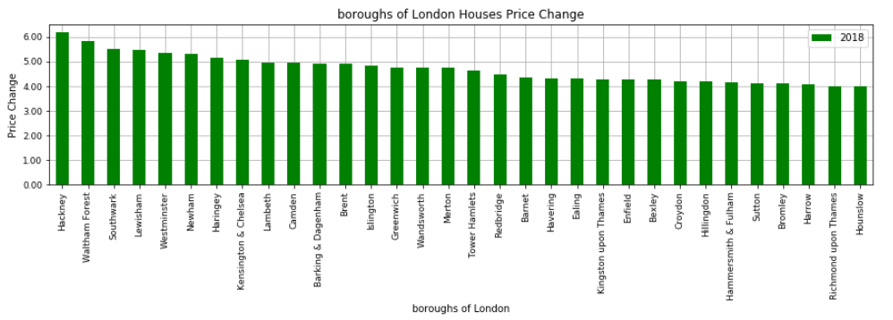
Which boroughs of London have seen the greatest increase in housing prices, on average, over the last two decades?
After completing our analysis; as shown from the chart in the left “Hackney” has seen the greatest price increase with ~6.2% when we compared average prices between 1998 and 2018.
6.2%

Slide 3
Analysis Details:
This project was divided into below 5 stages:
(1) Sourcing and loading:
(a) Importing Libraries.
(b) Loading the data
(2) Cleaning, transforming, and visualizing:
(a) Exploring the data.
(b) Cleaning the data.
(c) Transforming the data.
(3) Visualizing the data using matplotlib & Pandas.
(4) Modeling
(5) Evaluating and concluding
Main tools, techniques and concepts used in this project:
pandas
data ingestion and inspection (pandas Foundations, Module One)
exploratory data analysis (pandas Foundations, Module Two)
tidying and cleaning (Manipulating DataFrames with pandas, Module Three)
transforming DataFrames (Manipulating DataFrames with pandas, Module One)
subsetting DataFrames with lists (Manipulating DataFrames with pandas, Module One)
filtering DataFrames (Manipulating DataFrames with pandas, Module One)
grouping data, Resampling and melting data (Manipulating DataFrames with pandas, Module Four)
Visualization(Manipulating DataFrames with pandas, Module Three)
advanced indexing (Manipulating DataFrames with pandas, Module Four)
matplotlib (Intermediate Python for Data Science, Module One)
fundamental data types (Data Types for Data Science, Module One)
dictionaries (Intermediate Python for Data Science, Module Two)
handling dates and times (Data Types for Data Science, Module Four)
function definition (Python Data Science Toolbox - Part One, Module One)
default arguments, variable length, and scope (Python Data Science Toolbox - Part One, Module Two)
lambda functions and error handling (Python Data Science Toolbox - Part One, Module Four)

Slide 4
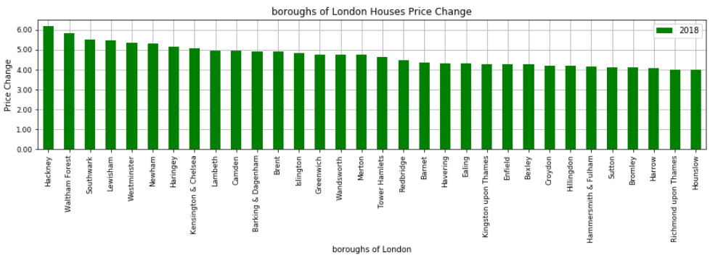
Why Hackney has shown the greatest price increase among all London Boroughs:
1/3
From the first sheet imported 'Average price’ we found out multiple things:
(1) Hackney has shown the greatest home price increase by ~6.2% when we compared prices between 1998 & 2018:
6.2%

Slide 5
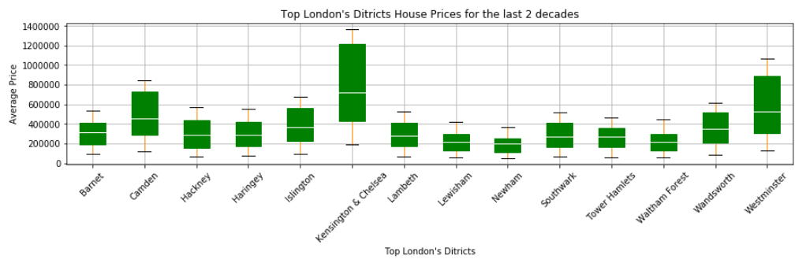
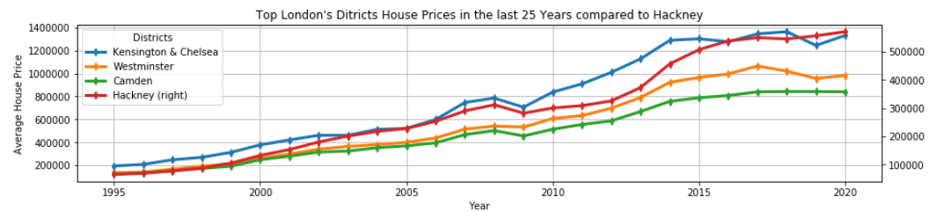
(2) Hackney’s start house pricing point (1995) was one the lowest among the top highest house prices in London Boroughs!
(suggests that Hackney was really an attractive & affordable neighborhood for middle class workers who can have easy access to the city):
2/3
When the demand curve for housing increases, so too do prices. It makes sense: If more people want something than is available for purchase, then they are willing to pay more for that product. As prices increase, demand generally drops (verified from chart next sheet), as affordability decreases.

Slide 6
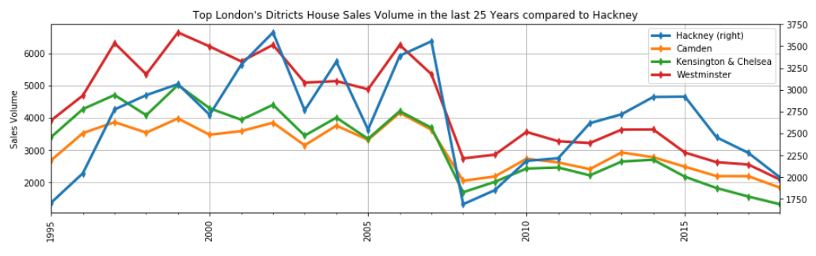
(3) From the second sheet imported ‘Sales Volume’ we found out that Hackney has shown the highest demands among the top highest house
prices in London Boroughs!
3/3
Sharp sales increase in Hackney mainly due to:
Low house prices compared to other London
Boroughs (Affordable by middle class).
(2) Easy access to the city of London.
(3) Explosion of new developments and boutique-
style businesses
Big spike in Demand only in Hackney, mainly because it was one of the 5 cities in London Hosting the Olympic Games in 2012
Low sales volume across the board was driven mainly due to low supply, so basically people will pay extra to get something beyond the supply and this will increase the price and reduce affordability
2008 Financial Crisis
”all got impacted’

Slide 7
Summary & Conclusion:
Hackney has shown the greatest price change among all London boroughs with ~6.2% compared 1995 with 2018.
From 1995 till 2015, Hackney has shown the highest demands due to:
Affordability: Low house prices compared to other London Boroughs (Affordable by middle class).
Easy Access to the city of London.
Explosion of new developments and boutique-style businesses.
Big demand spike in 2012 only in Hackney, after the 2008 Financial crisis, mainly because it was one of the 5 cities in London
Hosting the Olympic Games in 2012.
From 2015 till now, all London borough have shown a decline in house sales:
After analyzing both the Average Price and the Sales Volume sheets we can conclude that when the demand curve for housing increases, so too do prices. It makes sense: If more people want something than is available for purchase (Low. supply), then they are willing to pay more for that product. As prices increase, demand generally drops, as affordability decreases
There are so many factors that can affect the supply and demand for housing, and many aren't economic in nature. Consider the current COVID-19 pandemic, which grounded constructions, paused home sales for a period, and caused building materials to be intermittently (un)available. That certainly put significant downward pressure on housing supply and demand. Or, consider a local government that wants to encourage urban growth and opens up new urban land for development that will increase supply as inward migration increases demand. So as a conclusion, we can not look at only the price increase change without looking at many different factors that affect housing market supply and demand like in our example the Sale volumes.

