Slide 1
General project structure
- 10 mobile tests (4 classes)
- 13 page objects
- Property reader class (ResourceBundle class) + 5 property files
- Loger (log4j2 -> Console and File)
- Test infrastructure API (service class -> app installation)
- No “Product Under Test” API preconditions

Slide 2
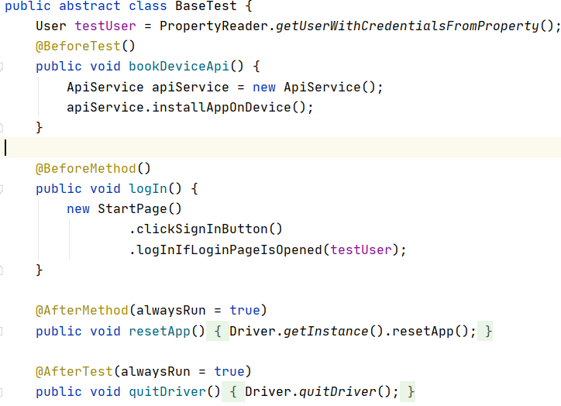
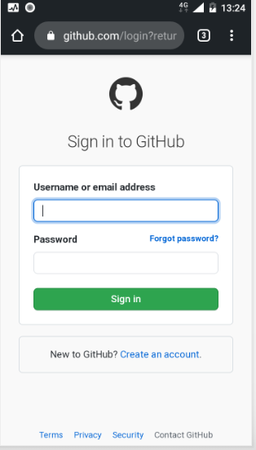
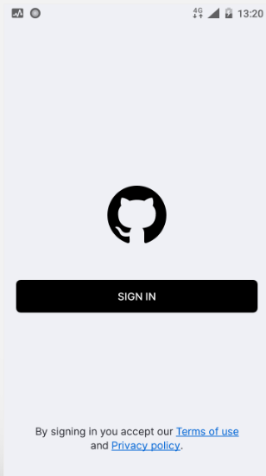
Mobile tests
Base test - general abstract class for all tests
Disconnection with a phone

Slide 3
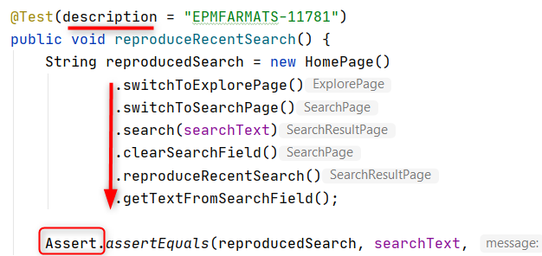
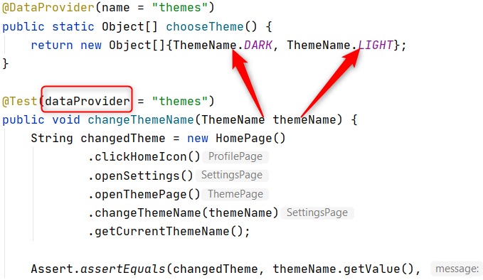
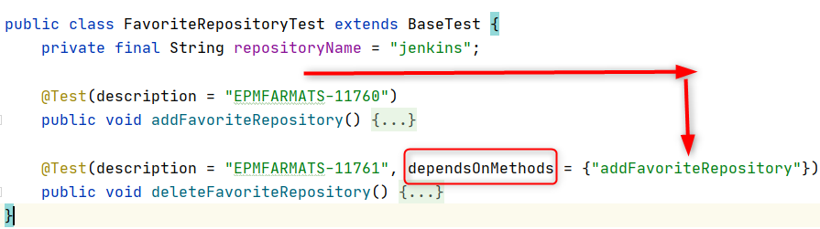
FavoriteRepositoryTest SearchTest SettingsTest
addFavoriteRepository() reproduceRecentSearch() logOut()
deleteFavoriteRepository() clearRecentSearches() changeThemeName()
searchTest() checkPassingToPrivacyStatementPage()
checkPassingToTermsOfServicePage()

Slide 4
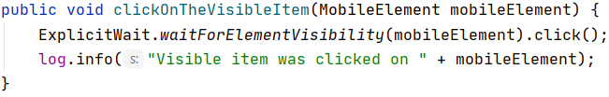
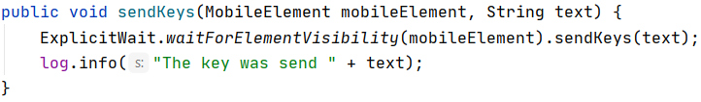
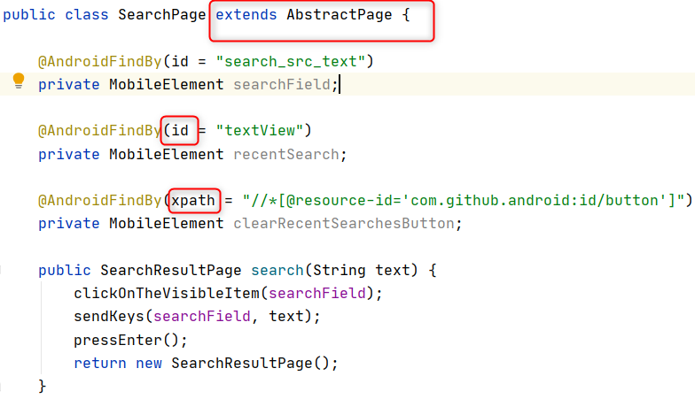
Page objects
AbstractPage ExplorePage HomePage LoginPage ProfilePage SearchPage StartPage ...

Slide 5
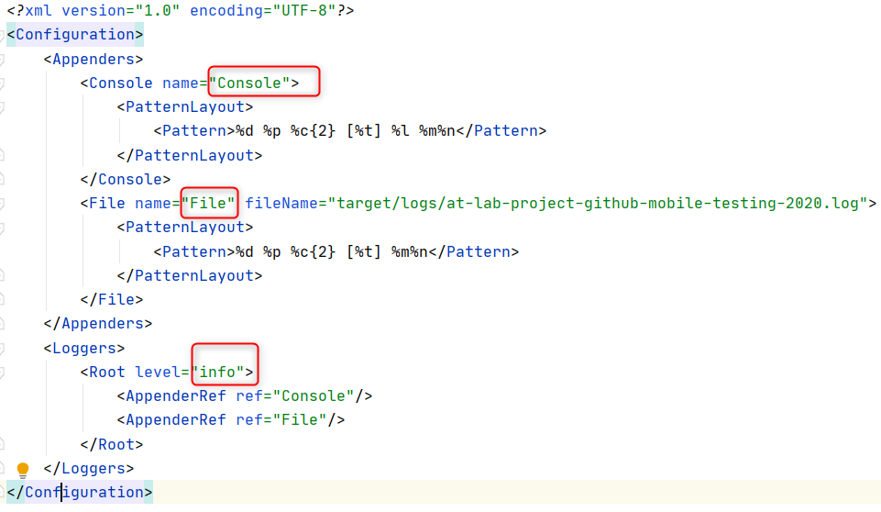
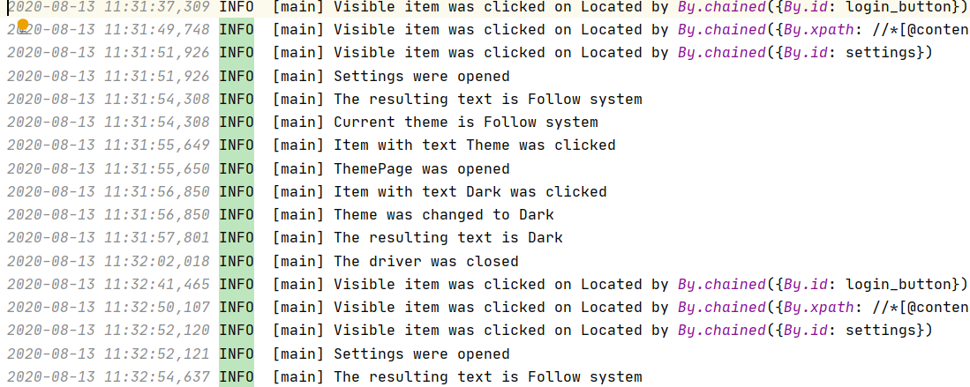
Logger
Add dependencies (log4j-core, log4j-api)
Configure log4j2.xml, create a file for loggs

Slide 6
Thank you all for listening
Now I would like to invite any questions you may have.

