Slide 1


LAKSHMI NARAIN COLLEGE OF TECHNOLOGY & SCIENCE, BHOPAL
Major Project Presentation
Team Members:
Ankit Kumar Kasyap (0157CS161024)
Akshat Gangrade (0157CS161013)
Anushka Soni (0157CS161033)
Apoorva Chauhan (0157CS161035)

Slide 2
ABSTRACT
Student Attendance System is an application developed for daily student attendance in schools, colleges and institutes. It facilitates to access the attendance information of a particular student in a particular class. This system will also help in evaluating attendance eligibility criteria of a student.
In this application, the admin will be able to manage faculty, who’ll take the attendance. The attendance and students will be managed by faculty. Student will only be able to view his/her attendance on the system.
We’ve provided the email notification facility for the students in our application. The faculty will be able to send attendance related notifications to students if needed.
We’ve also provided the feedback facility in our application. Faculty and students will be able to give useful feedback for the admin. The admin can read those feedbacks and also will be able to manage them
This project mainly focuses on developing a simple and better attendance system in order to digitalise the attendance process and also conserve the nature by saving paper.

Slide 3
INTRODUCTION
About:
This project is developed for the convenience and ease of faculty members and students of a college or organisation where their students or their members attendance is of paramount importance.
Student Attendance System is an application developed for daily student attendance in schools, colleges and institutes. It facilitates to access the attendance information of a particular student in a particular class.
Students will be able to view his/her attendance on the system. This project mainly focuses on developing a simple and better attendance system in order to digitalize the attendance process and also conserve the nature by saving paper.
Objectives:
Goal or aim of our project is to ease the process of attendance management and to introduce a better system for the same.
To provide a comparative and cumulative study of variation in each student profile of attendance for a certain duration of time.

Slide 4
FEATURES
Through the system, we can easily maintain the data without any loss or damage.
By using this system time consumption will be reduced.
By using this website students can easily know about the status of their attendance.
On the basis of details submitted students can match up their pace.
Admin monitors group activities and updation and deletion of records
Faculty can easily manage students and their attendance.
Faculty can easily notify students about their attendance if needed.
Faculty and Students can give useful feedback for the admin.

Slide 5
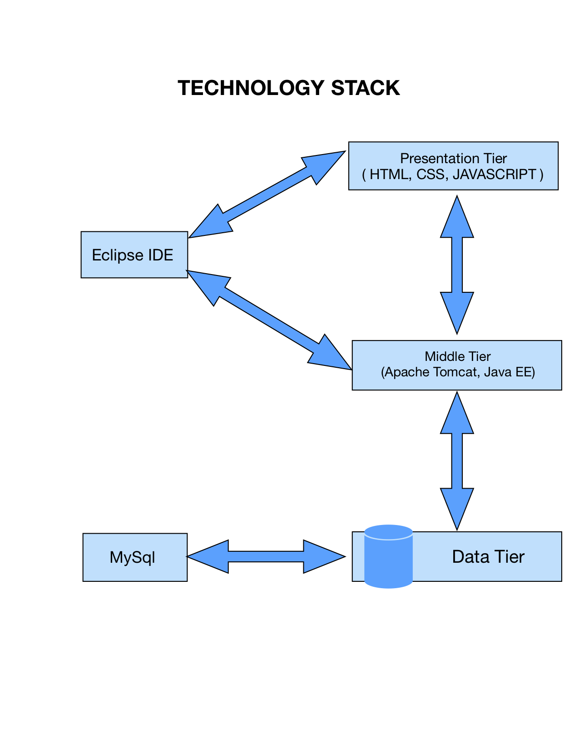

Slide 6
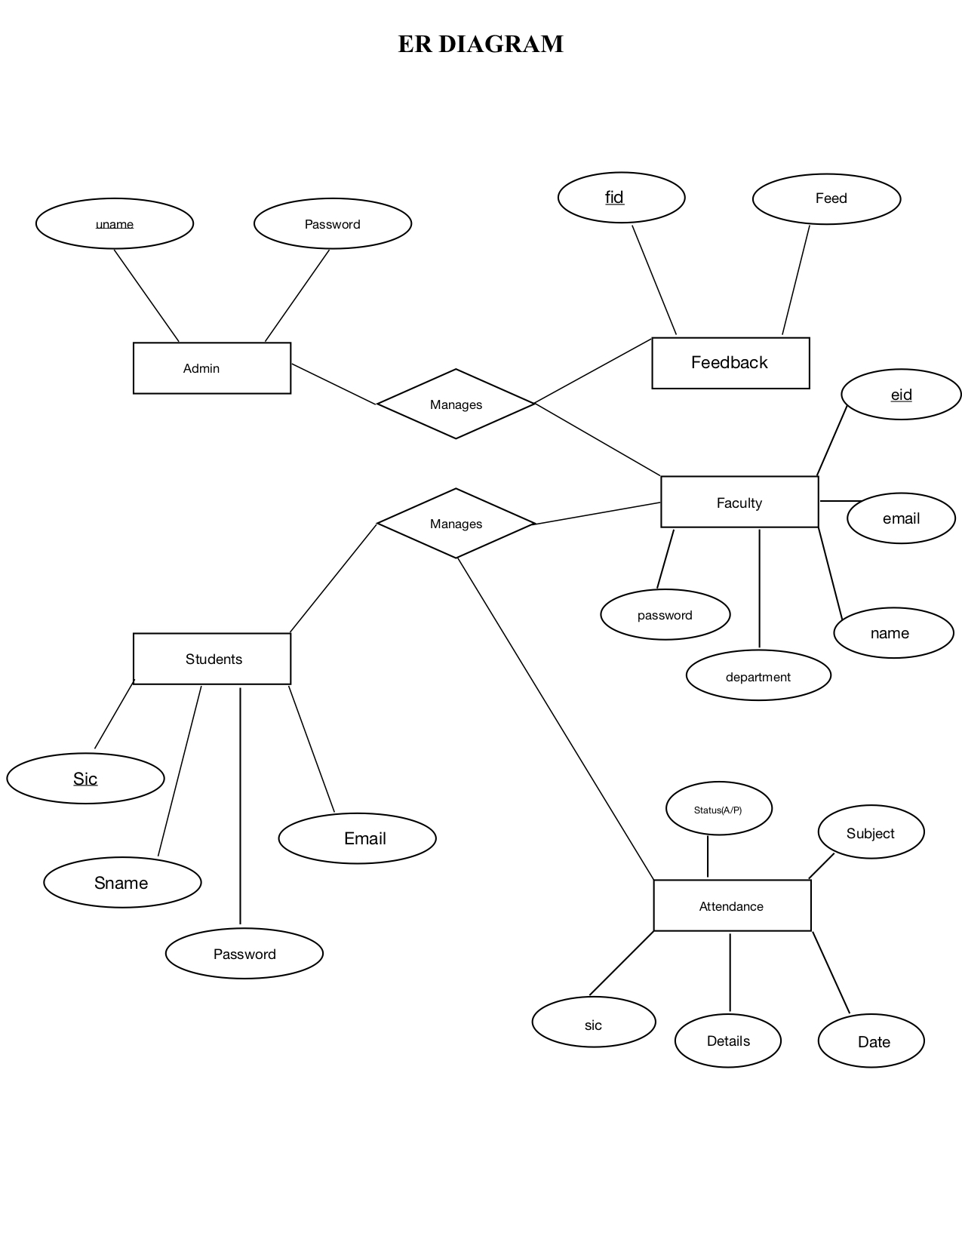

Slide 7
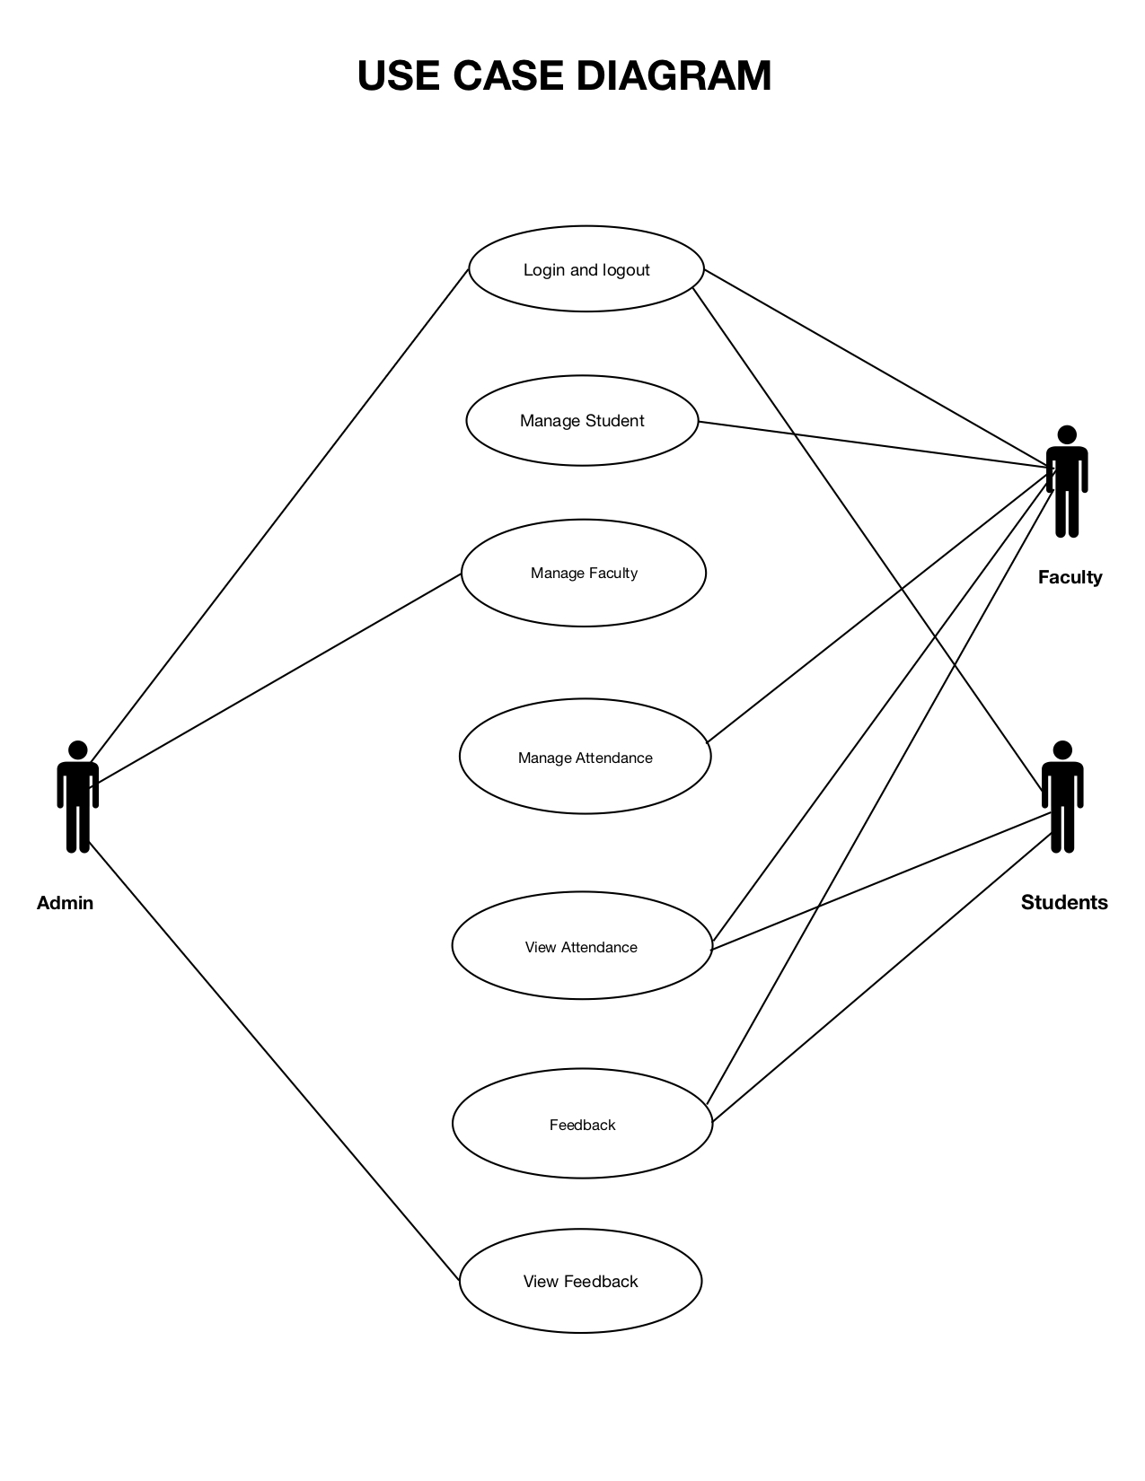

Slide 8
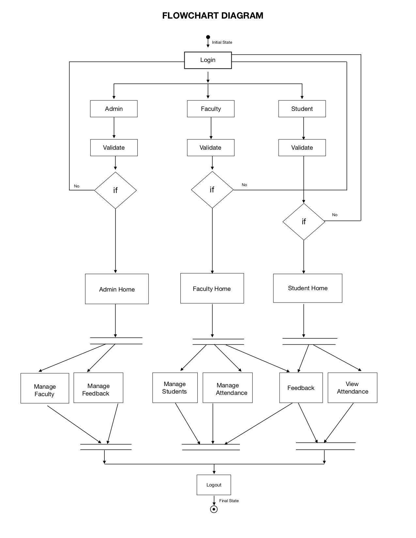

Slide 9
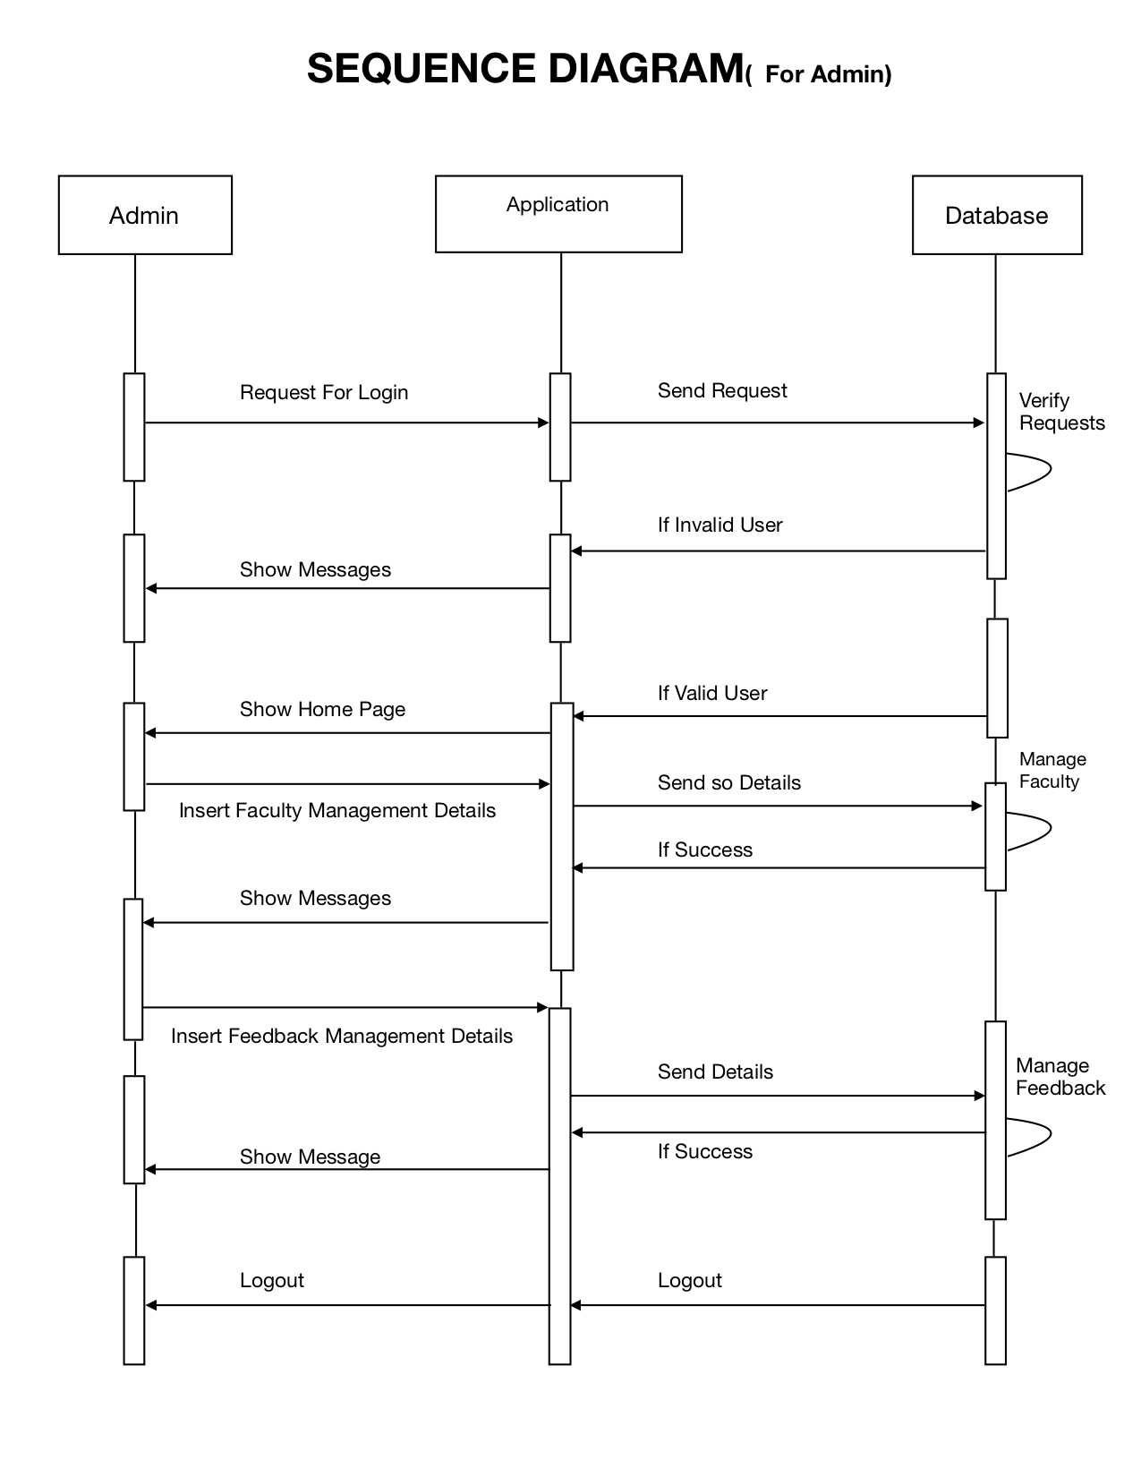

Slide 10


Slide 11
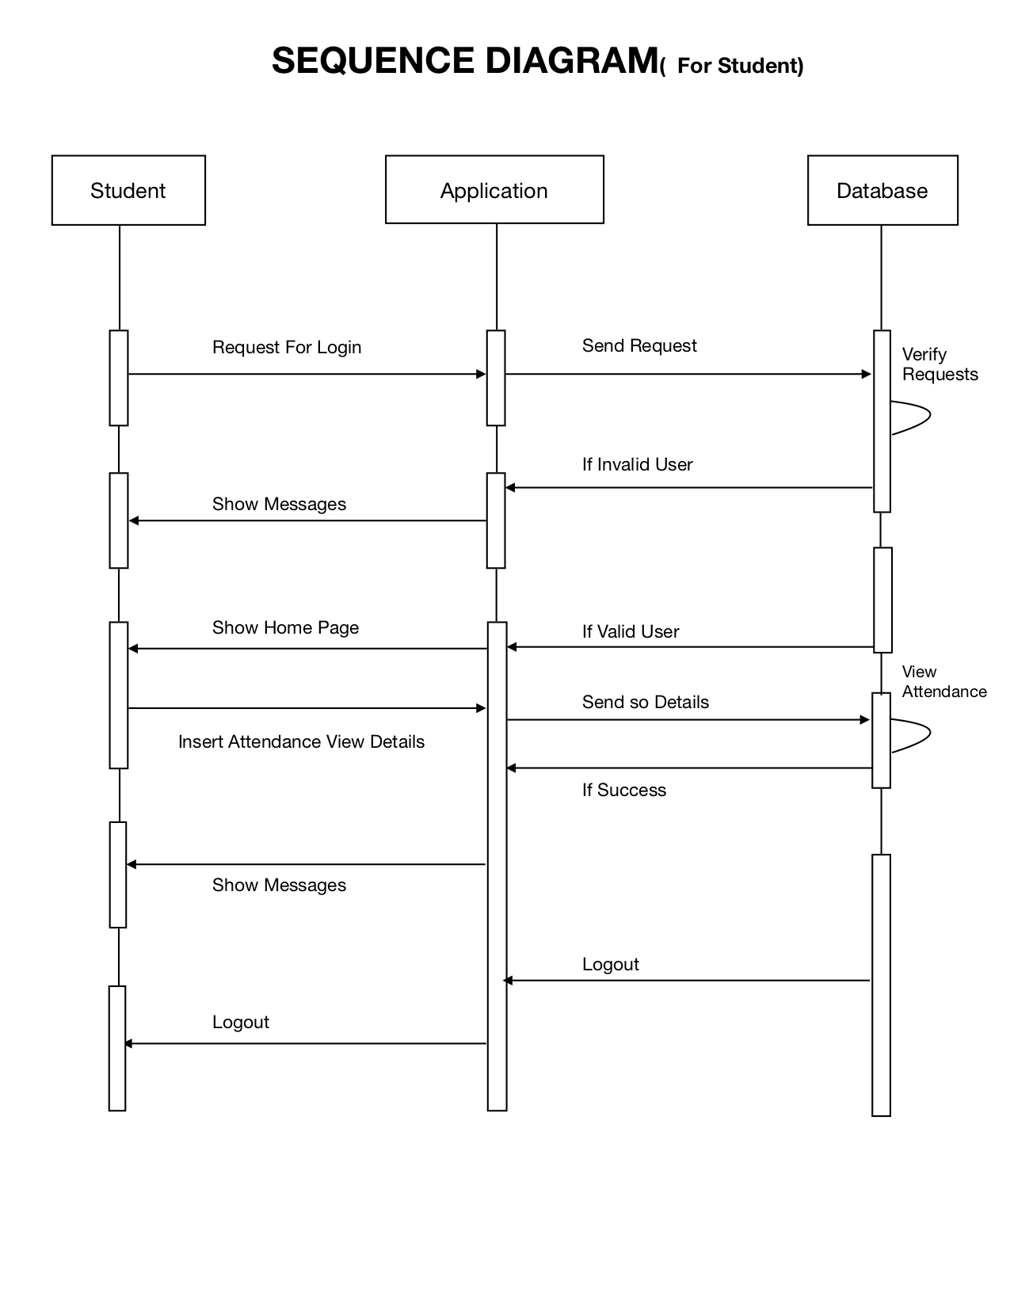

Slide 12
Thanks

