Slide 1
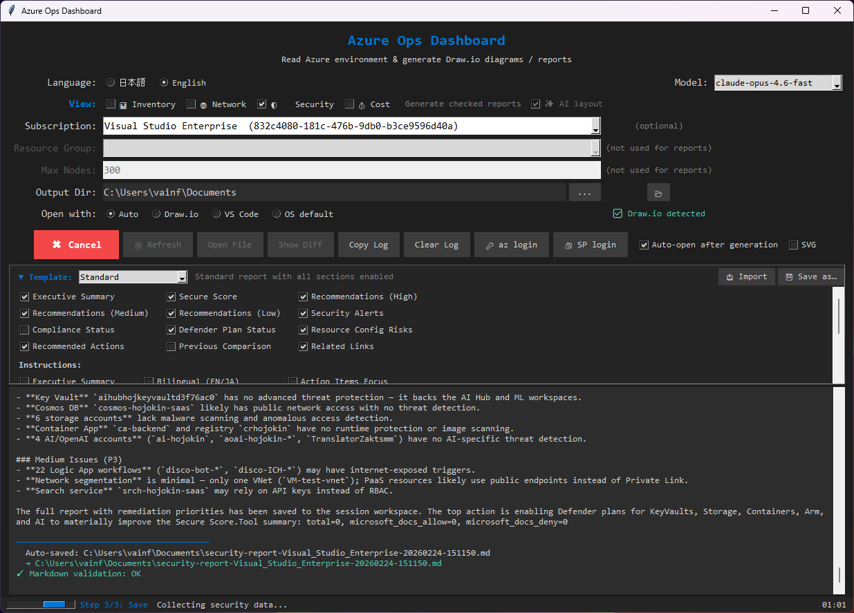
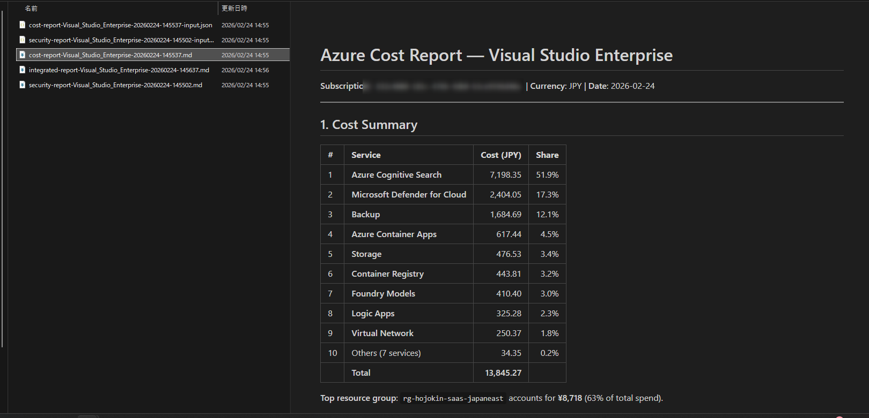
Azure Ops Dashboard
Tatsumi Yamamoto | FY26 Copilot SDK Enterprise Challenge
One-click Azure environment visualization & AI-powered operational reports
Problem
• IT ops teams waste hours switching Azure Portal, CLI, docs
• Architecture diagrams go stale — drift undetected
• Security & cost reviews are manual and inconsistent
• No single tool: diagrams + AI insights in one workflow
Solution
• One-click: Azure Resource Graph → Draw.io diagrams
• AI reports via GitHub Copilot SDK (streaming)
• Security + Cost analysis enriched with MS Learn docs
• Diff reports track environment drift automatically
• Desktop GUI — no cloud deployment needed
GUI — Collect & Diagram Generation
Enterprise Value
• Visualization in minutes (not hours) — reusable per customer
• Early security risk detection / cost optimization suggestions
• Template customization / JP-EN switching / Word-PDF-SVG export
AI Cost Report — Streaming Output
GitHub: https://github.com/aktsmm/azure-ops-dashboard

Slide 2
Architecture & Copilot SDK Integration
End-to-end flow: Azure data → AI analysis → actionable output
tkinter GUI
(main.py)
Azure CLI
Resource Graph
Security / Cost
Advisor
Copilot SDK
CopilotClient
(streaming)
MS Learn
Search API
+ MCP
Output
.drawio / .md
.docx / .pdf
GitHub Copilot SDK
Azure Integration
Ops & Responsible AI
• CopilotClient with streaming token callbacks
• Dynamic model: claude-sonnet / gpt-4.1 fallback
• Read-only tool permissions (frozenset)
• MS Docs MCP for document-grounded analysis
• Retry + exponential backoff + future.cancel()
• Thread-safe UI: atomic buffer swap @ 100ms
• Resource Graph — full inventory (1000 nodes)
• Defender for Cloud — Secure Score + alerts
• Cost Management — spend by service/RG
• Advisor — optimization recommendations
• Service Principal + Interactive login
• Reader role minimum (read-only ops only)
• 39 unit tests (no Azure/SDK needed)
• PyInstaller single-exe packaging
• Cross-platform: Windows/macOS/Linux
• No secrets stored to disk
• RAI notes in README
• Human-in-the-loop AI review gate
Key Capabilities: Draw.io diagrams (inventory + network views) | Security & Cost AI reports | Diff reports (drift detection) | Template customization | JP/EN switching | Word/PDF/SVG export
GitHub: https://github.com/aktsmm/azure-ops-dashboard | Tatsumi Yamamoto | FY26 Copilot SDK Enterprise Challenge

