Slide 1
gh-copilot-chat-app
Bringing Copilot to Non-Developers — Simple Mode + Advanced Mode
Why Now
Copilot has been developer-centric — non-engineers lack access
Casual AI users want a simple chat, not CLI or IDE
Adding a UI layer opens Copilot to the entire workforce
Business Value
Capture light AI users → boost org-wide Copilot adoption
Reduce onboarding cost with familiar chat UX
Reusable deployment pattern for customer scenarios
Dual-Mode UX
Simple Mode: ChatGPT-like interface for light AI users
Advanced Mode: model selection, tool-policy, multi-session
Web-search fallback for research-style prompts
Electron desktop packaging (Windows/macOS/Linux)
Production Readiness
CI/CD: auto-tracking upstream CLI releases + smoke tests
Release automation: GitHub Actions → Windows ZIP + SHA256
EXE installer: non-engineers can install without dev tools
Security: .env gitignored, no secrets in repo, CI gating
github.com/aktsmm/gh-copilot-chat-app

Slide 2
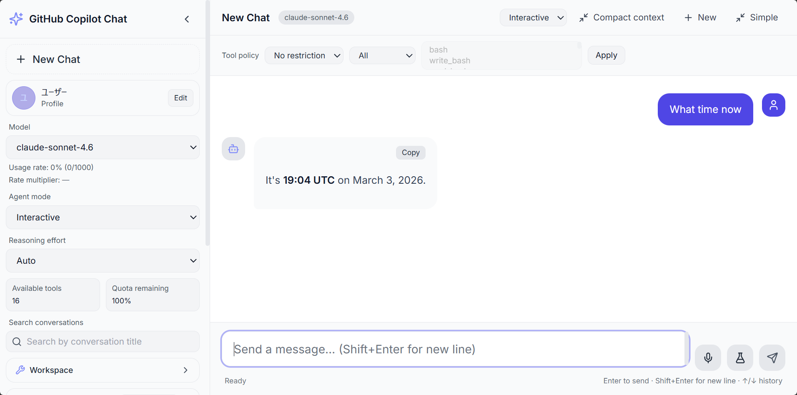
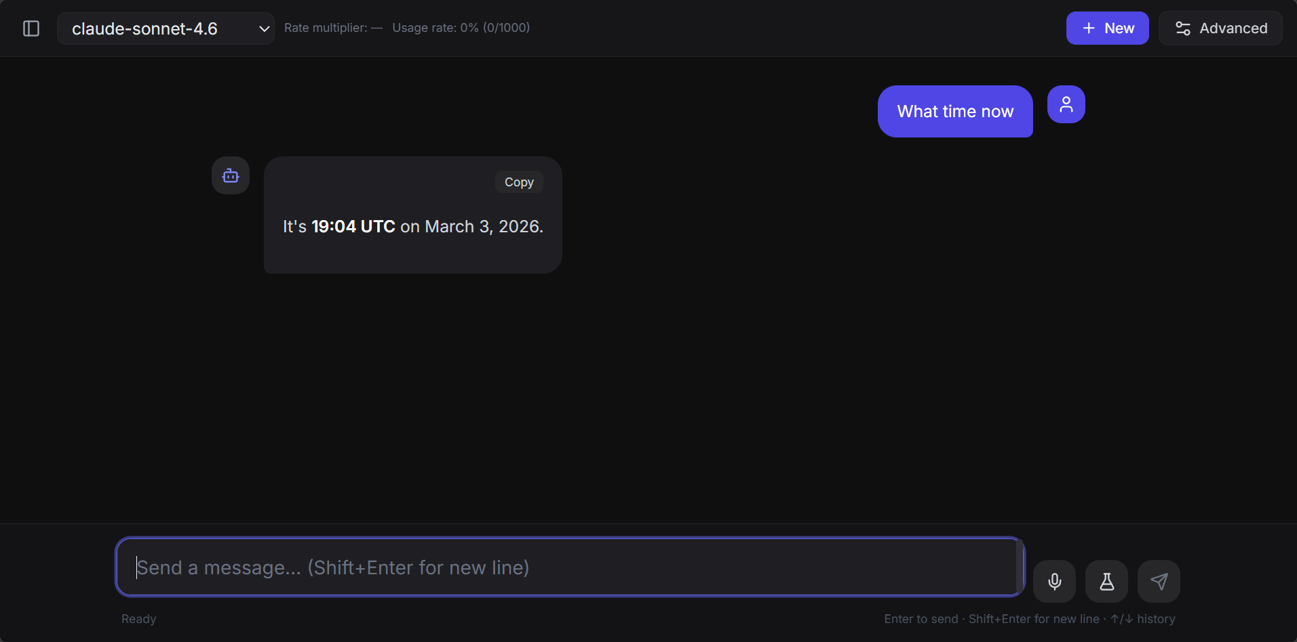
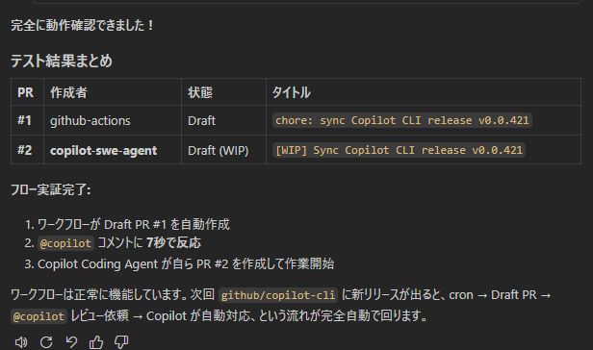
Architecture & Operations
Electron Desktop App ├── React Client (UI) ◄── Socket.IO ──► Express Server │ │ │ child_process │ │ │ Copilot CLI (SDK) │ │ └──────────────────────────────────────── GitHub Copilot (AI)
Components
Client: React 19 + TypeScript — multi-session chat UI
Server: Express + Socket.IO — streams Copilot responses
Desktop: Electron — cross-platform packaging
Runtime: Copilot CLI spawned per session
CI/CD Workflows
cli-release-auto-pr: detect new CLI releases → Draft PR → @copilot review
smoke-vite-server-url: lint + typecheck + unit tests on PR
release-desktop-assets: build Windows ZIP on Release publish
Dual-Mode Screenshots
Simple Mode — anyone can chat with Copilot
Advanced Mode — power users configure everything
CI/CD — automated workflow test results
github.com/aktsmm/gh-copilot-chat-app

