Slide 1
AB1003 - Reporting and Modularization
This presentation is for internal use only and not intended for external distribution. Its contents must be held in confidence.
Notes:
© 2006 Capgemini - All rights reserved

Slide 2

COURSE OBJECTIVES
Recap
Introduction to Reporting
Reporting Events
Modularization
Miscellaneous
Demonstration
Exercises

Slide 3


Slide 4
Recap
After completing this lesson, you will be able to:
Data Types
Data Objects
Structures & Internal Tables

Slide 5
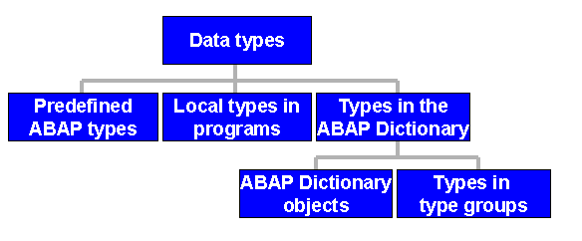
Recap
Data Types

Slide 6
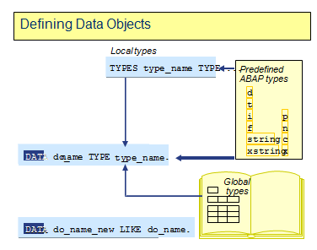
Recap
Defining Data Objects
Data objects are usually defined with the DATA statement
After the name of the data object, a fully-specified type is assigned to it using the TYPE addition

Slide 7
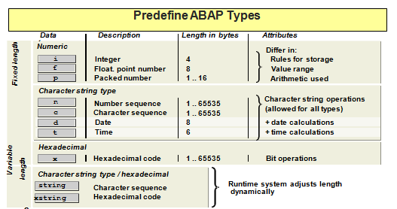
Recap
Predefined Data Types
ABAP types d, t, i, f, string, and xstring are used directly to type data objects and are therefore called fully specified types.
ABAP Types c, n, and x must include additional information before using them to define data objects:

Slide 8
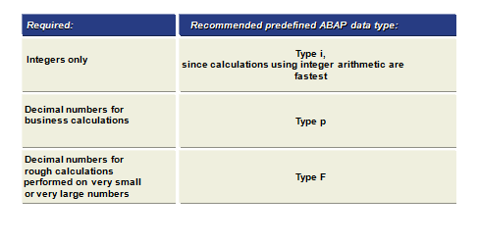
Recap
Recommendations for Using Numeric Data Types

Slide 9
Recap
Arithmetic Calculations
Operator
+, -, * , / , DIV
MOD
**
ABS
CEIL
FLOOR
TRUNC
FRAC
Meaning
Mathematical
Remainder of integer division
Powers
Absolute value of argument
Smallest integer value
Largest integer value
Integer part of argument
Fraction part of argument

Slide 10
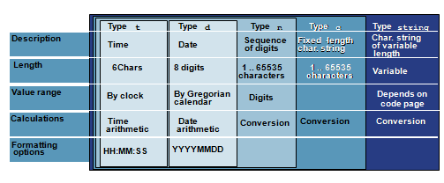
Recap
Predefined ABAP Types for Character Strings
The initial value of each character string with fixed length is a space character.
The initial value of each character in a numeric string is a zero.
The initial value of a date is '000000'.
The initial value of a time is '000000'.

Slide 11
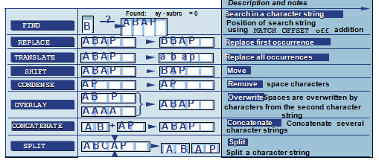
Recap
Character Strings Processing
All of the statements apart from TRANSLATE and CONDENSE set the system field SY-SUBRC

Slide 12
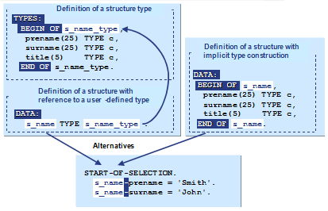
Recap
Defining Structures with local Types

Slide 13
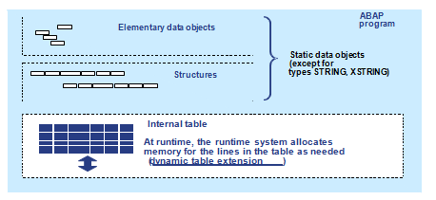
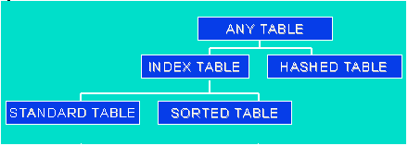
Recap
Internal Tables

Slide 14
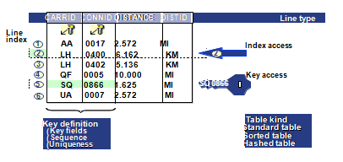
Recap
Attributes of Internal Tables
Line type: You use the line type to specify which columns are to be included in your internal table.
Key: The key is defined by: Specifying the columns that should belong to the key; the sequence; and whether or not the key should be unique or non-unique.
Table kind: The table kind specifies the possible accesses.

Slide 15
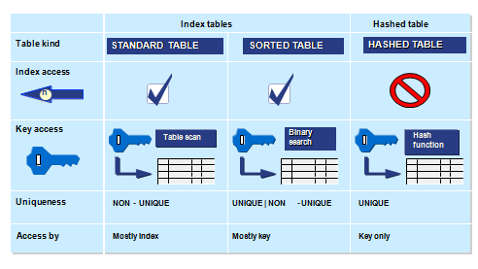
Recap
Link Between Table Kind and Access Type

Slide 16
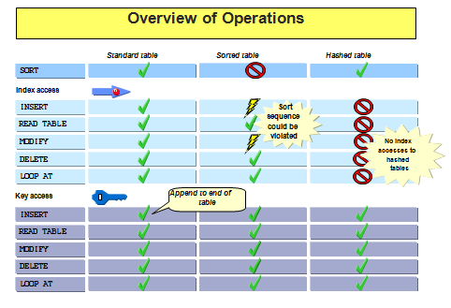
Recap
Overview of Operations

Slide 17
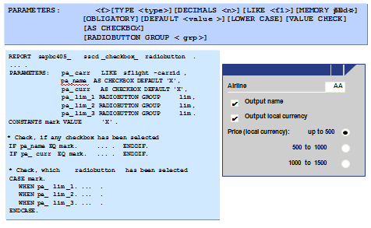
Recap
Selection Screen: Declaring Fields with Parameters

Slide 18
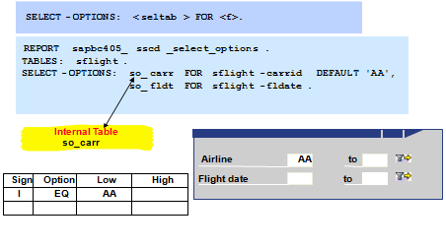
Recap
Selection Screen: Declaring Fields with Select-Options

Slide 19
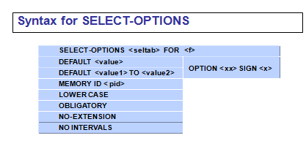
Recap
Selection Screen: Declaring Fields with Select-Options
MEMORY ID <PID>, the system retrieves the current value from SAP system memory and supplies it on the screen automatically
OBLIGATORY generates a mandatory field.
NO-EXTENSION suppresses multiple single or multiple range selections.
NO INTERVALS suppresses the SELTAB-HIGH (upper interval limit) entry on the selection screen.

Slide 20
Recap
Selection Screen: Formatting
SELECTION-SCREEN SKIP [<n>] - To produce blank lines on the selection screen
SELECTION-SCREEN ULINE [[/]<pos(LEN)>] [MODIF ID <key>] - To underline a line or part of a line on the selection screen
SELECTION-SCREEN COMMENT [/]<pos(LEN)> <name> [FOR FIELD <f>] [MODIF ID <key>] - To write text on the selection screen
SELECTION-SCREEN BEGIN OF BLOCK <block> [WITH FRAME [TITLE <title>]][NO INTERVALS]….SELECTION-SCREEN END OF BLOCK <block> - To create a logical block of elements on the selection screen

Slide 21
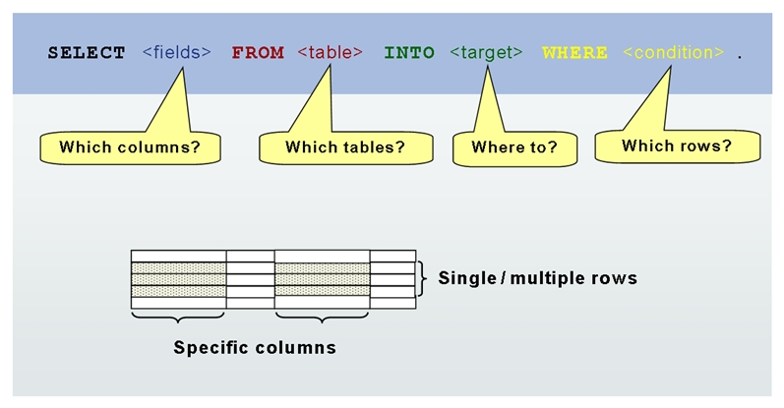
Recap
Select Statement
SELECT <result>
INTO <target>
FROM <source>
[WHERE <condition>]
[GROUP BY <fields>]
[ORDER BY <fields>].
ENDSELECT.

Slide 22
Recap
Select Statement
SELECT <result>
INTO <target>
FROM <source>
[WHERE <condition>]
[GROUP BY <fields>]
[ORDER BY <fields>].
ENDSELECT.

Slide 23
Recap
Select Statement
Reading the Whole Line
  SELECT * FROM EMP INTO TMPTABLE WHERE EMPNO = EMPNO
  ENDSELECT.
Reading a Single Line
  SELECT SINGLE * FROM EMP WHERE EMPNO = EMPNO.
Reading Lines Using Up To
  SELECT * FROM EMP WHERE EMPNO IN EMPNO UPTO N ROWS.
  ENDSELECT.
Reading Single Columns
  SELECT NAME EMPNAME FROM EMP WHERE EMPNO = EMPNO.
  ENDSELECT.
Reading Data Dynamically
  SELECT (TMPEMP) FROM (TBLNAME) WHERE EMPNO = EMPNO.
  ENDSELECT.
CLIENT SPECIFIED, BYPASSING BUFFER.

Slide 24
Recap
WHERE Condition
<Condition>
EQ, =
NE, <>, ><
LT, <
GT, >
LE , <=
GT , >=
[NOT] BETWEEN
[NOT] LIKE
[NOT] IN
Meaning
Equal
Not Equal
Less Than
Greater Than
Less Than or Equal
Greater Than or Equal
Between
Like Patten
In

Slide 25
Recap
WHERE Condition
<Condition>
EQ, =
NE, <>, ><
LT, <
GT, >
LE , <=
GT , >=
[NOT] BETWEEN
[NOT] LIKE
[NOT] IN
Meaning
Equal
Not Equal
Less Than
Greater Than
Less Than or Equal
Greater Than or Equal
Between
Like Patten
In

Slide 26


Slide 27
Introduction to Reporting
After completing this lesson, you will be able to:
Purpose of Reporting and Flow
How to Format List Output
Conditional and Unconditional page breaks

Slide 28
Introduction to Reporting
Purpose
Reports are Programs that read data from the database, processes the data
and displays the data to the required format.
Use
  Reports are used in day to day business environment. Example
    Displaying the purchase orders vendor wise
    Displaying the balance of vendors to be paid till a particular date
  Enhance the efficiency & transparency of Business Processes
  Sound Decision making with the control of master data and accurate reporting
  Relevant Documents immediately available for in case of drill down reports
  Multiple angles of Data representing and Forecasting Values

Slide 29
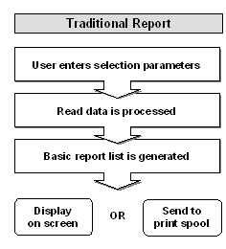
Introduction to Reporting
Program Flow

Slide 30
Introduction to Reporting
Introductory Statements for Programs
Program type | Introductory statement
1 | REPORT
M | PROGRAM
F | FUNCTION-POOL
K | CLASS-POOL
J | CLASS-POOL
S | PROGRAM
T | TYPE-POOL
I | PROGRAM

Slide 31
Introduction to Reporting
Attributes.
    Source code
    Text elements
    Documentation
    Variants
Report Statement.
REPORT ZREPNAME [NO STANDARD PAGE HEADING] [LINE-SIZE COL] [LINE-COUNT n(m)] [MESSAGE-ID mid].
NO STANDARD PAGE HEADING - Suppresses output of the standard page header
LINE-SIZE COL - Creates a report with COL columns per line.
LINE-COUNT n(m) - Creates a report list with n lines per page, of which m lines are reserved for the END-OF-PAGE processing.
SUBMIT <rep> [AND RETURN] [<options>]. starts the report whose name is stored in field <rep>

Slide 32
Introduction to Reporting
Text Symbols
    Text symbols are simple text literal.
    They can be translated to any other Language.
    You can address text symbols in a program one of two ways:
    TEXT-<xxx> (xxx is a three digit character sequence)
    '<Text>'(<xxx>) (xxx is a three digit character sequence)

Slide 33
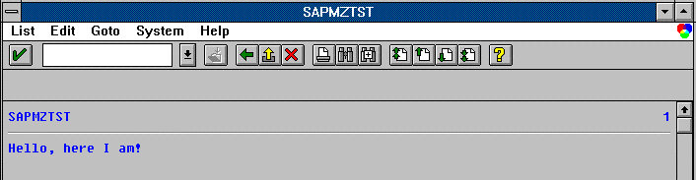
Introduction to Reporting
Write Statement
Syntax: WRITE <f>.
This statement writes field <f> to the current list in its standard output format.
Example
PROGRAM SAPMZTST.
WRITE 'Hello, here I am!'.

Slide 34
Introduction to Reporting
Positioning Write on Output List
Syntax
WRITE AT [/][<POs>][(<LEN>)] <f>.
where '/' denotes a new line,
<pos> is a number or variable up to three digits long denoting the
position on the screen,
<Len> is a number or variable up to three digits long denoting the output length.
In the default setting, you cannot create empty lines with the WRITE
statement.
WRITE: 'One',
/ ' ',
/ 'Two'.
This produces the following output:
One
Two

Slide 35
Introduction to Reporting
Formatting Options
Syntax
    WRITE .... <f> <option>.
    Formatting options for all data types
Option | Function
LEFT-JUSTIFIED | Output is left-justified.
CENTERED | Output is centered.
RIGHT-JUSTIFIED | Output is right-justified.
UNDER <g> | Output starts directly under field <g>.
NO-GAP | The blank after field <f> is omitted.
USING EDIT MASK <m> | Specifies format template <m>.
USING NO EDIT MASK | Deactivates a format template specified in the ABAP Dictionary.
NO-ZERO | If a field contains only zeros, these are replaced by blanks. For type C and N fields, leading zeros are replaced automatically.

Slide 36
Introduction to Reporting
Formatting Options…..Continued
Syntax
    WRITE .... <f> <option>.
    Formatting options for Numeric Fields
Option | Function
NO-SIGN | The leading sign is not displayed on the screen.
DECIMALS <d> | <d> defines the number of digits after the decimal point.
EXPONENT <e> | In type F fields, the exponent is defined in <e>.
ROUND <r> | Type P fields are multiplied by 10**(-r) and then rounded.
CURRENCY <c> | Format according to currency <c> in table TCURX.
UNIT <u> | The number of decimal places is fixed according to unit <u> specified in table T006 for type P fields.

Slide 37
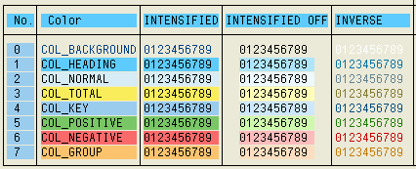
Introduction to Reporting
Write Options - Output Formatting.
Format Color n.
Format Color n Intensified On.
FORMAT COLOR OFF INTENSIFIED OFF INVERSE OFF HOTSPOT OFF INPUT Off.

Slide 38

Introduction to Reporting
Displaying Symbols and Icons on the List
You can output symbols or R/3 icons on a list by using the following syntax:
Syntax:
WRITE <symbol-name> AS SYMBOL.
WRITE <icon-name> AS ICON.
To make symbols and icons available to your program, you must import the
appropriate include or the more comprehensive include <LIST> in your
program.
INCLUDE <symbol>.
INCLUDE <icon>.
WRITE: / 'Phone Symbol:', SYM_PHONE AS SYMBOL.
SKIP.
WRITE: / 'Alarm Icon: ', ICON_ALARM AS ICON.
This produces the following output:

Slide 39
Introduction to Reporting
Blank Lines and Drawing lines
Horizontal lines
You can generate horizontal lines on the output screen by using the following
Syntax: ULINE [AT [/][<pos>][(<len>)]].
Vertical lines
You generate vertical lines on the output screen by using the following
Syntax: WRITE [AT [/][<pos>]] SY-VLINE.
Blank lines
You can generate blank lines on the screen by using the following :
Syntax: SKIP [<n>].

Slide 40

Introduction to Reporting
Displaying Field Content as Checkbox
You can output the first character of a field as a checkbox on the output
screen by using the following
Syntax: WRITE <f> AS CHECKBOX.
If the first character of field <f> is an "X", the checkbox is displayed filled. If
the first character is SPACE, the checkbox is displayed blank.
DATA: flag1(1) TYPE c VALUE ' ',
flag2(1) TYPE c VALUE 'X',
flag3(5) TYPE c VALUE 'Xenon'.
WRITE: / 'Flag 1 ', flag1 AS CHECKBOX,
/ 'Flag 2 ', flag2 AS CHECKBOX,
/ 'Flag 3 ', flag3 AS CHECKBOX.
This produces the following output list:

Slide 41
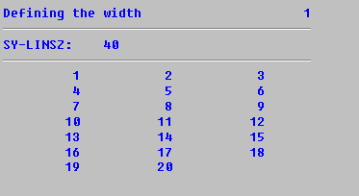
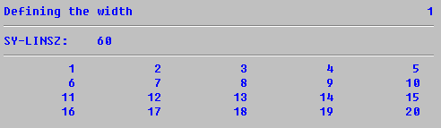
Introduction to Reporting
Determining List Width
To determine the width of the output list, use the LINE-SIZE option of the
REPORT statement. While creating the list, the system field SY-LINSZ
contains the current line width.
Syntax: REPORT <rep> LINE-SIZE <width>.
REPORT demo_list_line_size LINE-SIZE 40.
WRITE: 'SY-LINSZ:', SY-LINSZ.
ULINE.
DO 20 TIMES.
WRITE sy-index.
ENDDO.
REPORT demo_list_line_size LINE-SIZE 60.
WRITE: 'SY-LINSZ:', SY-LINSZ.
ULINE.
DO 20 TIMES.
WRITE sy-index.
ENDDO.

Slide 42
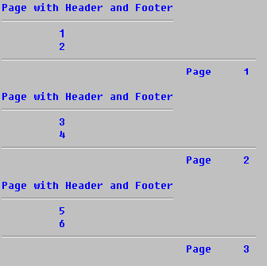
Introduction to Reporting
Determining the Page Length
To determine the page length of an output list, use the LINE-COUNT option
of the REPORT statement.
Syntax: REPORT <rep> LINE-COUNT <length>[(<n>)].
If you specify the optional number <n>, the system reserves <n> lines of the
page length for the page footer.
REPORT DEMO_LIST_END_OF_PAGE LINE-SIZE 40 LINE-COUNT 6(2) NO STANDARD PAGE HEADING.
TOP-OF-PAGE.
WRITE: 'Page with Header and Footer'.
ULINE AT /(27).
END-OF-PAGE.
ULINE.
WRITE: /30 'Page', sy-pagno.
START-OF-SELECTION.
DO 6 TIMES.
WRITE / sy-index.
ENDDO.

Slide 43
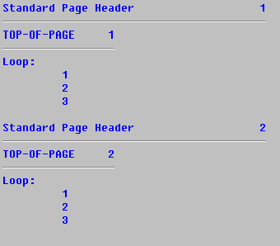
Introduction to Reporting
Programming Page Breaks - Unconditional Page Break
To trigger a page break during list processing, use the basic form of the
NEW-PAGE statement:
Syntax: NEW-PAGE.
This statement ends the current page. All other output appears on a new
page.
REPORT DEMO_LIST_NEW_PAGE LINE-SIZE 40.
TOP-OF-PAGE.
WRITE: 'TOP-OF-PAGE', SY-PAGNO.
ULINE AT /(17).
START-OF-SELECTION.
DO 2 TIMES.
WRITE / 'Loop:'.
DO 3 TIMES.
WRITE / sy-index.
ENDDO.
NEW-PAGE.
ENDDO.

Slide 44
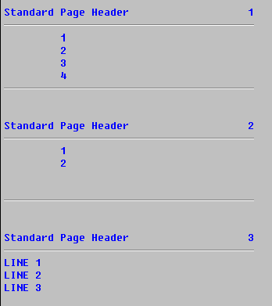
Introduction to Reporting
Programming Page Breaks - Conditional Page Break
To execute a page break on the condition that less than a certain number of
lines is left on a page, use the RESERVE statement:
Syntax: RESERVE <n> LINES.
REPORT DEMO_LIST_RESERVE LINE-SIZE 40
LINE-COUNT 8(2).
END-OF-PAGE.
ULINE.
START-OF-SELECTION.
DO 4 TIMES.
WRITE / SY-INDEX.
ENDDO.
DO 2 TIMES.
WRITE / SY-INDEX.
ENDDO.
RESERVE 3 LINES.
WRITE: / 'LINE 1',
/ 'LINE 2',
/ 'LINE 3'.

Slide 45
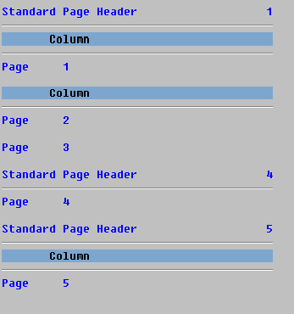
Introduction to Reporting
Standard Page Headers of Individual Pages
The standard page header consists of list and column headers. To influence
the representation of these individual components of the standard page
header, use the following options.
Syntax: NEW-PAGE [NO-TITLE|WITH-TITLE] [NO-HEADING|WITH
HEADING].
REPORT DEMO_LIST_NEW_PAGE_OPTIONS
LINE-SIZE 40.
WRITE: 'PAGE', SY-PAGNO.
NEW-PAGE NO-TITLE.
WRITE: 'PAGE', SY-PAGNO.
NEW-PAGE NO-HEADING.
WRITE: 'PAGE', SY-PAGNO.
NEW-PAGE WITH-TITLE.
WRITE: 'PAGE', SY-PAGNO.
NEW-PAGE WITH-HEADING.
WRITE: 'PAGE', SY-PAGNO.

Slide 46
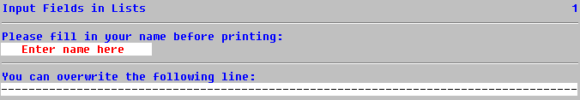
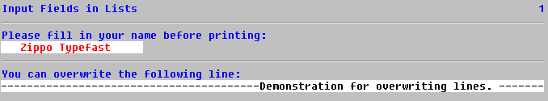
Introduction to Reporting
Enabling Fields for Input
To make output fields input-enabled from within the program, use the
FORMAT statement as follows:
Syntax: FORMAT INPUT [ON|OFF].
REPORT DEMO_LIST_FORMAT_INPUT.
WRITE 'PLEASE FILL IN YOUR NAME BEFORE PRINTING:'.
WRITE / ' ENTER NAME HERE ' INPUT ON.
ULINE.
WRITE 'YOU CAN OVERWRITE THE FOLLOWING LINE:'.
FORMAT INPUT ON INTENSIFIED OFF.
ULINE.
FORMAT INPUT OFF INTENSIFIED ON.

Slide 47
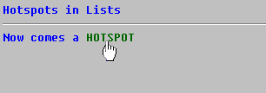
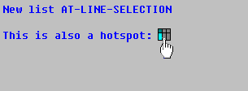
Introduction to Reporting
Output Fields as Hotspots
If the user clicks once onto a hotspot field, an event is triggered (for example,
AT LINE-SELECTION).To output areas as hotspots, use the following option
of the FORMAT statement:
Syntax: FORMAT HOTSPOT [ON|OFF].
REPORT DEMO_LIST_FORMAT_HOTSPOT.
INCLUDE <LIST>.
START-OF-SELECTION.
WRITE 'NOW COMES A'.
FORMAT HOTSPOT ON COLOR 5 INVERSE ON.
WRITE 'HOTSPOT'.
FORMAT HOTSPOT OFF COLOR OFF.
AT LINE-SELECTION.
WRITE / 'NEW LIST AT-LINE-SELECTION'.
SKIP.
WRITE 'THIS IS ALSO A HOTSPOT:'.
WRITE ICON_LIST AS ICON HOTSPOT.

Slide 48


Slide 49
Reporting Events
After completing this lesson, you will be able to:
Purpose and usage of Events
Classical and interactive Events

Slide 50
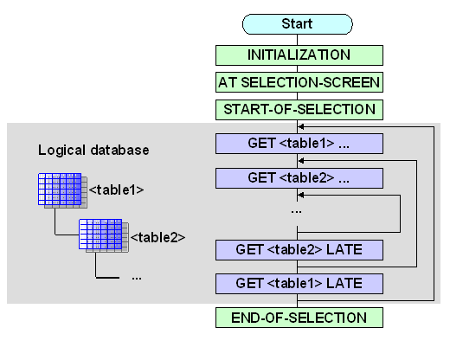
Reporting Events
Event Blocks in Executable Programs
When you run an executable program, the program flow is controlled by the external events in the ABAP runtime environment. The following diagram shows the sequence of the events:
The events in the gray box are only processed if you have entered a logical database in the program attributes. The AT SELECTION-SCREEN event is only processed if a selection screen is defined in the program or the logical database linked to the program. The other events occur when any executable program is run

Slide 51
Reporting Events
Event Blocks in Executable Programs
The following events occur when you run a typical executable program with a
logical database:
INITIALIZATION: Before the standard selection screen is displayed.
AT SELECTION-SCREEN: After user input on a selection screen has been processed, but while the selection screen is still active.
START-OF-SELECTION: After the standard selection screen has been processed, before data is read from the database.
GET <TABLE>: After the logical database has read an entry from the node <table>.
GET <TABLE> LATE: After all of the nodes of the logical database have been processed that are below <table> in the database hierarchy.
END-OF-SELECTION: After all data has been read by the logical database.

Slide 52
Reporting Events
List processor events
TOP-OF-PAGE: In list processing when a new page starts.
END-OF-PAGE: In list processing when a page ends.
AT LINE-SELECTION: Event is triggered by either the user double clicking a particular line or using F2 to select it.
AT PF<NN>: When the user triggers the predefined function code PF<NN>.
AT USER-COMMAND: When the user triggers a function code defined in the program.
TOP-OF-PAGE DURING LINE SELECTION: Event called during list processing when a detailed list is called.

Slide 53
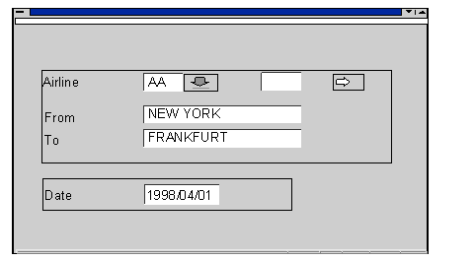
Reporting Events
Initialization
Processed before the presentation of the selection screen Can be used to initialize values in the selection screen or to assign values to any parameters that appear on the selection screen.
REPORT EVENT_DEMO.
PARAMETERS DATUM TYPE SY-DATUM
DEFAULT SY-DATUM.
NODES SPFLI.
INITIALIZATION.
CITY_FR = 'NEW YORK'.
CITY_TO = 'FRANKFURT'.
CARRID-SIGN = 'I'.
CARRID-OPTION = 'EQ'.
CARRID-LOW = 'AA'.
APPEND CARRID.
DATUM+6(2) = '01'.

Slide 54
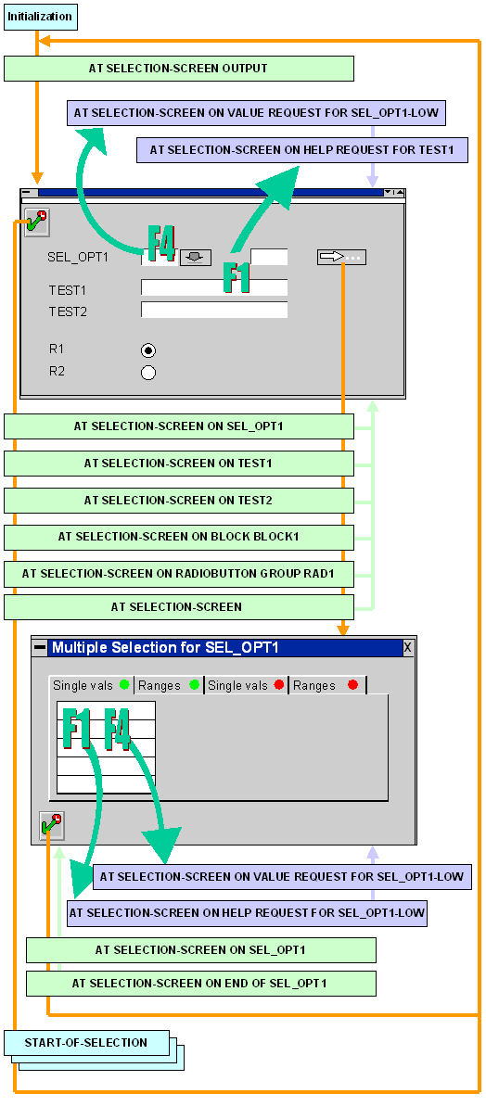
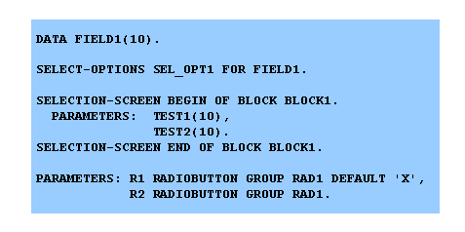
Reporting Events
At Selection Screen
Processing block is started after the user has specified all the criteria in the selection screen
This event can also be called on a particular parameter or select-option using At Selection-Screen on <parameter or select-option>

Slide 55
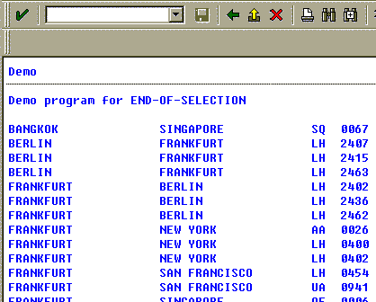
Reporting Events
Start-Of-Selection
  Processing block is executed after processing the selection screen
  All the data is selected in this block.
  All the main processing on the data except for interactive reporting is handled in this block.
End-Of-Selection
  Data which is selected and has been processed is printed to the screen in this block.
  List Processing happens in this block
REPORT EVENT_DEMO.
NODES SPFLI.
DATA: SPFLI_TAB TYPE SORTED TABLE OF SPFLI
WITH UNIQUE KEY CITYFROM CITYTO CARRID CONNID,
SPFLI_LINE TYPE SPFLI.
START-OF-SELECTION.
WRITE 'Demo program for END-OF-SELECTION'.
SKIP.
GET SPFLI FIELDS CARRID CONNID CITYFROM CITYTO.
MOVE-CORRESPONDING SPFLI TO SPFLI_LINE.
INSERT SPFLI_LINE INTO TABLE SPFLI_TAB.
END-OF-SELECTION.
LOOP AT SPFLI_TAB INTO SPFLI_LINE.
WRITE: / SPFLI_LINE-CITYFROM,
SPFLI_LINE-CITYTO,
SPFLI_LINE-CARRID,
SPFLI_LINE-CONNID.
ENDLOOP.

Slide 56
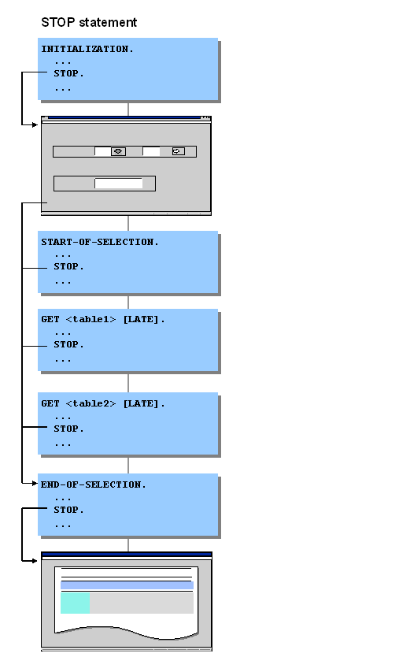
Reporting Events
Leaving Event Blocks using STOP
If you use the STOP statement within an event block, the system stops processing the block immediately. The ABAP runtime environment triggers the next event according to the following diagram:

Slide 57
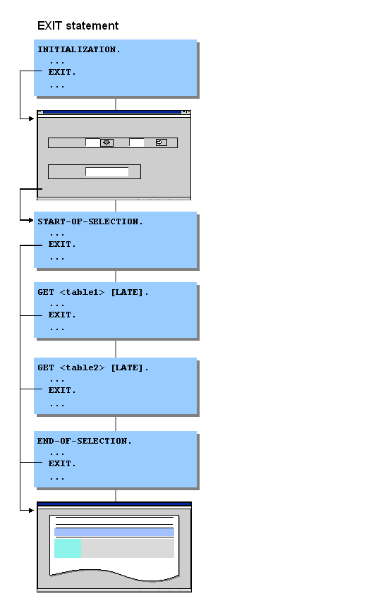
Reporting Events
Leaving Event Blocks using EXIT
From the START-OF-SELECTION event onwards, the system starts the list processor directly when the EXIT statement occurs, and displays the list.
If the EXIT statement occurs in a loop using DO, WHILE, or LOOP, it is the loop that terminates, not the processing lock.

Slide 58
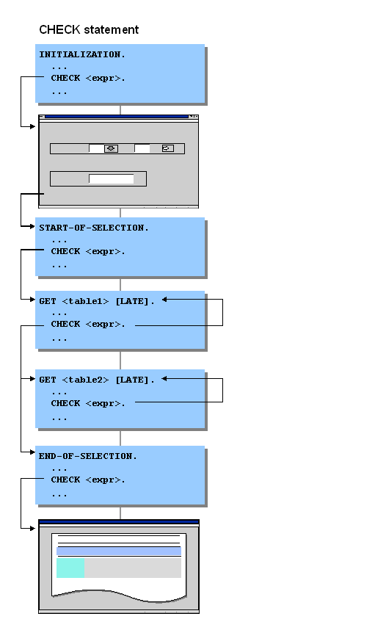
Reporting Events
Leaving Event Blocks using Check
If you use the CHECK <EXPR> statement within an event block but not within a loop, and the condition <EXPR> is not fulfilled, the system exits the processing block immediately.

Slide 59
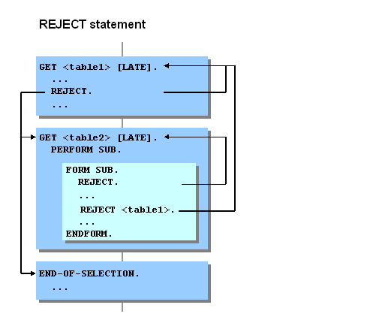
Reporting Events
Leaving a GET event block using REJECT
The REJECT statement was specially developed for leaving GET event blocks. Unlike CHECK and EXIT, REJECT always refers to the current GET event block. The REJECT statement allows you to exit a GET event block directly from a loop or a subroutine.

Slide 60
Reporting Events
Leaving a GET event block using REJECT
The REJECT statement was specially developed for leaving GET event blocks. Unlike CHECK and EXIT, REJECT always refers to the current GET event block. The REJECT statement allows you to exit a GET event block directly from a loop or a subroutine.

Slide 61
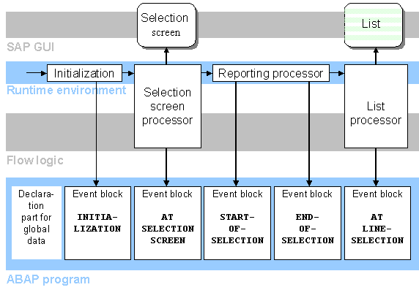
Reporting Events
Interactive Process Flow

Slide 62
Reporting Events
Program Flow in Detailed List
If the report has a custom GUI and the user selects a menu option, the event AT USER-COMMAND is triggered. The function code assigned to the menu option can be evaluated using a CASE construct to determine which menu option was selected.
If the user double-clicks on a report line, the AT LINE-SELECTION event is triggered. The event can also be triggered by single clicking on a report line and either pressing the Detail icon in the application tool bar, pressing F2, or entering the word PICK in the OK code field and pressing Enter.
Program Flow in Detail List
Program
Flow in Detail Lists
SY
List
Edit
Goto
System
Help
-
UCOMM
%EX
DEMO:
List ...
PRI
P+
P
-
. . .
System programs
SY
F2
-
UCOMM
PICK
REPORT SAPBC405_...
AT LINE
-
SELECTION.
AT LINE
-
SELECTION.
AT LINE
-
SELECTION.

Slide 63
Reporting Events
Interactive List
Up to 20 parallel detail lists can exist for each basic list.
Each list has in its own individual memory area called a list buffer.
Navigation Between Lists
Navigating Between Lists
DL 20
DL 2
DL 1
Basic list
double
-
click on line

Slide 64
Reporting Events
Events
The events START-OF-SELECTION, GET, END-OF-SELECTION, TOP-OF-PAGE and END-OF-PAGE can be used only to create basic lists. Once you leave a basic list, these events are no longer processed.
Detail lists are created using two basic events: AT LINE-SELECTION and AT USER-COMMAND. The event TOP-OF-PAGE DURING LINE-SELECTION is used to create headers for all detail lists.
Events:
Overview
* Basic list
START
-
OF
-
SELECTION.
GET ...
.
END
-
OF
-
SELECTION.
TOP
-
OF
-
PAGE.
* Detail lists
AT LINE
-
SELECTION.
AT USER
-
COMMAND.
TOP
-
OF
-
PAGE DURING LINE
-
SELECTION
.

Slide 65
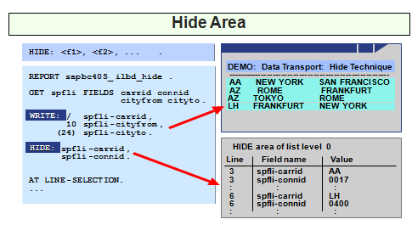
Reporting Events
Data Transport
The HIDE keyword is used to store data objects and their values so they can be made available when the User selects a report line. When a line is selected, the fields that were hidden are filled with the values that you hid for that line.

Slide 66
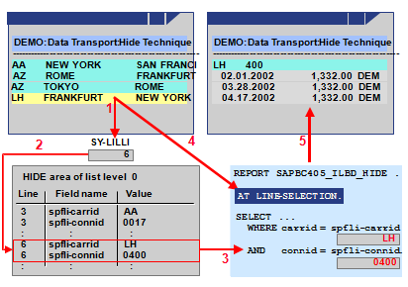
Reporting Events
Line Selection – The Hide Statement
The user selects a line for which data has been stored in the HIDE area.
The runtime system evaluates field SY-LILLI to determine the selected line.
The runtime system jumps to the point in the HIDE area where data for this line is stored.
The runtime system then inserts all values stored for the selected line in the HIDE area into their corresponding fields.
The runtime system processes the event AT LINE-SELECTION and its corresponding program processing block.
A detail list is created.

Slide 67
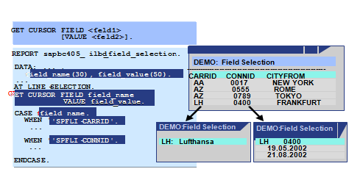
Reporting Events
Field Selection
GET CURSOR statement is used to create detail lists according to the cursor position.
The parameter FIELD provides the name of an output field. The parameter VALUE provide the output value.

Slide 68
Reporting Events
Reading and Modifying List Line
READ - Reading a Line from a List
      READS LINE NUMBER LINE OF THE LIST, USUALLY AFTER A LINE SELECTION
      READ LINE LINE.
      READ LINE LINE OF CURRENT PAGE.
      READ LINE LINE OF PAGE PAG
      READ CURRENT LINE
MODIFY LINE n.
      Change a List Line
      INDEX IDX - Changes the corresponding line in the list at list level IDX
      FIELD VALUE f1 FROM G1 ... FN FROM GN
      WINDOW STARTING AT X1 Y1 ENDING AT X2 Y2.
      Displays the current secondary list as a modal dialog box only up to 20 windows

Slide 69
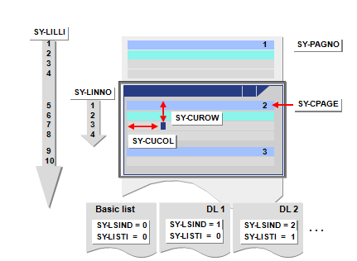
Reporting Events
System Fields for Interactive Lists

Slide 70
Reporting Events
System Fields for Interactive Lists
SY-LSIND Index for the current list
SY-LISTI Index of the last list displayed
SY-LILLI Absolute number of a selected line in the list displayed
SY-CPAGE Number of the upper-most displayed line in the list displayed
SY-CUCOL Number of the column in the window where the cursor was last
positioned in the list displayed
SY-CUROW Number of the line in the window where the cursor was last positioned in the list displayed
SY-STACO Number of the first column displayed in the list displayed
SY-STARO Number of the first visible line in the top displayed page
(SY- PAGE) in the list displayed (not including header lines)
SY-UCOMM Function code that triggered the interactive event in the list
displayed
SY-PFKEY Status of the list displayed

Slide 71


Slide 72
Modularization
After completing this lesson, you will be able to:
Purpose of Modularization
Different Modularization Techniques

Slide 73
Modularization
Modularization Techniques
ABAP contains the following kinds of procedures:
Subroutines
Subroutines are principally for local modularization, that is, they are generally called from the program
in which they are defined. You can use subroutines to write functions that are used repeatedly within a program. You can define subroutines in any ABAP program.
Function Modules
Function modules are for global modularization, that is, they are always called from a different program.
Function modules contain functions that are used in the same form by many different programs. They are important in the R/3 System for encapsulating processing logic and making it reusable.
Function modules must be defined in a function group, and can be called from any program.

Slide 74
Modularization
SUBROUTINES
Defining Subroutines
A subroutine is a block of code introduced by FORM and concluded by
ENDFORM.
FORM <SUBR> [USING ... [VALUE(]<p_{i}>[)] [TYPE <t>|LIKE <f>]... ]
[CHANGING... [VALUE(]<p_{i}>[)] [TYPE <t>|LIKE <f>]... ].
...
ENDFORM.
<SUBR> is the name of the subroutine.
The Parameter Interface
  Parameters Passed by Reference - list these parameters after USING without the VALUE addition
  Parameters Passed by Value - list these parameters after USING with the VALUE addition
  Passing by Value and Result - If you want to return a changed output parameter from a subroutine to the calling program only after the subroutine has run successfully, use CHANGING for the <pass> option of the FORM and PERFORM

Slide 75
Modularization
SUBROUTINES
Calling Subroutines
PERFORM………… [USING ... <pi>... ]
[CHANGING... <pi>... ].
Static Variable
  If you want to keep the value of a local data object after exiting the subroutine, you must use the STATICS statement to declare it instead of the DATA statement. With STATICS you declare a data object that is globally defined, but only locally visible from the subroutine in which it is defined.
  STATICS F_TEXT TYPE F_WORD VALUE 'INIT'.

Slide 76
Modularization
Function Modules
Calling Function Modules
  CALL FUNCTION <MODULE>
  [EXPORTING F1 = A 1.... F N = A N]
  [IMPORTING F1 = A 1.... F N = A N]
  [CHANGING F1 = A 1.... F N = A N]
  [TABLES F1 = A 1.... F N = A N]
  [EXCEPTIONS E1 = R 1....EN = RN [ERROR_MESSAGE = R E]
  [OTHERS = RO]].
Creating Function Modules (SE37)
  Attributes
  Parameter Interface
  Tables
  Exceptions

Slide 77
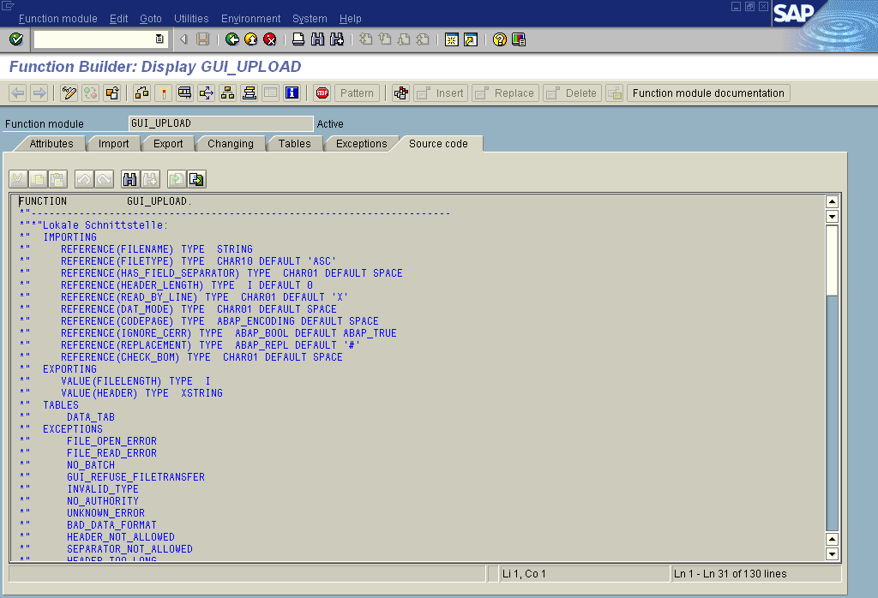
Modularization
Function Modules

Slide 78
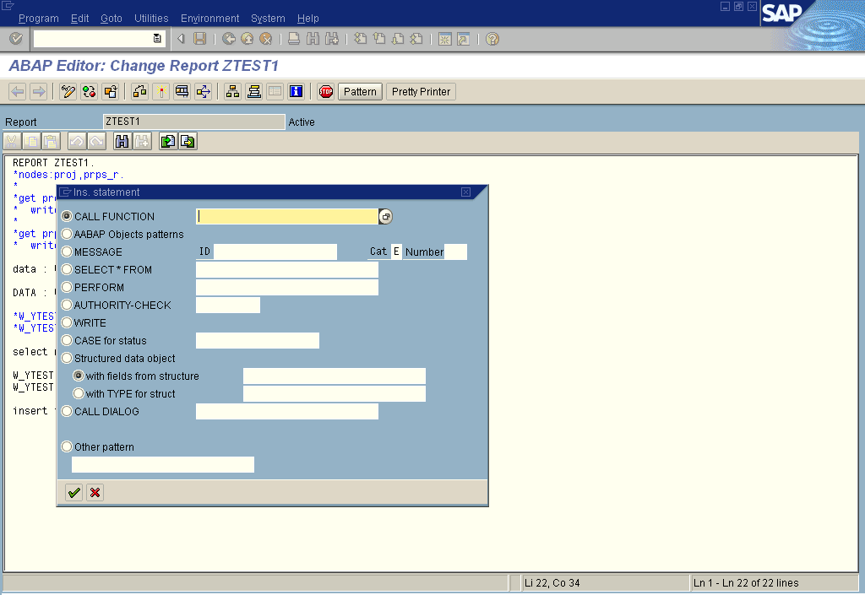
Modularization
Calling A Function modules - Pattern

Slide 79
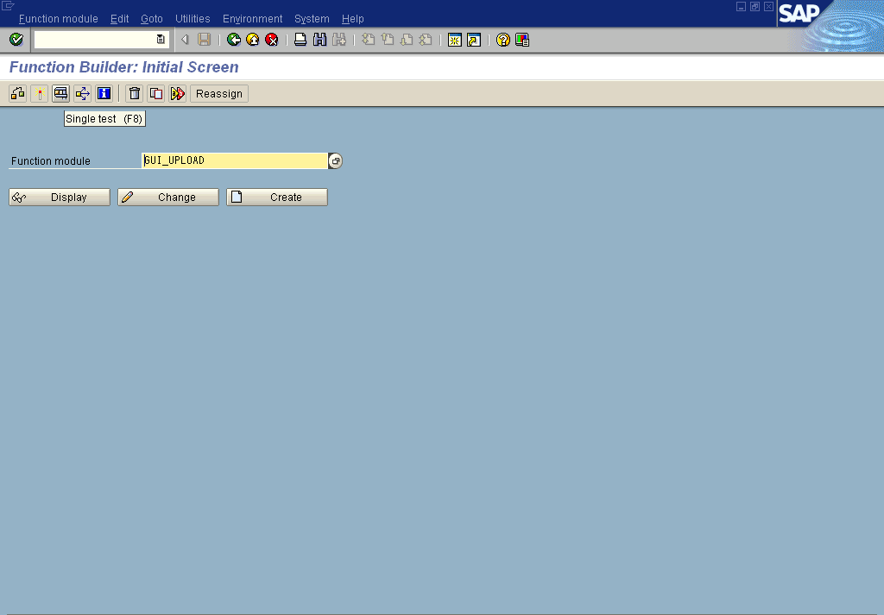
Modularization
Testing A Function modules – SE37

Slide 80


Slide 81
Miscellaneous
Message Statement
Using a Global Message Class
  If the introductory statement of a program contains the addition... MESSAGE-ID <id>. and a message class <id> contained in table T100, you can use the MESSAGE statement as follows:
  MESSAGE <t><num> [WITH <f1> ... <f 4>] [RAISING <EXC>]. where <t> is the single-character message type and <NNN> the three-digit message number.
Specifying the Message Statically
  To specify the message class, message number, and message type statically, use the following form of the MESSAGE statement:
  MESSAGE <t><NNN>(<id>) [WITH <f1> ... <f4>] [RAISING <EXC>].

Slide 82
Miscellaneous
Message Statement
Specifying the Message Dynamically
  To specify the message class, message number, and message type dynamically, use the following form of the MESSAGE statement:
  MESSAGE ID <id> TYPE <t> NUMBER <n> [WITH <f1> ... <f4>] [RAISING <EXC>].
  where <id>, <t>, and <n> are fields containing the message class, message number, and message type respectively.
Messages and Exceptions
  Within function modules and methods, you can use the RAISING addition in the MESSAGE statement to trigger exception:
  MESSAGE..... RAISING <EXC>.
  If the calling program does not handle the exception <EXC> itself, the message is displayed, and the program continues processing in the manner appropriate to the message type and context

Slide 83
Miscellaneous
Message Types
A
Termination
The message appears in a dialog box, and the program terminates. When the user has confirmed the message, control returns to the next-highest area menu.
E
Error
Depending on the program context, an error dialog appears or the program terminates.
I
Information
The message appears in a dialog box. Once the user has confirmed the message, the program continues immediately after the MESSAGE statement.
S
Status
The program continues normally after the MESSAGE statement, and the message is displayed in the status bar of the next screen.
W
Warning
Depending on the program context, an error dialog appears or the program terminates.
X
Exit
No message is displayed, and the program terminates with a short dump. Program terminations with a short dump normally only occur when a runtime error occurs. Message type X allows you to force a program termination. The short dump contains the message ID.

Slide 84
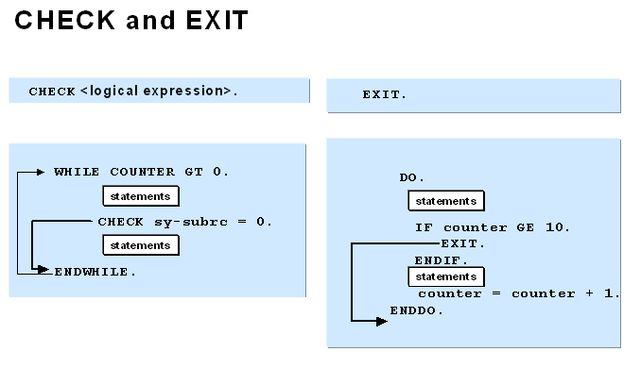
Miscellaneous
Check and EXIT
SAP recommends that you only use CHECK within loops.

Slide 85

Miscellaneous
Debugger
Fields | The scrollable field display contains the contents of up to eight fields. The contents of the three most important system fields are always displayed. This is the default display mode in the Debugger. See also Processing Fields
Table | Displays the contents of an internal table. This mode allows you to display and edit the entries in an internal table. See also Processing Internal Tables
Breakpoints | A scrollable display containing up to 30 breakpoints. Next to each breakpoint is a counter. You can also delete breakpoints in this display. See also Managing Dynamic Breakpoints
Watchpoints | You can set a watchpoint for a field so that the program is interrupted whenever the value of that field changes. This display mode contains a list of Watchpoints, the fields and programs to which they are assigned, the current values of the fields, and the conditions upon which the watchpoint is activated. See also Setting Watchpoints
Calls | This mode displays the current sequence of events, and the sequence of calls up to the current breakpoint. The last active call is displayed at the top of the list; previous calls are listed in reverse chronological order. When an event (for example, START-OF-SELECTION) concludes, it is deleted from the display.
Overview | This mode displays the structure of the program. It lists its events, subroutines, and modules, and shows which sections belong to which events. It also displays the section currently being processed.
Settings | This mode displays the current Debugger settings. You can change the settings by selecting or deselecting various options. For further information, refer to Settings and Warnings

Slide 86


Slide 87
Demonstration
Simple Report
REPORT TEST.
INITIALIZATION.
DATA: A TYPE I VALUE 10,
B TYPE I VALUE 15,
SUM TYPE I.
START-OF-SELECTION.
WRITE 'THIS IS A STATEMENT‘
*THIS IS COMMENTED LINE
*THE WRITE STATEMENT CAN ALSO BE WRITTEN AS.
END-OF-SELECTION.
WRITE 'THIS' & ' IS ' & 'A STATEMENT'.
SUM = A + B.
WRITE:/ SUM.

Slide 88
Demonstration
Data Declaration
DATA: BEGIN OF IT1 OCCURS 10, "HAS A HEADER LINE
NAME(10),
PHNO TYPE I,
END OF IT1.
DATA IT2 LIKE IT1 OCCURS 100. "DOESN'T HAVE A HEADER LINE
DATA IT3 LIKE IT1 OCCURS 100 WITH HEADER LINE. "IT DOES NOW
Name Phno
Header
Internal
Table Body

Slide 89
Demonstration
Data Declaration
DATA: PLAYER(35) TYPE C,
NICKNAME(35),
POINTS TYPE I.
DATA: GAMES TYPE I VALUE ‘10’,
AVERAGE(5) TYPE P,
STARTER,
ACQUIRED TYPE D.
DATA: PLAYER(35) TYPE C VALUE ‘CAPGEMINI’,
NICKNAME LIKE PLAYER,
ACQUIRED LIKE SY-DATUM.
CONSTANTS: TEAM1(20) TYPE C VALUE ‘76ERS’,
TEAM2 LIKE TEAM1 VALUE ‘CELTICS’,
TOT_GAMES TYPE I VALUE 82.
TYPE-POOLS Z400.
TYPES: NAME(35) TYPE C,
TEAMS(20) TYPE C.
DATA: PLAYER TYPE NAME VALUE ‘CAPGEMINI’,
NICKNAME LIKE PLAYER.
CONSTANTS: TEAM1 TYPE TEAMS VALUE ‘76ers’,
TEAM2 LIKE TEAM1 VALUE ‘Celtics’.
The “CLEAR” statement sets a field back to its initial value, not its default value.

Slide 90
Demonstration
Data Declaration
DATA: COUNTER TYPE I,
AMOUNT TYPE P VALUE 1000,
SUM TYPE P,
RESULT TYPE P,
NUMBER(2) TYPE C VALUE ’99’,
ROOT TYPE F.
COUNTER = COUNTER + 2.
RESULT = AMOUNT * COUNTER.
SUM = RESULT + NUMBER – COUNTER.
RESULT = COUNTER * ( AMOUNT + NUMBER ).
BREAK-POINT. “Creates a breakpoints.
ROOT = SQRT ( NUMBER + COUNTER

Slide 91
Demonstration
Internal Table
REPORT …
TYPES: BEGIN OF LINE_TYPE,
F1, F2,
END OF LINE_TYPE.
DATA: TAB1 TYPE SORTED TABLE OF LINE_TYPE WITH UNIQUE KEY F1
WITH HEADER LINE.
TAB1-F1 = ‘Y’. TAB1-F2 = ‘1’. INSERT TABLE TAB1.
TAB1-F1 = ‘X’. TAB1-F2 = ‘1’. INSERT TABLE TAB1.
TAB1-F1 = ‘A’. TAB1-F2 = ‘1’. INSERT TABLE TAB1.
READ TABLE TAB1 WITH TABLE KEY F1 = ‘A’.
LOOP AT TAB1.
WRITE:/ TAB1-F1, TAB1-F2.
ENDLOOP.

Slide 92


Demonstration
Internal Table - Reading
TYPES: BEGIN OF LINE_TYPE,
F1, F2, F3,
END OF LINE_TYPE.
DATA: TAB1 TYPE STANDARD TABLE OF LINE_TYPE WITH KEY F1 F2,
WA TYPE LINE_TYPE.
WA-F1 = 'B'.
WA-F2 = '5'.
WA-F3 = '12.45'.
READ TABLE TAB1 FROM WA INTO WA.
READ TABLE TAB1 WITH TABLE KEY F1 = 'B'
F2 = '5' INTO WA.
Work area wa
Wa before
Wa after read
Internal Table tab1

Slide 93
Demonstration
Subroutines
TYPES: BEGIN OF LINE,
COL1,
COL2,
END OF LINE.
DATA: WA TYPE LINE,
ITAB TYPE HASHED TABLE OF LINE WITH UNIQUE KEY COL1,
KEY(4) VALUE 'COL1'.
WA-COL1 = 'X'. INSERT WA INTO TABLE ITAB.
WA-COL1 = 'Y'. INSERT WA INTO TABLE ITAB.
PERFORM DEMO USING ITAB.
FORM DEMO USING P TYPE ANY TABLE.
DATA: T_WA TYPE LINE. “LOCAL VARIABLE FOR SUBROUTINE.
READ TABLE P WITH TABLE KEY (KEY) = 'X' INTO WA.
WRITE:/ T_WA-COL1.
ENDFORM.

Slide 94


Slide 95
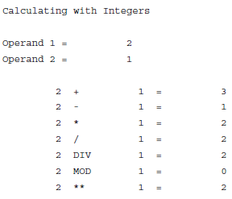
Exercises
    Exercise – 1 Data Types
    Task 1:Create a program with the name ZBC402_##_DATA_EX1. This program will
    test the effect of the above arithmetic operations for integer variables. Your program
    should have a selection screen that allows the user to enter two values. The system
    should then perform the calculations on both values and display the results in a
    list. Create a separate line in the list for each calculation. In each case, display the two
    values, the operator used, and the result. When creating your list, use the following
    example as a guide:
    List Output of the program.

Slide 96
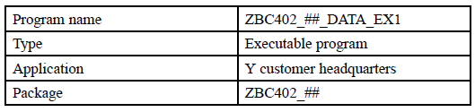
Exercises
    Exercise – 1 Data Types
    Task 2: Use the Object Navigator to create a program with the following data:
    Declare two parameters and a results field (as a normal variable) for the two operands. All data objects should have data type i (suggested names for the data objects: pa_val1, pa_val2, gv_result)
    Perform the calculations in the START-OF-SELECTION event block. Display the result of each calculation in the list.

Slide 97
This presentation is for internal use only and not intended for external distribution. Its contents must be held in confidence.
Notes:
© 2006 Capgemini - All rights reserved

