Slide 1
AB1006 - Conversion Techniques
This presentation is for internal use only and not intended for external distribution. Its contents must be held in confidence.
Notes:
© 2006 Capgemini - All rights reserved

Slide 2

COURSE OBJECTIVES
List of Topics to be covered
Hands on exercises
Tips and Tricks
Additional information

Slide 3
What is Data migration?
In an SAP R/3 implementation the data from legacy system (non SAP R/3) needs to be transferred to the SAP system
Periodic data transfer between R/3 and other system (interfacing) is also required
Both of the above form a part of data migration

Slide 4
Significance of data migration
  Data migration comes in the end of R/3 implementation.
  To start with Data Migration first configuration should be fully completed
  Data migration is about 20% to 40% of the total implementation expenses.

Slide 5
Data Migration Tools
The tools for data migration are:-
BDC (Batch Data Communication)
LSMW (Legacy System Migration Workbench)

Slide 6
Adv/Disadv BDC & LSMW
Advantages of using BDC (Custom program):
Complex coding needed for handling complex header and item relationship can be managed efficiently.
Suitable in certain cases of table control where handling step-loop is difficult to code in the field mapping step.
Output reporting can be as per user designs.
Disadvantages of using BDC (Custom program):
Requires extensive coding to match all the advantages of using LSMW
Cannot be modified directly in different systems. Need to be transported every time for changes made.
No interface available to inspect read data and converted data so as to avoid errors before uploading.

Slide 7
BDC (Batch Data Communication)
Batch input sessions enter data non-interactively into an R/3 System
It contains the input value for screen fields and navigation through different screens in transaction.
There are two ways BDC methods can be used in program. Both of these use the recording approach.
Call Transaction
Batch Input Session Method

Slide 8
General Steps followed for BDC
Execute the transaction SHDB , specify transaction name to be recorded.
When recording is started , Click and enter some valid value for all fields that need to be mapped form legacy file.
Save the recording and use this recording in new custom program
Build your logic like field conversion , validation and populate the internal table with structure ‘BDCDATA’. (See the structure in next slide)
Use above internal table and decide the approach ‘Call Transaction ’ or ‘Batch Session’.
First 4 steps will be common for both approaches. They only differ in 5th step , which decide the way they are executed.

Slide 9
BDCDATA Structure
Online program name
Screen number
Screen Begin (New screen)
Screen field name
Screen field value
ABAP Dictionary
The BDCDATA ABAP Dictionary structure is
used in Batch Input programs to collect this
information for an entire transaction
PROGRAM
DYNPRO
DYNBEGIN
FNAM
FVAL
Notes:
© 2004 Capgemini - All rights reserved

Slide 10
Call transaction
      Processing batch input data with CALL TRANSACTION USING is the faster of the two recommended data transfer methods. In this method, legacy data is processed inline in your data transfer program.
      Syntax:
      CALL TRANSACTION <tcode>
      USING <bdctab>
      MODE <mode>
      UPDATE <update>
A | Display all
E | Display errors only
N | No display
S | Synchronous
A | Asynchronous
L | Local update

Slide 11
Synchronous v/s Asynchronous
CALL TRANSACTION ‘FK02’
USING BDC_TAB
MODE ‘N’
UPDATE ‘S’.
IF SY-SUBRC < > 0.
WRITE: /‘ERROR’.
ENDIF.
CALL TRANSACTION ‘FK02’
USING BDC_TAB
MODE ‘N’
UPDATE ‘A’.
IF SY-SUBRC < > 0.
WRITE: /‘ERROR’.
ENDIF.
With synchronous updating, we can check SY-SUBRC to determine the success of the transaction and the actual update to the database.
With asynchronous updating, we can check SY-SUBRC to determine the success of the transaction only, not the actual update to the database.
Notes:
© 2004 Capgemini - All rights reserved

Slide 12
The process flow of call transaction
A program that uses CALL TRANSACTION USING to process legacy data should execute the following steps:
Prepare a BDCDATA structure for the transaction that you wish to run.
Prepare a internal table to store error messages TAB_MESS having structure of BDCMSGCOLL.
With a CALL TRANSACTION USING statement, call the transaction and prepare the BDCDATA structure. For example:
CALL TRANSACTION ‘MM01' USING BDCDATA
MODE 'A'
UPDATE 'S‘
MESSAGES INTO TAB_MESS.
IF SY-SUBRC <> 0.
<Error_handling>.
ENDIF.
Value | Explanation
0 | Successful
<=1000 | Error in Dialog program
>1000 | Batch input error
Notes:
© 2004 Capgemini - All rights reserved

Slide 13
BATCH INPUT SESSION METHOD
We have 3 function modules that will be used in program for batch input session method.
BDC_OPEN_GROUP - for creating session
BDC_INSERT - Transferring data from internal table(BDCDATA) to session
BDC_CLOSE_GROUP – Closing session
Internal Table
DB table

Slide 14
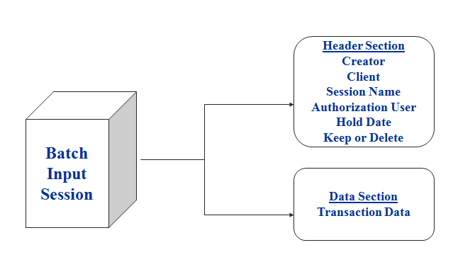
Batch Input Session Structure
12char
YYYYMMDD
Notes:
© 2004 Capgemini - All rights reserved

Slide 15
BDC_OPEN_GROUP
CALL FUNCTION ‘BDC_OPEN_GROUP’
EXPORTING
CLIENT = <client>
GROUP = <session name>
HOLDDATE = <lock session until date>
KEEP = <keep or delete session>
USER = <user name>
EXCEPTIONS
CLIENT_INVALID = 1
………..
OTHERS = 11.
Creates Session
Notes:
© 2004 Capgemini - All rights reserved

Slide 16
BDC_INSERT
CALL FUNCTION ‘BDC_INSERT’
EXPORTING
TCODE = <transaction code>
TABLES
DYNPROTAB = <bdc internal table>
EXCEPTIONS
INTERNAL_ERROR = 1
………..
OTHERS = 5.
Moves flow logic and data into Session
Notes:
© 2004 Capgemini - All rights reserved

Slide 17
BDC_CLOSE_GROUP
CALL FUNCTION ‘BDC_CLOSE_GROUP’
EXCEPTIONS
NOT_OPEN = 1
QUEUE_ERROR = 2
OTHERS = 3
Close Session
Notes:
© 2004 Capgemini - All rights reserved

Slide 18
Processing Batch Input Session
When you create a batch input session, it remains in the batch input queue until it is explicitly started. Session processing can be started in two ways:
An on-line user can start the session using the batch input menu
options. (To access the batch input options, choose System →
Services → Batch Input) or SM35.
Select session and process it in Foreground / Background / Error only mode.
You can submit the background job RSBDCSUB to start a session
in background processing. If several sessions have the same
name, RSBDCSUB starts them all.
Notes:
© 2004 Capgemini - All rights reserved

Slide 19
Comparison Call Transaction / Session Method
Call Transaction | Session method
1. Error handling / LOG Transactions are triggered at the time of processing itself and so the ABAP program must do the error handling. | 1. Error handling / LOG When session is processed in SM35 error log is generated automatically and can be viewed later time also.
2. We can update the database both synchronously and asynchronously. We can specify the mode in the program | 2. Synchronous Database update. During processing, no transaction is started until the previous transaction has been written to the database
3. While re-execution it starts from the first. | 3. When re-executed , it only processes error records.
4. Faster than session method | 4. Comparatively slower

Slide 20
Key Points :
You should be completely aware of all transaction fields in scope.
Make sure that , you are understand the transaction well . All the mandatory fields should be considered while recording.
Navigation through screens should be in sequential and well defined manner.
Field value conversion is most important for fields like date , currency ,UOM etc. Field value should be provided as per the the user profile.
For e.g . In the table date is stored as YYYYMMDD , but if the user profile is MMDDYYYY , when transaction is executed we see date in this format. So while providing value for this field , date should be converted to MMDDYYYY from YYYYMMDD.

Slide 21
Transaction Recorder(SHDB)
Before you work with the Batch Input methods, you should know the
purpose of the tool Transaction Recorder.
Use:
You can use the transaction recorder to record a series of transactions and
their screens.
Features:
You can use the recording to create
Data transfer programs that use batch input or CALL TRANSACTION
Batch input sessions
Test data
Note: It doesn’t record F1, F4 and Scrollbar movements
Notes:
© 2004 Capgemini - All rights reserved

Slide 22
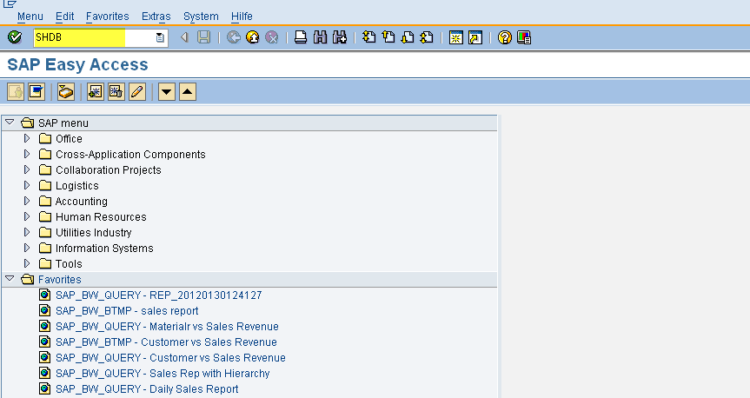

Slide 23
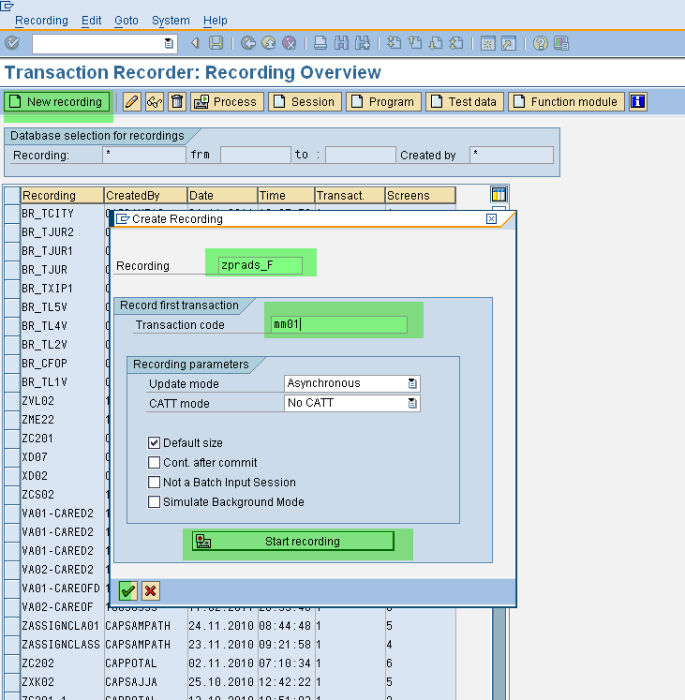

Slide 24
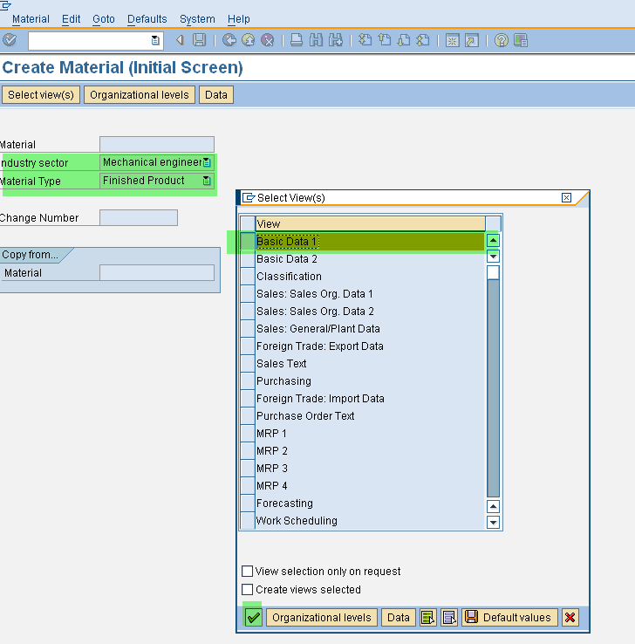

Slide 25
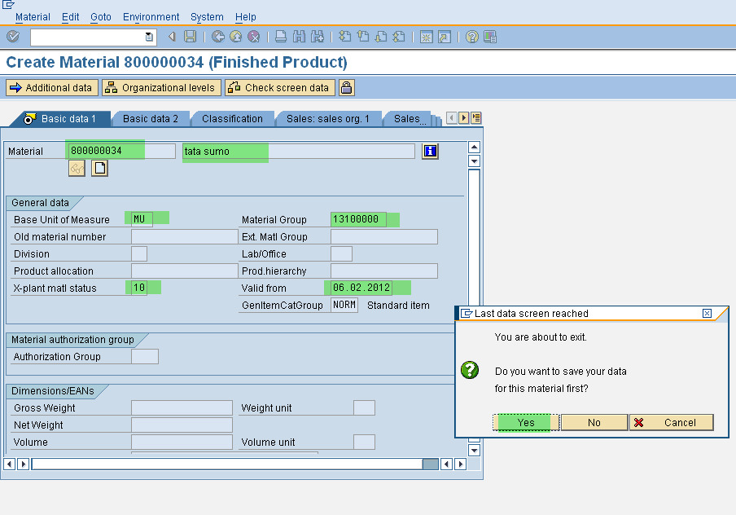

Slide 26
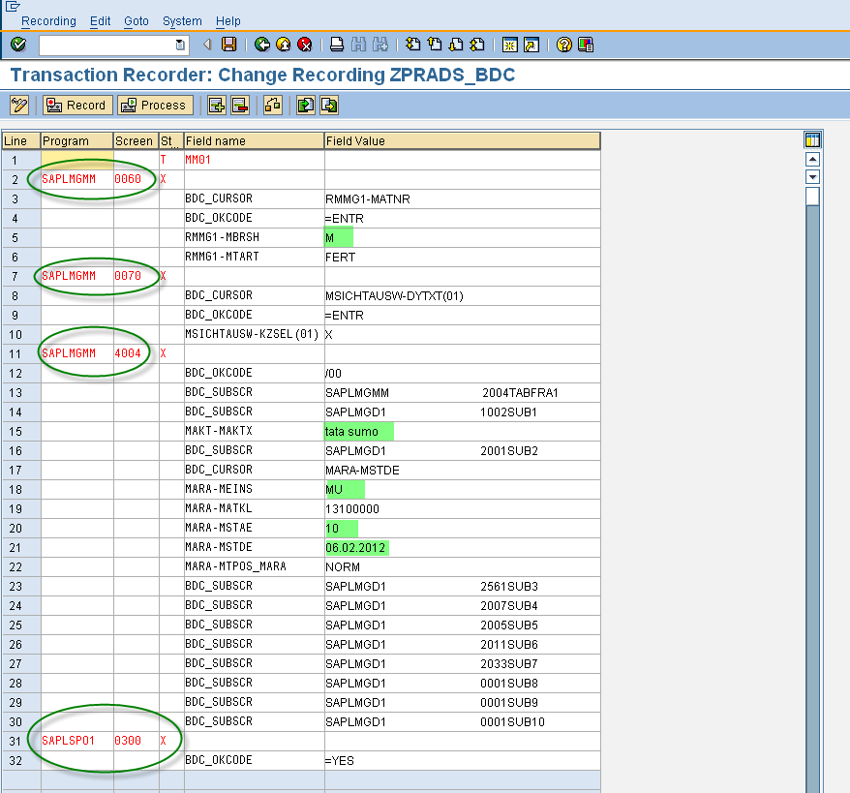

Slide 27
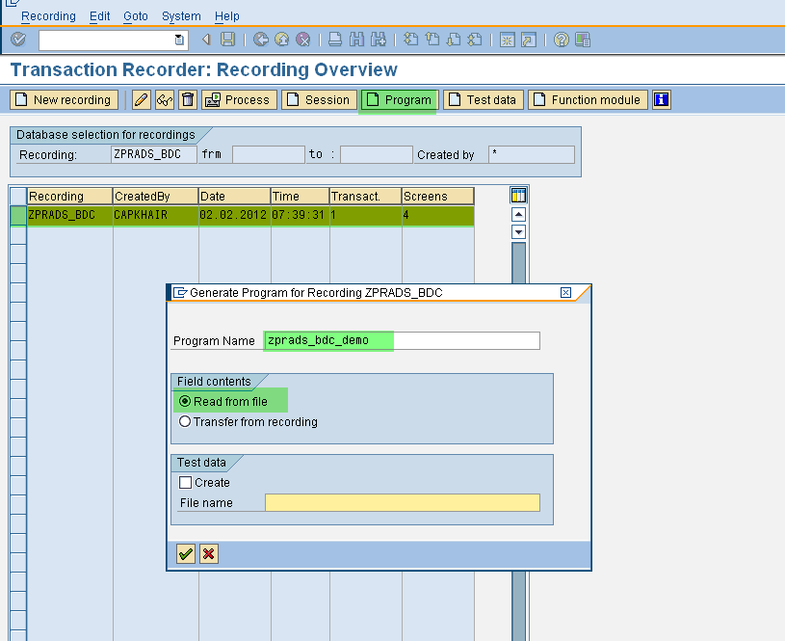

Slide 28
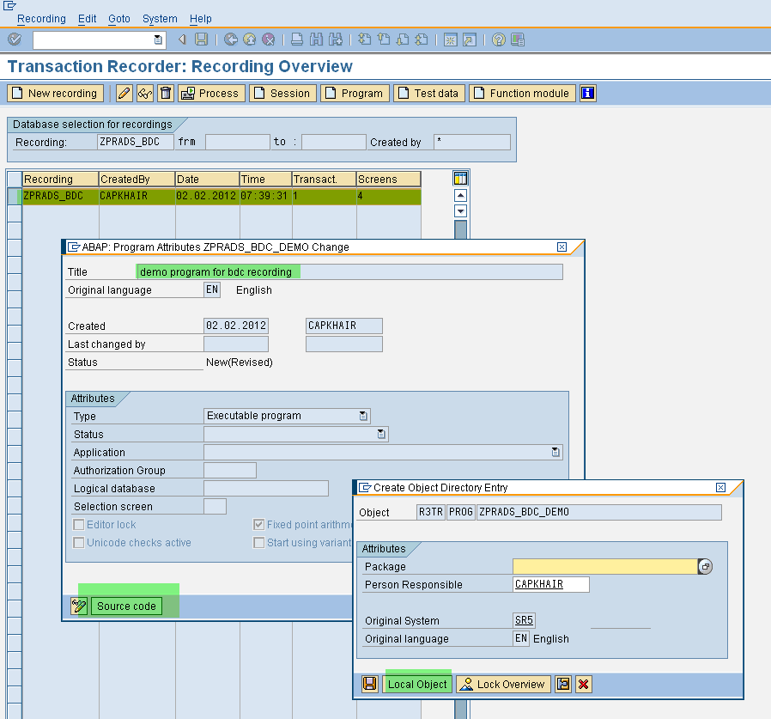

Slide 29
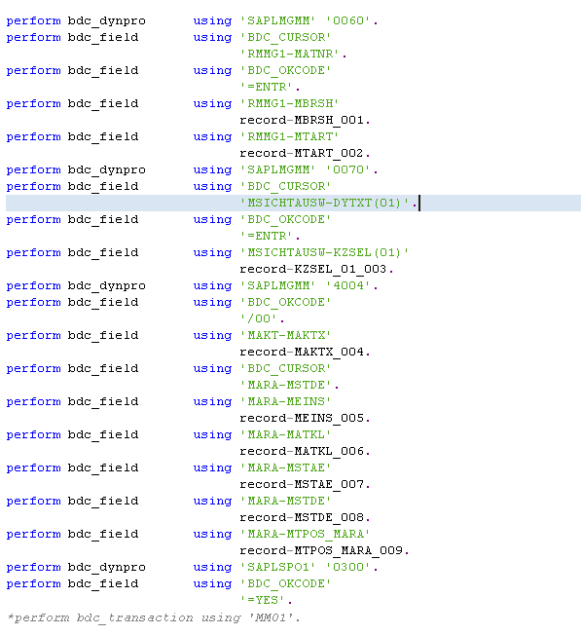

Slide 30
Program
Call Transaction Method

Slide 31
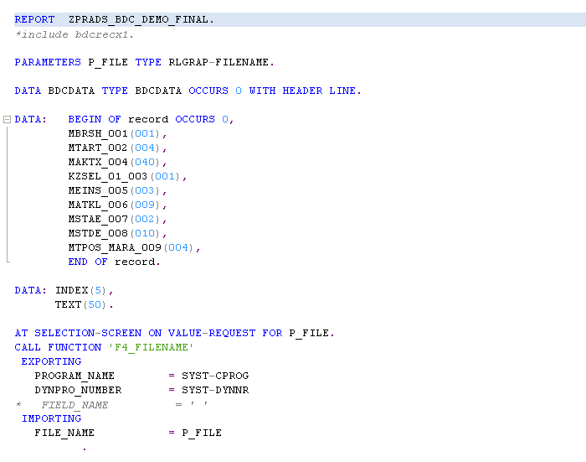

Slide 32
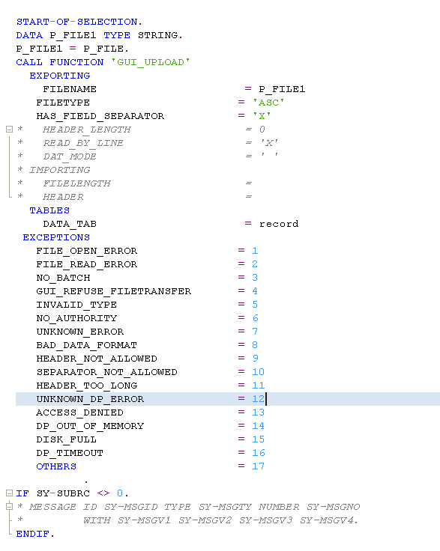
128char

Slide 33
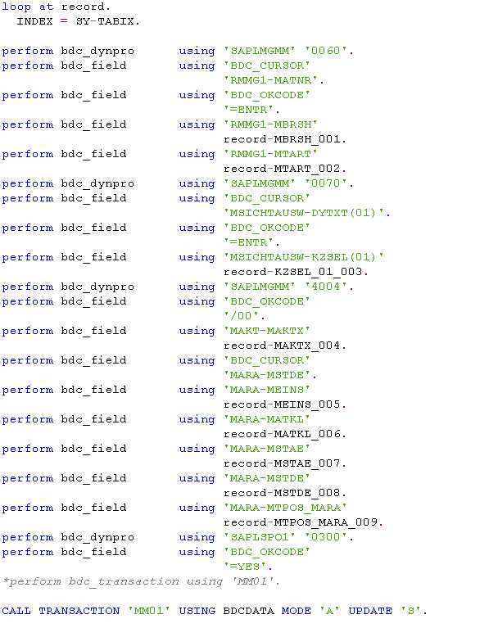

Slide 34
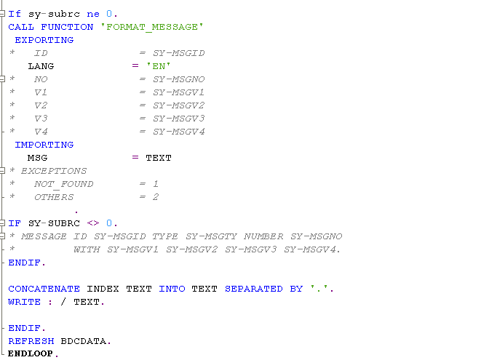

Slide 35
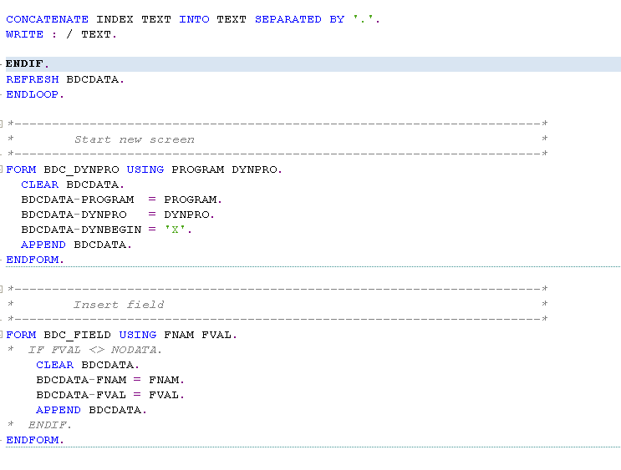

Slide 36
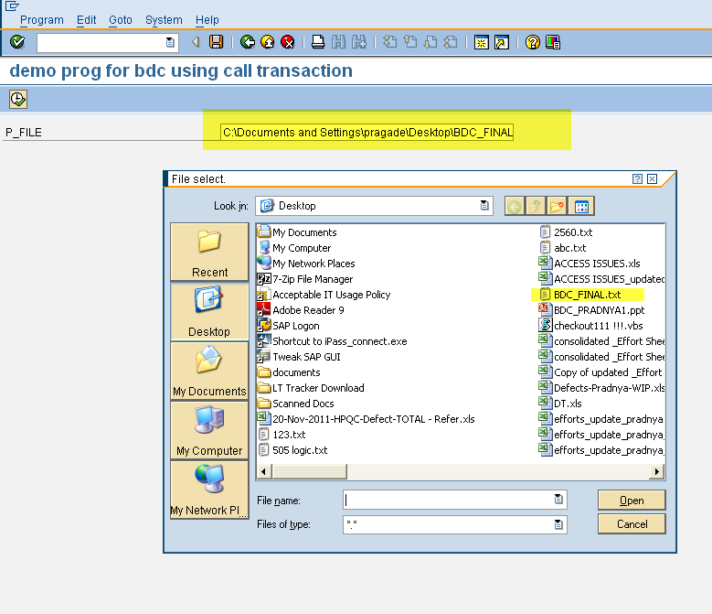

Slide 37
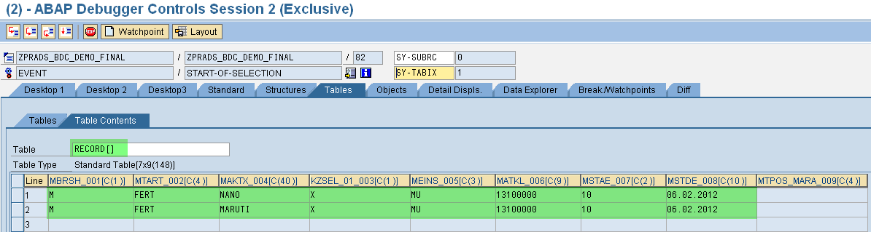

Slide 38
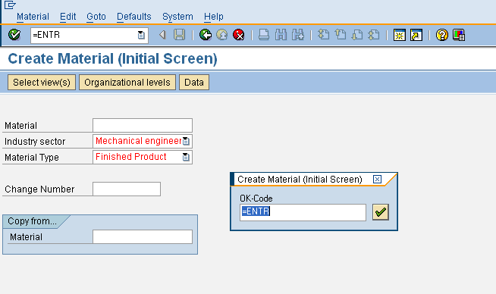

Slide 39
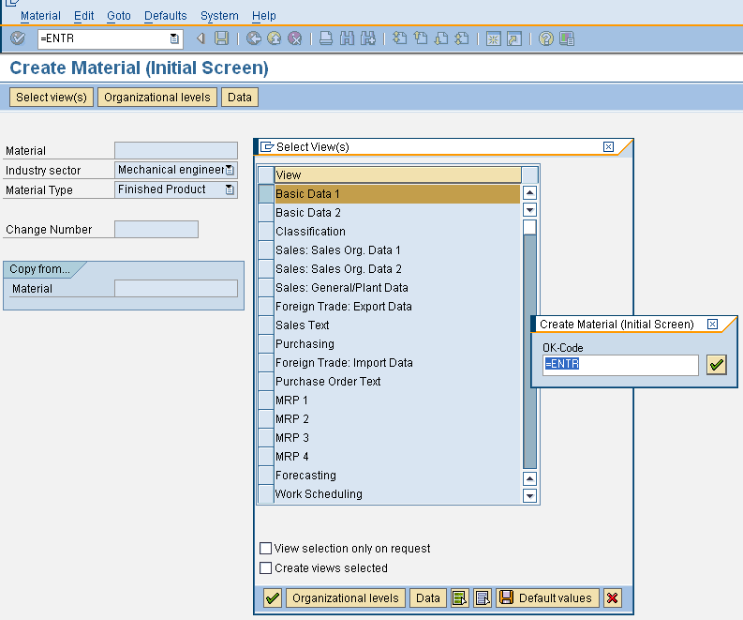

Slide 40
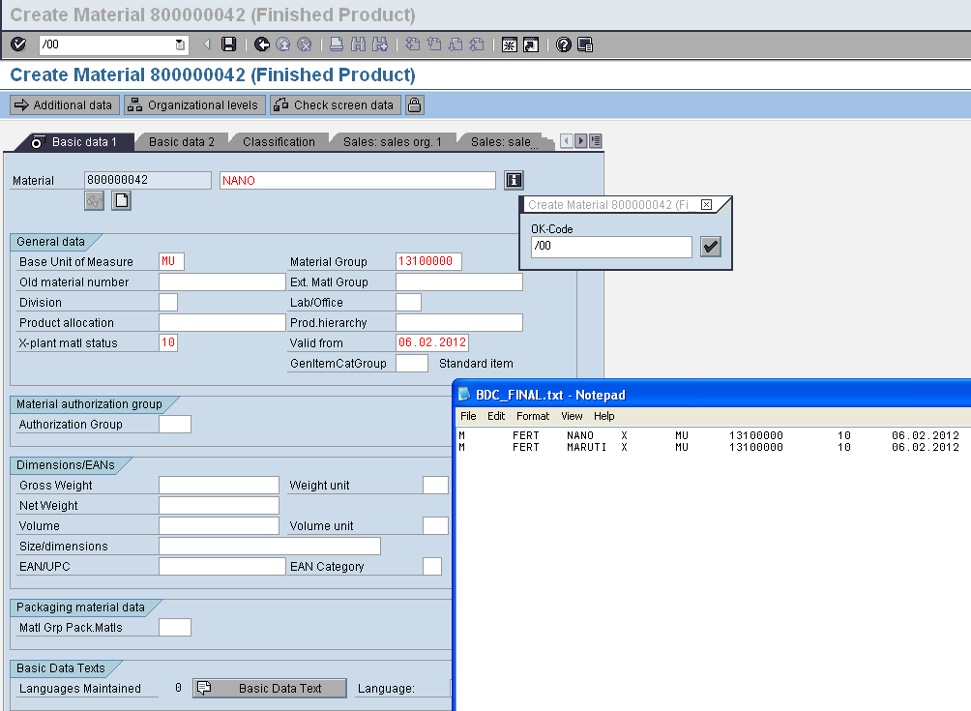

Slide 41
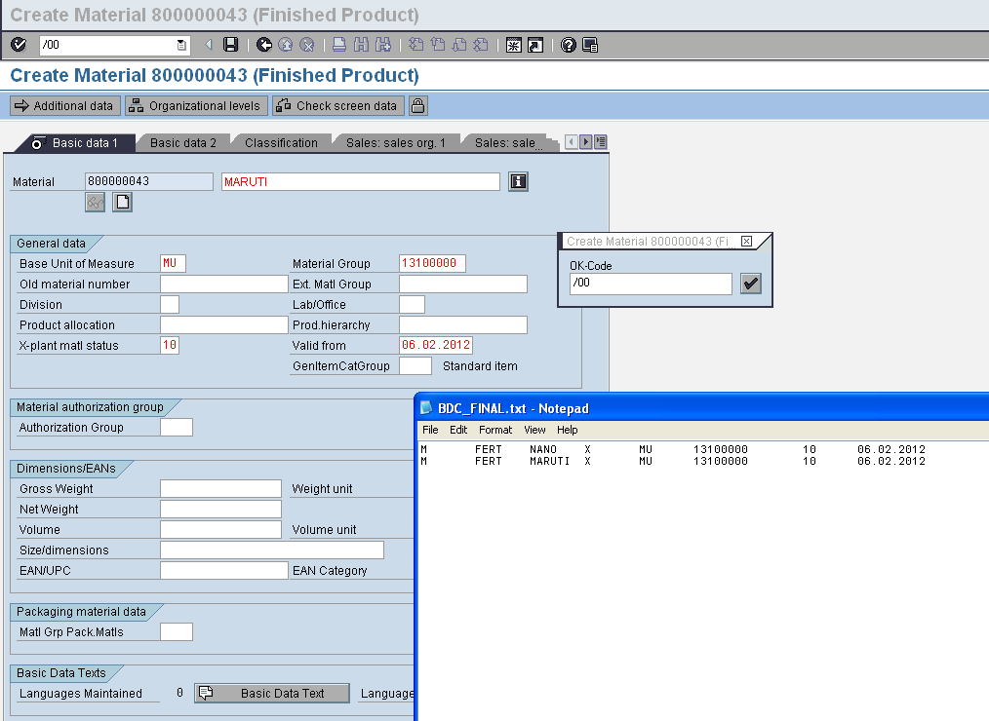

Slide 42
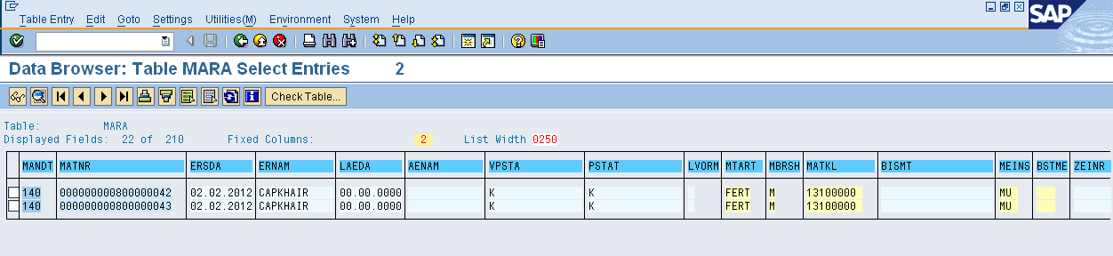
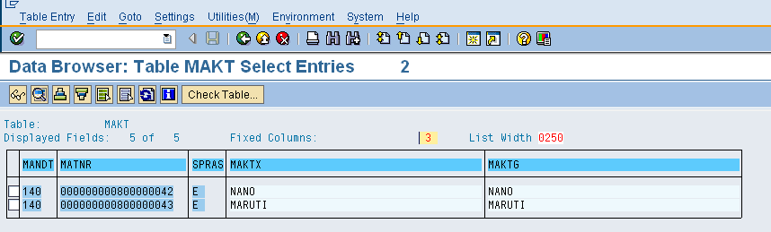

Slide 43
Program
Batch Input Method

Slide 44
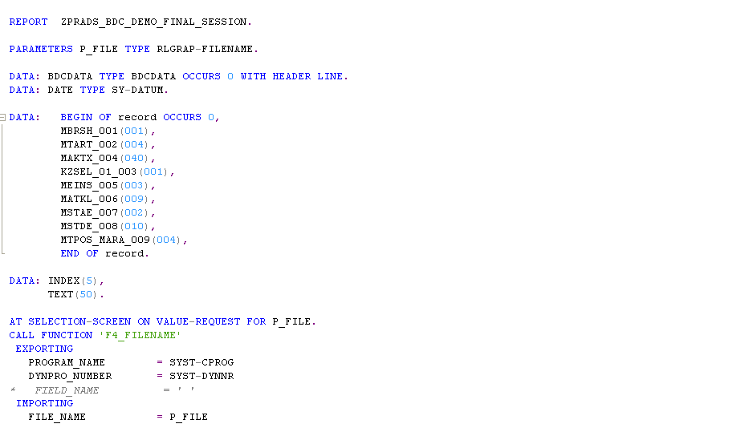

Slide 45
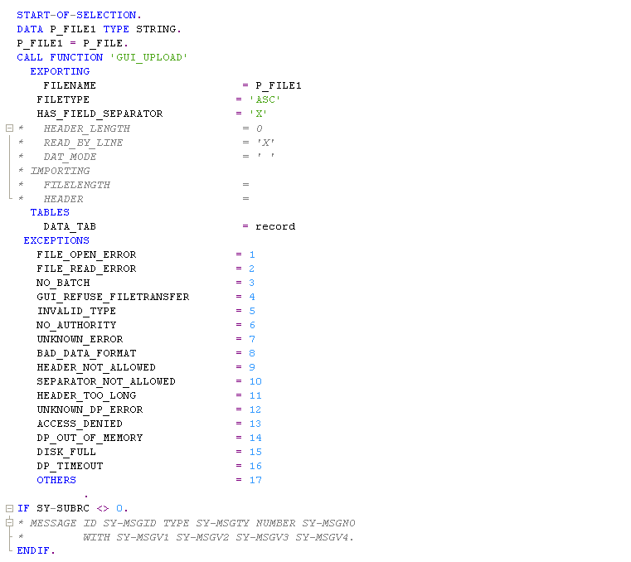

Slide 46
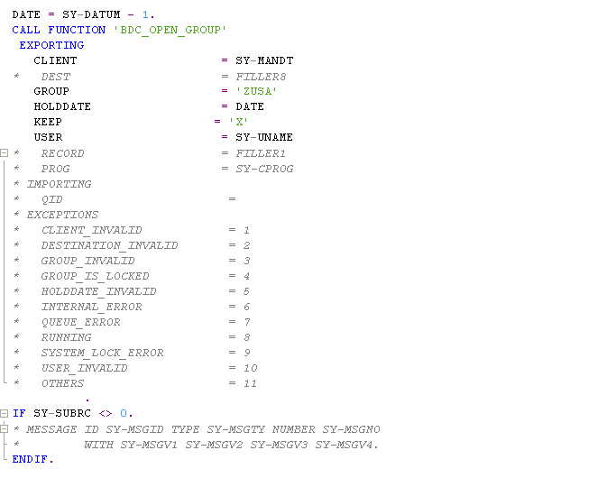

Slide 47
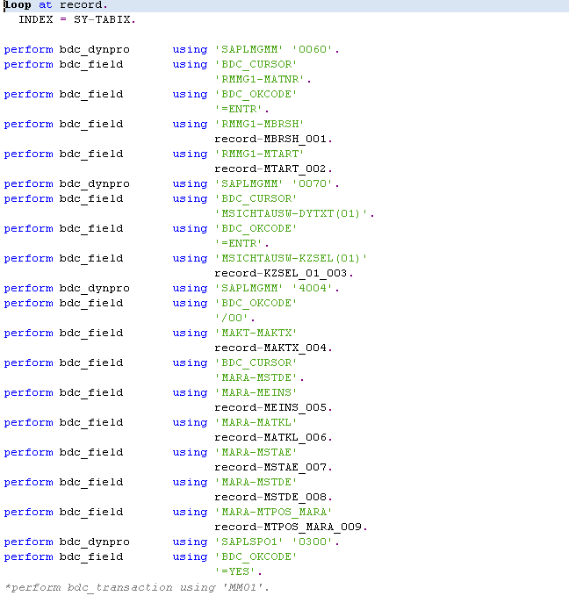

Slide 48
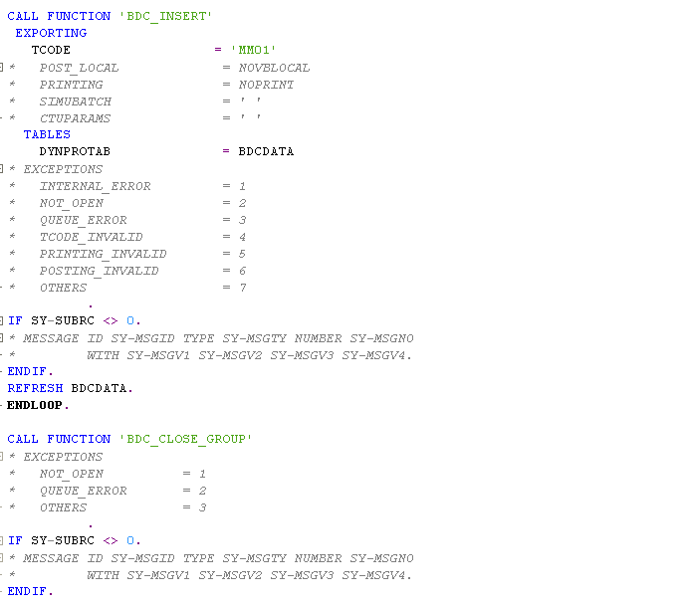

Slide 49
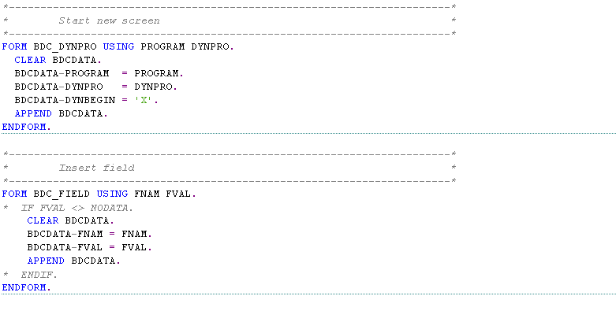

Slide 51
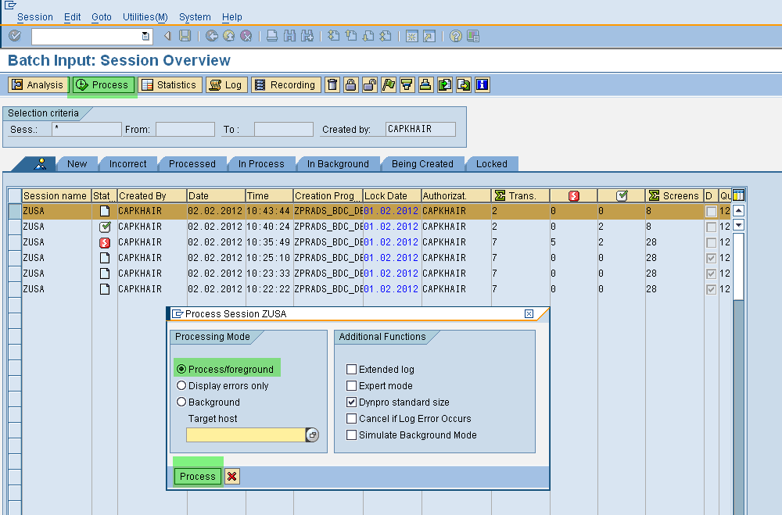
SM 35-BATCH INPUT SESSION OVERVIEW

Slide 52
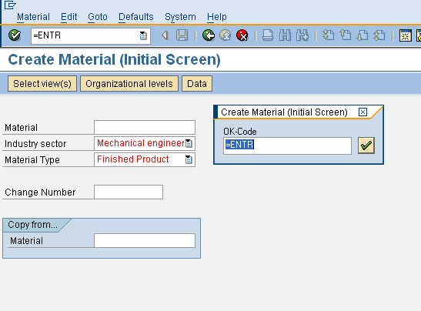

Slide 53
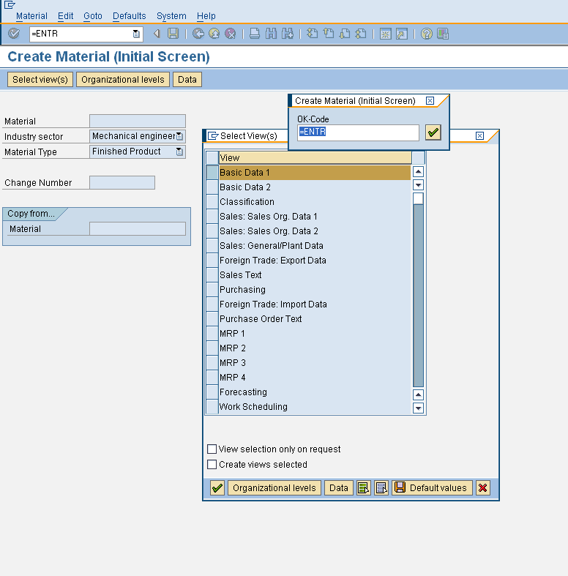

Slide 54
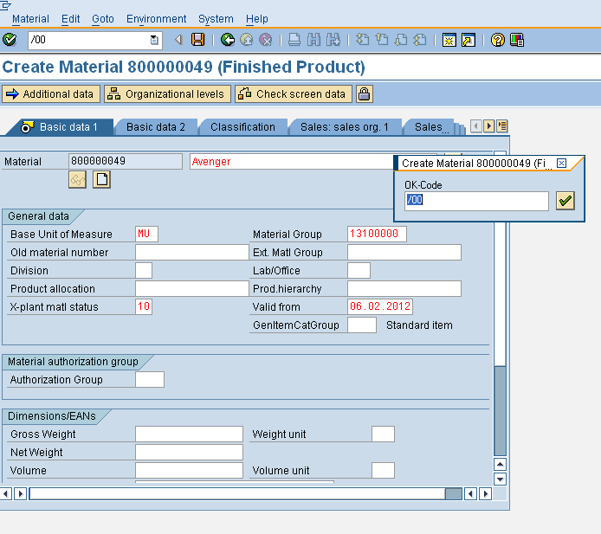

Slide 55
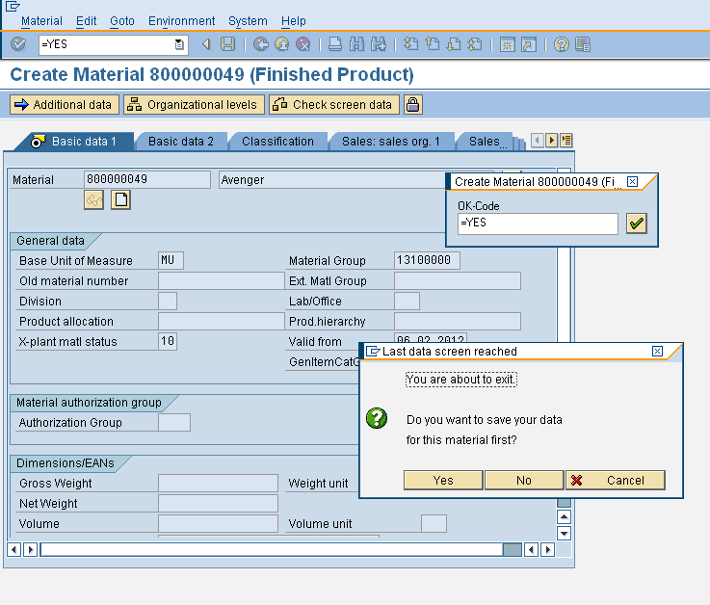

Slide 56
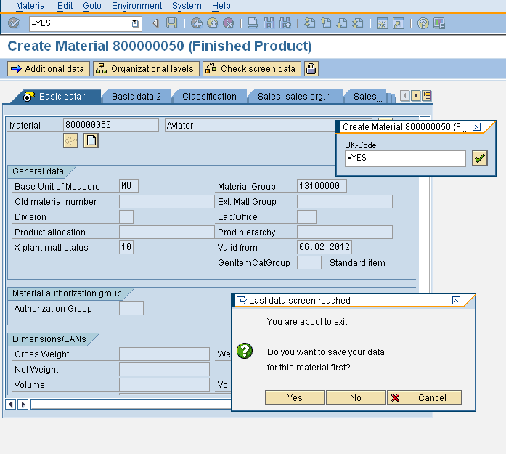

Slide 57
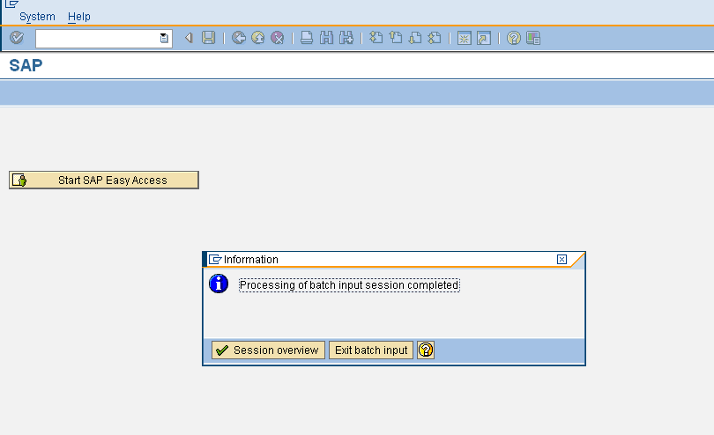
Session Overview

Slide 58
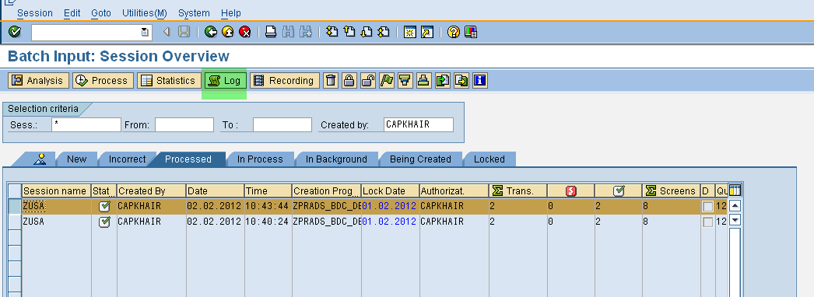
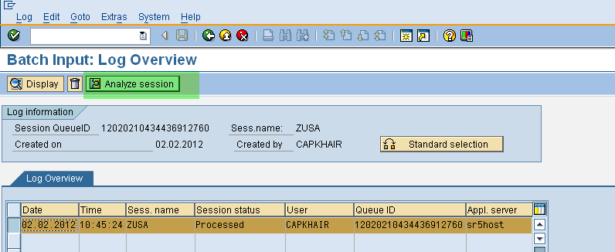
PROCESSED SESSION

Slide 59
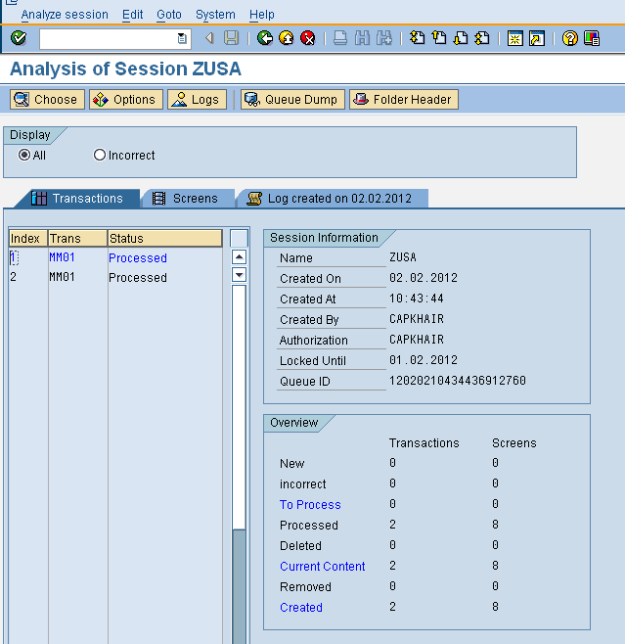
ANALYSIS OF SESSION LOG

Slide 60
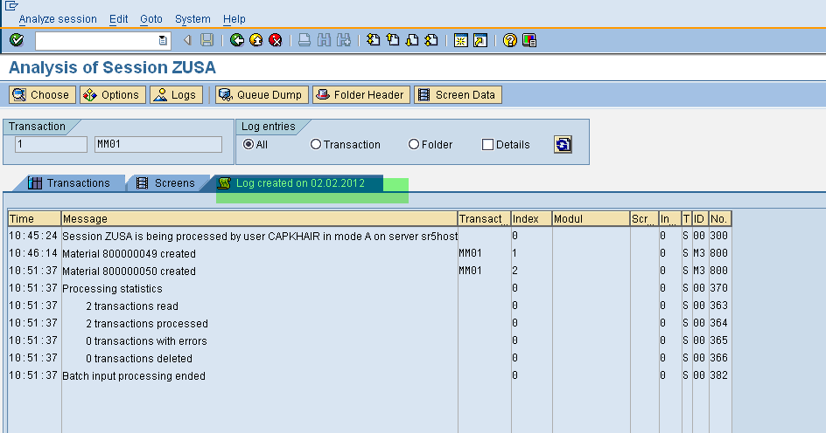
ANALYSIS OF SESSION LOG

Slide 61
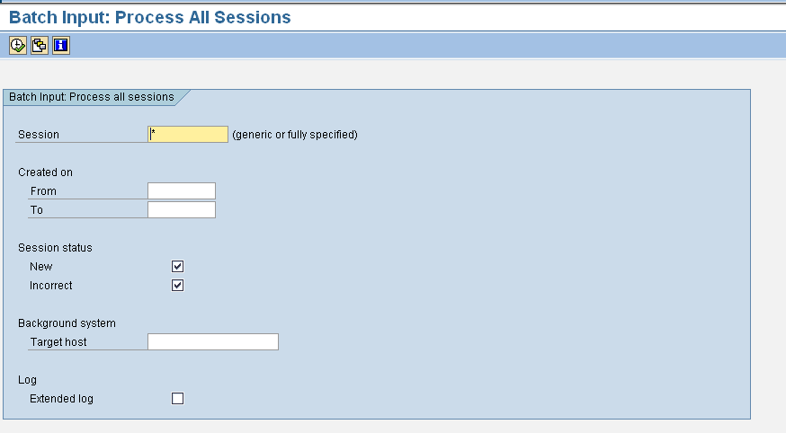
RSBDCSUB

Slide 62
This presentation is for internal use only and not intended for external distribution. Its contents must be held in confidence.
Notes:
© 2006 Capgemini - All rights reserved

