Slide 1


Industry Specific Solutions Round1-Idea Submission Round
Sponsored By
Team Name: Team - Prakash GS
Team bio : We are energetic technical team want to explore more on Microsoft Technologies. We work majorly on application developments, backend systems, analytical tools, UI designs and cloud solutions.
Prakash Somasundaram – Worked in most of the Azure Products as Solution Architect
Rajthilak Somasundaram – UI/UX expert
Mohan Thangamani – Fullstack Developer with 3+ years of experience
Santhosh Gopalakrishnan – Fullstack Developer with 6+ years of experience
Date: 24-April-2023

Slide 2
Problem Statement
Why did we decide to solve this Problem statement?
We are from a city where lot of building constructions are happening houses, banglaws, flats, commercial shops, shopping complexes etc., Once the building is constructed, materials such as Bricks, Steel rods, Wires, Metal Stones, Pipes, Tiles, Granites, Wood panels, PVC, UPVS materials etc., that are bought as standby or backup by the builders/owners are just leftover on roadside or in front of the building for periods. These materials costs high and are throwed out as waste. We see these leftovers are not even used products in most of the cases.
This causes problems such as
Waste of money
After a period, these leftover materials like wires, cements, steels are buried in the land which pollutes the soil
Blocking roads, traffic jams and thus causing different environmental pollution
More demand of such raw materials and thus factories producing it and thus causing environmental pollution again
Costs for such materials are growing higher which is causing economical problems
Etc.,

Slide 3
Solution
Considering the above problems, the simple solution would be making the construction engineers to estimate the raw materials realisticaly and buy for their construction. But in construction industry it is hard to do that.
So, our idea is to follow
“Record, Report, Reduce, Remove, and Replace” approach and make use, reuse of such raw materials in other constructions.
The Solution
Collect the leftover material
Check the quality
Enable others to reuse for other construction

Slide 4
Technical Approach Of the Solution
Build a platform that will act as a co-ordinating matketplace for the building owners, Middleman/company or builders/construction companies to implement the above solution.
The high-level flow of the platform will be
Building owner posts the information about the leftover materials, quality, quantity, other details, photo of the materials in a marketplace website/applicaion.
A registered middleman/company will collect the materials based on the post that are posed by the owners. These middleman/company will check the quality of the material and collects the material. They are the one who decides that the material can be resold to other builders or scraped, if the materials are useless. The building owners who sells the leftover materials to these middleman/company will be paid by these middleman/company based on the quality & quantity of the material.
There should be a marketplace (web portal/app) for the individual/builder/construction company) who need such raw materials for their building construction. These people will raise their requirements in this marketplace portal and that reaches the middleman/company.
Middleman/company will deliver the material at low cost when compared to the cost of the same material in regular market.

Slide 5
User Segment & Pain Points
The below user segments would be early adopter of this platform for the reasons mentioned below
User Segment | Pain point | Usage
Building Owner who will sell the leftovers | Stocking and maintaining unwanted materials will occupy space, waste of money | Cleaning the area, can sell the leftover materials and monetize it
A registered middleman/company | Lot of youngsters, individuals who are eager to start unique business has no idea what to start | These youngsters, individuals can register into the platform and act as middleman
Anyone/any entity who want to construct houses including Government building contractors | They buy materials in regular market with high-cost | Can buy these materials at low cost
Builder/Construction company/Engineer | Stocking and maintaining unwanted materials will occupy space, waste of money if the materials cannot fit for their construction | Cleaning the area, can sell the leftover materials and monetize it

Slide 6
Tech Stack & Azure Services Required
Azure App Service Azure Functions Azure SQL Storage Blobs CosmosDB ServiceBus Azure Cache for Redis Azure Data Factory Azure Bot Service Azure Data Lake Storage Azure Databricks Azure Synapse Analytics Power BI Embedded Key Vault, Azure Front Door, Azure DDoS Protection Notification Hub Azure DevOps – Boards, Pipelines .Net Core - ASP.Net Core, C#, Web API More services can be used, the above is a tentative list at this stage.

Slide 7
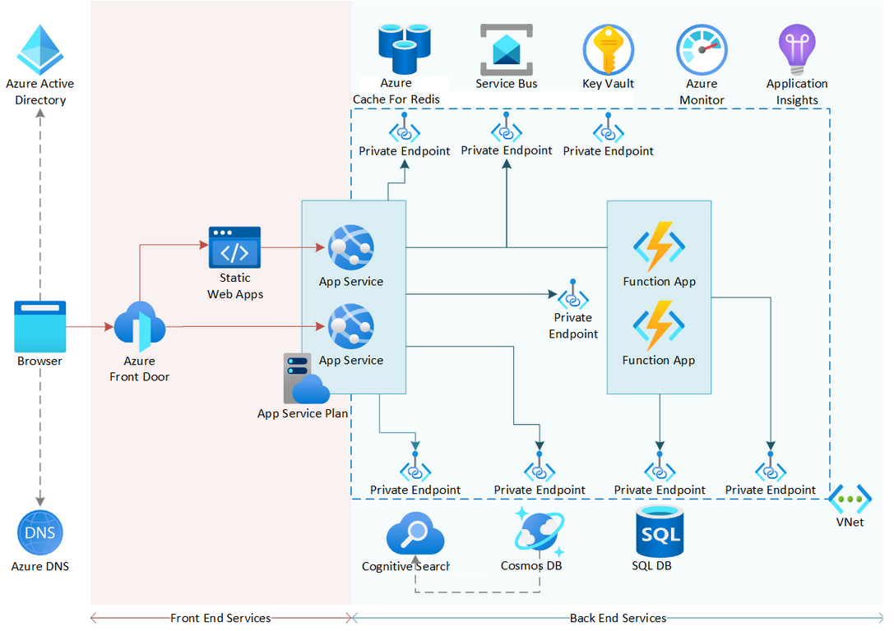
Highlevel Architecure
We recommend to build this platform using a serverless microservice architecture

Slide 8
Competitive products
I don’t see a competative product that will solve this problem specific to construction materials wastage.

Slide 9
Thank You
(Team - Prakash GS)
Prakash Somasundaram
Rajthilak Somasundaram
Mohan Thangamani
Santhosh Gopalakrishnan

