Slide 1



Brogrammers
Microsoft - Azure Women’s Hackathon 2022

Slide 2


Problem Statement
Device tech-based solutions to make education accessible to rural women.

Slide 3
Solution
The idea is to make education more accessible to rural women by developing a web service to bridge the gap between education and poverty. This chatbot feature will enable women in rural backgrounds to access educational materials in different cross-cultural languages by automatic translation and autosuggestion to ensure an upward learning graph. A special audio feature is provided in this application for audio listeners and auditory learners.
The learning material is accessed from reliable resources like Rashtriya Madhyamik Shiksha Abhiyan (RMSA), Beti Bachao Beti Padhao(BBBP) and Central Board of Secondary Education(CBSE), is provided according to previous application history of the study materials accessed by the user. Meanwhile, ensuring a holistic approach to female students growth with various subjects like personal finance, physics, moral science, history, environmental studies, economics, emotional intelligence and many more.
This application aims to be the one stop solution to prepare young girls to become successful women irrespective of their financial backgrounds, by achieving mastery in all necessary life skills.
We wish to develop an offline version for the same to provide the opportunity of basic education to everyone.

Slide 4



Tech Stack
Approach
App language selection: The user selects the language in which they wish to use the application services. The User Interface changes according to Users input, developed using HTML, CSS and Js.
FRONTEND
USED:
HTML
CSS
TO BE IMPLEMENTED:
JavaScipt- React & AJax
Study Material selection: Choice of multiple courses.
BACKEND
USED:
Python
Azure translator API
Azure Text to Speech SDK
TO BE IMPLEMENTED:
Flask
Language Detection: According to user's selection of course, material is provided. The language of the given material is analyzed using Python Libraries.
Read/Translate: Accordingly the study material is converted to speech using Azure Text to Speech SDK or translated to another language using Azure Translator API

Slide 5
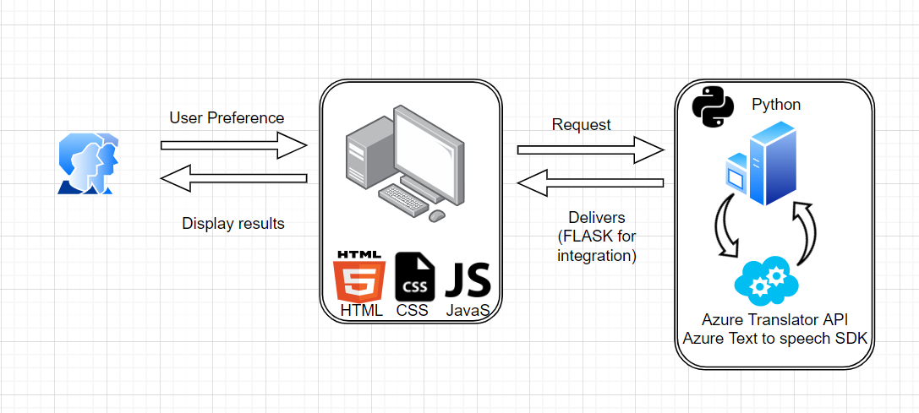
Architecture Diagram

Slide 6

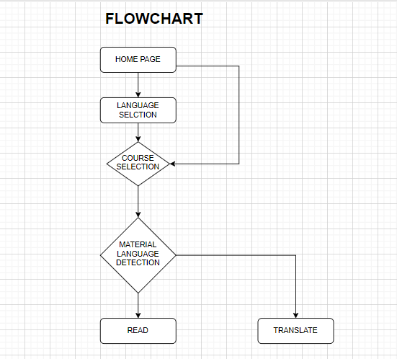
Flowchart

Slide 7

Image to text and audio
Future Scope
To develop additional feature of detecting text from images scanned by user. The detected text can be translated or converted to speech.
Offline access
Providing an offline version of this application will ensure users with no to limited internet connectivity to browse conveniently from the comfort of their homes
Human Computer Interaction
Vocal interactions to ensure one-on-one learning specially curated according to students need
Unlimited courses
Unlimited courses for unlimited learning

Slide 8

Team members
Shruti Gupta
Jahanvi Joshi
Akanksha Kushwaha
(Amity University, Noida. B.Tech Computer Science and Engineering. 2020-24)
(Amity University, Noida. Btech Computer Science and Engineering. 2020-24)
(Amity University, Noida. B.Tech Computer Science and Engineering. 2020-24)

Slide 9
Thank you!
Happy programming, wear your glasses to C#

