Slide 1
Technical Bootcamp
Week 1
Akshita Verma
IT Data Engineer

Slide 2
Day 1 BA REQUIREMENTS AND AGILE
Introduction to Business Analysis
What are requirements analysis : Functional and Non-Functional
Modelling and Management Techniques
Requirements Traceability
Project Management
Waterfall vs Agile methodology
Introduction to Agile practices
Sprints
Roles in agile: Scrum master, Product Owner etc

Slide 3
Day 2 BA REQUIREMENTS AND AGILE
Hands on azure devops , create epic, user stories, Task, Sub task
Sprint Board
Product/sprint backlog
Scrum Fundamentals
Workflow/Roadmap
Logging Work
Reports: Burndown, Velocity, Burnup
Activity1: Simulated a standup meeting comprising of scrum master, product owner and stakeholders.
Activity2: Hands on azure devops

Slide 4
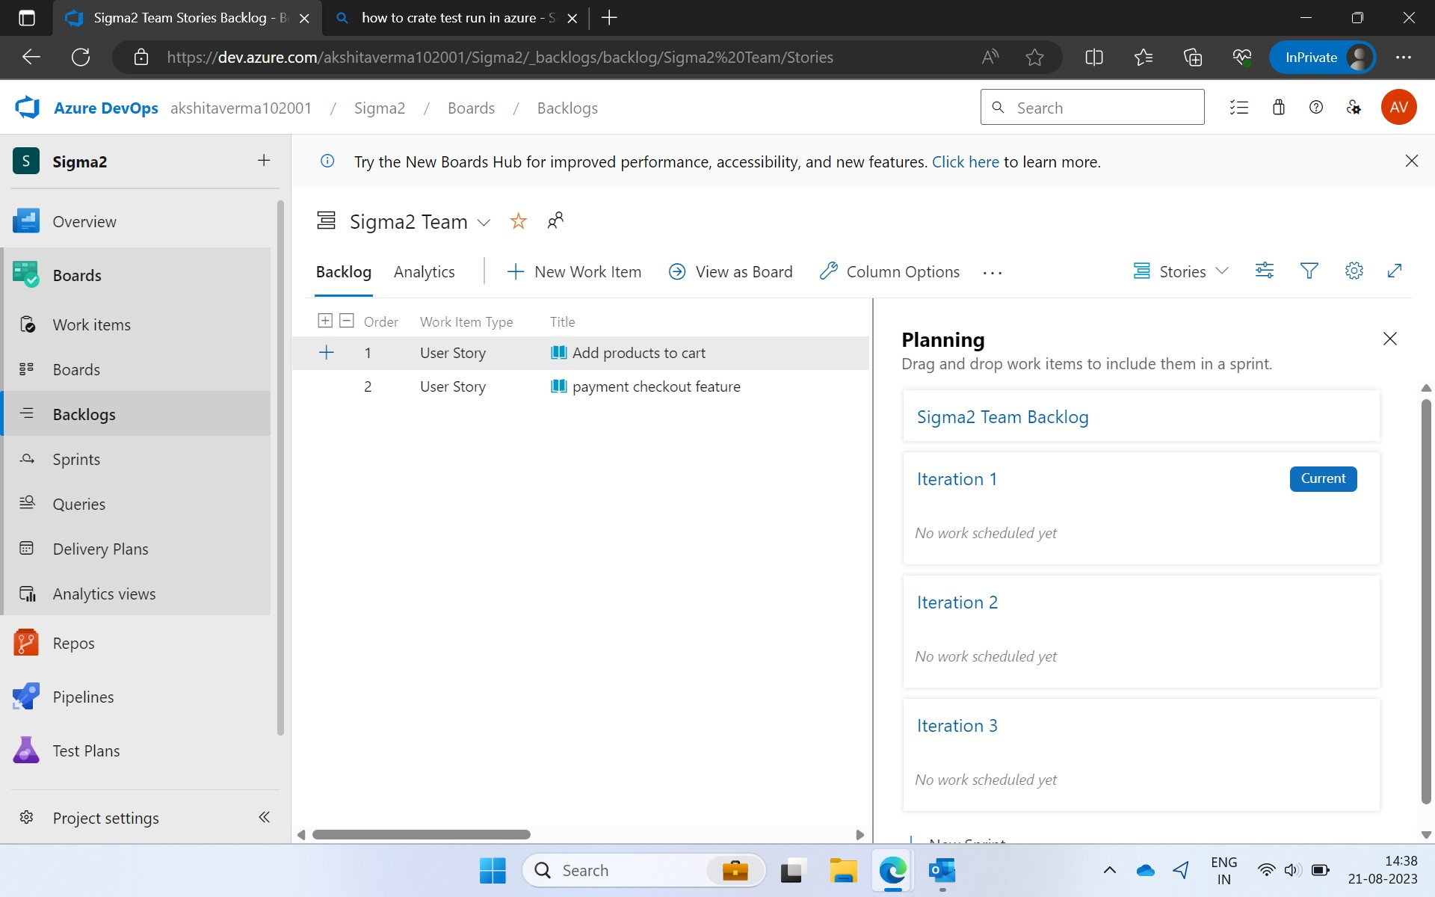
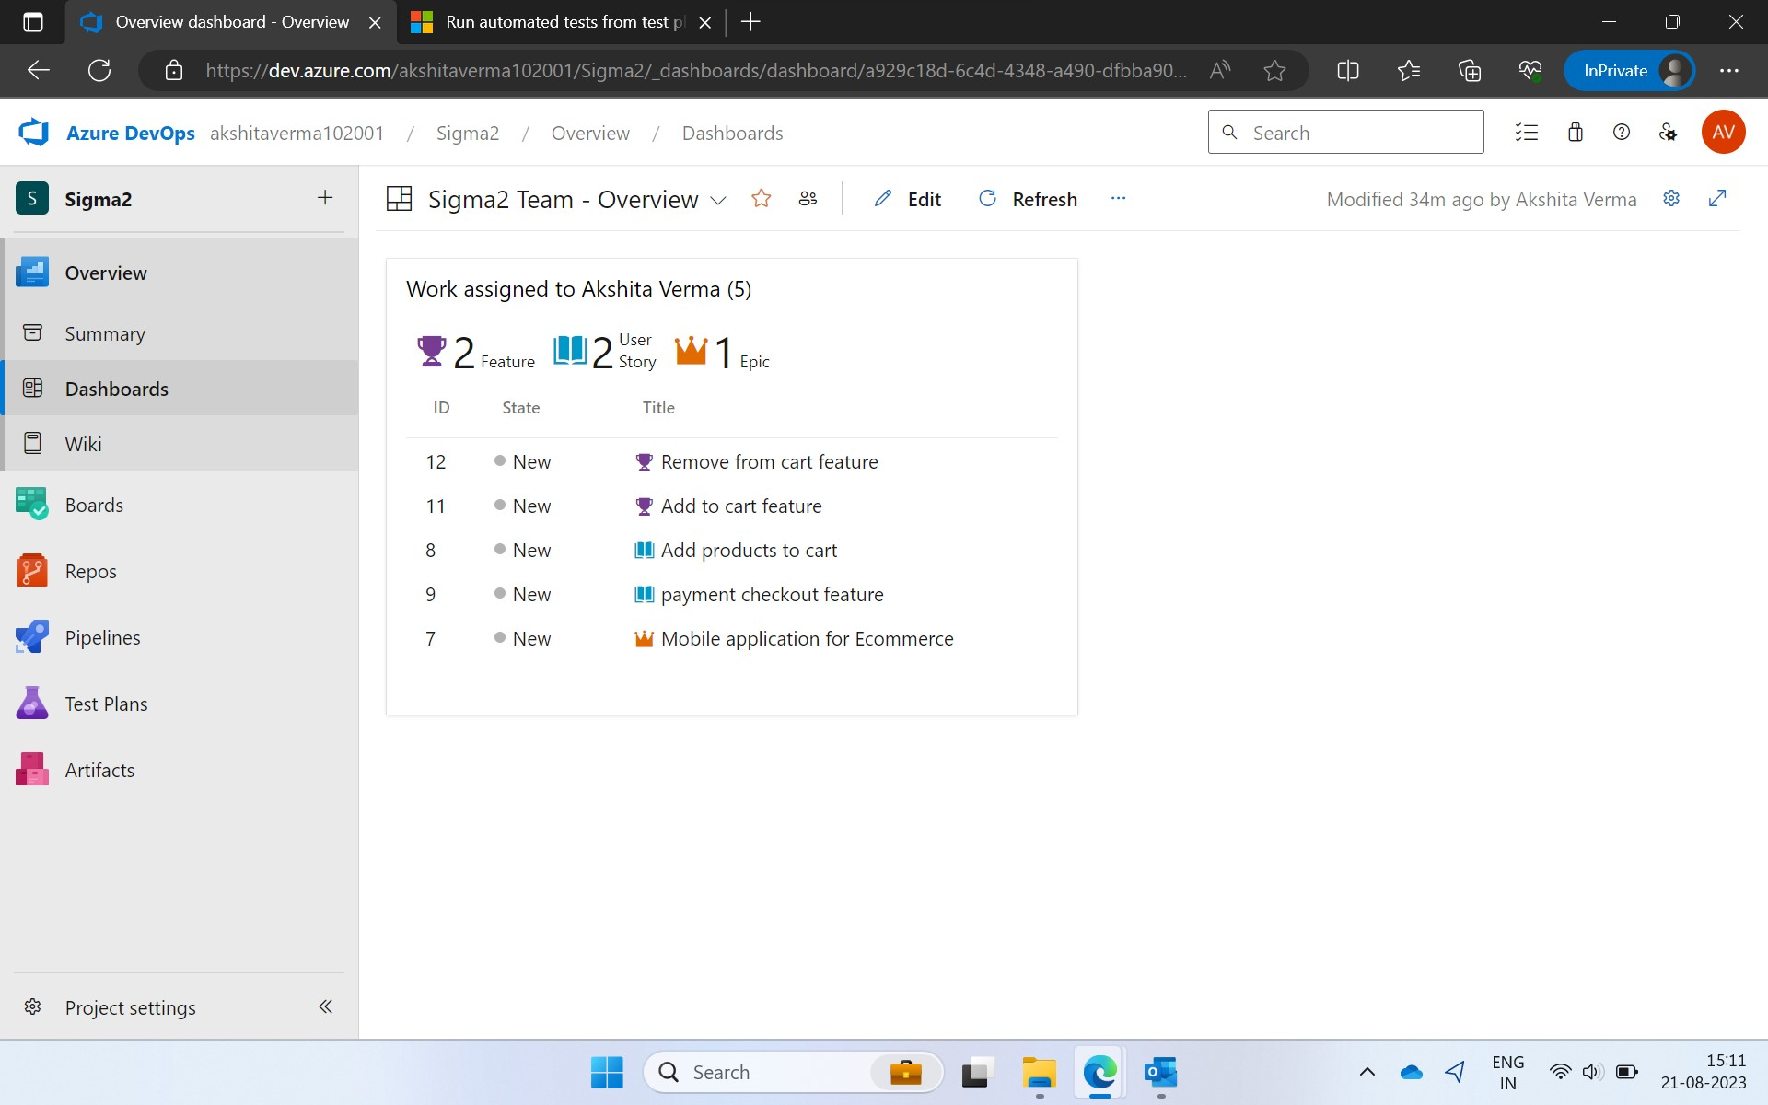
Day 2 BA REQUIREMENTS AND AGILE

Slide 5
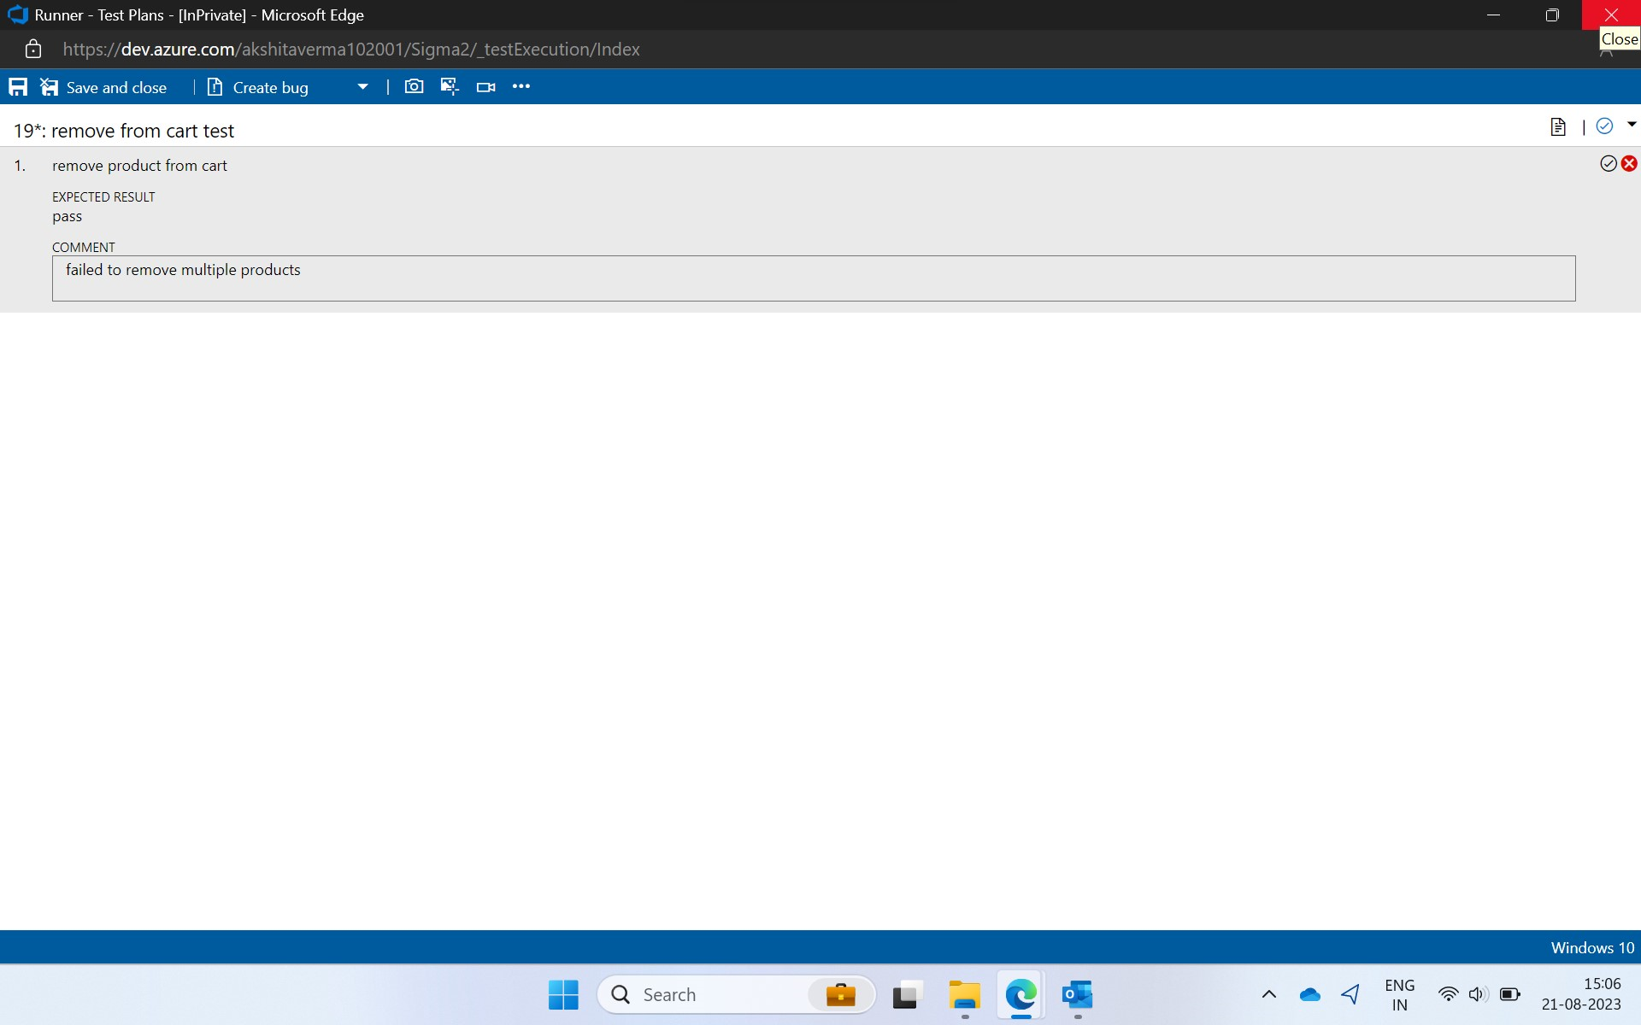
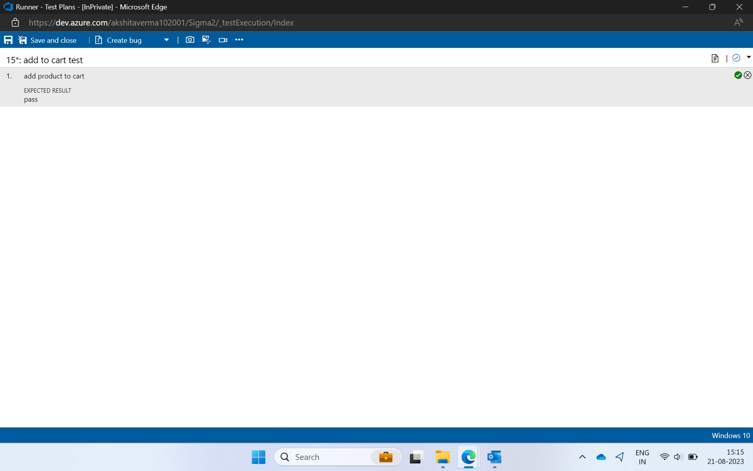
Day 2 BA REQUIREMENTS AND AGILE

Slide 6
Day 3 DBMS
Introduction to DBMS
Types of databases: SQL,NOSQL, data warehouses
Features of each type
Introduction to SQL
DML,DDL,DCL,TCL,DQI commands
Natural, outer, inner joins
Aggregate functions
Normalization: 1NF,2NF,3NF,4NF,BCNF,5NF
Activity: Technical Team Presentation on concepts of DBMS

Slide 7
Day 4 SOFTWARE TESTING
Introduction to software testing
Software test life cycle
SDLC vs STLC
Automation Testing
Unit Testing
White/Grey/Black Box testing
TDD
ATDD

Slide 8
Day 5 DEVOPS
Introduction to Devops
Devops lifecycle
Devops tools: Git, Kubernetes, Docker, Jenkins etc
Devops stages :CI, CD, CT, CD, Monitoring, feedback, operations
Devops principles: Automation, Iteration, Continuous improvement, Collaboration
CI/CD
Github actions: workflows, events, jobs, runners, Actions
Activity: Handson- Create workflow and execute in github actions

Slide 9
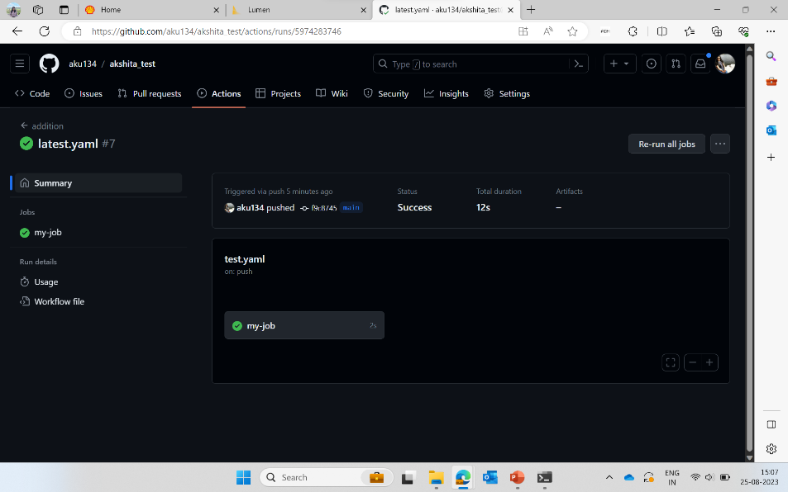
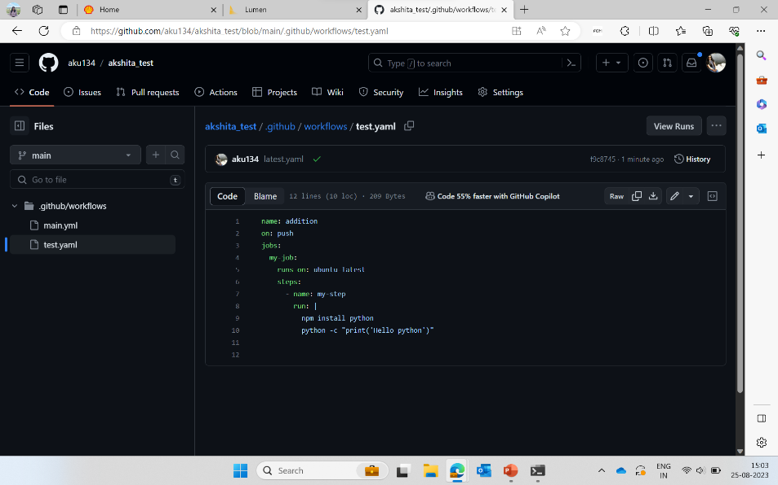
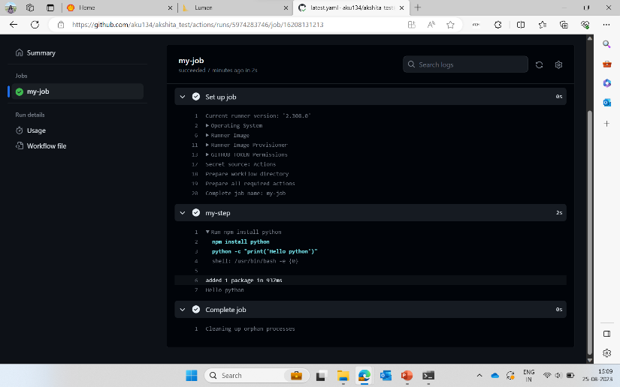
Day 5 DEVOPS

Slide 10
Day 6 CLOUD
Introduction to cloud computing
Software as a Service(SAAS)
Platform as a Service(PAAS)
Infrastructure as a Service(IAAS)
Virtualization
Virtual Machines
Cloud Taxonomy
Advantages/Disadvantages of cloud computing
Activity: Handson –creating vm on Azure

Slide 11
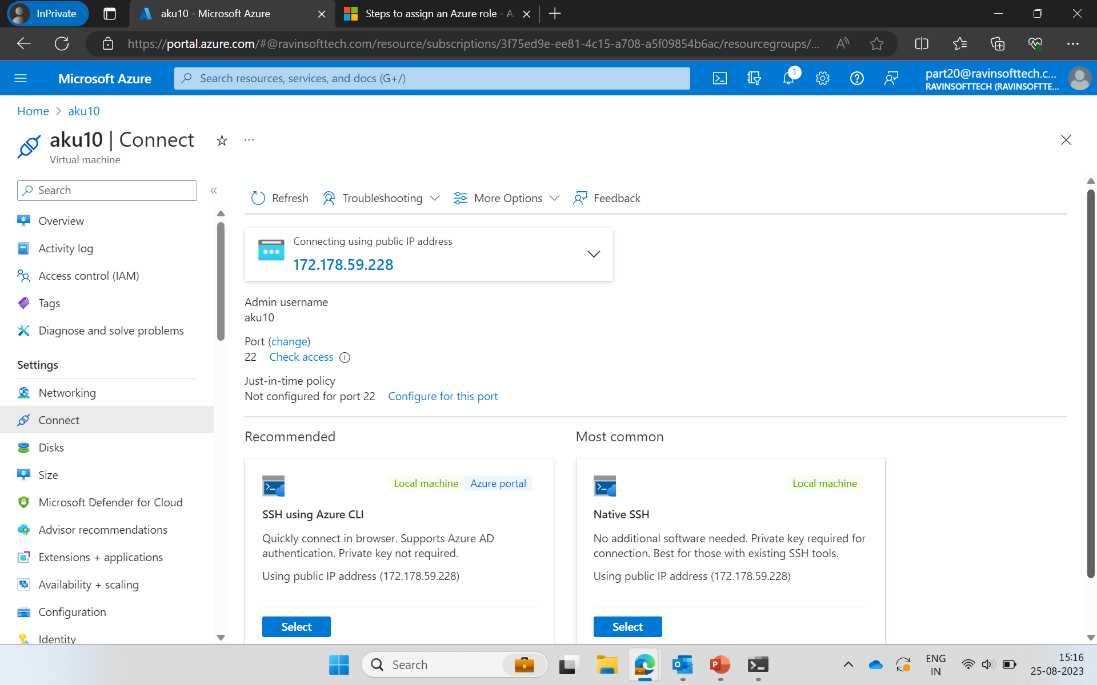
Day 6 CLOUD

