Slide 1


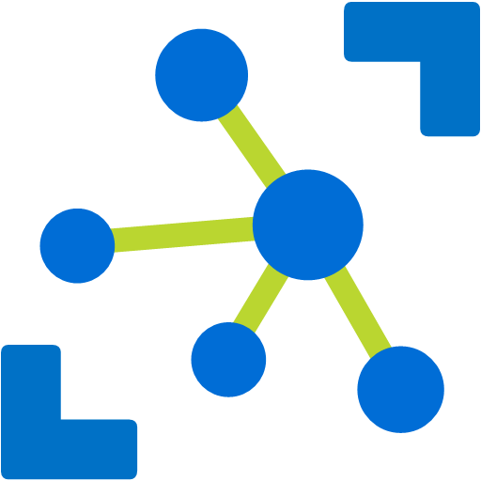



Timeseries Insights
IoT Hub
Azure Stream Analytics
Azure Function App
IoT Hub SDK
Slack
Blob Storage

