Slide 1

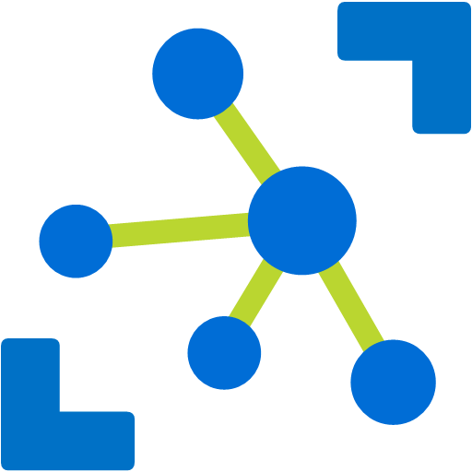




Azure DevOps
IoT Hub
Azure Stream Analytics
Azure Function App
IoT Hub SDK
Slack
Timeseries Insights
Blob Storage

