Slide 1
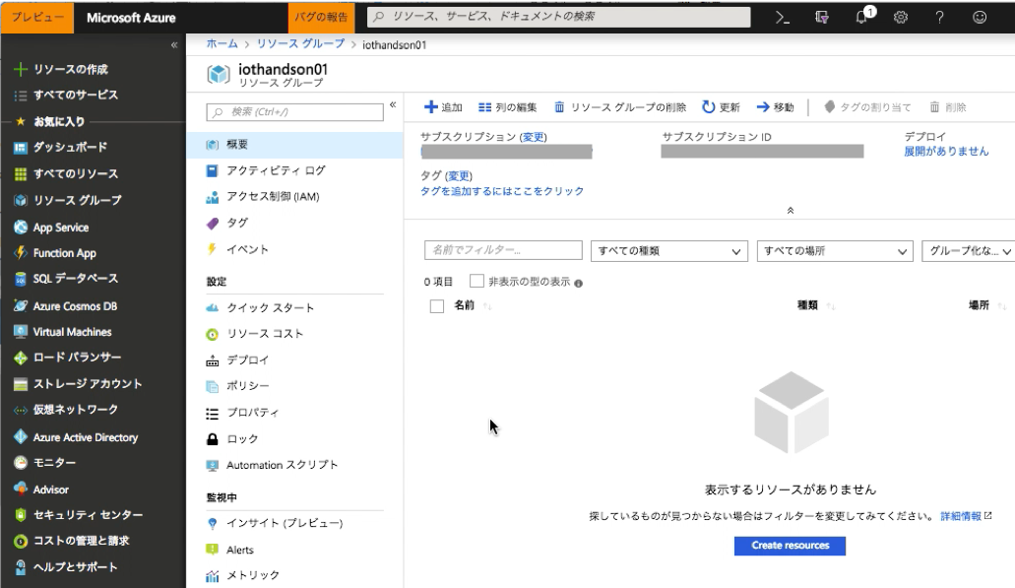
iothub-hub-add.png

Slide 2
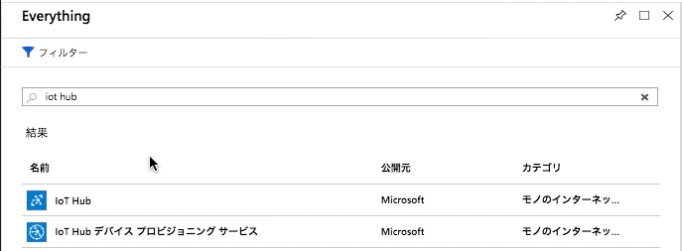
iothub-hub-filter.png

Slide 3
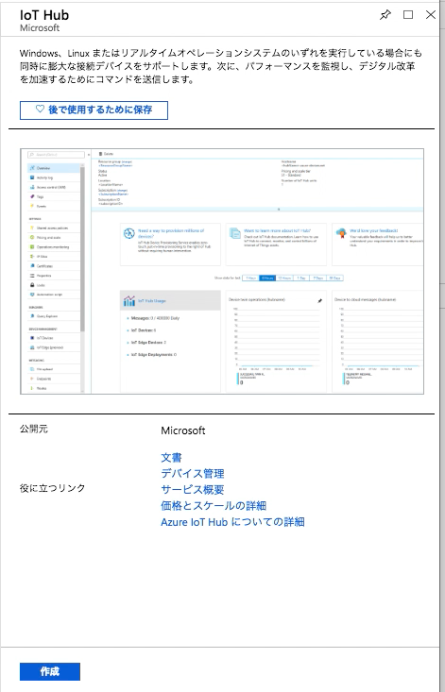
iothub-hub-create.png

Slide 4
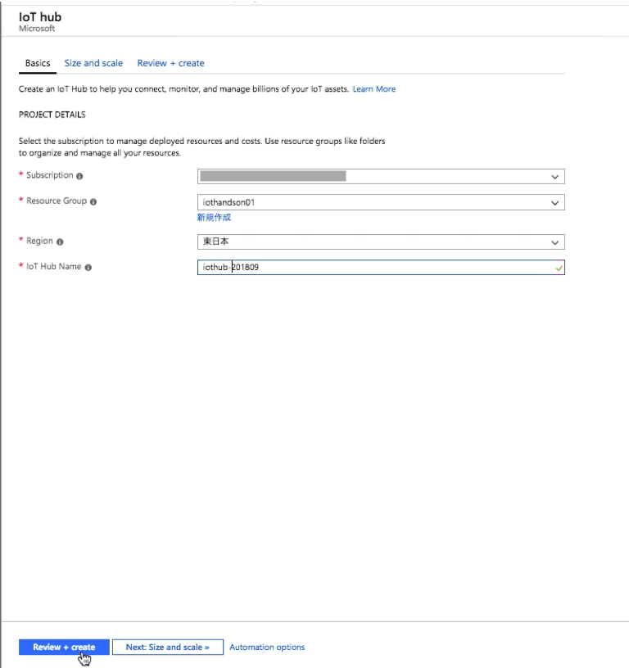
iothub-hub-config-basic.png

Slide 5
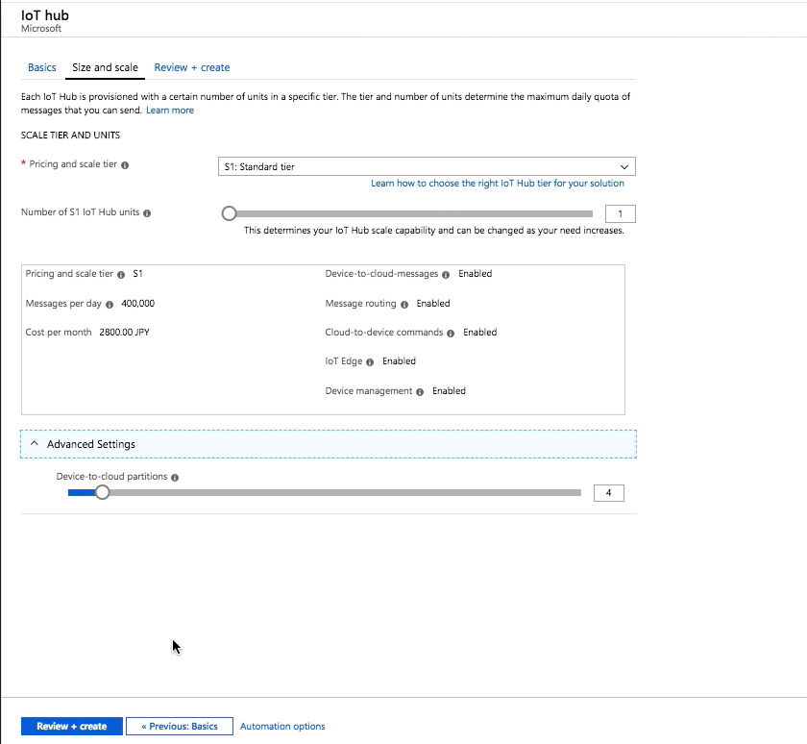
iothub-hub-config-size.png

Slide 6
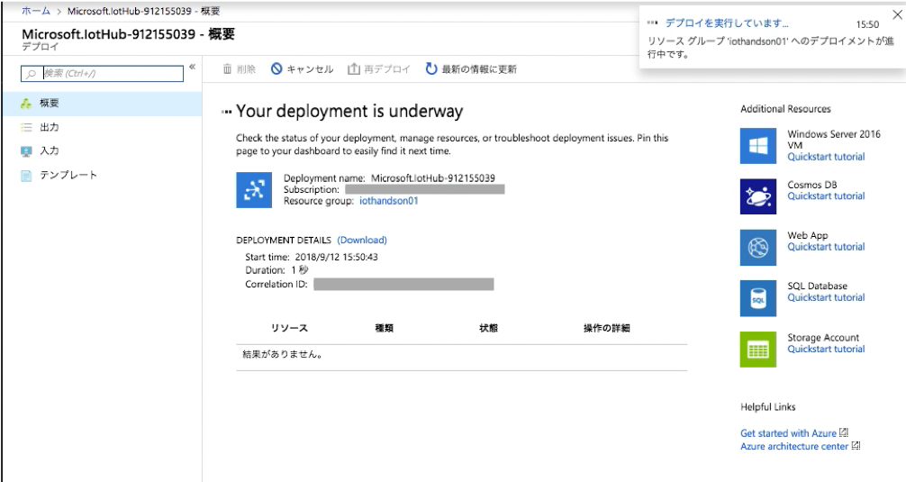
iothub-hub-deploying.png

Slide 7
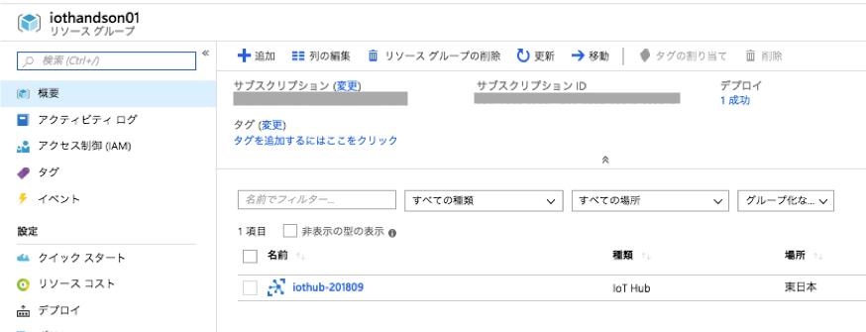
iothub-hub-confirm.png

Slide 8
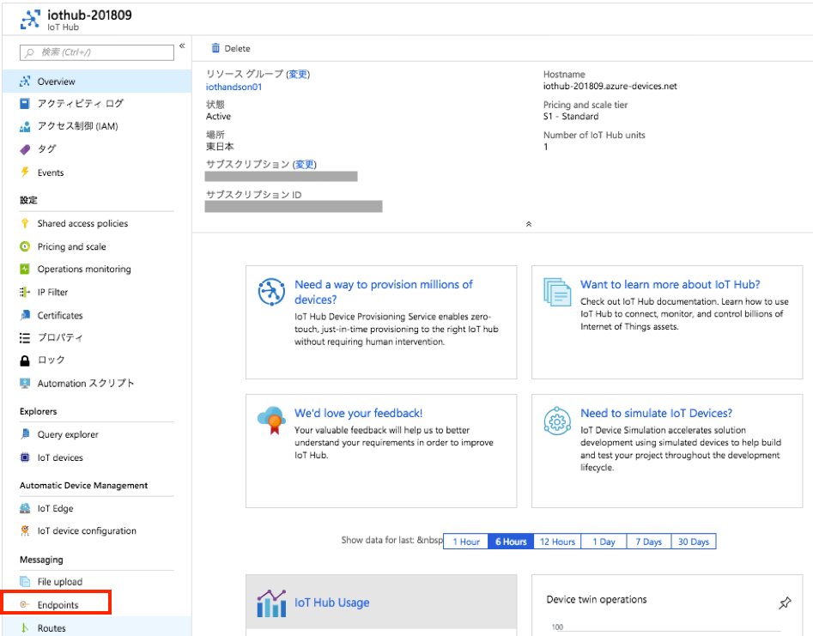
iothub-endpoint-create.png

Slide 9
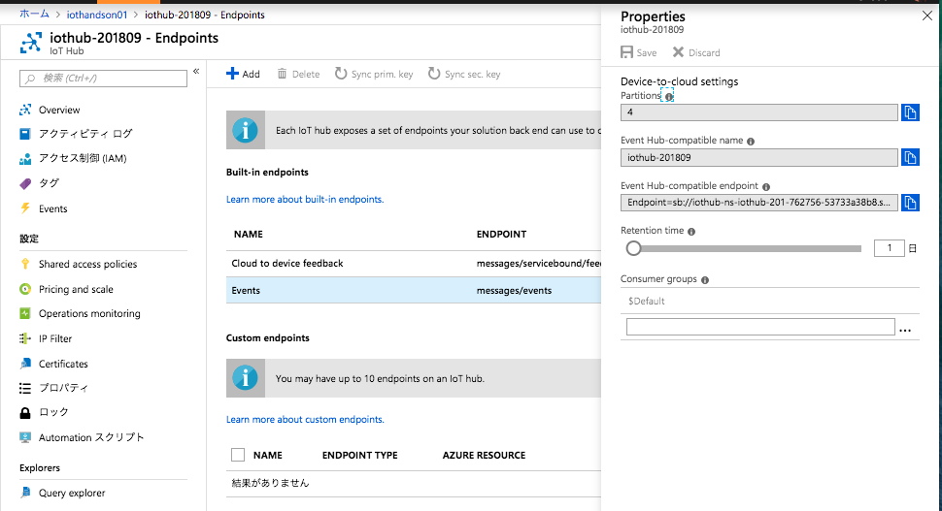
iothub-endpoint-config.png

Slide 10
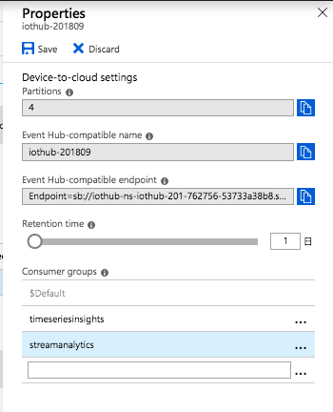
iothub-endpoint-properties.png

Slide 11
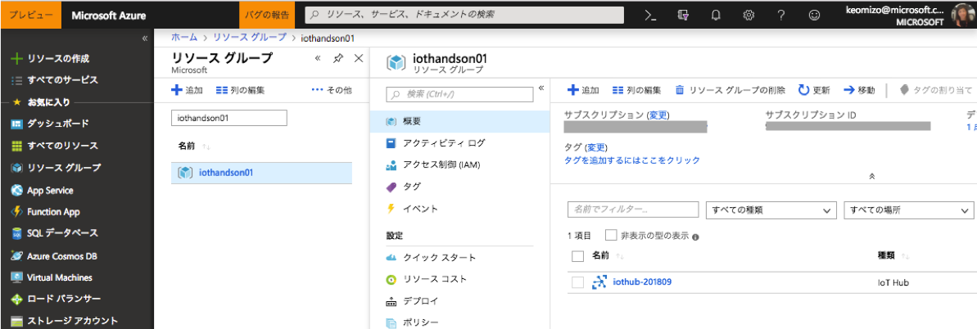
iothub-hub-select.png

Slide 12
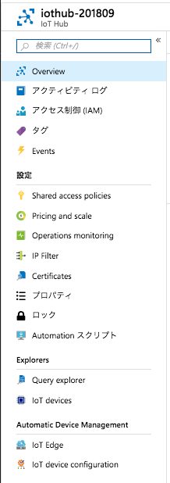
iothub-device-explorer.png

Slide 13
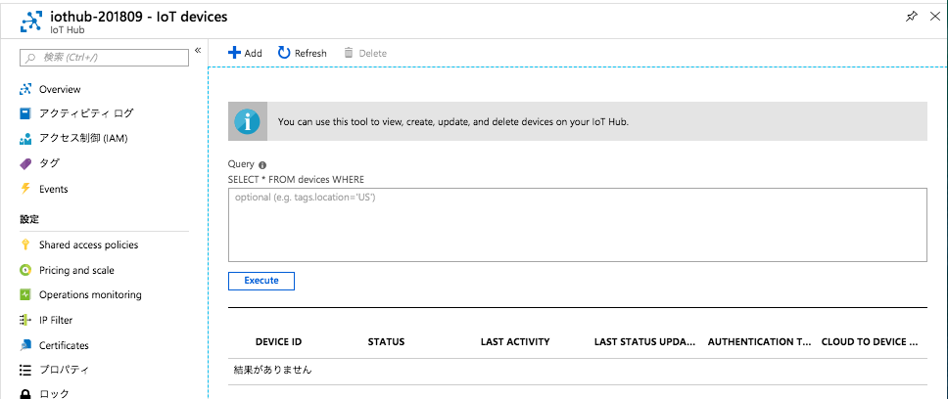
iothub-device-add.png

Slide 14
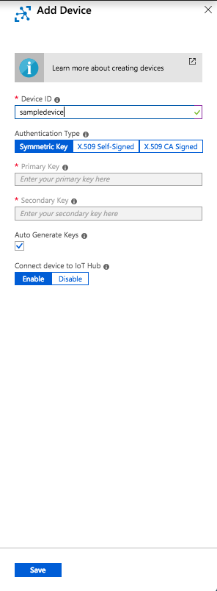
iothub-device-config.png

Slide 15
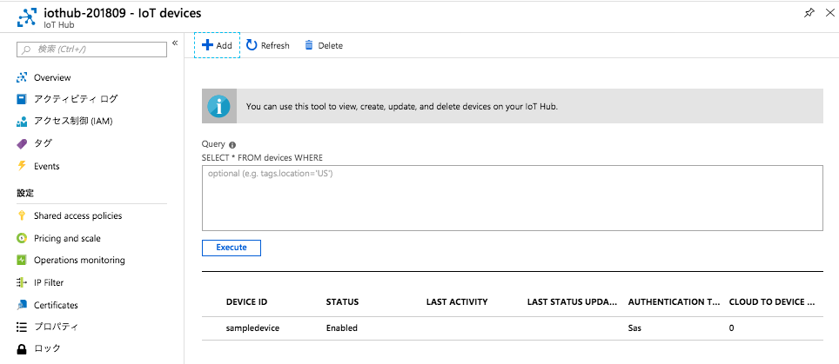
iothub-device-confirm.png

Slide 16
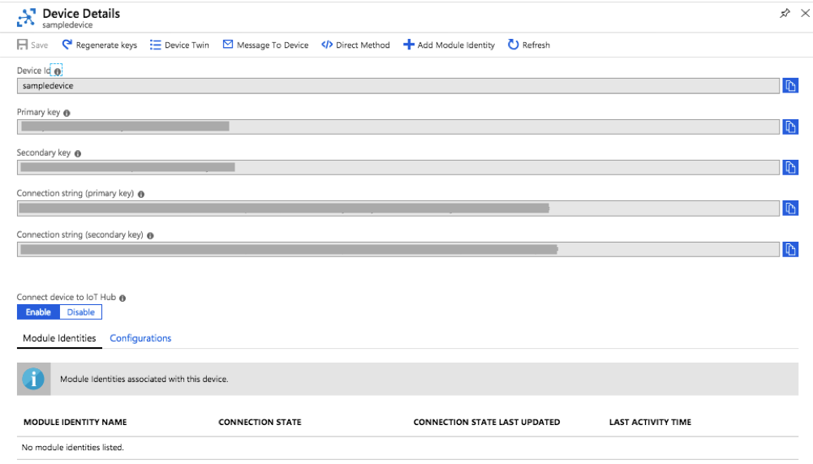
iothub-device-details.png

Slide 17
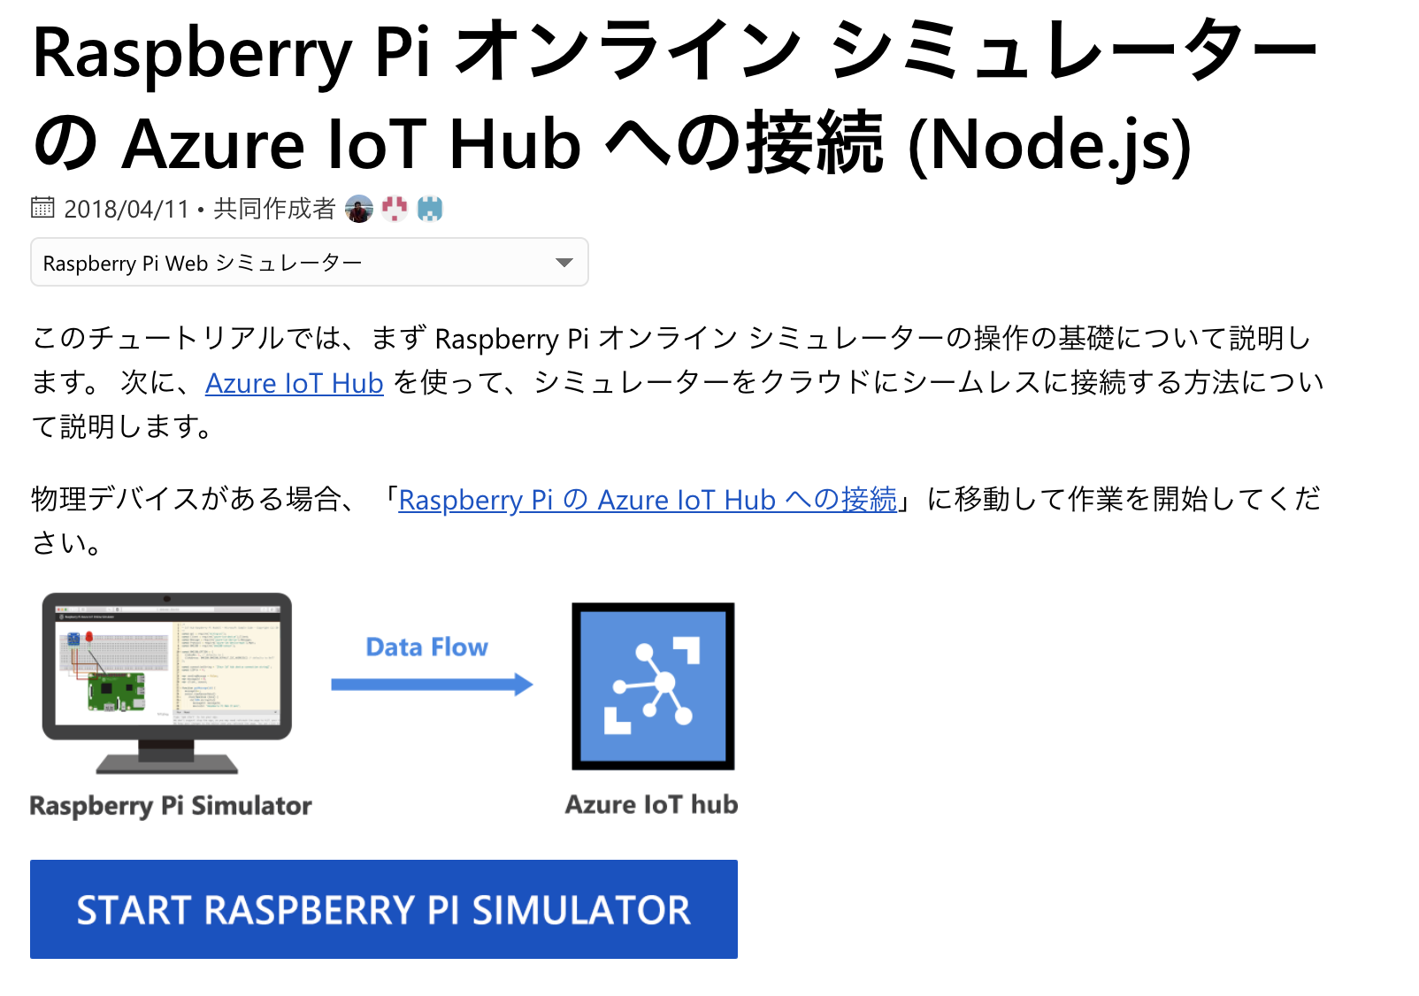
iothub-pi-gettingstarted.png

Slide 18
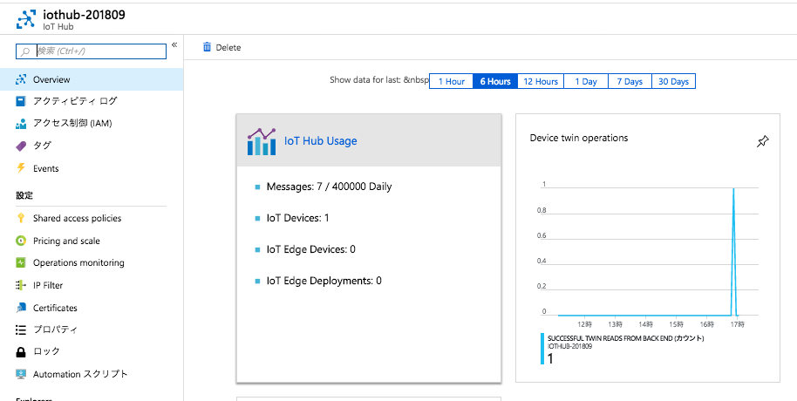
iothub-pi-telemetry.png

