Slide 1
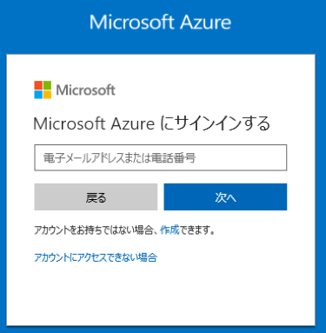
azure-signin.png

Slide 2
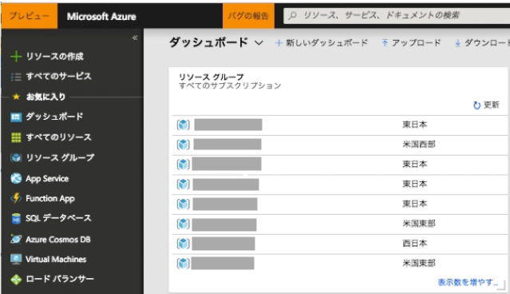
azure-resourcegroup.png

Slide 3
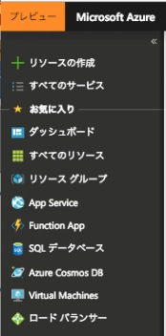
azure-create-resourcegroup.png

Slide 4

azure-add-resourcegroup.png

Slide 5
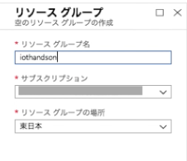

azure-config-resourcegroup.png

Slide 6
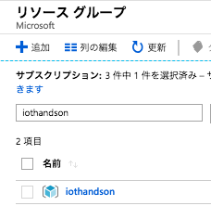
azure-confirm-resourcegroup.png

