Slide 1
Composable Tests in Junit
Bachelor Project
Lea Hänsenberger

Slide 2
Overview
which are the goals of the project
what is already done
what needs to be done
roadmap

Slide 3
Goals
You should be able to:
define dependencies between testmethods (also between
testmethods of different classes)
define testmethods, that have a return value
define testmethods that take parameters (only, if
the method depends on a testmethod, which returns an
object of the same type as the type of the parameter)

Slide 4
What is already done?
testmethods with return values and/or parameters
are accepted as valid testmethods
testmethods are run in the order of their dependencies
testmethods are ignored, if the testmethod, they depend
on, has failed or was skipped itself
Notes:
show little demo

Slide 5
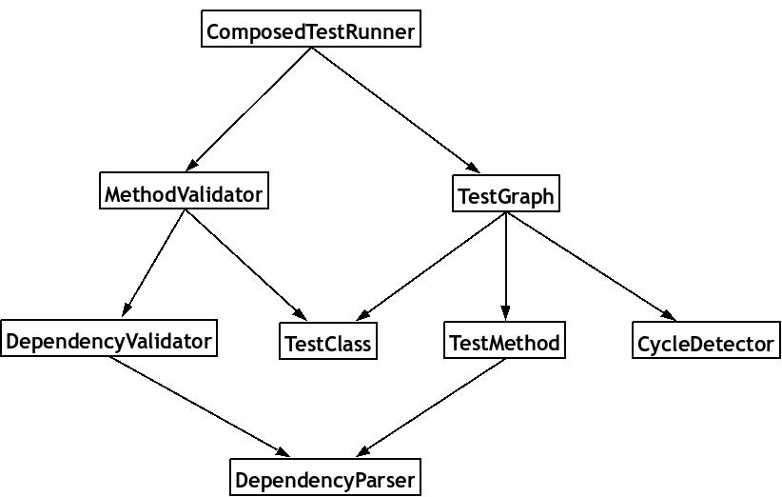
UML
Notes:
show little demo

Slide 6
What needs to be done?
take the return value from a testmethod as parameter for
a testmethod that depends on it
case study: rewrite „normal“ JUnit-Tests of an application
with composable tests and compare them
adapt the eclipse plugin to display some more information
  e.g. a graph-visualization of the test-dependencies

Slide 7
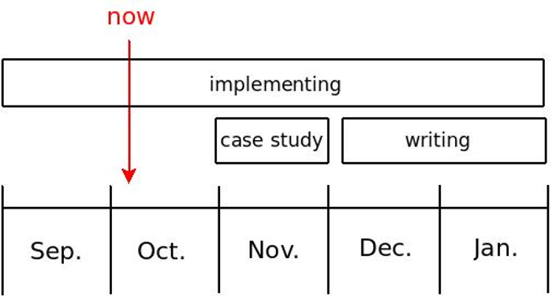
Roadmap

