Slide 1
CAPSTONE Project: Chicago QSR area selection
By Abhay Kukreja
April 2020

Slide 2
CONTENT
-- Background and Problem statement
-- Data and Solution
-- Methodology
-- Results
-- Observation
-- Conclusion
-- References

Slide 3
Background and Problem Statement
-- Chicago Demographics
-- 2.7 Million people
-- Food hub
-- Ethnic City
-- Crime Rate
-- Quick Service Restaurant (QSR) Location
-- Choosing a safe location for QSR (Chipotle and Subway)
-- Selecting a high income area for QSR

Slide 4
Data and Solutions
-- Data
-- Chicago Demographic Data: https://ibm.box.com/shared/static/05c3415cbfbtfnr2fx4atenb2sd361ze.csv
-- Chicago Crime Data: https://ibm.box.com/shared/static/svflyugsr9zbqy5bmowgswqemfpm1x7f.csv
-- Chicago Public School Data: https://ibm.box.com/shared/static/f9gjvj1gjmxxzycdhplzt01qtz0s7ew7.csv
-- FourSquare API Data: Venues and QSRs

Slide 5
Methodology
-- Solution
-- Analyze crime data to identify neighborhoods with the least occurrences of crime.
-- For these neighborhoods identify the the top 3 with high income, and population
-- For these neighborhoods, run the Four Square APIs, to get the venues
-- From these venues identify restaurants
-- Verify the concentration of QSRs and do specifics on “Chipotle” and “Subway”
-- Map these to identify the potential locations for the restaurant.

Slide 6
Results
LOW CRIME AREA
7.0 | Lincoln Park | 0.8 | 12.3 | 5.1 | 3.6 | 21.5 | 71551 | 2.0
12.0 | Forest Glen | 1.1 | 7.5 | 6.8 | 4.9 | 40.5 | 44164 | 11.0
33.0 | Near South Side | 1.3 | 13.8 | 4.9 | 7.4 | 21.8 | 59077 | 7.0
47.0 | Burnside | 6.8 | 33.0 | 18.6 | 19.3 | 42.7 | 12515 | 79.0
55.0 | Hegewisch | 3.3 | 17.1 | 9.6 | 19.2 | 42.9 | 22677 | 44.0
75.0 | Morgan Park | 0.8 | 13.2 | 15.0 | 10.8 | 40.3 | 27149 | 30.0
HIGH INCOME
COMMUNITY | CRIME
AREA Number | COUNT
33 | 1
75 | 1
47 | 1
55 | 1
12 | 1
7 | 1

Slide 7
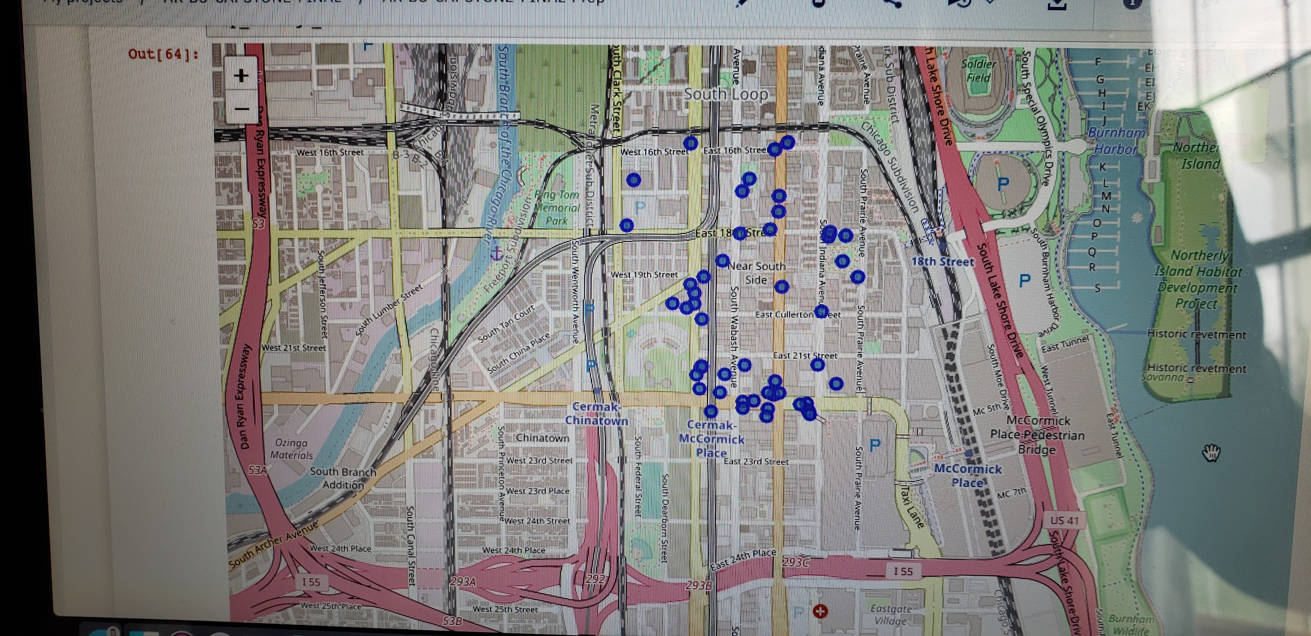
Results: Near South Side Area
Types of restaurants.
No Quick Service Restaurants
No Chipotle No Subway
Location of venues in the Near South Side. 2 areas of concentration
Cermark and McCormick, 2) Cullerton and State
categories | name | lat | lng
American Restaurant | 1 | 1 | 1
Bistro | 1 | 1 | 1
Burger Joint | 1 | 1 | 1
Café | 2 | 2 | 2
Caribbean Restaurant | 1 | 1 | 1
Fast Food Restaurant | 1 | 1 | 1
Food Court | 1 | 1 | 1
Fried Chicken Joint | 1 | 1 | 1
Italian Restaurant | 1 | 1 | 1
Mexican Restaurant | 1 | 1 | 1
New American Restaurant | 1 | 1 | 1
Pizza Place | 2 | 2 | 2
Restaurant | 1 | 1 | 1
Seafood Restaurant | 1 | 1 | 1
Sushi Restaurant | 1 | 1 | 1
Thai Restaurant | 1 | 1 | 1

Slide 8
Observations
-Some observations of the Near South Side community area:
-- Multi cuisine restaurants
-- No QSR restaurants
-- No Sandwich shops
-- 1 Mexican restaurant but not fast food
-- 2 potentially good locations 1 near McCormick place (Convention center) and 1 near Cullerton Park
Analysis of Lincoln park community area provides the following statistics:
-- There were 18 venues
-- No Chipotle nor Subway restaurants
-- Near the Depaul University
-- 2 QSRs Pizza Hut and White Castle
-- 1 Mexican Bar and restaurant
-- No Sandwich shops

Slide 9
Conclusion
We have got a small glimpse of how real life data-science projects look like. Some standard and frequently used python libraries have been used to scrape web-data, perform data manipulation, use Foursquare API to explore the community areas of Chicago and saw the results of recommendation of areas using the Folium leaflet map. Potential for this type of analysis in a real life business problem is discussed in great detail. Finally, since the analysis was mostly concentrated on the possibilities of opening a QSR restaurant targeting the safe, high income community areas of Chicago, I am sure more analysis can be done for other areas with different criteria. The data points to favorable observations regarding opening QSRs in the two community areas (Lincoln Park and Near South Side). Also, this is just a starting point, further analysis needs to be done on exact location, price analysis of locations, profitability and feasibility assessment of foot traffic, etc. Hopefully, this kind of analysis will provide some initial guidance to solve for more real-life challenges using data-science.

Slide 10
References
REFERENCES.
[1] Chicago — Wikipedia
[2] IBM Data sources
[3] Foursquare API
[4] Google Map

