Slide 1
The GenAI Augmentation Paradox
Evaluating Synthetic Data in Low-Data Image Classification
Akul Ameya • Nhat Quang Bui • Aayush Aneja • Cahyani Karunia Putri
Notes:
We present a controlled study asking a specific question: can synthetic images from diffusion models recover performance in low-data classification? And critically — does more synthetic data always mean better results? Our findings suggest the answer is more nuanced than the literature currently assumes.

Slide 2
Motivation
Low-data → overfitting, poor calibration, unstable features
Diffusion models proposed as augmentation source
Prior work: single budget, accuracy-only evaluation
Notes:
When training data is scarce, pretrained models still overfit and produce poorly calibrated predictions. Synthetic data from diffusion models is widely proposed as a fix, but most prior work evaluates a single augmentation level and measures only accuracy. That leaves open whether synthetic data genuinely improves the model or just inflates one metric.

Slide 3
Research Questions
Does synthetic data recover performance toward a full-data ceiling?
Does performance scale with synthetic volume?
Does class-aware allocation outperform uniform augmentation?
Are gains real across calibration, robustness, and representation?
Notes:
We structure the study around four questions. First, how much of the performance gap can synthetic data close? Second, does adding more synthetic data continue to help? Third, does smart allocation matter? And fourth, do improvements hold up beyond aggregate accuracy — across calibration, robustness, and feature quality?

Slide 4
Experimental Setup
Tiny ImageNet, 200 classes, 64×64
5% data regime → 25 images/class
Stable Diffusion v1.5, fixed prompts
Pipelines: Baseline | Uniform 5×, 10×, 15× | Adaptive (HC, Unc, PU) | Ceiling
ResNet-18 (primary), MobileNetV3-Small (validation)
Notes:
We use Tiny ImageNet at 5% — just 25 real images per class. Synthetic images are generated once from Stable Diffusion and combined with real data at three budget levels. We also test three adaptive allocation policies that redistribute the synthetic budget based on class difficulty. A full-data ceiling anchors the upper bound. All experiments run on ResNet-18 with MobileNetV3 as cross-architecture validation.

Slide 5
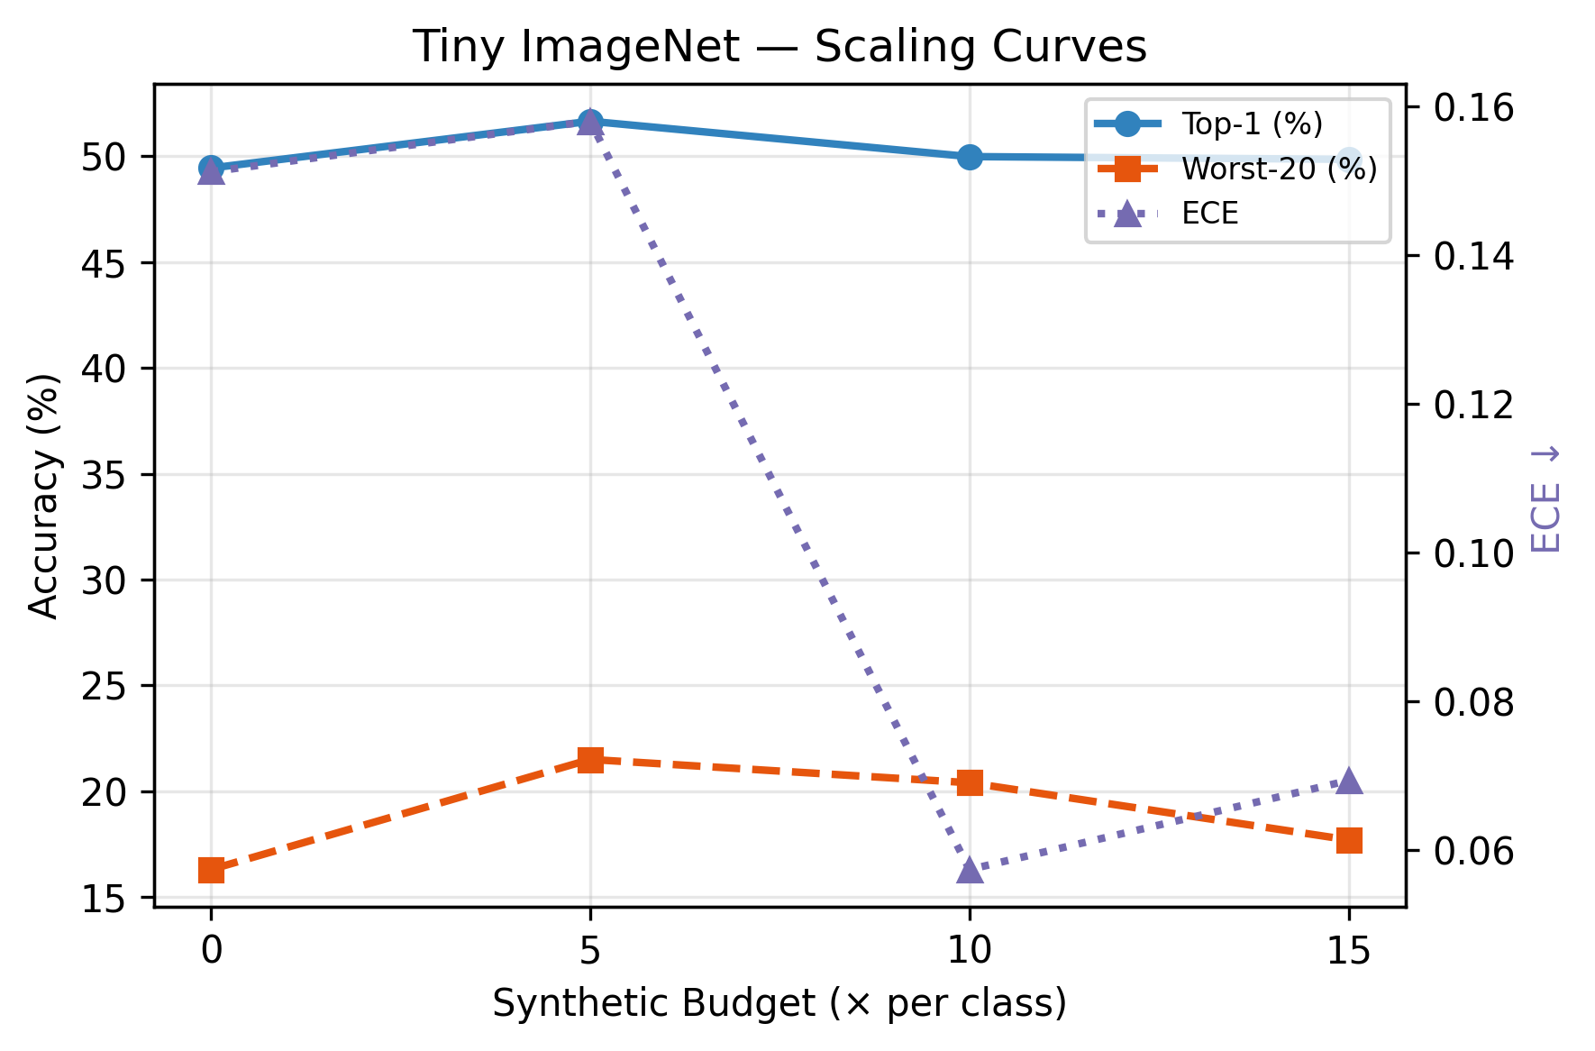
Dose–Response Framework
Treat synthetic volume as independent variable
Measure response across multiple axes
Not "does it help?" → "how much, and when does it stop?"
Notes:
The core framing is dose–response. Instead of testing one augmentation setup, we vary the synthetic budget and observe how each metric responds. This figure shows the full picture: accuracy peaks at 5× and flatlines after. ECE drops monotonically. The scaling behavior is non-monotonic — more data does not mean more performance.

Slide 6
Main Accuracy Results
Pipeline | Top-1 (%) | Top-5 (%) | Macro (%) | Worst-20 (%) | ECE
Baseline | 49.44 | 75.59 | 49.44 | 16.3 | 0.151
Uniform 5x | 51.65 | 75.41 | 51.65 | 21.5 | 0.158
Uniform 10x | 49.98 | 74.56 | 49.98 | 20.4 | 0.057
Uniform 15x | 49.85 | 75.72 | 49.85 | 17.7 | 0.069
Adaptive HC 15x | 49.96 | 75.22 | 49.96 | 21.5 | 0.057
Adaptive Unc 15x | 49.99 | 75.21 | 49.99 | 20.2 | 0.058
Adaptive PU 15x | 49.29 | 74.90 | 49.29 | 21.4 | 0.039
Ceiling | 70.99 | 89.26 | 70.99 | 48.6 | 0.082
Baseline: 49.44% → Uniform 5×: 51.65% (+2.21pp)
10×: 49.98%, 15×: 49.85% — saturation
Ceiling: 70.99% — gap of 21.55pp
Normalized gain at 5×: only 10.3% of recoverable gap
Notes:
The numbers are clear. The best synthetic configuration gains just over 2 percentage points, and that's at the lowest budget. Doubling or tripling the synthetic volume adds nothing. Against a ceiling of 71%, synthetic data recovers roughly one-tenth of the gap. The full results table confirms this pattern holds across Top-1, Top-5, macro, and worst-class metrics.

Slide 7
FID and Synthetic Distribution
FID: 5× = 140.05, 10× = 139.61, 15× = 139.48
Near-constant → same generative manifold
More volume ≠ more diversity
Notes:
FID stays essentially flat across budgets. This tells us that adding more synthetic images doesn't shift the distribution — it just resamples from the same generative manifold. The saturation in accuracy is consistent with this: once you've seen what the generator can produce, more copies don't help.

Slide 8
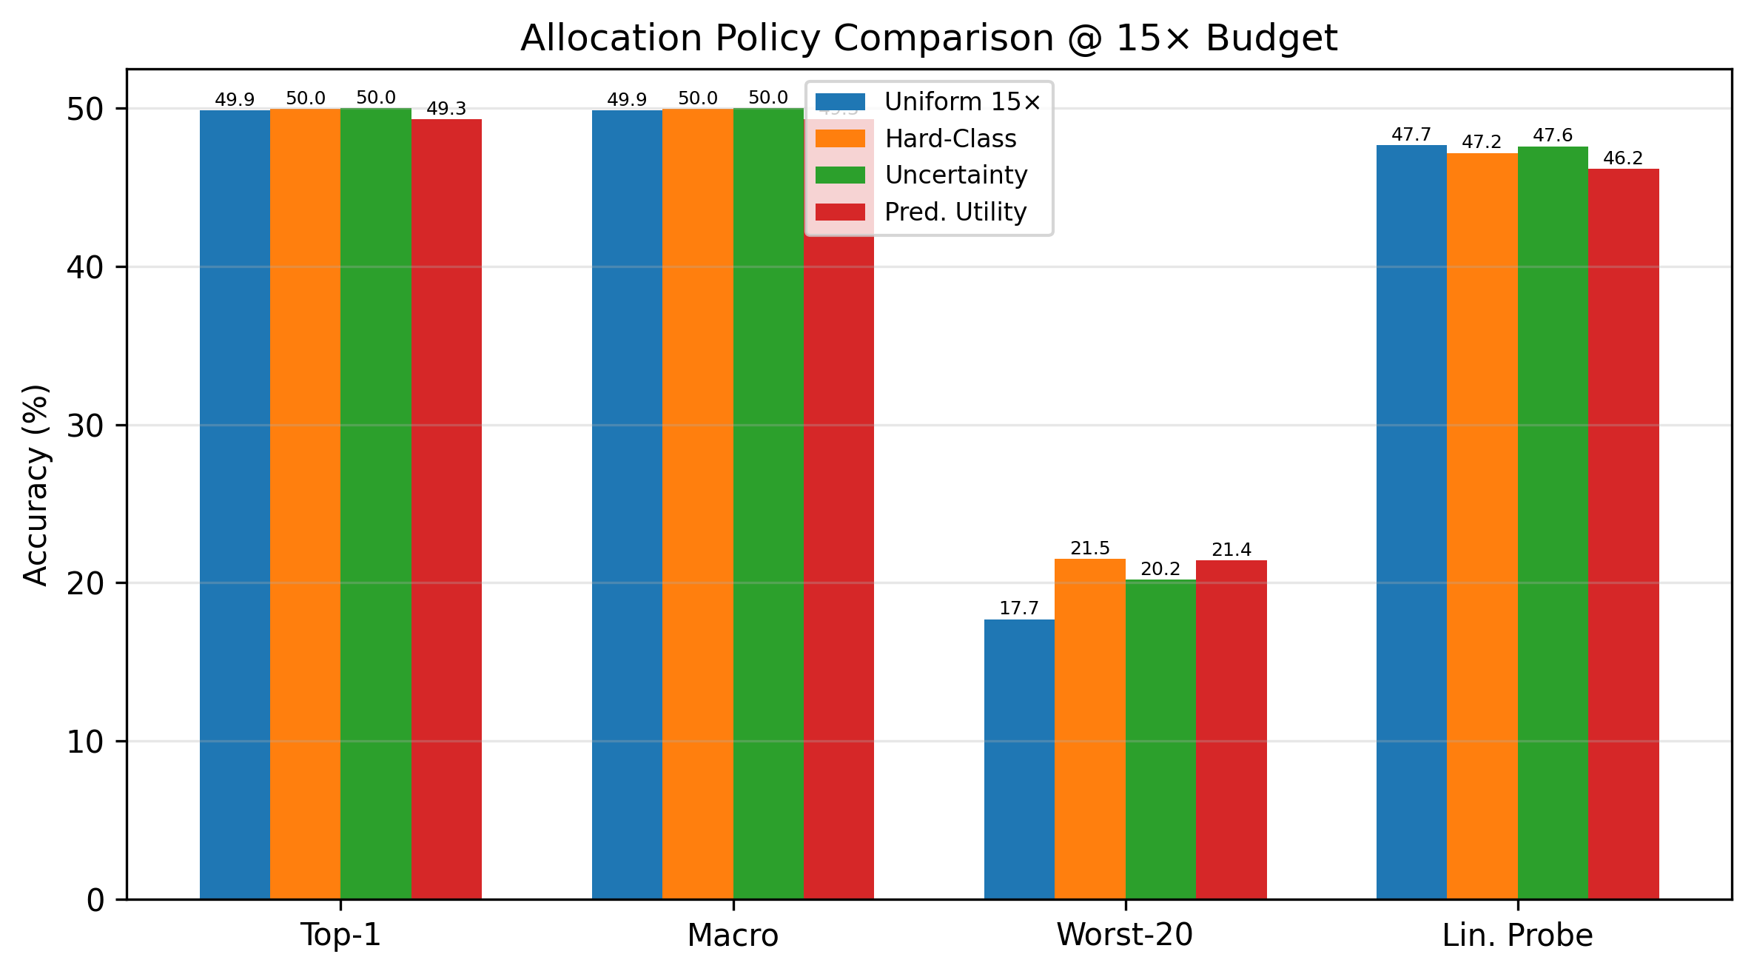
Allocation Policy Comparison
All three adaptive policies within ≤1pp of uniform at 15×
Predicted-utility ridge R² = 0.013
Per-class utility is nearly unpredictable
Notes:
On Tiny ImageNet, all three adaptive policies land within one percentage point of uniform — allocation doesn't help. The ridge model predicting per-class utility achieves an R-squared of 0.013. But as we'll show later, this null result does not generalize — on CIFAR-100, adaptive allocation produces a meaningful advantage, suggesting the effectiveness of allocation strategy is dataset-dependent.

Slide 9
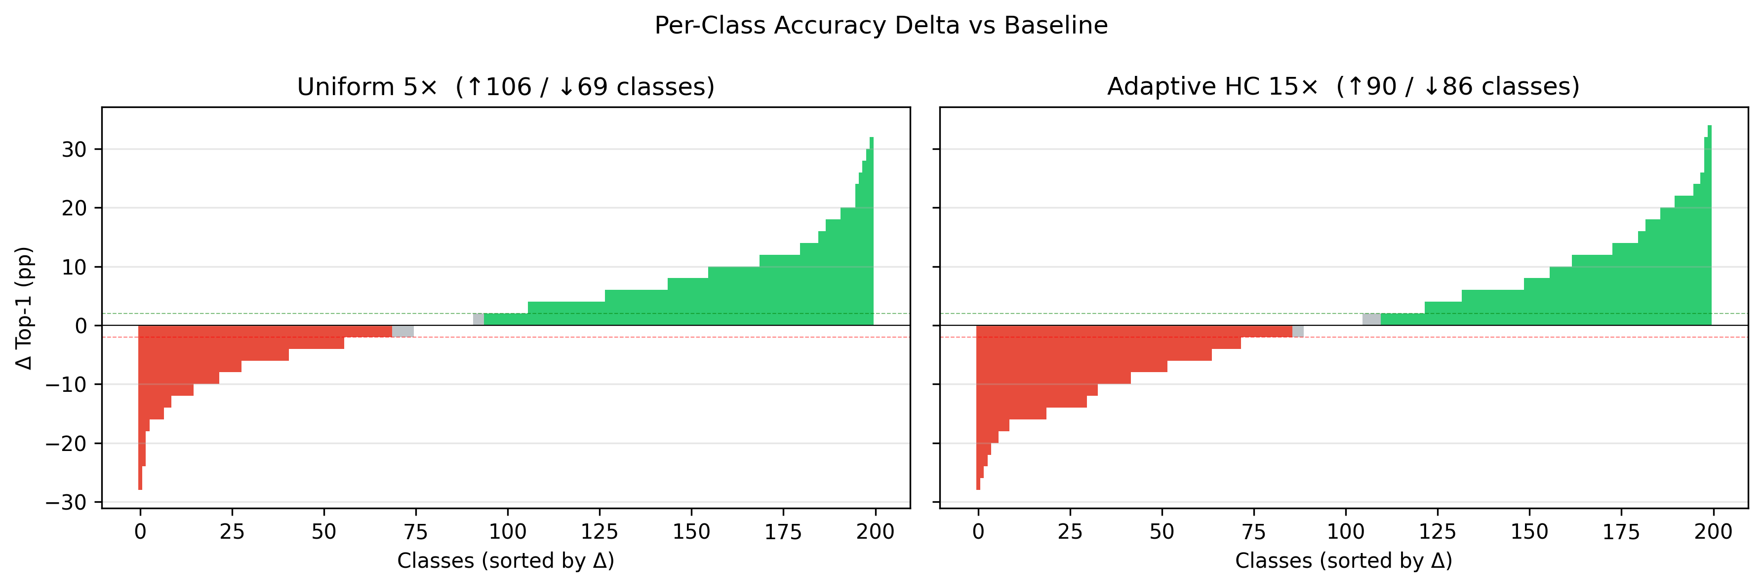
Per-Class Impact
5×: 106 helped, 69 harmed → HHR = 0.185
15×: 90 helped, 86 harmed → HHR = 0.0
Net benefit disappears at scale
Notes:
This is one of the most telling results. At 5×, about half the classes benefit and a third are harmed — net positive. At 15×, the help-harm ratio drops to exactly zero. Higher budgets don't just stop helping — they actively introduce harm to as many classes as they benefit. The synthetic distribution is not uniformly useful across the class space.

Slide 10
Calibration
Pipeline | Raw ECE | T | Cal. ECE
Baseline | 0.151 | 0.754 | 0.024
Uniform 5x | 0.158 | 0.754 | 0.038
Uniform 10x | 0.057 | 0.855 | 0.030
Uniform 15x | 0.069 | 0.855 | 0.032
Adaptive HC 15x | 0.057 | 0.855 | 0.030
Adaptive Unc 15x | 0.058 | 0.855 | 0.038
Adaptive PU 15x | 0.039 | 0.956 | 0.034
Ceiling | 0.082 | 0.754 | 0.036
Baseline ECE: 0.151 → Uniform 10×: 0.057 (62% reduction)
Post temperature scaling: all models converge (0.024–0.038)
Augmented models need less aggressive recalibration (T = 0.855 vs 0.754)
Notes:
Calibration is where synthetic data shows a cleaner benefit. Raw ECE drops by over 60% at moderate budgets. After temperature scaling, all models converge to similar calibrated error, but the augmented models start from a better place — they require less correction. This is consistent with synthetic data acting as a confidence regularizer, though part of the improvement may reflect lower overall confidence rather than strictly better probability estimates.

Slide 11
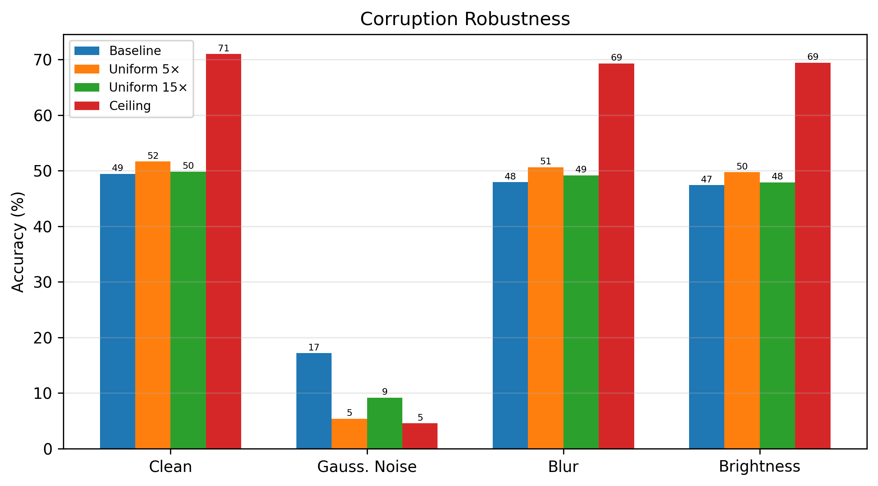
Corruption Robustness
Blur/brightness: synthetic models improve over baseline
Gaussian noise: severe degradation (baseline 17% → Uniform 5× 5.5%)
Ceiling shows same noise vulnerability → not synthetic-specific
Notes:
Robustness reveals a trade-off. Synthetic augmentation improves resilience to blur and brightness, but noise robustness collapses — dropping from 17% to under 6%. Importantly, the ceiling model trained on full real data shows the same noise vulnerability. This suggests the degradation comes from learning finer discriminative features, not from synthetic artifacts specifically. It's the known accuracy-robustness trade-off.

Slide 12
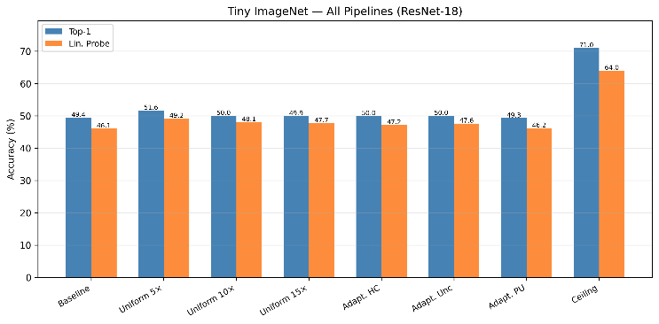
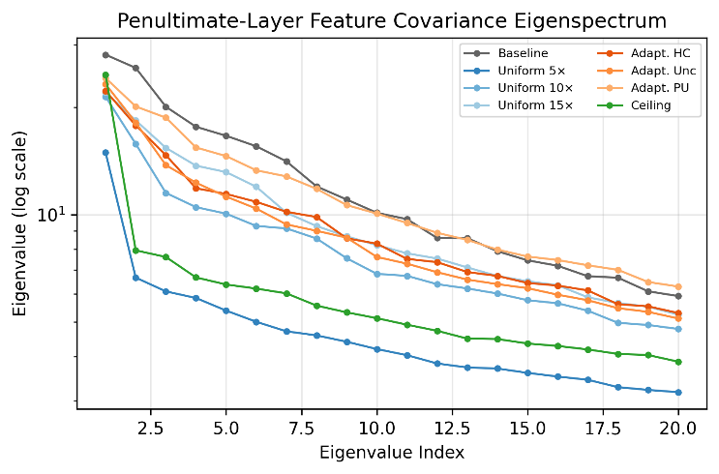
Representation Geometry
Linear probe: Baseline 46.06% → Uniform 5× 49.18% (+3.12pp, exceeds Top-1 gap)
Effective rank: 31.77 → 35.83
Feature improvement persists even when accuracy saturates
Notes:
Representation analysis shows something the accuracy numbers miss. Linear probe accuracy — which measures feature quality independently of the classifier head — improves by over 3 points at 5×, exceeding the Top-1 gain. Effective rank increases as well, meaning the model uses a higher-dimensional feature space. These improvements persist at budgets where accuracy has already saturated. Synthetic data genuinely improves feature structure, even when the classifier can't fully exploit it.

Slide 13
Cross-Architecture Validation (MobileNetV3)
MobileNetV3 baseline: 50.31% → Uniform 15×: 55.21% (+4.90pp)
Recovers 22.9% of ceiling gap vs 1.9% for ResNet-18 at same budget
Stronger inductive bias extracts more from same synthetic distribution
Pipeline | Top-1 (%) | Top-5 (%) | Macro (%) | Worst-20 (%) | ECE
Baseline | 50.31 | 77.69 | 50.31 | 18.40 | 0.094
Uniform 15x | 55.21 | 79.66 | 55.21 | 26.40 | 0.039
Adaptive PU 15x | 55.03 | 79.84 | 55.03 | 27.60 | 0.055
Ceiling | 71.69 | 90.56 | 71.69 | 48.00 | 0.102
Notes:
MobileNetV3 validates the pattern but with a key difference. It benefits significantly more from synthetic data — nearly 5 percentage points at 15×, recovering 23% of the ceiling gap compared to under 2% for ResNet. The architecture's stronger inductive bias appears to extract more useful signal from the same synthetic pool before saturating. The qualitative finding — saturation with diminishing returns — holds across both architectures.

Slide 14
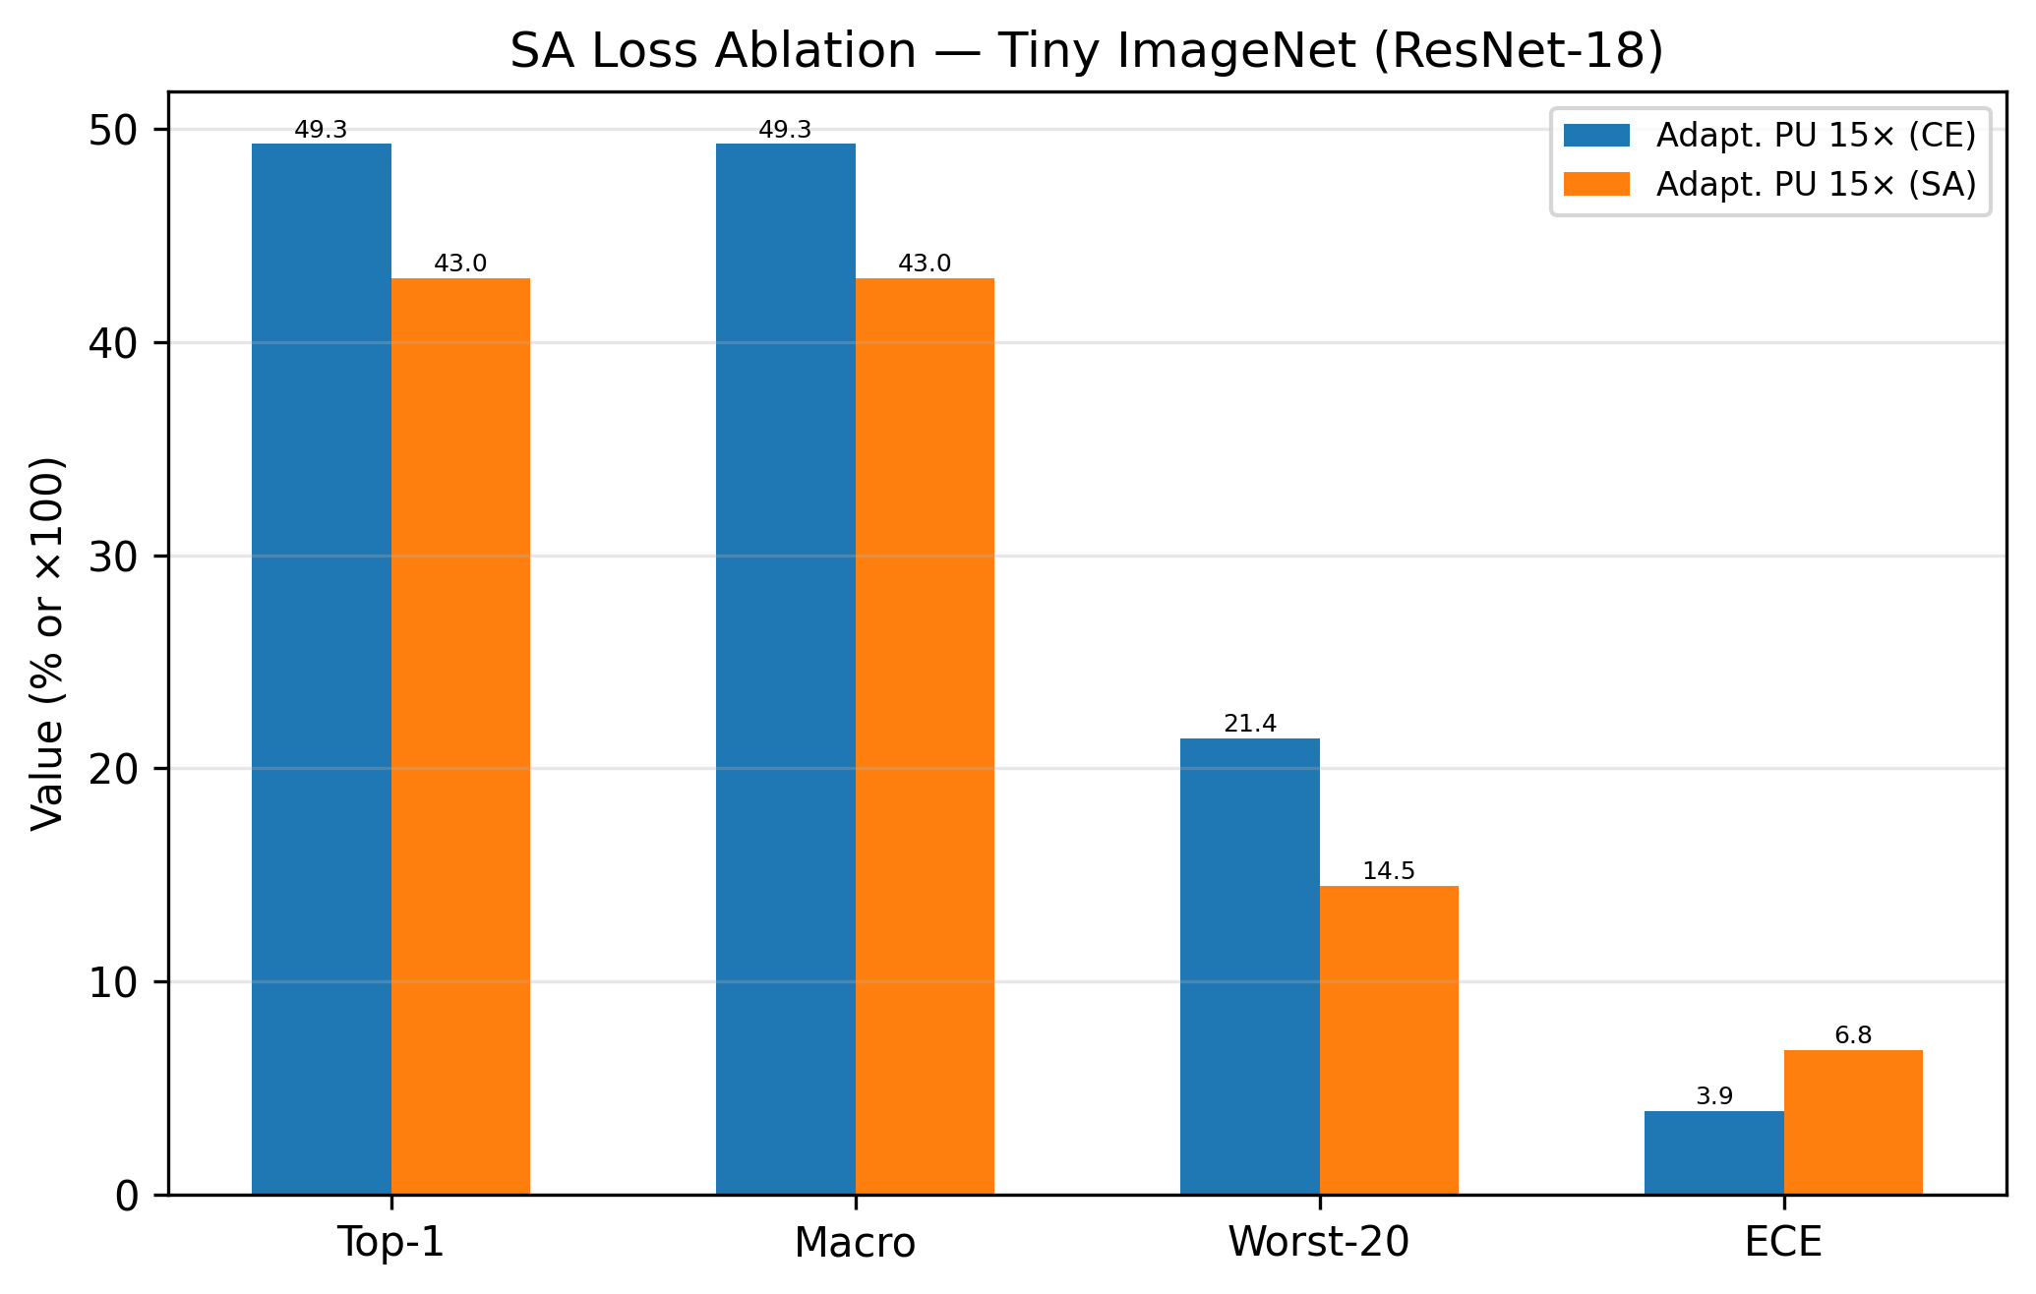
SA Loss Ablation
SA slightly underperforms CE on both datasets at Uniform 15×
Downweighting misaligned samples removes useful signal at this budget
Confirms limitation is data-driven: even optimizing for alignment doesn't help
Notes:
We tested whether a synthetic-aware loss could improve results by downweighting samples far from real class centroids. It actually performs slightly worse than standard cross-entropy on both Tiny ImageNet and CIFAR-100 at Uniform 15×. This makes sense — at a budget where the synthetic pool's diversity is already exhausted, selectively suppressing samples just removes volume without adding quality. The saturation is in the data, not the loss.

Slide 15
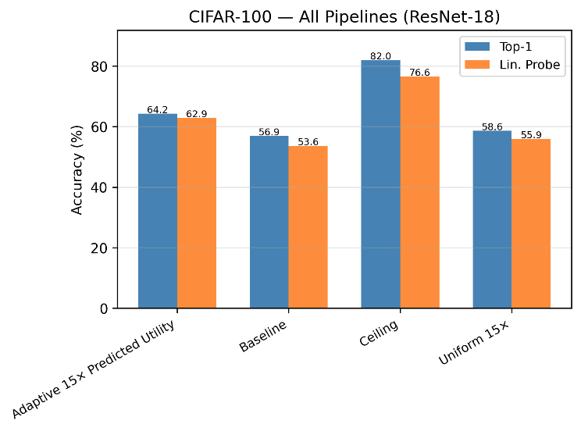
CIFAR-100 Generalization
Uniform 15×: +1.72pp over baseline (consistent with Tiny ImageNet)
Adaptive PU 15×: 64.23% — 5.61pp above uniform (contrasts Tiny ImageNet)
Allocation effectiveness is dataset-dependent
Noise robustness trade-off persists (PU drops to 2.48%)
Linear probe: PU reaches 62.88%, effective rank 36.00
Notes:
Two key findings here. First, the synthetic-aware loss does not change the saturation pattern on Tiny ImageNet — the limitation is data-driven, not optimization-driven. Second, CIFAR-100 partially validates and partially complicates our findings. The modest gain from uniform augmentation holds. But adaptive predicted-utility allocation jumps to 64% — over 5 points above uniform at the same budget. This is a sharp contrast with Tiny ImageNet where allocation made no difference. The implication is that allocation strategy effectiveness depends on the dataset's class structure. The noise robustness trade-off persists regardless.

Slide 16
The Paradox
Synthetic data helps — but only at low doses
Cannot substitute real data diversity
Gains are bounded by generative diversity, not volume
Allocation strategy: ineffective on Tiny ImageNet, significant on CIFAR-100
Calibration and representation improve beyond accuracy
Notes:
The paradox holds but with a caveat. Synthetic data provides measurable improvements that saturate quickly — the bottleneck is generative diversity, not volume. But the CIFAR-100 result adds nuance: allocation strategy, which was irrelevant on Tiny ImageNet, produces meaningful gains when class difficulty is more structured. So the full picture is that synthetic augmentation utility depends on diversity, distribution alignment, and the interaction between allocation strategy and dataset properties. Real data still provides information that text-conditioned generation cannot replicate.

Slide 17
Conclusion + Future Work
Dose–response framework formalizes synthetic data utility
Moderate augmentation: measurable, limited tool
Allocation strategy effectiveness is dataset-dependent — not universally null
Future: higher-fidelity generators, adaptive prompting, image-conditioned synthesis
Notes:
We contribute a dose–response framework that moves the question from 'does synthetic data help' to 'how much helps and when does it stop.' The answer is regime-dependent: a little helps, more saturates, and allocation strategy matters only when class structure supports it. Future work should test higher-fidelity generators and investigate what dataset properties determine whether adaptive allocation provides an advantage. Synthetic augmentation is a useful but bounded tool — and characterizing that bound is as valuable as pushing past it.

