Slide 1
VPC

Slide 2
VPCs and Subnets
A virtual private cloud (VPC) is a virtual network dedicated to your AWS account.
It is logically isolated from other virtual networks in the AWS Cloud. You can launch your AWS resources, such as Amazon EC2 instances, into your VPC. You can specify an IP address range for the VPC, add subnets, associate security groups, and configure route tables.
A subnet is a range of IP addresses in your VPC. You can launch AWS resources into a specified subnet.
Use a public subnet for resources that must be connected to the internet, and a private subnet for resources that won't be connected to the internet.
To protect the AWS resources in each subnet, you can use multiple layers of security, including security groups and network access control lists (ACL).

Slide 3
Supported Platforms
By launching your instances into a VPC instead of EC2-Classic, you gain the ability to:
Assign static private IPv4 addresses to your instances that persist across starts and stops
Optionally associate an IPv6 CIDR block to your VPC and assign IPv6 addresses to your instances
Assign multiple IP addresses to your instances
Define network interfaces, and attach one or more network interfaces to your instances
Change security group membership for your instances while they're running
Control the outbound traffic from your instances (egress filtering) in addition to controlling the inbound traffic to them (ingress filtering)
Add an additional layer of access control to your instances in the form of network access control lists (ACL)
Run your instances on single-tenant hardware

Slide 4
Default and Nondefault VPCs
The default VPC is a public VPC. It is designed to make it easy to get going with EC2/RDS and other related AWS services.
It has an internet gateway and public subnets with corresponding route table.
So, it's a good way to go if you don't know how to setup a VPC, you only need publicly accessible resources, or you're playing around or quickly prototyping something.
However, for production or environments in which you need to keep parts of your network private, I would recommend creating your own.
This allows you to setup exactly what need. It is more complicated than just using the default but if you already know how to setup a VPC, it's recommended.

Slide 5
Accessing the Internet
You control how the instances that you launch into a VPC access resources outside the VPC.
Your default VPC includes an internet gateway, and each default subnet is a public subnet.
Each instance that you launch into a default subnet has a private IPv4 address and a public IPv4 address.
These instances can communicate with the internet through the internet gateway. An internet gateway enables your instances to connect to the internet through the Amazon EC2 network edge.

Slide 6
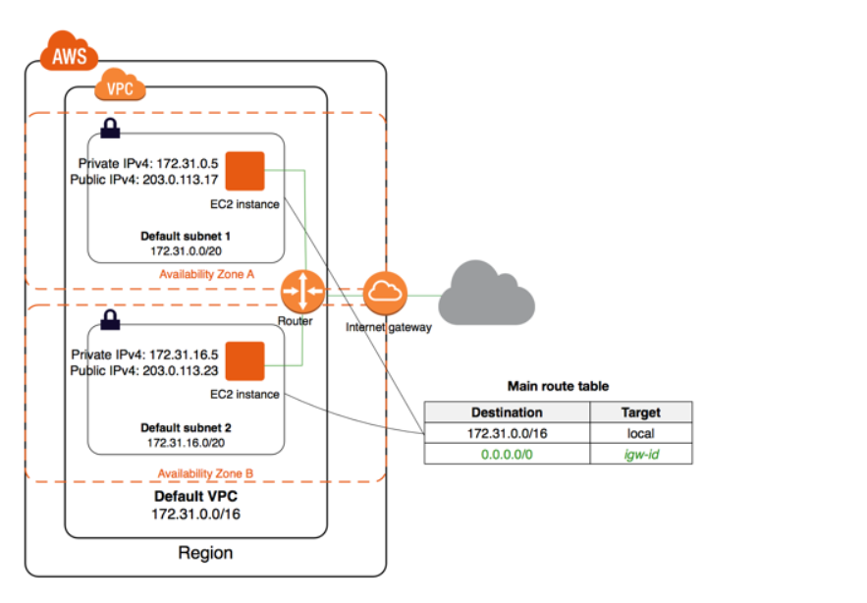

Slide 7
To protect the AWS resources in each subnet, you can use multiple layers of security, including security groups and network access control lists (ACL).
When you create a VPC, you must specify a range of IPv4 addresses for the VPC in the form of a Classless Inter-Domain Routing (CIDR) block; for example, 10.0.0.0/16. This is the primary CIDR block for your VPC.

Slide 8
Non default VPC
By default, each instance that you launch into a nondefault subnet has a private IPv4 address, but no public IPv4 address, unless you specifically assign one at launch, or you modify the subnet's public IP address attribute.
These instances can communicate with each other, but can't access the internet.

Slide 9
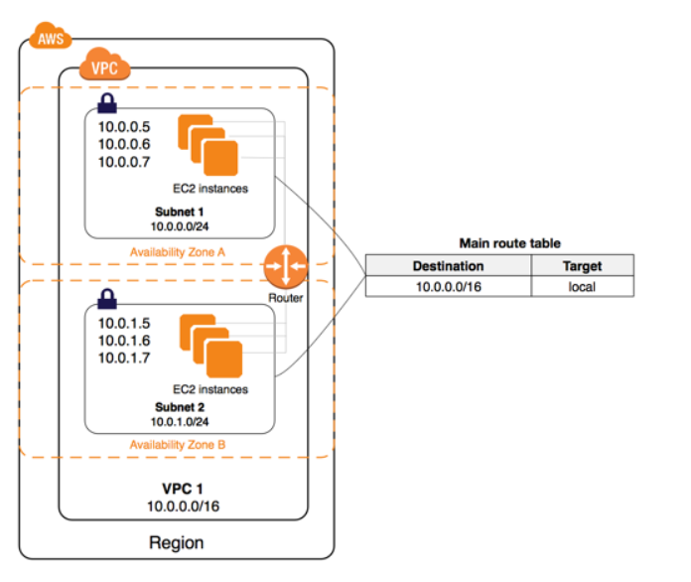

Slide 10
You can enable internet access for an instance launched into a nondefault subnet by attaching an internet gateway to its VPC (if its VPC is not a default VPC) and associating an Elastic IP address with the instance.

Slide 11
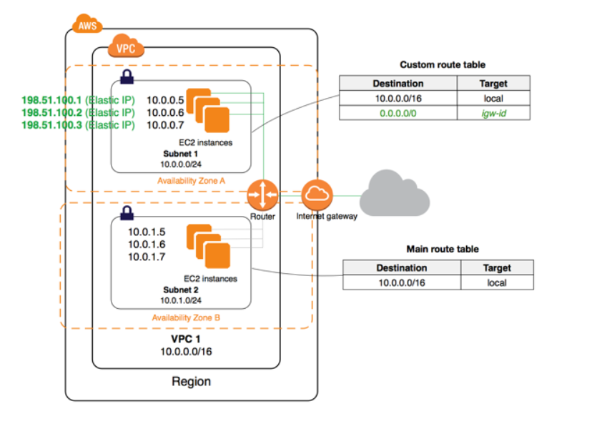

Slide 12
Alternatively, to allow an instance in your VPC to initiate outbound connections to the internet but prevent unsolicited inbound connections from the internet, you can use a network address translation (NAT) device for IPv4 traffic.
NAT maps multiple private IPv4 addresses to a single public IPv4 address.
A NAT device has an Elastic IP address and is connected to the internet through an internet gateway.
You can connect an instance in a private subnet to the internet through the NAT device, which routes traffic from the instance to the internet gateway, and routes any responses to the instance.

Slide 13
Accessing a Corporate or Home Network
AWS PrivateLink is a highly available, scalable technology that enables you to privately connect your VPC to supported AWS services, services hosted by other AWS accounts (VPC endpoint services), and supported AWS Marketplace partner services. You do not require an internet gateway, NAT device, public IP address, AWS Direct Connect connection, or VPN connection to communicate with the service. Traffic between your VPC and the service does not leave the Amazon network.
To use AWS PrivateLink, create an interface VPC endpoint for a service in your VPC. This creates an elastic network interface in your subnet with a private IP address that serves as an entry point for traffic destined to the service.
You can create your own AWS PrivateLink-powered service (endpoint service) and enable other AWS customers to access your service

Slide 14
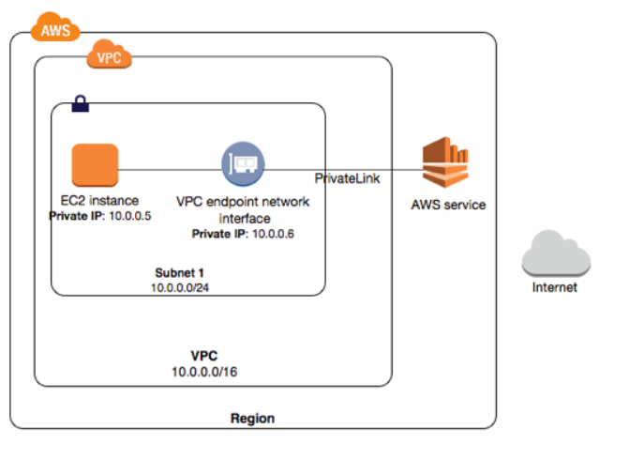

Slide 15
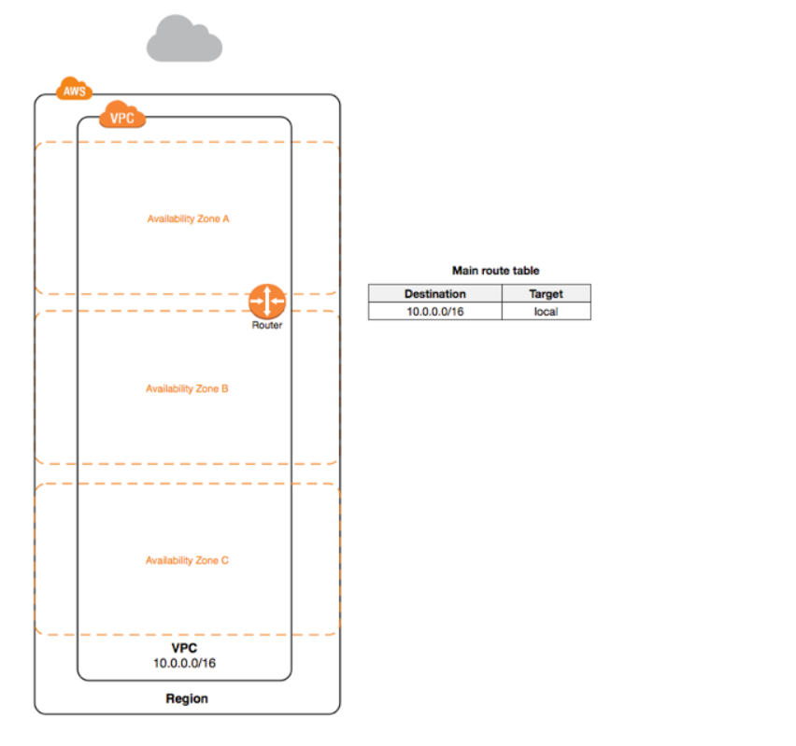

Slide 16
A VPC spans all the Availability Zones in the region. After creating a VPC, you can add one or more subnets in each Availability Zone.
When you create a subnet, you specify the CIDR block for the subnet, which is a subset of the VPC CIDR block.
Each subnet must reside entirely within one Availability Zone and cannot span zones.
Availability Zones are distinct locations that are engineered to be isolated from failures in other Availability Zones. By launching instances in separate Availability Zones, you can protect your applications from the failure of a single location. A unique ID is assigned to each subnet.
You can also optionally assign an IPv6 CIDR block to your VPC, and assign IPv6 CIDR blocks to your subnets.

Slide 17
The following diagram shows a VPC that has been configured with subnets in multiple Availability Zones.
1A, 1B, 2A, and 3A are instances in your VPC. An IPv6 CIDR block is associated with the VPC, and an IPv6 CIDR block is associated with subnet 1.
An internet gateway enables communication over the internet, and a virtual private network (VPN) connection enables communication with your corporate network.

Slide 18
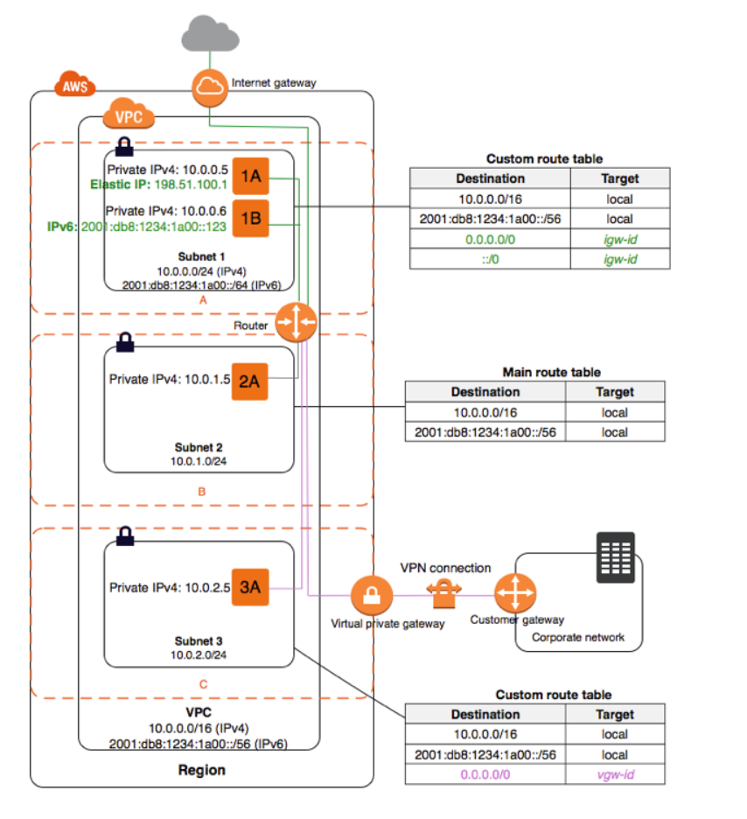

Slide 19
If a subnet's traffic is routed to an internet gateway, the subnet is known as a public subnet. In the above diagram, subnet 1 is a public subnet. If you want your instance in a public subnet to communicate with the internet over IPv4, it must have a public IPv4 address or an Elastic IP address (IPv4).
If you want your instance in the public subnet to communicate with the internet over IPv6, it must have an IPv6 address.

Slide 20
Scenario 1: VPC with a Single Public Subnet
The configuration for this scenario includes a virtual private cloud (VPC) with a single public subnet, and an Internet gateway to enable communication over the Internet.
We recommend this configuration if you need to run a single-tier, public-facing web application, such as a blog or a simple website.
This scenario can also be optionally configured for IPv6—you can use the VPC wizard to create a VPC and subnet with associated IPv6 CIDR blocks. Instances launched into the public subnet can receive IPv6 addresses, and communicate using IPv6.

Slide 21
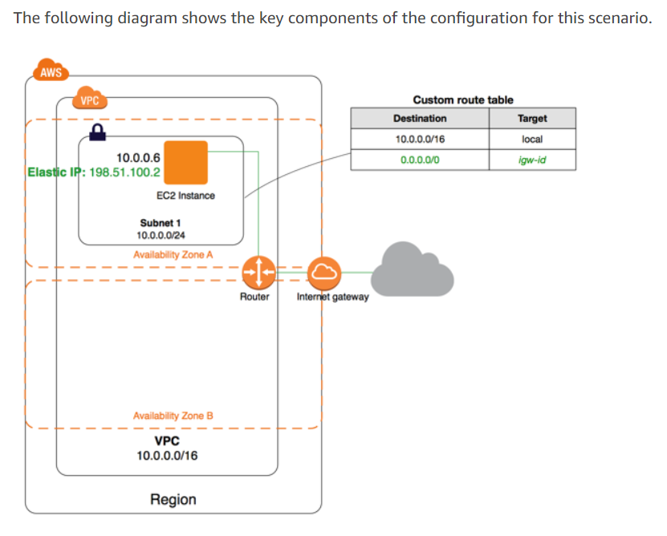

Slide 22
Quick Notes
One subnet can have only one route table.
One route table can be associated with multiple subnets.
If there is no explicit association then it will be associated by default with default route table.
VPC cannot span across regions but will do across availability zones.
Subnets CIDR range should not clash with each other subnet.
Internet gateway allows traffic penetration from VPC to outside internet
Internet gateway is auto scalable so we can only attach one internet gateway to one VPC

Slide 23
Always chose NAT Gateway in public subnet while creating it
Tag NAT gateway to a private Route Table
NAT Gateway helps in getting all internet bound traffic from private instances to go to internet and then get the reply from them
NAT Gateway is autoscalable

Slide 24
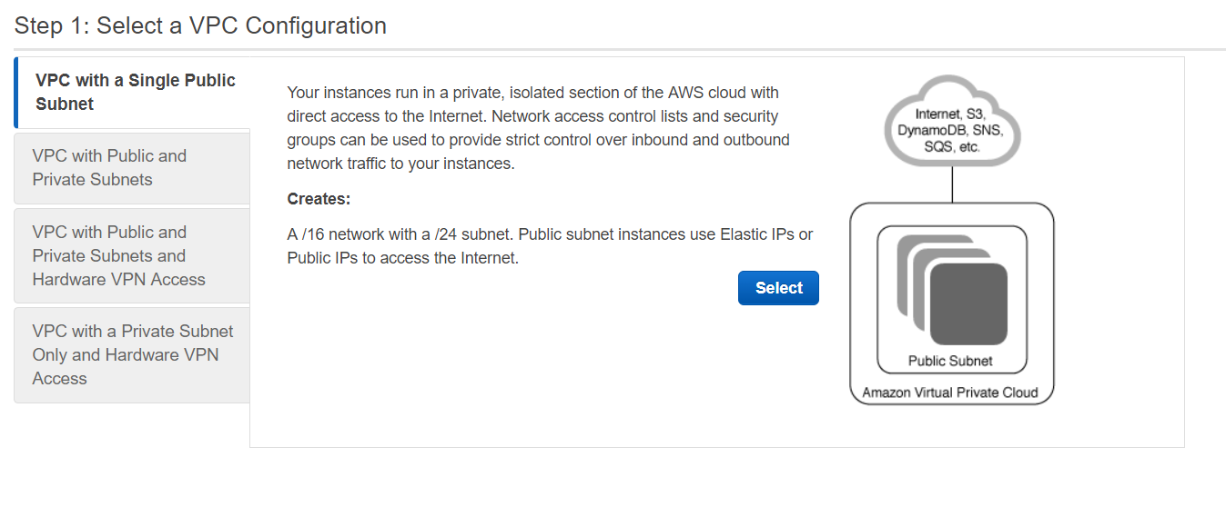
Types of VPCs

Slide 25
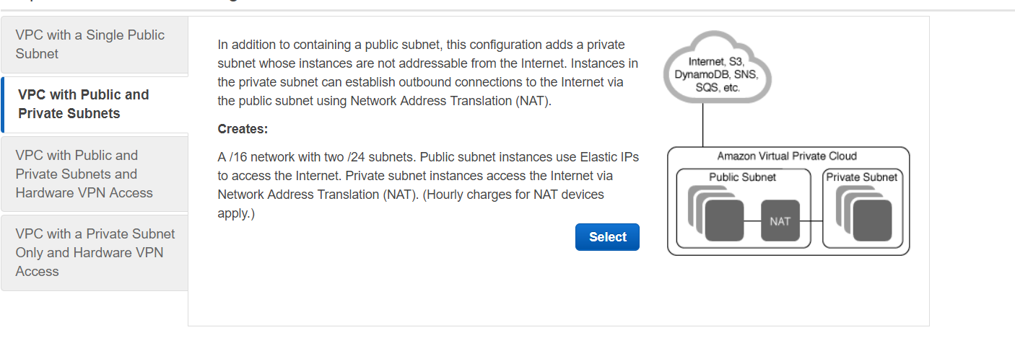
VPC with Public and Private Subnets

Slide 26
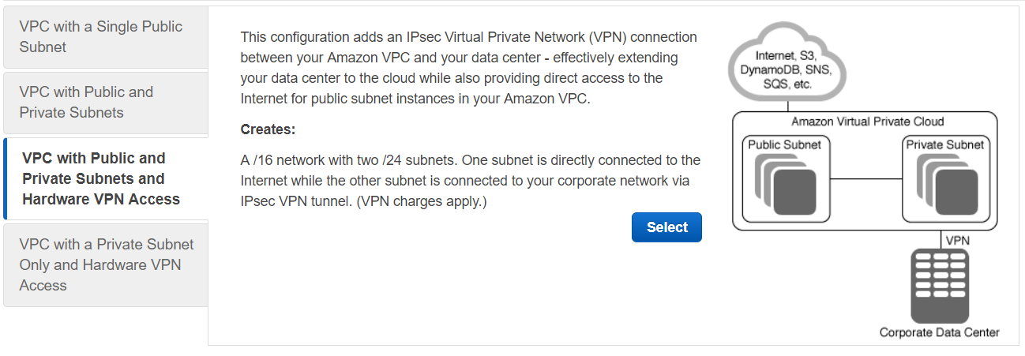
VPC with Public and Private Subnets and Hardware VPN access

Slide 27
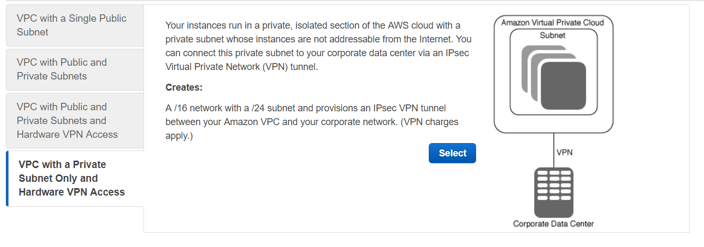
Type 4

Slide 28
Senario 1: VPC with a Single Public Subnet
The configuration for this scenario includes a virtual private cloud (VPC) with a single public subnet, and an Internet gateway to enable communication over the Internet.
We recommend this configuration if you need to run a single-tier, public-facing web application, such as a blog or a simple website.
This scenario can also be optionally configured for IPv6—you can use the VPC wizard to create a VPC and subnet with associated IPv6 CIDR blocks.
Instances launched into the public subnet can receive IPv6 addresses, and communicate using IPv6.

Slide 29
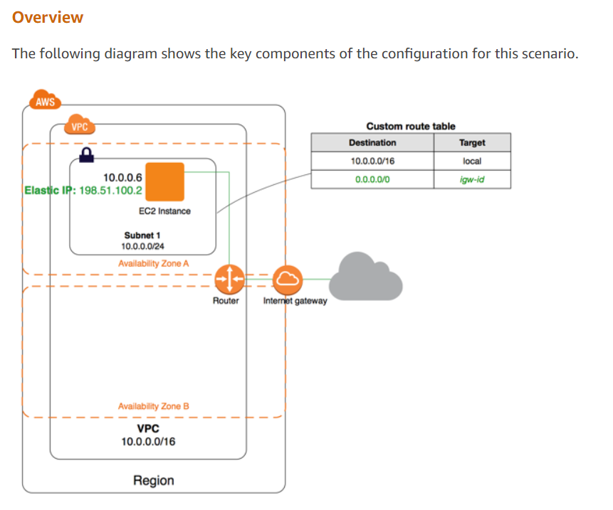

Slide 30
The configuration for this scenario includes the following:
A virtual private cloud (VPC) with a size /16 IPv4 CIDR block (example: 10.0.0.0/16). This provides 65,536 private IPv4 addresses.
A subnet with a size /24 IPv4 CIDR block (example: 10.0.0.0/24). This provides 256 private IPv4 addresses.
An Internet gateway. This connects the VPC to the Internet and to other AWS services.
An instance with a private IPv4 address in the subnet range (example: 10.0.0.6), which enables the instance to communicate with other instances in the VPC, and an Elastic IPv4 address (example: 198.51.100.2), which is a public IPv4 address that enables the instance to be reached from the Internet.
A custom route table associated with the subnet. The route table entries enable instances in the subnet to use IPv4 to communicate with other instances in the VPC, and to communicate directly over the Internet. A subnet that's associated with a route table that has a route to an Internet gateway is known as a public subnet.

Slide 31
Using IPv6
You can optionally enable IPv6 for this scenario. In addition to the components listed above, the configuration includes the following:
A size /56 IPv6 CIDR block associated with the VPC (example: 2001:db8:1234:1a00::/56). Amazon automatically assigns the CIDR; you cannot choose the range yourself.
A size /64 IPv6 CIDR block associated with the public subnet (example: 2001:db8:1234:1a00::/64). You can choose the range for your subnet from the range allocated to the VPC. You cannot choose the size of the subnet IPv6 CIDR block.
An IPv6 address assigned to the instance from the subnet range (example: 2001:db8:1234:1a00::123).
Route table entries in the custom route table that enable instances in the VPC to use IPv6 to communicate with each other, and directly over the Internet.

Slide 32
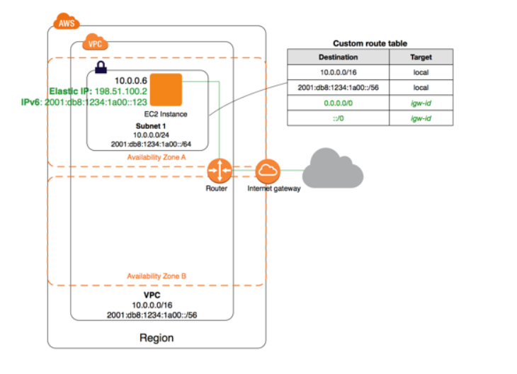

Slide 33
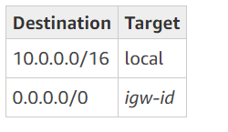
Routing
Your VPC has an implied router (shown in the configuration diagram above). In this scenario, the VPC wizard creates a custom route table that routes all traffic destined for an address outside the VPC to the Internet gateway, and associates this route table with the subnet.
The following table shows the route table for the example in the configuration diagram above. The first entry is the default entry for local IPv4 routing in the VPC; this entry enables the instances in this VPC to communicate with each other. The second entry routes all other IPv4 subnet traffic to the Internet gateway (for example, igw-1a2b3c4d).

Slide 34
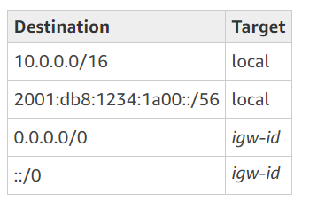
Routing for IPv6
If you associate an IPv6 CIDR block with your VPC and subnet, your route table must include separate routes for IPv6 traffic.
The following table shows the custom route table for this scenario if you choose to enable IPv6 communication in your VPC.
The second entry is the default route that's automatically added for local routing in the VPC over IPv6. The fourth entry routes all other IPv6 subnet traffic to the Internet gateway.

Slide 35
Security
AWS provides two features that you can use to increase security in your VPC: security groups and network ACLs.
Security groups control inbound and outbound traffic for your instances, and network ACLs control inbound and outbound traffic for your subnets.
In most cases, security groups can meet your needs; however, you can also use network ACLs if you want an additional layer of security for your VPC.
For this scenario, you use a security group but not a network ACL.

Slide 36
Your VPC comes with a default security group.
An instance that's launched into the VPC is automatically associated with the default security group if you don't specify a different security group during launch.
You can add rules to the default security group, but the rules may not be suitable for other instances that you launch into the VPC.
Instead, we recommend that you create a custom security group for your web server.
For this scenario, create a security group named WebServerSG. When you create a security group, it has a single outbound rule that allows all traffic to leave the instances.
You must modify the rules to enable inbound traffic and restrict the outbound traffic as needed. You specify this security group when you launch instances into the VPC.

Slide 37
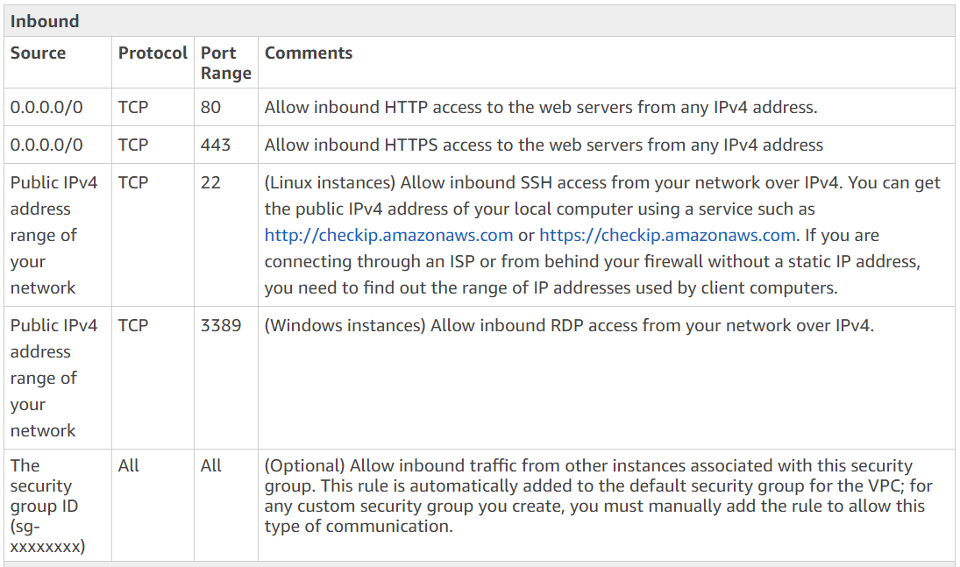
The following are the inbound and outbound rules for IPv4 traffic for the WebServerSG security group.

Slide 38
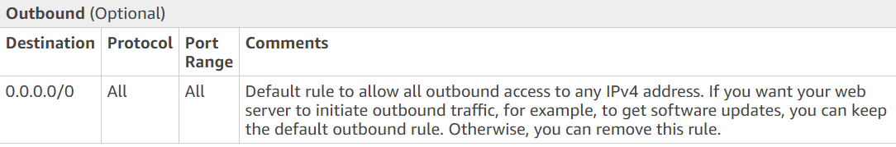
Outbound is optional but recommendable

Slide 39
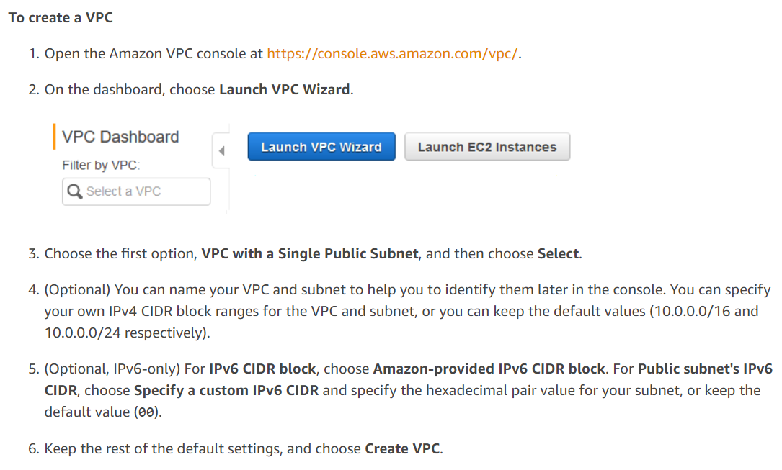
Steps of implementation of scenario 1

Slide 40
To create the WebServerSG security group
Open the Amazon VPC console at https://console.aws.amazon.com/vpc/.
In the navigation pane, choose Security Groups.
Choose Create Security Group.
Provide a name and description for the security group. In this topic, the name WebServerSG is used as an example. Select the ID of your VPC from the VPC menu, and then choose Yes, Create.
Select the WebServerSG security group that you just created. The details pane include a tab for information about the security group, plus tabs for working with its inbound rules and outbound rules.

Slide 41
On the Inbound Rules tab, choose Edit, and then do the following:
Select HTTP from the Type list, and enter 0.0.0.0/0 in the Source field.
Choose Add another rule, then select HTTPS from the Type list, and enter 0.0.0.0/0 in the Source field.
Choose Add another rule, then select SSH (for Linux) or RDP (for Windows) from the Type list. Enter your network's public IP address range in the Source field. (If you don't know this address range, you can use 0.0.0.0/0 for testing purposes; in production, you authorize only a specific IP address or range of addresses to access your instance.)
(Optional) Choose Add another rule, then select ALL traffic from the Type list. In the Source field, enter the ID of the WebServerSG security group.
(Optional, IPv6-only) Choose Add another rule, select HTTP from the Type list, and enter ::/0 in the Source field.
(Optional, IPv6-only) Choose Add another rule, select HTTPS from the Type list, and enter ::/0 in the Source field.
(Optional, IPv6-only) Choose Add another rule, select SSH (for Linux) or RDP (for Windows) from the Type list. Enter your network's IPv6 address range in the Source field. (If you don't know this address range, you can use ::/0 for testing purposes; in production, you authorize only a specific IPv6 address or range of addresses to access your instance.)
Choose save
(Optional) On the Outbound Rules tab, choose Edit. Locate the default rule that enables all outbound traffic, choose Remove, and then choose Save.

Slide 42
To launch an instance into the VPC
Open the Amazon EC2 console at https://console.aws.amazon.com/ec2/.
From the dashboard, choose Launch Instance.
Follow the directions in the wizard. Choose an AMI, choose an instance type, and then choose Next: Configure Instance Details.
Note
If you intend to use your instance for IPv6 communication, you must choose a supported instance type; for example, T2. For more information, see Amazon EC2 Instance Types.
On the Configure Instance Details page, select the VPC that you created in step 1 from the Network list, and then specify a subnet.
(Optional) By default, instances launched into a nondefault VPC are not assigned a public IPv4 address. To be able to connect to your instance, you can assign a public IPv4 address now, or allocate an Elastic IP address and assign it to your instance after it's launched. To assign a public IPv4 address now, ensure that you select Enable from the Auto-assign Public IP list.
Note
You can only use the auto-assign public IP feature for a single, new network interface with the device index of eth0. For more information, see Assigning a Public IPv4 Address During Instance Launch.

Slide 43
(Optional, IPv6-only) You can auto-assign an IPv6 address to your instance from the subnet range. For Auto-assign IPv6 IP, choose Enable.
On the next two pages of the wizard, you can configure storage for your instance, and add tags. On the Configure Security Group page, select the Select an existing security group option, and select the WebServerSG security group that you created in step 2. Choose Review and Launch.
Review the settings that you've chosen. Make any changes that you need, and then choose Launch to choose a key pair and launch your instance.
If you did not assign a public IPv4 address to your instance in step 5, you will not be able to connect to it over IPv4. Assign an Elastic IP address to the instance:
Open the Amazon VPC console at https://console.aws.amazon.com/vpc/.
In the navigation pane, choose Elastic IPs.
Choose Allocate new address.
Choose Allocate.
Note
If your account supports EC2-Classic, first choose VPC.
Select the Elastic IP address from the list, choose Actions, and then choose Associate address.
Select the instance to associate the address with, and then choose Associate.

