Slide 1
your CODE SMELLS* or how to avoid issues with OOP
*Main part of a talk will be about Java code, but we will also discuss some basic principles

Slide 2




$ whoami
02
03
04
01
Now we are here in 2k20

Slide 3
What is a code smell?
In computer programming, a code smell is any characteristic in the source code of a program that possibly indicates a deeper problem. (c) Wikipedia

Slide 4

Application with a good code quality
Reusable and maintainable
Addition of new features takes little time
Developer can easily deploy and support application in production
Stable and has less bugs
Developer can identify problems in production
App can survive in emergency situations
Code works as planned, if not - you can workaround it
Readable
Business functionality can be understood from code. Code becomes better than documentation for developers
Easy for a review process
Sustainable
Can survive over time with minimal changes (written once – functions for a long time)

Slide 5
How to achieve quality
Obvious things (industry standard)
Use design patterns (start from reading Gang Of Four book)
Always setup a review process
Avoid code smells
Use CI/CD and automate as much as possible
Test your code (at least with unit tests)

Slide 6
Antipattern typical general causes
Obvious things
Lack of an object-oriented architecture
Lack of (any) architecture
Lack of architecture enforcement
Too limited intervention (fear-driven develoment)
Specified disaster

Slide 7
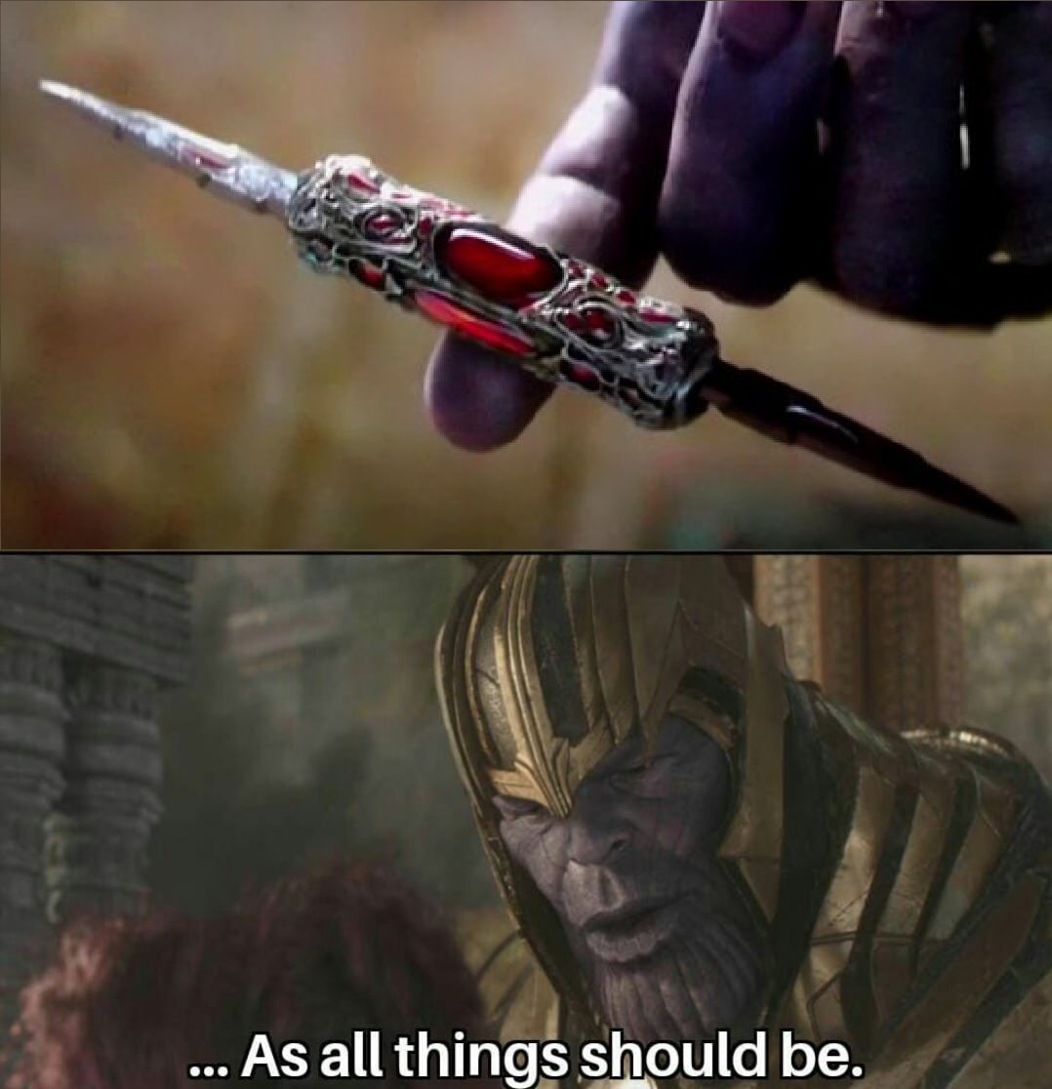
Anti-pattern #1: Comments – two extremes and balance
“Self documented” code
Each line has obvious comment

Slide 8
Anti-pattern #1: No comments at all
public class SomePerfectClassName { private static final int PERFECTLY_NAMED_COEFFICIENT = 31; private String somePerfectVar1; private String somePerfectVar2; private boolean flag; private int numberOfBlaBlaBla = 0; <... constructors and other stuff ...> void doSomeStrangeThingWithYourObject() { if (this.flag && somePerfectVar1.equals(somePerfectVar2)) { numberOfBlaBlaBla *= PERFECTLY_NAMED_COEFFICIENT; } } }

Slide 9
Anti-pattern #1: Each line commented
public class SomePerfectClassName { // The value 31 was chosen because it is an odd prime. // A nice property of 31 is that the multiplication can be replaced by a shift and
// a subtraction for better performance: 31 * i == (i << 5) - i. // Modern VMs do this sort of optimization automatically. private static final int PERFECTLY_NAMED_COEFFICIENT = 31; // some perfectly named string variable private String somePerfectVar1; // some perfectly named string variable private String somePerfectVar2; // some perfectly named boolean variable private boolean flag; // some integer adder private int numberOfBlaBlaBla = 1; // <... constructors and other stuff ...> /** * this method does some strange thing with your object * * @return void
* @see A */ void doSomeStrangeThingWithYourObject() { // if flag is true and somePerfectVar1 is equal to somePerfectVar1 then // multiply numberOfBlaBlaBla on PERFECTLY_NAMED_COEFFICIENT if (this.flag && somePerfectVar1.equals(somePerfectVar1)) { // multiplying numberOfBlaBlaBla on PERFECTLY_NAMED_COEFFICIENT numberOfBlaBlaBla *= PERFECTLY_NAMED_COEFFICIENT; } } }
Easter egg for juniors

Slide 10
Anti-pattern #1: Recommendations
Don’t use Russian/Hindi/Chinese/e.t.c. for comments.
Use same language that your code is using for keywords.
Don’t use comments as an obvious translation for your code.
Try to comment all magic constants and all workarounds you are adding.
Try to add comments for API you are creating, sometimes it is appropriate to add examples of usage.

Slide 11
Anti-pattern #1: Recommendations
Don’t forget about javadoc comments – it should describe API and functionality of a method, pitfalls and other code that you should @see also
No need to put this information inside a method code block
/** * Returns an Image object that can then be painted on the screen. * * @param url an absolute URL giving the base location of the image * @param name the location of the image, relative to the url argument * @return the image at the specified URL * @see Image */ public Image getImage(URL url, String name) { try { // Returns an Image object that can then be painted on the screen. return getImage(new URL(url, name)); } catch (MalformedURLException e) { return null; } }

Slide 12
Anti-pattern #1: Recommendations
Comments are not a source control:
avoid commenting of code lines.
Delete unused code and use version control history if you will need to restore this code in future
public class SomePerfectClassName { private static final Logger log = LoggerFactory.getLogger("SomePerfectClassName"); private int numberOfBlaBlaBla; SomePerfectClassName(int some) { this.numberOfBlaBlaBla = some; } public int getAndLogBlaBlaBla() { nonSenceMethod(); return numberOfBlaBlaBla; } private void nonSenceMethod() { // StringBuilder stringBuilder = new StringBuilder(); // for (int i = 0; i < numberOfBlaBlaBla; ++i) { // stringBuilder.append(numberOfBlaBlaBla).append(" + "); // } // log.info("Dummy info {}", stringBuilder.toString()); } }

Slide 13
Anti-pattern #1: Recommendations
Comments are not a source control:
Do not add history to comments – you are a developer, not a source control system.
// Function: does something // Copyright Information: Some Company Limited 2015-2018 // Change History: 2015-03-17 12:00 XXX XXXXXXXX Created // 2017-03-17 12:00 XXX XXXXXXXX Modified XXX

Slide 14
Anti-pattern #2: D.R.Y. and W.E.T. principles
Don’t Repeat Yourself principle – your program should be able to perform it’s task and should have small readable code.
Write Everything Twice/(We enjoy typing) principle – duplicating the logic (Cut-and-Paste Programming)
Duplicated code - the worst and most common industrial code smell (you have that in your code)
Happens because of: - lazy programmers that do not know what inheritance/design patterns/function is needed for
DRY in rare cases can be harmful (client/server interaction)

Slide 15
Anti-pattern #3: Long Method/Large Class
Long method:
Determining “how long should method be” is not a straightforward process.
Try to split your method that becomes not visible once (~70 lines) on the screen on smaller methods if possible.
Large class (God class/Blob class):
Complex controller class surrounded by simple data classes
Class knows too much or does too much

Slide 16
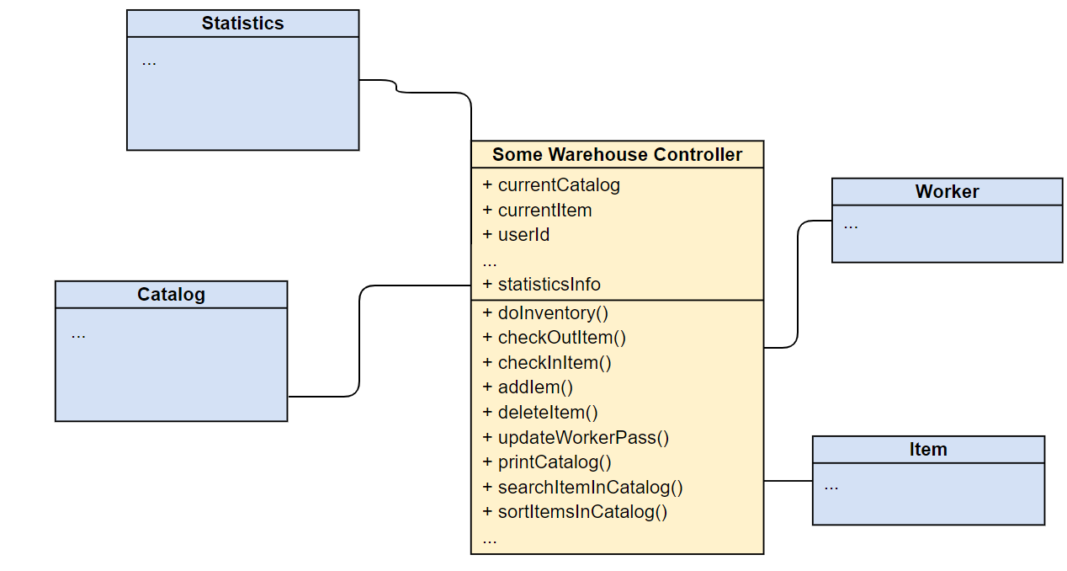
Anti-pattern #3: Blob class

Slide 17
Anti-pattern #3: Blob class
Item
Catalog

Slide 18
Anti-pattern #3: Blob class
Far-coupling? Make coupling loose

Slide 19
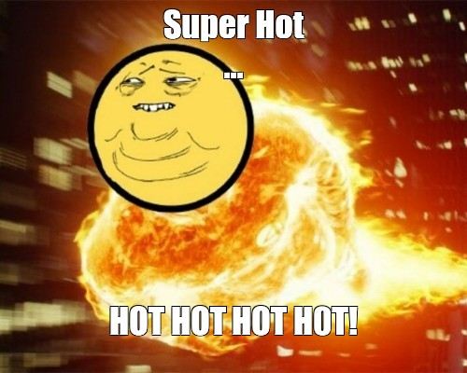
Anti-pattern #4: Data Class (can cause debates)

Slide 20
Anti-pattern #4: Data Class
public class TwoDimensionalPoint { private String x; private String y; public String getX() { return x; } public void setX(String x) { this.x = x; } public String getY() { return y; } public void setY(String y) { this.y = y; } }
Data class:
Another opposite extreme of large class.
Small (in most cases) class that contains only data and no real functionality. Java Beans as an example.
Breaks the idea of “true OOP” with “rich data models principle”
BTW: have a look at Scala (case class) and Kotlin (data class)

Slide 21
Anti-pattern #4: Data Class
Data classes in mixed languages (FP and OOP):
Scala:
Kotlin:
case class DataClass1(a: String, b: String) case class DataClass2(a: String, var b: String) val someList: List[DataClass2] = List( DataClass1(a("1", "2"), DataClass1(a("3", "4") ).map(x => DataClass2 (x.a, x.b))
data class DataClass(var a: String, val b: String) val dtClass = DataClass("1", "2") fun foo() { dtClass.a = “NEW" }
*Controlling immutability
Easy access (omg, where are getters/setters?)
Commonly used for modeling in BigData world (Spark)
because case classes are Serializable

Slide 22
Anti-pattern #4: Data Class
What to do with perfect libraries for serialization like Jackson?
Use it! Forget what you have seen on the previous slide.
public class SomePerfectClassName { public final String name; public final String betterName; // haha public field @JsonCreator public SomePerfectClassName(String name, String betterName) { this.name = name; this.betterName = betterName; } }

Slide 23
Anti-pattern #5: Data Clumps
Very common code smell
Group of data that can be unified but anyway is passed to method/class as separate arguments/fields
Solution: unify in class, but avoid data classes
public void someMethod(String userName, boolean isUserActive, String userSurname, int userId, String userJob) { // ... }

Slide 24
Anti-pattern #6: Long Parameter List
public void preProcessAndAutoFixForIDE(String codeNetProjectName, String codeNetProjectCodeFolder, String subjectProjectOrModuleName, String subjectProjectOrModuleCodeFolder, String timestamp, String operator, String versionNumber, List<String> filesPath, String fixedFilePath, String repoId,
String clientIDE, String userNumber, String fixerType) {
preProcessAndAutoFixForIDE(null, null, args.getProjectName(), args.getRepoPath(), args.getTimestamp(), args.getOperator(), args.getVersion(), args.getFixFilesPath(), args.getFixbotBasePath(), args.getRepoId(),args.getClientIDE(),args.getUserNumber(),args.getFixerType());
Very close to Data Clumps problem
Obvious that it is completely not supportable
Split the data to subclasses and move the complexity to the function/class body

Slide 25

Anti-pattern #7: Divergent Class/Divergent Change
Divergent change – need to change everything to add one simple thing
Examples:
- adding new option or new field in class with hardcoded logic
- Blob/BlackHole large classes
Unify behavior, follow single responsibility principle
public class ArgumentParser { private Option arg1; private Option arg2; ArgumentParser(Option arg1, Option arg2) { arg1 = arg1; arg2 = arg2; } int calcNumberOfArgs() { return 2; } void displayArgs() { System.out.println(arg1.toString() + arg2.toString()); } int multiplyArgs() { return arg1.num() * arg2.num(); }
}

Slide 26
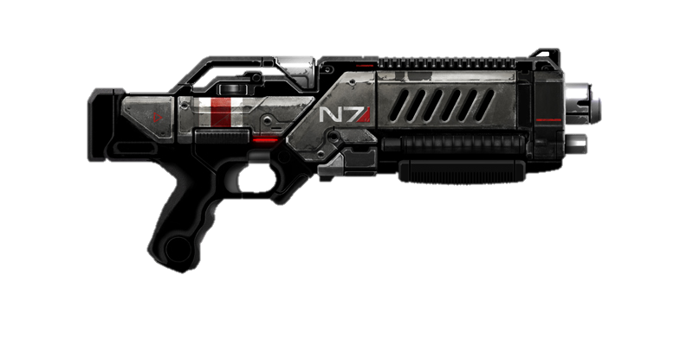
Classical example
Anti-pattern #8: Shotgun Surgery
Small change to class A (method a) causes changes to dozens of other classes (methods)
Not a ctrl-A + ctrl-V issue
Normally resolved by unification and move methods to common classes
void func1() { log.info("Starting func1"); // ... } void func2() { log.info("Starting func2"); // ... } void func3() { log.info("Starting func3"); // ... }

Slide 27
Anti-pattern #9: Feature Envy
public class IsinListingCountry { private final String[] isinWithCountry; public IsinListingCountry(String someStr) { this.isinWithCountry = someStr.split(":"); } public String getIsin(){ return isinWithCountry[0]; } public String getCountry(){ return isinWithCountry[1]; } }
public class Enricher { private IsinListingCountry isin; public String normalizeIsin() { return "country:" + isin.getCountry() + " " +
"isin:" + isin.getIsin(); } }
Method/class is more interested in the details of other class than the one it is in.
“Romeo and Juliet” pattern
Don’t refactor if it was done intentionally
(Strategy/Visitor pattern)

Slide 28
Anti-pattern #10: Inappropriate Intimacy
Close to Feature Envy, but much worse as it breaks OOP main principle (encapsulation)
One class uses some internal (but not marked private) fields and methods of other class
Most extreme case:
Field f = obj.getClass().getDeclaredField(“somePrivateField"); f.setAccessible(true);

Slide 29
Anti-pattern #10: Inappropriate Intimacy
public class MainClass { public static void main(String[] args) { IAmVeryBadProgrammerPleaseFireMe class1 = new IAmVeryBadProgrammerPleaseFireMe("test"); //test class1.foo(); // test1 new MamaWhatIsWrongWithMe().foo(class1); // test2 } }
public class MamaWhatIsWrongWithMe { void foo(IAmVeryBadProgrammerPleaseFireMe arg) { arg.somePrivateField = "test2"; } }
class IAmVeryBadProgrammerPleaseFireMe { String somePrivateField; IAmVeryBadProgrammerPleaseFireMe(String somePrivateField) { this.somePrivateField = somePrivateField; } void foo() { somePrivateField = "test1"; } }

Slide 30
Anti-pattern #11: Message Chains
Law of Demeter (in OOP) or a Principle of Least Knowledge

Slide 31
Anti-pattern #11: Message Chains
Law of Demeter (in OOP)
Each program module (read as “method”) M of an object O should be able to call only methods that:
are encapsulated inside object O
belong to parameters (arguments) of method M
belong to other objects, created in the scope of M
belong to direct component objects of O
global variables from O
public class O { public static final String GLOBAL_CONST = ""; private Friend I = new Friend(); public void foo1(Friend otherFriend) { foo2(); // 1 otherFriend.foo(); // 2 this.I.foo(); // 3 Friend b = new Friend(); b.foo(); // 4 System.out.println(GLOBAL_CONST); // 5 } public void foo2() { } }

Slide 32
Anti-pattern #11: Message Chains
class SomeClass { ConfigurationComposite config; void getConfig() { this.config.getConfig(); } }
class ConfigurationComposite { Config config; void getConfig() { this.config.loadConfig("configType"); } }
class Config { void loadConfig(String configType) { } }

Slide 33
Anti-pattern #11: Message Chains
class Config { void loadConfigWrapper(String arg1, String arg2, String arg3) { loadConfig(arg1, arg2, arg3); }
void loadConfig(String arg1, String arg2, String arg3) { someFacade(arg1, arg2); } void someFacade(String arg1, String arg2) { loadSpecialConfig(arg1); } void loadSpecialConfig(String arg1) { } }

Slide 34
Anti-pattern #12: Primitive Obsession
Class has fields with primitive types for solving small tasks:
Multiple fields that are used as constants for coding information:
Fields with primitive types are used to control state
Non-OOP way of thinking
String name; int amountGBP; String phoneNumber; long timeInMillis; String currency; String rangeLeft; String rangeRight; int amountUsd;
private static final int ADMIN_ROLE = 1; private static final int USER_ROLE = 2; private static final int GUEST_ROLE = 3;
boolean counterParty; boolean borrow; boolean market; boolean client;

Slide 35
Anti-pattern #13: Switch Statements
Switch statements are a code smells that
occur when switch statements
are scattered through out a program.
If a switch is changed, then the others
must be found and updated as well.
What if we have perimeter/e.t.c switch?
public double calculateArea(int shape, int a, int b, int r) { double area = 0; switch(shape) { case SQUARE: area = a * a; break; case RECTANGLE: area = a * b; break; case CIRCLE: area = Math.PI * a * a; break; } return area; }

Slide 36

Anti-pattern #14: Speculative Generality
Remember about the balance!
No need to make a superclass, interface, or code
that is not needed at the time, but that
may (or may not) be useful someday
Software changes frequently
Follow the idea of Just in Time Design

Slide 37
Anti-pattern #15: Refused Bequest
Occurs when a subclass inherits something but does not need it
Someone was motivated to create inheritance between classes only by the desire to reuse the code in a superclass
Cat has “legs”, table has “legs” – cat == table?
Animal
----------
Legs
Cat
----------
Legs
Table
----------
Legs

Slide 38
Java-specific problems
Don’t catch all exceptions:
Please try to initialize simple collections in the beginning of the class (works for 90% of cases):
Avoid of using static methods, try to follow OOP style if you write on OOP-language
Try to handle checked exceptions on the lowest level or use “throws”
catch (Exception e) {
private List<String> paths = new ArrayList<>();

Slide 39
Java-specific problems
Please use enums instead of hardcoded constants or static final variables:
public enum EnumValue { VALUE ("value"); private final String value;

Slide 40
Java-specific problems
public static void main(String[] args) { ResourceBundle properties = ResourceBundle.getBundle("codenet"); ArgumentParser parser = ArgumentParsers.newFor("App").build(); parser.addArgument("-repoID").help("ID of repository under fix"); parser.addArgument("-repoPath") .help("path to repository under fix and path used to read a compile command database."); parser.addArgument("-fixPath").help("path to directory that stores fixed files"); parser.addArgument("-scanPaths").action(Arguments.append()).help("paths to directories that need to be scanned by fixbot, splited by ';'."); parser.addArgument("-warningFilterPaths").action(Arguments.append()).help("paths to directories that filter warnings, splited by ';'."); parser.addArgument("-fixFilterPaths").action(Arguments.append()).help("paths to directories that filter fixes, splited by ';'."); parser.addArgument("-clang-tidy-binary").setDefault("clang-tidy").help("path to clang-tidy binary"); parser.addArgument("-clang-apply-replacements-binary").setDefault("clang-apply-replacements") .help("path to clang-apply-replacements binary"); parser.addArgument("-check").help("specify the type of check"); parser.addArgument("-fix").action(Arguments.storeTrue()).help("apply fix."); parser.addArgument("-gui").action(Arguments.storeTrue()).help("run in gui model."); parser.addArgument("-buildPath").help("path used to read a compile command database."); parser.addArgument("-v", "--version").action(Arguments.version()).help("show the version."); parser.addArgument("-client").setDefault("cli").help("name of the client that call CodeNet."); parser.addArgument("-excludedPath").action(Arguments.append()).help("path to derectory to be ignored."); parser.addArgument("-fixFilesPath").action(Arguments.append()) .help("the absolute path of single file which needs fix"); parser.version(properties.getString("version")); parser.addArgument("-clientIDE").help("name of the client that call CodeNet."); parser.addArgument("-checkstyle-path").help("path to checkstyle"); parser.addArgument("-huawei-format-binary").help("path to format tools"); parser.addArgument("-userNumber").help("user number for ide"); parser.addArgument("-fixbot-dir").help("the dir of .fixbot"); parser.addArgument("-specifyFixPathForOneClick").action(Arguments.storeTrue()).help("specify the fix path for one-click-format, not directly change the source file"); parser.addArgument("-codeRange").help("the start line and end line of code snippet, splited by :"); Namespace res = null;

Slide 41
Java-specific problems
public enum FixBotOptions { //@formatter:off // option action default value help CALLER ("caller", null, "cli", "name of the client that call FixBot. Value list: cli/ide"), CHECK_WITH_EDKII ("checkWithEDKII", Arguments.storeTrue(), null, "EDKII will be enabled for the check"), CLIENT_IDE ("clientIDE", null, null, "ide name if called as a ide plugin."), CODE_RANGE ("codeRange", null, null, "ide plugin mode only. the start line and end line of code snippet, splited by :"), COPY_AND_FIX_FLAG_FOR_ONE_CLICK ("copyAndFixFlagforOneClick", Arguments.storeTrue(), null, "flag that if fix source files directly, for one-click-format only"), FIX_FILE_PATH ("fixFilePath", Arguments.append(), null, "the absolute path of single file which needs fix"), FIX_FOLDER_PATH ("fixFolderPath", null, null, "the relative directory under fixbot_dir that stores all files to be fixed."), FIXED_FILE_PATH ("fixedFilePath", null, null, "the relative directory under fixbot_dir that stores fixed files"), FIXBOT_DIR ("fixbot-dir", null, null, "the dir of .fixbot, which user can specify."), EXCLUDED_PATH ("excludedPath", Arguments.append(), null, "path to directory to be ignored"), ONLY_CHECK ("onlyCheck", null, null, "do only check without fixing"), PYTHON_STYLE_OPTIONS ("pythonstyle-options", null, null, "extra options that can be specified for python style"), REPO_ID ("repoID", null, null, "ID of repository under fixbot_dir, like 'test1101'"), RULE_SET ("ruleset", null, null, "specify the type of fix/check, now only one rule once."), USER_DOMAIN_ID ("userDomainId", null, null, "user number for ide"), // cli only VERSION ("version", Arguments.version(), null, "version of the application"), CLANG_SCAN_PATHS ("scanPaths", Arguments.append(), null, "relative directory which specify scan target folder by clang"), CLANG_WARNING_FILTER_PATHS ("warningFilterPaths", Arguments.append(), null, "relative directory which filter warnings by clang"), CLANG_BUILD_PATH ("buildPath", null, null, "cxx only, absolute path used to read a compile command database."), CLANG_FIX_FLAG ("applyFixByClang", Arguments.storeTrue(), null, "apply fix by clang"), CHECK_FILES_PATH ("checkFilesPath", null, null, "the absolute path of files which need check only, seperated by ,"), OUTPUT_PATH_FOR_CHECK ("outputPathForCheck", null, null, "path to output file for check."), CHECK_RULES ("checkRules", null, null, "specify the type of check"), ; // checker only end //@formatter:on

Slide 42
In the end
Don’t invent your own bicycles!
ALWAYS use existing solutions

Slide 43
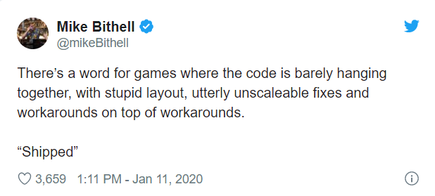
In the end

Slide 44
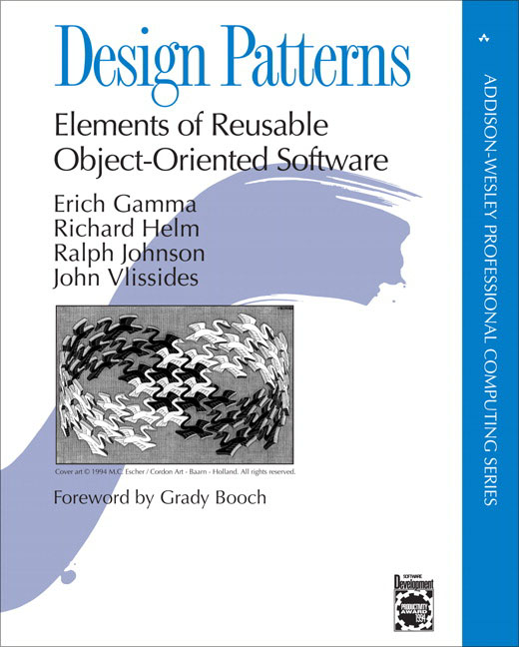

Must read
Design patterns by the Gang of four
Refactoring by Martin Fowler

Slide 45


Must read, buy and discuss
Elegant Objects by Egor Bugaenko (Huawei)
This guy
Useful web resources:
https://sourcemaking.com/
https://refactoring.guru/

Slide 46
Thanks and let’s connect on linkedIn

