Slide 1
GraalVM
Initialize Once Start Fast: Application Initialization at Build Time
Andrey Kuleshov, RRI, MRC

Slide 2
What you should get from this talk?
Brief knowledge about new technology
New popular words in your lexicon: Graal and GraalVM
Passion to try it in your project
This is an overview, I haven’t yet used it in Production
Moscow, Russian Research Institute, 2020

Slide 3
01
GraalVM overview

Slide 4
What is GraalVM
GraalVM – huge ecosystem (polyglot VM, compiler, tools and shared runtime) created by Oracle. It can compile and execute different languages on one VM platform.
https://www.graalvm.org/
https://github.com/oracle/graal

Slide 5
Code processing
Languages
GraalVM
Runtime
JVM languages (Kotlin, Java, Scala)
LLVM-based languages like C/C++
Other: Python, JS, Ruby
Java Hotspot VM
(normal VM with GC)
NodeJS environment
(node signal handlers, e.t.c)
Standalone native app
(AOT of JVM bytecode)
transforming interpreter to compiler
native or managed application

Slide 6
Java in a standalone native app???
Ahead of time compilation instead of JIT
Application becomes fairly smaller
Fast startup (milliseconds for a web server) and low memory usage (less metadata for JIT)
Full runtime support including GC
Overhead for AOT compilation
No portability to platforms
No reflection (limited)
Should not be used for long running apps
Moscow, Russian Research Institute, 2020

Slide 7
Native execution
Placing together all possible bytecode. All reachable methods, fields, classes
Static analysis,
boundary checks
Application is running without deps and class loading
JAVA
Java application
JDK
Substrate VM
AOT
Machine code, image heap

Slide 8
Why GraalVM?
Faster VM and a runtime for Java, Scala, Kotlin, better optimizations than in C2
Some attempts to have polyglot compiler and support to run several non-JVM languages inside of JVM!
And as a super bonus - native execution of your JVM bytecode with AOT compilation!
Moscow, Russian Research Institute, 2020

Slide 9
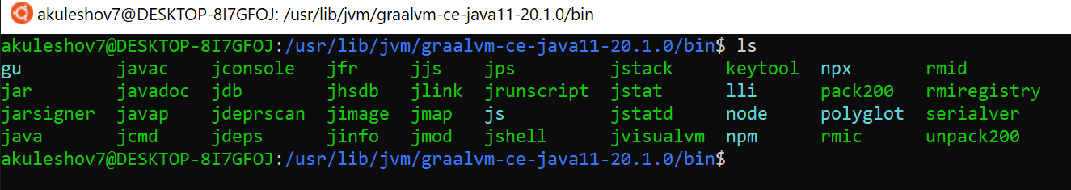
Package
Moscow, Russian Research Institute, 2020

Slide 10
Package
Which Java JIT compiler is the most optimizing in openJDK?
Moscow, Russian Research Institute, 2020

Slide 11
Package
Which Java JIT compiler is the most optimizing in openJDK?
- C2 compiler (also known as ‘opto’).
Moscow, Russian Research Institute, 2020

Slide 12
02
GraalVM architecture

Slide 13
Implementation for JVM-languages
Java, Scala, Kotlin (Normal JVM process runs on hotspot)
GraalVM Compliler
(replaced JIT compilers, default compilers are still in package)
Java Hotspot VM
JVM compiler interface (JEP253)
Moscow, Russian Research Institute, 2020

Slide 14
Interpreters
How do other frameworks work with JVM on non-JVM languages, Jython for example?
Making optimizing compilers themselves, translating language, making mapping from Python to Java bytecode!
Why not interpreters? – Extremely slow to execute each node of AST. Incredibly dynamic!
Moscow, Russian Research Institute, 2020

Slide 15
Implementation
Python, Ruby, JS, Haskell (Hi Bulat!) and some other
Java, Scala, Kotlin
Truffle Framework
(API for creating interpreters on a high level language)
GraalVM Compliler
(optimizes merged interpreter code and app code on runtime)
Java Hotspot VM
Moscow, Russian Research Institute, 2020

Slide 16

Implementation for native languages
C, C++, and
Python, Ruby, JS, e.t.c
LLVM bitcode
Java, Scala, Kotlin
Truffle Framework
(API for creating interpreters on a high level language)
GraalVM Compliler
(optimizes merged interpreter code and app code on runtime)
Java Hotspot VM
Moscow, Russian Research Institute, 2020

Slide 17
03
Repository
Some info about setup

Slide 18
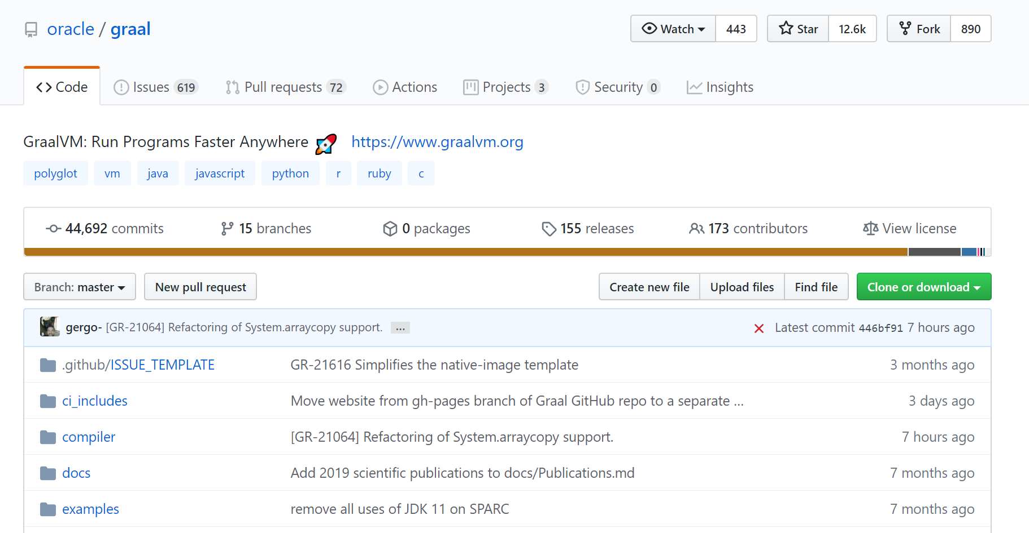
Github
JAVA source code

Slide 19
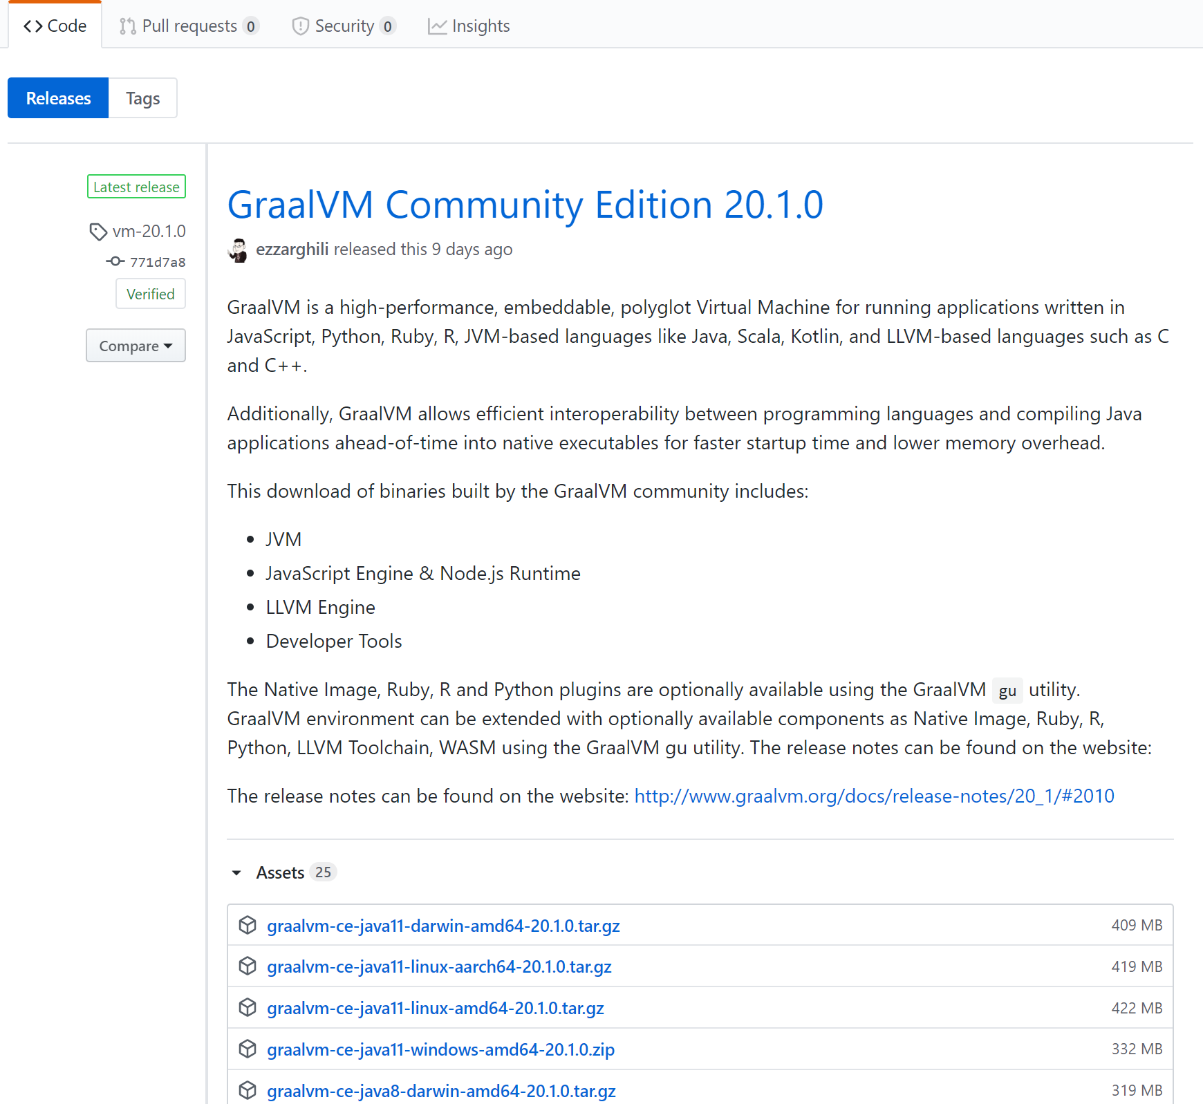
Github
https://github.com/graalvm/graalvm-ce-builds/releases

Slide 20
Simple installation
Load archive as normal Java
Set Path and java home:
$ export PATH=<path to GraalVM>/bin:$PATH
$ export JAVA_HOME=<path to GraalVM>
Run java and note that at any time you are able to switch to default JIT compiler:
$ java –XX:-UseJVMCICompiler

Slide 21
04
Other benefits

Slide 22
Polyglot compiler
GraalVM allows you to write polyglot applications with a seamless way to pass values from one language to another
It will be run in ONE single process
Now you can write code on the language you prefer without holywars!
If you will use java from Graal then there will be no need to add dependencies for org.graalvm.* - polyglot will be already in classpath

Slide 23
Polyglot compiler
JS goes by the default:
import org.graalvm.polyglot.*; class Polyglot { public static void main(String[] args) { Context polyglot = Context.create();
// it can be python or other Truffle language here!!! Value array = polyglot.eval("js", "[1,2,42,4]"); int result = array.getArrayElement(2).asInt(); System.out.println(result); } }
For other languages you will get an error on Runtime:
A language with id 'python' is not installed. Installed languages are: [js]

Slide 24
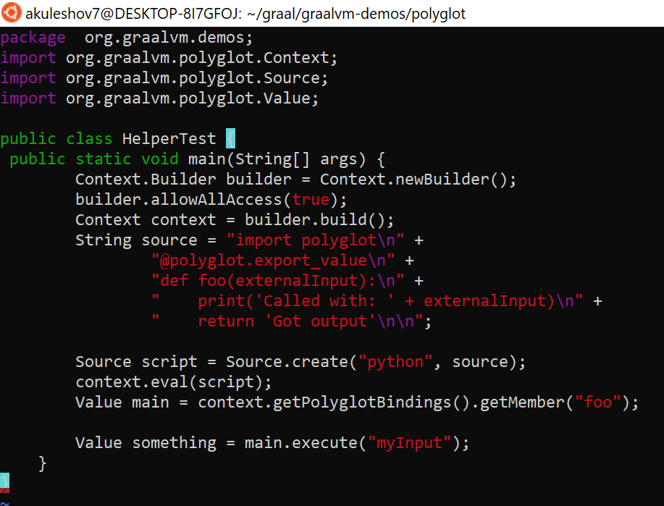
Polyglot compiler
Need to install python:
$PathToGraal/bin/gu install python
$ PathToGraal/bin/gu install -c org.graalvm.python

Slide 25

Why do I need this hell? I will never put Ruby inside Java!!

Slide 26
Because…
Now you can use any JVM tool to watch and control your damn Ruby application!
You can use for example chromium debugging tools to debug C++
You can use jconsole or sampler or anything else for Python/Ruby/e.t.c!
Btw – Ruby is faster on GraalVM ☺

Slide 27
05
Some benchmarks

Slide 28
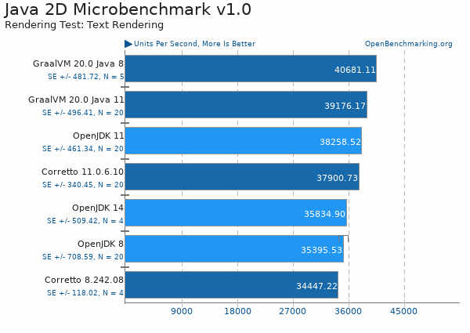
Benchmarks
Escape analysis is better?

Slide 29
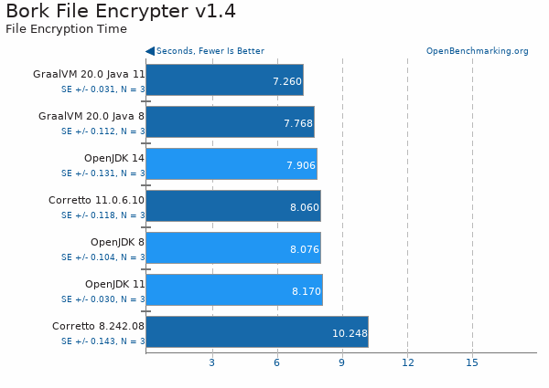
Benchmarks

Slide 30
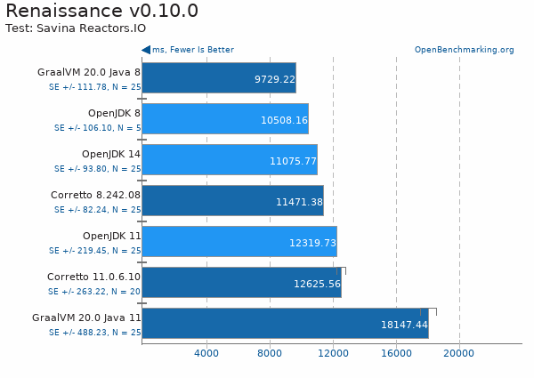
Benchmarks

Slide 31
Simple installation

Slide 32
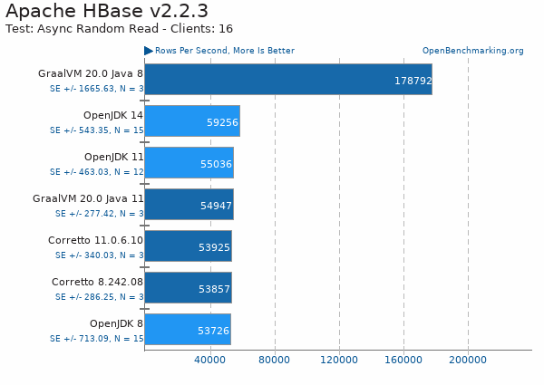
Benchmark

Slide 33
Thanks
That’s all folks

