Slide 1
Combining structure and
sequence-based neural networks
through transfer learning
Anastasiya Kulikova
Dec 17, 2021

Slide 2
How the three models were trained
1) CNN
Made in the Ellington lab by Raghav
Trained on 17,000 proteins
Trained on 1.7 million boxes encoding the positions of atoms.
Each box encodes the individual atoms, solvent accessibility and charge within a 20Å³ space.
Predicts the central masked residue for each box.
2) Transformer:
A BERT model (Bidirectional Encoder Representations from Transformers)
In 2018, Google introduced and open-sourced BERT (Masked language model)
The BERT framework was pre-trained using text from Wikipedia.
Rostlab trained it on 216 million protein sequences (Uniref100 set from UniProt).
The self-supervised training exclusively relies upon the sequential order.
Trained on raw sequences (not labeled them in any way with an automatic process to generate inputs and labels from those protein sequences)
Predicts masked sequence tokens.

Slide 3
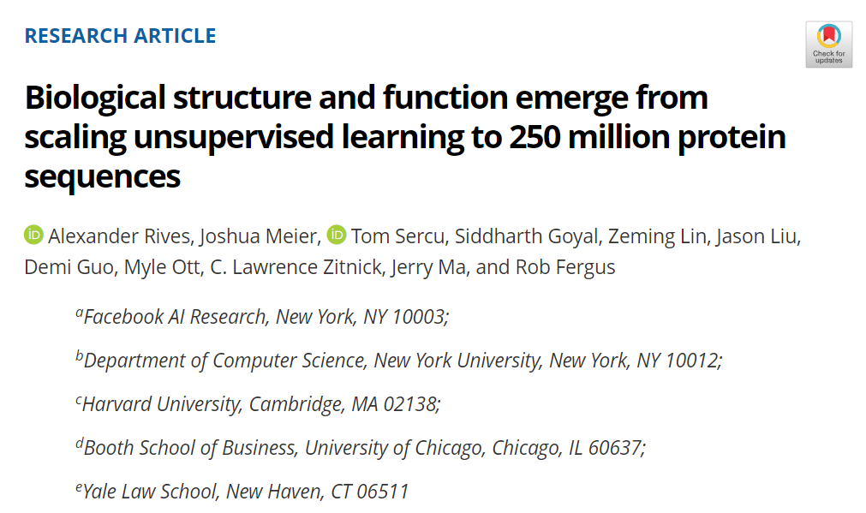
3)
Evolutionary Scale Modeling Transformer (ESM1b)
Trained on 250 million sequences in the UniParc database.
Trained using the masked language modeling objective, where each input sequence is corrupted by replacing a fraction of the amino acids with a special mask token. The network is trained to predict the missing tokens from the corrupted sequence.

Slide 4
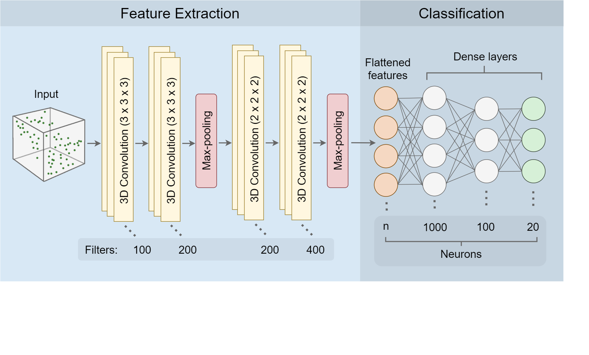
CNN Architecture

Slide 5
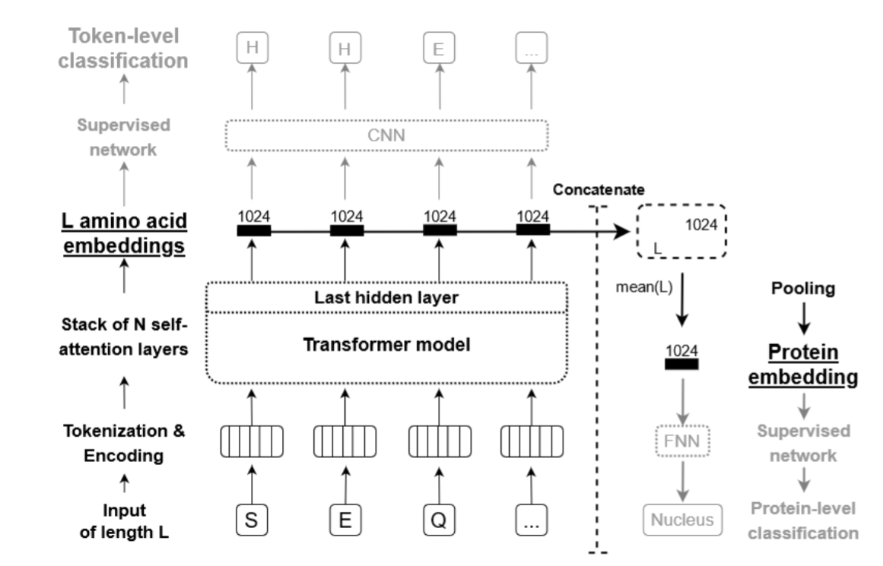
BERT Transformer Architecture
(Masked language modeling)
Elnaggar et. al. 2020
https://www.biorxiv.org/content/10.1101/2020.07.12.199554v3.full.pdf

Slide 6
Central question: Since each of these models learns different protein representations, would a combined model perform better than each model individually?

Slide 7
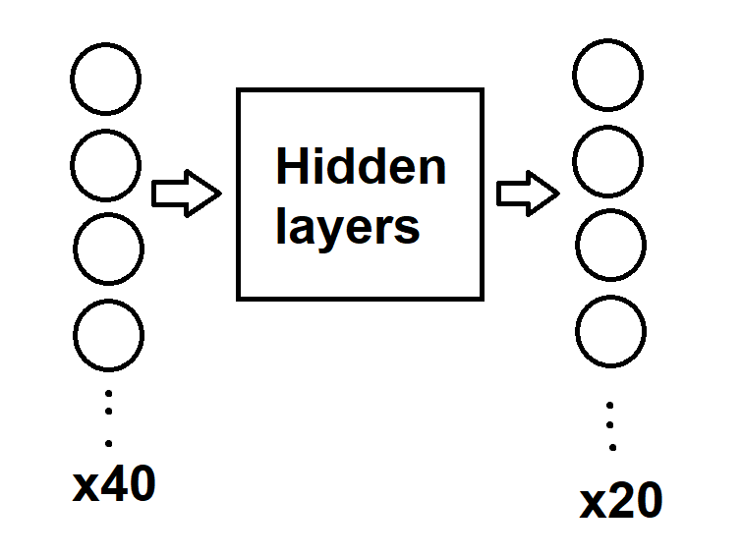
Preliminary data: I trained a combined network on a very small set of proteins (~100) to
predict the wt residue.
CNN and BERT
Output combined
Output from both models
used as input
Output probability
for each amino acid

Slide 8
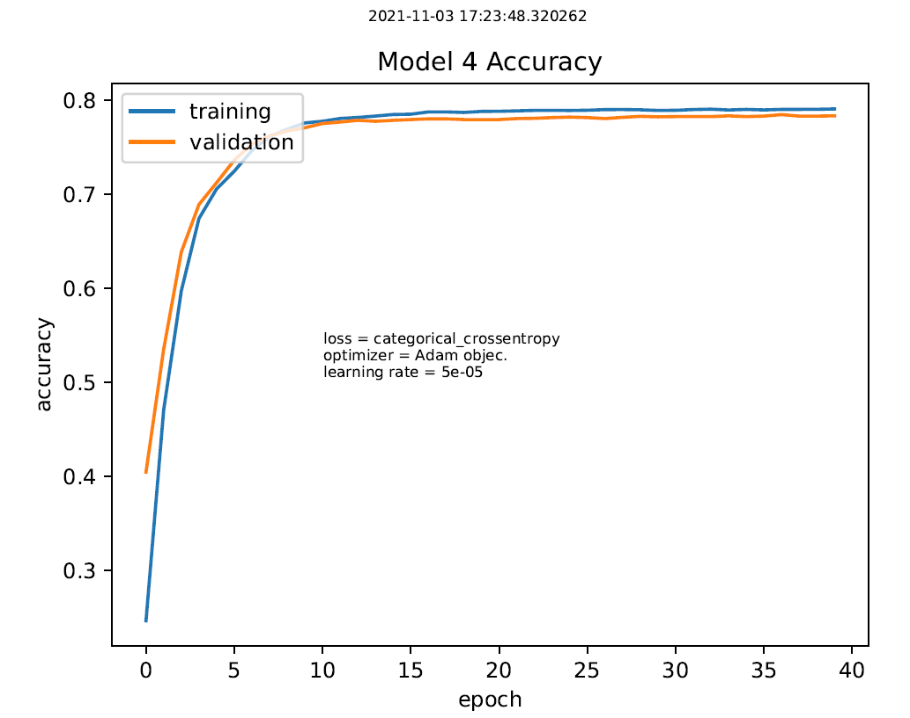
Preliminary data: I trained a combined network on a very small set of proteins (~100) to
predict the wt residue.
Validation accuracy: 78%

Slide 9
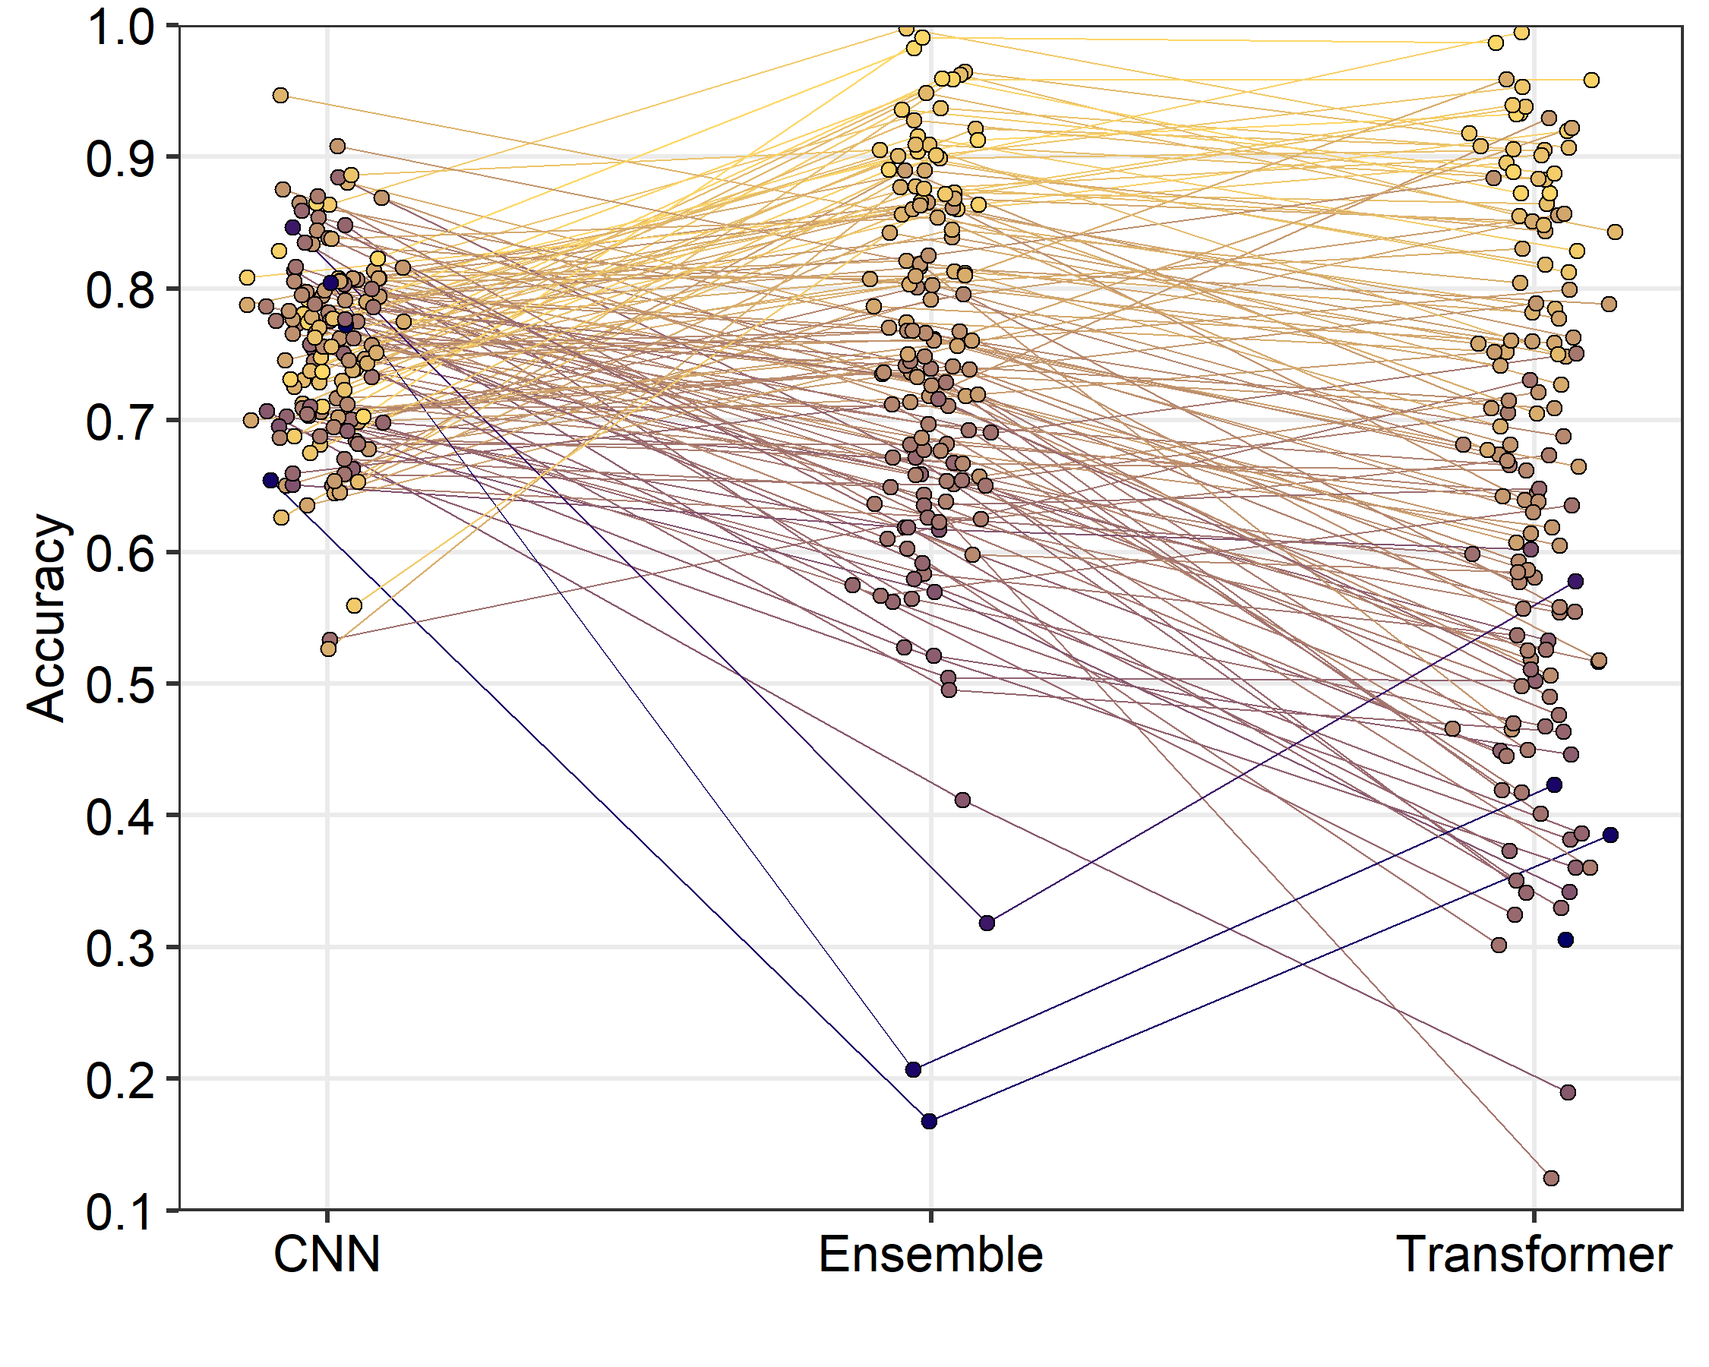
First, I made an ensemble, where I averaged the probabilities at each position.
Mean: 75.2%
Mean: 74.9%
Mean: 67.7%

Slide 10
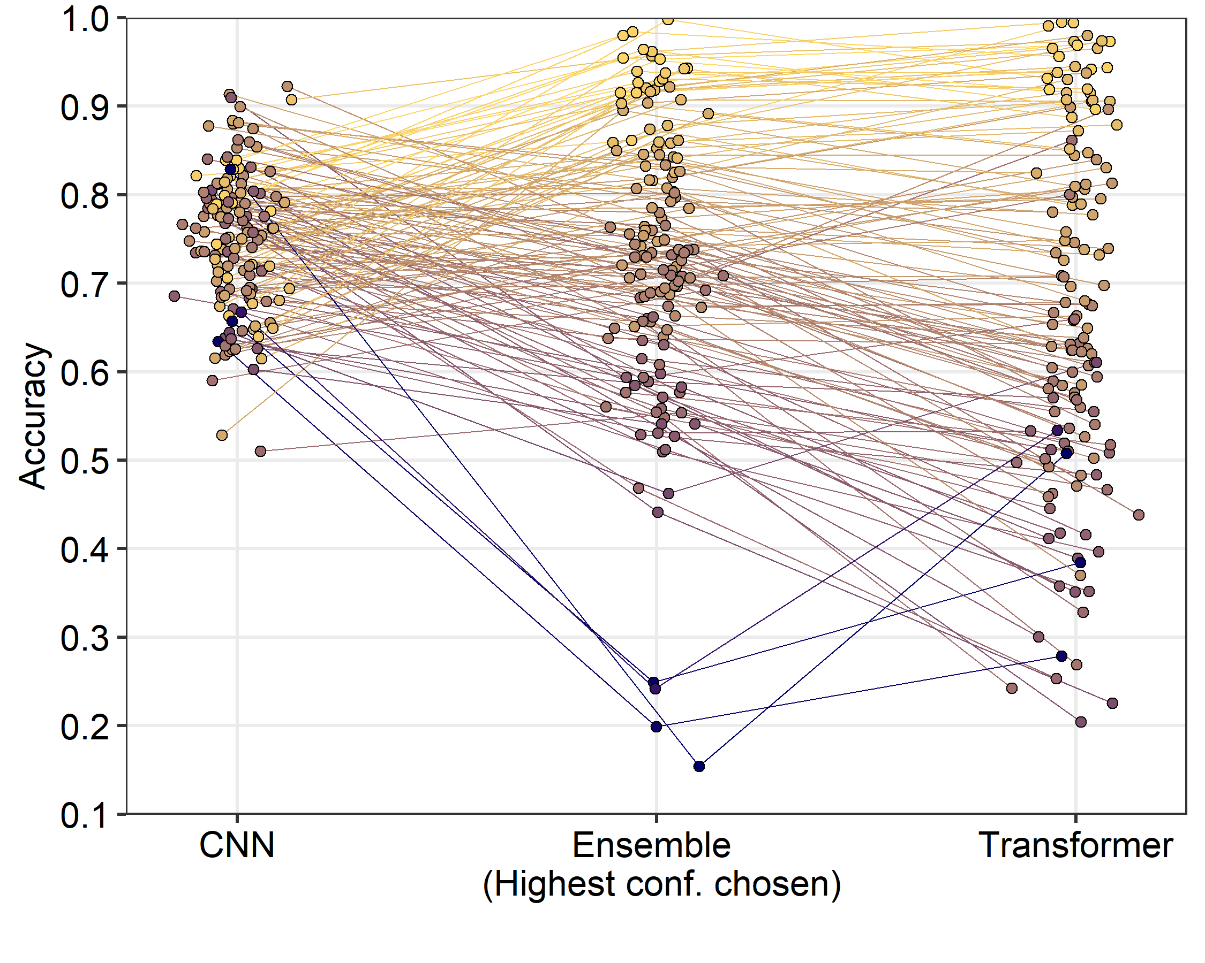
Next, I made an ensemble, where I took the higher conf. prediction at each position.
Mean: 75.2%
Mean: 67.7%
Mean: 74.0%

Slide 11
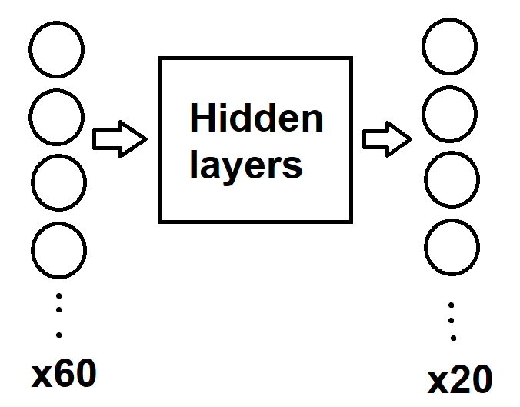
Preliminary data: I trained a combined network on a very small set of proteins (~100) to
predict the wt residue.
CNN, BERT and ESM1b
Output combined
Output from all three models used as input
Output probability
for each amino acid

Slide 12
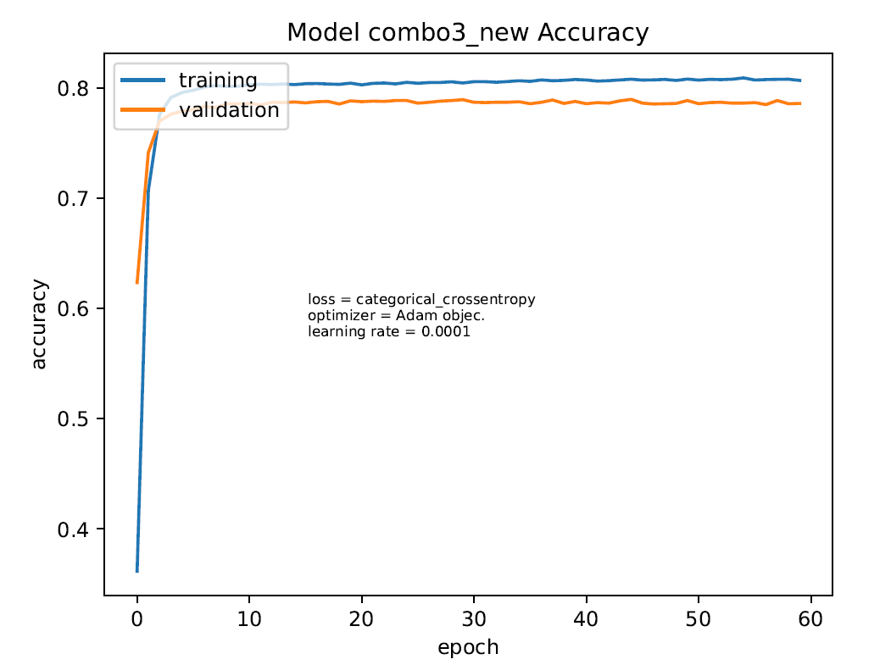
Preliminary data: I trained a combined network on a very small set of proteins (~100) to
predict the wt residue.
Validation accuracy: 78.57%

Slide 13
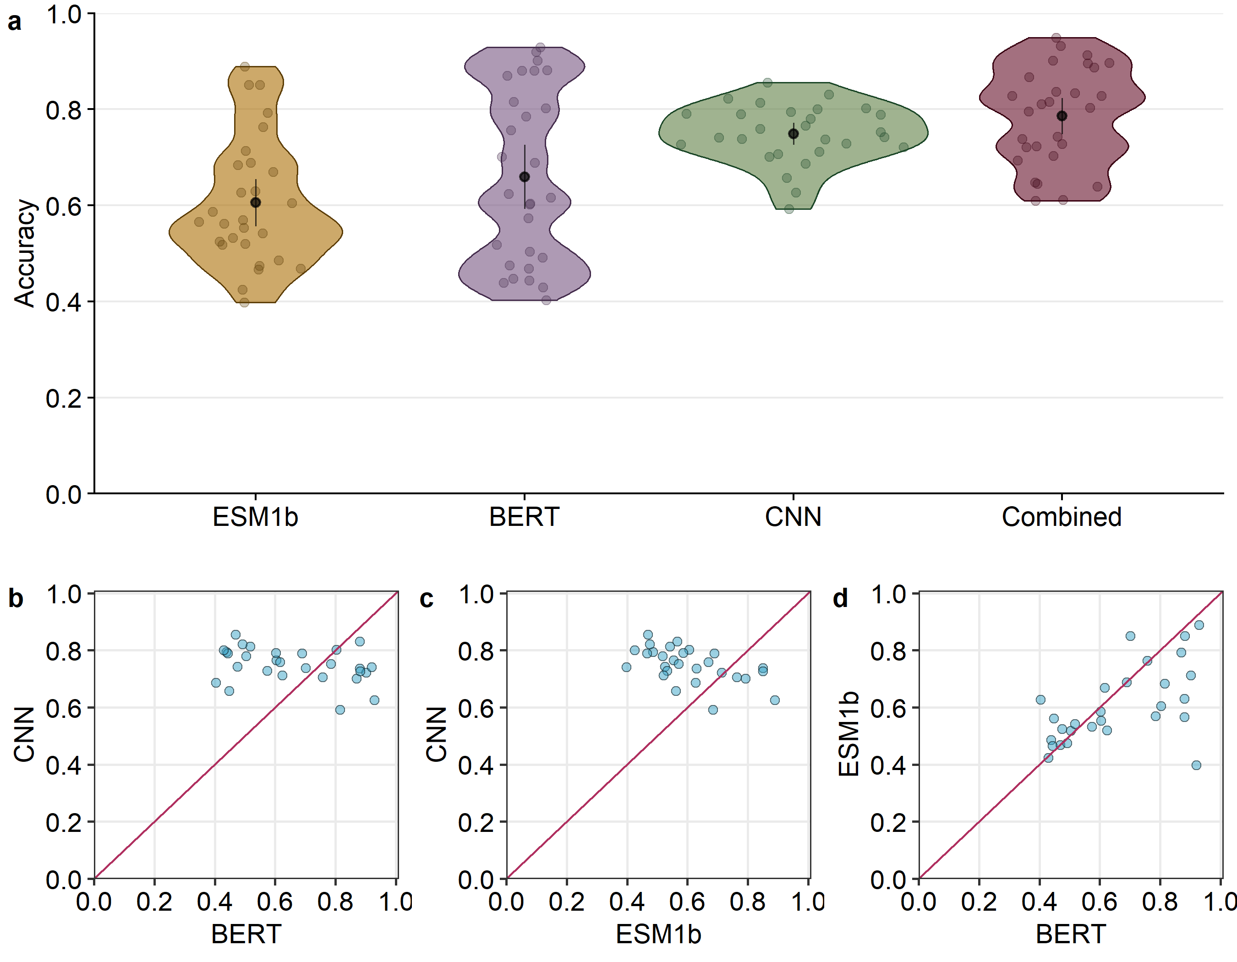
Combined network was trained on 17,951 positions and tested on 3,799 positions (28 proteins)

Slide 14
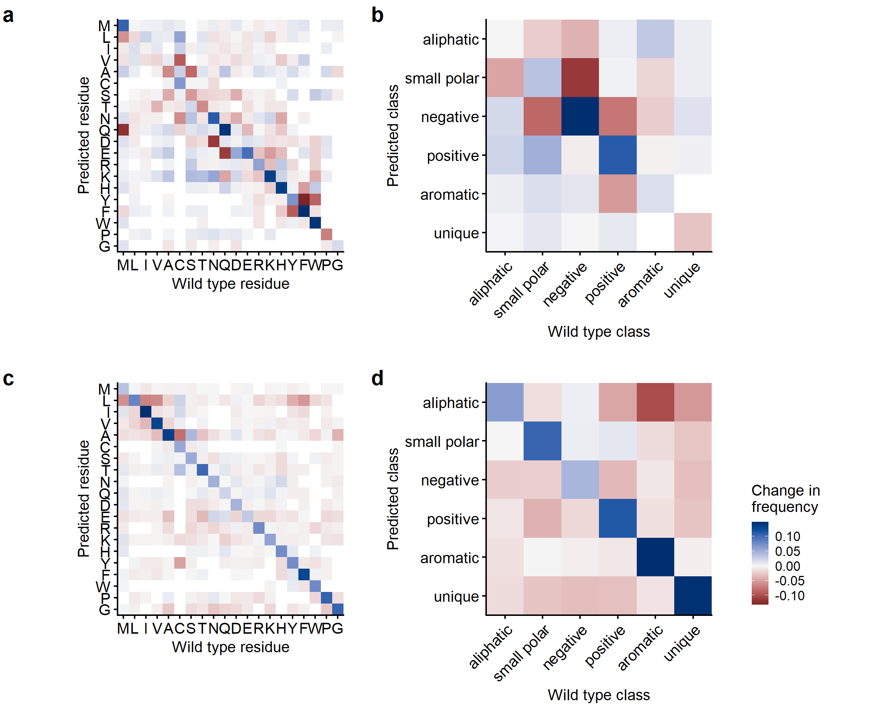
CNN
BERT

Slide 15
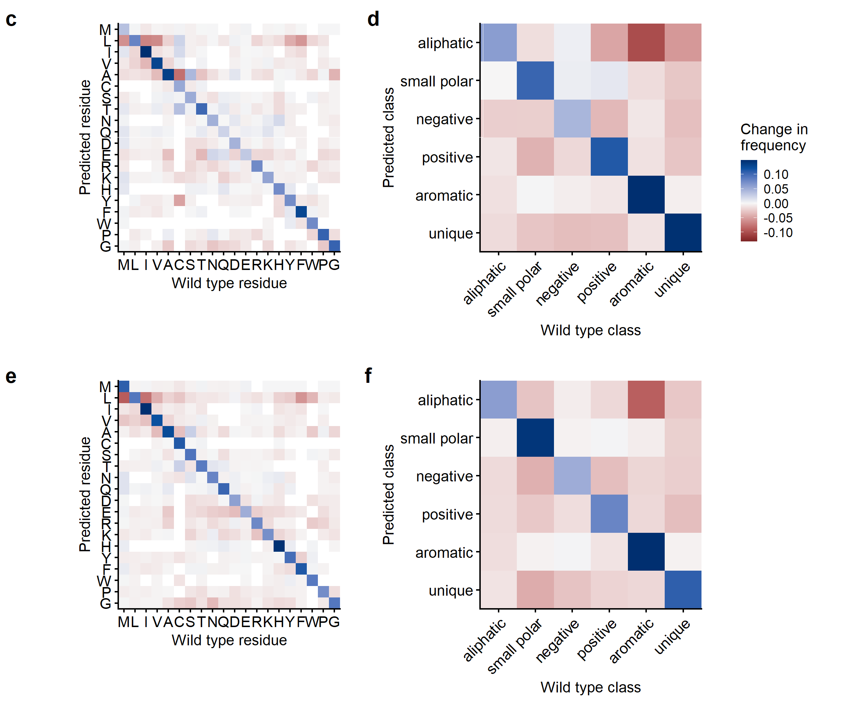
BERT
ESM1b

Slide 16
I divided the predictions into 8 decision groups.
1) all three nets unanimous
2) only CNN prediction used
3) only BERT prediction used
4) only ESM1b prediction used
5) CNN and BERT
6) BERT and ESM1b (transformers unanimous)
7) CNN and ESM1b
9) completely unique prediction
Drawbacks of this analysis:
We did not give the net only the predicted amino acids.
There may be higher confidence predictions found in the output of a single net, causing the neural network to ignore/not see the “winners”. The three winners do not necessarily have the three highest probabiliies.

Slide 17
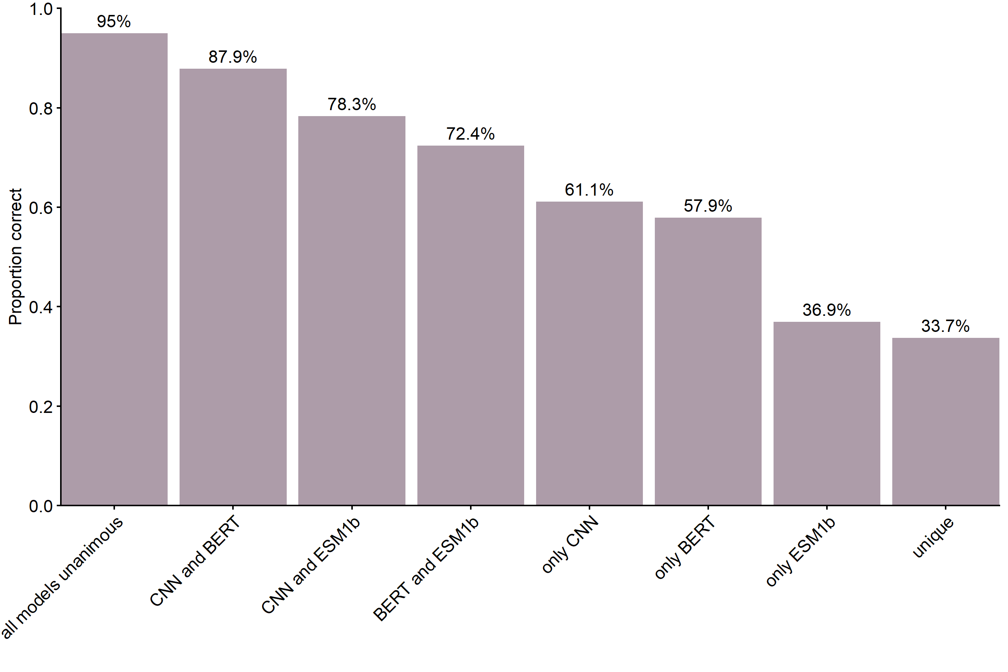
In each decision group, what is the proportion
of correct predictions?

Slide 18
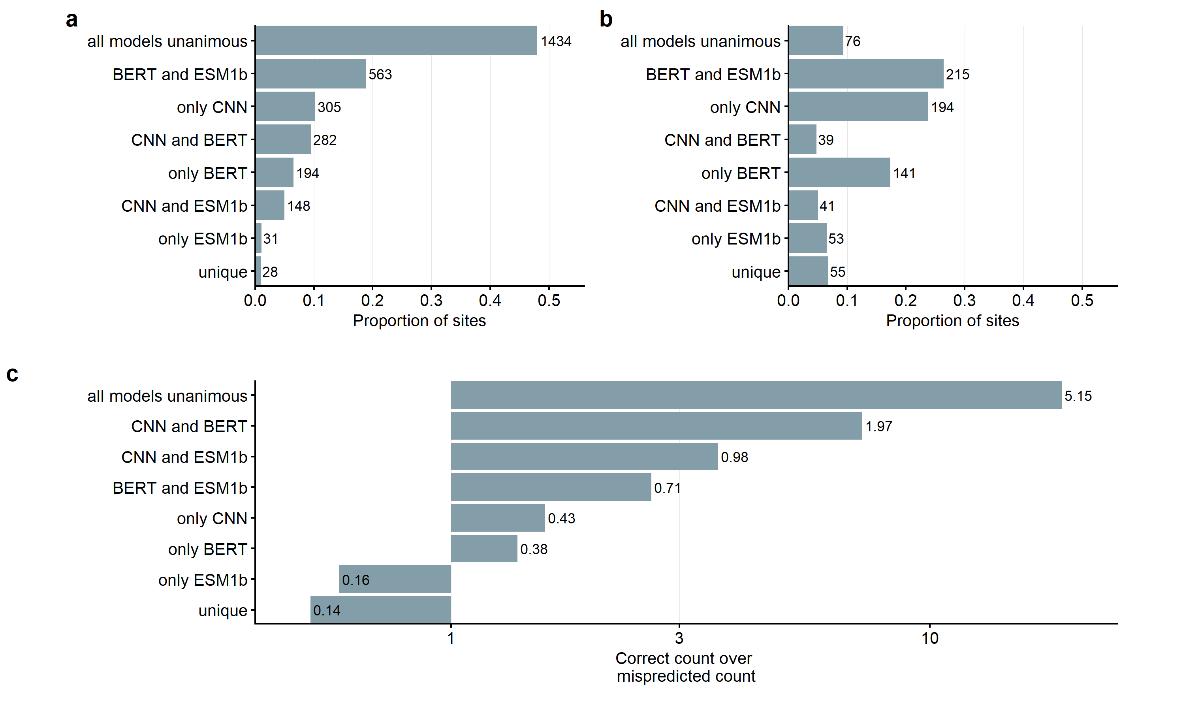
Which decision groups have highest and lowest
ratios of correct predictions to mispredictions?
Correct predictions
Mispredictions
c

Slide 19
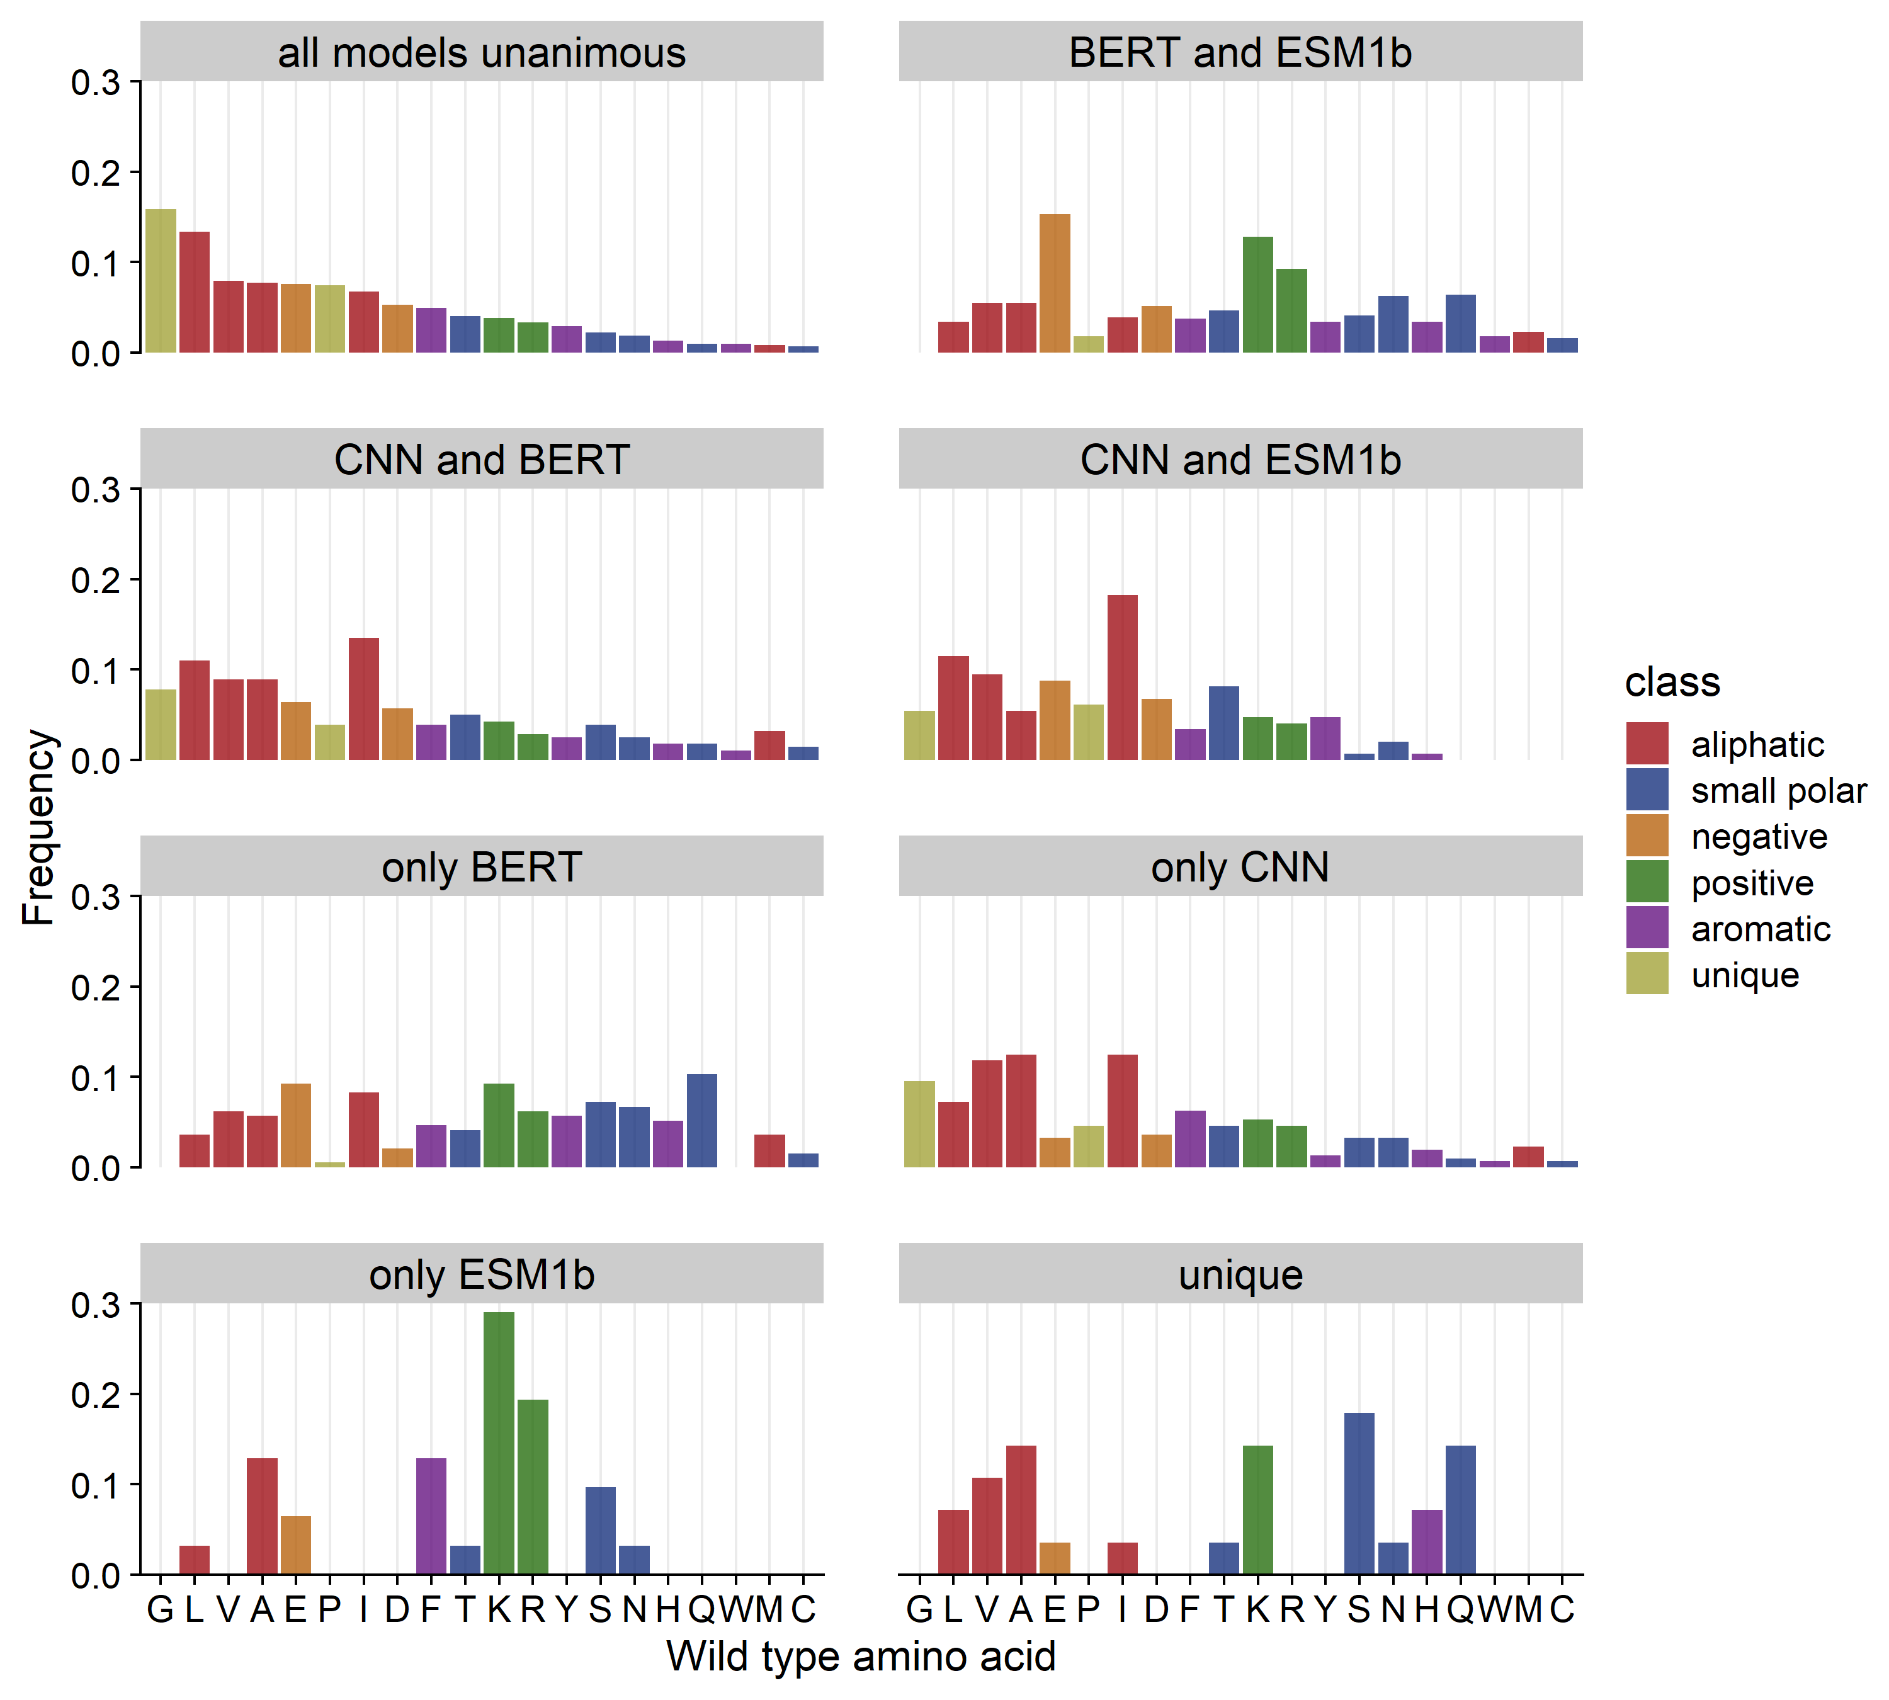
Correct
predictions

Slide 20
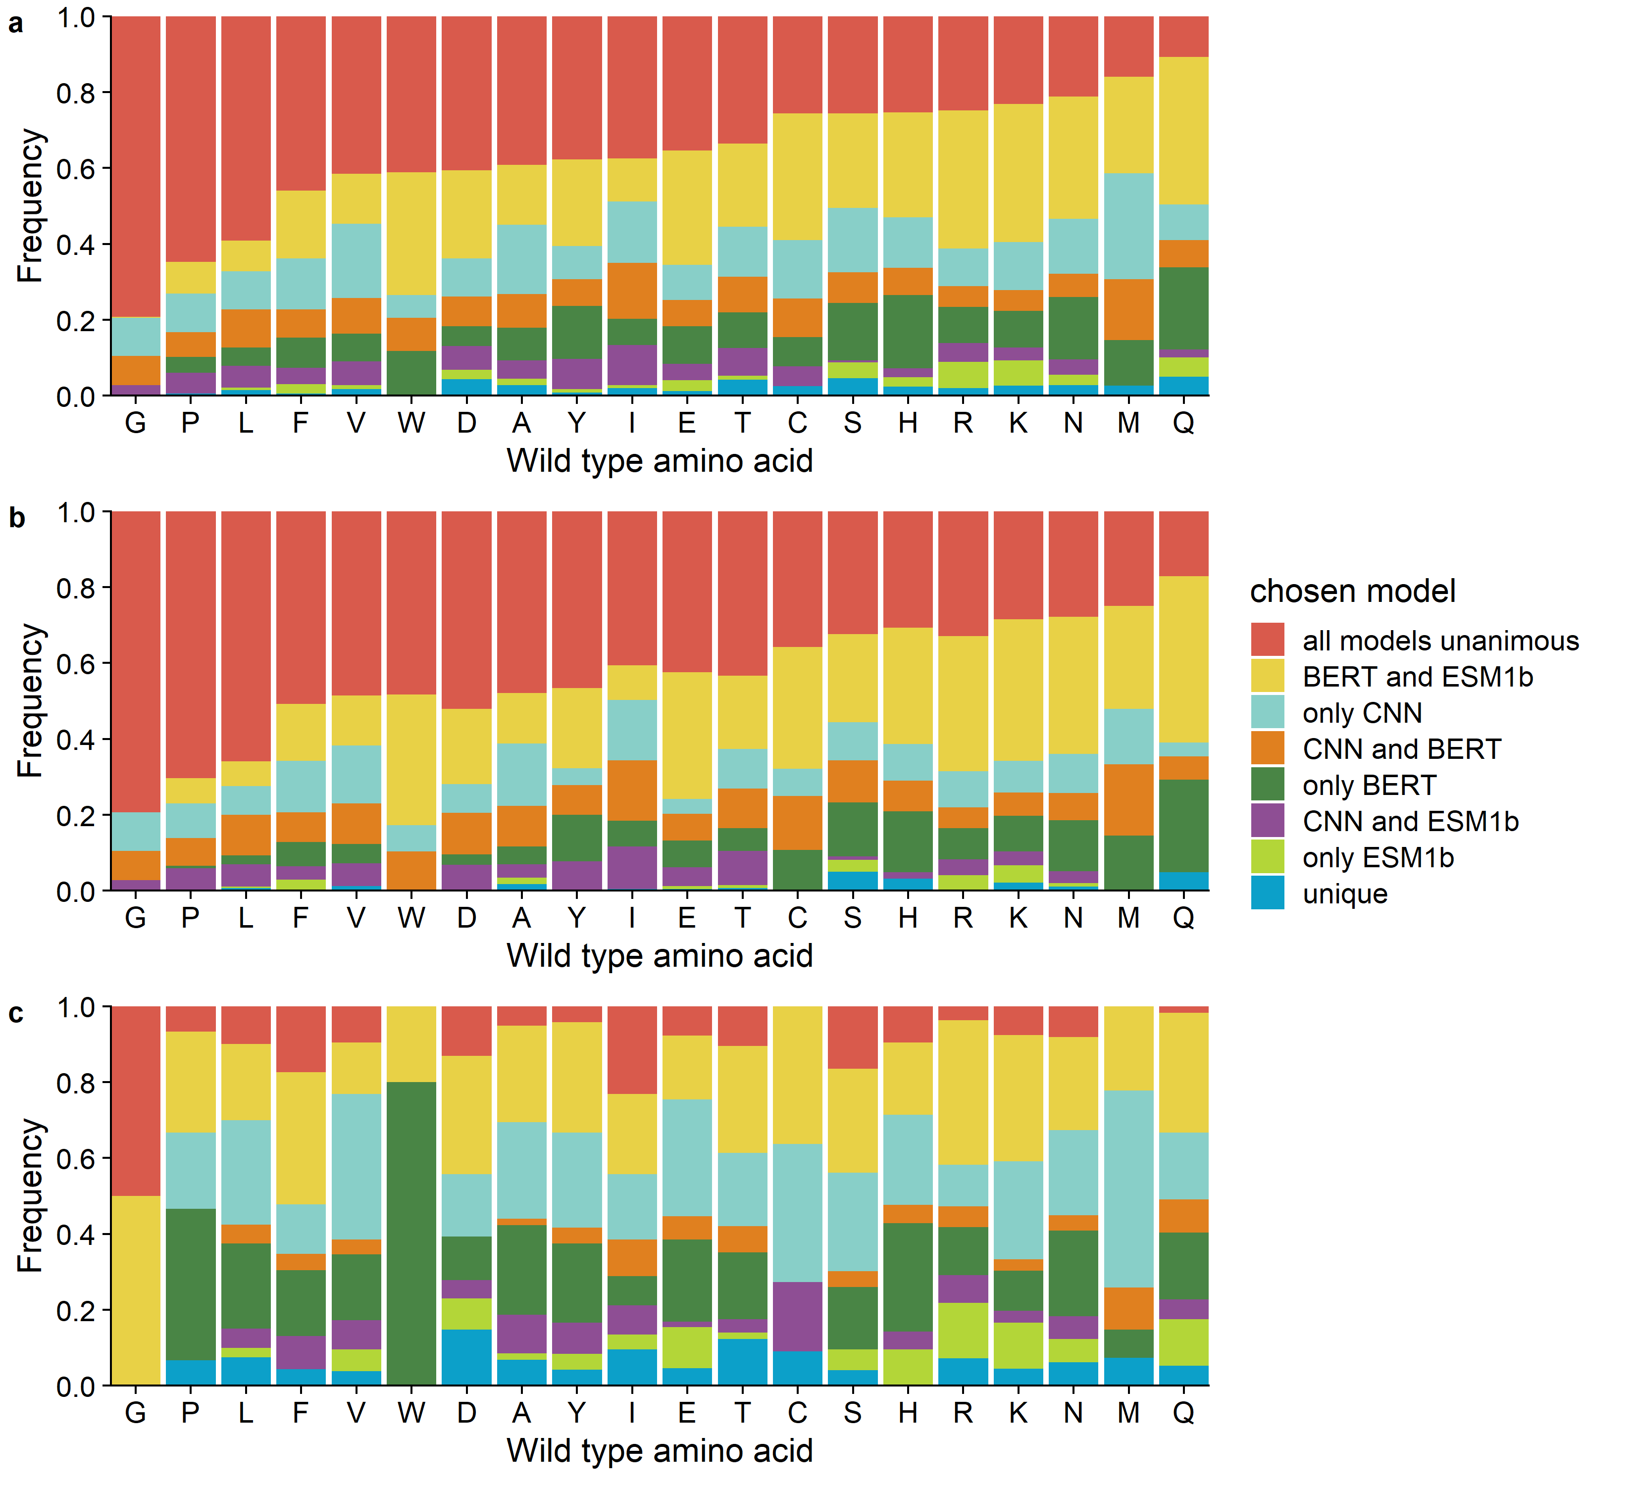
All sites
Correct
Pred.
Mispred.

Slide 21
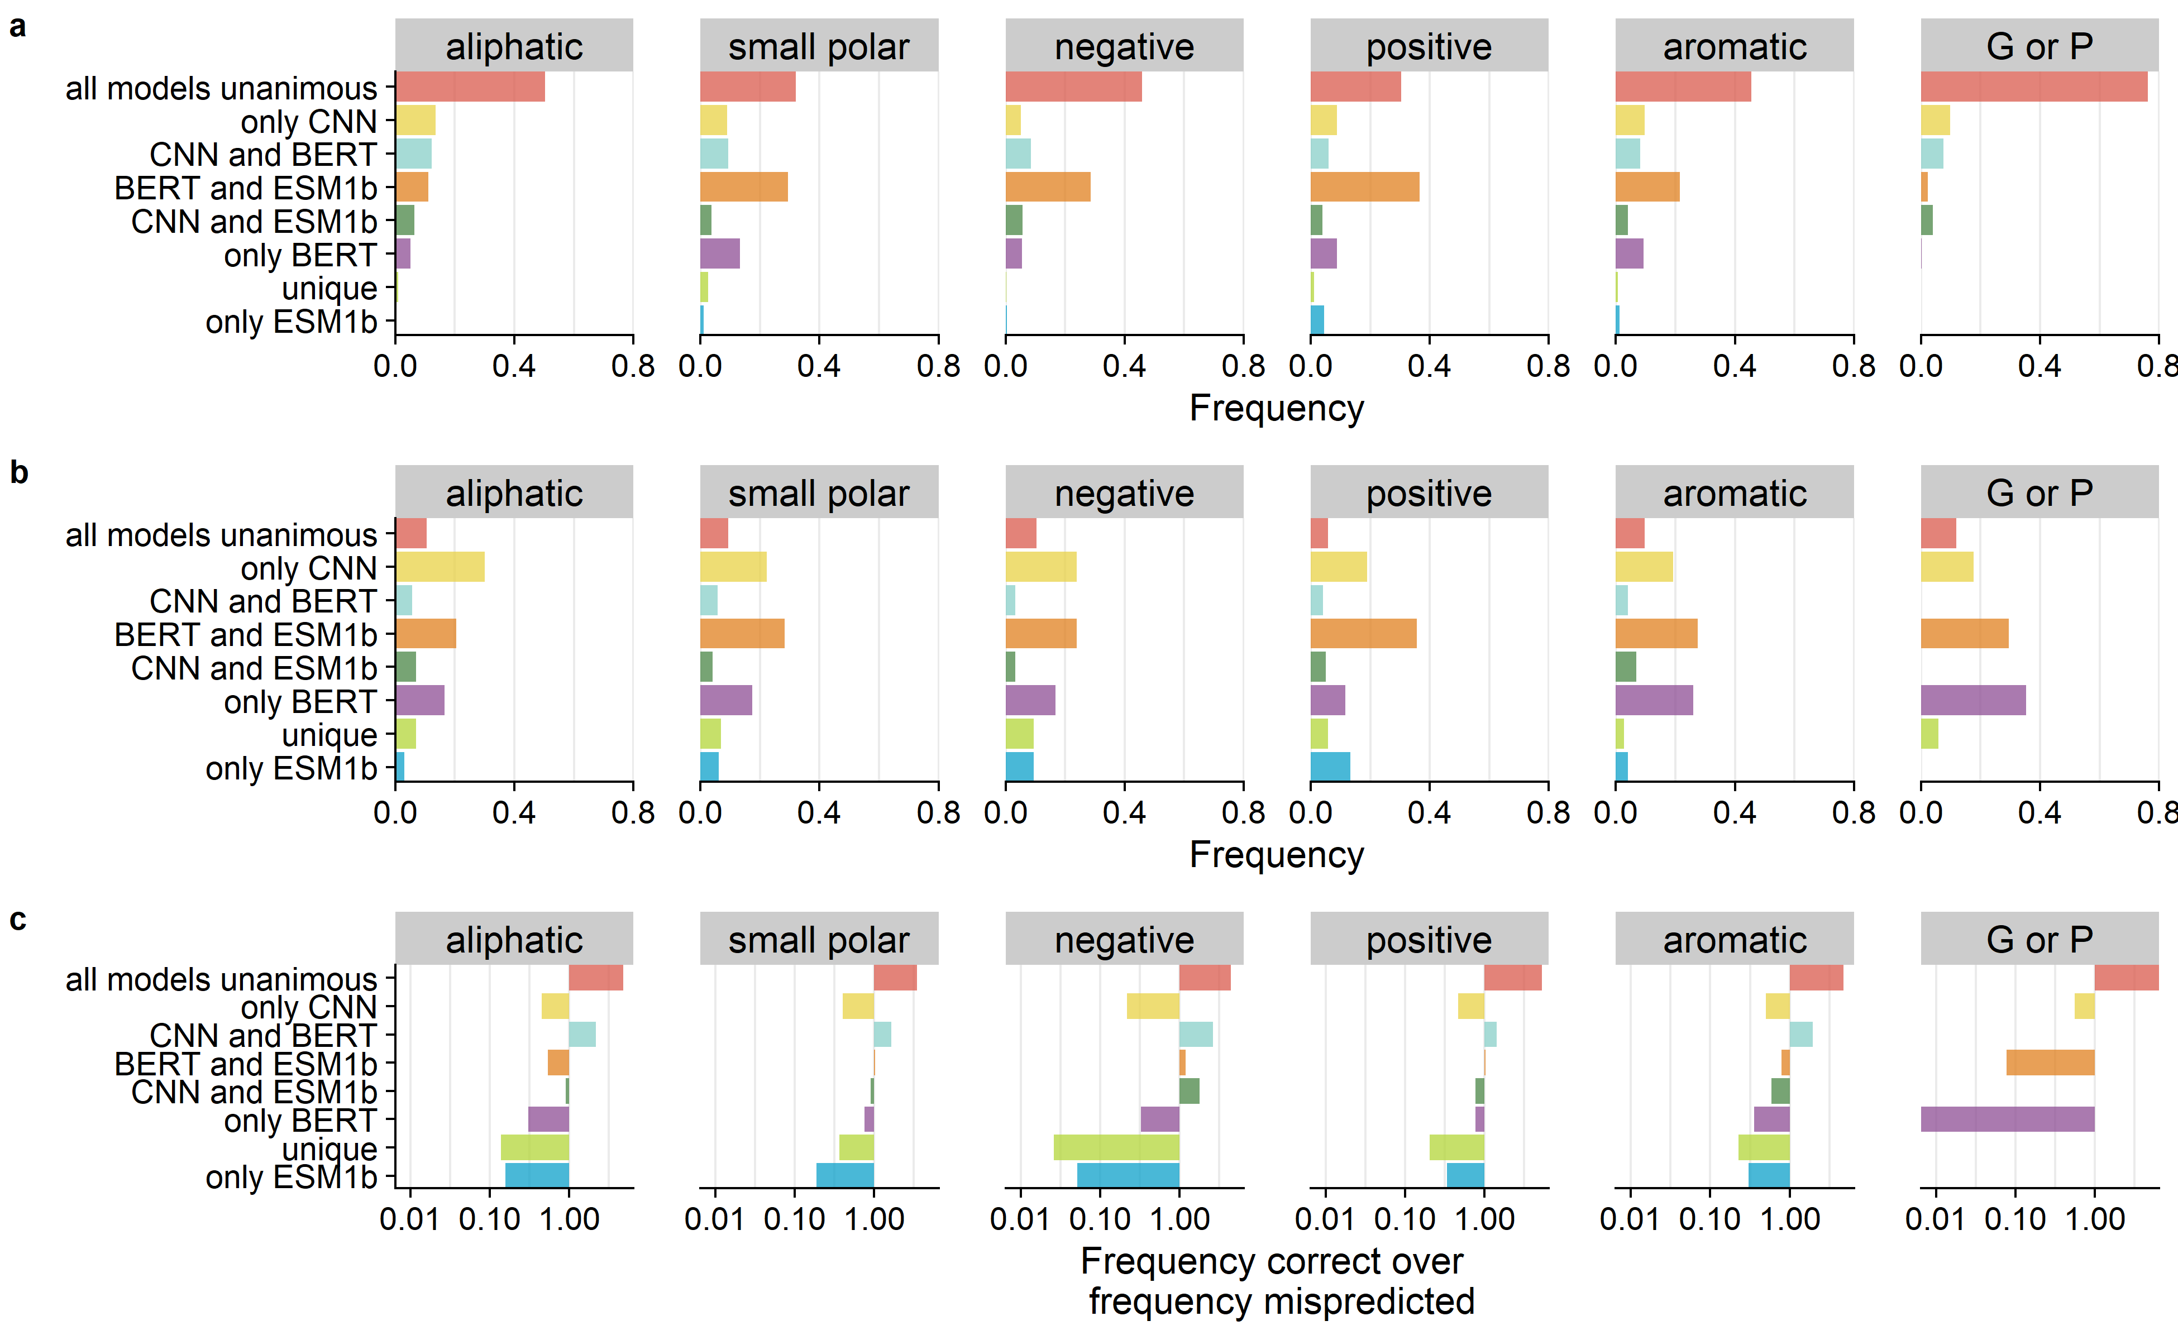
Which choices (decision groups) are best
for each amino acid class?
Cor.
Mis.
odds

Slide 22
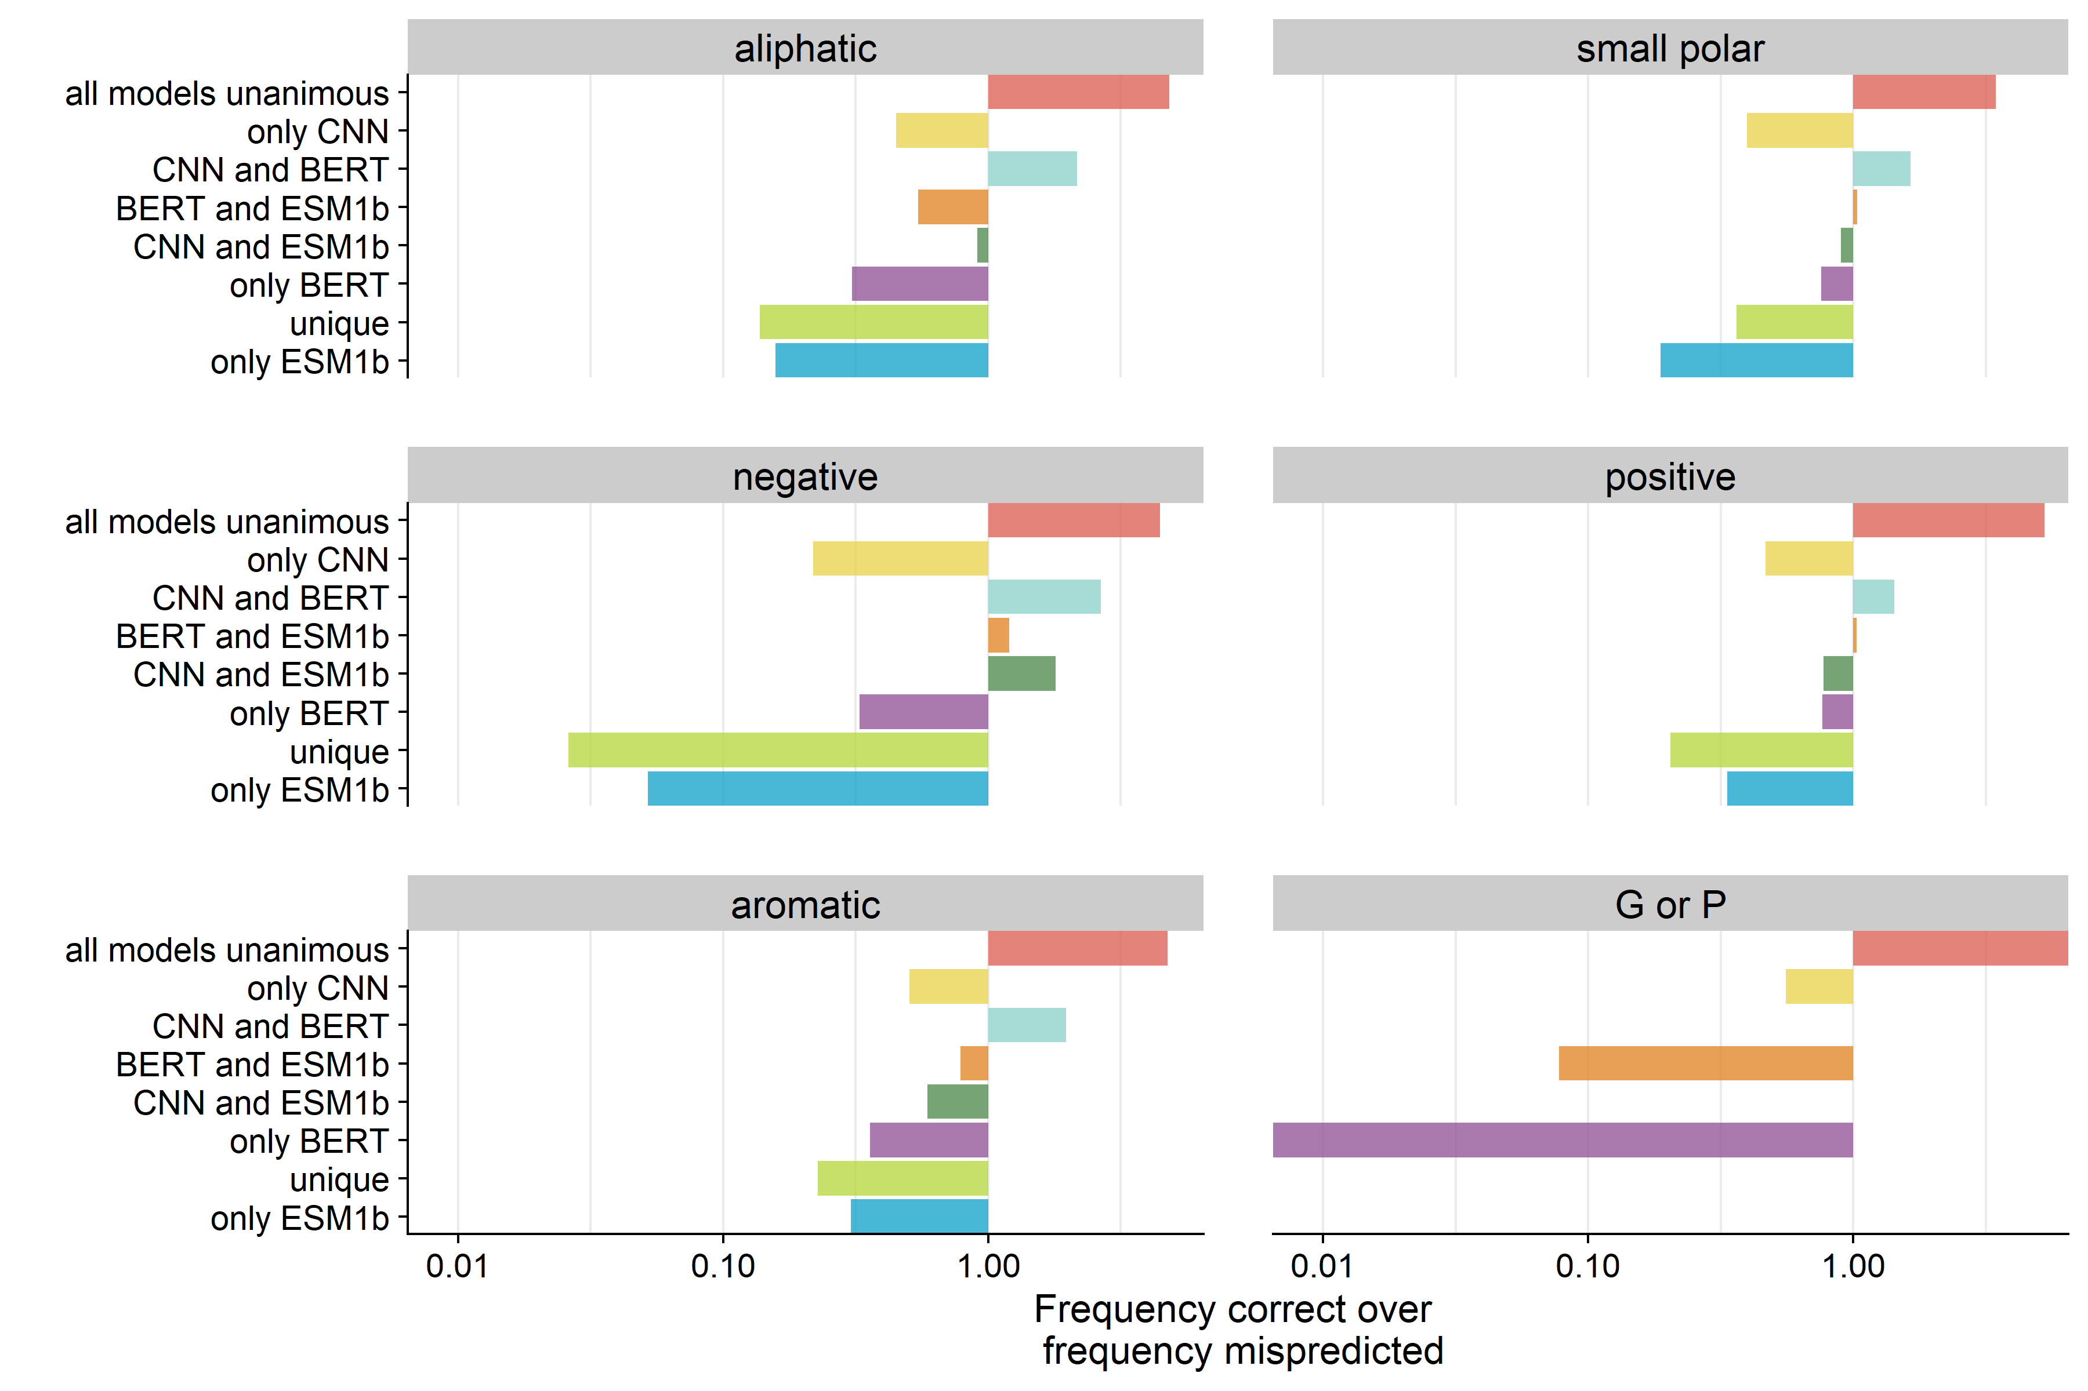
Which choices (decision groups) are best
for each amino acid class?

Slide 23
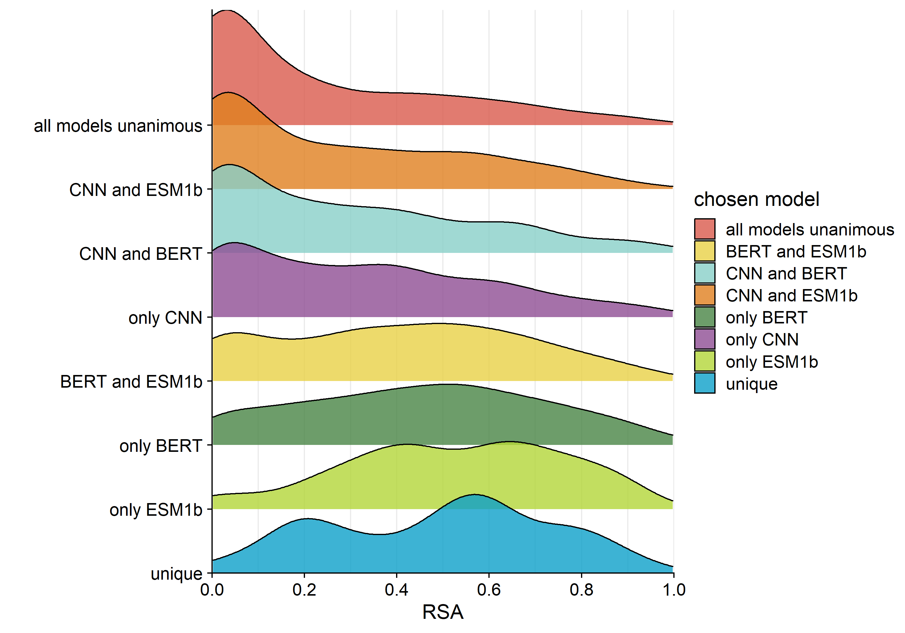
Groups that tend to have the most error are surface
residues in the combined model.

Slide 24
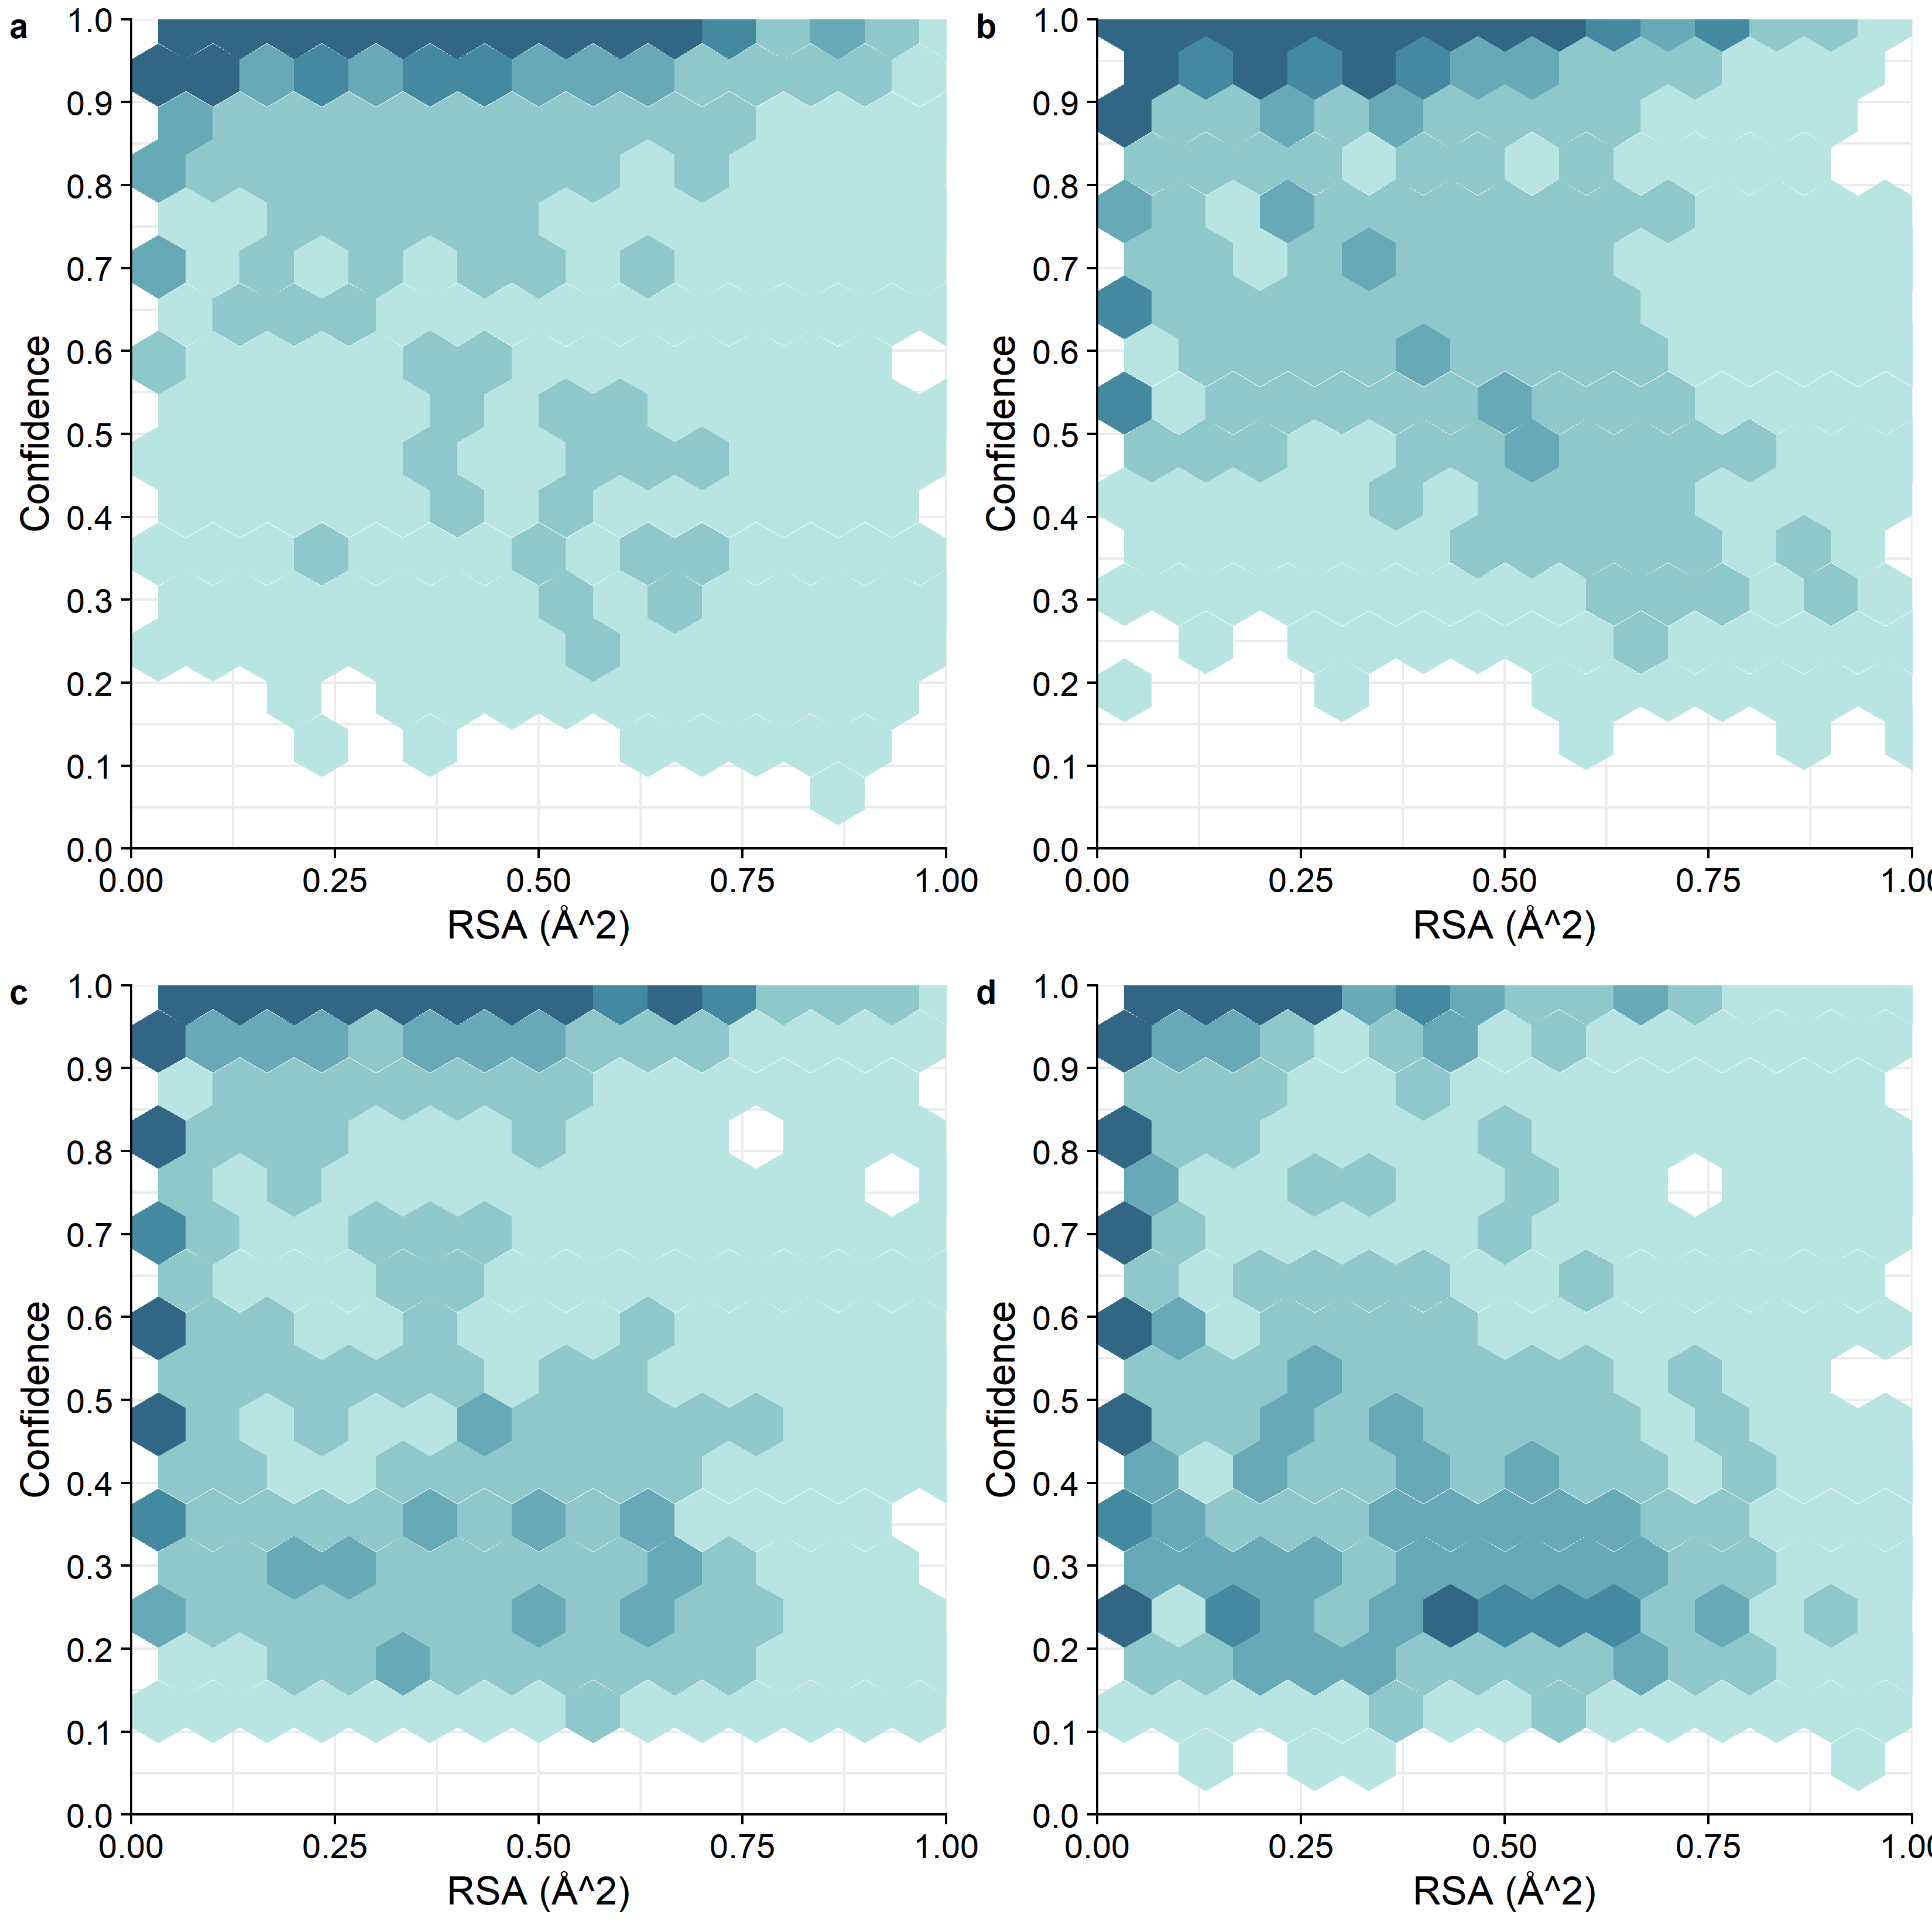
combo
CNN
BERT
ESM1b

Slide 25
In the positions where the prediction from the combined model did not match any of the single model predictions, what is the % correctly predicted?
Only 28 out of 548 positions (5%), where the answer was not predicted by any of the three single models, were correct.

Slide 26
Looking only at mispredicted sites, how often was the answer missed by all three single models?
Out of all mispredicted sites (814), the answer was not predicted by any model 64% of the time (521/814).

Slide 27
Looking only at uniquely predicted sites, how often was the correct prediction missed by all three single models?
There were 55 positions total unique positions.
In 21 (38.2%) of those unique predictions, the correct amino acid had been predicted by one or more of the models.

Slide 28
Next steps
Train on larger data set (thousands of proteins)
Does the chosen amino acid (CNN prediction vs ESM1b vs BERT prediction) correlate with, secondary structure?
Look into confidence for all 4 models.

