Slide 1
Comparing the CNN prediction (using 20A box) to the BERT sequence transformer predictions.

Slide 2
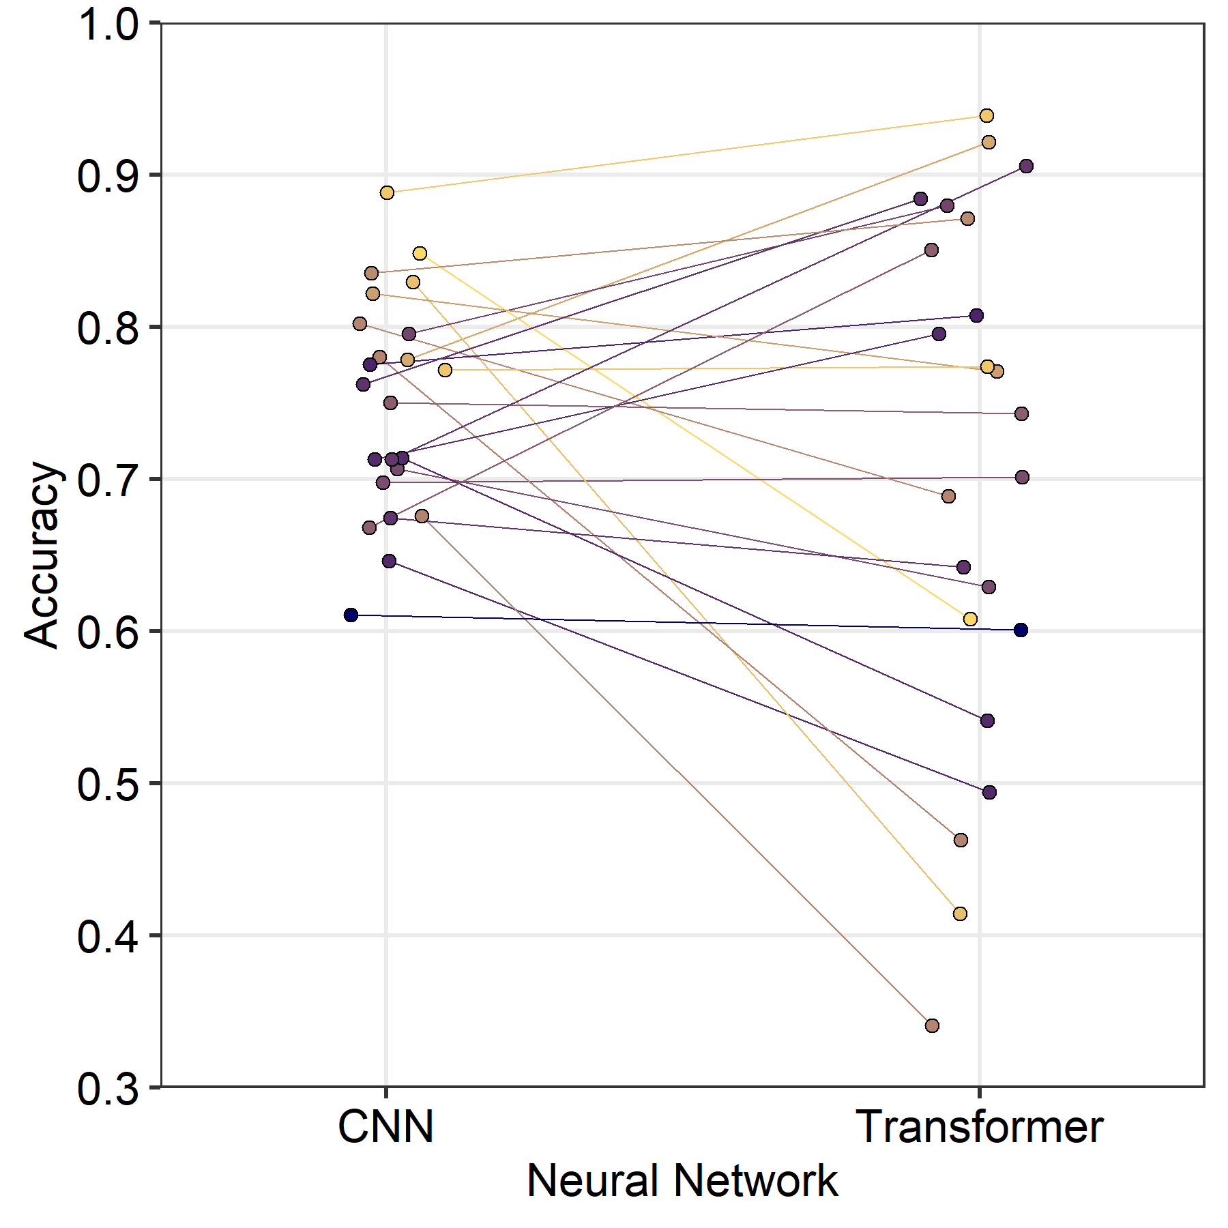
Comparing prediction accuracy between CNN and transformer
across 23 PSICOV proteins
Mean: 75.8%
Mean: 71.6%

Slide 3
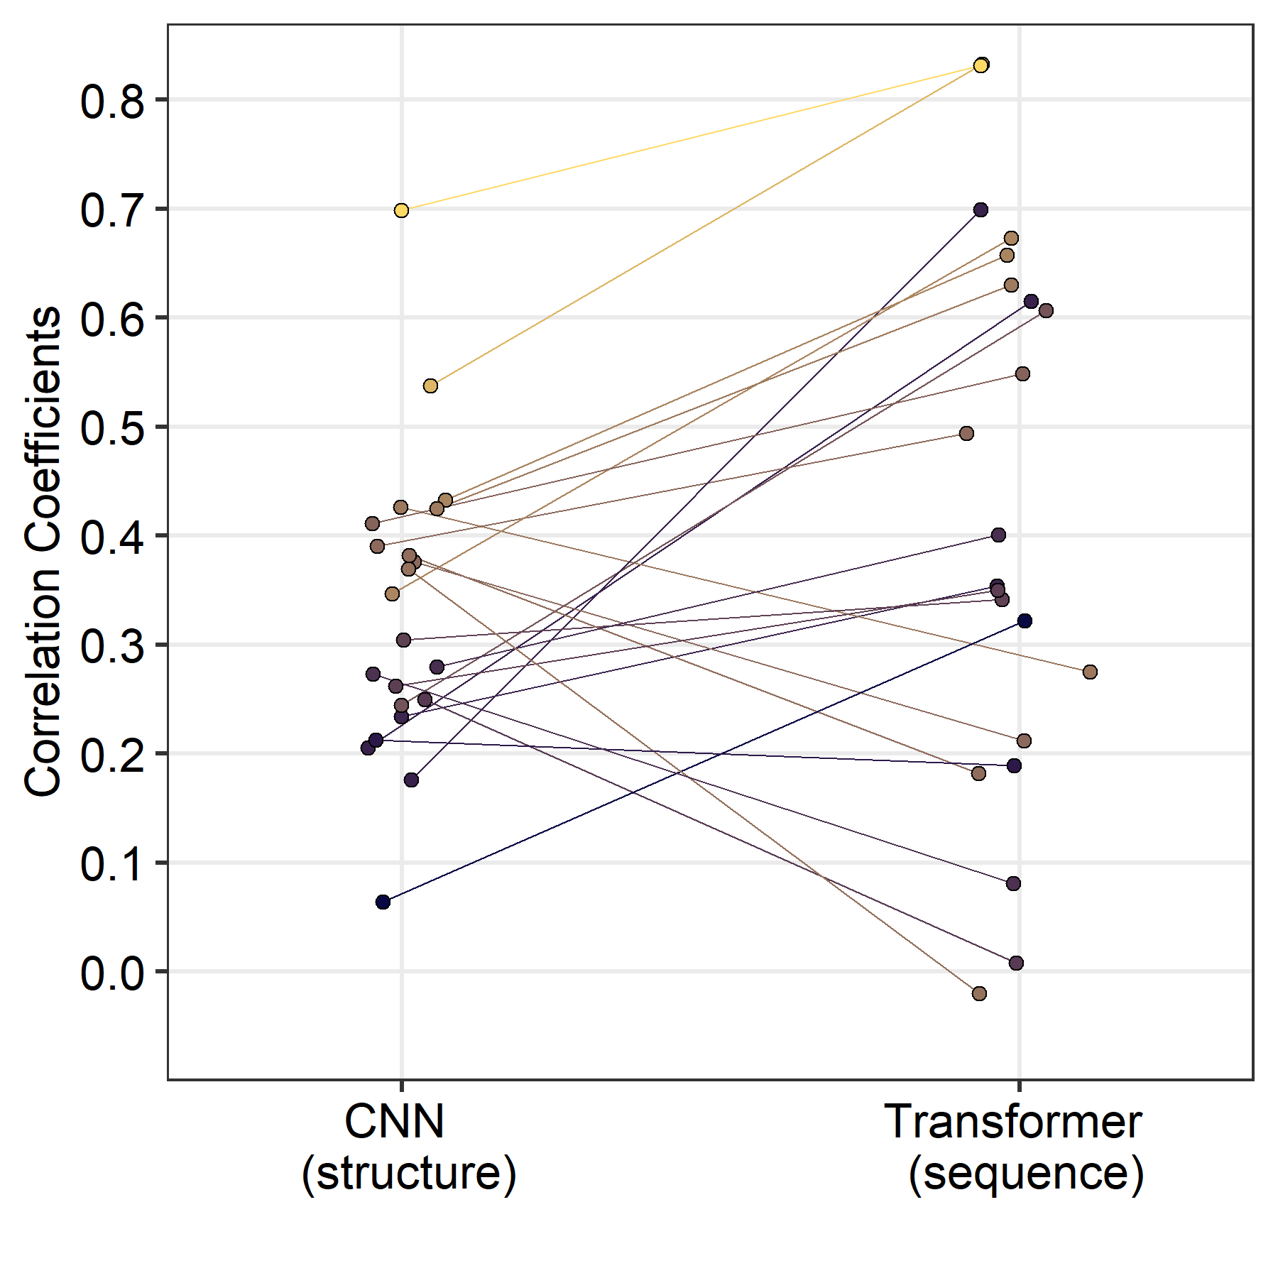
Comparing ability to recapitulate natural variation (n-eff)
between CNN and transformer across 23 PSICOV proteins
Mean: 0.325
Mean: 0.404

