Slide 1
Anastasiya Kulikova
July 16, 2021

Slide 2
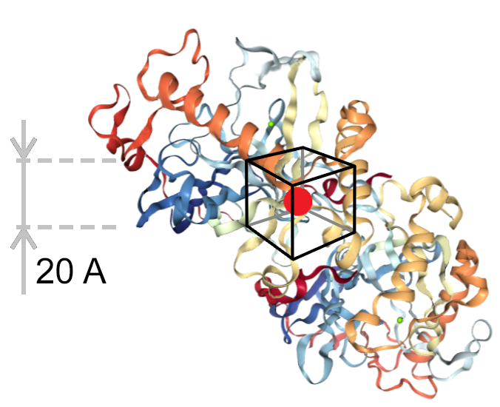
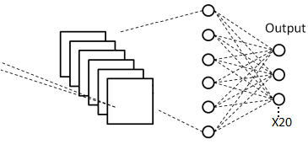
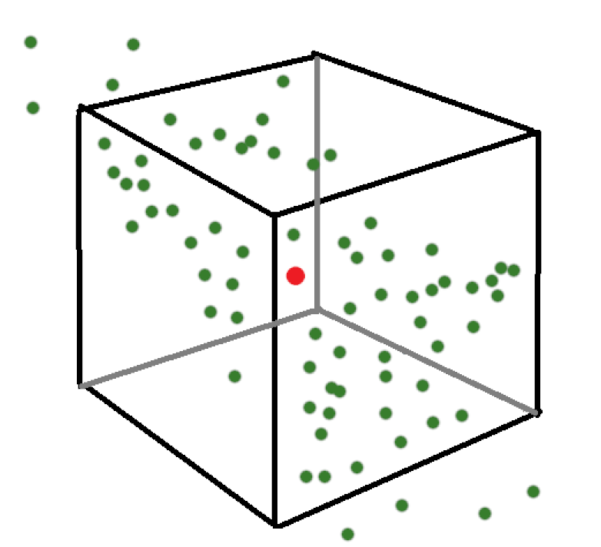
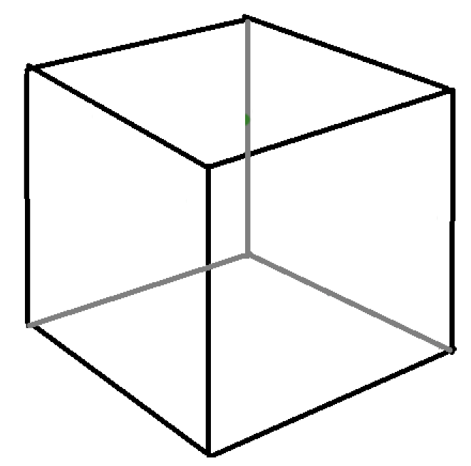
A CNN that can predict a focal amino acid given
the surrounding cube environment.
Shows promise for protein engineering: how does the chemical context of residues impact their exchangeability?
Output
x1,700,000
x20

Slide 3

Definitions:
Wild type amino acid- the amino acid that was originally in the structures.
CNN confidence- the probability assigned to each amino acid by the network.
Prediction for residue 5 in protein “1b4t”:
A = 0
V = 0
R = 0.9
L = 0.1
P = 0
High CNN confidence (0.8-1.0)
Very low CNN confidence (0-0.2)
x20

Slide 4
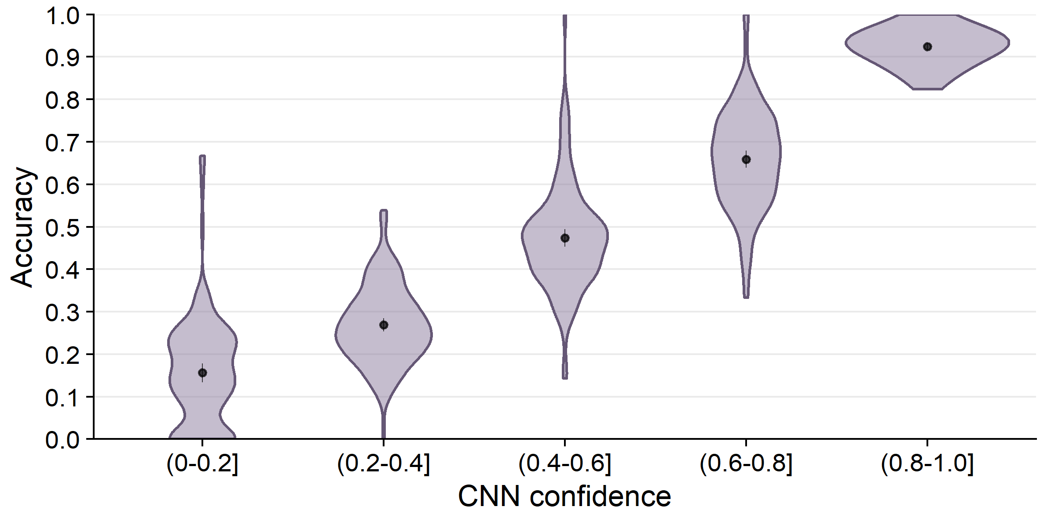
CNN prediction probability is a good predictor of accuracy in predicting the wild type amino acid.

Slide 5
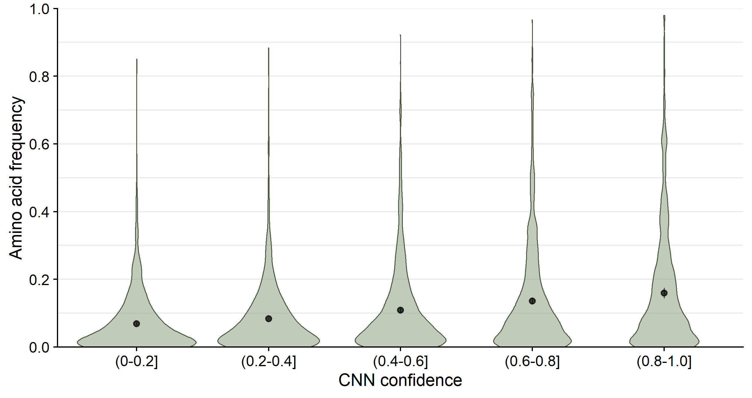
Mispredicted amino acids are not abundant in nature even when predicted at high CNN probability.

Slide 6
Looking at high confidence predictions only (0.8-1.0], what amino acids is the network best at predicting and are these amino acids types often conserved in nature?

Slide 7
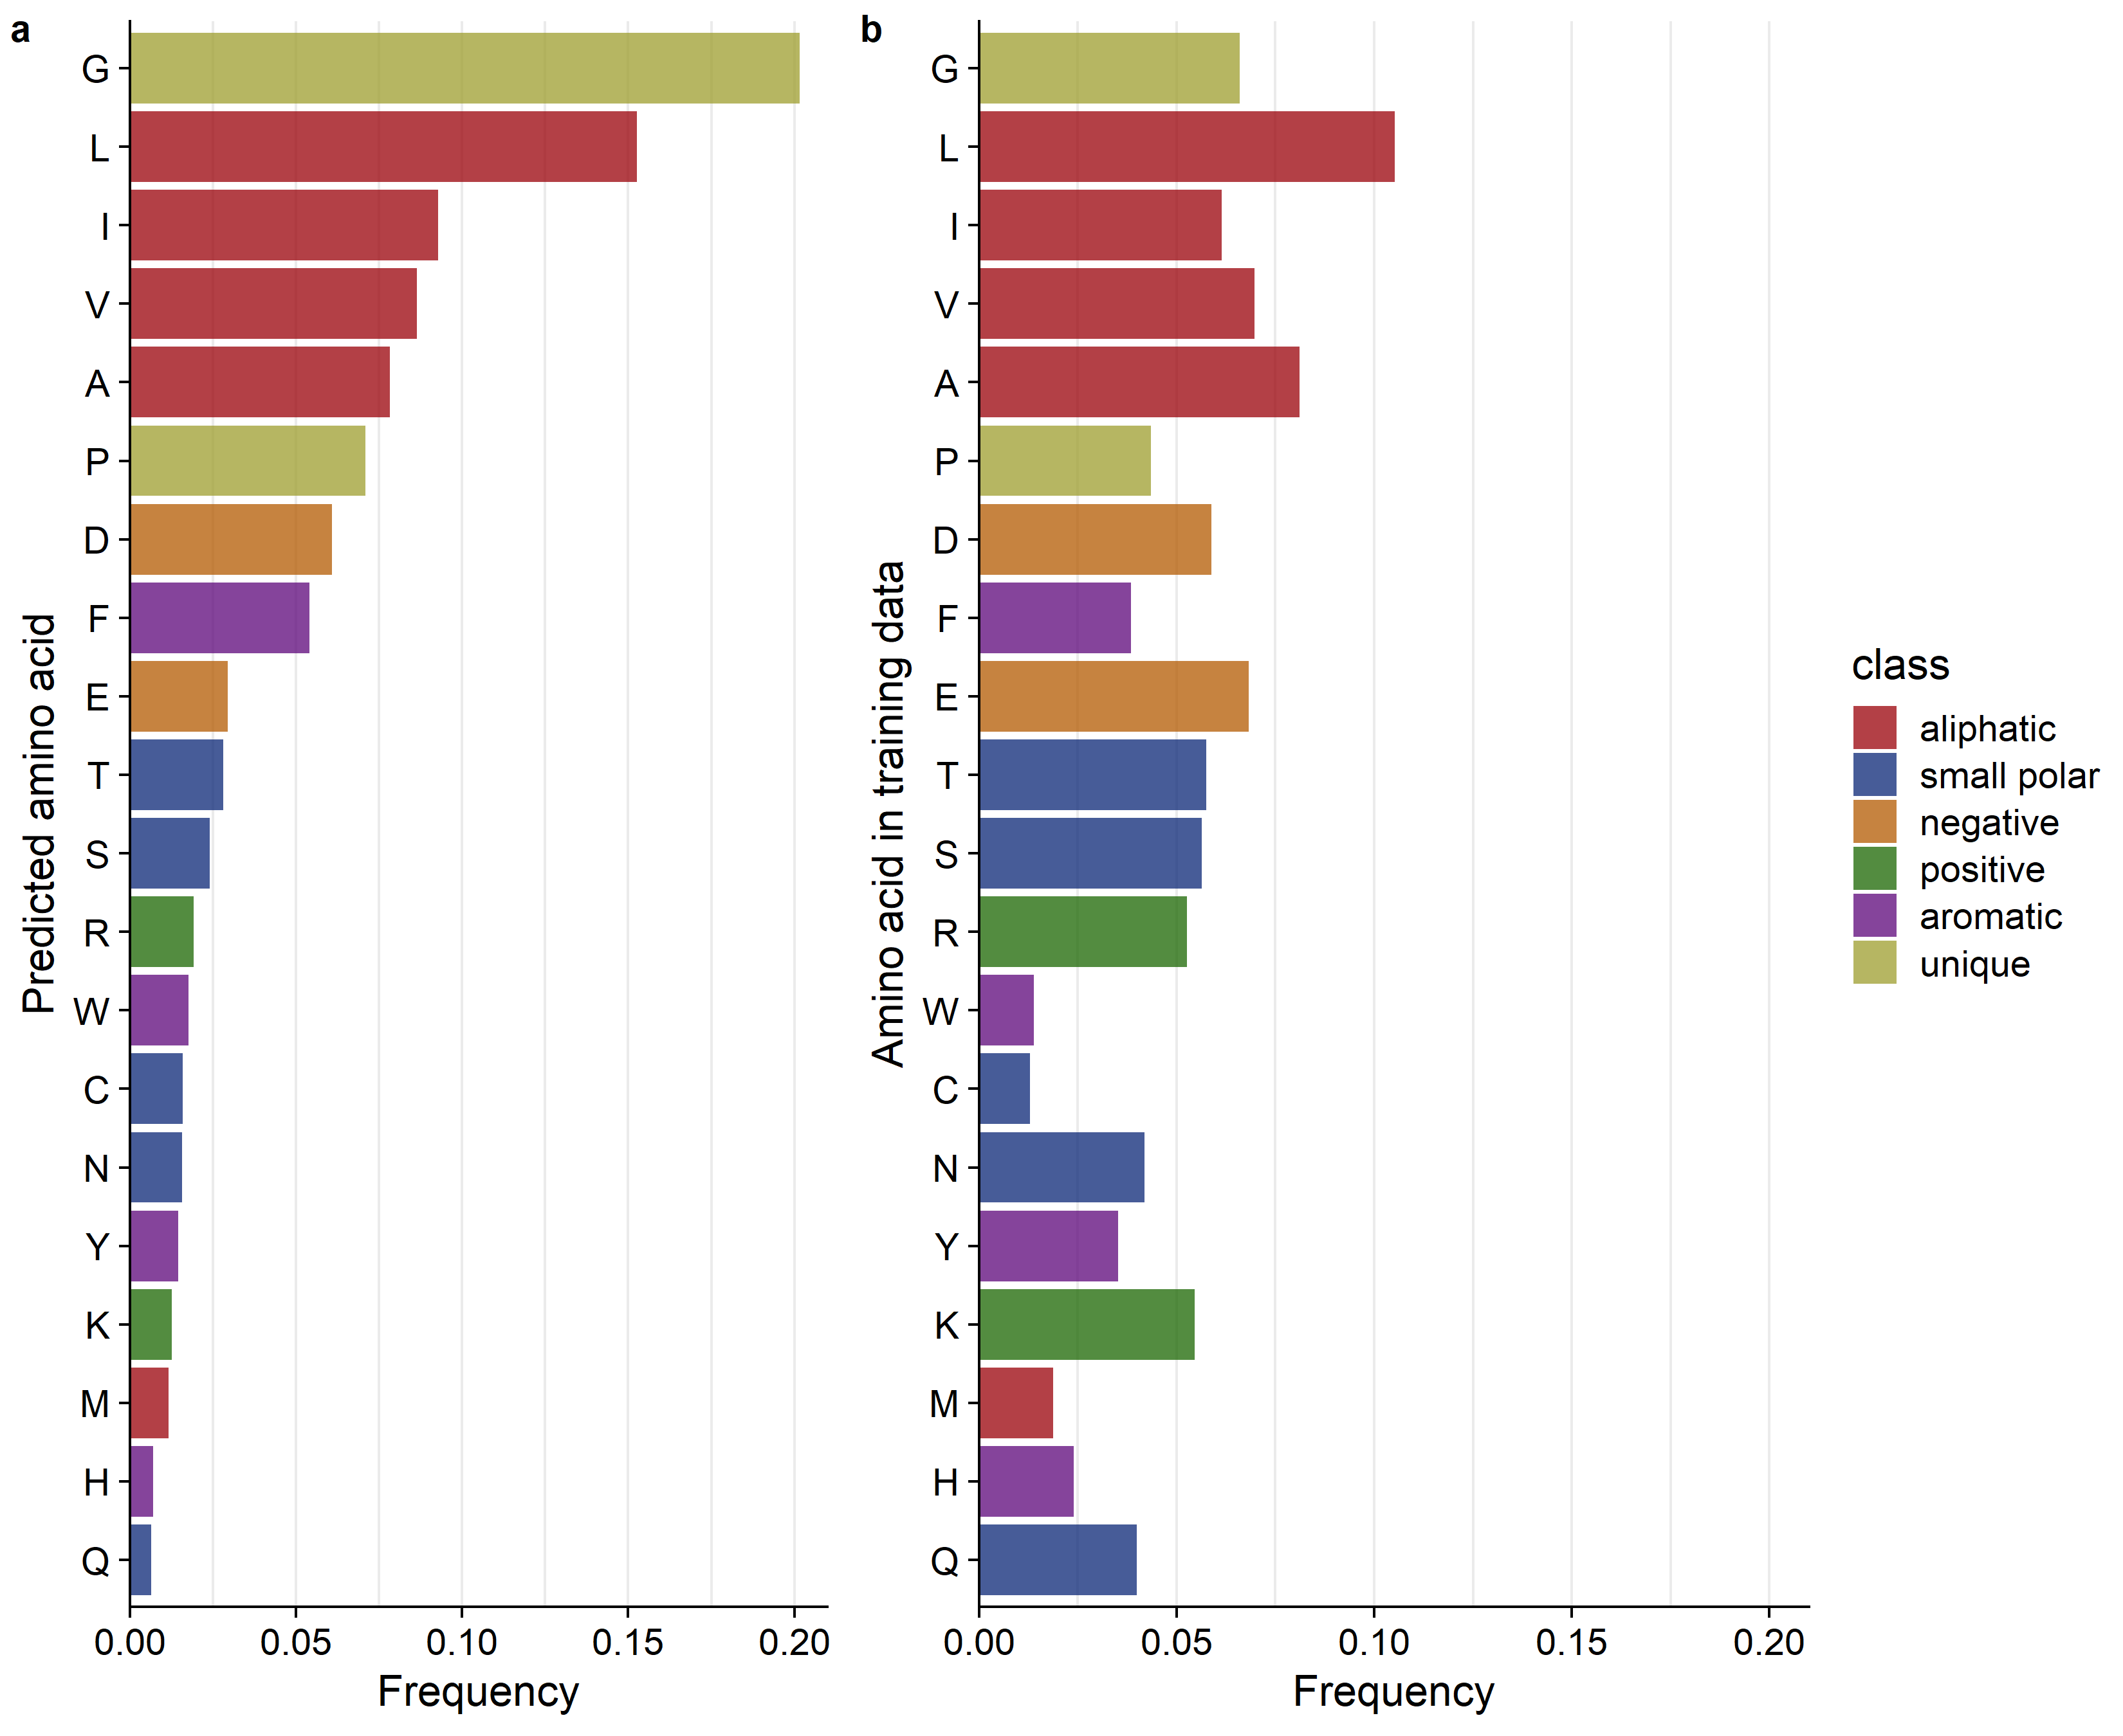
We wanted to see what amino acids is the network best at predicting.
We used sites where network predicted amino acids with
(0.8-1.0] prob. (high confidence)

Slide 8
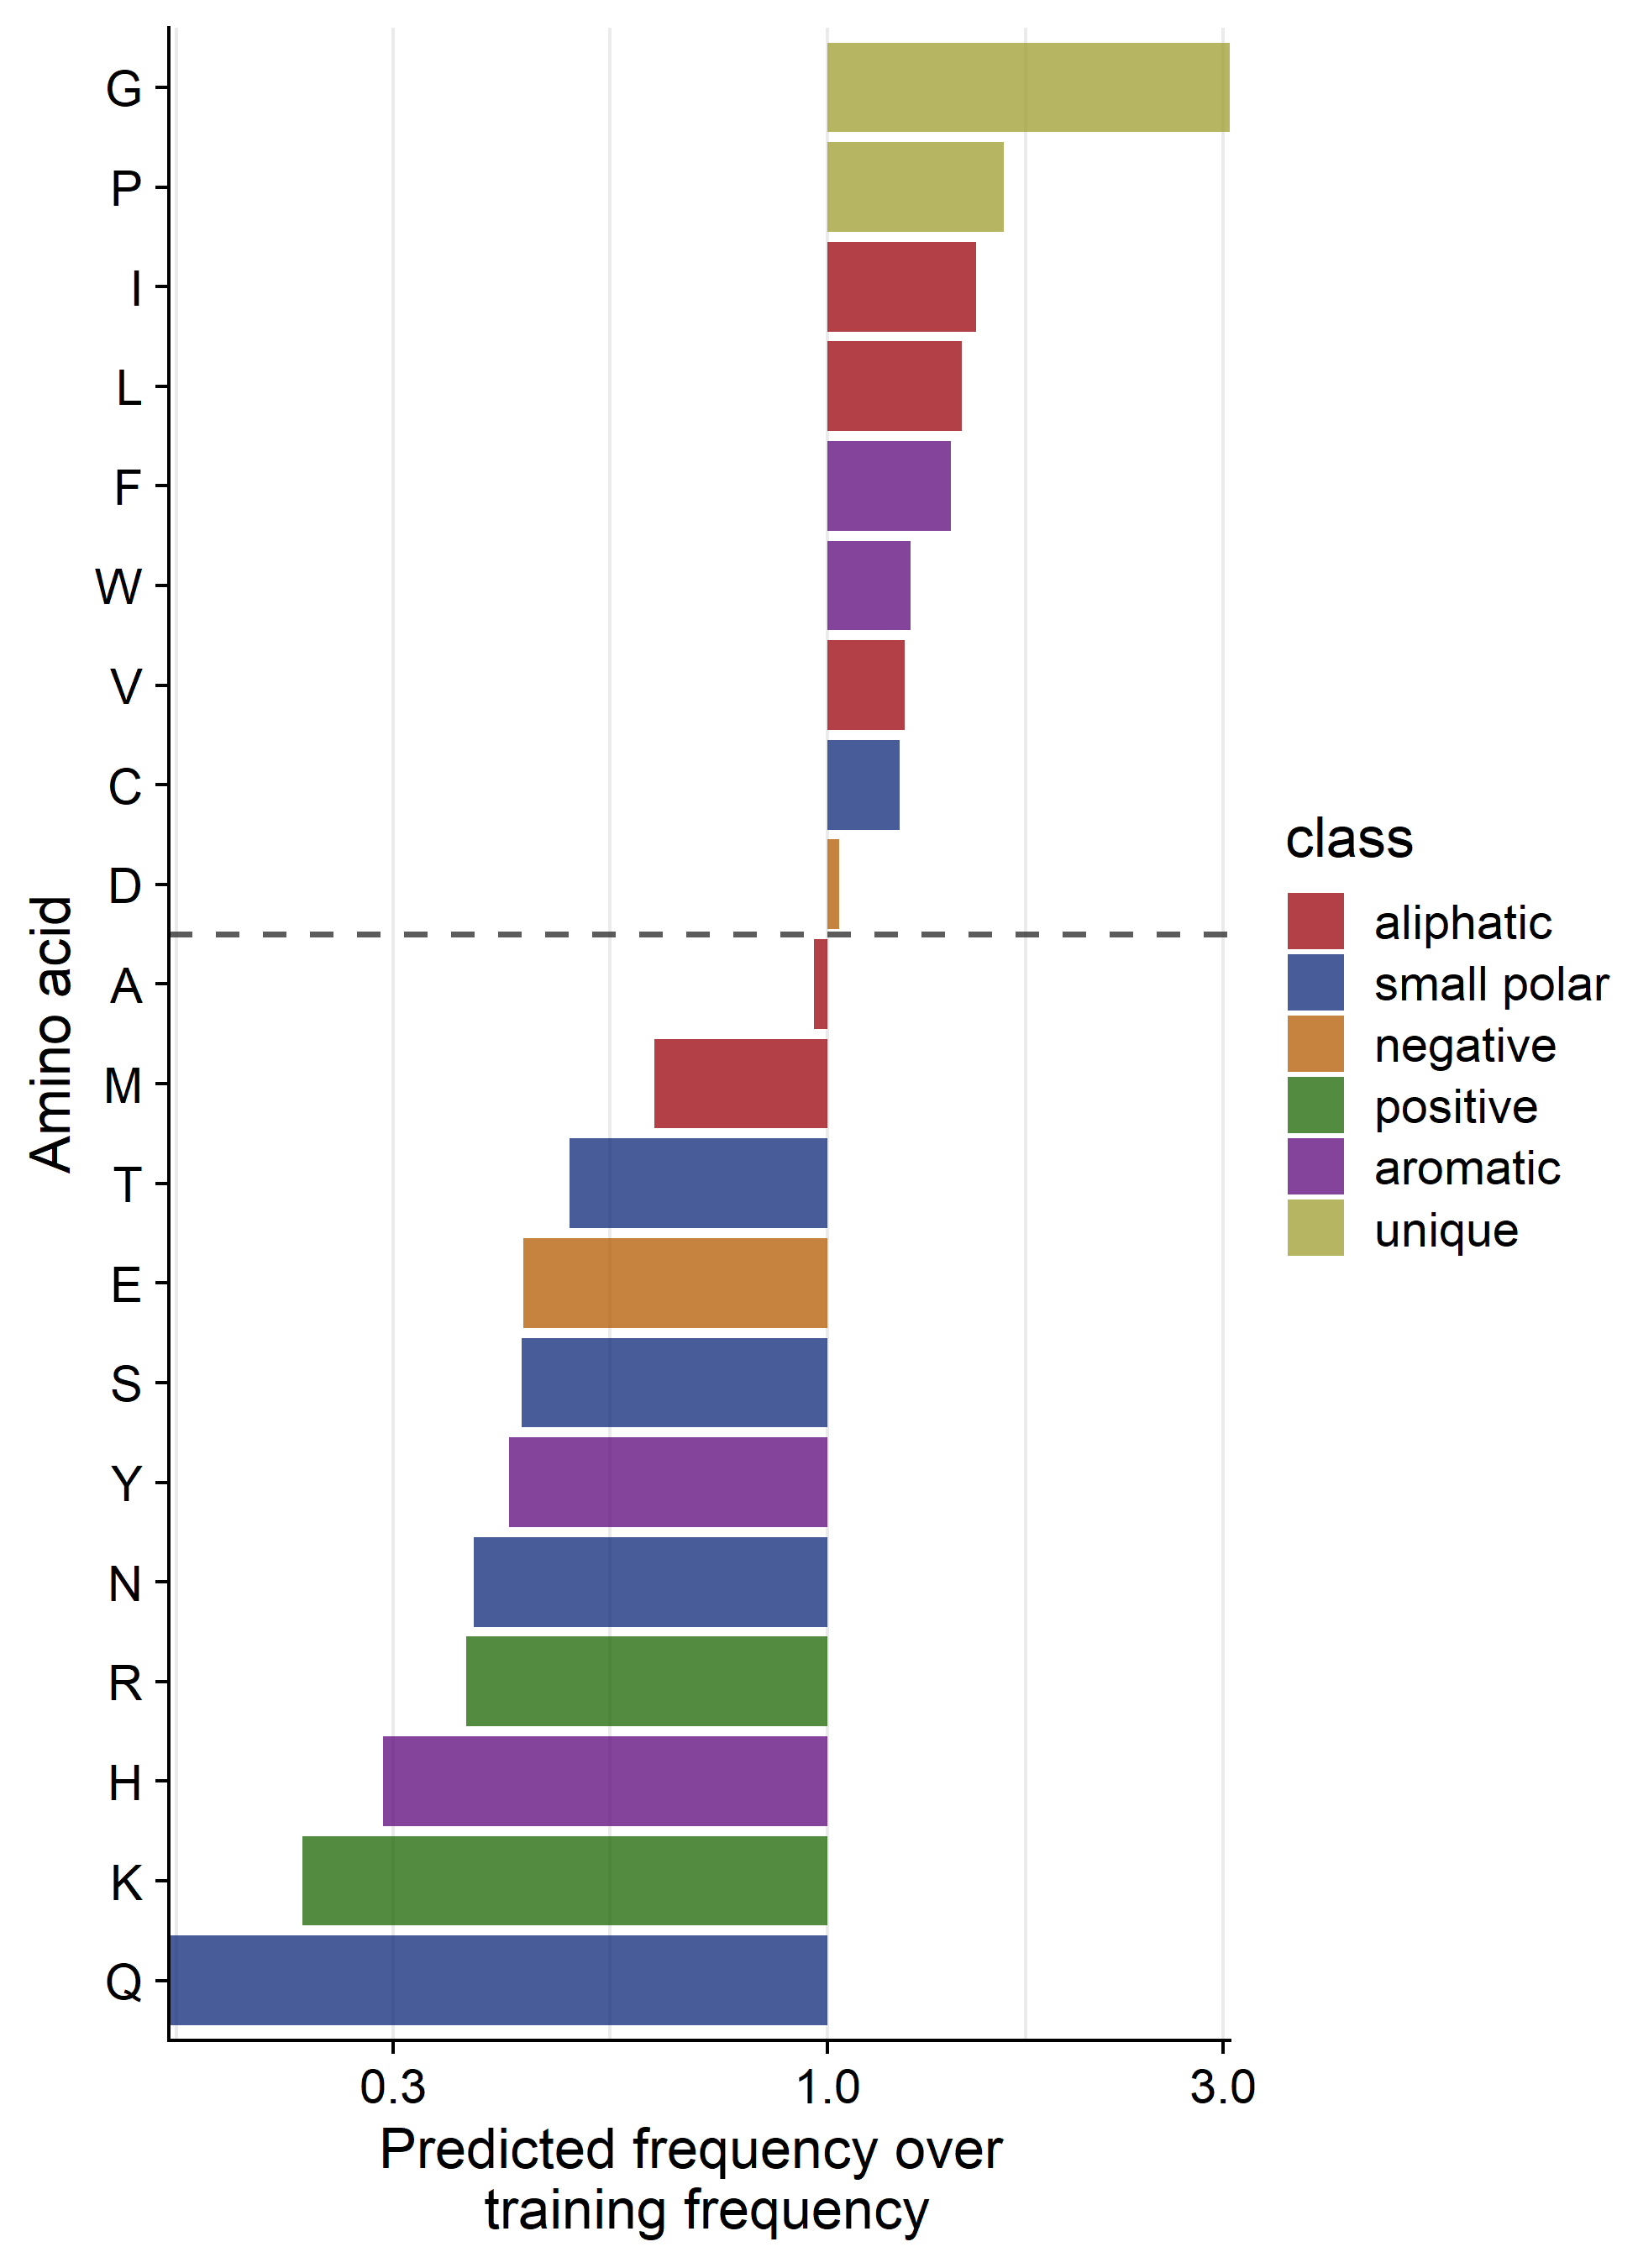
Network is best at predicting hydrophobic amino acids.

Slide 9
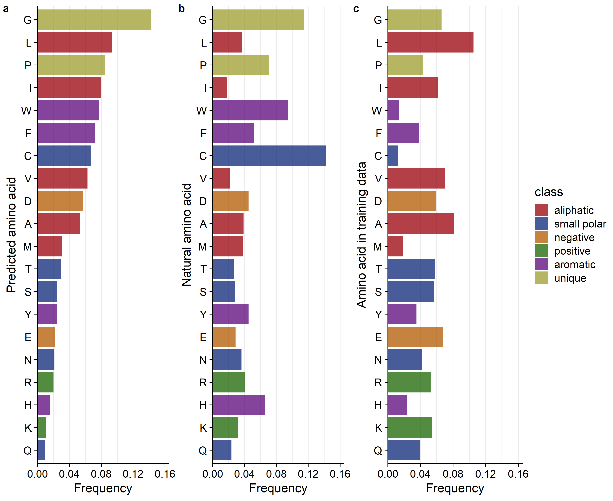
Network is best at predicting hydrophobic amino acids.

Slide 10
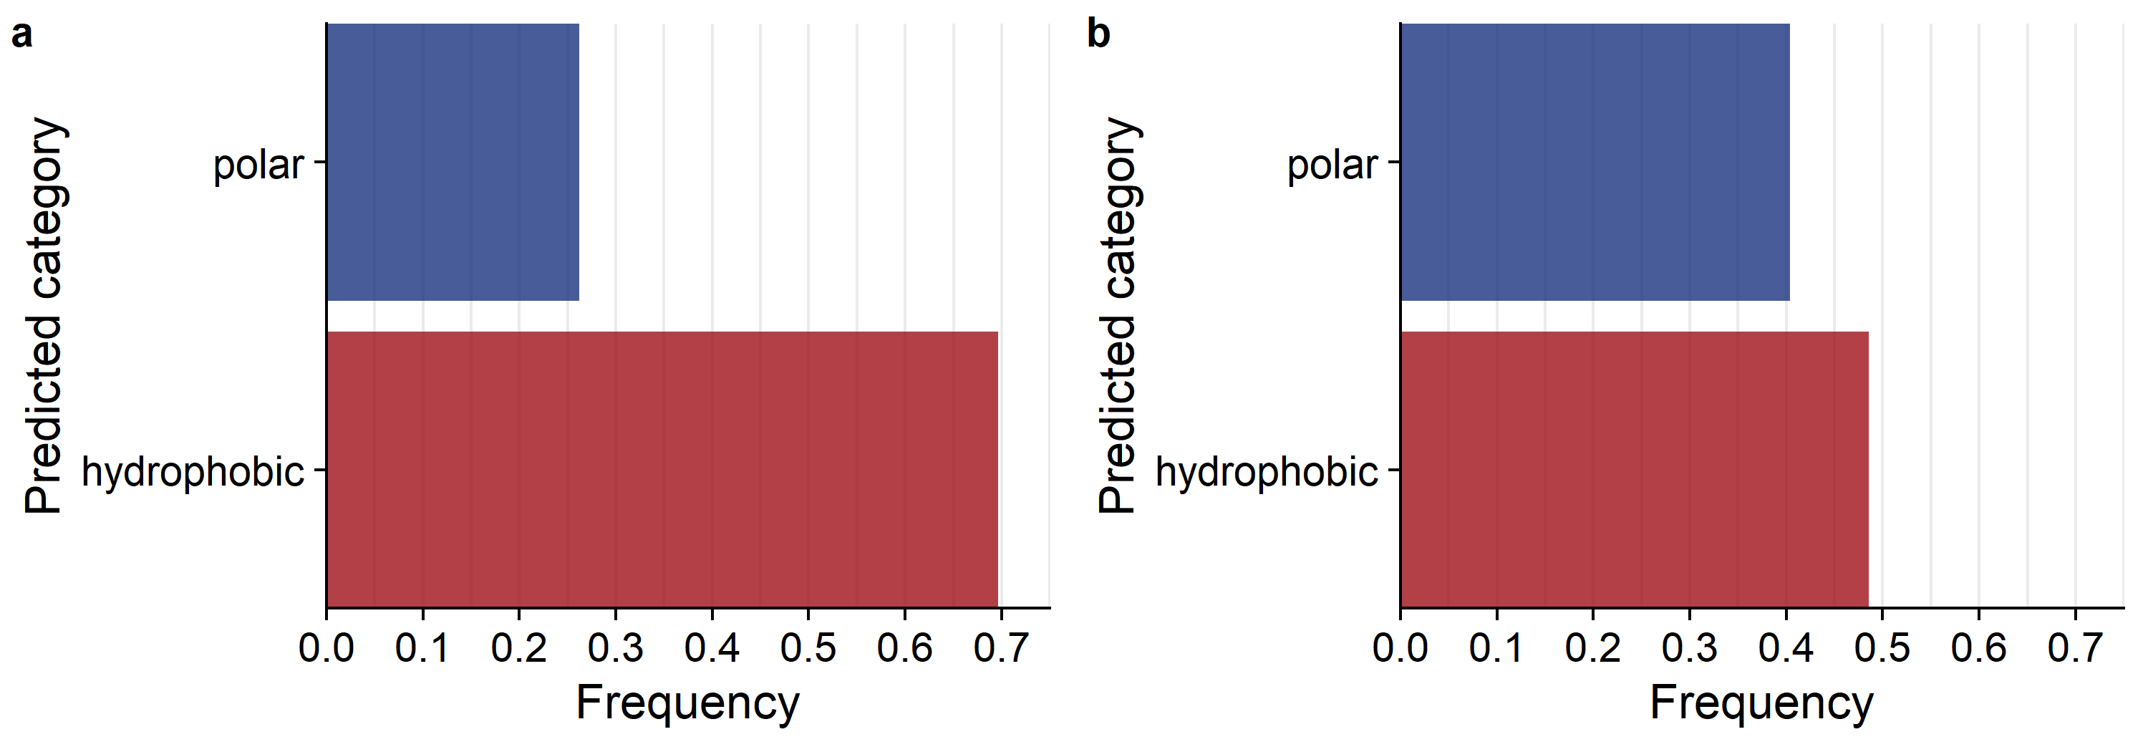
Network is best at predicting hydrophobic amino acids.
Sum of predicted frequencies:
Sum of natural frequencies:
Hydrophobic amino acids (9):
"G", "P", "I", "A", "V", "L", "F", "M", "W"
Polar amino acids (9):
"C", "S", "T", "N", "Q", "D", "E", "R", "K")

Slide 11
Looking at mispredictions: what wild type amino acids tend to be mispredicted and where are mispredictions found in the protein structure?

Slide 12
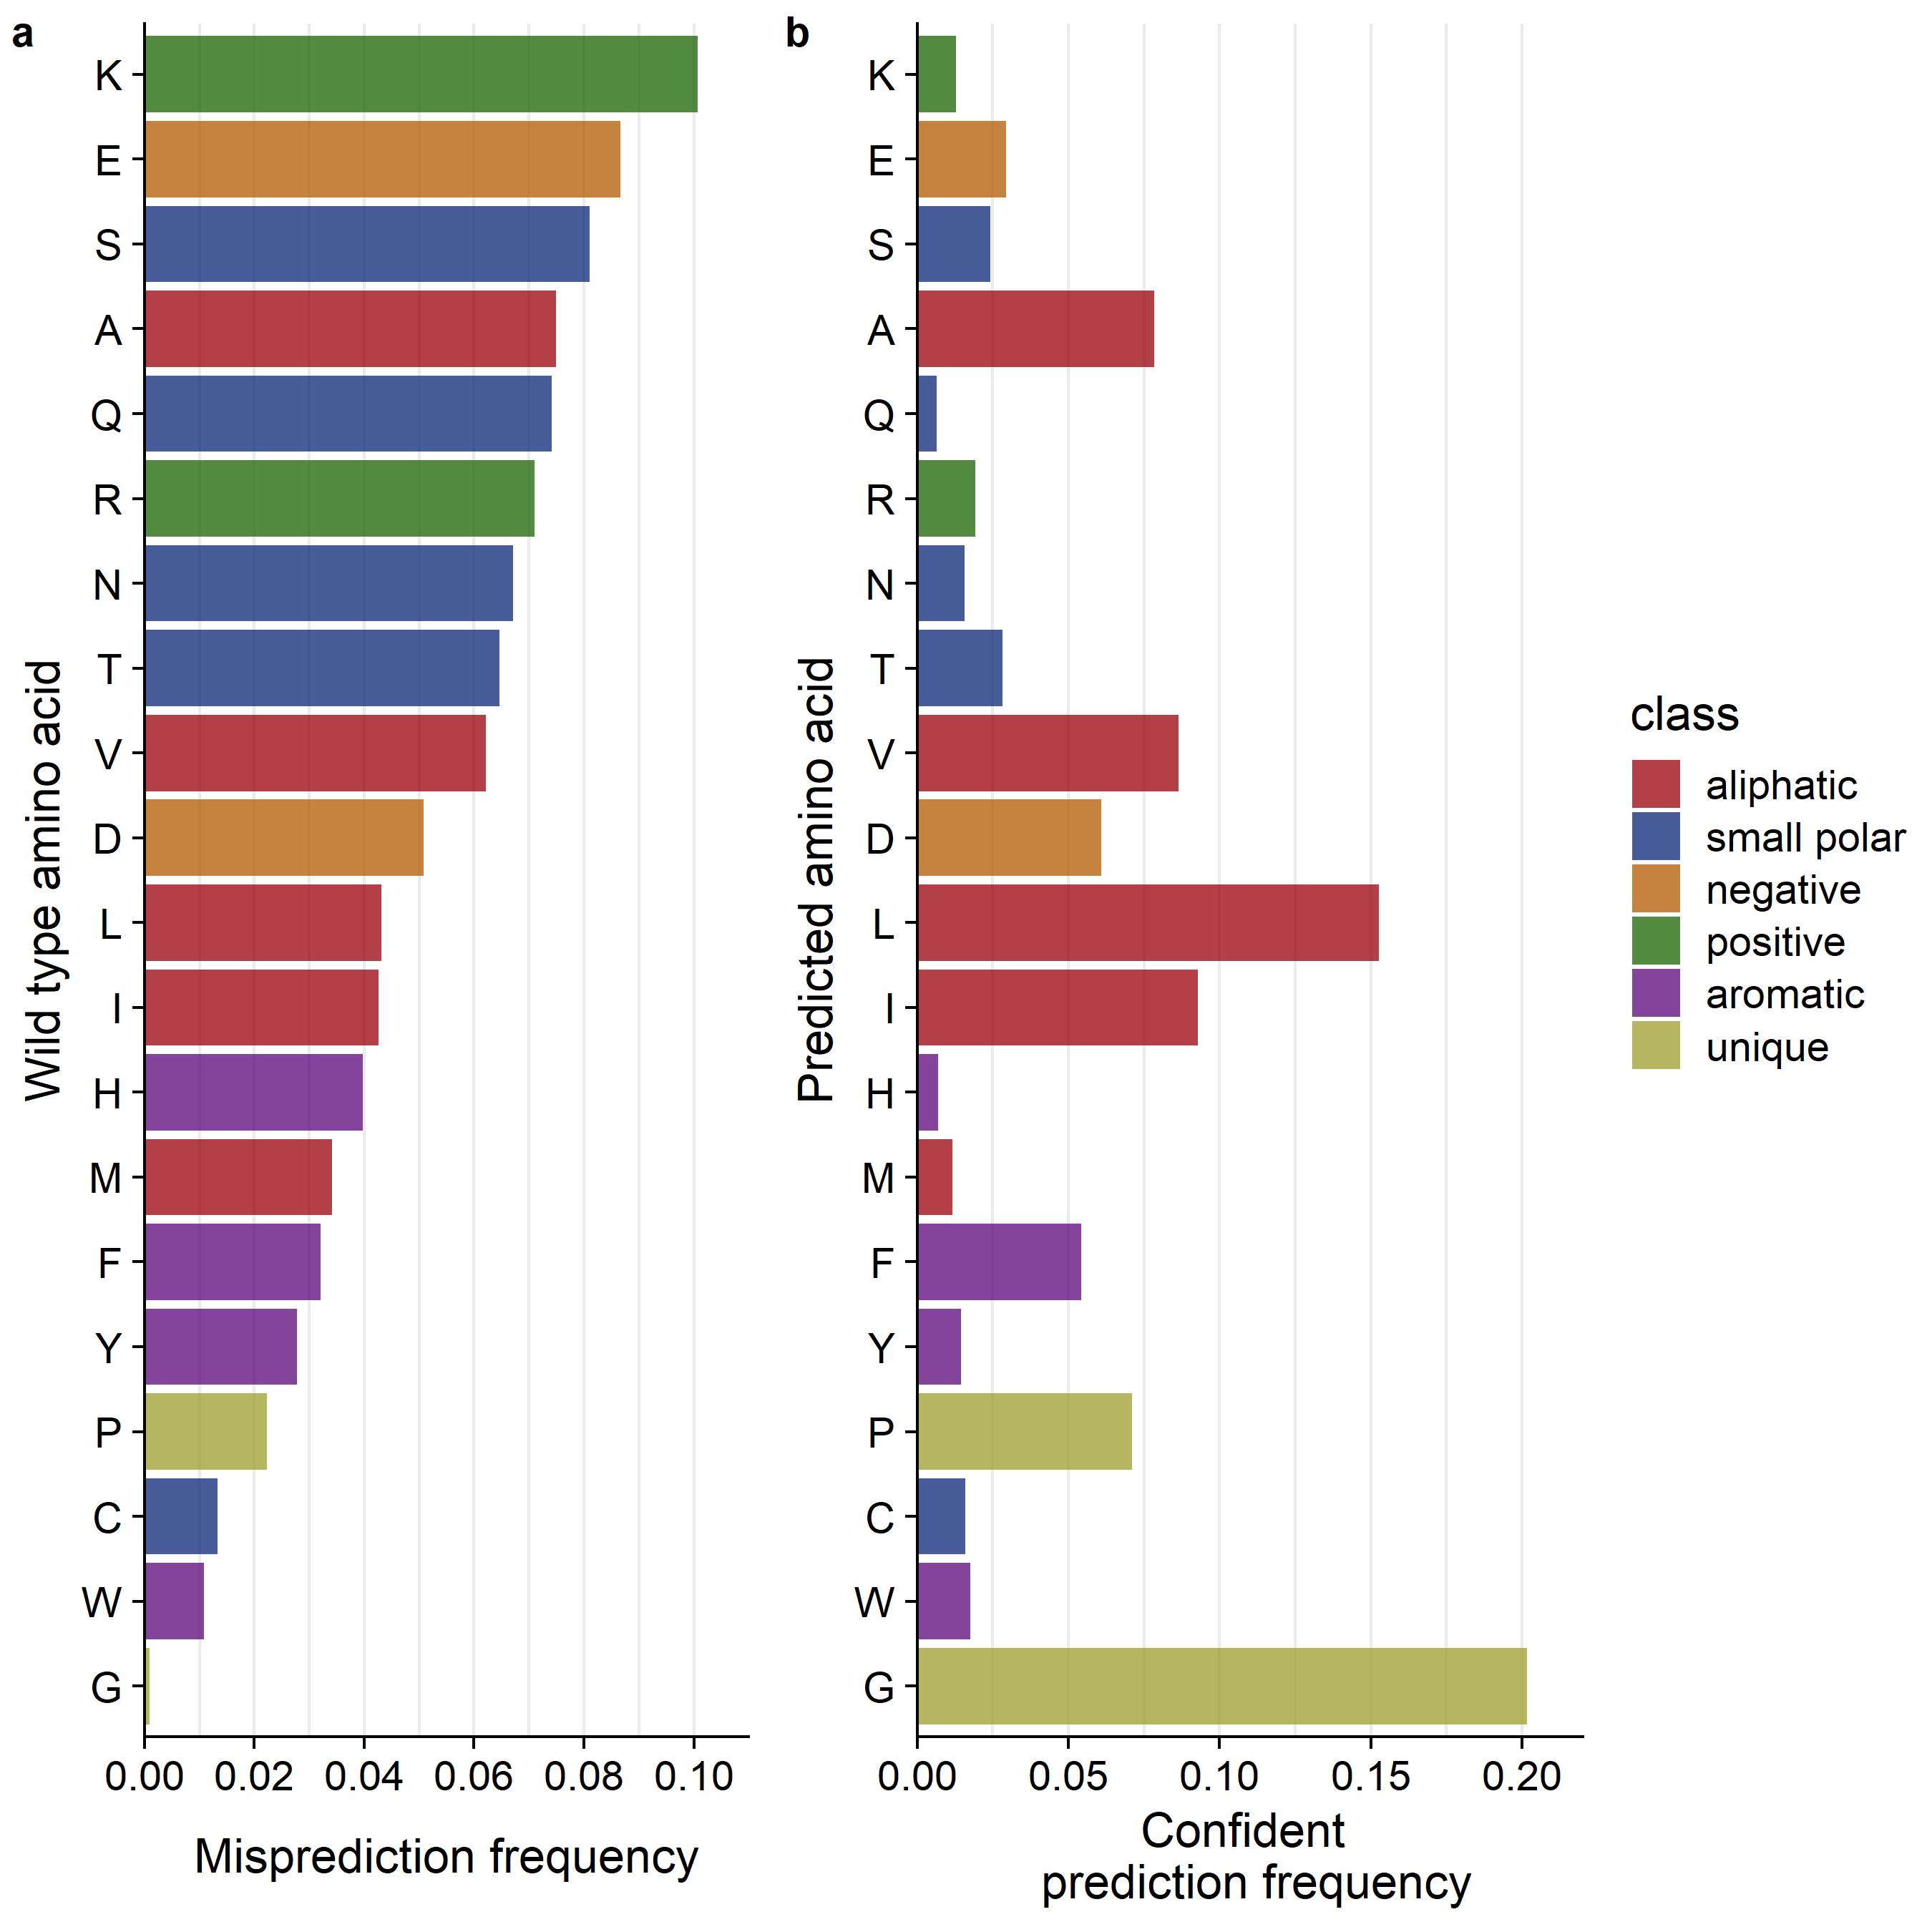
The most frequently mispredicted amino acids are least likely to be predicted with high confidence.
(7,356 mispredictions)
Confident prediction means predicted with a probability of (0.8-1.0]

Slide 13
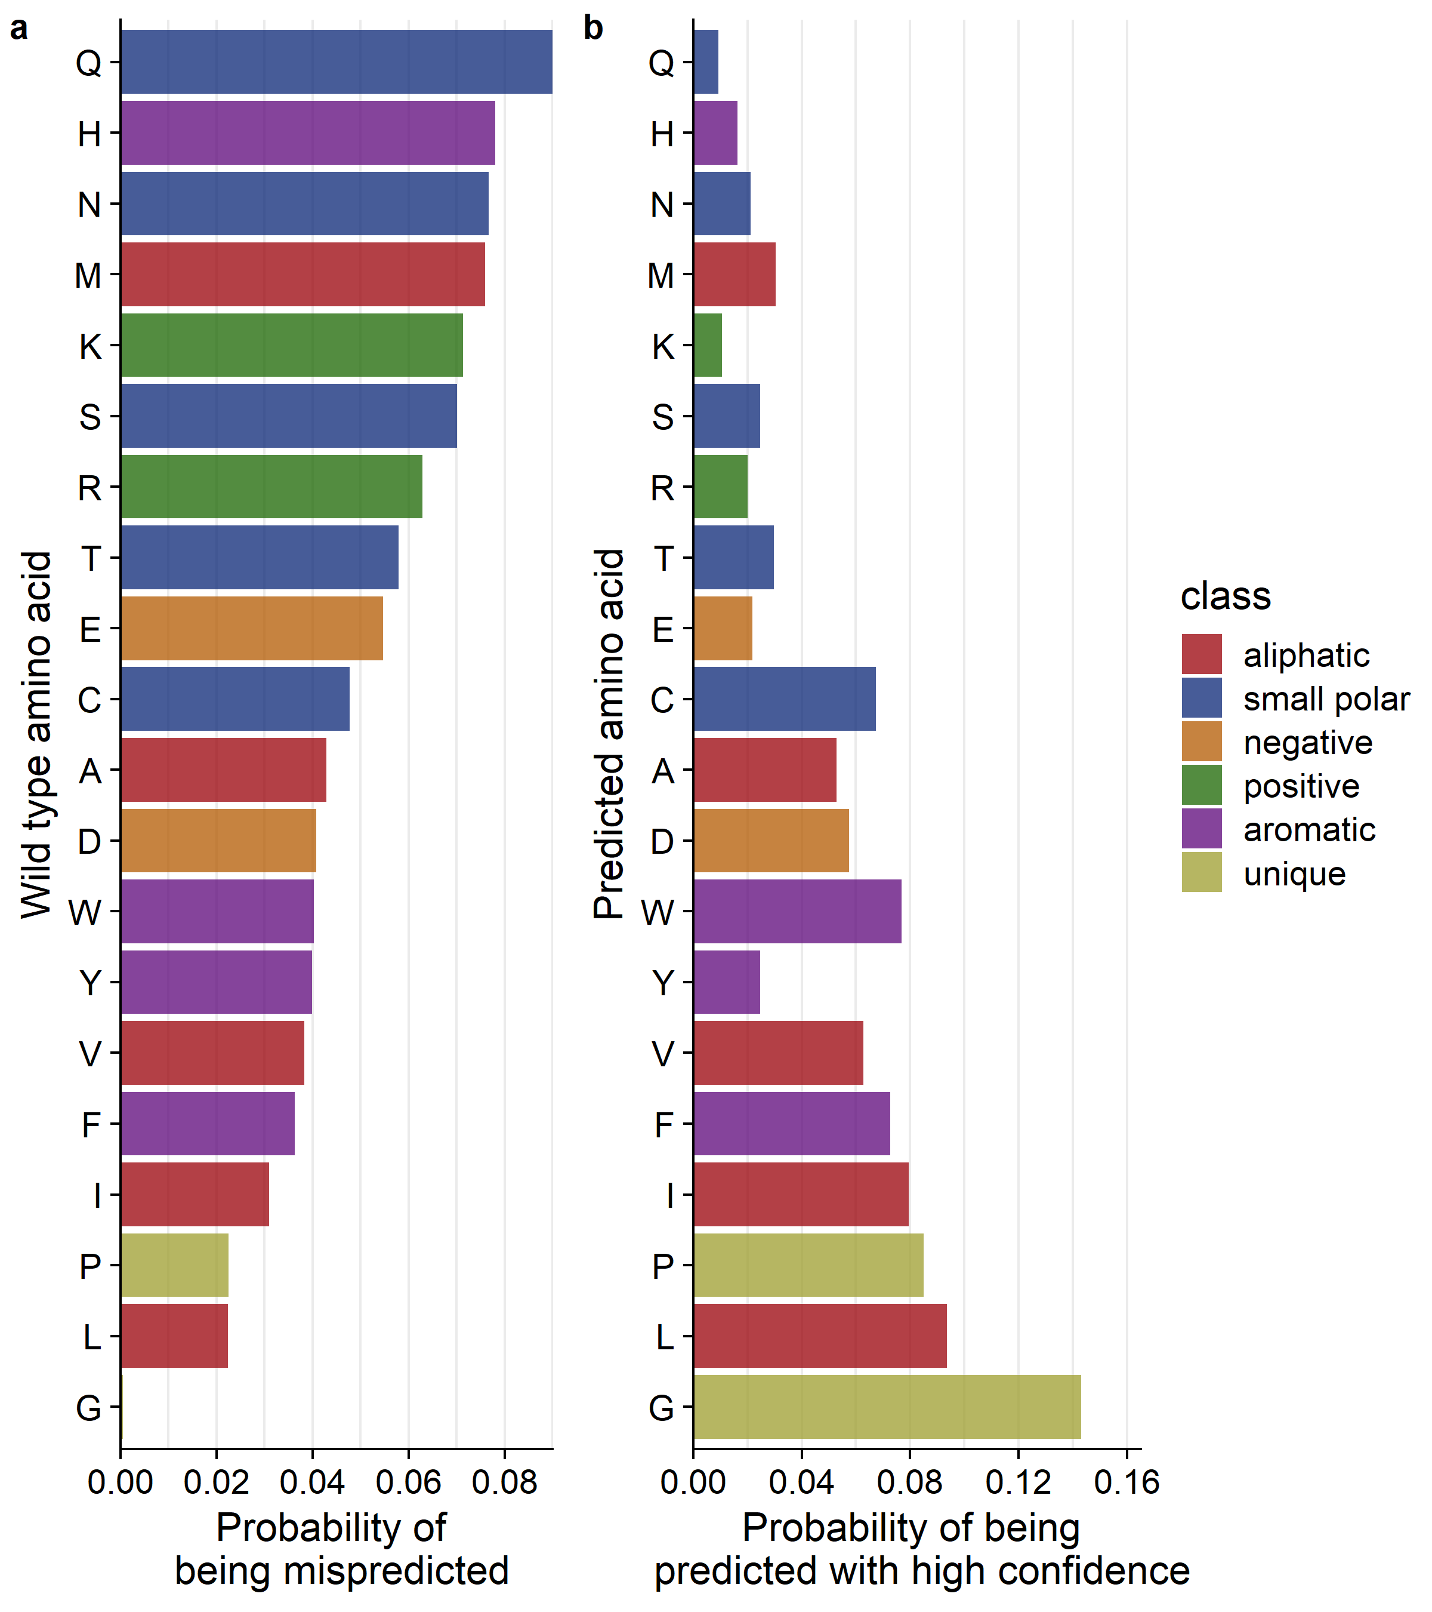
The most frequently mispredicted amino acids are least likely to be predicted with high confidence.
High confidence means predicted with a probability of (0.8-1.0]
High confidence predictions
7,356 mispredictions

Slide 14
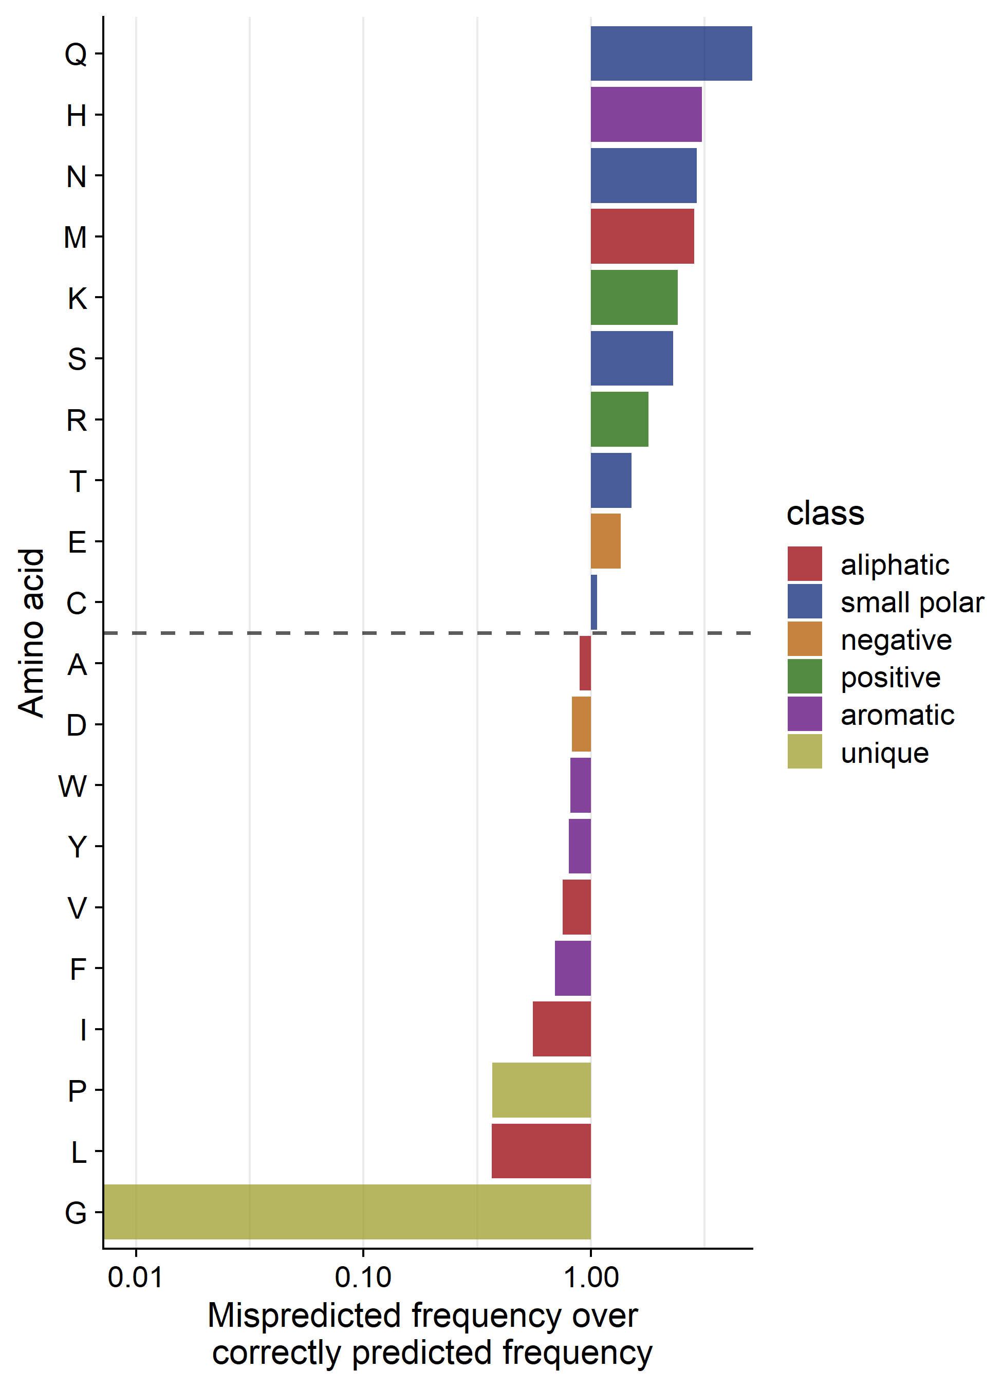
Charged/polar amino acids, Histidine and Methionine are mispredicted more often than correctly predicted.
(7,356 mispredictions)
High confidence means predicted with a probability of (0.8-1.0]

Slide 15
Does the network predict certain secondary structures better than others?

Slide 16
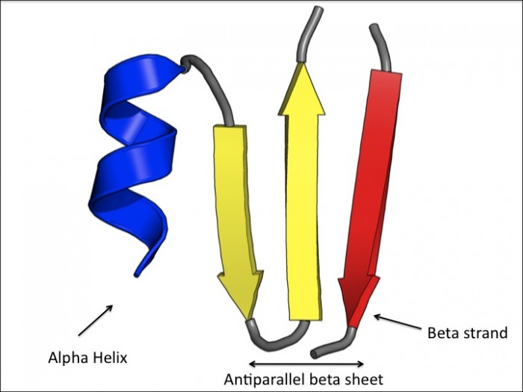
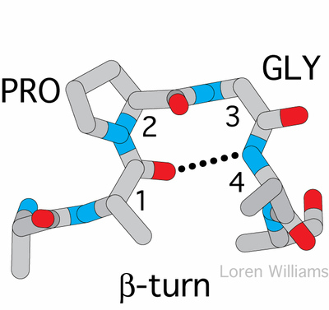
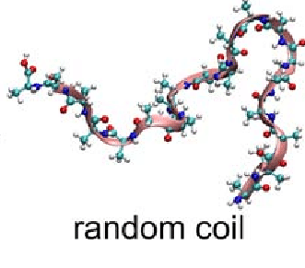
We annotated all protein positions with secondary structure.
Alpha helices
Beta strands
Random coils
Turns
Noncanonical helices
Bridge

Slide 17
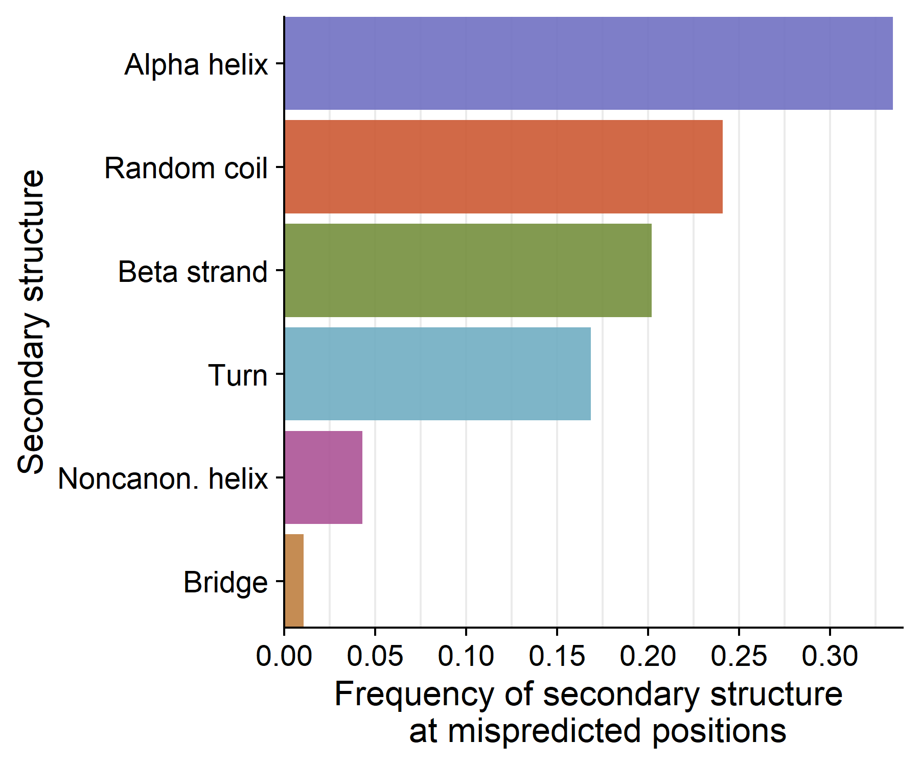
Over a third of mispredictions occur in Alpha helices, in second place are random coils and beta strands.
(7,356 total mispredictions out of 18,487 positions)

Slide 18
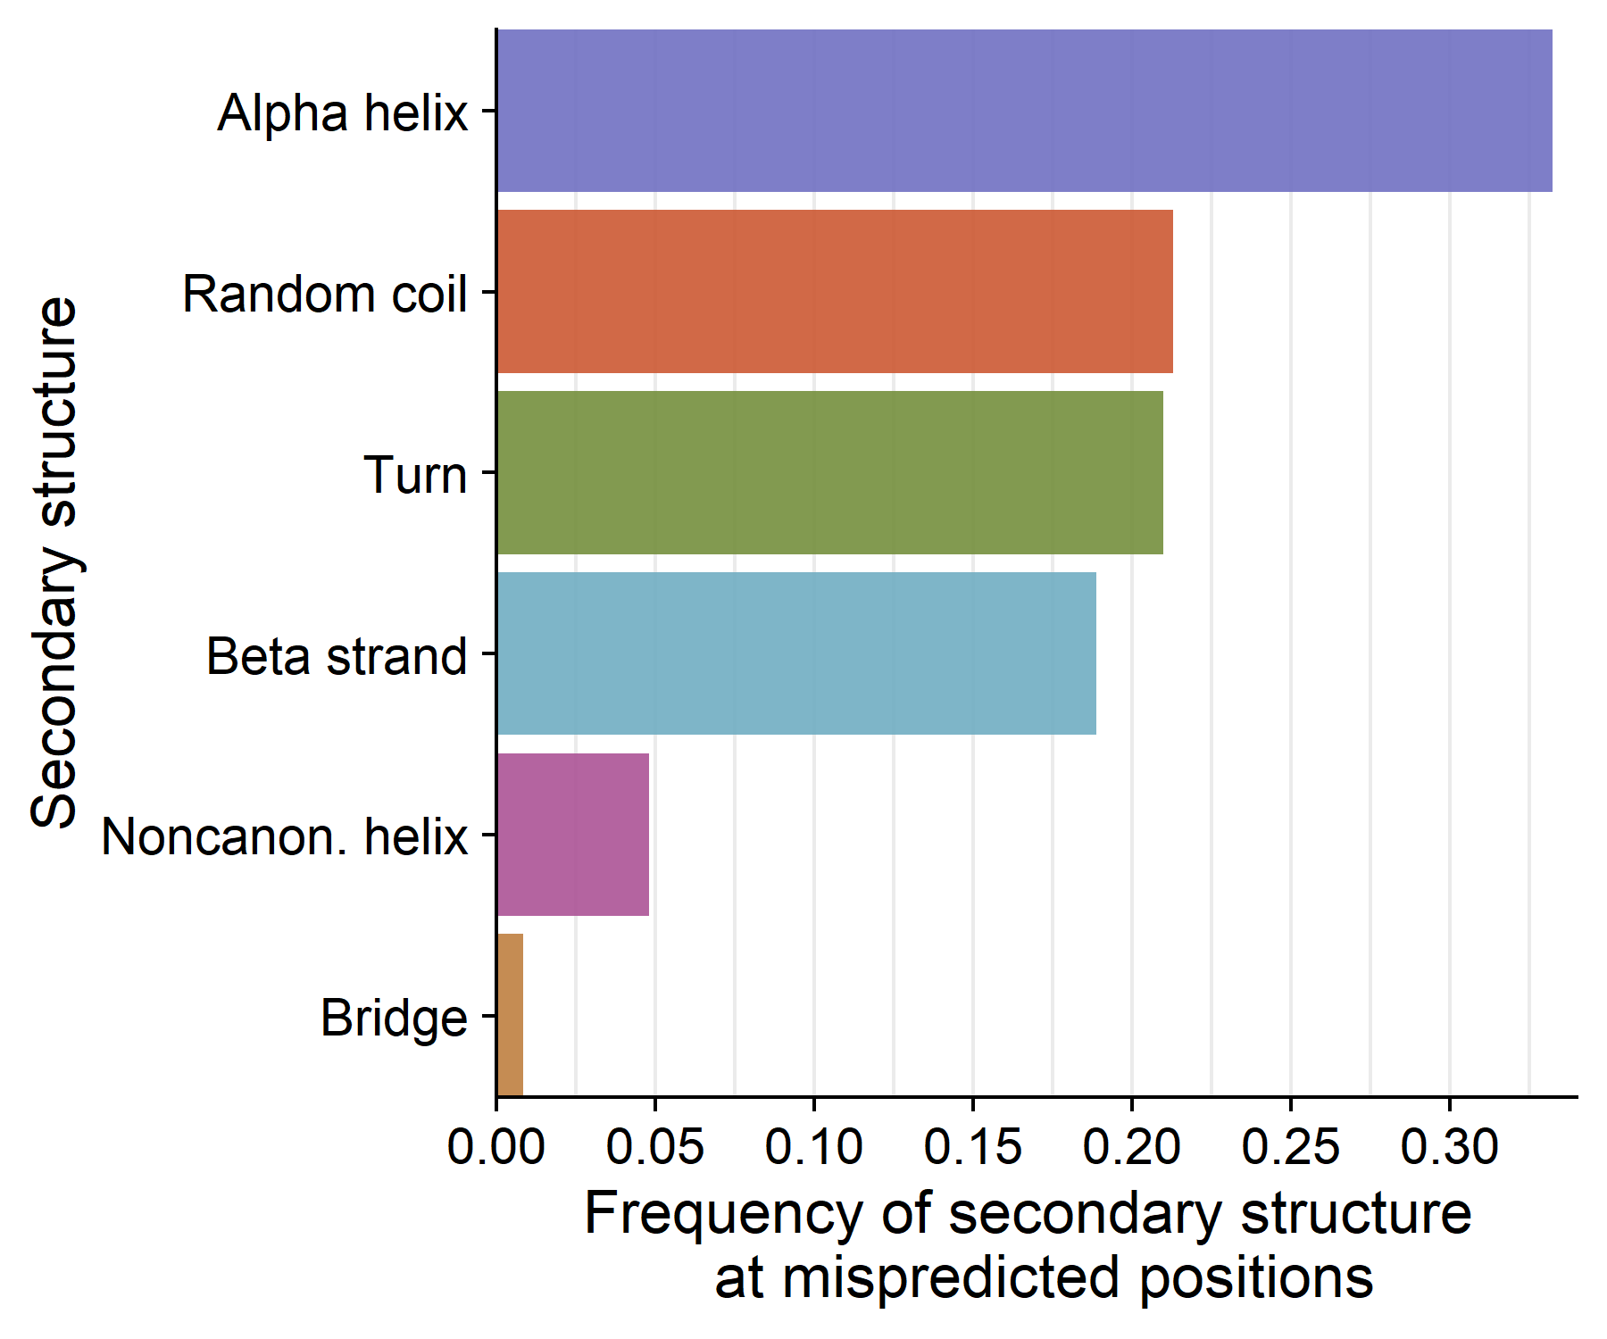
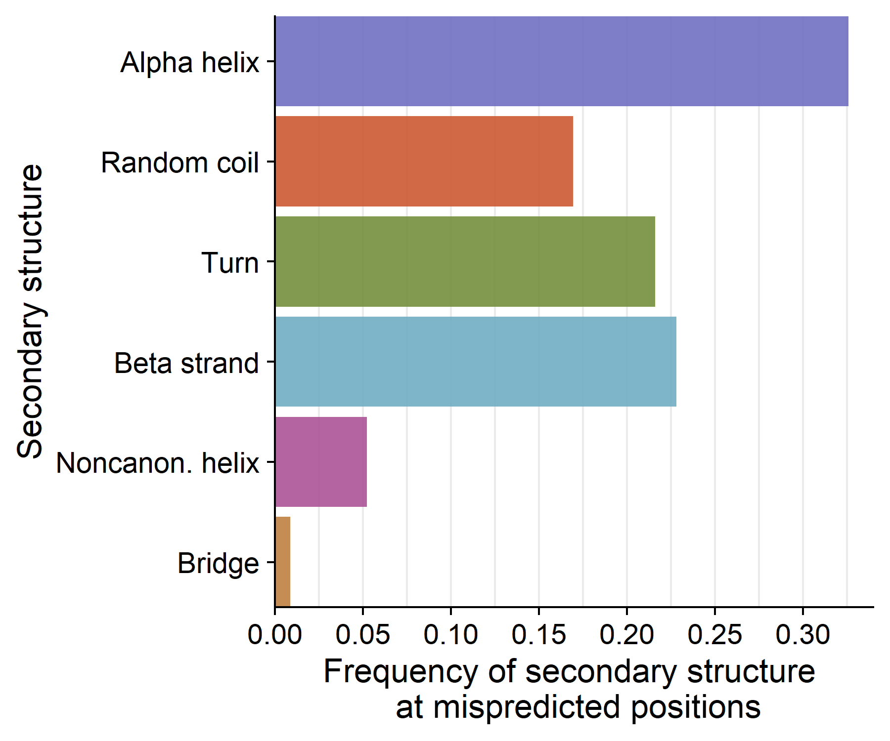
Mispredictions are scattered across all secondary structures regardless of the wild type probability.
Wild type given <10% prob.
(3,874 out of 18,487 positions)
Wild type given <2% prob.
(921 out of 18,487 positions)

Slide 19
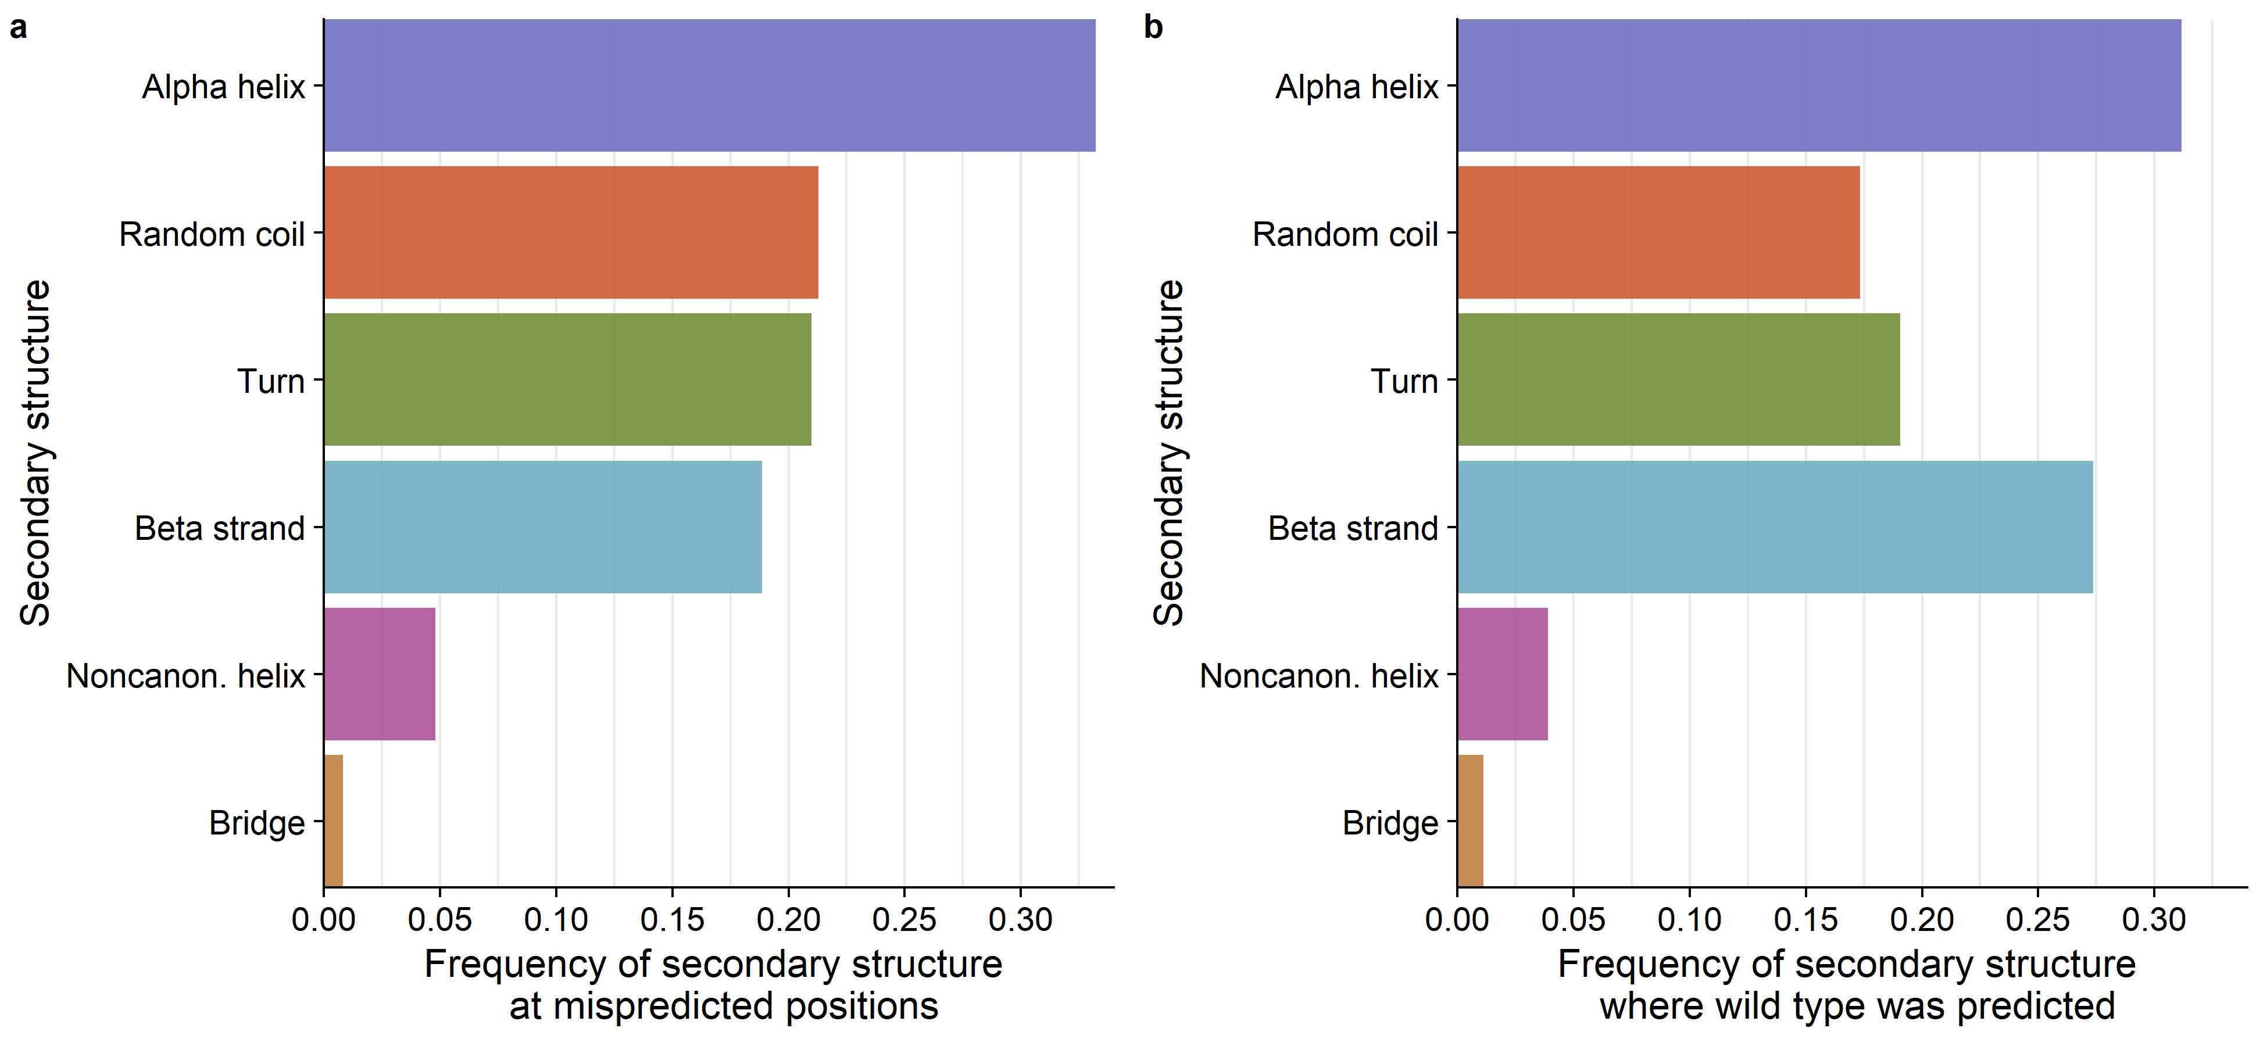
Distribution of 2º structure across mispredicted sites is similar to the distribution of 2º structure across correctly predicted sites.
Mispredictions:
(3,874 out of 18,487 positions)
Correct Predictions:
(~11,000 out of 18,487 positions)

Slide 20
Distribution of 2º structure across mispredicted sites is similar to the distribution of structure across correctly AND confidently (0.8-1.0 prob.) predicted sites.
Mispredictions:
(3,874 out of 18,487 positions)
Correct and confident Predictions:
(~11,000 out of 18,487 positions)

Slide 21
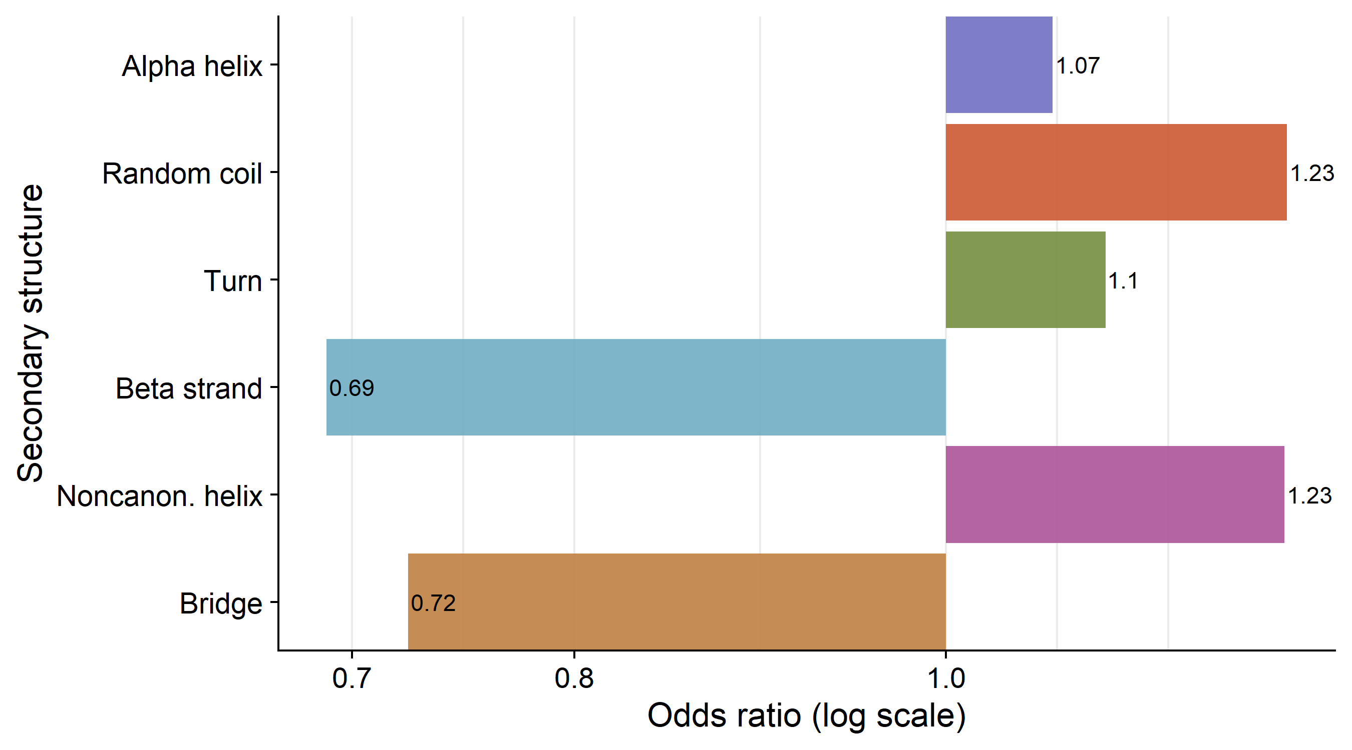
Mispredictions tend to appear in random coils and noncanonical helices more often than correct predictions.
3,874 total mispredictions out of 18,487 positions

Slide 22
Summary
CNN prediction probability is a reliable estimate of accuracy
CNN is better at predicting hydrophobic residues.

