Slide 1
Group Meeting Presentation
Anastasiya Kulikova
July 2, 2021

Slide 2
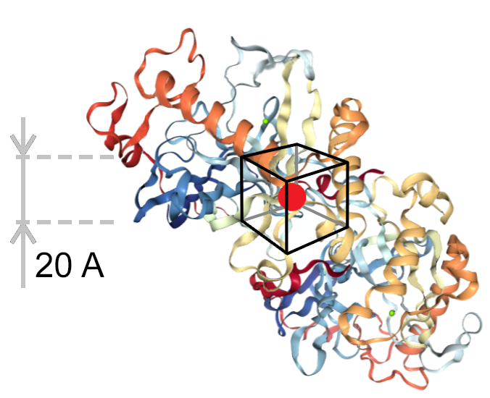
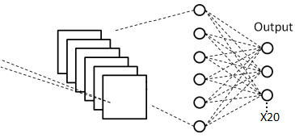
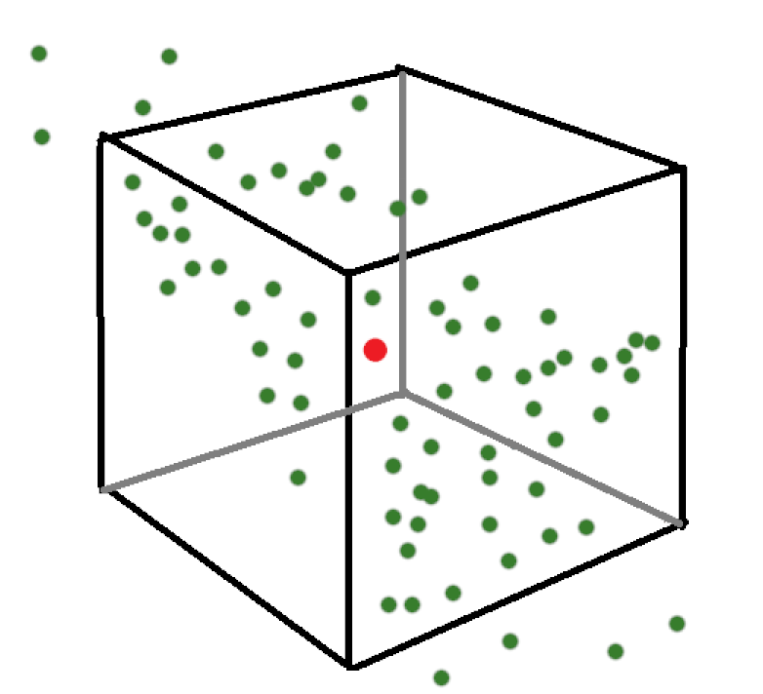
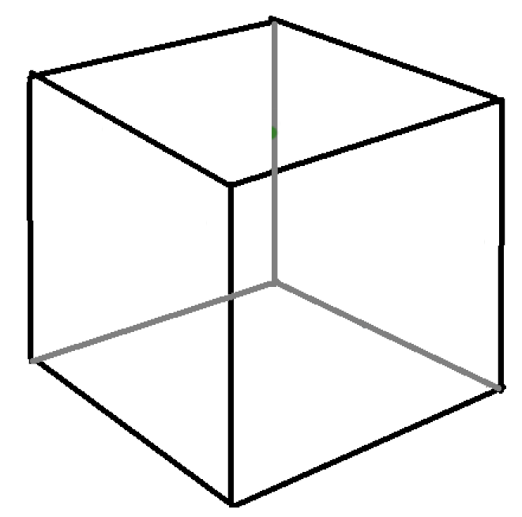
A CNN that can predict a focal amino acid given
the surrounding cube environment.
Output
x1,700,000
x20

Slide 3
A CNN that can predict a focal amino acid given
the surrounding cube environment.
Shows promise for protein engineering: how does the chemical context of residues impact their exchangeability?
Output
x1,700,000
x20

Slide 4
A CNN that can predict a focal amino acid given
the surrounding cube environment.
Shows promise for protein engineering: how does the chemical context of residues impact their exchangeability?
Can this CNN recapitulate the variation that we see in natural proteins?
Output
x1,700,000
x20

Slide 5
A CNN that can predict a focal amino acid given
the surrounding cube environment.
Shows promise for protein engineering: how does the chemical context of residues impact their exchangeability?
Can this CNN recapitulate the variation that we see in natural proteins?
Does the box size impact the predictions?
Output
x1,700,000
x20

Slide 6
Training and analysis datasets:
Newly made training dataset:
17,613 protein chains used for training:
  - Removed similar chains within the same PDB file.
  - Removed chains with over 50% sequence similarity.
  - Removed chains with over 50% sequence similarity to the PSICOV dataset.
PSICOV dataset for analysis:
150 well-studied protein structures
alignments of 1,000 – 10,000 homologous sequences per structure

Slide 7
Three sections in the analysis:
Overall CNN performance.
Comparing the variation of predicted amino acids to natural variation in sequence alignments.
Assessing the effect of box size.

Slide 8
Definitions:
Wild type sequence- the sequence that comes from the structure given to the CNN for predictions.
Wild type amino acid- the amino acid that was originally in the structures.
Consensus amino acid- the amino acid that is found with the highest frequency at a position in a multiple sequence alignment (MSA).

Slide 9
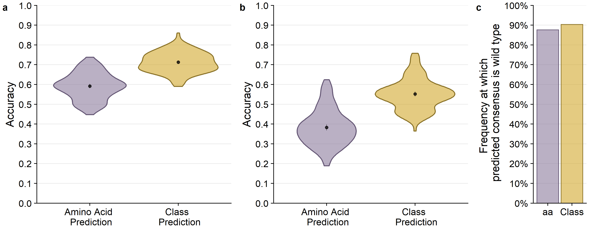
Wild type amino acids are predicted with an average of 60%
across the PSICOV dataset
predicting the wild type
predicting the consensus

Slide 10
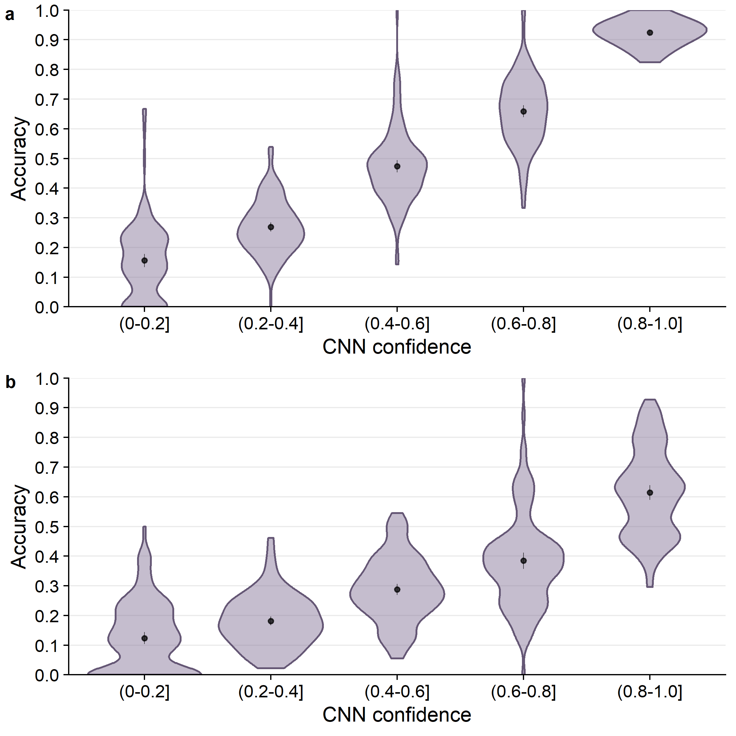
CNN prediction probability is a good predictor of accuracy.

Slide 11
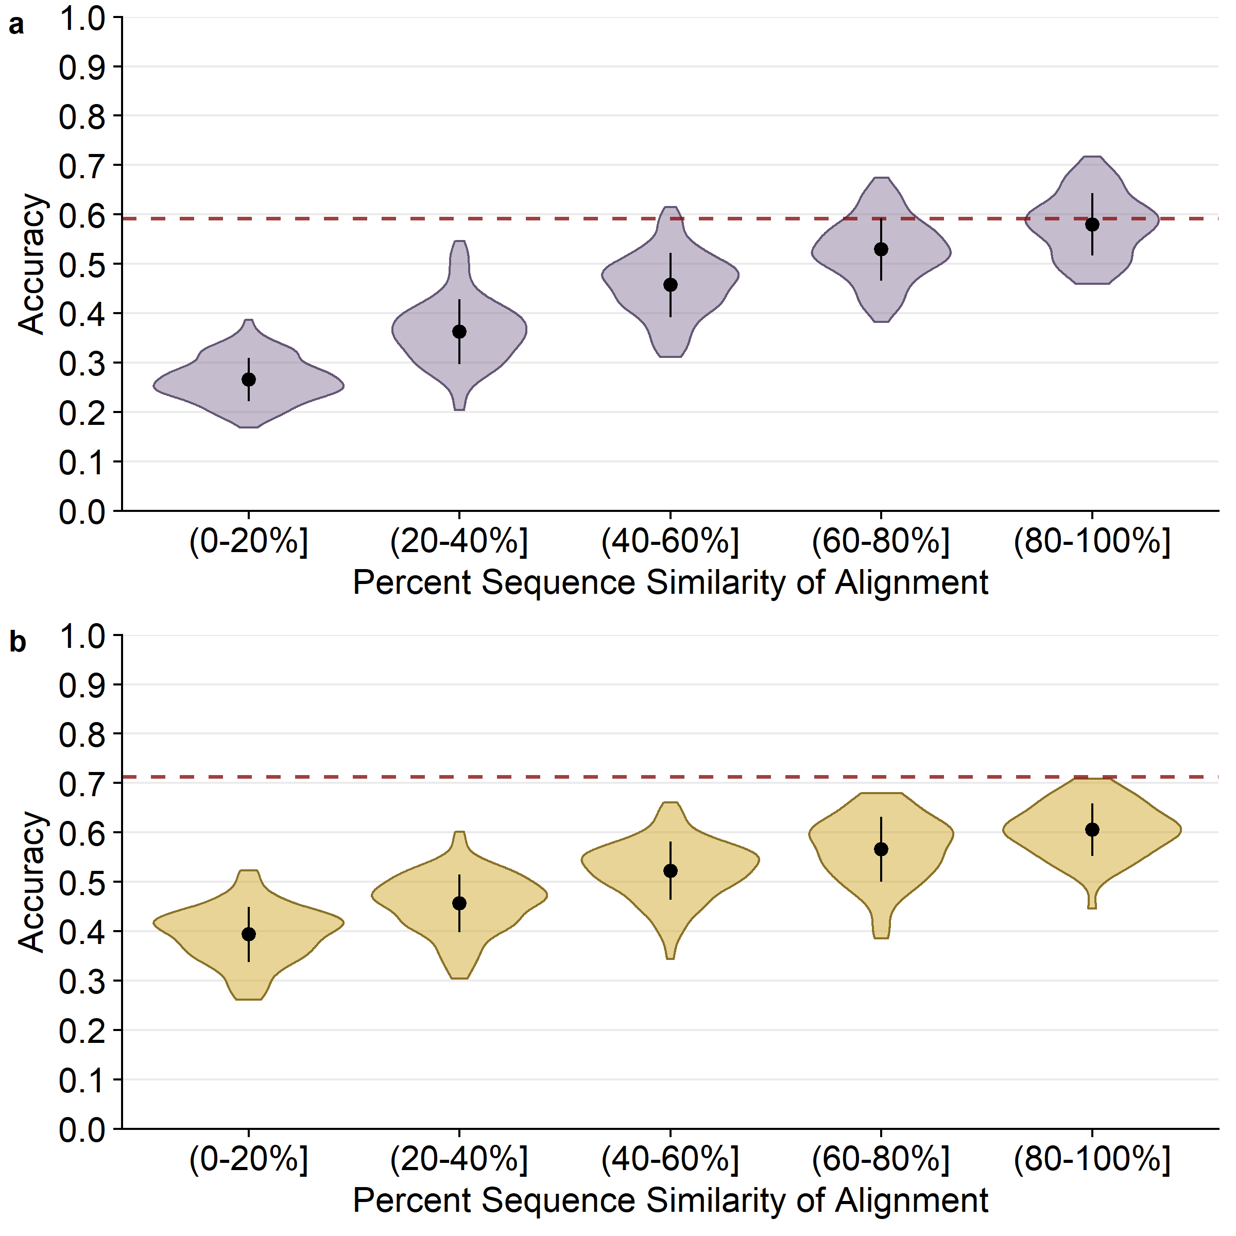
Figure 2. 20A box CNN predictions of alignment consensus by alignment similarity.
As percent similarity increases, accuracy of prediction also increases.

Slide 12
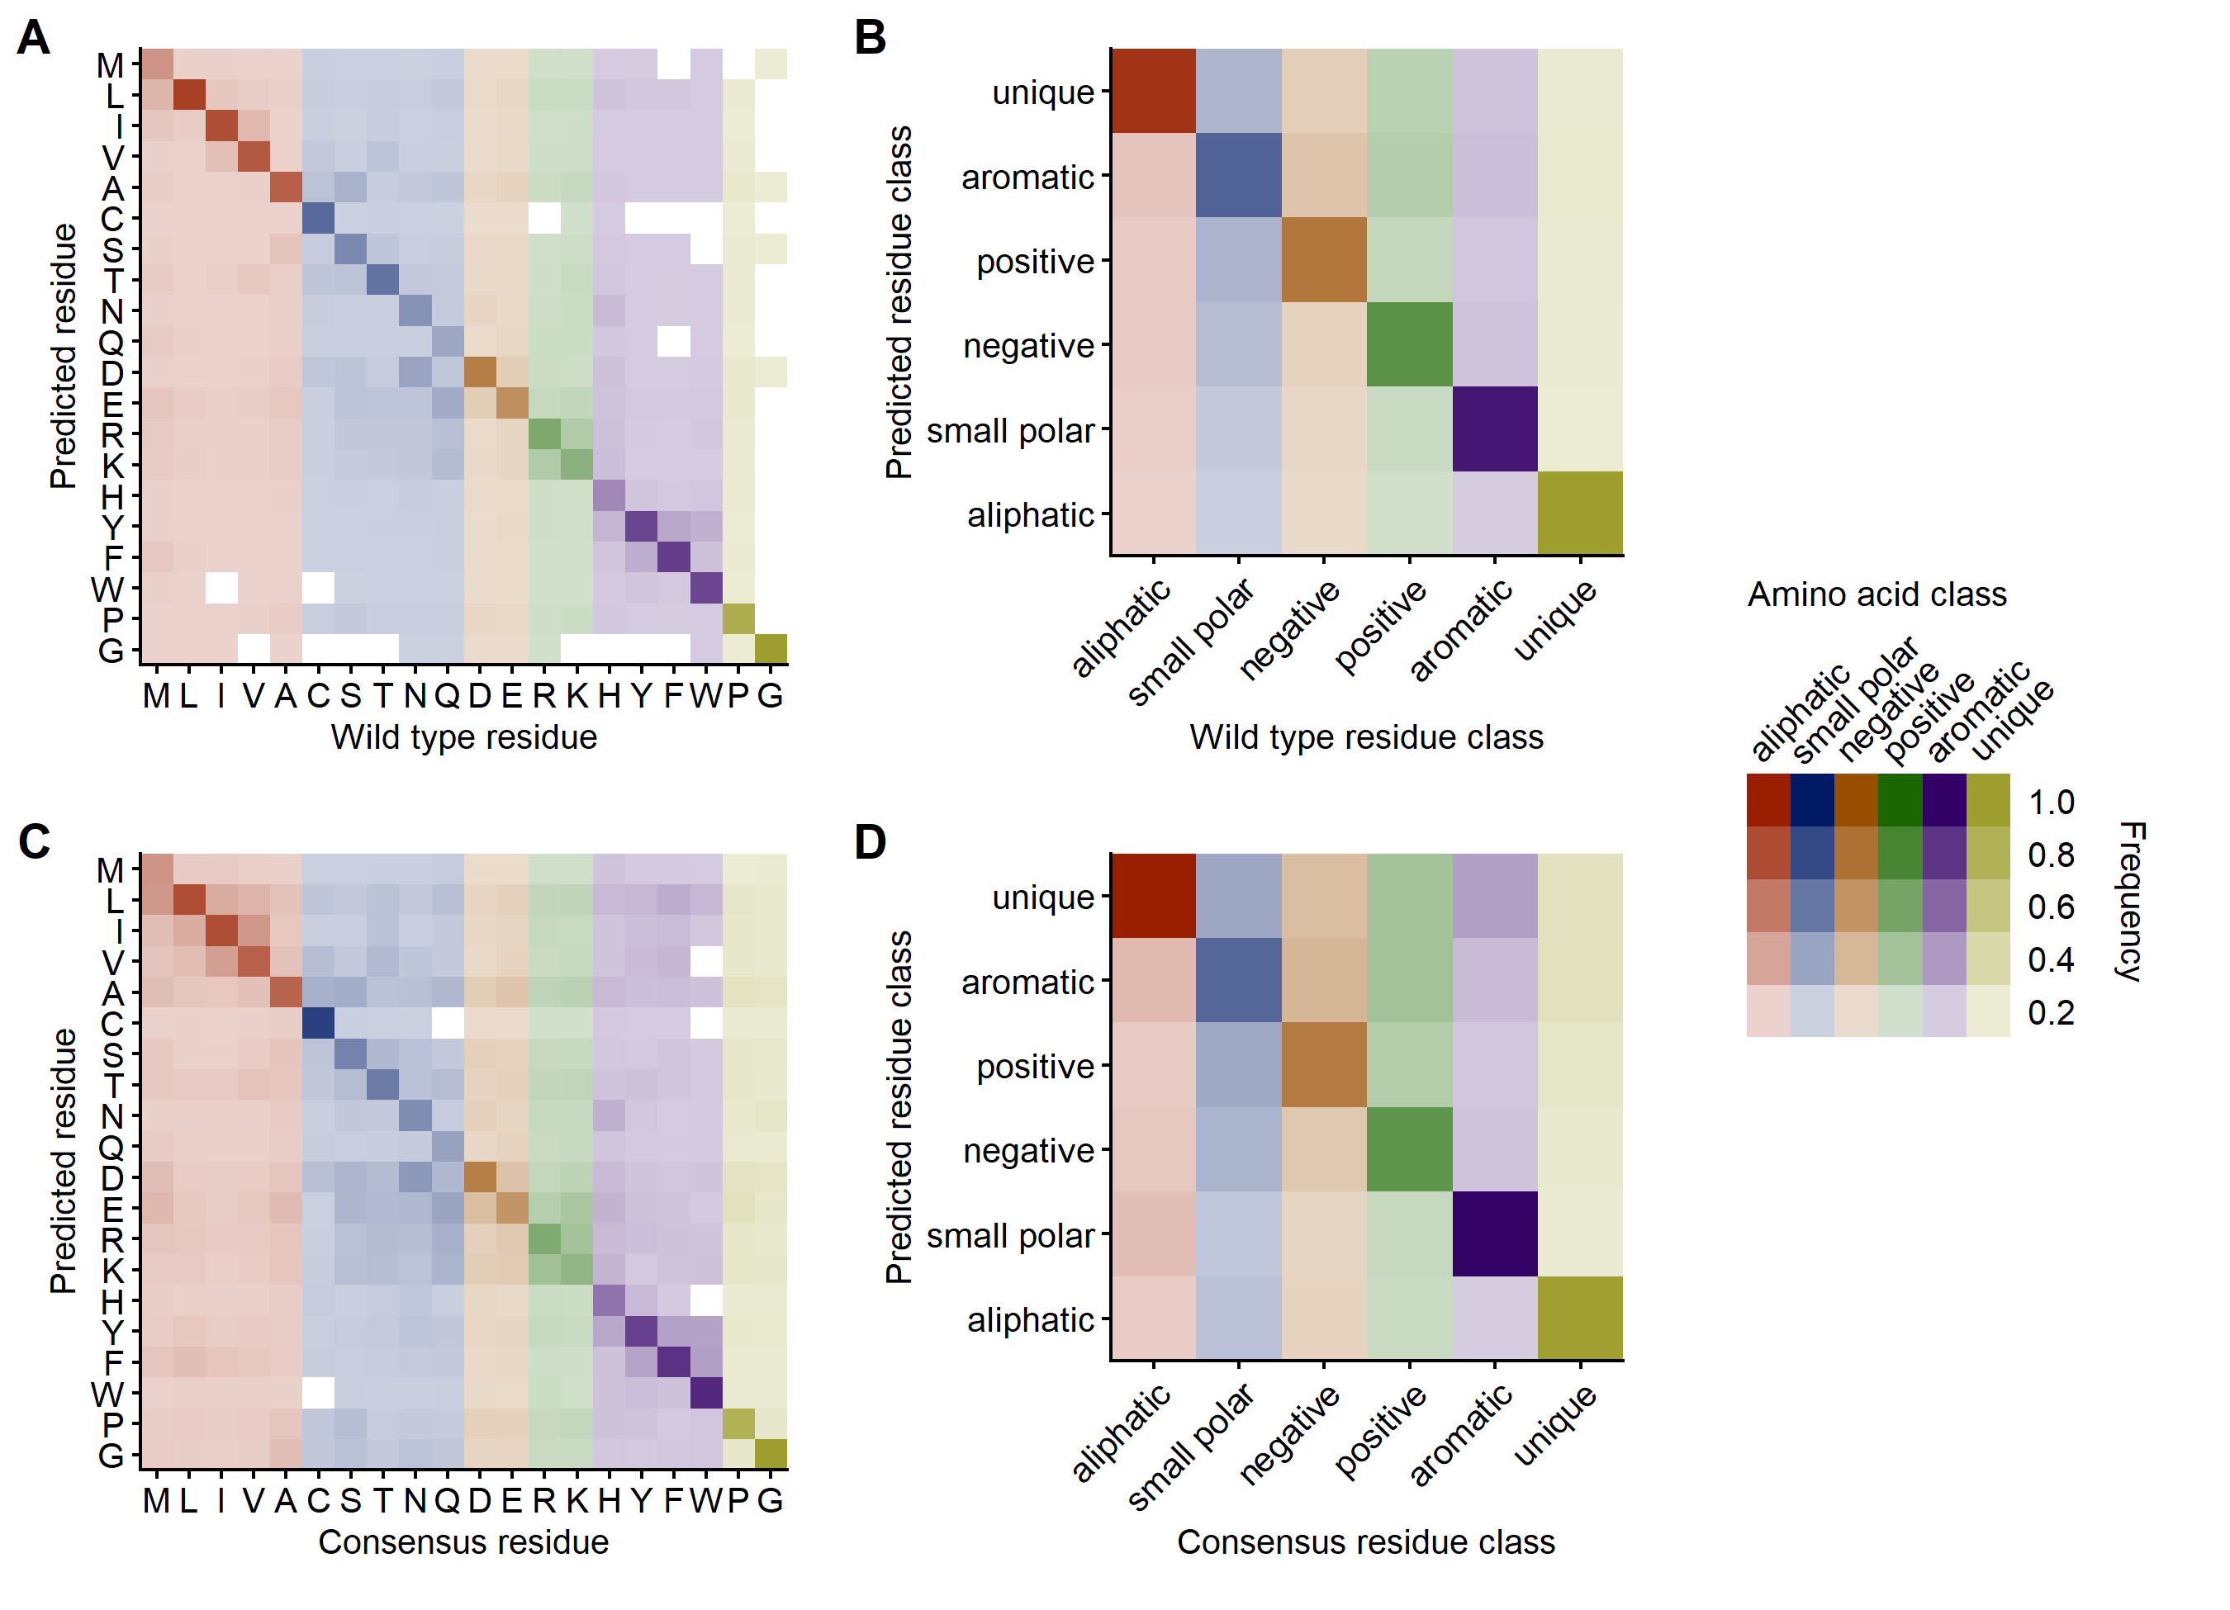
Figure 3. 20A box CNN prediction frequencies

Slide 13
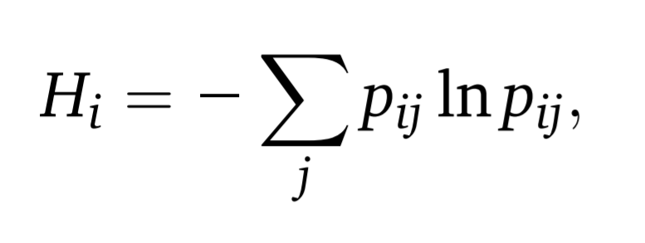
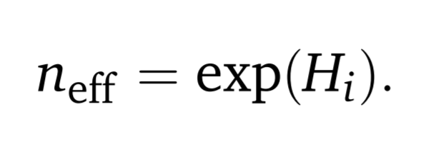
Part 2: Comparing the variation of predicted amino acids to natural variation in sequence alignments.
The effective number of amino acids represents the number of amino acids that make up the majority of the distribution at a given site.
where “p” is the relative frequency of amino acid “j” at site “i” in the alignment.

Slide 14
Examples of n-effective:
Amino acids at a site in a Multiple Sequence Alignment:
1) [V, V, V, V, V, V, V, V, V, V, V, I, ] n-eff = 1.59
2) [V, V, V, V, V, V, I , I , I , I , I , I ] n-eff = 2
3) [V, V, V, V, V, V, I , I , I , I , I , A ] n-eff = 2.5
The majority are Valine
Both Valine and Isoleucine are equally distributed
A little over two effective amino acids because of Alanine

Slide 15
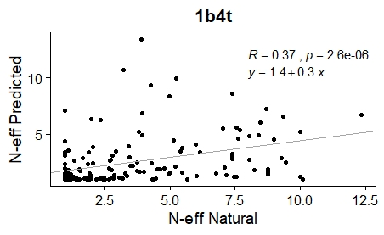
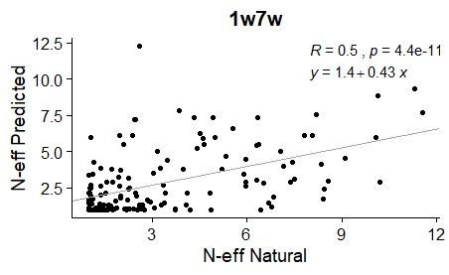
First, we found the correlations between n-eff predicted and n-eff from multiple sequence alignments for each of the 150 proteins.

Slide 16
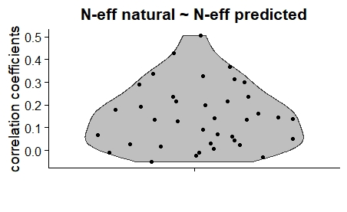
Correlations between the natural and predicted correlations are all weakly positive.
Most correlations we found were weak.
So, we decided to control for the similarity of the MSA sequences to the wild type sequence.

Slide 17
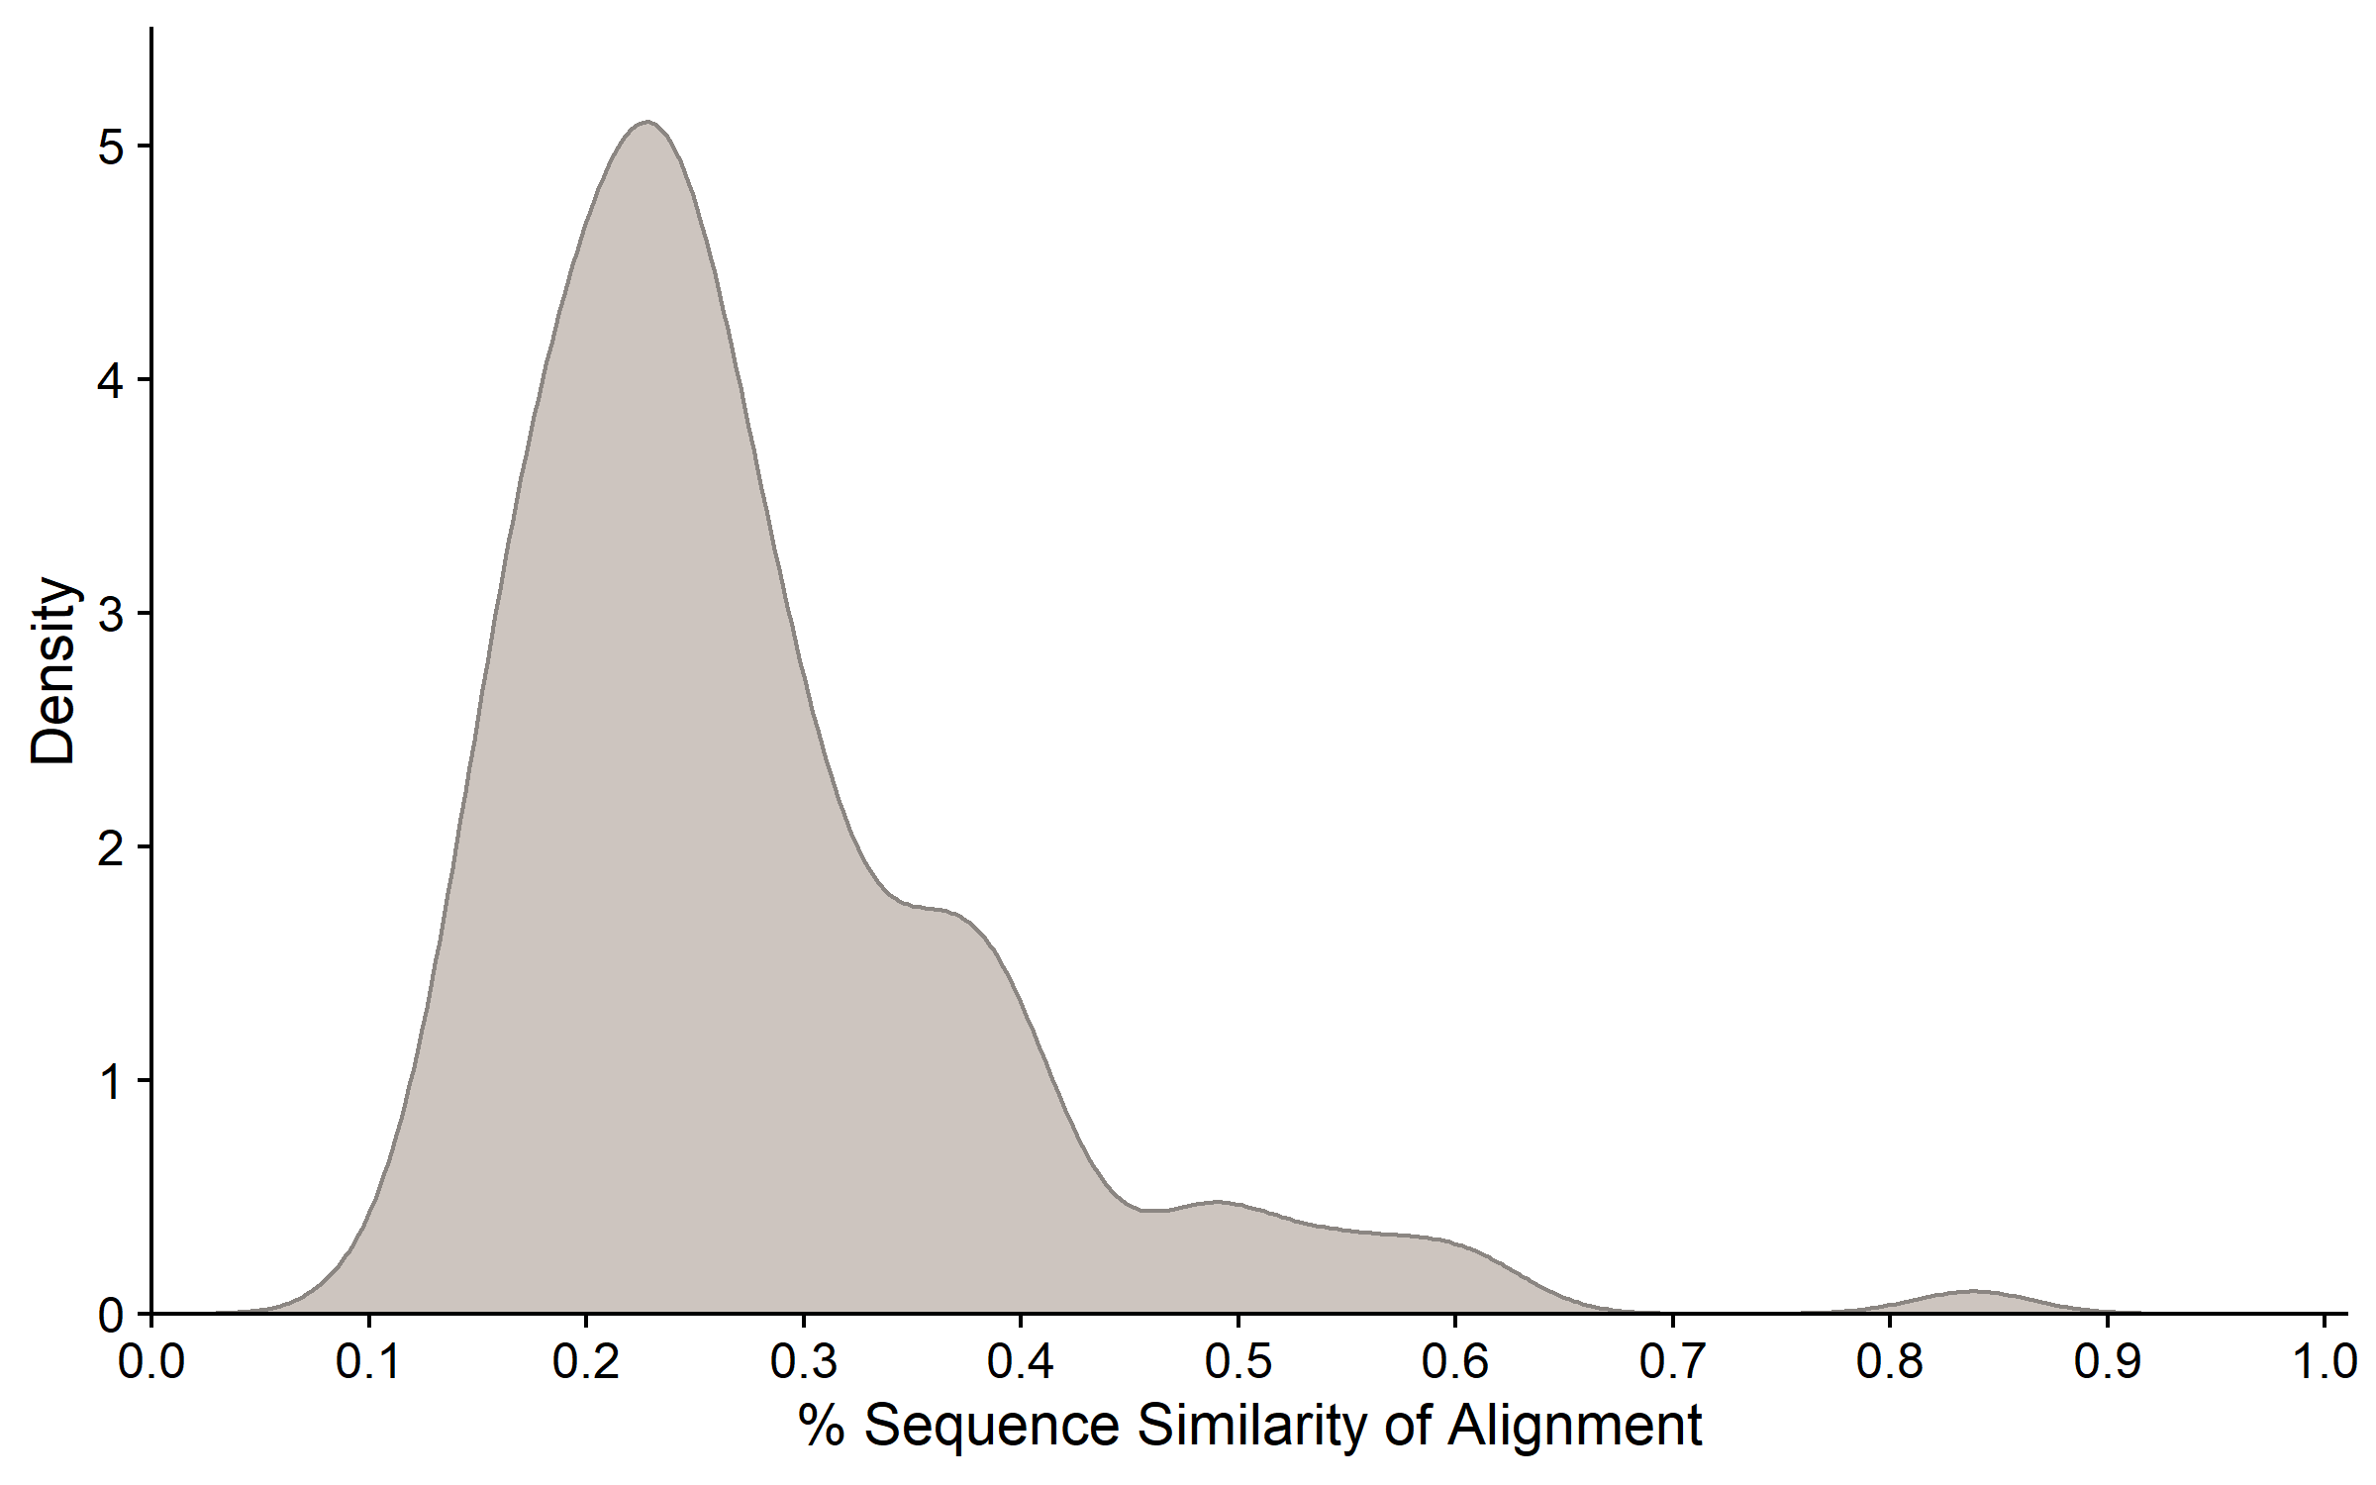
Most multiple sequence alignments have around 25%
similarity with the wild type sequence.

Slide 18
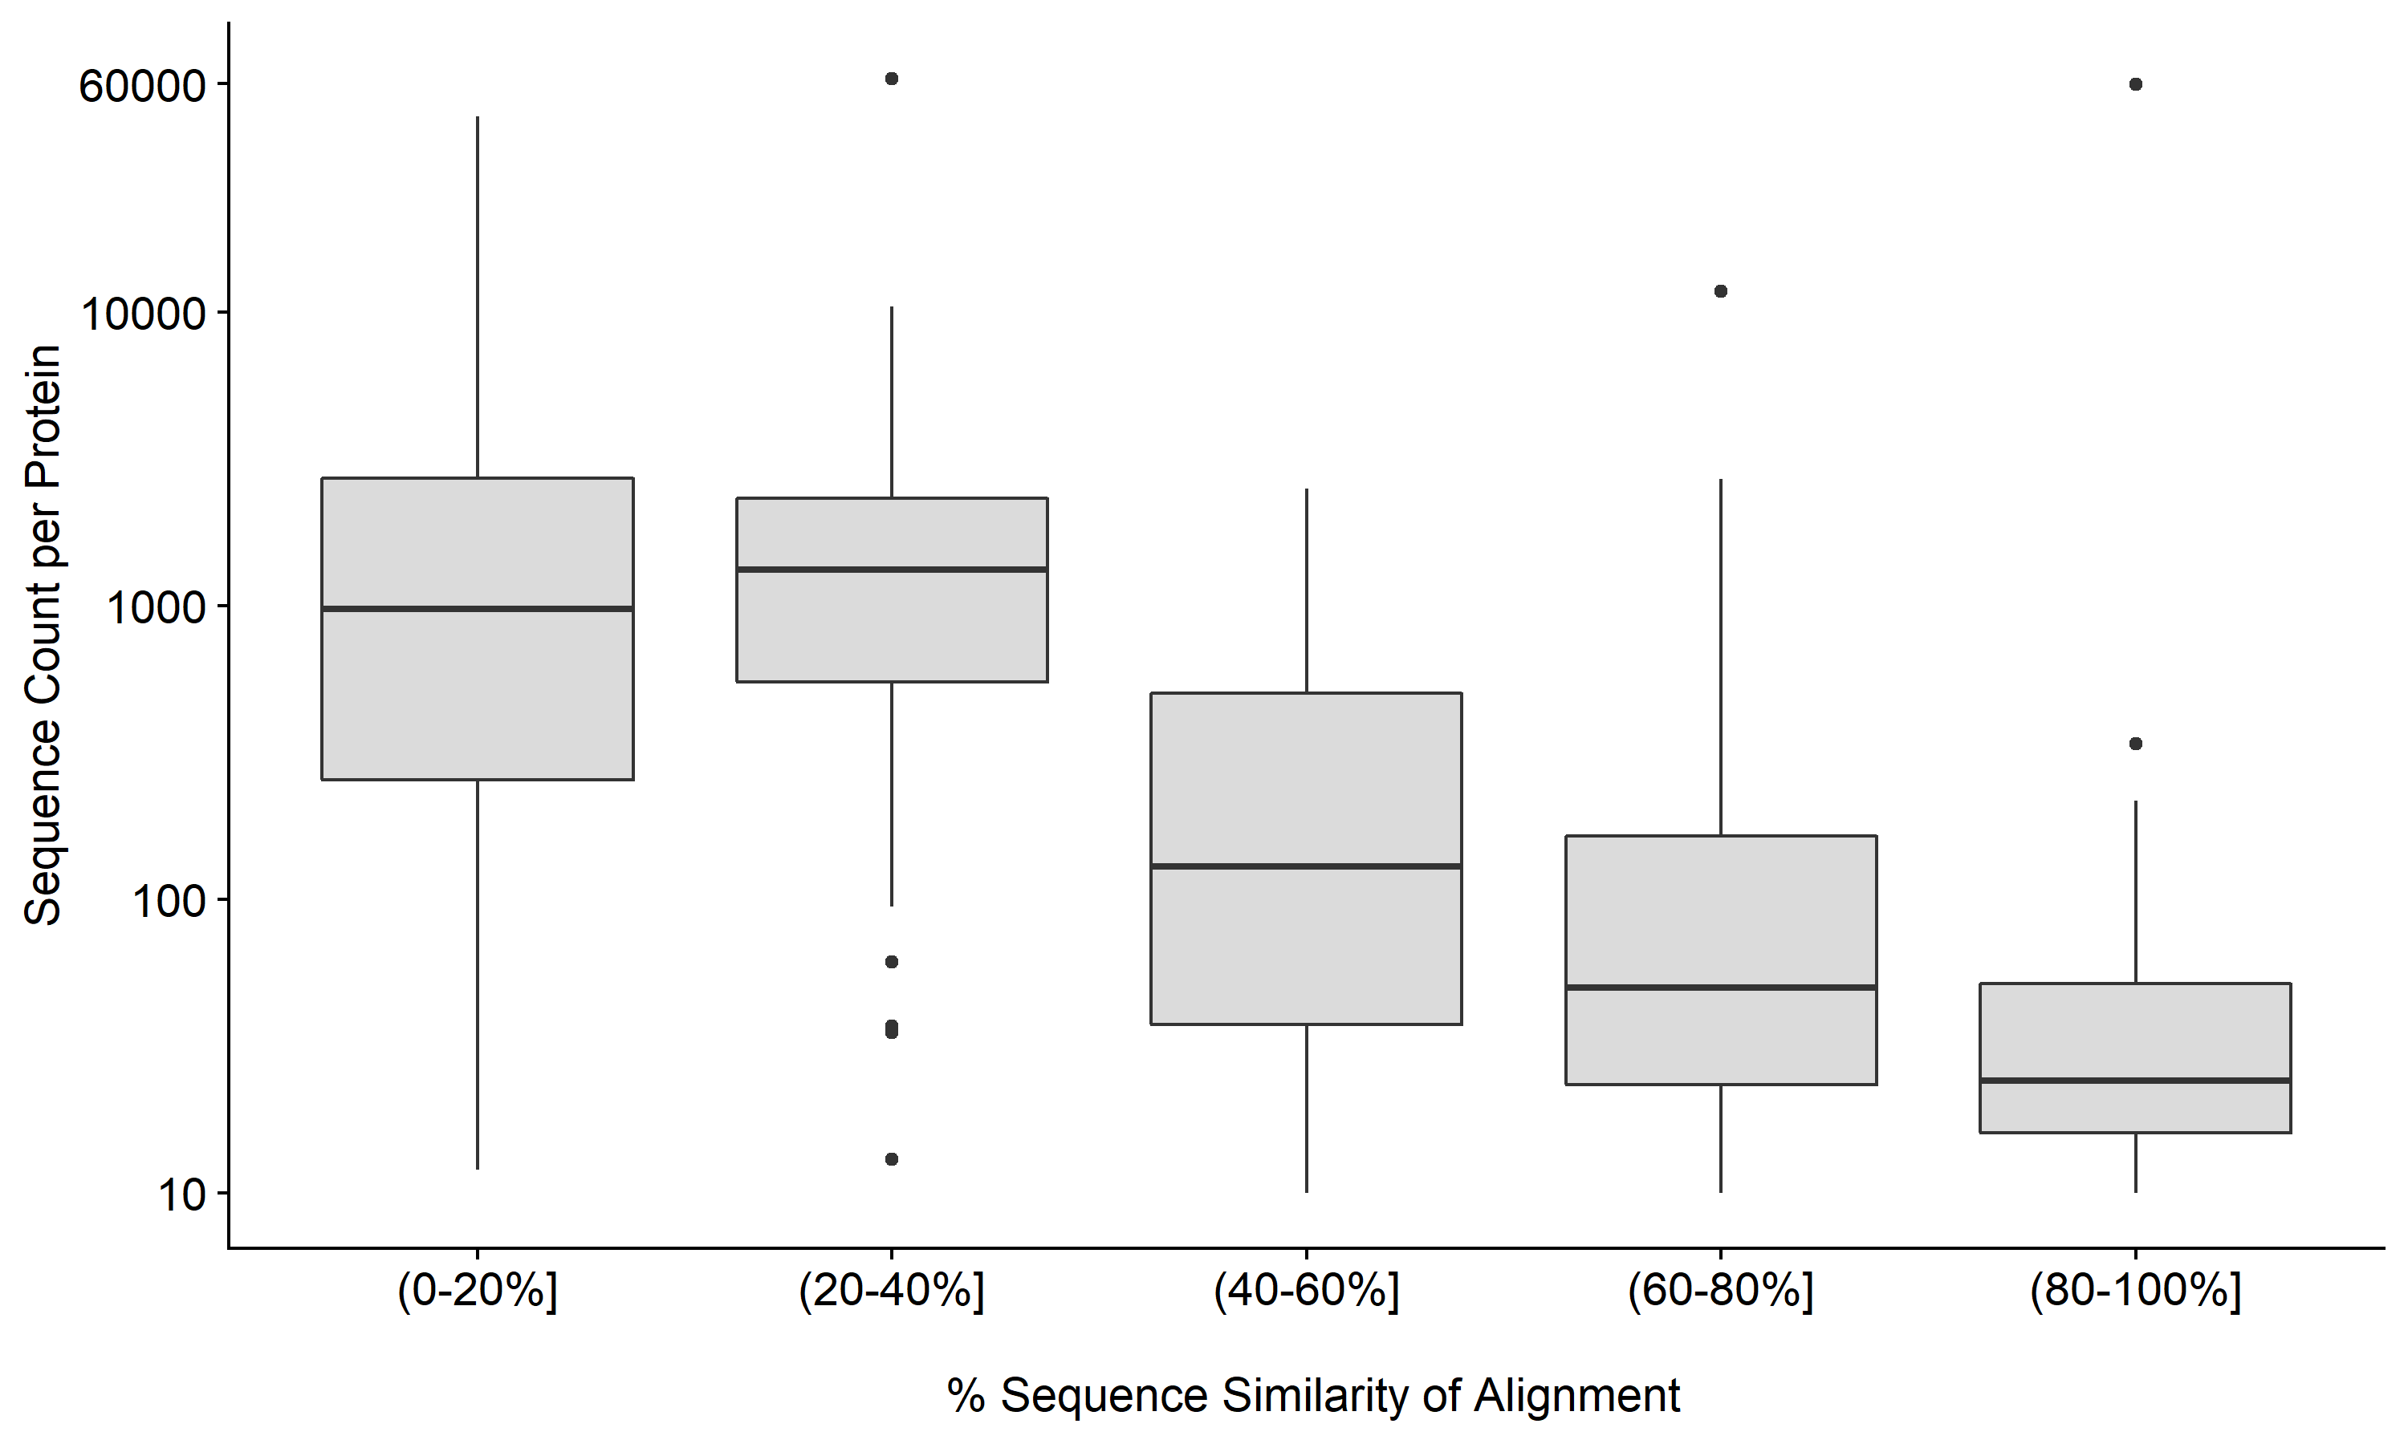
We made new sets of alignments where all sequences within that alignment were within a given similarity range to the wild type sequence.

Slide 19
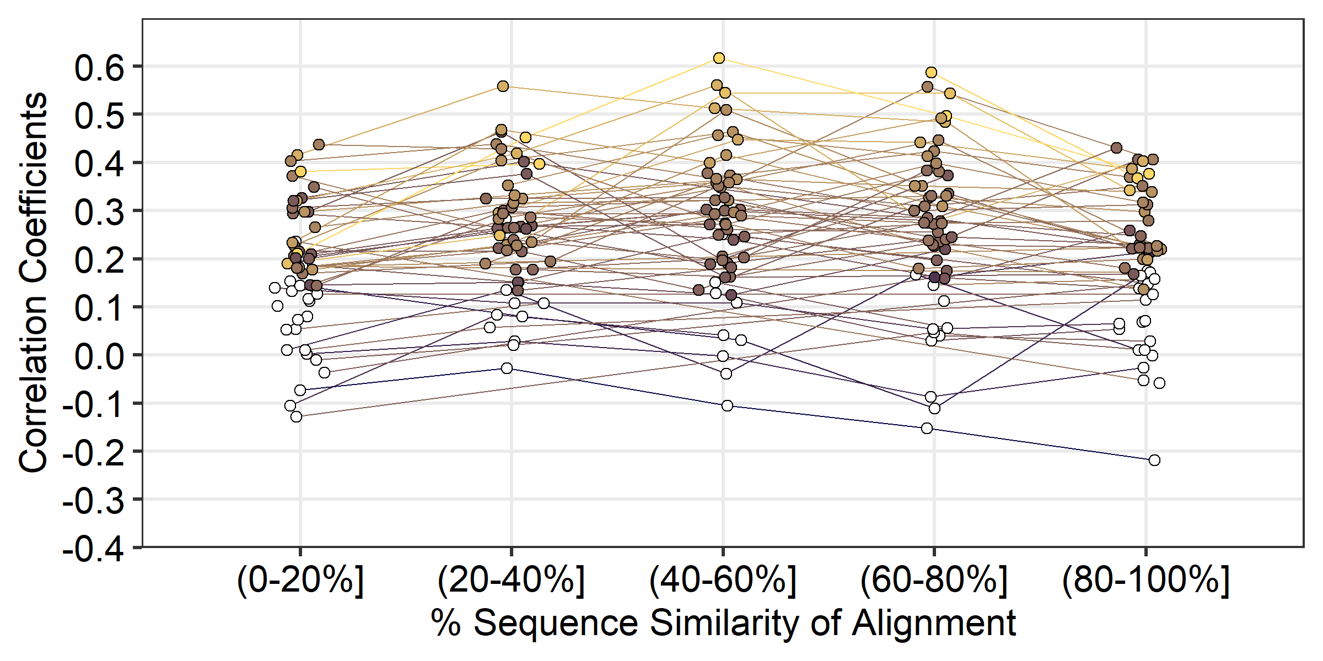
All bins showed weak correlations with the highest overall correlations in the (40-60%] similarity bin.

Slide 20
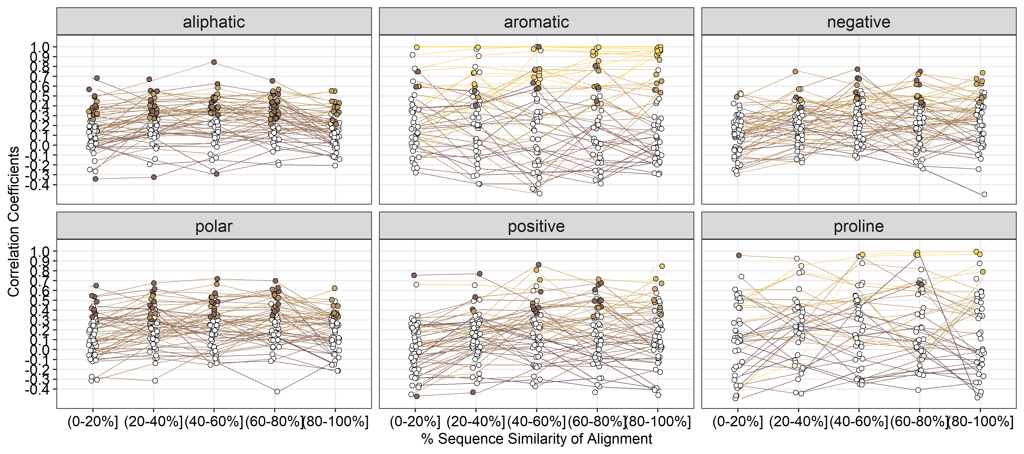
S3: Correlation coefficients peak within the 40-60% similarity group. Most positive correlations are significant.

Slide 21
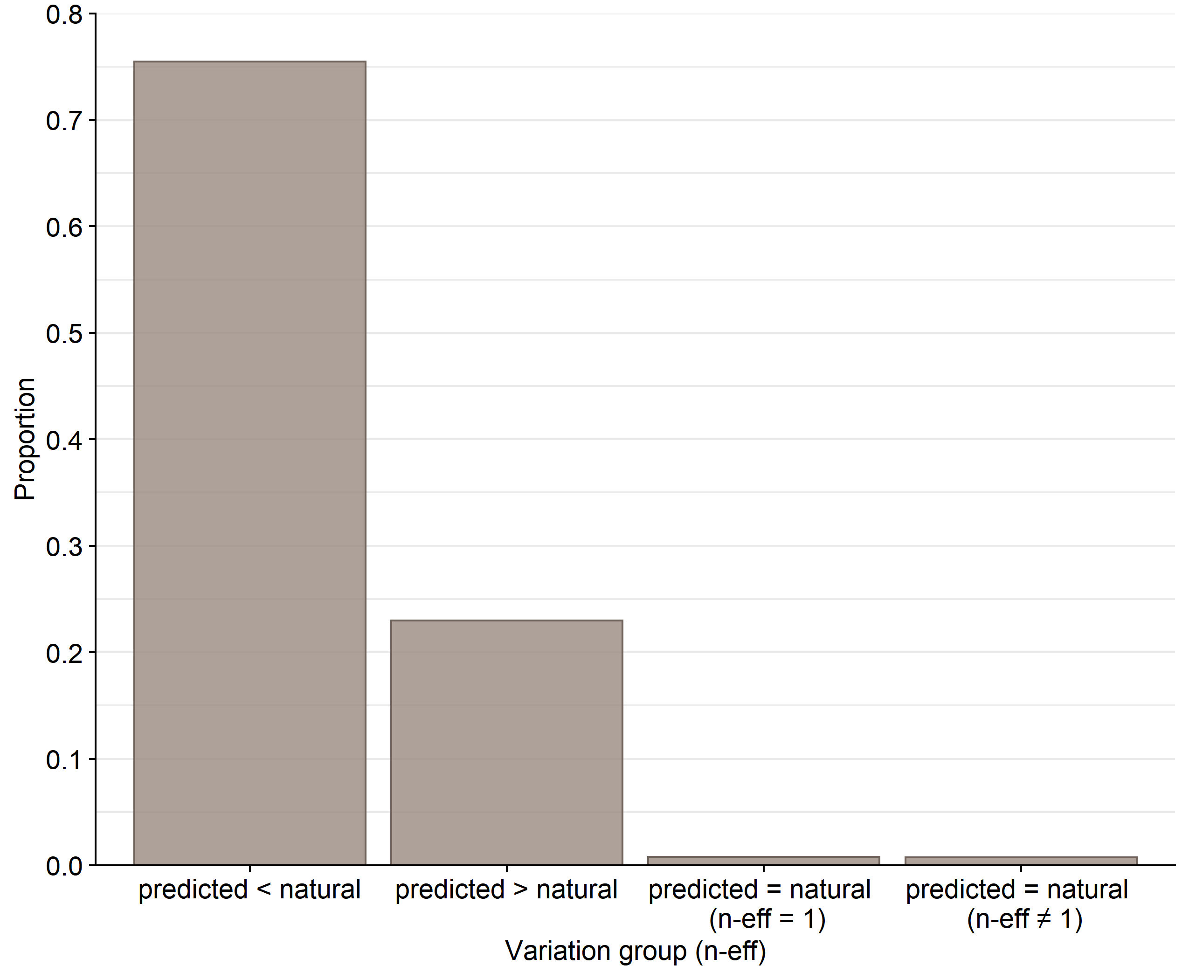
The network is trained to predict one amino acid, while nature most often selects for variation.

Slide 22
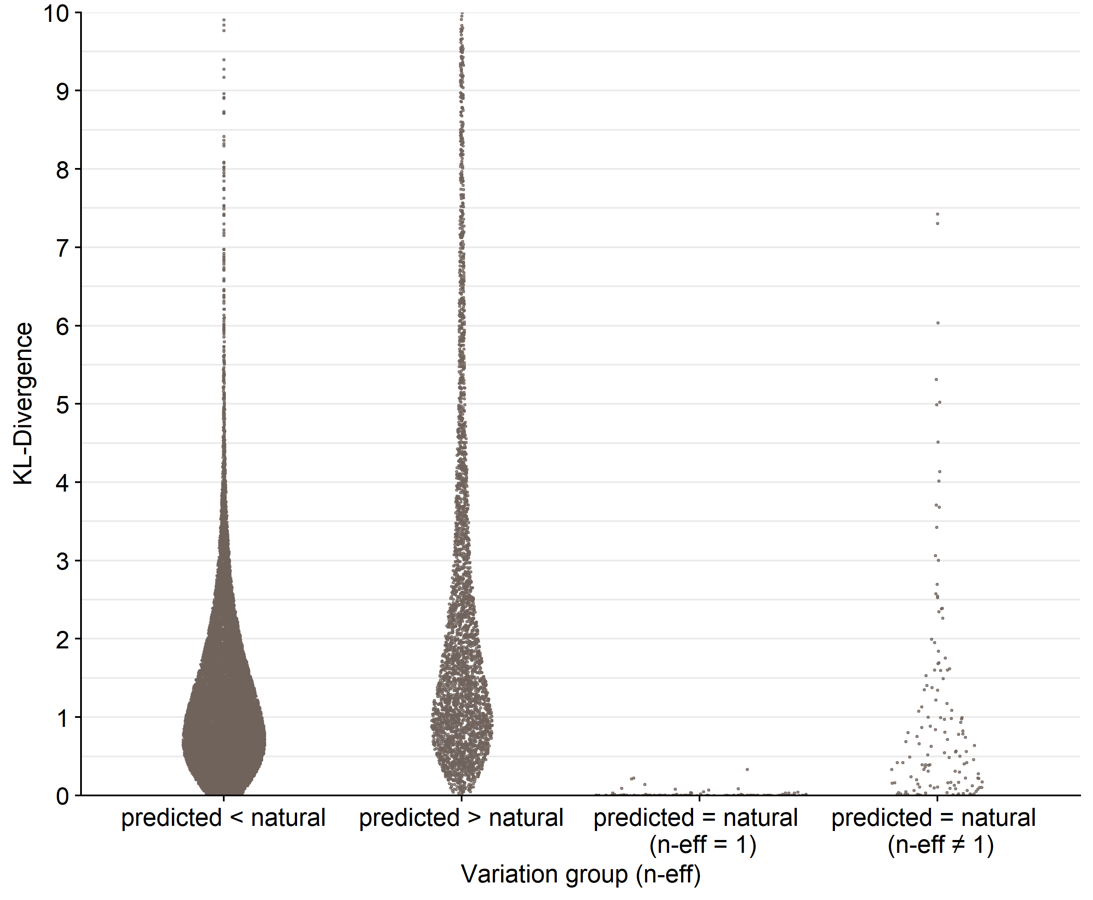

Slide 23
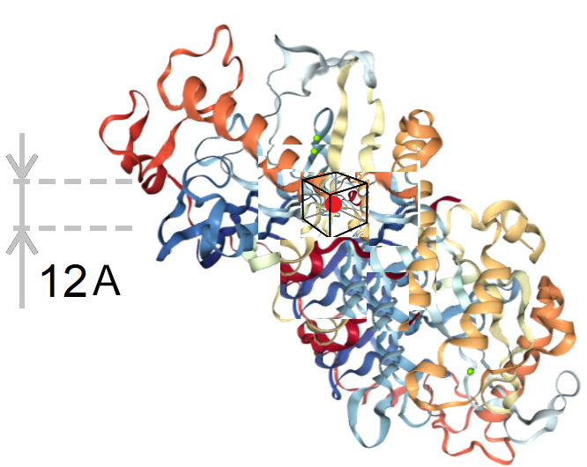
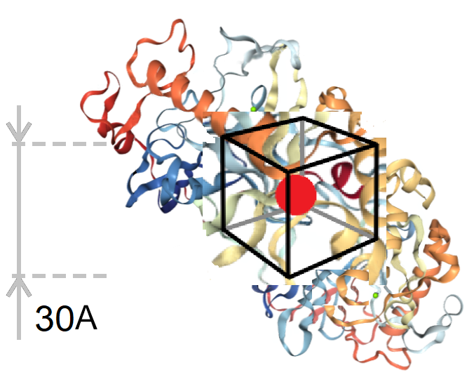
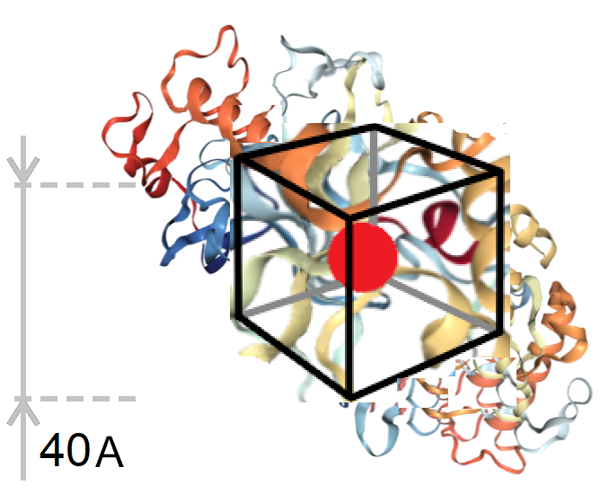
Question: Does box size have an effect on accuracy or the models ability to recapitulate natural variation?

Slide 24
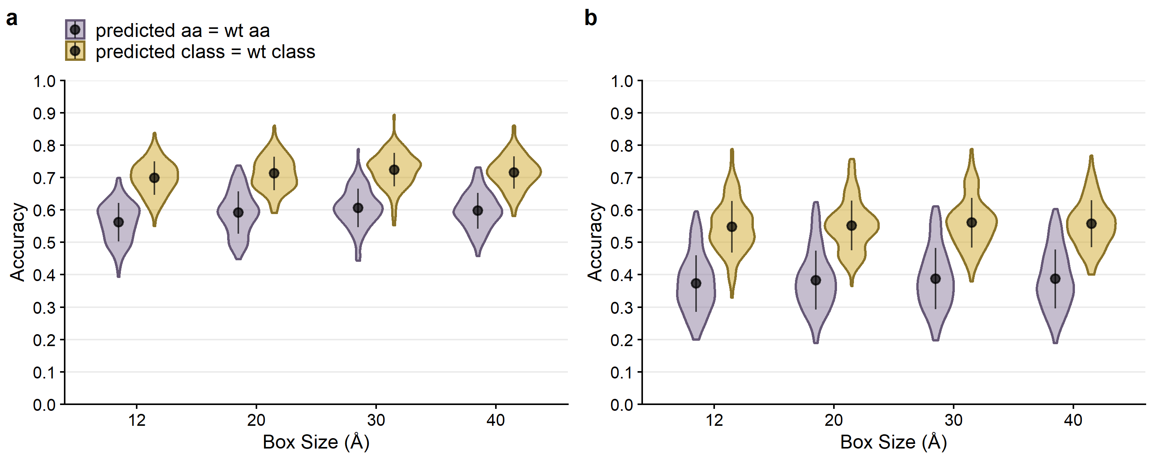
Figure 5: Overall performance of CNN predictions for boxes of size 12A, 20A, 30A and 40A.

Slide 25
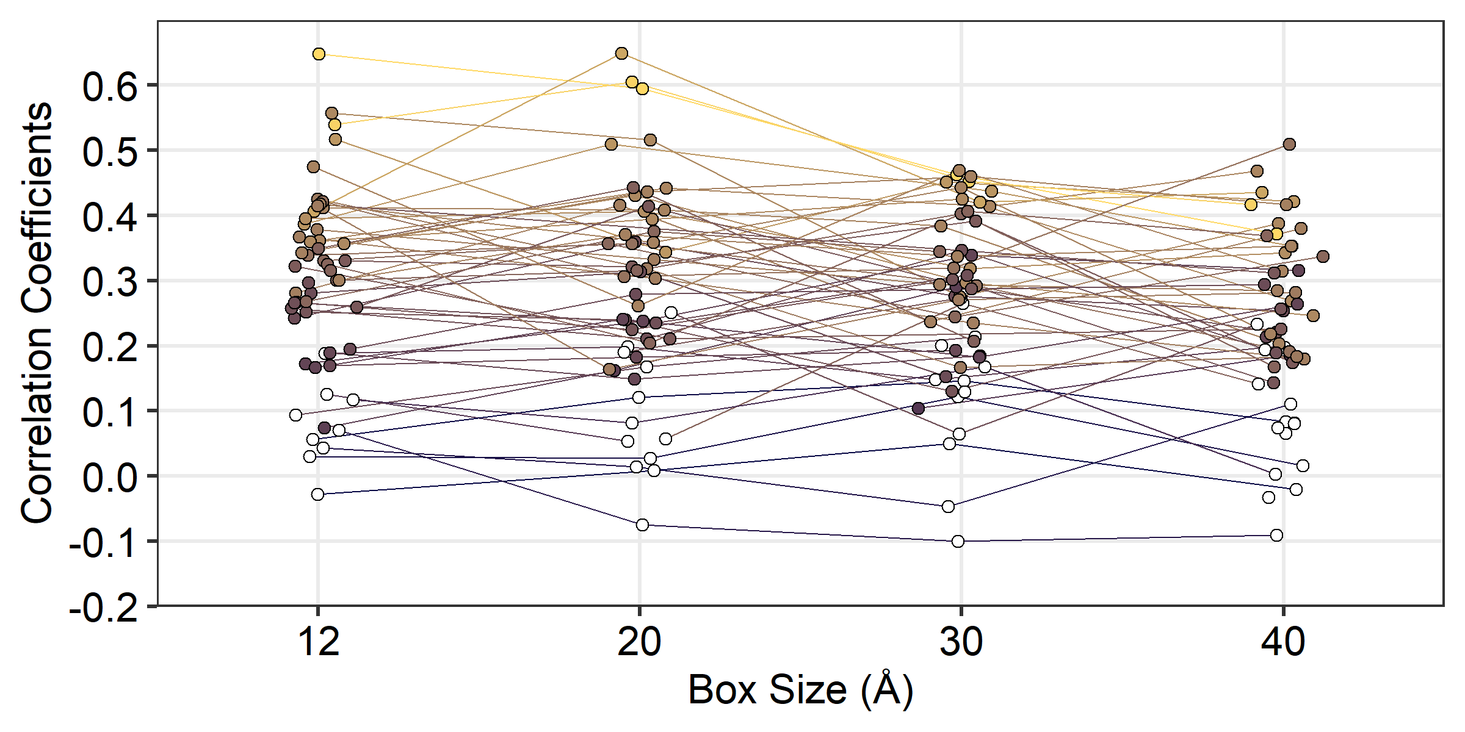
Predictions made from smaller boxes tend to correlate better with natural variation.

Slide 26
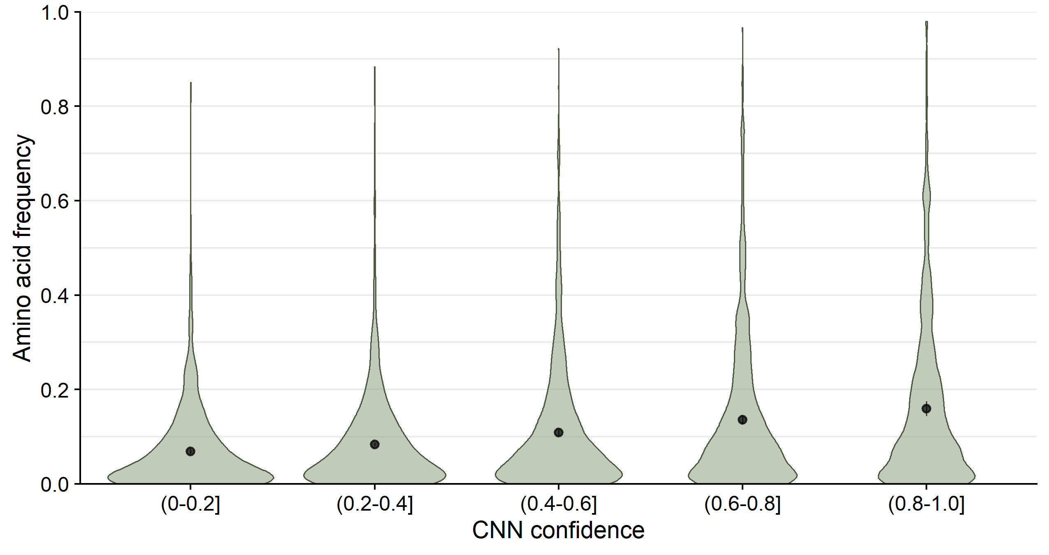
Mispredicted amino acids are not abundant in nature even when predicted at high CNN probability.

Slide 27
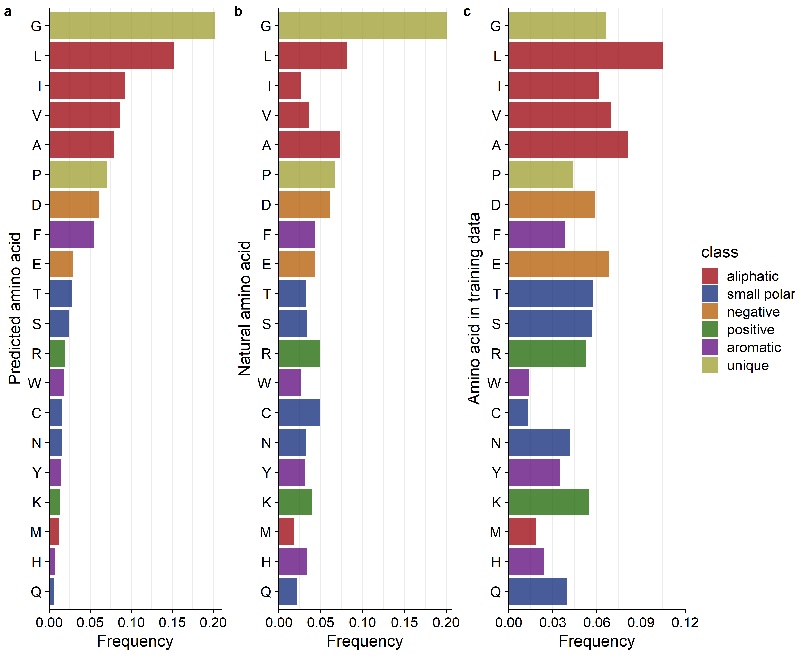
We wanted to see what amino acids is the network best at predicting.
We used sites where network predicted amino acids with
80-100% prob. (high confidence)

Slide 28
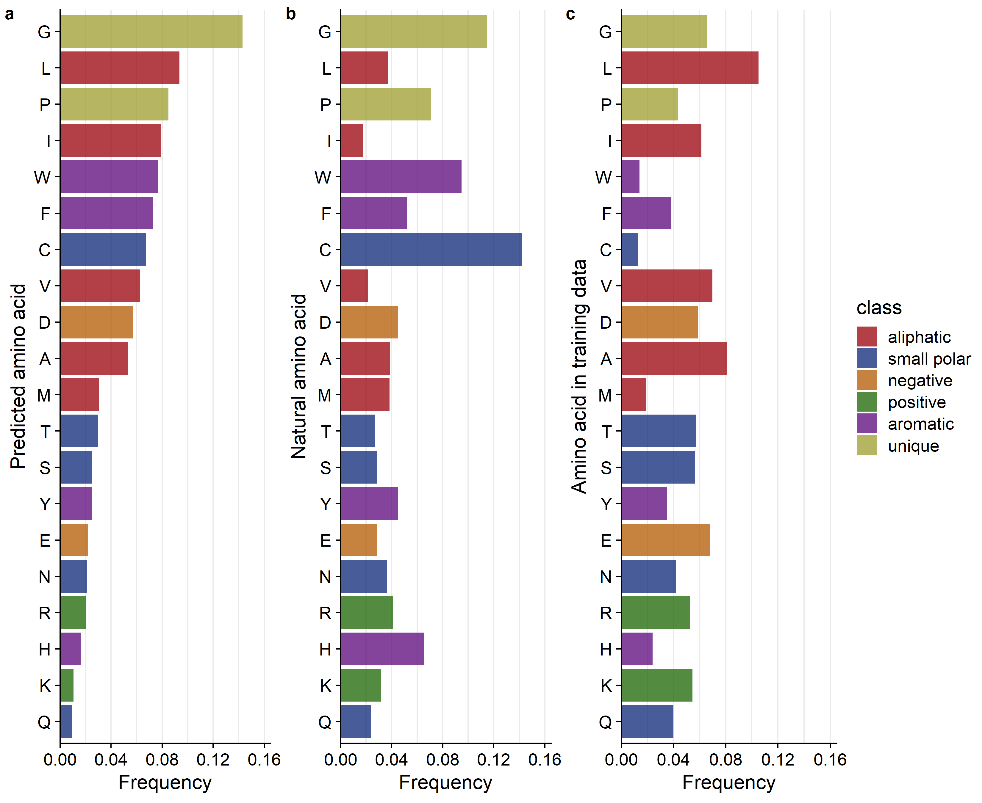
Network is best at predicting hydrophobic amino acids.

Slide 29
Looking at mispredictions: what wild type amino acids tend to be mispredicted and where are mispredictions found in the protein structure?

Slide 30
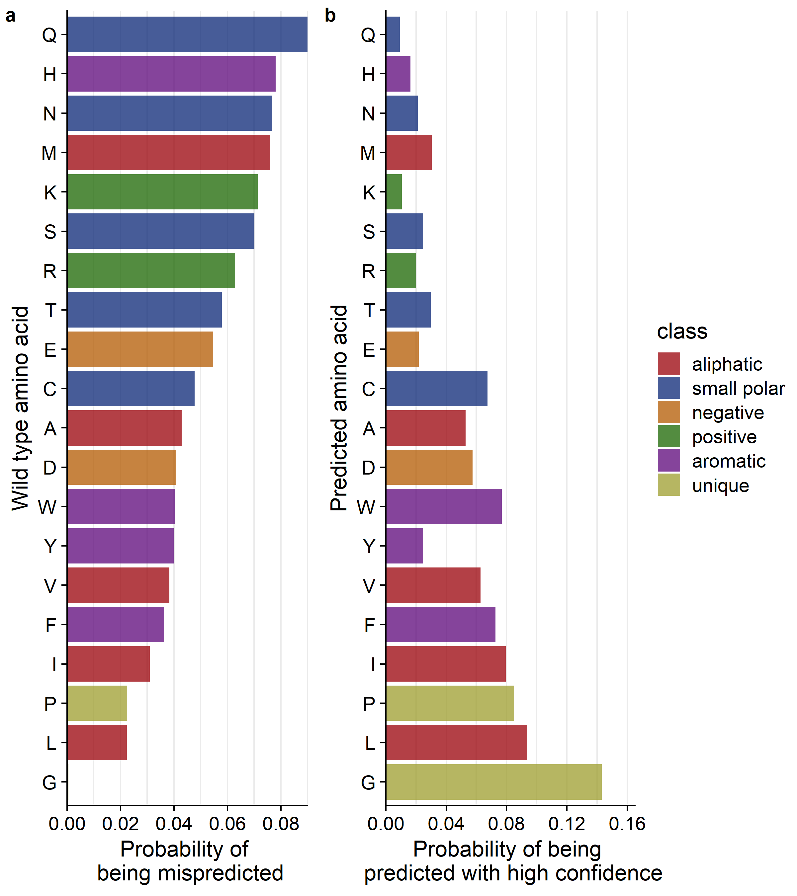
Question: are the most frequently mispredicted amino acids the most interchangeable in protein structures?
(7,356 total mispredictions)
High confidence means predicted with 80-100% probability.

Slide 31
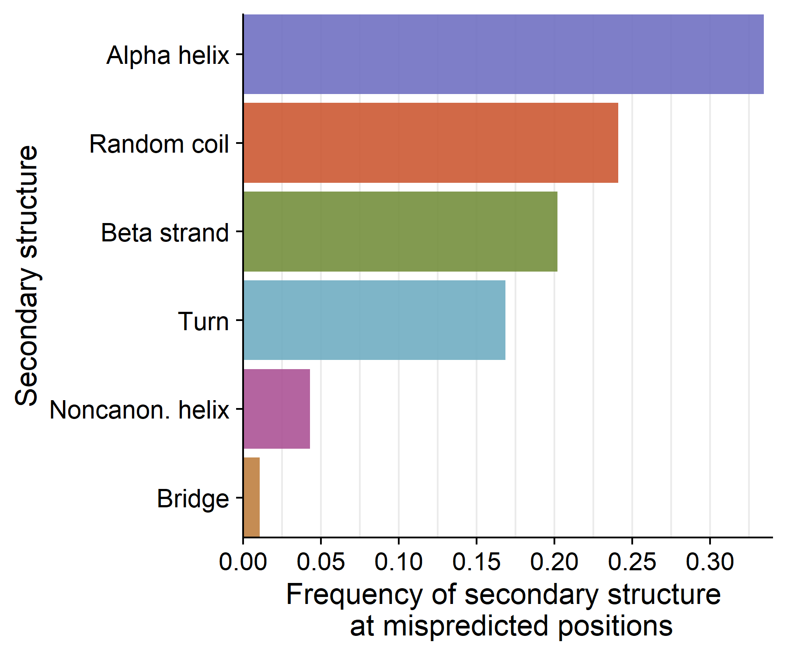
Over a third of mispredictions occur in Alpha helices, in second place are random coils and beta strands.
(7,356 total mispredictions out of 18,487 positions)

Slide 32
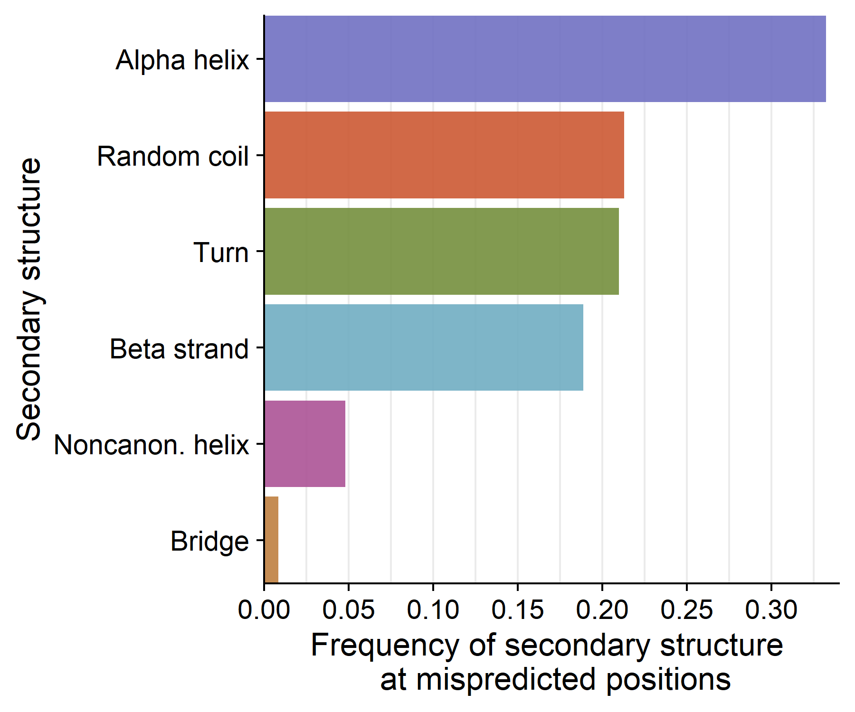
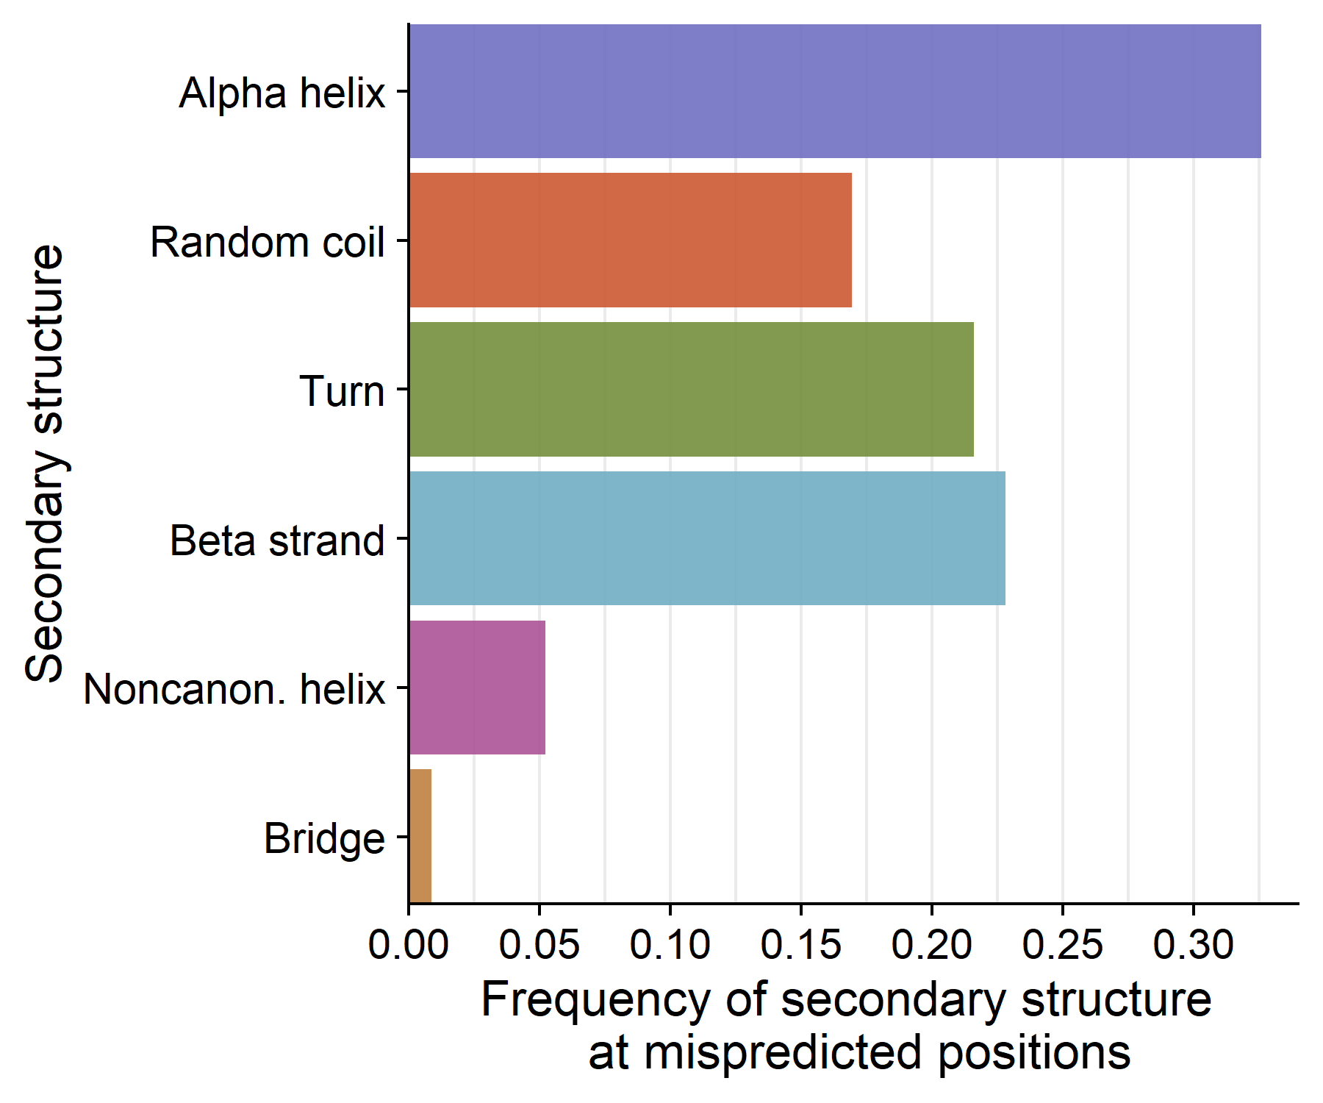
Mispredictions are scattered across all secondary structures.
Wild type given <10% prob.
Wild type given <2% prob.
(3,874 total mispredictions
out of 18,487 positions)
(921 total mispredictions out of 18,487 positions)

Slide 33
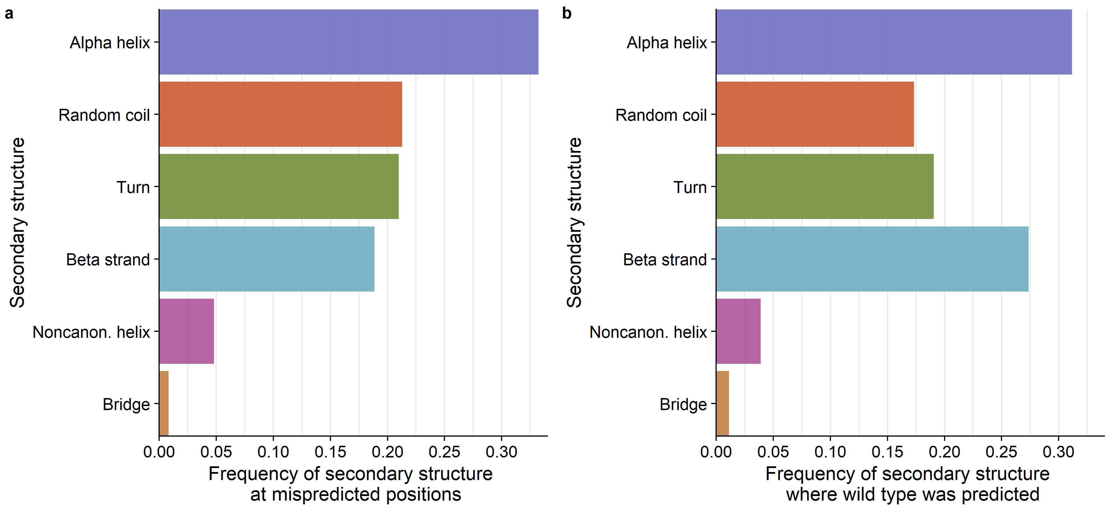
Distributions of structure across mispredicted sites are similar to the distribution of structure at correctly predicted sites.
(3,874 total mispredictions
out of 18,487 positions)
~11,000 positions

Slide 34
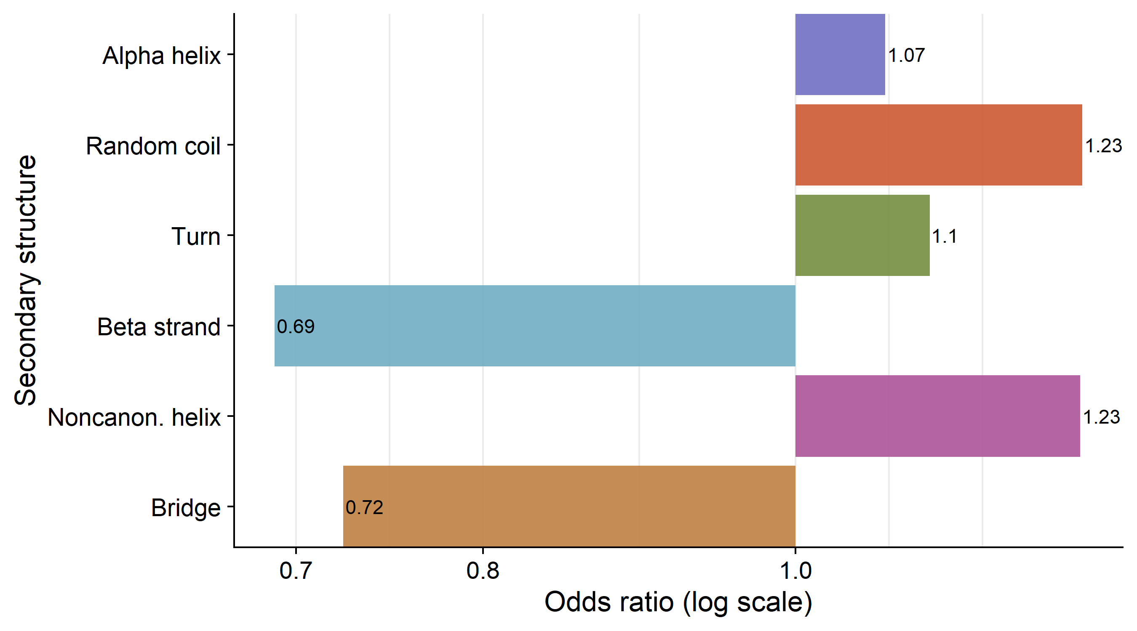
Mispredictions tend to appear in random coils and noncanonical helices more often than the correct predictions.
(3,874 total mispredictions out of 18,487 positions)

Slide 35
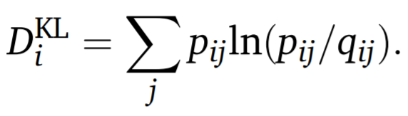
Kullback-Leibler (KL) Divergence is used as a measure of distance between two distributions.
Where “q_{ij}” is the frequency of amino acid “j” in column “i” of the sequence alignment, and “p_{ij}” is the probability predicted by the CNN of amino acid “j” at position “i”.

Slide 36
Simple example of Kullback-Leibler (KL) Divergence
Probabilities produced by the CNN
for a single protein site:
Frequencies found within a single column in an MSA:
A, G, C, V, R, F
A, G, C, V, R, F
[0, 0, 0, 0, 0.2, 0.8] [0, 0, 0, 0, 0.2, 0.8] KL-Div = 0
[0, 0, 0, 0, 0.1, 0.9] [0, 0, 0, 0, 0.2, 0.8] KL-Div = 0.036
[0, 0.2, 0.3, 0, 0.1, 0.4] [0.1, 0.9, 0, 0, 0, 0] KL-Div = 35.583

Slide 37
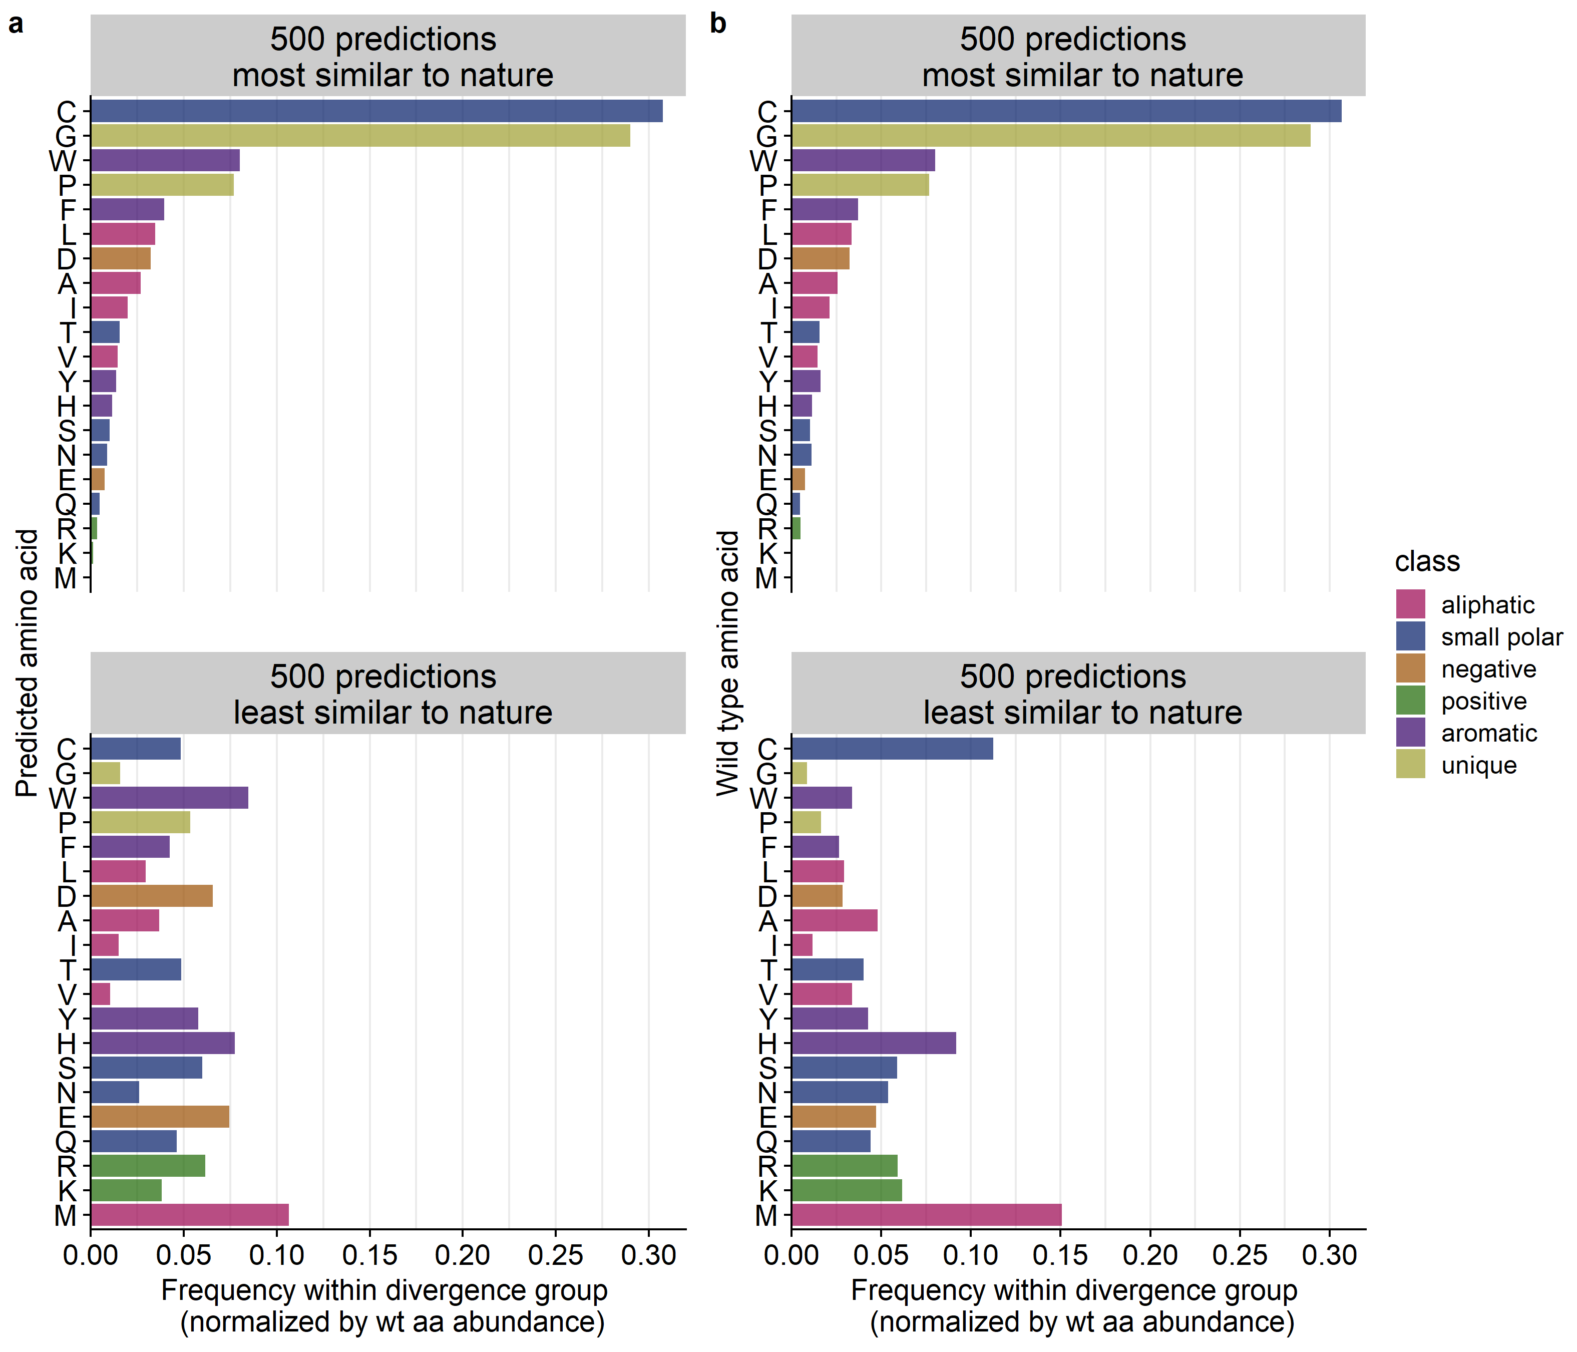
Figure

Slide 38
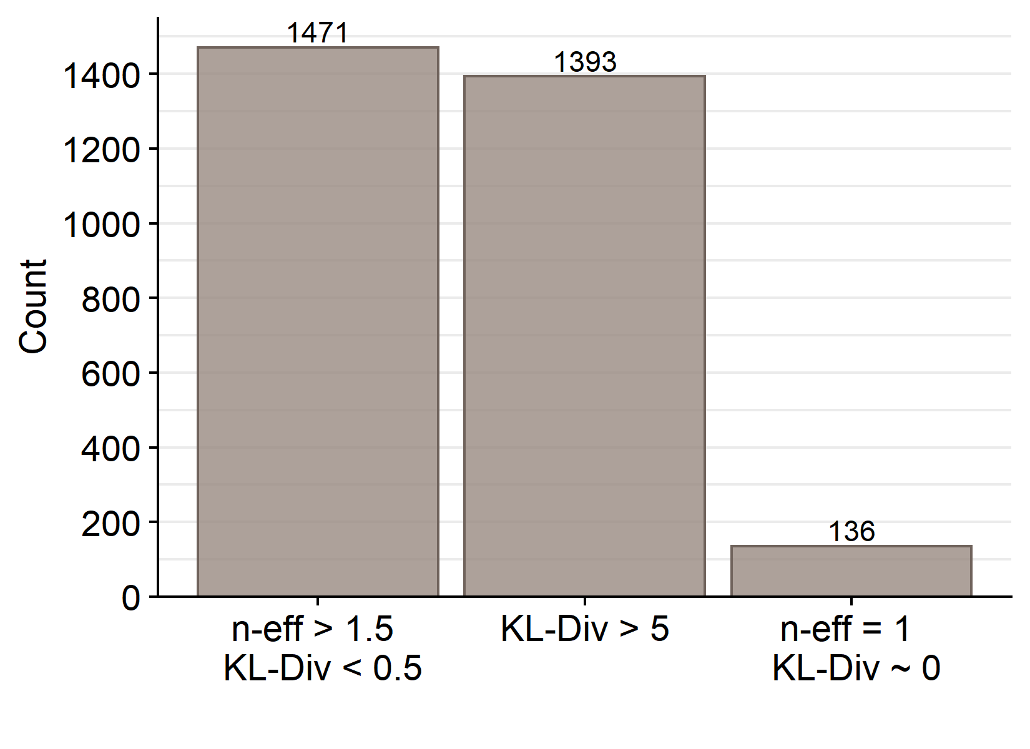
I divided all positions in the PSICOV dataset into three groups.
1) Positions where cnn predicts phylogeny:
2) Positions where cnn does not predict phylogeny:
3) Positions where only 1 amino acid was predicted and 1 in phylogeny:

Slide 39
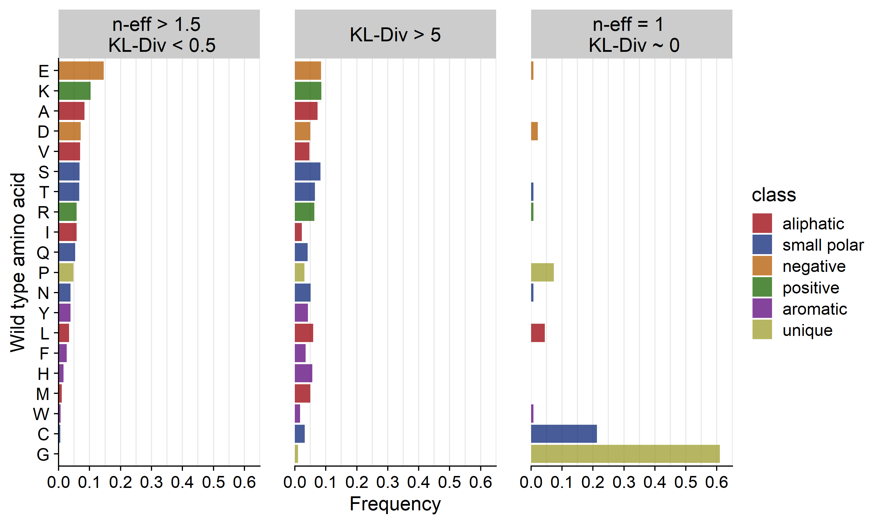
The least variable amino acids in nature and in CNN predictions are Glycine and Cystein.

Slide 40
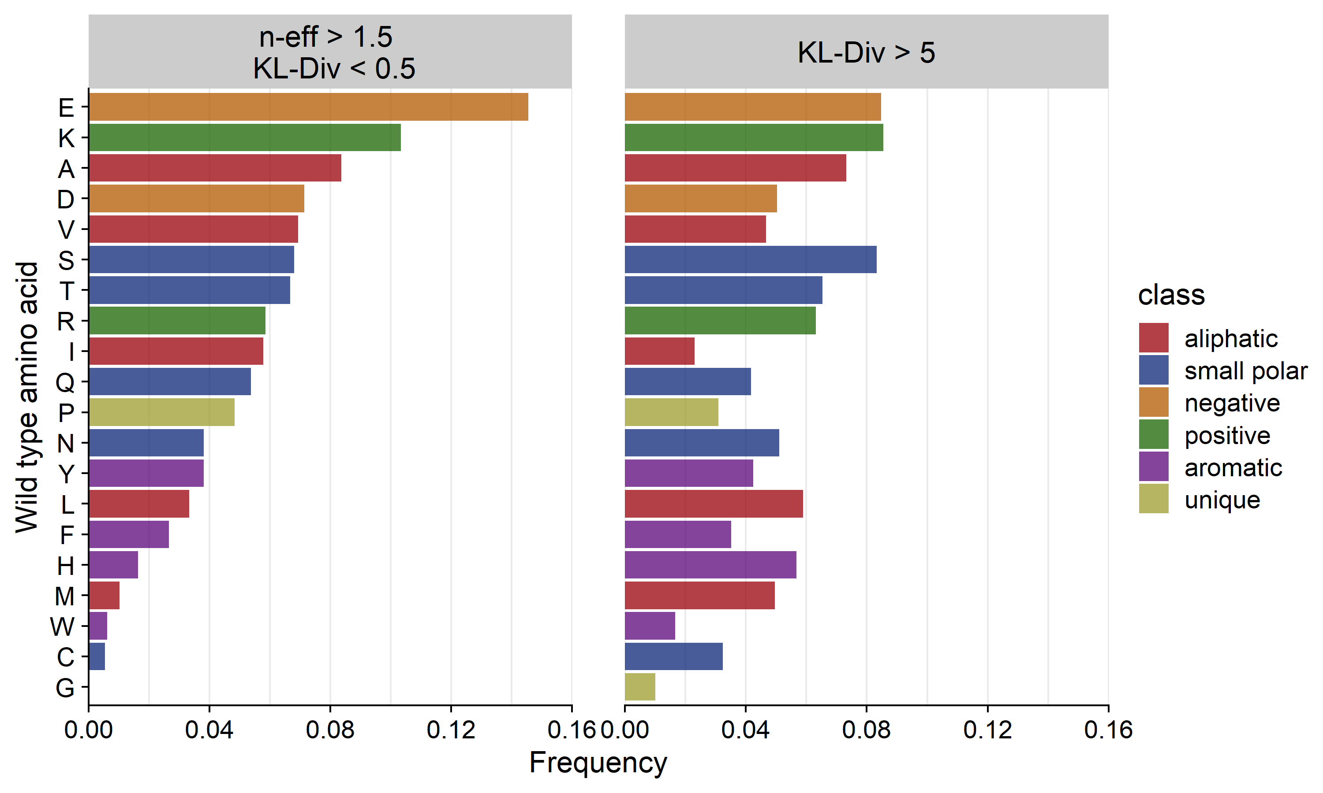
In general, network predictions correlate better for polar amino acids.

Slide 41
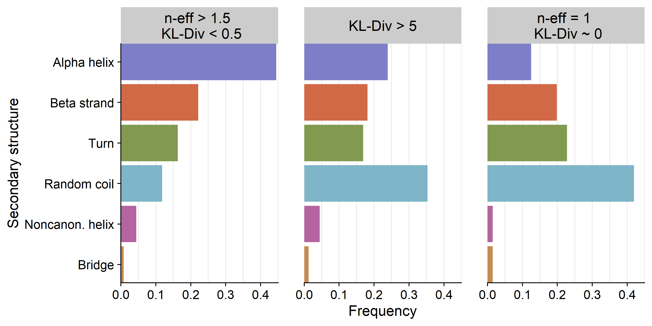
Most and least diverged sites are in random coils. Sites where the net is able to predict variability occur at alpha helices.
Positions where cnn predicts phylogeny:
Positions where cnn does not predict phylogeny:
Positions where only 1 amino acid was predicted and 1 in phylogeny:

Slide 42
Summary and Limitations
Summary of results:
The CNN can predict both the wt residues and consensus residue.
The variation in CNN predictions does NOT correlate well with the variation in natural proteins.
The first contact shell (12A) is sufficient in predicting protein residues from their structural context.
CNN prediction probability is a reliable estimate of accuracy
Limitations:
Multiple sequence alignments vary extensively by the number of sequences per alignment. Some proteins have alignments of only 10 sequences.
The amino acids and amino acid classes are not equally represented, we have an over-representation of aliphatic amino acids because they are most common. This might be problematic for protein engineering applications.
If we want the network to predict natural variation in MSA, we need to train it on MSAs.

Slide 43
Protein examples:

Slide 44
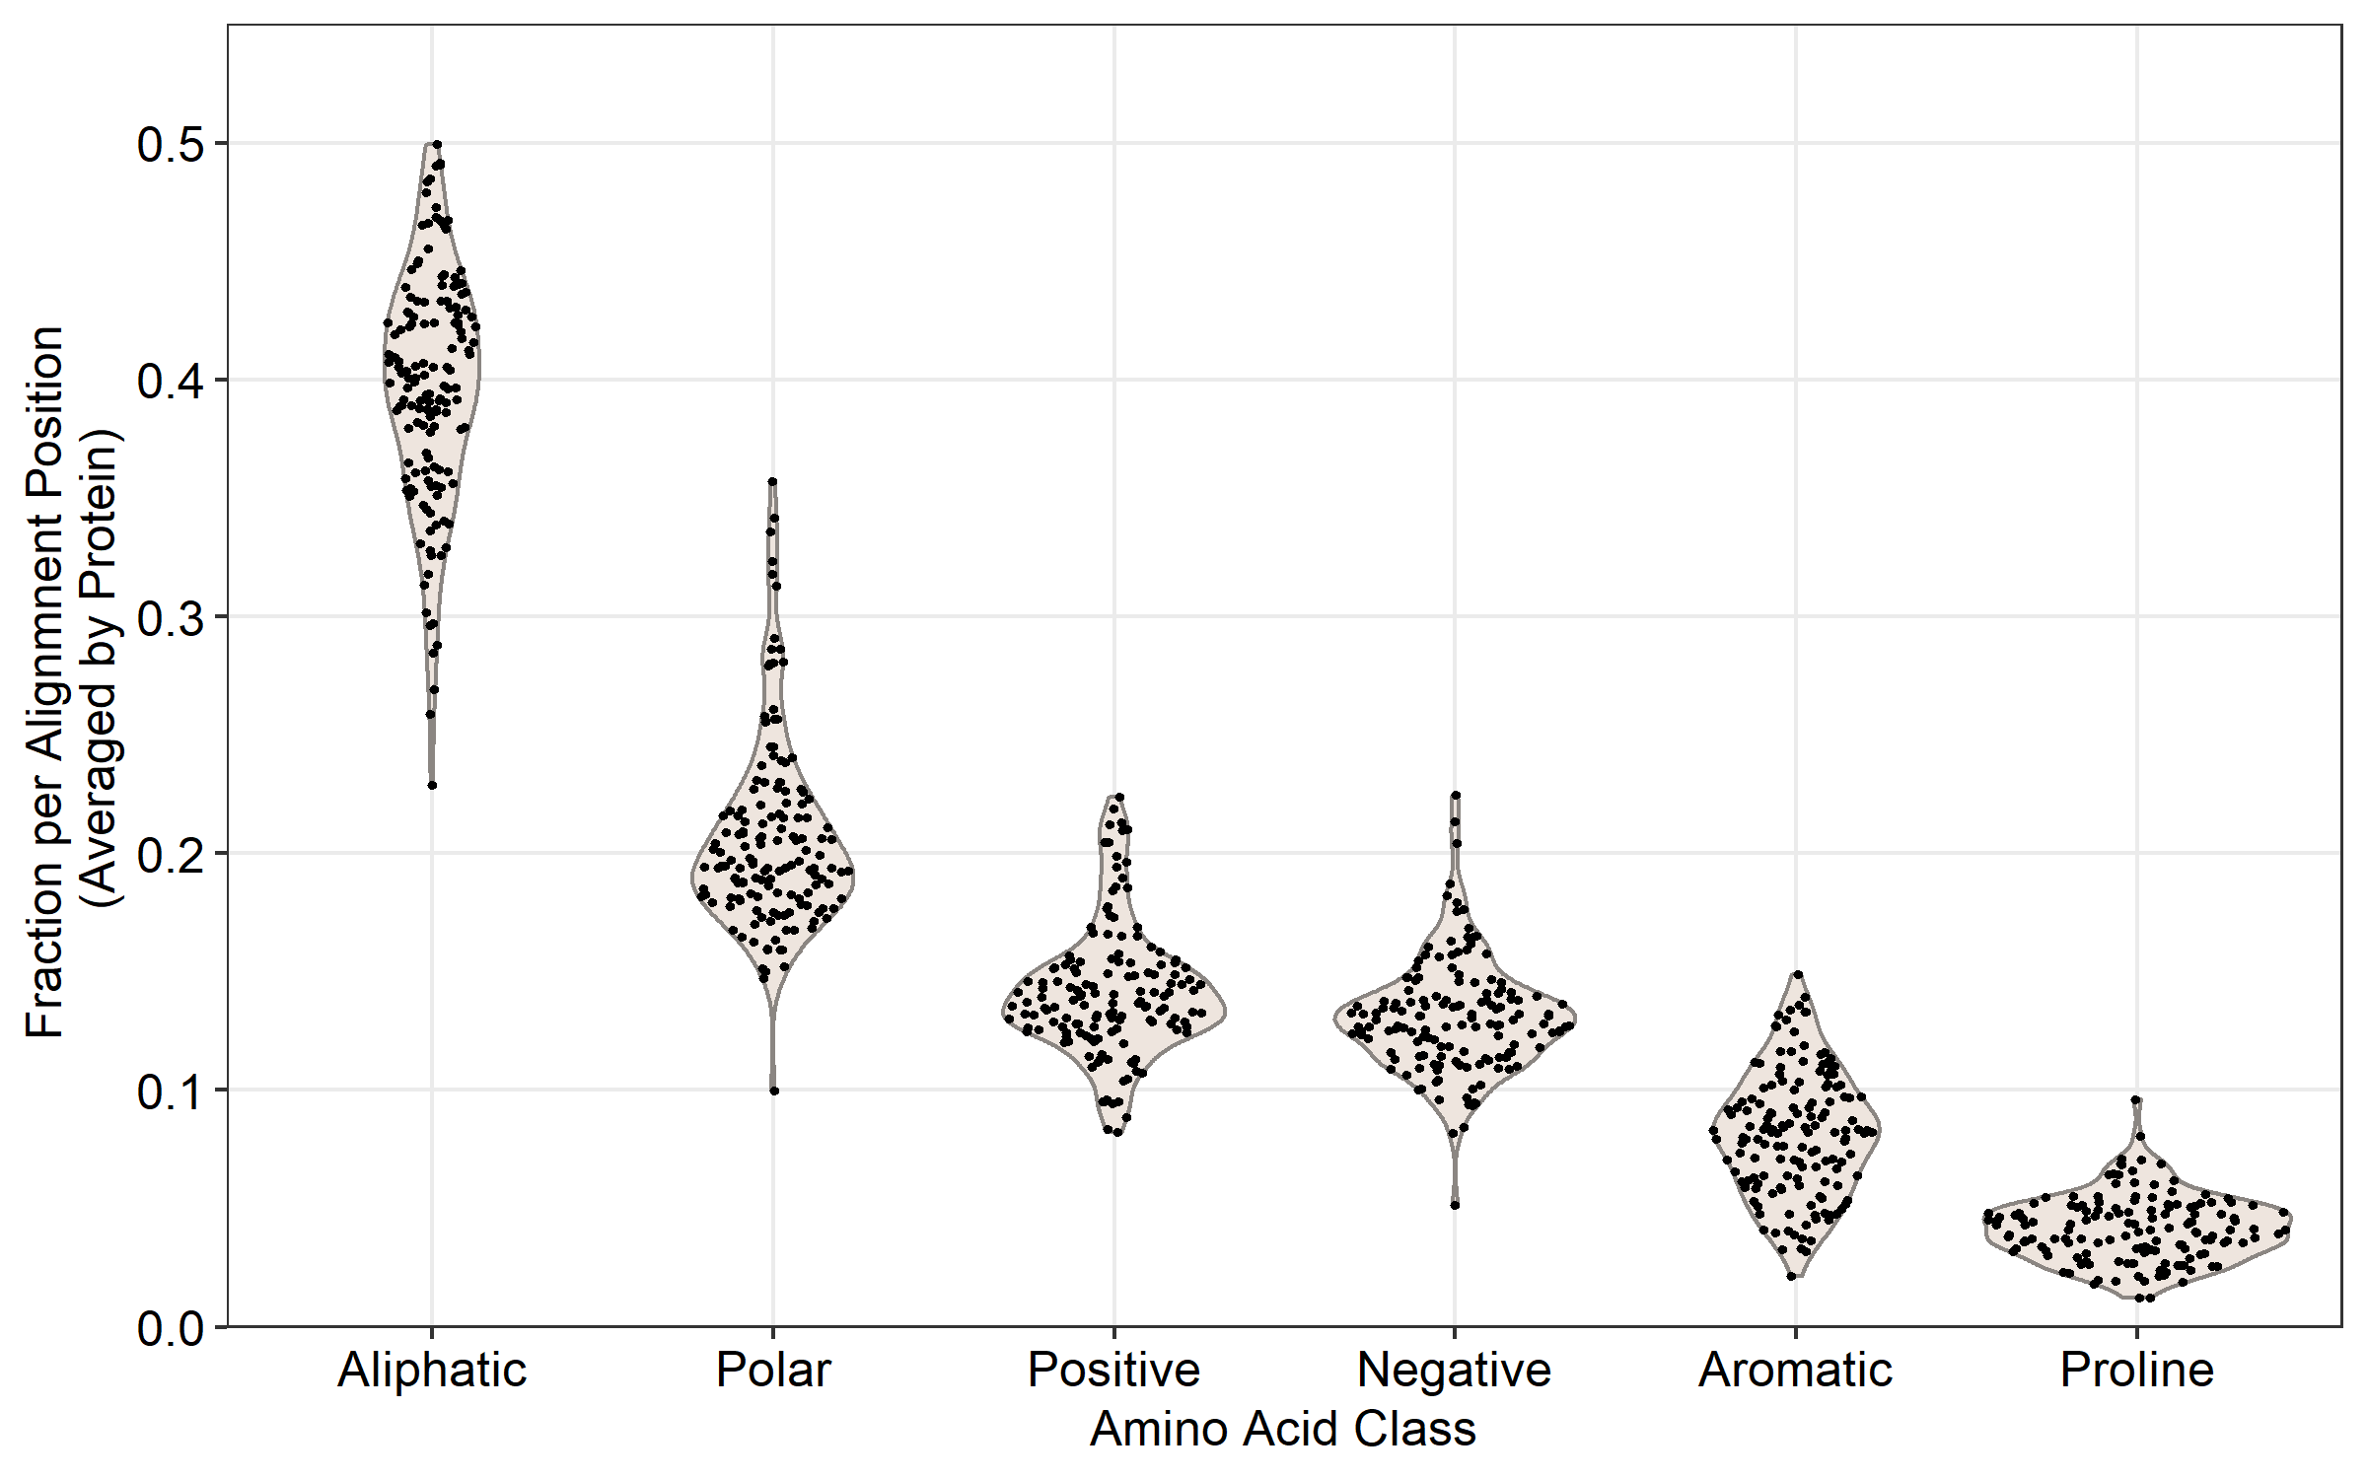
On average per protein alignment, alignment columns contain from 25% to 50% aliphatic residues.

Slide 45
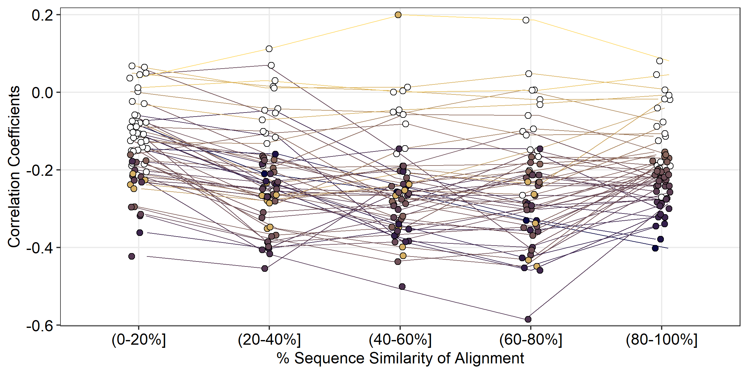
Correlation coefficients are lowest within the 60-80% similarity group. Most negative correlations are significant.

Slide 46
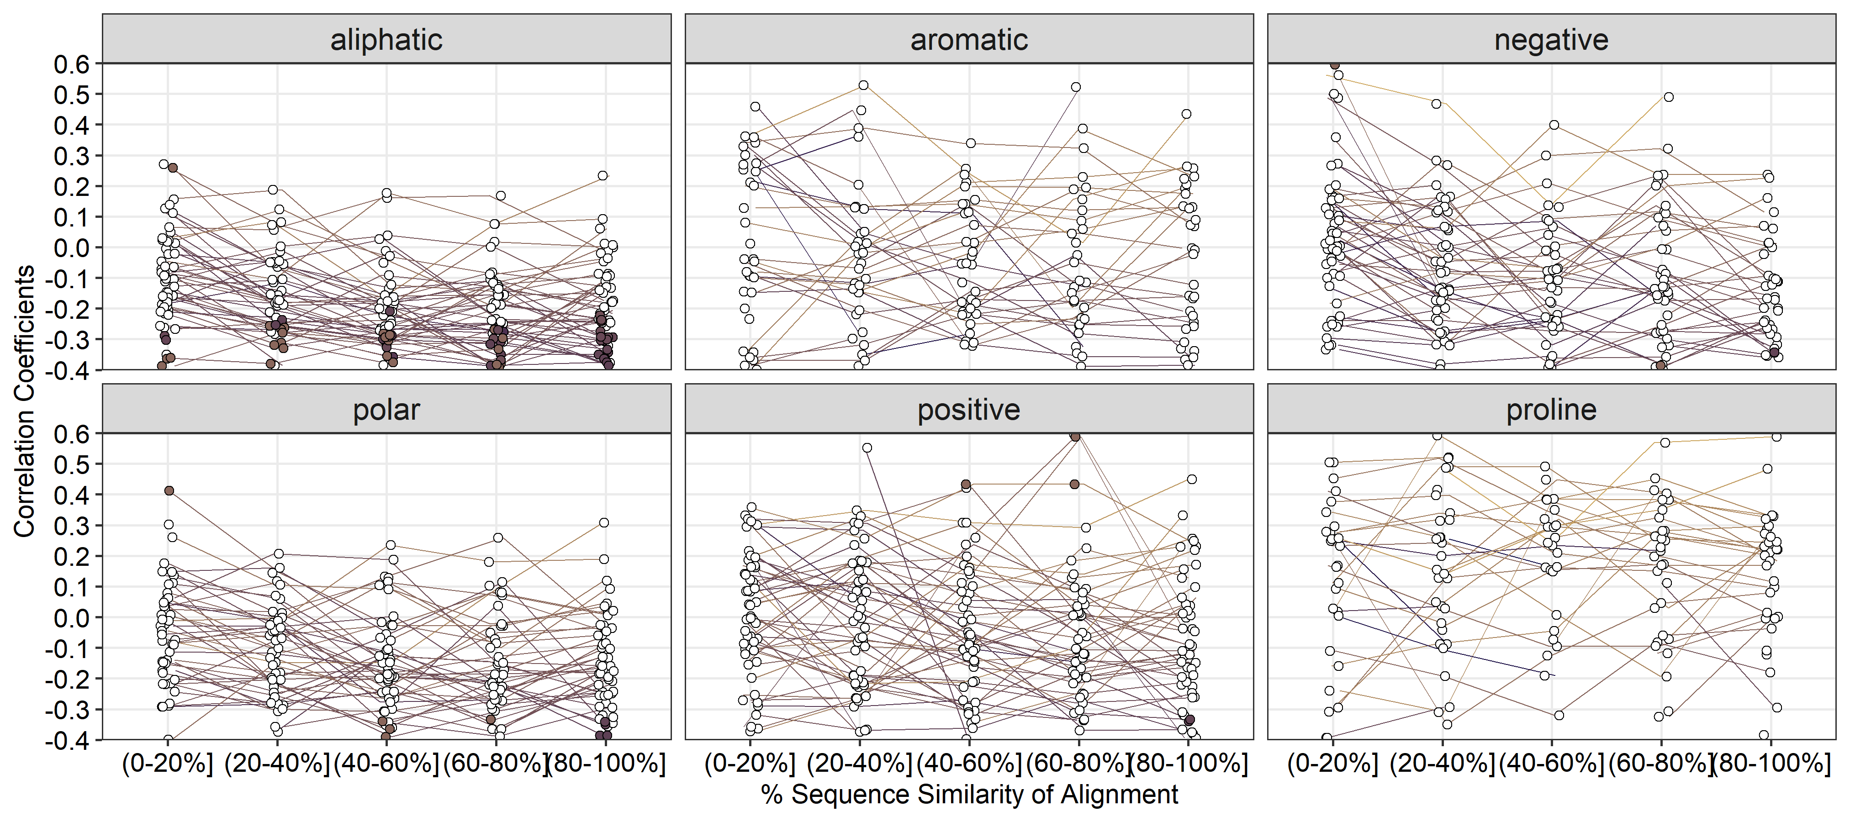
Significant negative correlations are seen at positions where wild type amino acid is aliphatic.

Slide 47
Summary and Limitations
Summary of results:
The CNN can predict both the wt residues and consensus residue.
The variation in CNN predictions correlates very weakly with the variation in natural proteins.
The first contact shell (12A) is sufficient in predicting protein residues from their structural context.

Slide 48
Summary and Limitations
Summary of results:
The CNN can predict both the wt residues and consensus residue.
The variation in CNN predictions correlates with the variation in natural proteins.
The first contact shell (12A) is sufficient in predicting protein residues from their structural context.
Limitations:
Multiple sequence alignments vary extensively by the number of sequences per alignment. Some proteins have alignments of only 10 sequences.
The amino acids and amino acid classes are not equally represented, we have an over-representation of aliphatic amino acids because they are most common. This might be problematic for protein engineering applications.
It would also be interesting to correlate the predictions with the variation generated by directed evolution or in-vitro mutagenesis.
Need a cleaner training set. The PSICOV proteins sequences should not be a subset of any protein used for training. Assessing for less than 50% similarity might not have been enough.

