Slide 1
The Attention Mechanism:
What Makes Transformers So Efficient
4/2/21

Slide 2
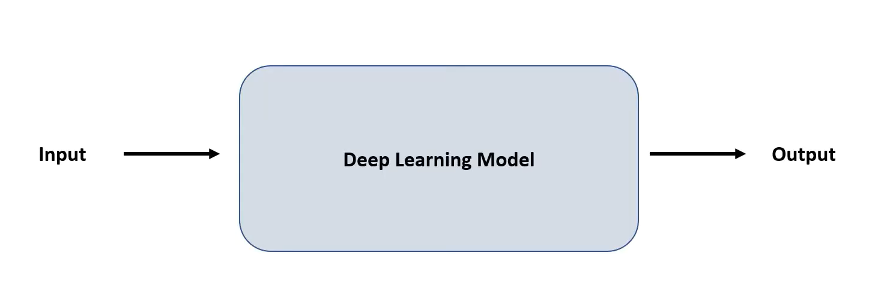
The attention mechanism is a method in deep learning that forces the input data structures to be contextualized and “attend” to each other.
The attention block takes input data as vectors and assigns contextualized meaning to the vectors by comparing them to each other.

Slide 3
The attention mechanism is a method in deep learning that forces the input data structures to be contextualized and “attend” to each other.
The attention block takes input data as vectors and assigns contextualized meaning to the vectors by comparing them to each other.
The attention block can be added to ANY deep learning model. Think of it as a “lego” block.

Slide 4
The attention mechanism is a method in deep learning that forces the input data structures to be contextualized and “attend” to each other.
The attention block takes input data as vectors and assigns contextualized meaning to the vectors by comparing them to each other.
The attention mechanism can be applied to ANY deep learning model. Think of it as a “lego” block.
The most common application of the attention mechanism is Transformers, which have now become the standard in natural language processing tasks.

Slide 5
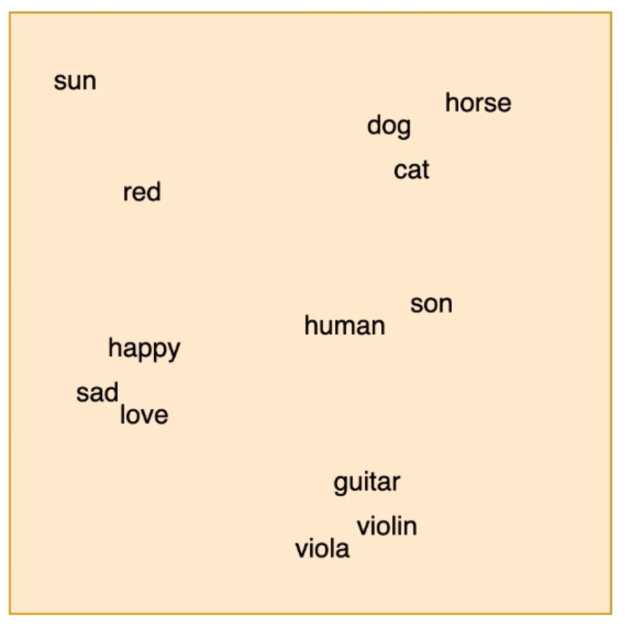
Let’s look at an example when attention is used in natural language processing.
Sentence: “The dog jumped over the cat.”
First, each word in the sentence is converted to a vector.
This vector is mapped to a pre-trained embedding space.
3) The resulting embedded vector is then passed to the attention block.

Slide 6
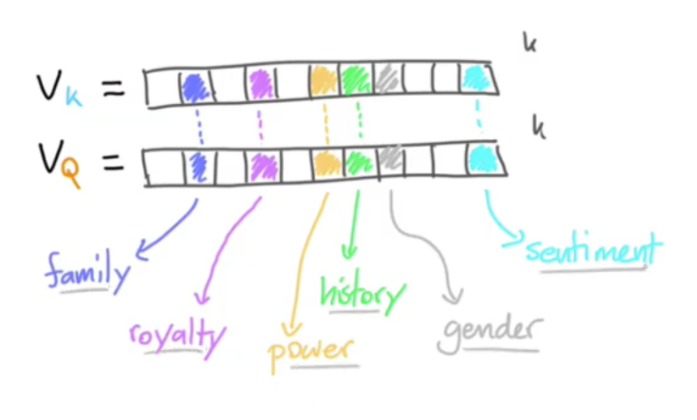
Here is what two embedded vectors might look like:
Word: “King”
Word: “Queen”

Slide 7
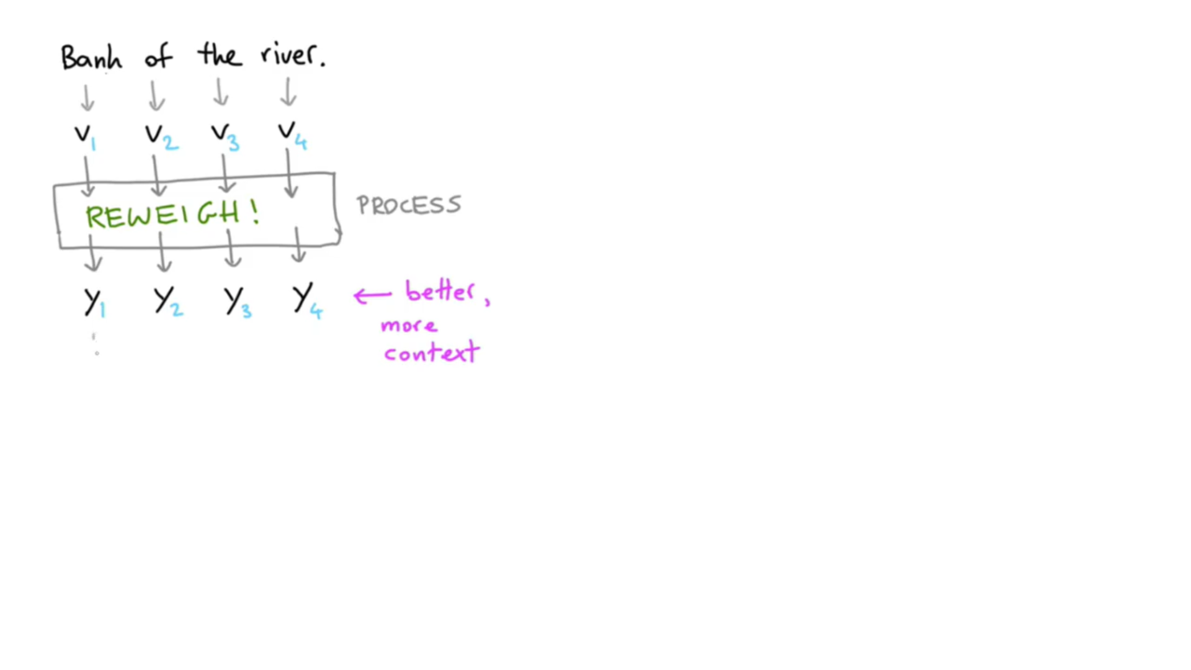
We have our embedded vectors, now let’s go through the attention mechanism.
We don’t know if “bank” here means “money” or “river bank”.
So, we need to also encode the context in the embedding for “bank:.

Slide 8
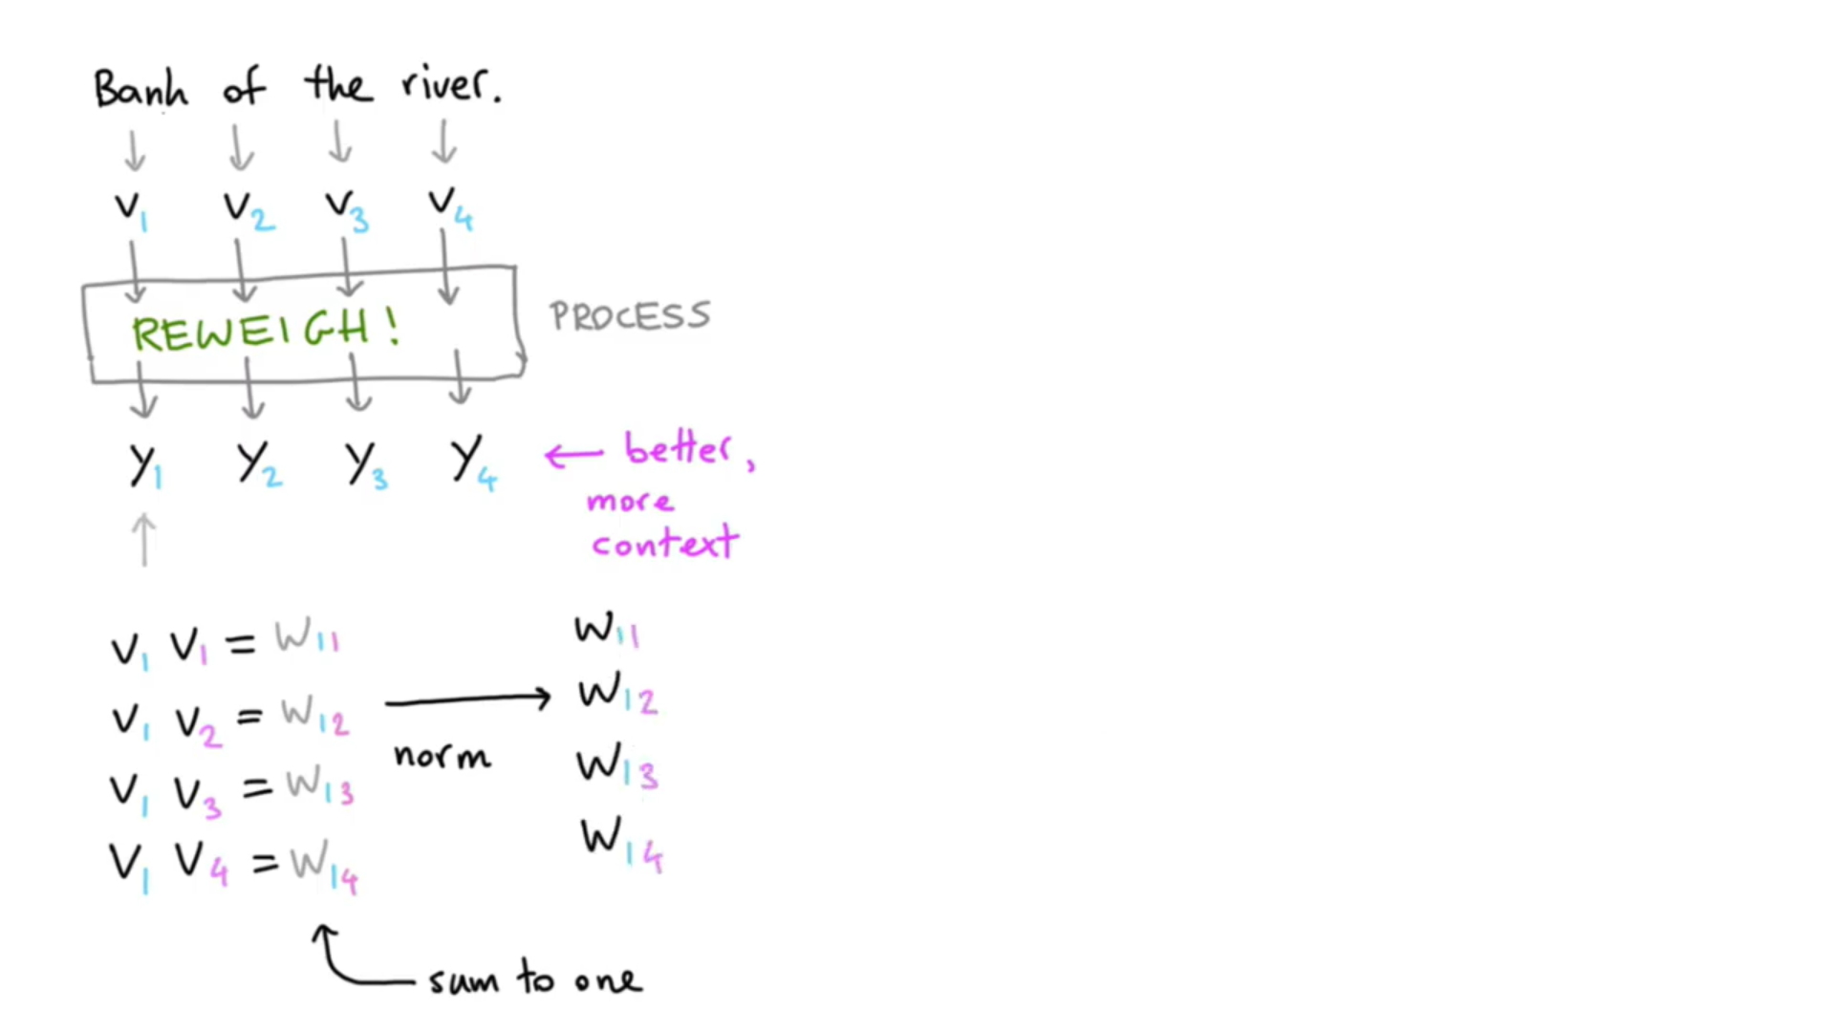

Slide 9
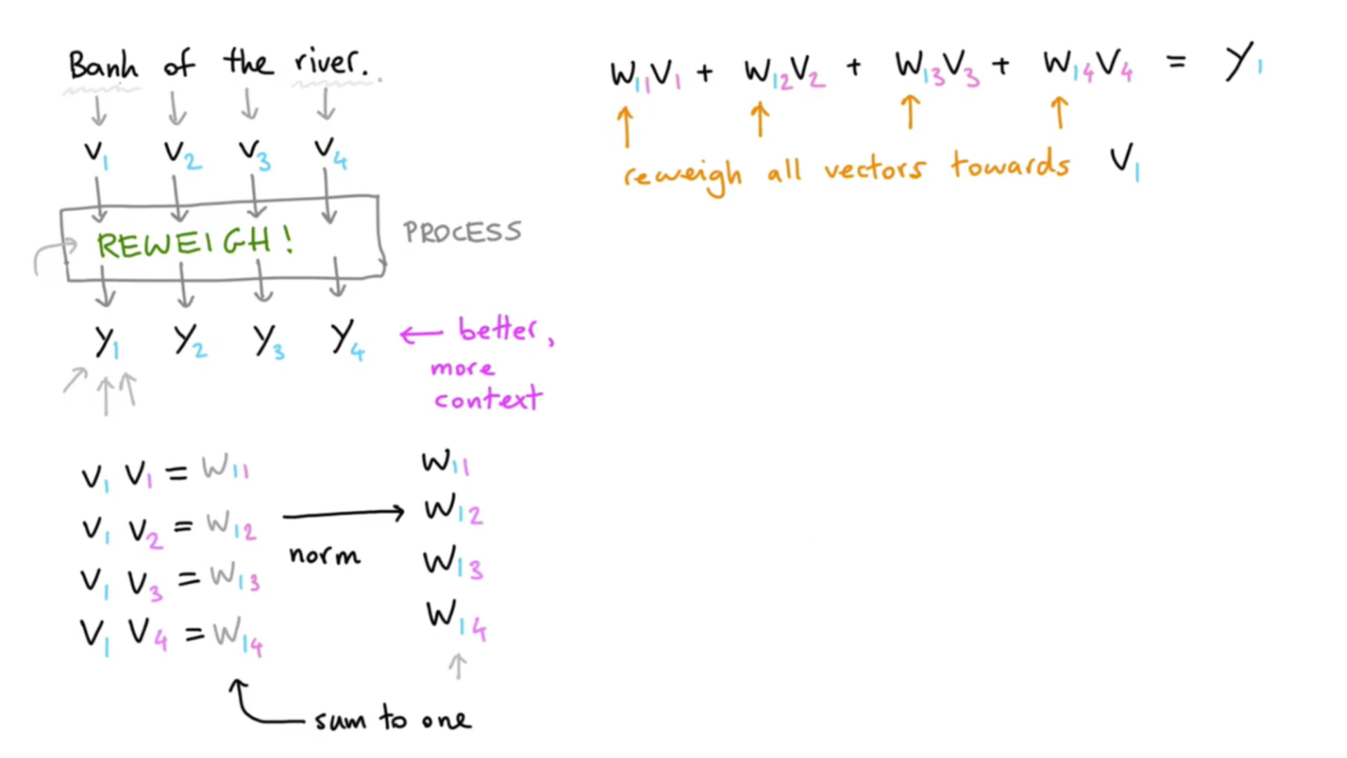

Slide 10
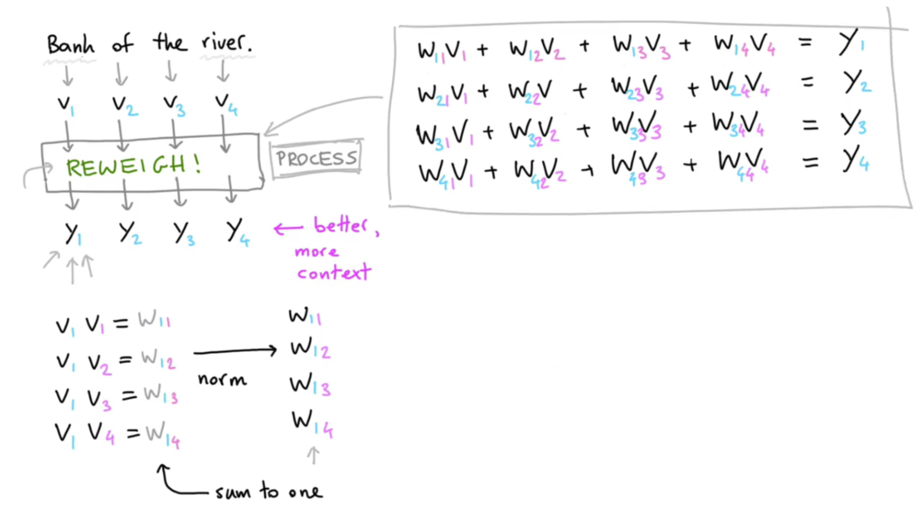

Slide 11
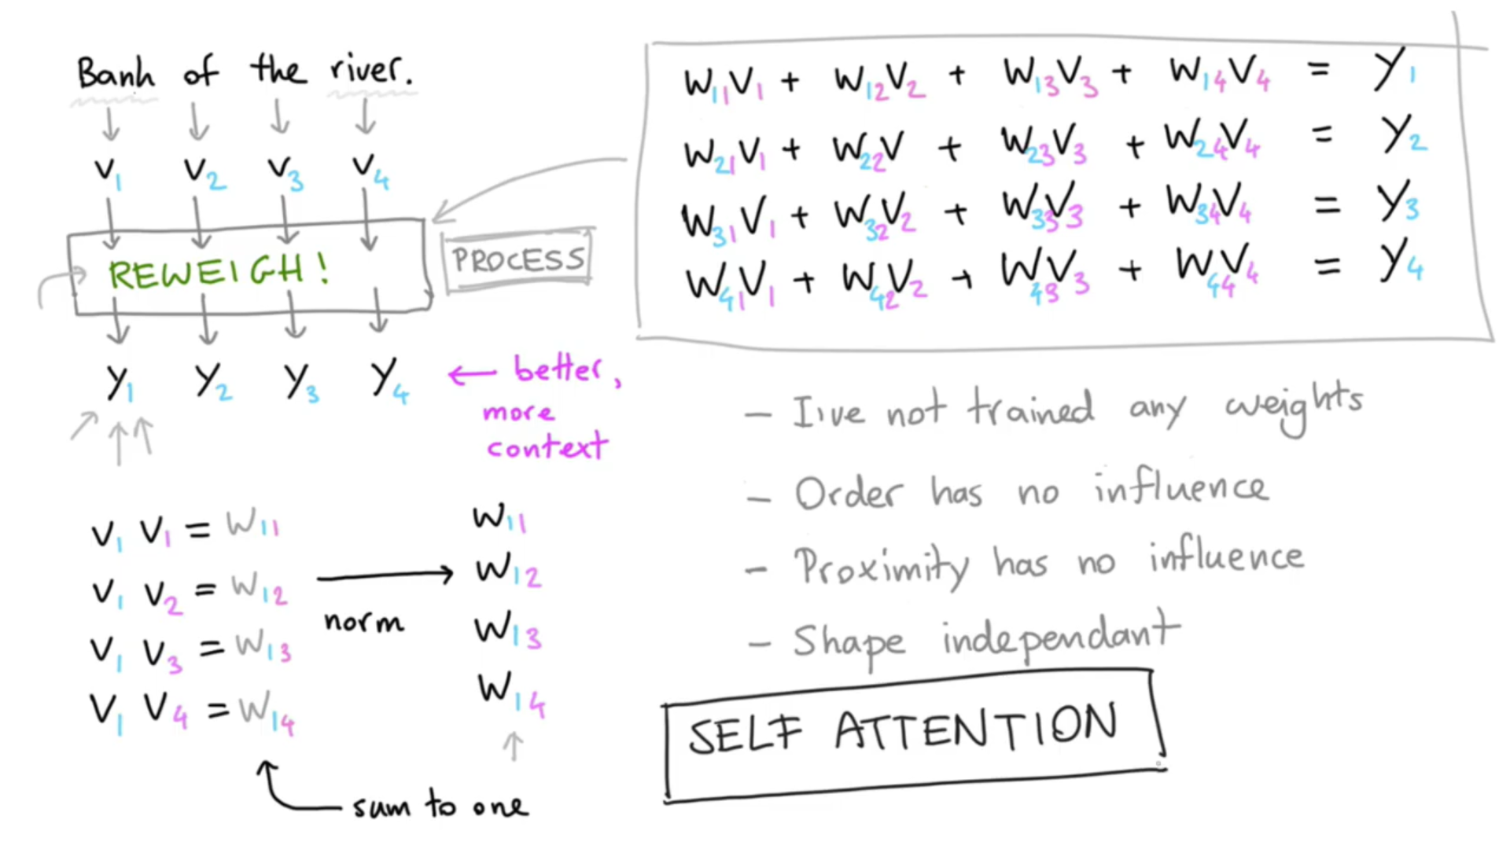

Slide 12
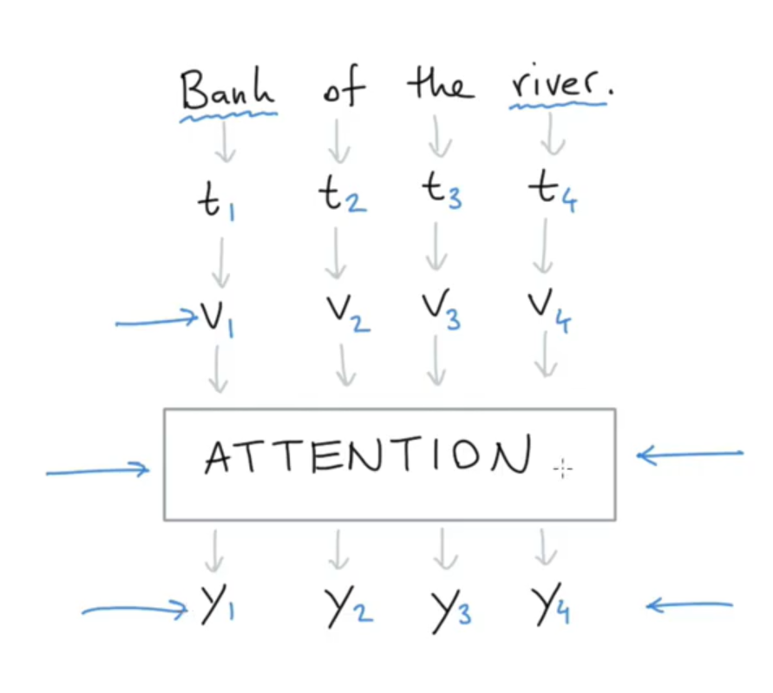
In summary:
Could mean “money”
Weights applied
We hope this now means “river bank”
Vectors with more context

Slide 13
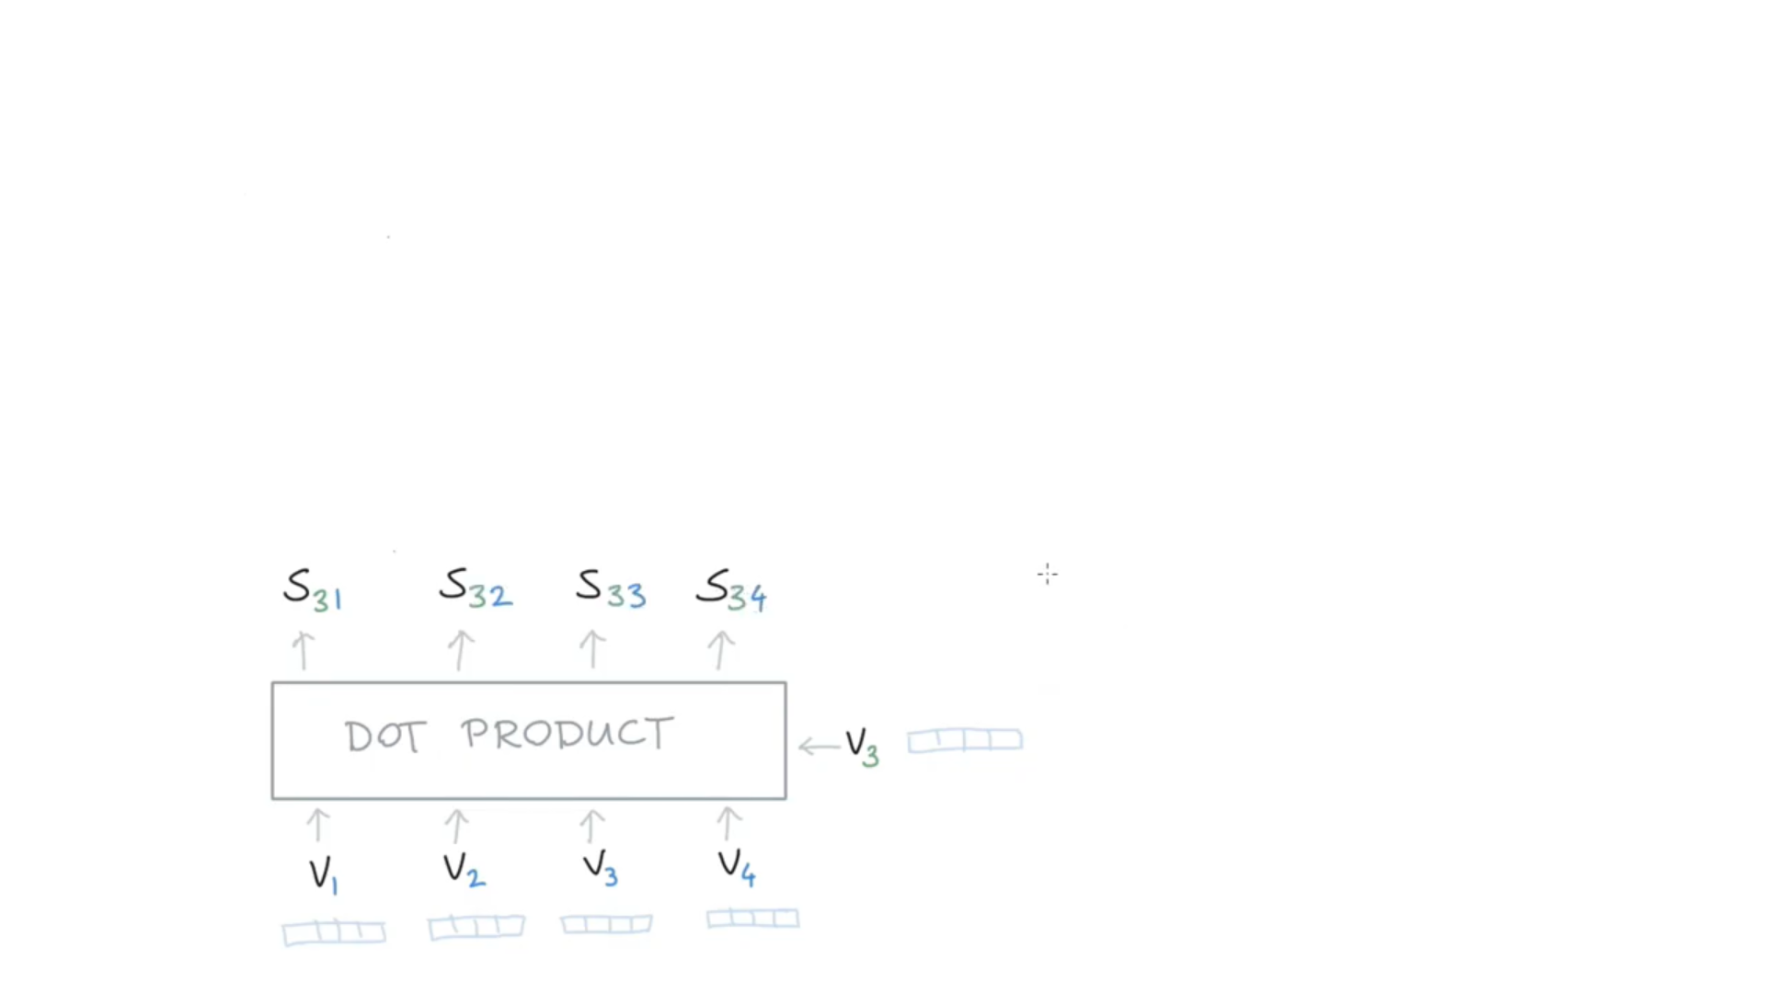
Another recap of what we just did:

Slide 14
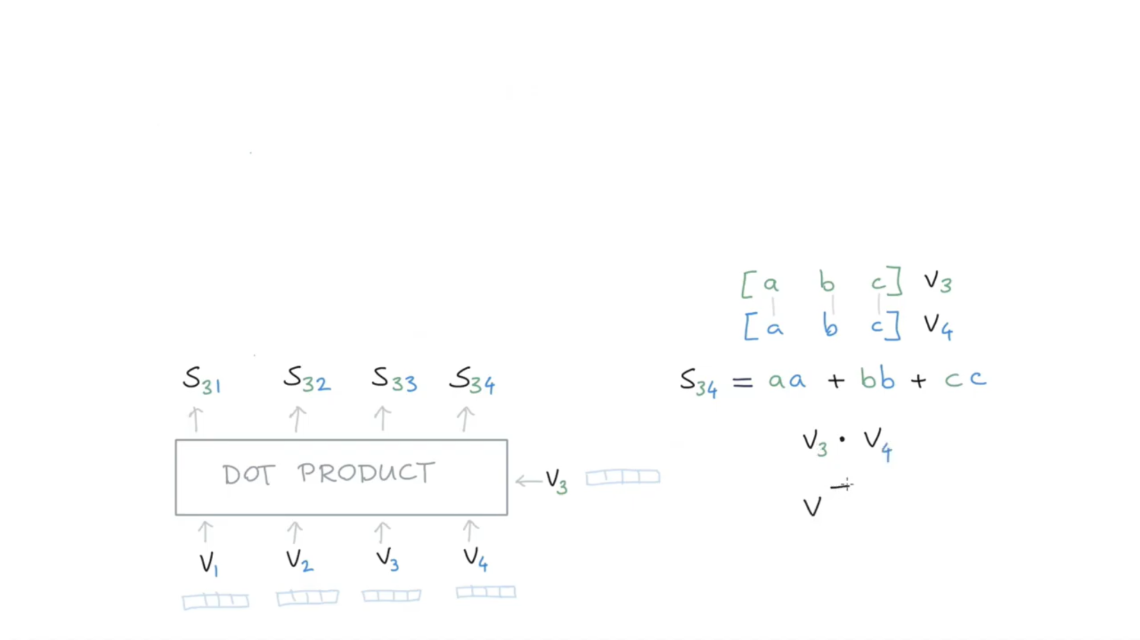

Slide 15
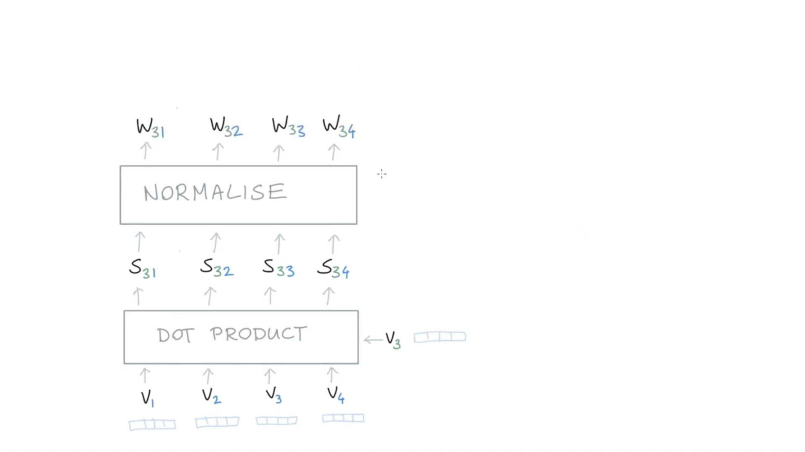

Slide 16
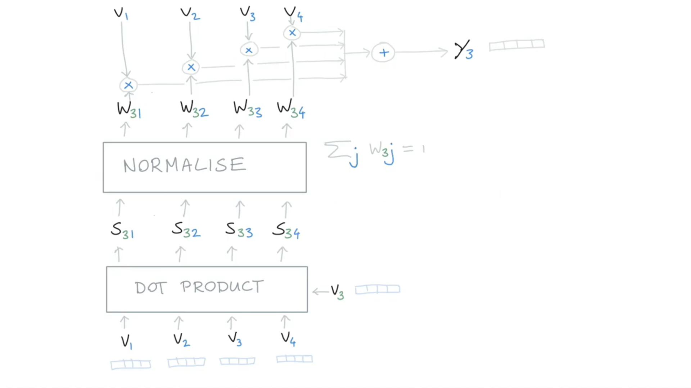

Slide 17
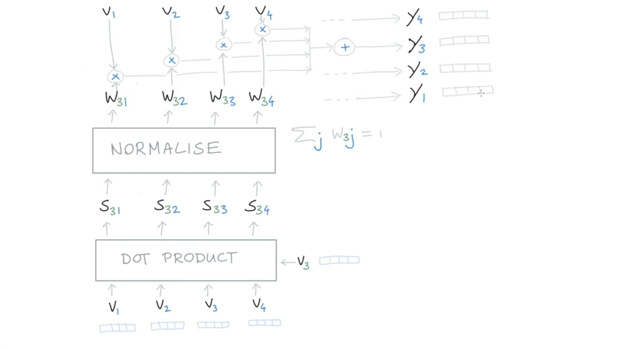

Slide 18
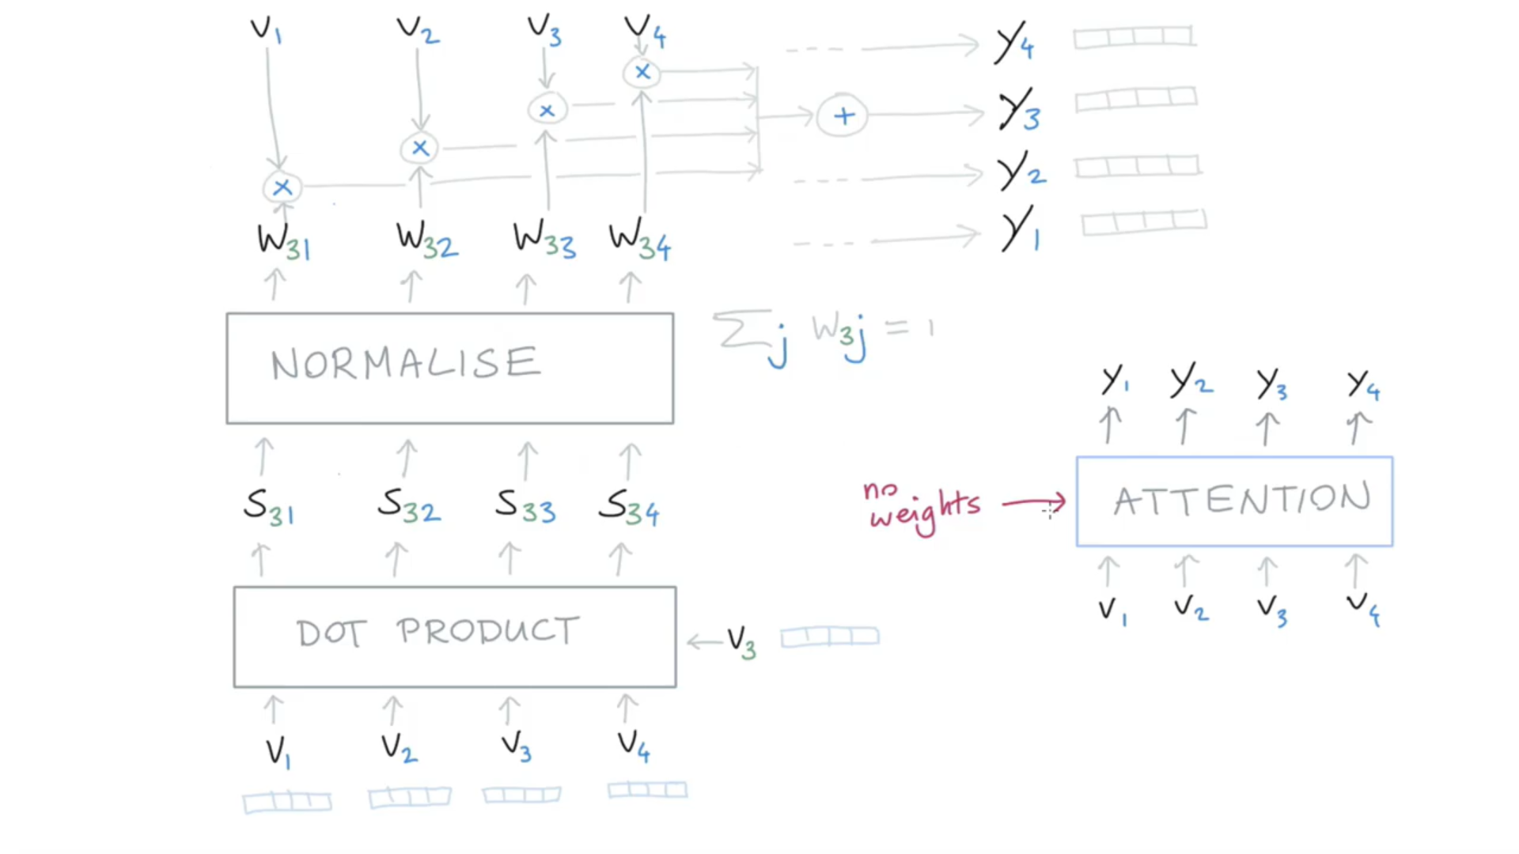

Slide 19
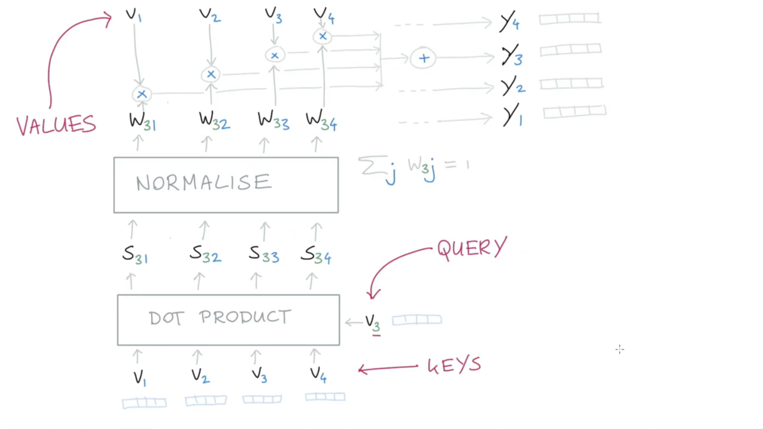

Slide 20
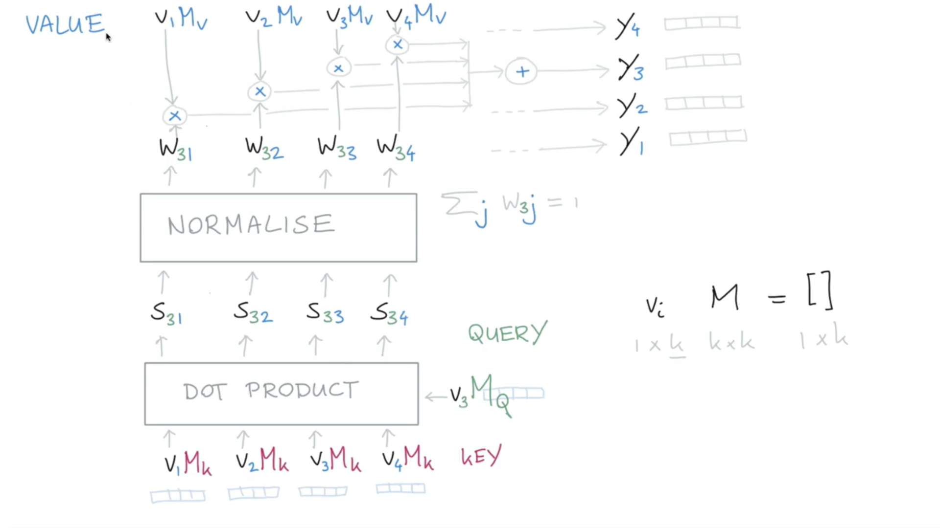
Adding trainable weights

Slide 21
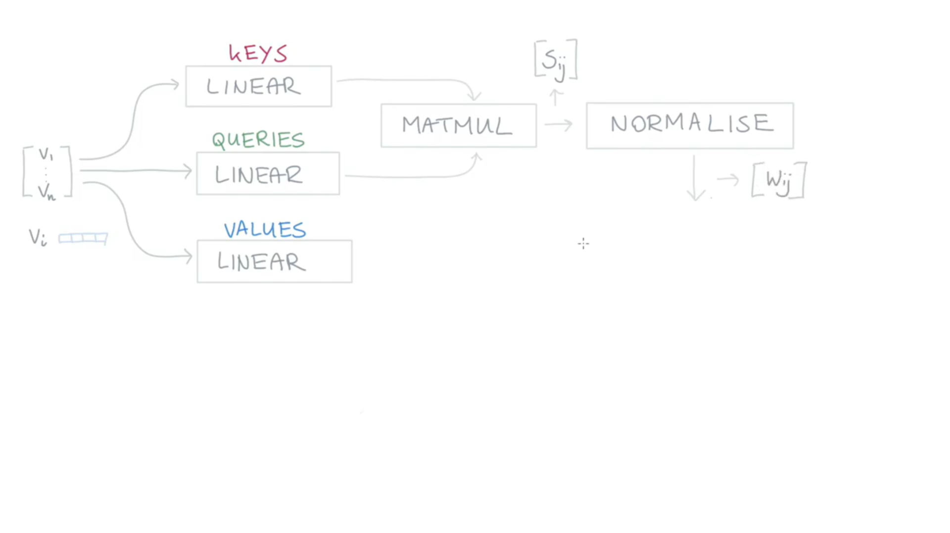
Let’s put everything into a diagram

Slide 22
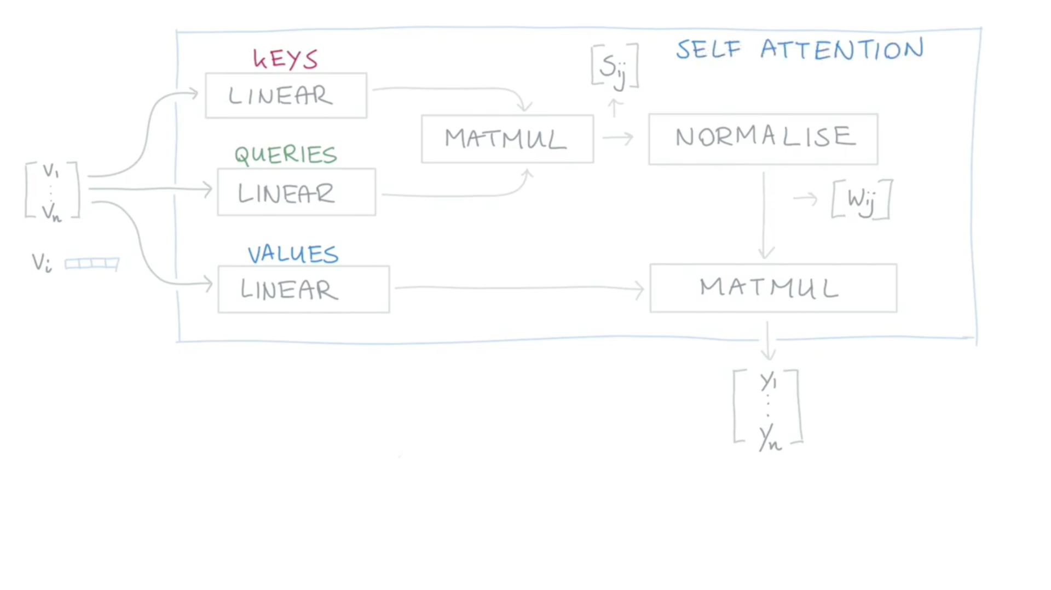

Slide 23
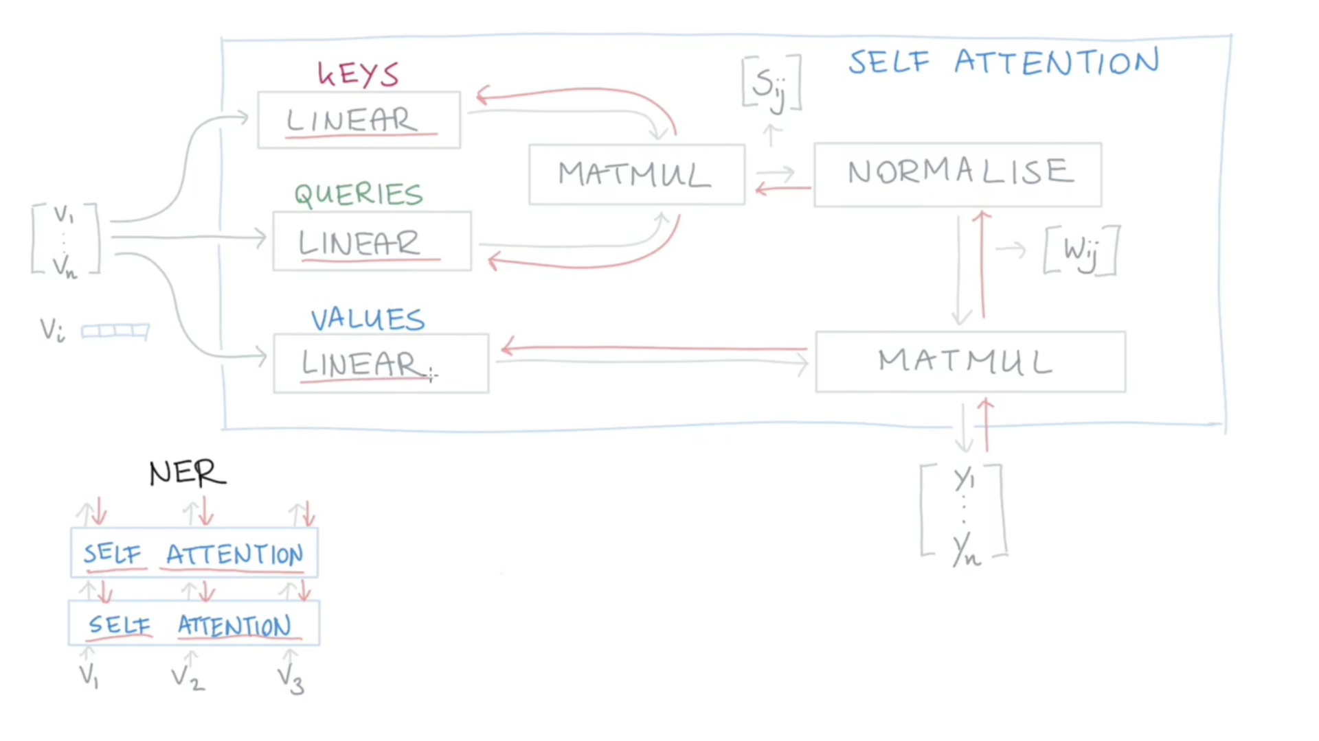
Red arrows represent back propagation and updating of the weights with training.
There can be multiple consecutive self-attention blocks.

Slide 24
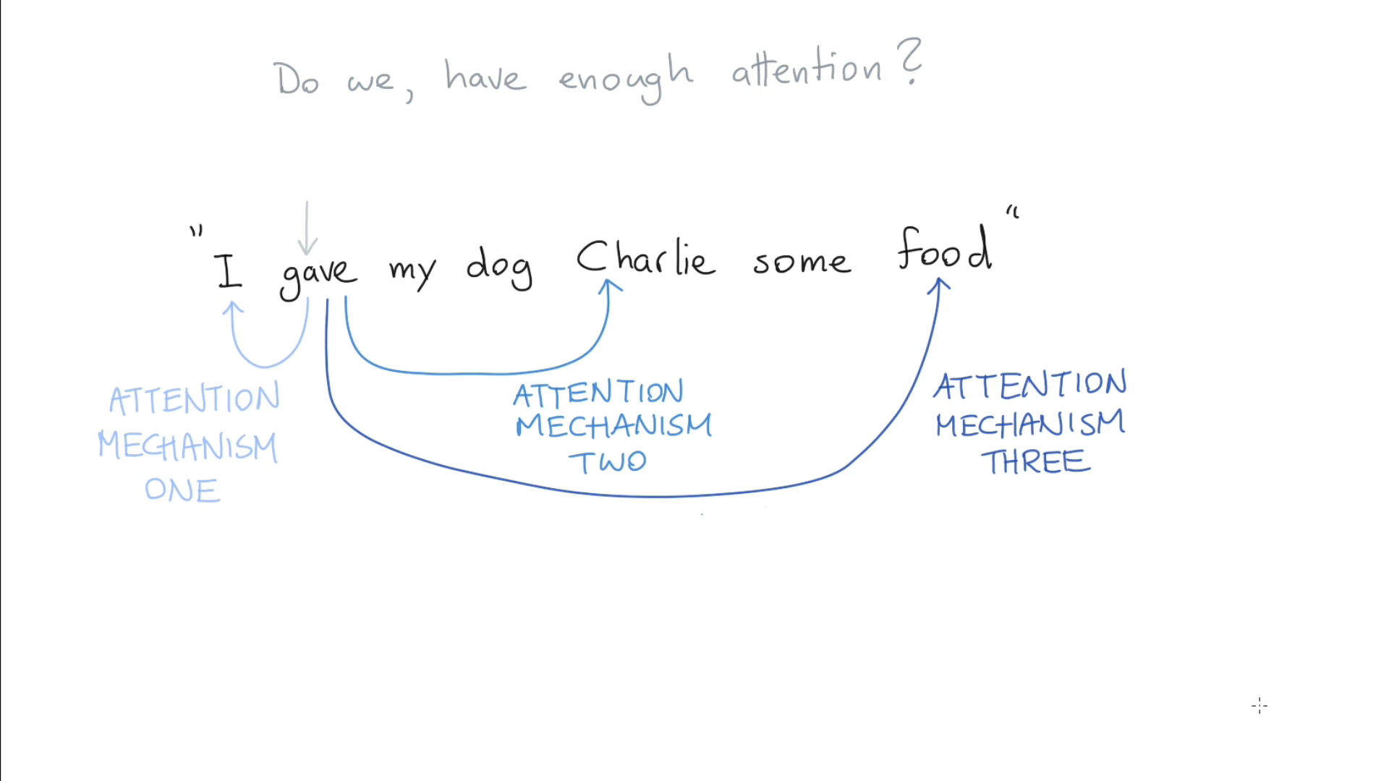
Let’s look at another more complicated sentence:

Slide 25
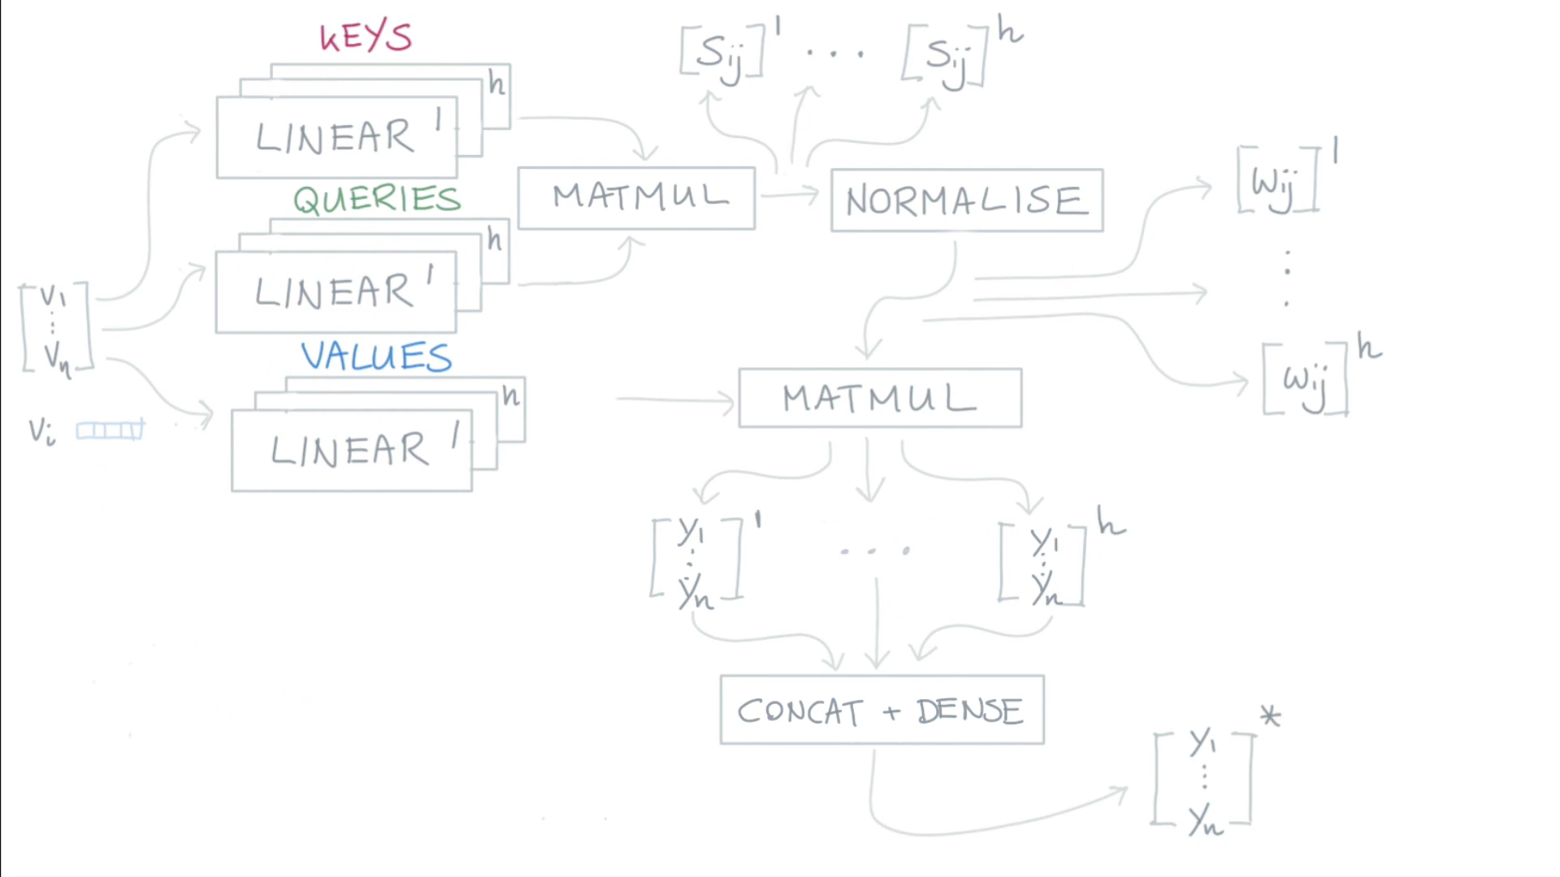
We can have multiple attention heads
Single contextualized vector

Slide 26
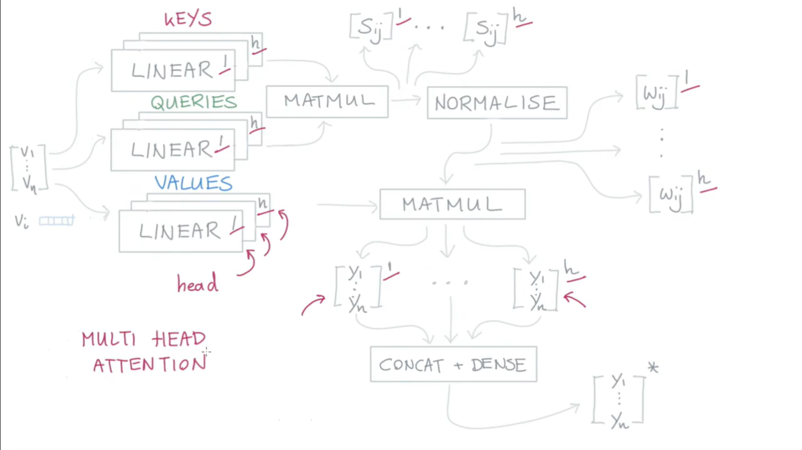

Slide 27
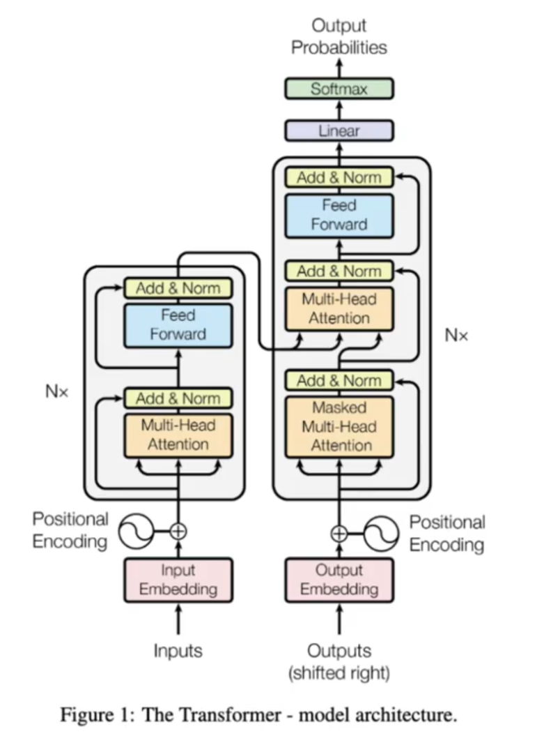
Now let’s look at the original transformer published in the “Attention is All You Need” paper in 2017.
This transformer was used for translating English to French.

Slide 28
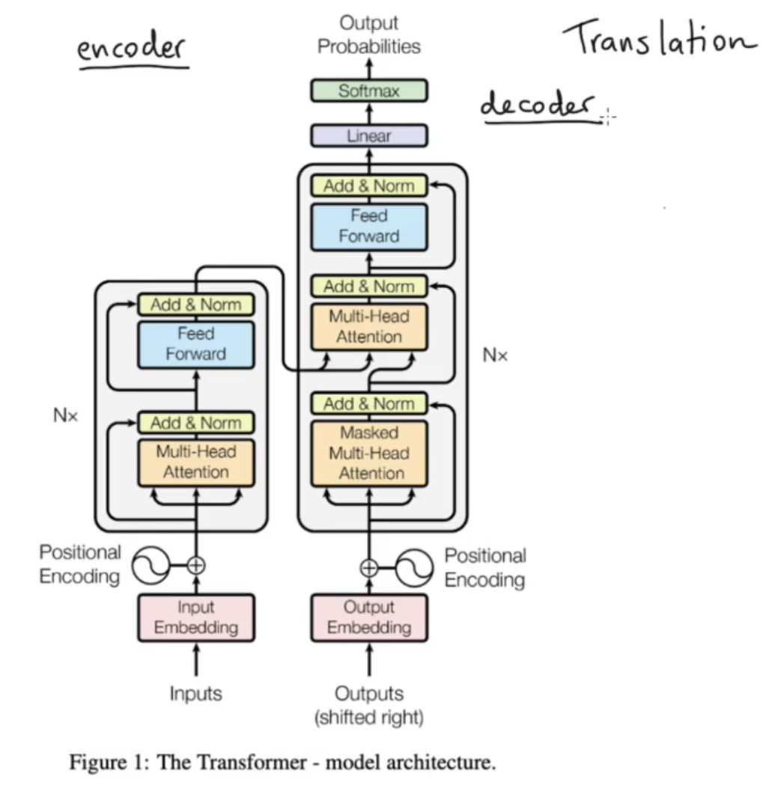
Accepts the English coming in.
Generates the French coming out.

Slide 29
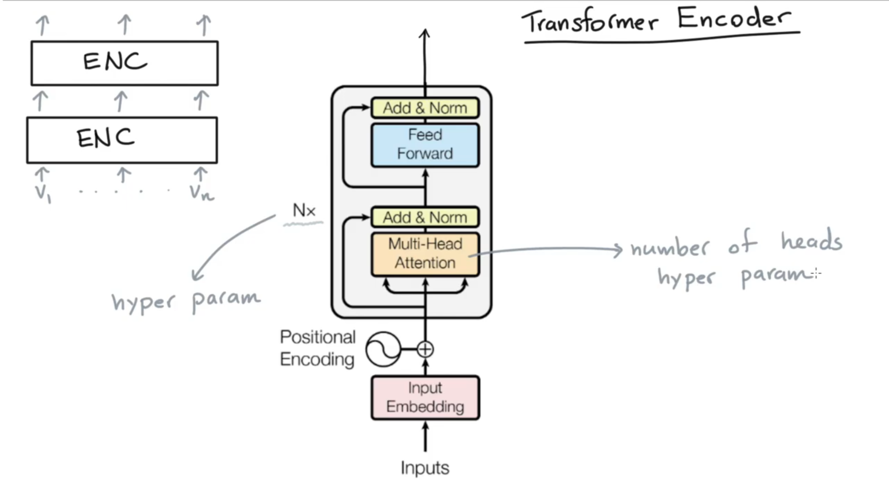

Slide 30
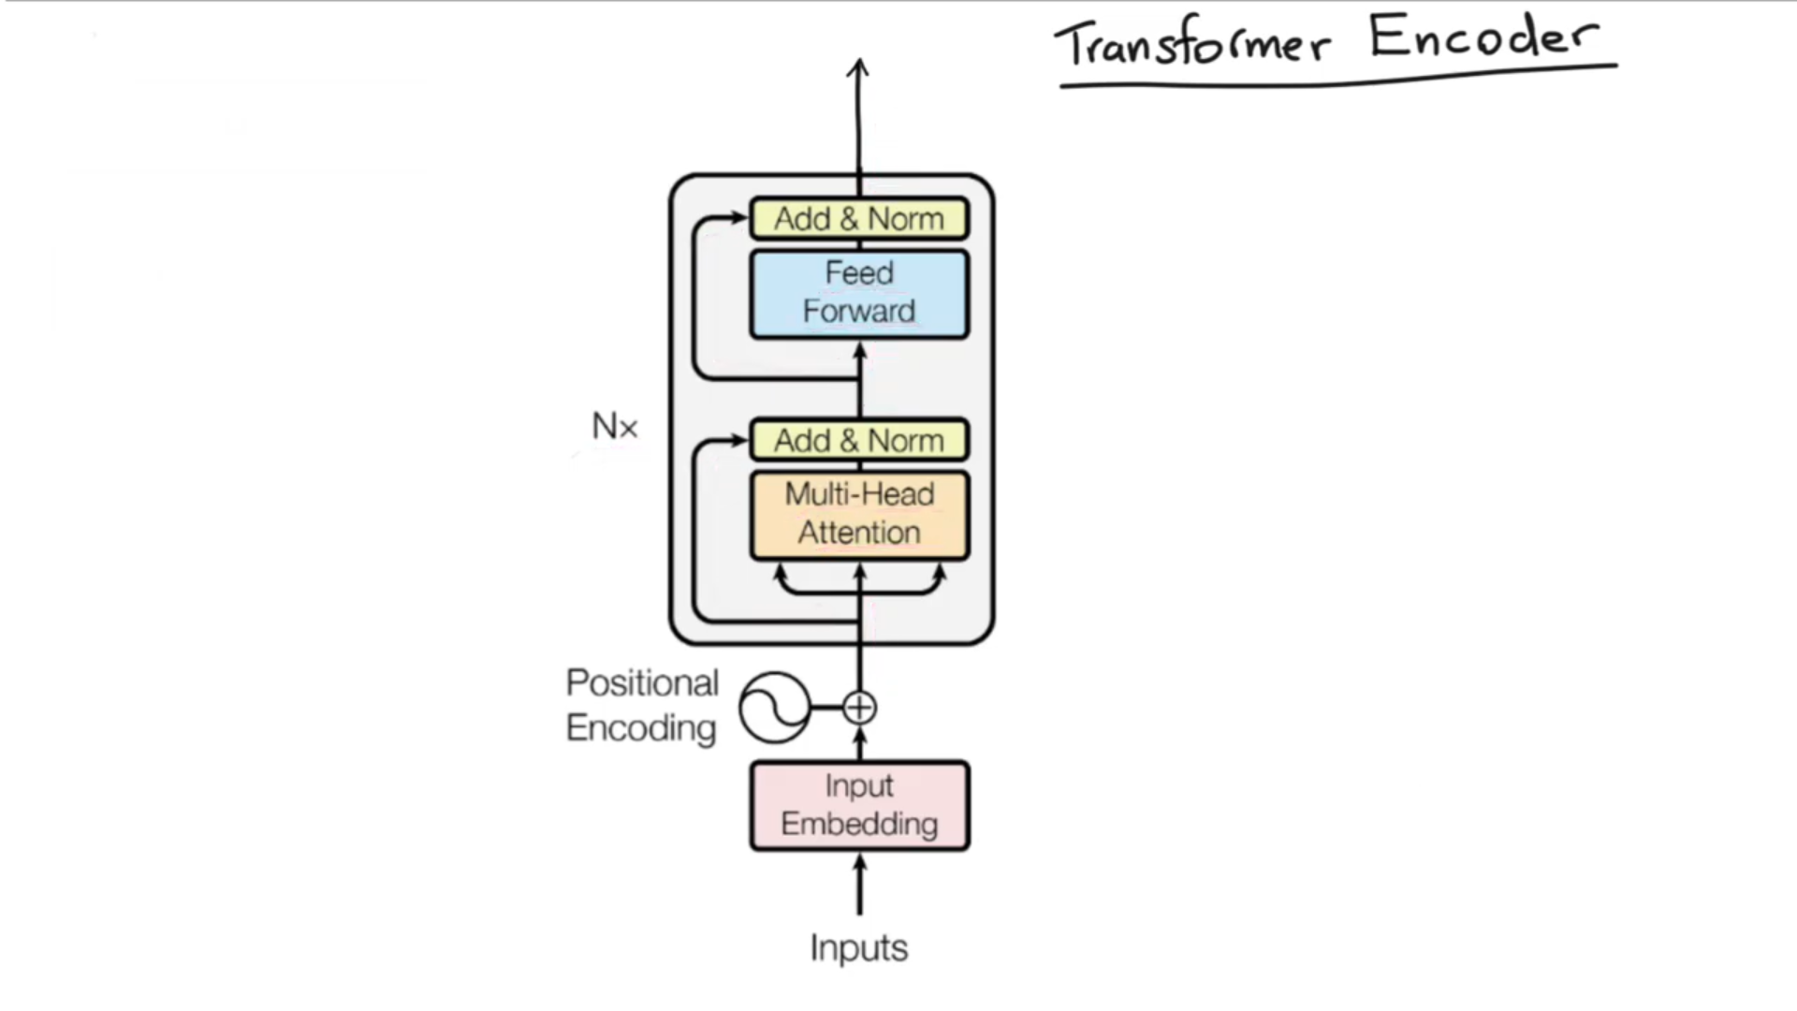
Original input vectors are added back to Multi-Head Attention output vectors to reduce effects of the vanishing gradient.

Slide 32
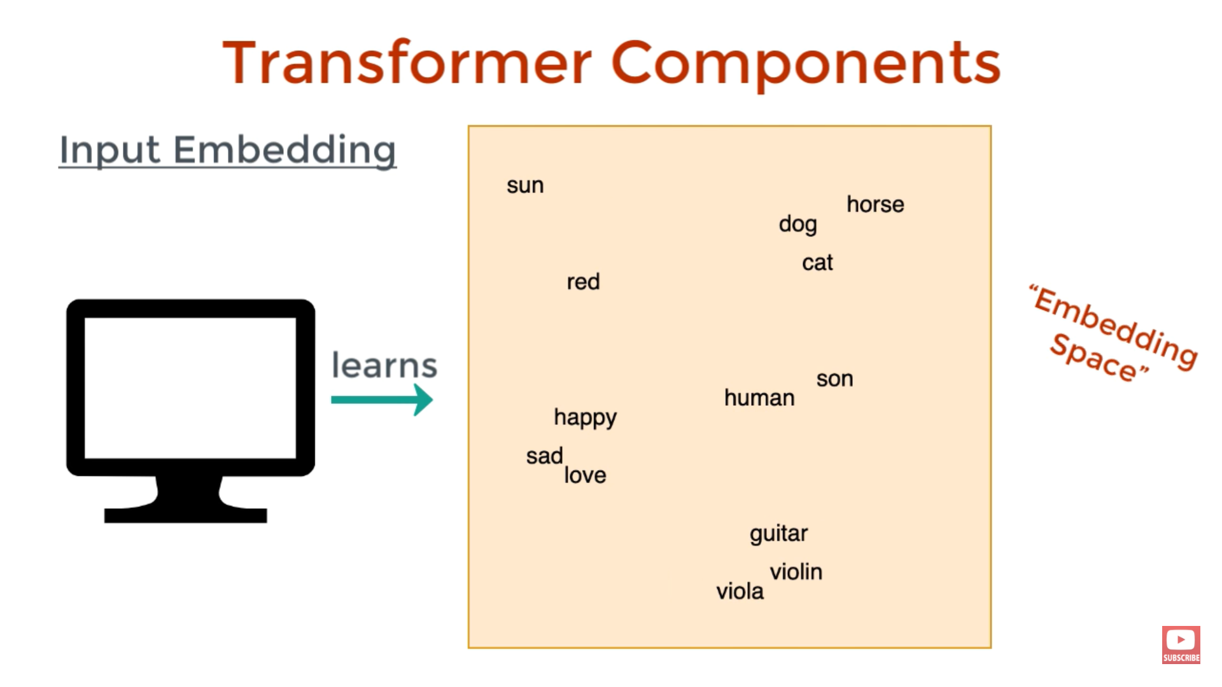

Slide 34
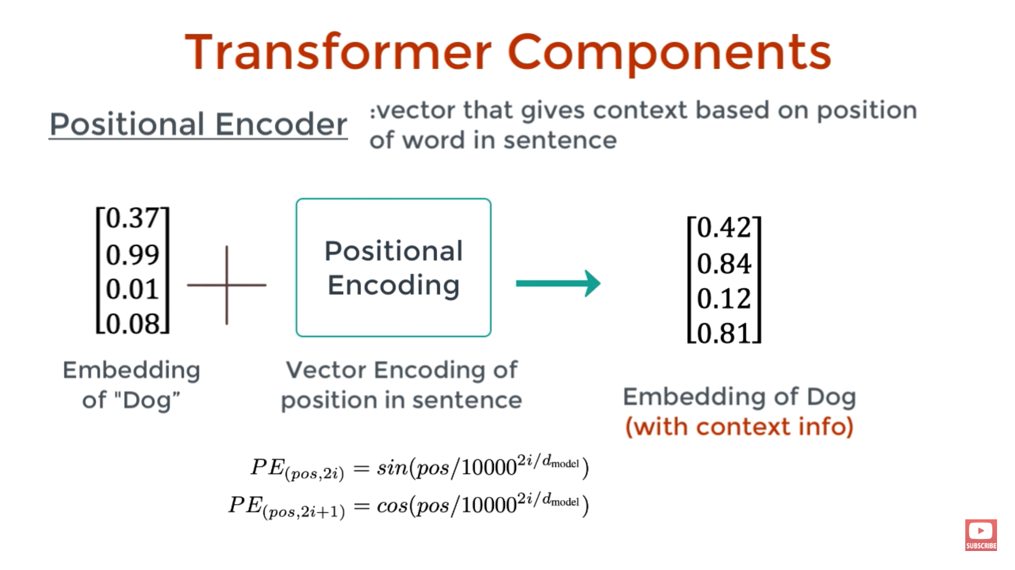

Slide 35
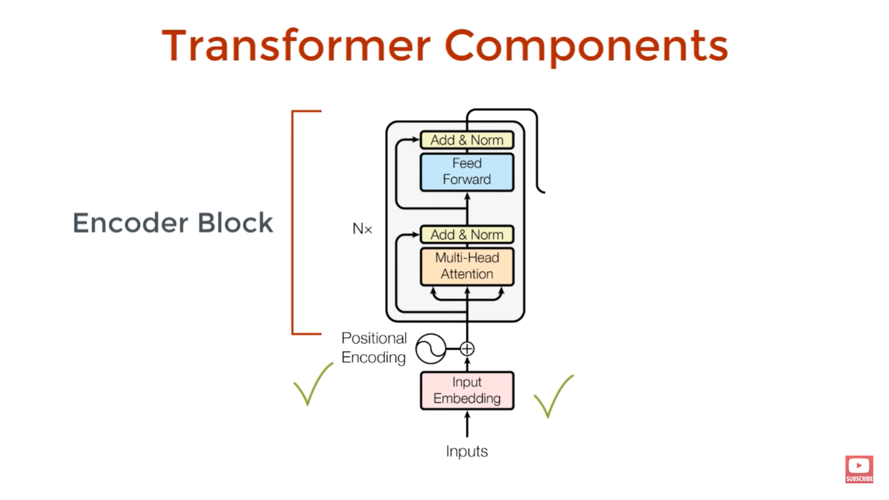

Slide 36

Adds context that is based on a very parallelizable algorithm.

Slide 37
Accepts the English coming in.
Generates the French coming out.

Slide 38
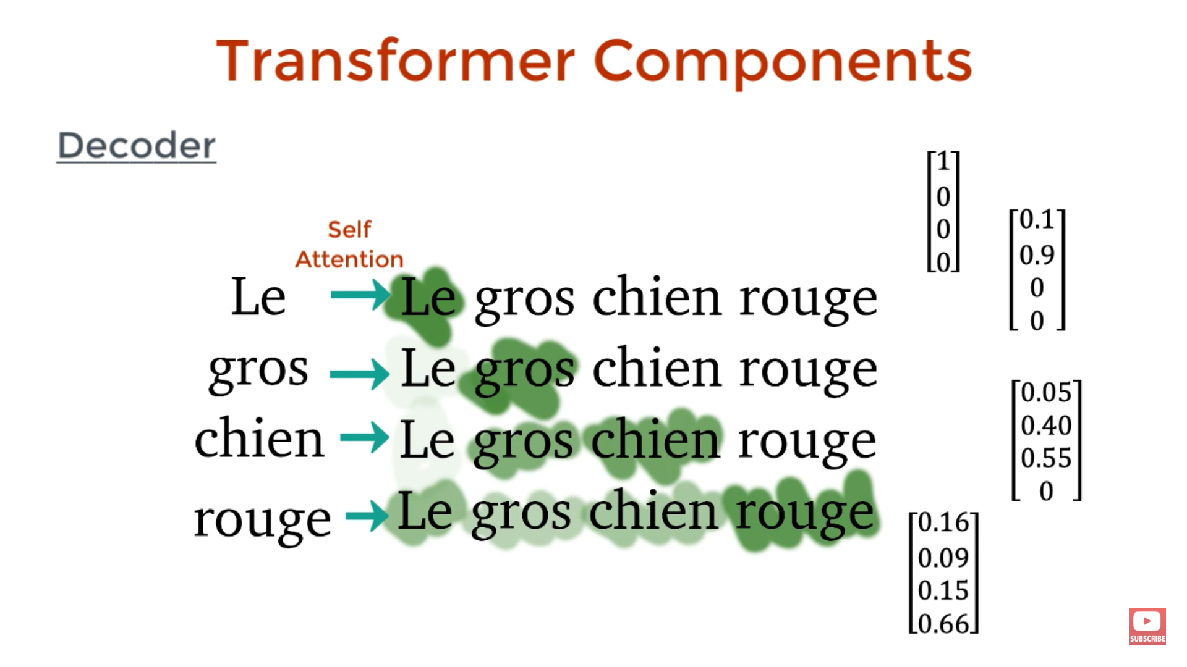

Slide 39
Accepts the English coming in.
Generates the French coming out.

Slide 40
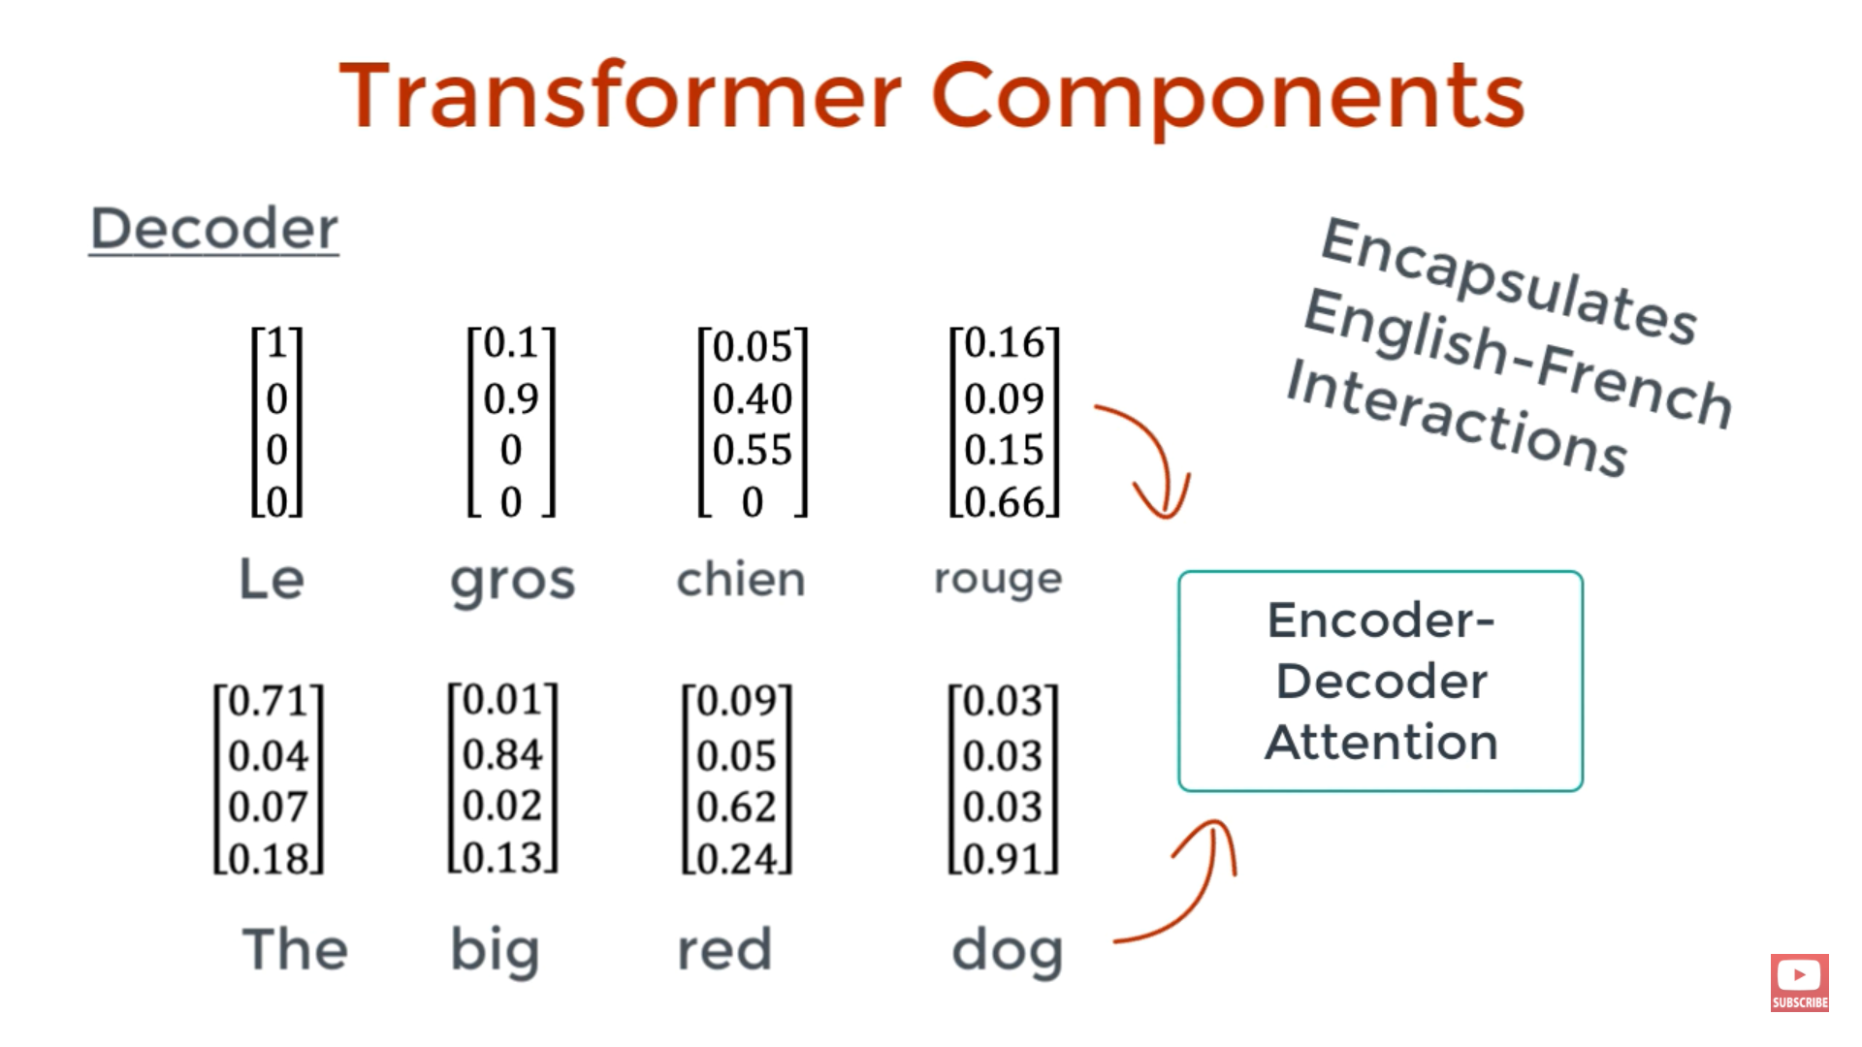
The english word vectors coming out of the encoder and the french word vectors are passed into the encoder-decoder attention block.
Every French word vector is multiplied by every English vector.

Slide 41
Accepts the English coming in.
Generates the French coming out.

Slide 42
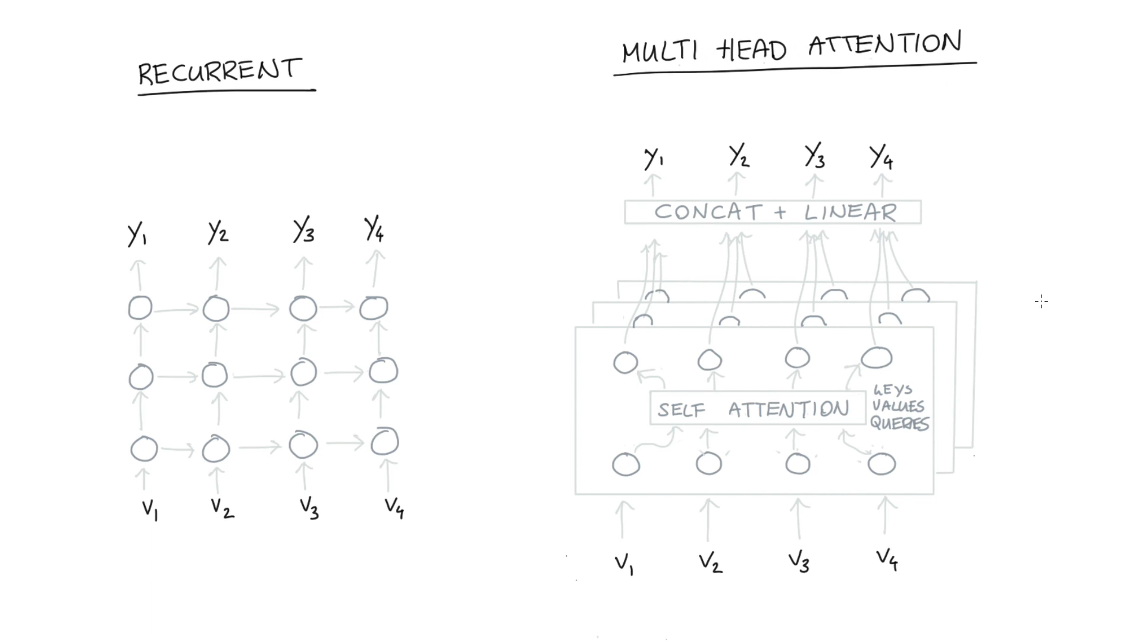
In an RNN, to figure out the value of the top right node, you need to know the values of all the neighbors and their neighbors.
Vanishing gradient problem.
You need inputs of the previous state to make any operations on the current state.
Multiple attention heads can be trained in parallel.
Enables us to focus out “attention” right away to words/embeddings that are far apart.

Slide 43
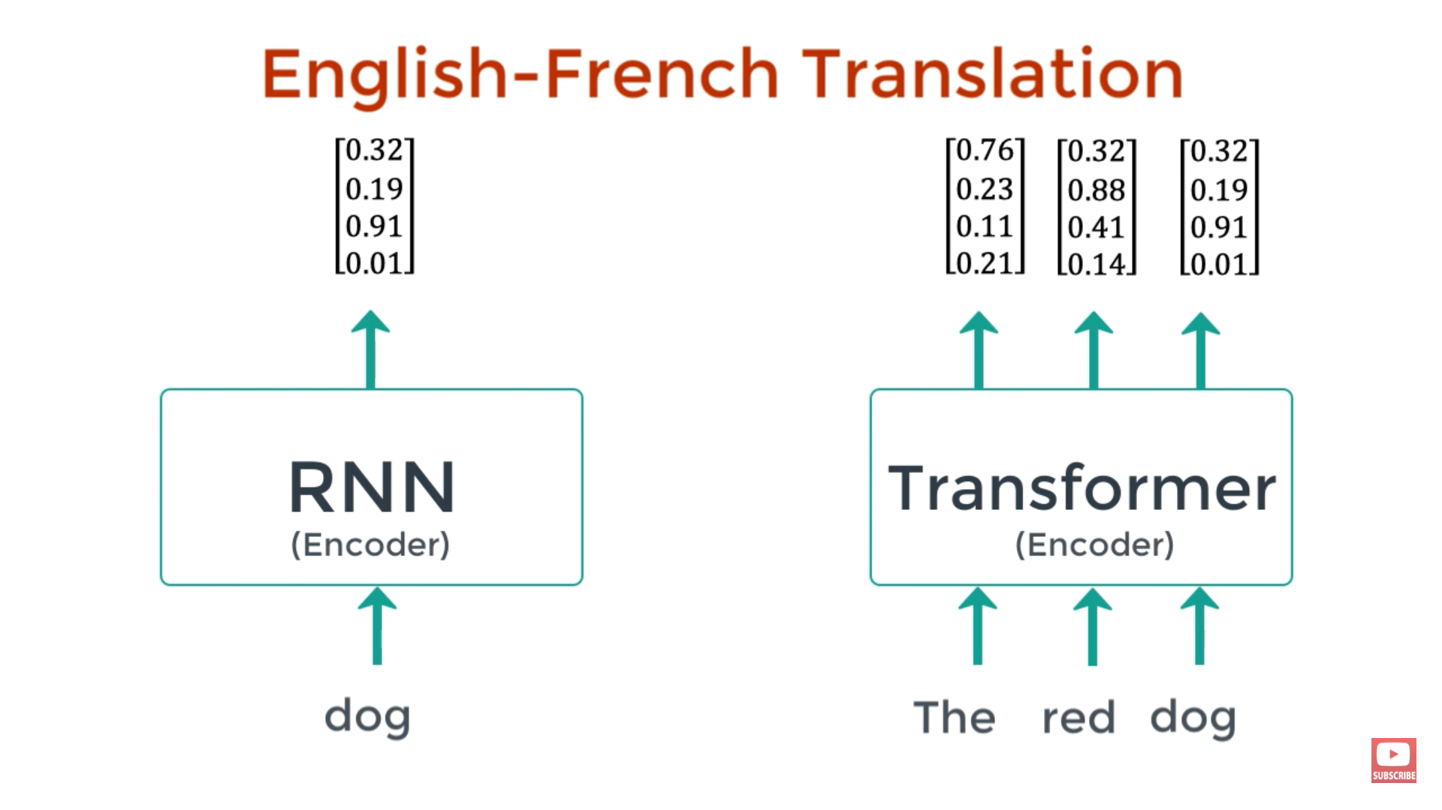

Slide 44
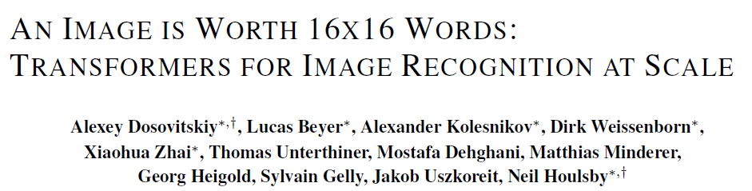
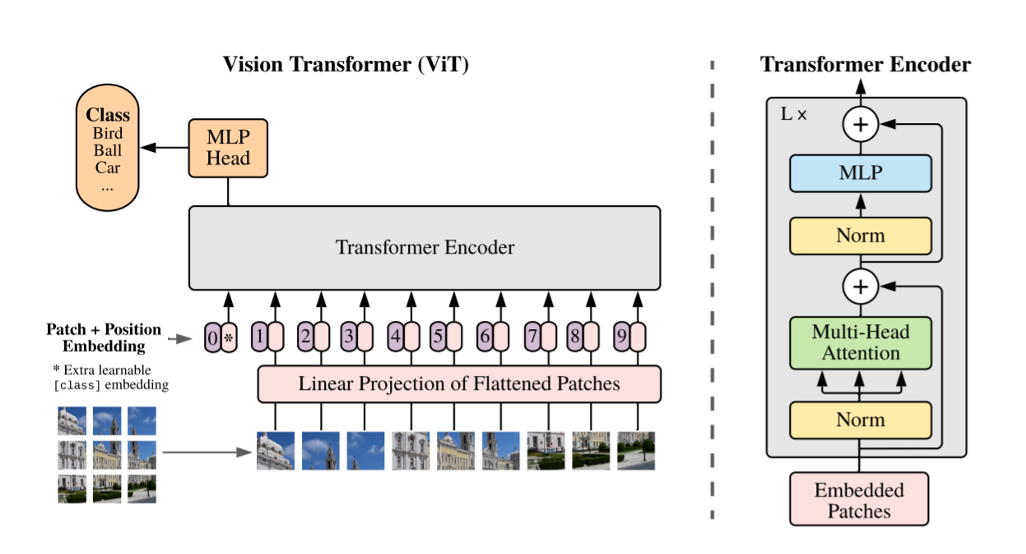
A pure transformer was applied directly to images.
Every patch needs to “attend” to every other patch.

