Slide 1
AUTOMATED TAGGING MECHANISM

Slide 2
Contents
PROBLEM STATEMENT
SOLUTION STRATEGY
PROCEDURE
VISUALIZATION
SUMMARY

Slide 3
Problem Statement
Build a Tagging mechanism for sports articles
Tags should be meaningful
Generated tags to be used for recommendation system and data classification

Slide 4
Solution Strategy
HEURISTIC
CLUSTERING
LSA
NMF
Vectorizer
LDA

Slide 5
Clustering
Useful for Topic Modelling, such that topics could be employed in recommendation systems and classification
Some clustering techniques are:
Latent Semantic Analysis
Latent Dirichlet Allocation
Non-Negative Matrix Factorization
These methods involve a probabilistic approach to find appropriate topics for given documents

Slide 6
Heuristic
This method employs deterministic or rule based approaches to come up to a solution
The solution may not be optimal but is sufficient to reach an immediate objective
To solve this case study, a heuristic approach has been followed to come up with decent results since the number of articles are not sufficient to employ clustering algorithms

Slide 7
Procedure
Read Data from HTML
Read text from link using BeautifulSoup package in python
Create a list consisting of all six articles
Form Vocabulary
Form a list of unique words present in the documents
Remove special characters, symbols and punctuations
Filter unnecessary words using nltk package and words module

Slide 8
Procedure
Term Frequency – Inverse Document Frequency (Tf-Idf)
Pass vocabulary in the Tf-Idf vectorizer
Fit the list of documents in the Tf-Idf vectorizer and obtain a Tf-Idf matrix consisting of documents as rows and columns as words.
Each cell represents a particular score a word has in a given document.
Words not present in the vocabulary but present in the document will carry no score. Hence the importance of a good vocabulary is evident

Slide 9
Procedure
Using the Tf-Idf scores
Create a dataframe of words and respective Tf-Idf scores for the desired article
Sort the dataframe in descending order with respect to the scores
The top words represent the tags for the given document

Slide 10
Visualization
The visualization of the documents is done using Singular Value Decomposition (SVD)
This technique reduces the Tf-Idf matrix into basic constituents
Hence allows representation of high dimensional data on a 2D plot

Slide 11
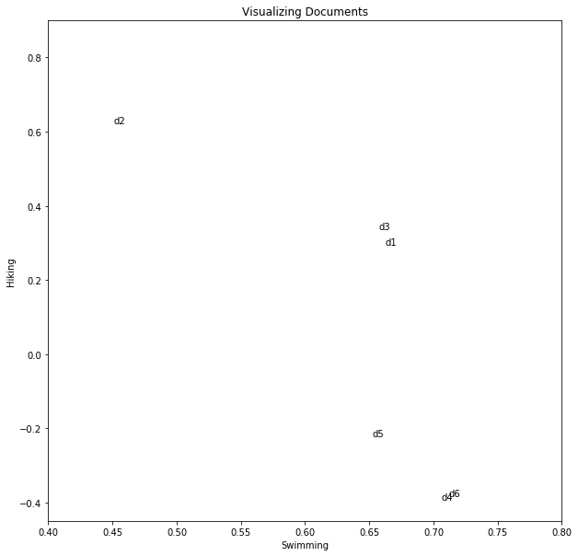
Visualization

Slide 12
Visualization
Looking closely at document four and six, it is quite evident that they are related to the swimming/aqua tag
While document two is highly mapped to hiking, document five, three and one have a generic representation
The generic representation is due to the terms present in the articles which need to be further classified provided the number of documents are sufficiently high.

Slide 13
Summary
The detailed results can be found in the ipynb file
The Tf-Idf vectorizer is able to provide decent results, depending on the vocabulary being provided
To reduce the generic representation of some documents in the data set, it is advised working with around 200 such articles
This will facilitate a much clearer representation of documents and allow the algorithm to identify pattern/topics effectively

