Slide 1
EXCELERATE DATA VISUALIZATION INTERNSHIP — WEEK 4 FINAL DELIVERABLE
SLU International Student
Compliance Analysis
End-to-end SEVIS compliance analytics — from data cleaning and SQL validation to a live Looker Studio dashboard.
Esther Akumah Chinomso
Research & Documentation Coordinator · Team 25
Dataset: Saint Louis University SEVIS F-1 Records (3,524)
SLU International Student Compliance Analysis | Excelerate Data Visualization Internship — Week 4
1

Slide 2
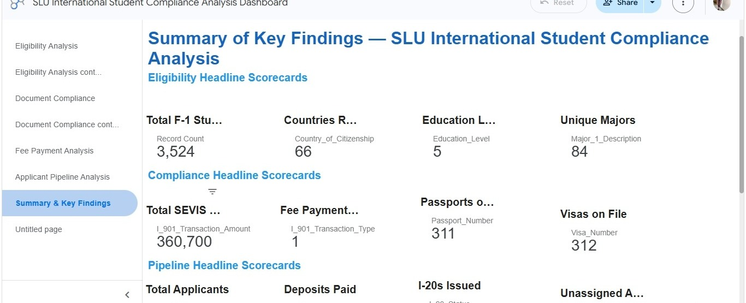



PROJECT OVERVIEW
Scope, Dataset & Objective
Analyze Saint Louis University's SEVIS F-1 international student data end-to-end — clean and validate the dataset, verify metrics in SQL, and deliver a live compliance dashboard for institutional decision-making.
3,524
Student records analyzed
66
Countries of citizenship
5
Education levels · 84 majors
Live Compliance Dashboard
Why it matters
TOOLS USED
SEVIS compliance errors put students' F-1 status — and the university's ability to sponsor international enrollment — at risk. This dashboard turns raw records into an early-warning system for eligibility, documentation, and fee-payment gaps.
PostgreSQL (pgAdmin 4) — data validation & SQL analytics
Google Looker Studio — live, multi-page dashboard
Excel — cleaning documentation log
SLU International Student Compliance Analysis | Excelerate Data Visualization Internship — Week 4
2

Slide 3



METHODOLOGY
A Four-Week Analytical Journey
Week 1
Week 2
Week 3
Week 4
Data Preparation
Exploratory Analysis
SQL Validation + Dashboard
Insights & Reporting
Cleaned & documented 3,524-record SEVIS export; standardized fields for analysis.
Profiled eligibility, demographics, and compliance patterns across the dataset.
Verified key metrics in pgAdmin, then built a live 7-page Looker Studio dashboard.
Consolidated findings into institutional recommendations — this deliverable.
SLU International Student Compliance Analysis | Excelerate Data Visualization Internship — Week 4
3

Slide 4


WEEK 1 · DATA PREPARATION
Raw Export vs. Cleaned Dataset
RAW SEVIS EXPORT
CLEANED & VALIDATED
81 raw columns incl. unused/blank fields (mailing address, phone — 99%+ empty)
Inconsistent date formats across DOB, entry, program dates
Fee status stored only as free-text transaction type, no clear ‘unpaid’ flag
No documented join key between SEVIS and Applicant systems
Not verifiable — no reproducible query trail
3,524 records retained; 0 duplicate SEVIS IDs confirmed
Dates standardized to a single consistent format for analysis
Fee payments recoded as PAYMENT / CANCELLATION / No Record (1,869 flagged)
Core compliance fields (country, education level, I-20 reason) fully populated
Every metric re-verified with SQL queries in pgAdmin before dashboarding
SLU International Student Compliance Analysis | Excelerate Data Visualization Internship — Week 4
4

Slide 5
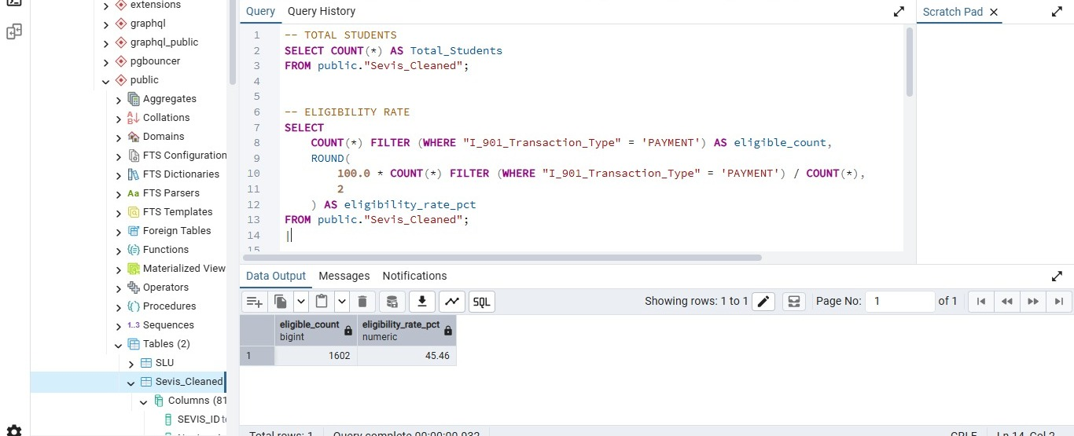
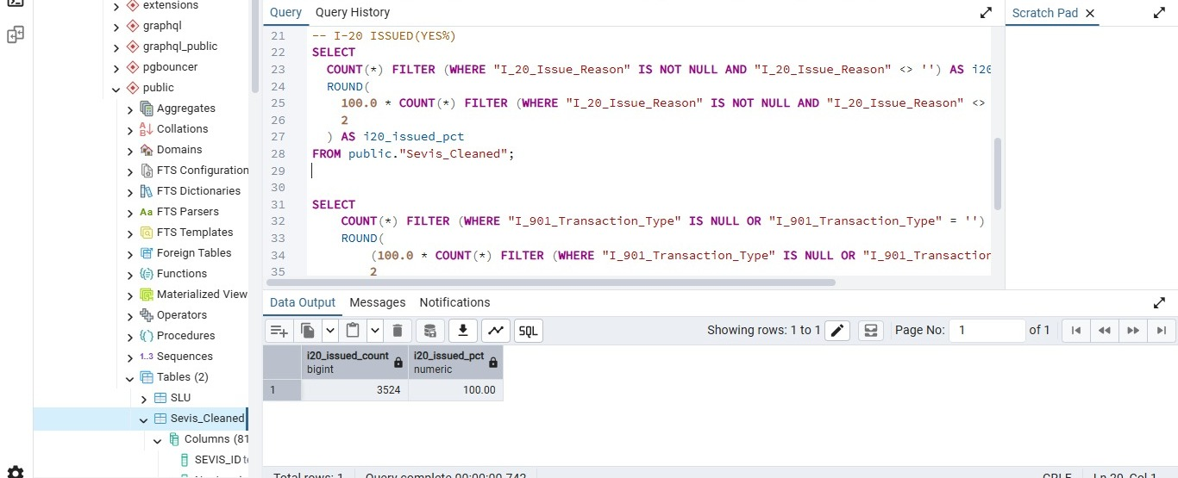
WEEK 3 · VALIDATION
SQL Verification in pgAdmin
Every headline metric shown on the dashboard was first computed and cross-checked directly against the PostgreSQL database — not just read off a chart.
Total Students & Eligibility Rate
I-20 Issuance Verification
SLU International Student Compliance Analysis | Excelerate Data Visualization Internship — Week 4
5

Slide 6
VALIDATION APPROACH
SQL Backend vs. Looker Studio Frontend
SQL — Source of Truth (pgAdmin)
Looker Studio — Visual Layer
Every scorecard in Looker Studio traces back to a query written and run in pgAdmin — giving the dashboard an auditable, reproducible foundation.
SLU International Student Compliance Analysis | Excelerate Data Visualization Internship — Week 4
6

Slide 7
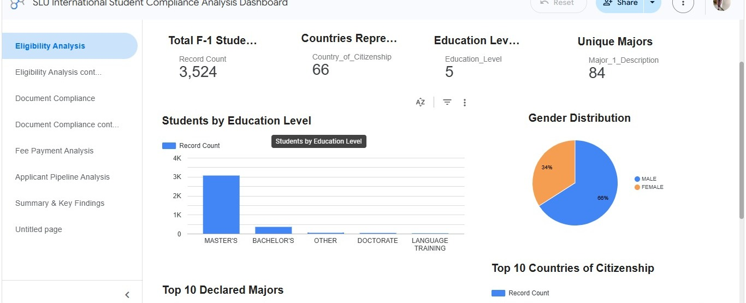
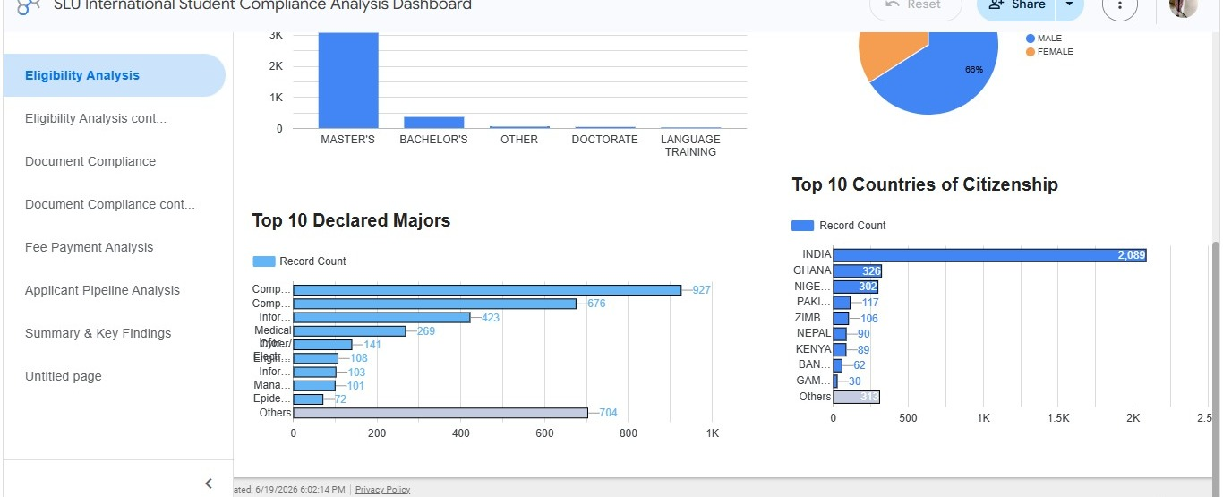
DASHBOARD · PAGE 1
Eligibility Analysis
Enrollment Overview & Gender Split
Top Majors & Countries
SLU International Student Compliance Analysis | Excelerate Data Visualization Internship — Week 4
7

Slide 8
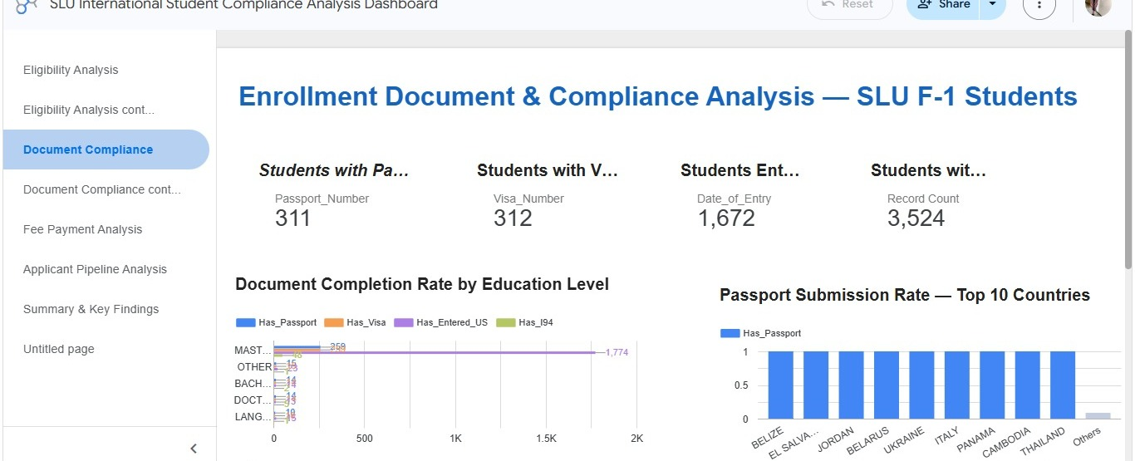
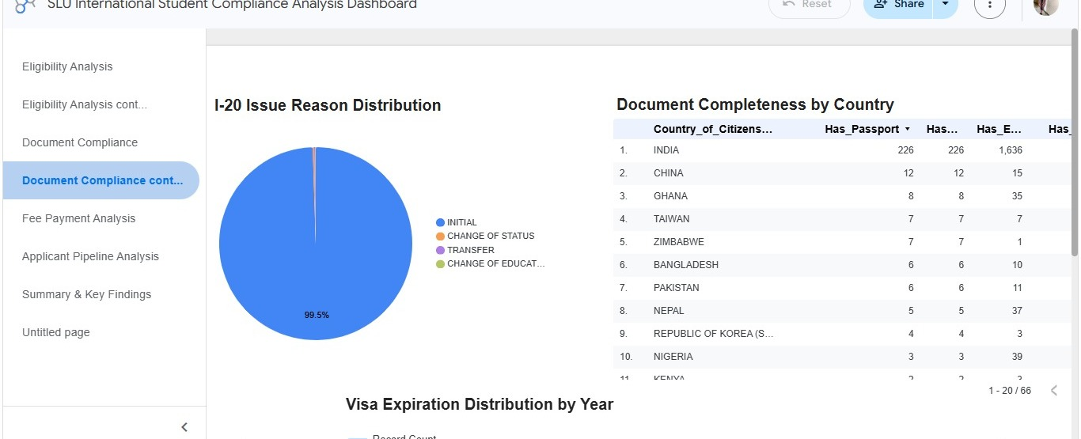
DASHBOARD · PAGE 2
Document Compliance
Passport, Visa & Entry Documentation
I-20 Issue Reason & Completeness
SLU International Student Compliance Analysis | Excelerate Data Visualization Internship — Week 4
8

Slide 9
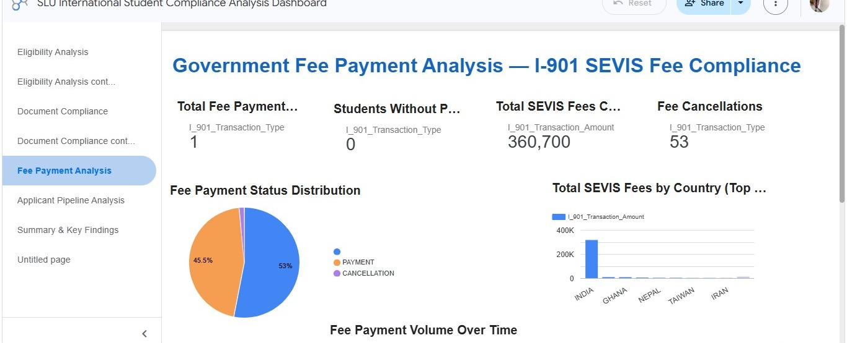
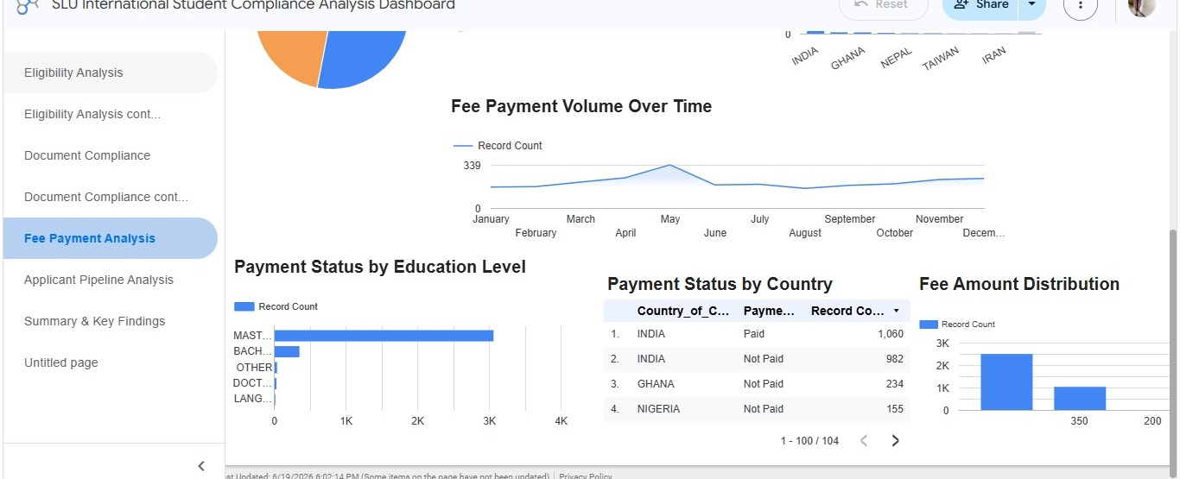
DASHBOARD · PAGE 3
Government Fee Payment Analysis
I-901 SEVIS Fee Compliance
Payment Volume & Status by Country
SLU International Student Compliance Analysis | Excelerate Data Visualization Internship — Week 4
9

Slide 10
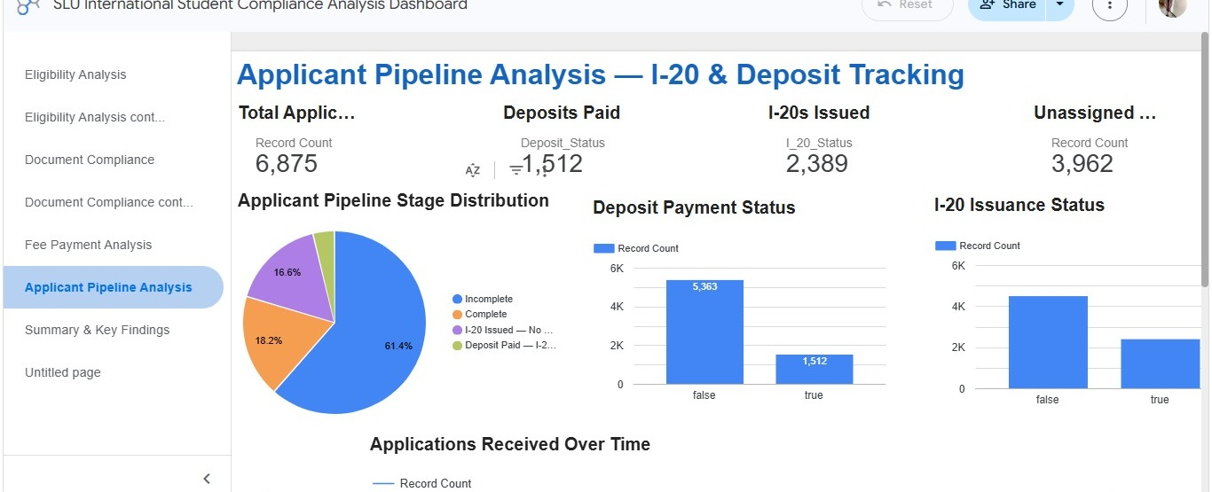
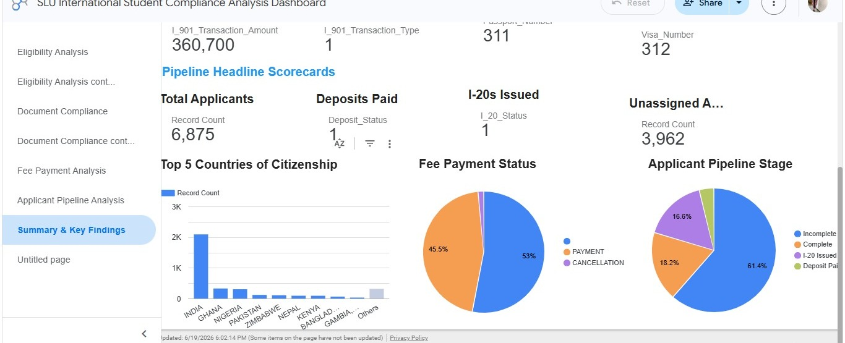
DASHBOARD · PAGE 4
Applicant Pipeline & Executive Summary
I-20 & Deposit Tracking
Consolidated Scorecards
SLU International Student Compliance Analysis | Excelerate Data Visualization Internship — Week 4
10

Slide 11

KEY INSIGHTS
Compliance Risks Uncovered
1
Enrollment is concentrated
86.9% of F-1 students are Master's-level and 59% are from India — a concentration risk for visa-processing delays.
2
Over half have no fee record
53% of students (1,869) show no I-901 SEVIS fee payment — a critical block to visa issuance.
3
Document readiness is low pre-arrival
Only ~9% have a passport or visa on file; expected pre-Fall 2025, but requires active monitoring.
4
Pipeline is under-resourced
57.6% of 6,875 applicants (3,962) have no advisor assigned; only 22% have paid a deposit.
5
A data-integration gap remains
No shared key links SEVIS and Applicant records; a reconciliation flag also surfaced between SQL fee-cancellation counts and the dashboard's cancellation %.
SLU International Student Compliance Analysis | Excelerate Data Visualization Internship — Week 4
11

Slide 12





RECOMMENDATIONS
Data-Driven Next Steps
Run a fee-compliance sweep
Diversify enrollment mix
Close the advisor gap
Contact the 1,869 students with no I-901 payment before their visa appointment window.
Build outreach targets to reduce reliance on India/Master's concentration (59% / 86.9%).
Prioritize advisor assignment for the 3,962 unassigned applicants using pipeline stage.
Build a SEVIS–Applicant key
Automate document reminders
Resolve the reconciliation flag
Work with OIS to create a shared mapping table for unified compliance reporting.
Trigger passport/visa upload reminders as students approach the Fall intake date.
Audit the fee-cancellation discrepancy between SQL output and the dashboard filter logic.
SLU International Student Compliance Analysis | Excelerate Data Visualization Internship — Week 4
12

Slide 13
CONCLUSION
From Raw Records to
Institutional Insight
This internship delivered a complete compliance-analytics pipeline: 3,524 SEVIS records were cleaned and documented, every headline metric was cross-verified in PostgreSQL, and the results were published to a live, 7-page Looker Studio dashboard.
The result is more than a report — it's a reusable, auditable system SLU's International Office can use to catch eligibility gaps, fee-payment risk, and pipeline bottlenecks before they threaten a student's F-1 status.
3,524
66
$360.7K
7
records validated
countries
SEVIS fees tracked
dashboard pages
SLU International Student Compliance Analysis | Excelerate Data Visualization Internship — Week 4
13

