Slide 1
Final Review

Slide 2
Homework questions
Homework 7 Q1
Memory devices with 7 address lines, 8 data lines will be used in a memory system for a computer with the following specifications:
27-bit address bus, (where A1-A0 are used for a byte access in 8-data lines)
32-bit data bus, (which can access bytes, words, and long words)
Memory at pages 0 to N
How many addressable memory locations are in each memory device?
7 address lines of a memory device → 2⁷ addressable locations
What is the total number of memory devices required in this memory design?
If one address can access 4 bytes, total number of memory devices → (2²⁷ *32) / (2⁷ *8)
If one address can access 1 byte, total number of memory devices → (2²⁷ *8) / (2⁷ *8)
Correct analysis: (2²⁵ *32) / (2⁷ *8) = 2²⁰

Slide 3
In-Class Quiz 14
Suppose we build a memory with 1M*8 bit total memory capacity (1M is the total number of addresses and 8 is the width of data bus), using 32K * 8 memory chips (32K is the total number of addresses and 8 is the width of data bus).
How many address bits (width of address bus) are needed for the memory to be built?
How many 32K * 8 memory chips are needed to build the expected memory?
How many selection bits should be allocated out of the total address bits for the memory to be built?

Slide 4
Homework questions
Homework 6 Q3-1

Slide 5
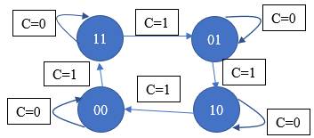
Question 2 and Question 3 in the prep question sheet
Question 2 in the final prep question sheet
This is about the same as the in-class example and homework question
The value of “AB” is considered a system state. The state changes as follows: if C is 0, the state does not change; if C is 1, the state changes in the order of 11, 01, 10, 00, and repeat.

Slide 6
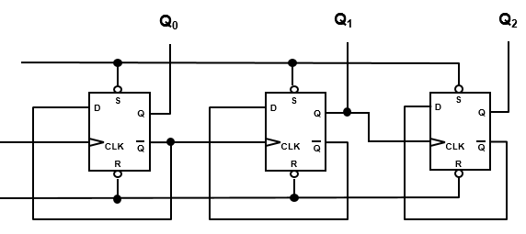
Question 2 and Question 3 in the prep question sheet
Question 3 from the final review
The first two are the same as the example in class
The last one just needs to use Q1 as the clock signal

Slide 7
Question 4 in the prep question sheet

