Slide 1
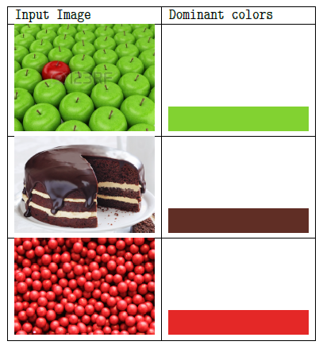
Mining Image Features
Anil Kumar, Samarth, Sahiti Chaganti
Problem and Motivation
Clustering of given set of images Reverse Image Search – list all the visually similar images corresponding to a given image Dominant color detection in an image
Proposed Solution
K-Means Clustering a) Clustering based on SIFT features b) Clustering based on image histogram Reverse Image Search :K-nearest neighbors algorithm to report the closest image based on SIFT features Dominant Color Detection : Misra-Gries technique to find the k-most frequent colors in an image
System Design
Read Images OpenCV
K Clusters
Set of visually similar images
Set of Images
K Dominant Colors
Clustering
Reverse Image Search
Dominant Color
Results
Clustering - Histogram based clustering **NOT** a good approach to cluster visually similar images - SIFT based clustering works well for easy-to-cluster images Reverse Image Search Lists all the visually similar images with some error rate Dominant Color Detection reports K-Dominant colors in an image
Future work
Comparative study of Min Count Sketch, Misra-Gries and K-Means clustering for dominant colors detection Comparative study of SIFT, SURF and FAST techniques for image feature extraction Principle Component Analysis(PCA) for extracting only the dominant/key pixels in images before applying SIFT, Misra-Gries or any other techniques
Demo
Dominant Color Detection | Misra-Gries Algorithm

