Slide 1
Platform Autopilot
1
Autonomous Platform intelligence for continuous monitoring, decision support and governed automation
Platform Architecture
Continuous Platform Workflow
DevOps Control Center
Unified executive and developer experience for service health, pipeline health, security, risks, cost and change.
1
Sense
2
Understand
Collect pipeline events, telemetry, changes and enterprise context
Classify failures, anomalies, risks, dependencies and intent
Autonomous Agent Platform
6 specialist agents continuously monitor delivery, infrastructure and engineering signals and operate without user initiation.
3
Correlate
4
Decide
Combine evidence across agents, applications and systems
Apply policy, risk and business impact to determine action
MCP Tool & Context Layer
Standardized access to Azure DevOps, Terraform, Grafana, Azure Monitor, CMDB and other tools.
5
Act
6
Learn
Recommend, create tickets or execute approved remediation
Measure outcomes and improve recommendations continuously
Logic Apps
Executes approved workflows with policy checks, business rules, retries, notifications and human approval gates.
Business Outcomes
↓ Deployment Risk
Reduced failure rate and shorter lead time to production
↓ MTTD / MTTR
Faster detection, resolution and reduced operational exposure
↑ Engineer Velocity
Time returned to value creation and improved upgrade readiness
↑ Governance
Policy enforcement, auditability and fewer manual approval gaps
↓ Manual Work
Automated triage, reporting and routine remediation
↑ Visibility
Unified context across pipelines, systems and teams
DevOps principle: continuously sense → understand → correlate → decide → act → learn, with human approval where risk requires it.

Slide 2
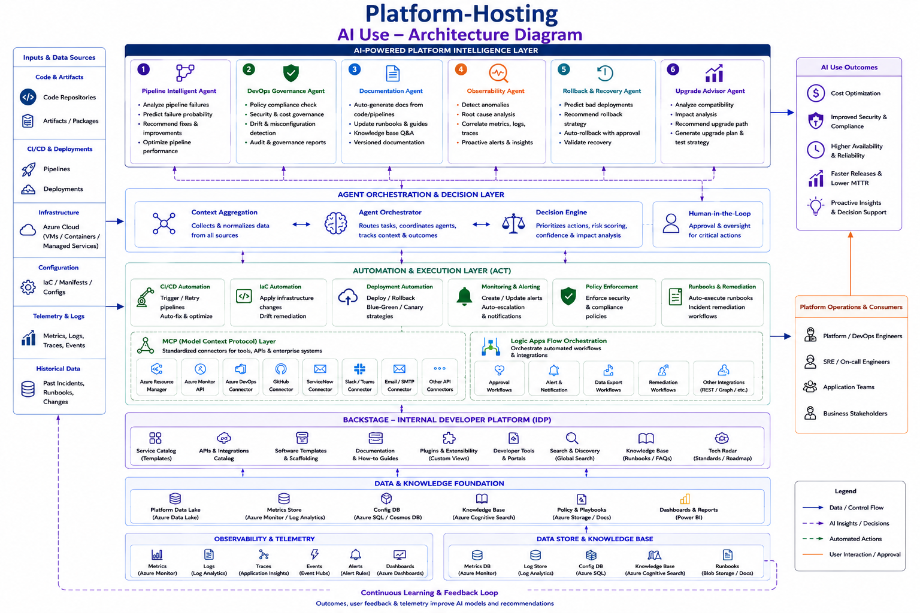
2

Slide 3
Platform Autonomous Agent Portfolio
3
Six specialist agents share the same control plane, MCP tools, enterprise context and governed workflow layer
1
Pipeline Intelligence Agent
2
DevOps Governance Agent
3
Observability Agent
Predict pipeline/build/deployment failures and recommend delivery optimizations.
Continuously assess policy, access, security, audit and configuration risk.
Correlate metrics, logs and traces to detect anomalies and accelerate root-cause analysis.
Trigger: Pipeline / release events
Trigger: Policy / access / audit events
Trigger: Monitoring / telemetry events
4
Rollback & Recovery Agent
5
Upgrade Advisor Agent
6
Knowledge Assistant Agent
Assess rollback strategies, validate safe recovery windows and guide or automate recovery.
Analyze dependencies, versions and vulnerabilities and recommend upgrade paths.
Continuously learn from enterprise documentation, runbooks and historical data and provide grounded guidance.
Trigger: Deployment / health events
Trigger: Version / dependency changes
Trigger: Knowledge refresh + user query
Operating Model
Observe → Recommend → Automate | Low risk: auto-execute | Medium risk: approval workflow | High risk: recommendation only
Shared capabilities: Agent Registry • Routing & Context • Policy & Guardrails • Security & Identity • Audit & Compliance • Observability • Cost & Token Management
The Knowledge Assistant remains user-facing when needed; the other agents are designed to continuously monitor and act in the background.

Slide 4
FinOps Autopilot
3
A proactive, autonomous multi-agent platform for continuous cost intelligence, optimization, forecasting and governed automation
Platform Architecture
Continuous FinOps Workflow
FinOps Control Center
Unified executive experience for cost, savings, forecasts, risks and actions.
1
Sense
2
Analyze
Collect costs, usage, changes, budgets & operational events
Detect anomalies, forecast, optimize & score risk
Autonomous Agent Platform
9 specialist agents continuously monitor systems and run from events or schedules — no user action required.
3
Correlate
4
Decide
Combine evidence across resources, owners and business context
Apply policy, risk and business-impact guardrails
MCP Tool & Context Layer
Standardized, governed access to Azure, Fabric, Power BI, ServiceNow, SaaS and FinOps tools.
5
Act
6
Learn
Recommend, create tickets or execute approved actions
Measure outcomes and feed results back into the platform
Logic Apps
Executes governed workflows with policy checks, approvals, retries, notifications and enterprise integrations.
Business Outcomes
↓ Cost Leakage
Earlier anomaly detection and faster containment
↓ Cloud Run-Rate
Rightsizing, lifecycle and capacity optimization
↑ Forecast Accuracy
Proactive budget and spend risk management
↑ Governance
Continuous policy, drift and compliance visibility
↓ Manual Work
Automated reporting, tickets and routine actions
↑ Visibility
Unified FinOps context across technology and business
FinOps principle: continuously observe → analyze → decide → act → learn, with human approval only where risk requires it.

Slide 5
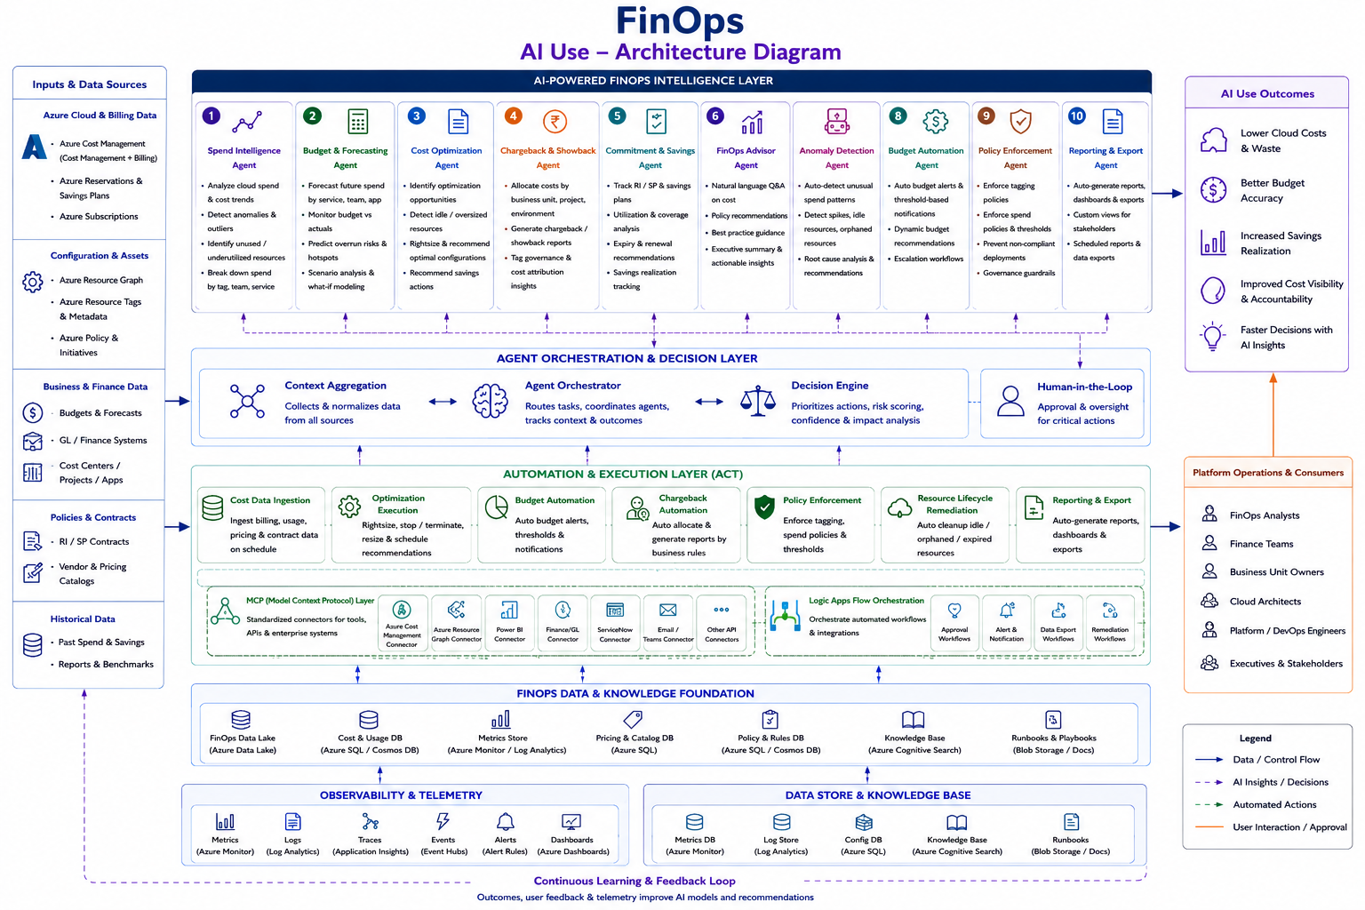
4

Slide 6
FinOps Autonomous Agent Portfolio
5
Nine specialist agents share the same data, intelligence, tool and workflow platform
1
Cost Anomaly Detection
2
Cost Optimization Advisor
3
Cloud Spend Forecasting
Detect unusual spend and explain drivers before overspend becomes material.
Identify idle/oversized resources and prioritize savings opportunities.
Forecast month-end/quarterly spend and predict budget risk.
Trigger: Event + near-real-time
Trigger: Scheduled + change-driven
Trigger: Scheduled + data refresh
4
Environment Drift Detection
5
Environment Health
6
Fabric Capacity Optimization
Detect configuration/IaC divergence and governance risk.
Correlate health, capacity, backup and incident signals.
Optimize Fabric/Power BI capacity against workload demand.
Trigger: Configuration event
Trigger: Monitoring + scheduled
Trigger: Scheduled + capacity change
7
Executive FinOps Reporting
8
Resource Lifecycle
9
FinOps Copilot
Generate evidence-backed KPI, risk and action summaries.
Find stale/unused resources and guide governed cleanup.
Provide governed natural-language FinOps insight when users ask.
Trigger: Scheduled + material event
Trigger: Scheduled + inactivity threshold
Trigger: User-facing (optional)
Autonomy model: Low risk → auto-execute | Medium risk → approval workflow | High risk → recommendation only
The FinOps Copilot is user-facing; the other agents are designed to operate continuously in the background without user action.

Slide 7
Release Autopilot
7
Autonomous release intelligence for continuous release communication, governance and deployment readiness
Platform Architecture
Continuous Release Workflow
Release Control Center
Unified view of release readiness, governance, evidence, changes, risks and stakeholder communication.
1
Sense
2
Correlate
Capture release, code, deployment and governance events
Link requirements, work items, code, tests, changes and incidents
Autonomous Agent Platform
2 specialist agents continuously analyze release artifacts and governance signals from release events and scheduled checkpoints.
3
Assess
4
Generate
Classify impact, readiness, compliance and release risk
Create grounded release notes and evidence summaries
MCP Tool & Context Layer
Standardized access to Azure DevOps, GitHub/GitLab, ServiceNow, SharePoint, testing and security tools.
5
Decide
6
Learn
Apply policy, approvals and release-gate rules
Validate outcomes and improve release intelligence
Logic Apps
Executes governed approval, publishing and release-gating workflows with auditability, retries and notifications.
Business Outcomes
↓ Release Effort
Automated release-note preparation and evidence packaging
↑ Release Readiness
Continuous validation before deployment
↑ Governance
Consistent controls, approvals and audit evidence
↓ Release Risk
Earlier detection of missing or conflicting evidence
↑ Communication
Audience-specific, business-focused release summaries
↑ Traceability
End-to-end linkage from requirement to deployment
Release principle: continuously sense → correlate → assess → generate → decide → act → validate → learn, with deterministic controls for mandatory governance.

Slide 8
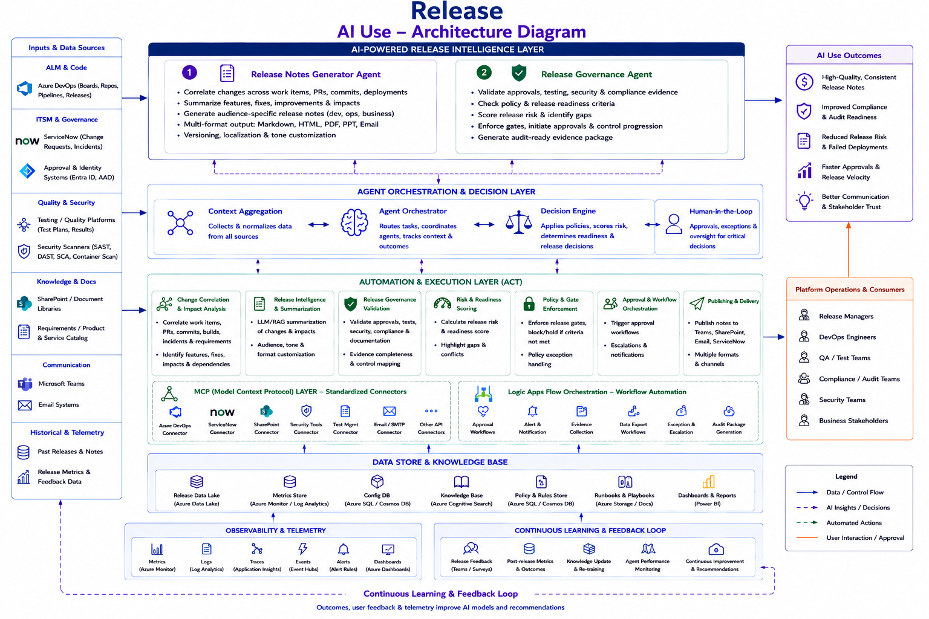
8

Slide 9
Release Autonomous Agent Portfolio
9
Two specialist agents share the same evidence foundation, control plane, MCP tools and governed workflow layer
1
Release Notes Generator Agent
2
Release Governance Agent
Continuously correlate work items, code, deployments and incidents to generate grounded, audience-specific release communications.
Continuously validate approvals, testing, security, change records and documentation; score readiness and identify governance gaps.
Trigger: Release / deployment events + scheduled checkpoints
Trigger: Release / change / test / security events + scheduled checkpoints
Shared Autonomous Operating Model
Observe
Release, code, test, security & change signals
Correlate
Build a trusted release evidence graph
Assess
Readiness, risk, impact & governance
Generate
Notes, summaries & evidence package
Decide
Policy, approval & gate decision
Act
Publish, approve, hold or block
Validate
Confirm outcome after release
Autonomy model: Low-risk communication / evidence actions → auto-execute | Governance decisions → policy-driven gates / approvals | High-risk exceptions → human decision
Release Autopilot is designed to operate continuously in the background; users intervene only for approvals, exceptions or decisions requiring business accountability.

Slide 10
DBA Autopilot
10
Autonomous database access-risk intelligence for continuous privileged-access monitoring, governance and remediation
Platform Architecture
Continuous DBA Risk Workflow
DBA Risk Control Center
Unified view of privileged-access risk, audit findings, remediation status and evidence.
1
Sense
2
Baseline
Collect permission, identity, audit and change signals
Establish approved access and normal activity patterns
Autonomous DBA Agent
Continuously analyzes permissions, identities, audit activity, changes and historical findings without user initiation.
3
Assess
4
Prioritize
Detect excessive, stale or anomalous privileged access
Score risk using identity, database and business context
MCP Tool & Context Layer
Standardized access to SQL metadata, audit data, Entra ID, ServiceNow and governance knowledge.
5
Act
6
Validate
Recommend, approve or execute governed remediation
Verify remediation effectiveness and update audit evidence
Logic Apps
Executes governed remediation and approval workflows with policy checks, notifications, audit trails and rollback controls.
Business Outcomes
↓ Access Risk
Earlier identification of excessive and anomalous privileges
↓ Audit Exposure
Continuous evidence and proactive audit-risk detection
↑ Remediation Effectiveness
Verify that corrective actions actually reduced risk
↓ Manual Review
Automated permission analysis and evidence preparation
↑ Governance
Consistent application of privileged-access standards
↑ Traceability
Link identity, permission, change, finding and remediation history
DBA principle: continuously sense → baseline → assess → prioritize → act → validate, with deterministic access controls and human approval for high-risk changes.

Slide 11
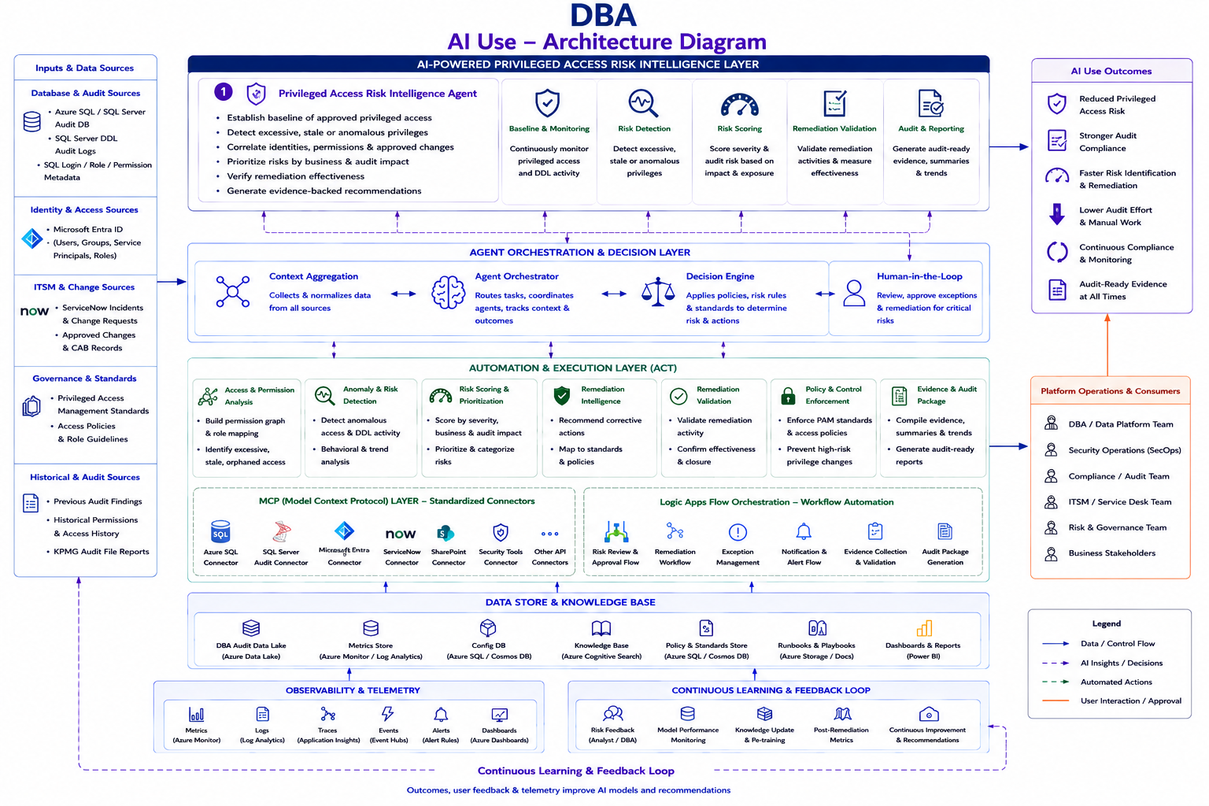
11

Slide 12
DBA Autonomous Agent Portfolio
12
One specialist agent today, built on a reusable DBA control, context and workflow platform
Privileged Access Risk Intelligence Agent
1
Continuously analyzes SQL Server permissions, audit activity, identity context, ServiceNow changes, historical findings and privileged-access standards to detect high-risk access, explain the risk, prioritize remediation and verify effectiveness.
Trigger: Permission / identity / DDL / audit / change events + scheduled privileged-access reviews
Autonomous Operating Model
Observe
Identity, permission, audit & change signals
Baseline
Approved privileged-access state
Detect
Excessive, stale or anomalous access
Prioritize
Risk, criticality & audit impact
Remediate
Recommend / approve / execute
Validate
Confirm access reduction & evidence
Autonomy model: Low-risk analysis / evidence → auto-generate | Medium-risk remediation → approval workflow | High-risk privileged-access change → human authorization
DBA Autopilot is designed for continuous background operation; DBAs, security and audit teams intervene for approvals, exceptions and high-impact access decisions.

Slide 13
SecOps Autopilot
13
Autonomous vulnerability intelligence for continuous finding analysis, remediation planning, governed closure and security-risk reduction
Platform Architecture
Continuous SecOps Workflow
Security Risk Control Center
Unified view of vulnerabilities, penetration-test findings, exposure, remediation status and verified closure.
1
Sense
2
Enrich
Collect vulnerability, penetration-test and security findings
Map findings to assets, owners, architecture and dependencies
Autonomous SecOps Agent
Continuously analyzes security findings and enriches them with asset, architecture, dependency and business context.
3
Assess
4
Plan
Evaluate exploitability, exposure, criticality and root cause
Generate remediation options, effort and risk trade-offs
MCP Tool & Context Layer
Standardized access to security scanners, Defender, Azure Resource Graph, ServiceNow, Azure DevOps and security knowledge.
5
Act
6
Validate
Route through governed engineering and approval workflows
Re-scan, verify closure and learn from remediation outcomes
Logic Apps
Executes governed remediation, approval, notification and validation workflows with complete auditability.
Business Outcomes
↓ Security Exposure
Faster remediation of critical vulnerabilities
↓ MTTR
Shorter security-to-engineering remediation cycle
↑ Remediation Quality
Evidence-backed plans and verified closure
↓ Manual Analysis
Automated finding enrichment and root-cause assessment
↑ Governance
Consistent approval, tracking and audit evidence
↑ Security Knowledge
Reusable repository of successful remediations
SecOps principle: continuously sense → enrich → assess → plan → act → validate → learn, with high-impact remediation remaining approval-controlled.

Slide 14
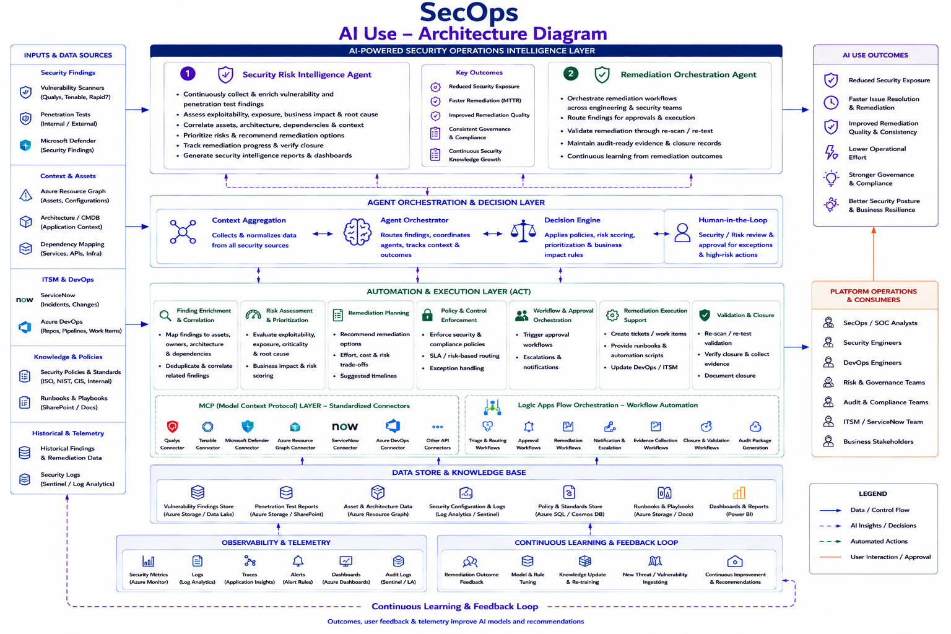
14

Slide 15
SecOps Autonomous Agent Portfolio
15
One specialist agent today, built on a reusable SecOps evidence, context and governed workflow platform
Vulnerability Resolution Agent
1
Continuously ingests vulnerability and penetration-test findings, enriches them with asset, architecture, dependency and business context, analyzes exploitability and root cause, recommends remediation paths, orchestrates governed closure and validates the outcome.
Trigger: New security finding / report / asset context / remediation event + scheduled vulnerability reviews
Autonomous Operating Model
Observe
Findings, assets, security & change signals
Enrich
Map finding → asset → dependency → owner
Assess
Exploitability, exposure & business risk
Plan
Remediation options + effort / trade-offs
Remediate
Governed engineering workflow
Validate
Re-scan and verify closure
Autonomy model: Low-risk analysis / recommendations → auto-generate | Medium-risk remediation → approval workflow | High-impact security changes → human authorization
SecOps Autopilot is designed for continuous background operation; security and engineering teams intervene for approvals, exceptions and high-impact remediation decisions.

Slide 16
Business Intelligence Autopilot
16
Autonomous AI for proactive customer-risk prediction and independent actuarial decision assurance
Platform Architecture
Continuous Business Intelligence Workflow
Business Risk Control Center
Unified view of complaint propensity, conduct risk, actuarial review findings and decision-assurance status.
1
Ingest
2
Analyze
Continuously collect customer, policy, claims and actuarial evidence
Predict complaint risk or reconcile actuarial conclusions to data
Autonomous Agent Platform
Two specialist agents continuously analyze business, customer and actuarial evidence with scheduled and event-driven processing.
3
Challenge
4
Prioritize
Explain drivers, anomalies, assumptions and evidence gaps
Rank customer-risk or actuarial issues by materiality and confidence
AI & Context Layer
Governed predictive models, RAG, LLM reasoning, evidence reconciliation and explainability across domain data.
5
Act
6
Learn
Route investigations, interventions or actuarial review workflows
Monitor outcomes, drift, fairness and recurring review findings
Logic Apps / Workflow
Routes investigations, reviews, approvals, interventions and assurance packs through controlled enterprise workflows.
Business Outcomes
↓ Preventable Complaints
Earlier identification of complaint-prone patterns
↑ Customer Experience
Proactive investigation and intervention
↑ Decision Confidence
Independent actuarial challenge before publication
↓ Governance Risk
Evidence-linked findings and transparent review trails
↓ Manual Review
Automated prediction, reconciliation and prioritization
↑ Auditability
Traceable evidence, assumptions and decisions
Principle: continuously ingest → analyze → challenge → prioritize → act/review → validate → learn, with human accountability retained for material decisions.

Slide 17
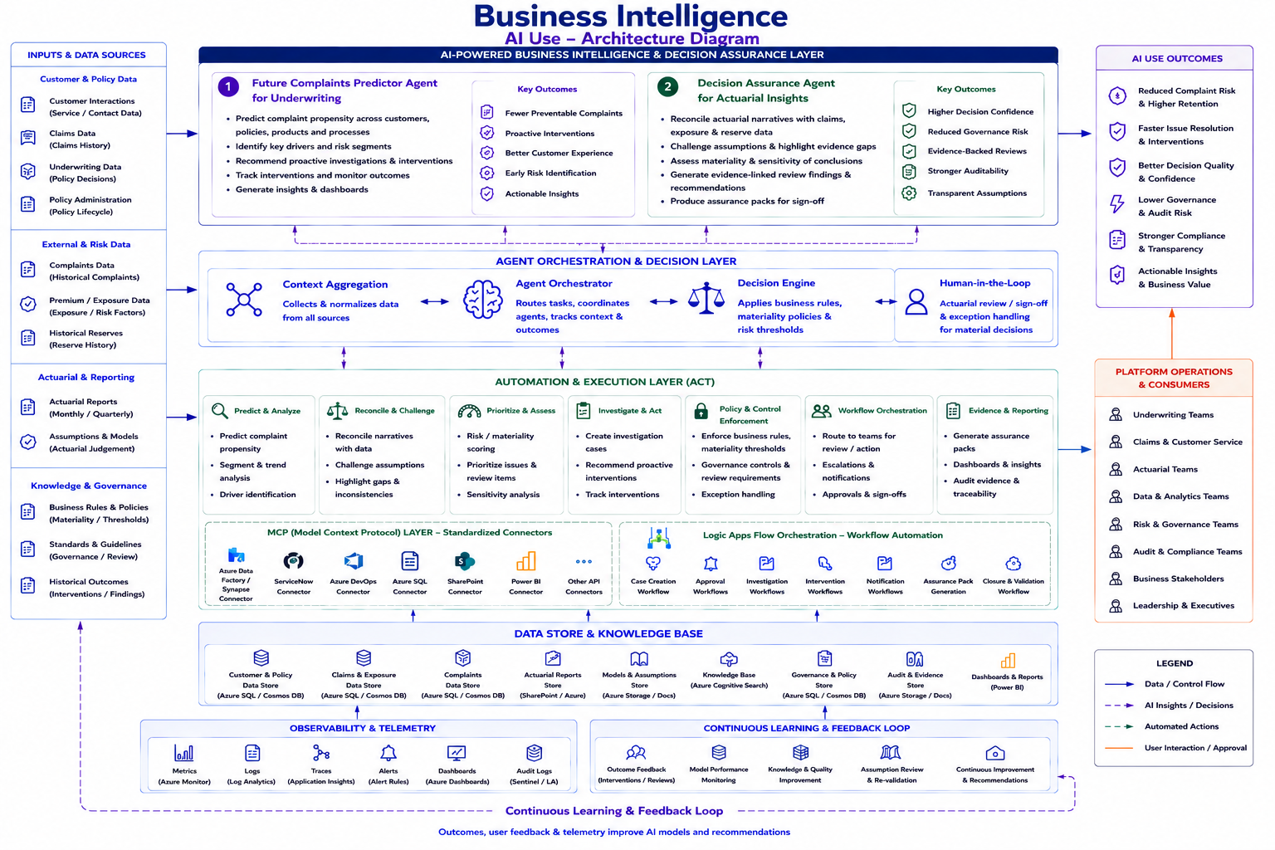
17

Slide 18
Business AI Autonomous Agent Portfolio
18
Two specialist agents share a governed data, AI, evidence and workflow platform
Future Complaints Predictor Agent for Underwriting
Decision Assurance Agent for Actuarial Insights
1
2
Predict complaint propensity across customers, policies, products and processes; explain drivers and recommend proactive investigations.
Independently reconcile actuarial narratives with claims, exposure and reserve data; challenge assumptions and produce evidence-linked review findings.
Trigger: Customer interaction / claim / underwriting / policy signals + scheduled model runs
Trigger: Monthly actuarial reports / material movements / data refresh + scheduled assurance reviews
Shared Autonomous Operating Model
Observe
Domain data & events
Analyze
Predict / reconcile
Challenge
Explain evidence & assumptions
Prioritize
Risk, materiality & confidence
Act / Review
Governed workflow
Validate
Outcomes & assurance
Learn
Drift, fairness & feedback
Autonomy model: Low-risk analysis / recommendations → automated output | Medium-risk actions → governed workflow | Material customer or actuarial decisions → human authorization/sign-off
Business AI Autopilot operates continuously in the background; business, actuarial and governance teams intervene where judgement, accountability or customer impact requires it.

