Slide 1
Case study of Image processing with Ingenic T31 and T41 chipset with Magik tool kit
https://github.com/wispytrace/magik-toolkit/blob/main/README_en.md

Slide 2
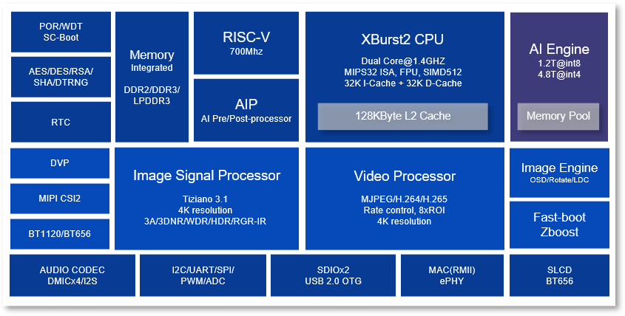
T31/T41
Notes:
Magik tool kit upports model training quantization and post-quantization, focusing on end-side AI full-stack development, the platform sets model quantization training, layer merging optimization, and end-side efficient deployment. From version 1.0 in 2020 to the latest version, magik quantization platform has been keeping up with the pace of model quantization deployment, after in-depth optimization iteration, the platform to complete the one-click quantization; enrich the ModelZoo repository, covering speech, vision, Transformer

Slide 3
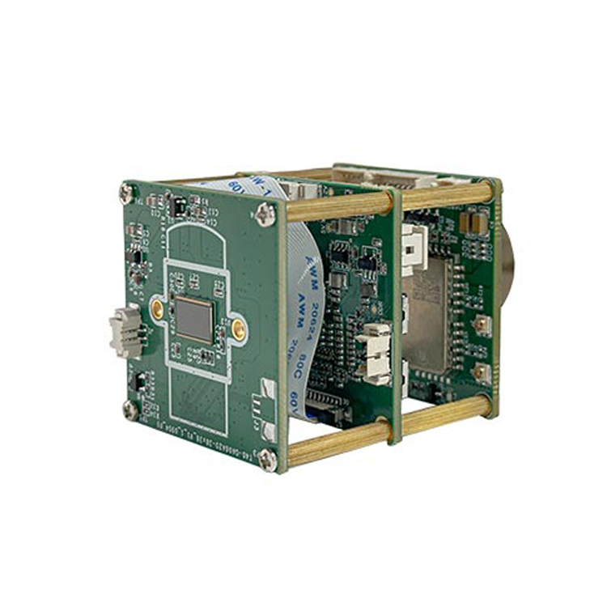
T41 Rs 900
Notes:
T41 12nm chipset.

Slide 4
Case Study
Magic AI on T41 has been successfully applied in various real-world scenarios, demonstrating its effectiveness for object detection in diverse environments.
One notable application is in low-light environments where T41, leveraging IR cameras, achieved real-time detection of various objects like pedestrians, vehicles, and bicycles with minimal loss. Another example is vessel detection using T41 and SHA-256, showing improved precision and data security. Additionally, T41 has been used for tomato quality inspection, achieving high accuracy in detecting and classifying defective and non-defective tomatoes. Furthermore, T41 has been employed for small-target detection in tea insect infestation, demonstrating improved accuracy.
It is capable of detecting 5 people in a single frame, all at 45 fps!

Slide 5
some more case studies:
Low-Light Object Detection:
The model successfully detected various objects, including pedestrians, cars, and bikes, demonstrating its ability to perform real-time detection with minimal loss.
Vessel Detection:
A study by IndiaAI integrated T41 with advanced architectures and a class-balanced dataset to detect vessels. The results showed a significant improvement in precision compared to T31 and ensured data security through the use of SHA-256.
Tomato Quality Inspection:
T41 was utilized in a case study to inspect the quality of tomatoes.

Slide 6
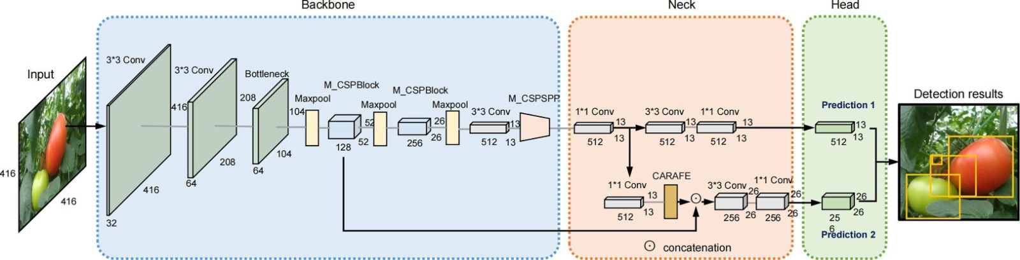
Yolo (45 frames per second)

Slide 7




Advantages
Chip Capabilities
Multimedia Processing
The T41 functions as a powerful NPU, capable of running operating systems like Linux or RTOS.
It supports H.264/H.265 coding and decoding for efficient multimedia handling.
Robust Connectivity
Edge AI Optimization
Equipped with Gigabit Ethernet interfaces for reliable network connections.
Tailored for edge AI solutions with its Mips32 architecture, on-chip memory, and low power consumption.
Combined with Ingenic's MAGIK tools, provide a strong foundation for developing advanced embedded AI applications.

Slide 8



MAGIK: Deep Learning Development Kit
Model Quantization & Training
MAGIK offers pre-developed models or a Model Zoo with popular models, which can be trained with customer data to produce 4-8 bit quantized models. It also supports training with TensorFlow, mxnet, PyTorch, or yolo.
Model Transforming
This involves model checking for hardware suitability, converting models from different platforms into MAGIK models, and optimizing them to best utilize the T41 features.
System Deploying
II can be deployed on GPU, TPU and NPUs

Slide 9






T41 with Magik AI
MAGIK AI Platform
Comprehensive development kit for deep learning.
Operating Systems & Kits
Linux OS/RTOS.
Computing Resources
XBurst CPU with MIPS ISA and advanced memory management.
The T41 chip’s AI capacity, combining image processing, video coding/decoding, and connectivity, enables its deployment as a standalone edge AI agent.

Slide 10
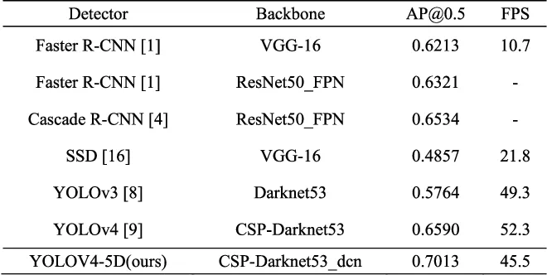

Slide 11
Conclusion/Findings
T41/T31 with Rs 900 we can have 45 FPS object , person and texture detections.
Family of 5 person in a home can be trained and detected
Door open/close, baby crying detection and theft alarm
Person count
https://github.com/akumrao/MagicAI/tree/AIPeopleCount

