Slide 1
FPS Control Mediaserver
Receiver 1
5 fps
Mediaserver
Sender
25 fps
24
10 fps
Receiver 2
Queue of I,P Frames and IDR
0
15 fps
Receiver 3
Drop 20 – 15 fps

Slide 2
A. Adaption of frame rate with transport-cc statistics
Adaption of bit rate with transport-cc statistics, google’s congestion control and bwe
(Not doing it right now)
Adaption of screen resolution based on simulcast (Not doing it right now)
Adaption of frame rate with transport-cc statistics
We can do it in two ways
a) Reduce the Frame rate of sender it self. But then all receiver will get frame with very low frame rate. Which is not good
b)We will implement frame rate Adaption as shown in slide 1.
The advantage of this algorithm is if a receiver have good connectivity he will receive good frame rate even when other participants receiving lower frame rate

Slide 3
Vectone algorithm is as follows:-
If IDR
Yes
On Arrival of each RTP packet we check for IDR, I & P frames
WebRTC Receiver
SRTP Packets
No
If
I Frame
Transport-cc Statistics
Yes
No
Drop since bitrate of line drop below threshold
Drop of RTP having P frames until I frame comes
If P Frame
Yes
Yes
No
WebRTC Sender
Drop all the other frames like B

Slide 4
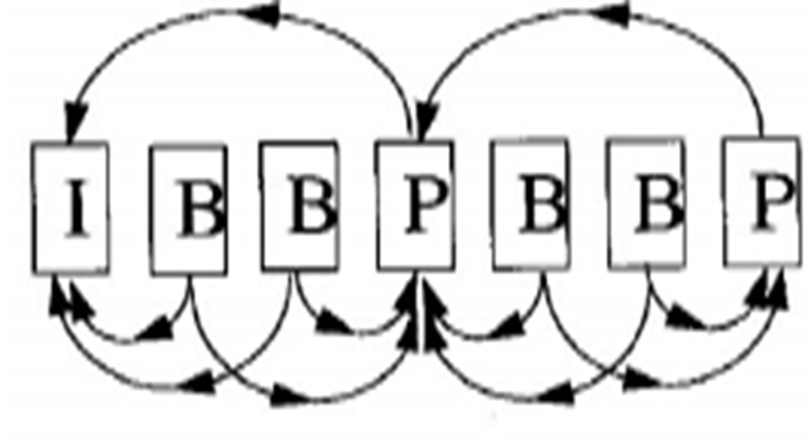
B frames will never comes in video calls, since we use strict base line profile H264

Slide 5
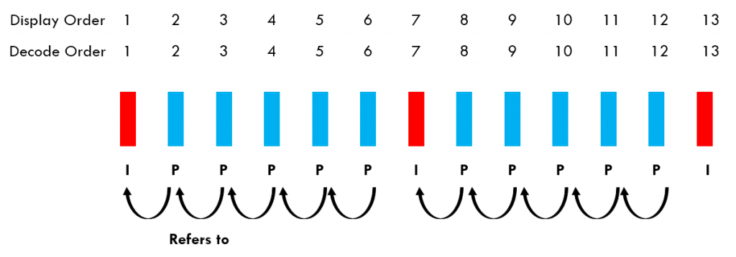
This is the only possible situation in video call
The P-frames refer to previously encoded I/P-frames as discussed earlier.
You can also see that the order in which the frames are encoded/decoded is the same as how
they are presented to the user. This is because P-frames only refer to previously encoded
pictures.

Slide 6
WebRTC receiver receives the RTP packets from sender
On arrival of each RTP packets we peek inside RTP to check for IDR, I and P frames without
decoding frames
Only trailing P frames will be drop if the bitrate of peer connection drop below threshold
To peek inside Secured RTP we need certificates.

