Slide 1

Crime Analysis in Chapel Hill from 2018-2020
Amarachi Akụnna Onyekachi

Slide 2

Introduction
Why I chose this topic?
I was tired of working with data related to pollutants in environment
To know how safe where I live is
To see the relationship between age, race and gender and the number of arrests
To know the most frequent crimes committed at UNC

Slide 3
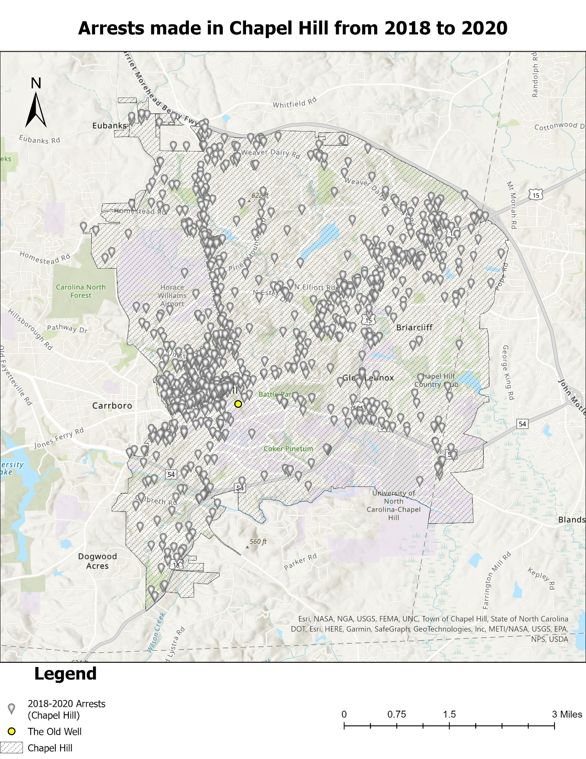
Methods and Results

Slide 4
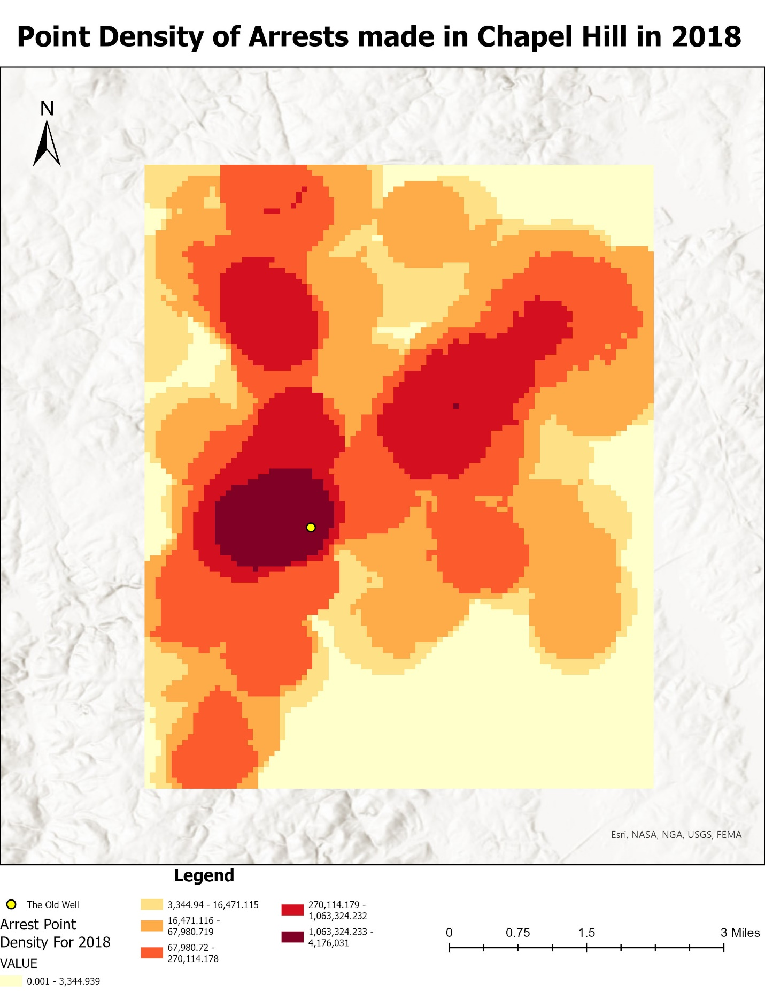
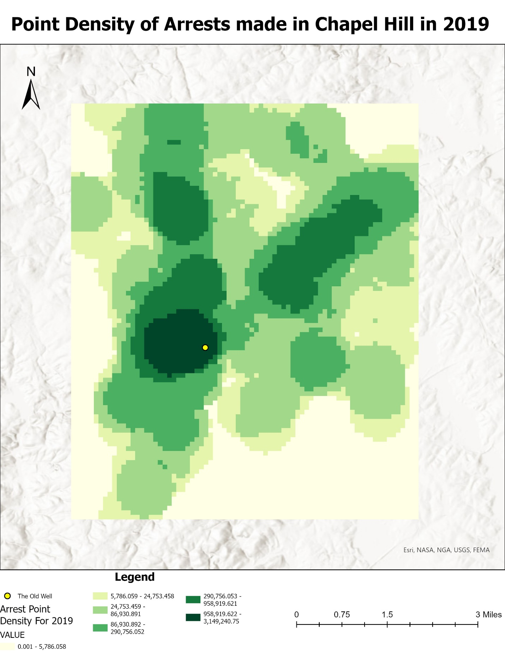
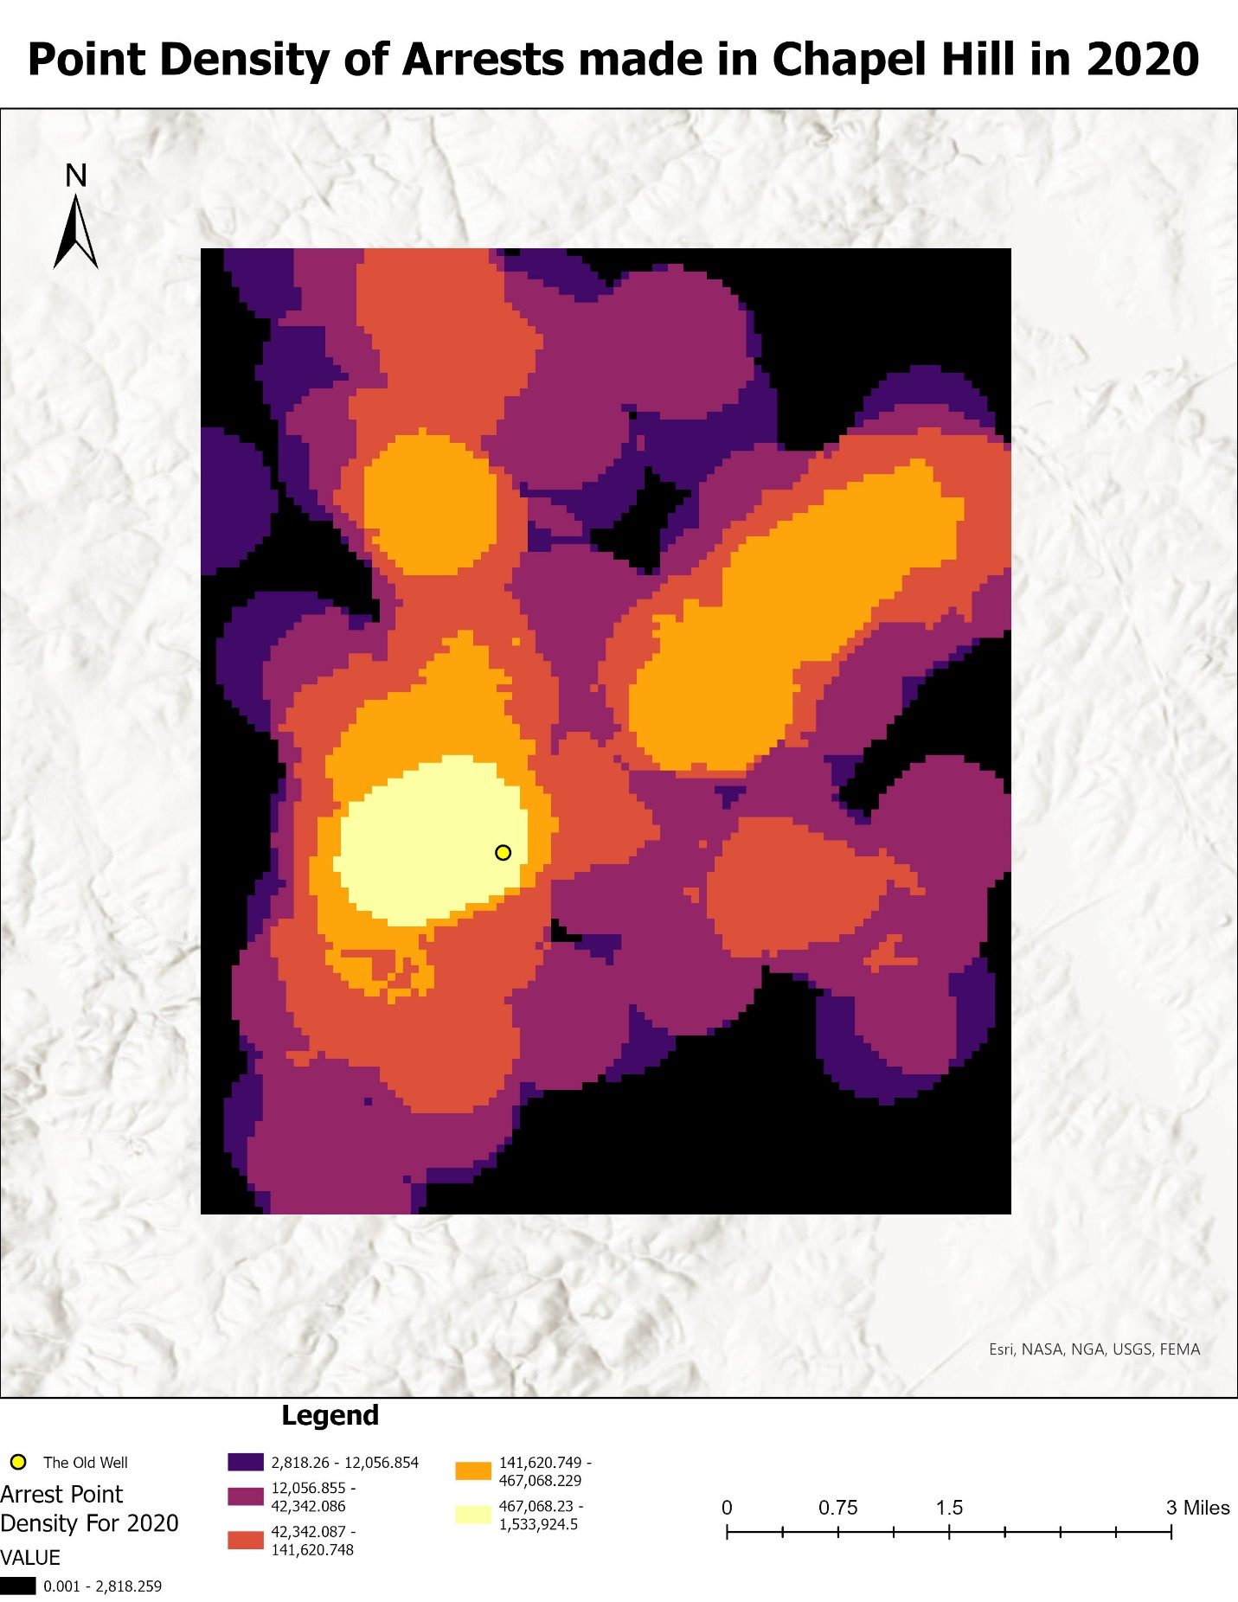
Point Density Calculations

Slide 5
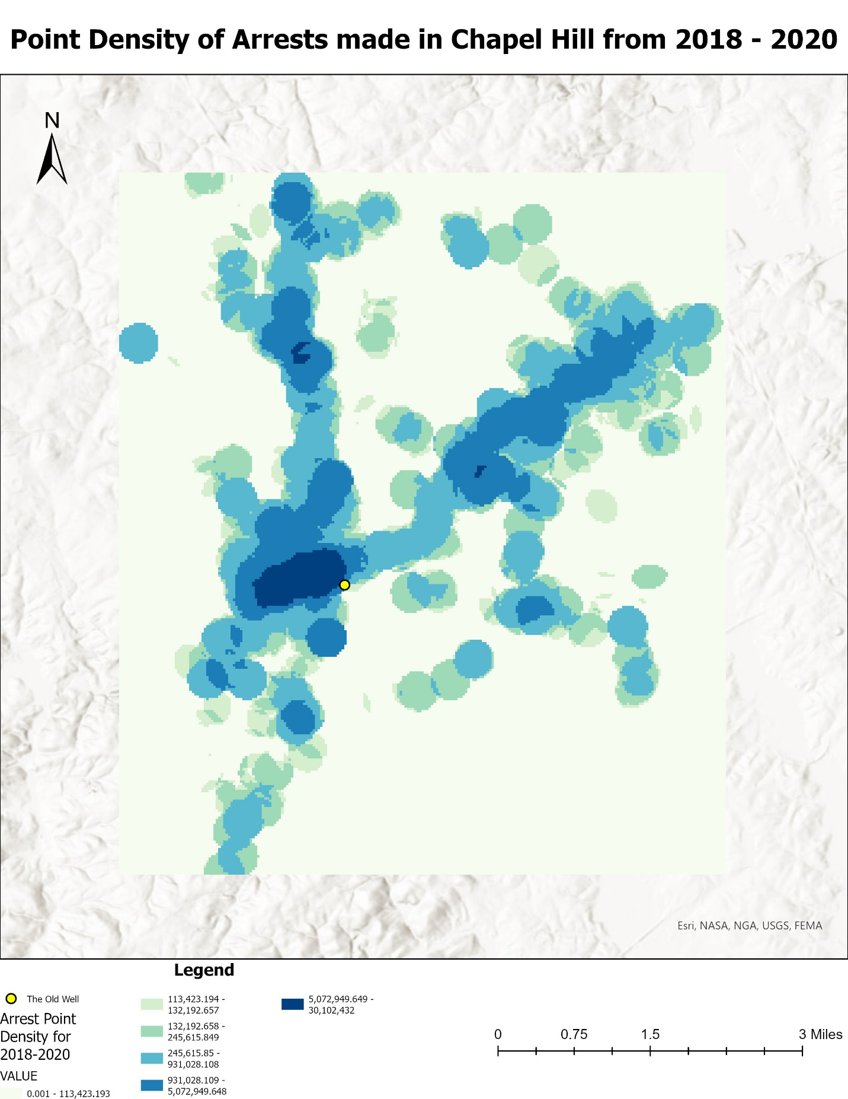
Point Density Calculations of the Three Years

Slide 6
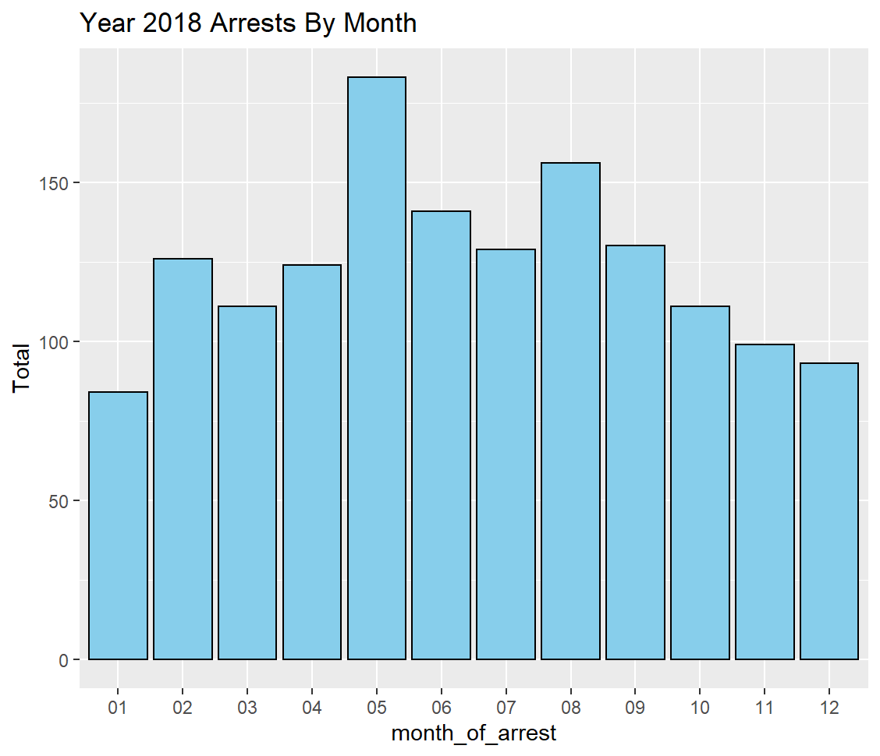
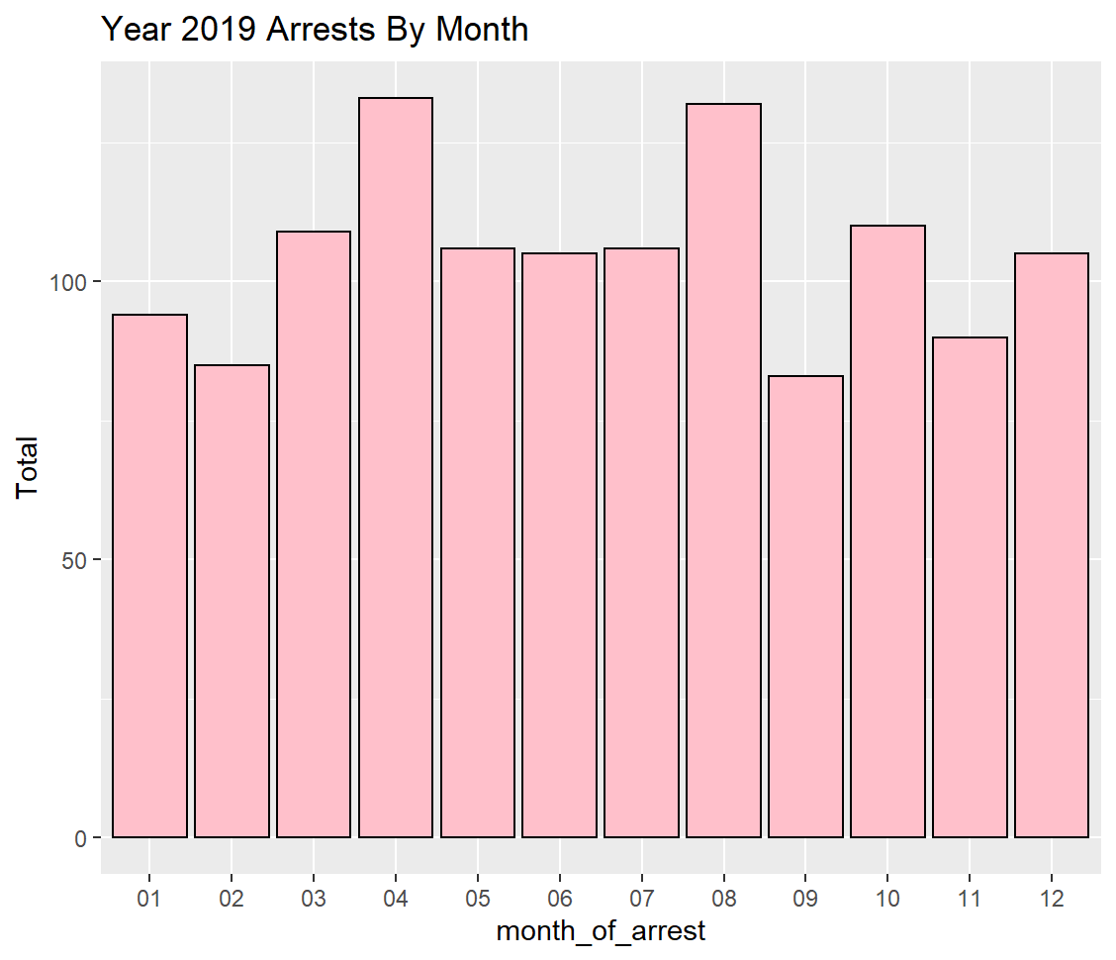
Variation of Arrests by Month for 2018 and 2019
Highest three: May, August, June
Lowest: January
Highest three: April, August, October
Lowest: September

Slide 7
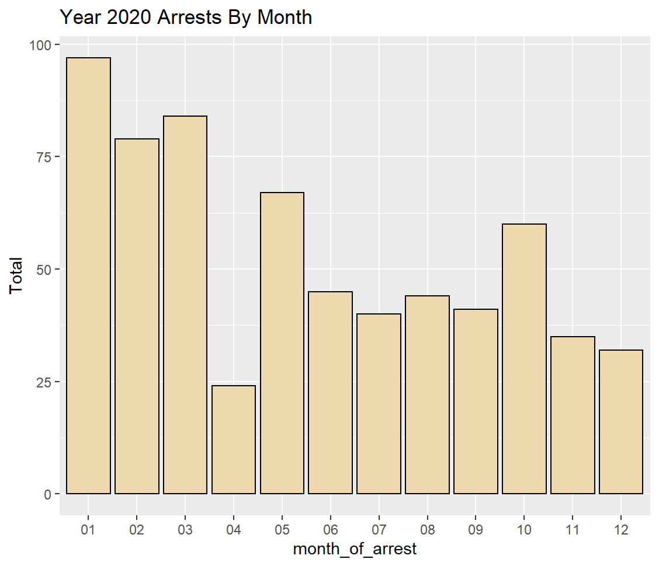
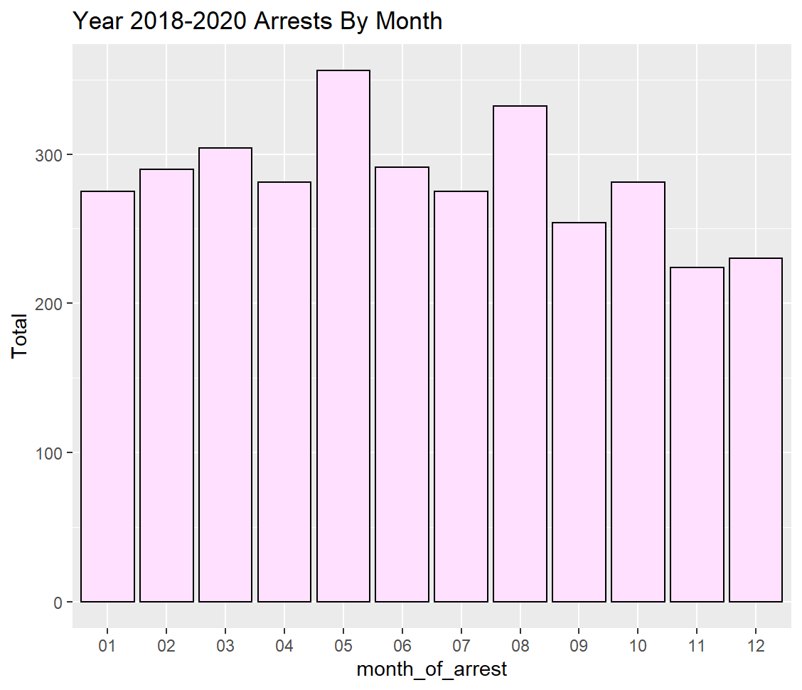
Variation of Arrests by Month for 2020 and 2018-2020
Highest three: January, March, February
Lowest: April
Highest three: May(Spring), August (Summer), Mar(Spring)
Lowest: November

Slide 8
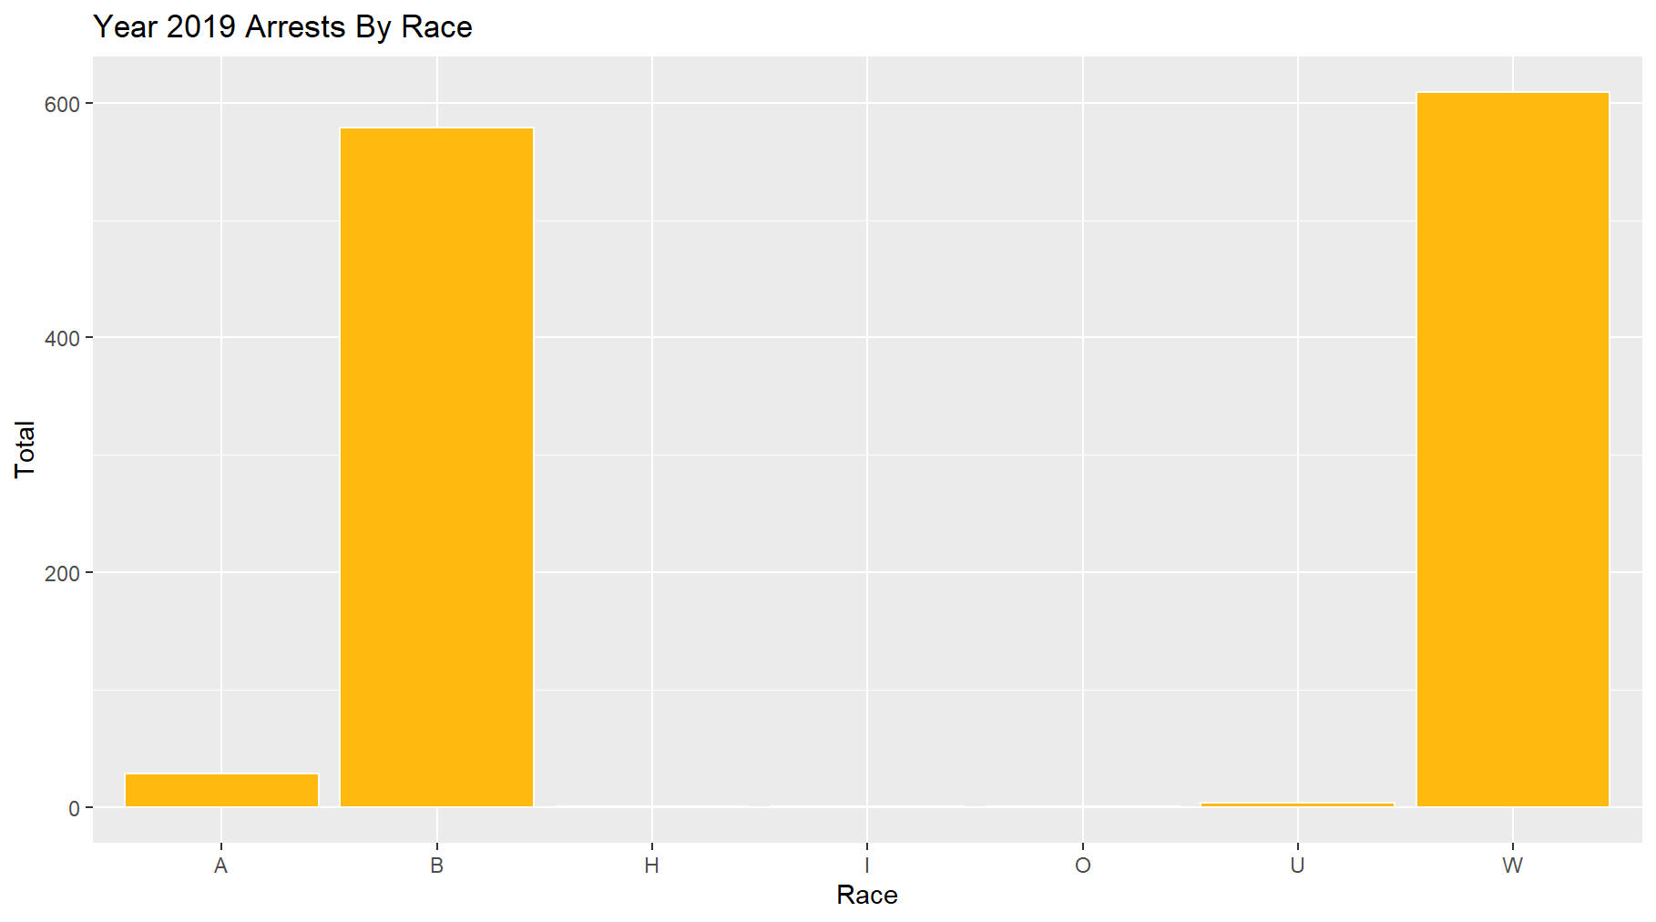
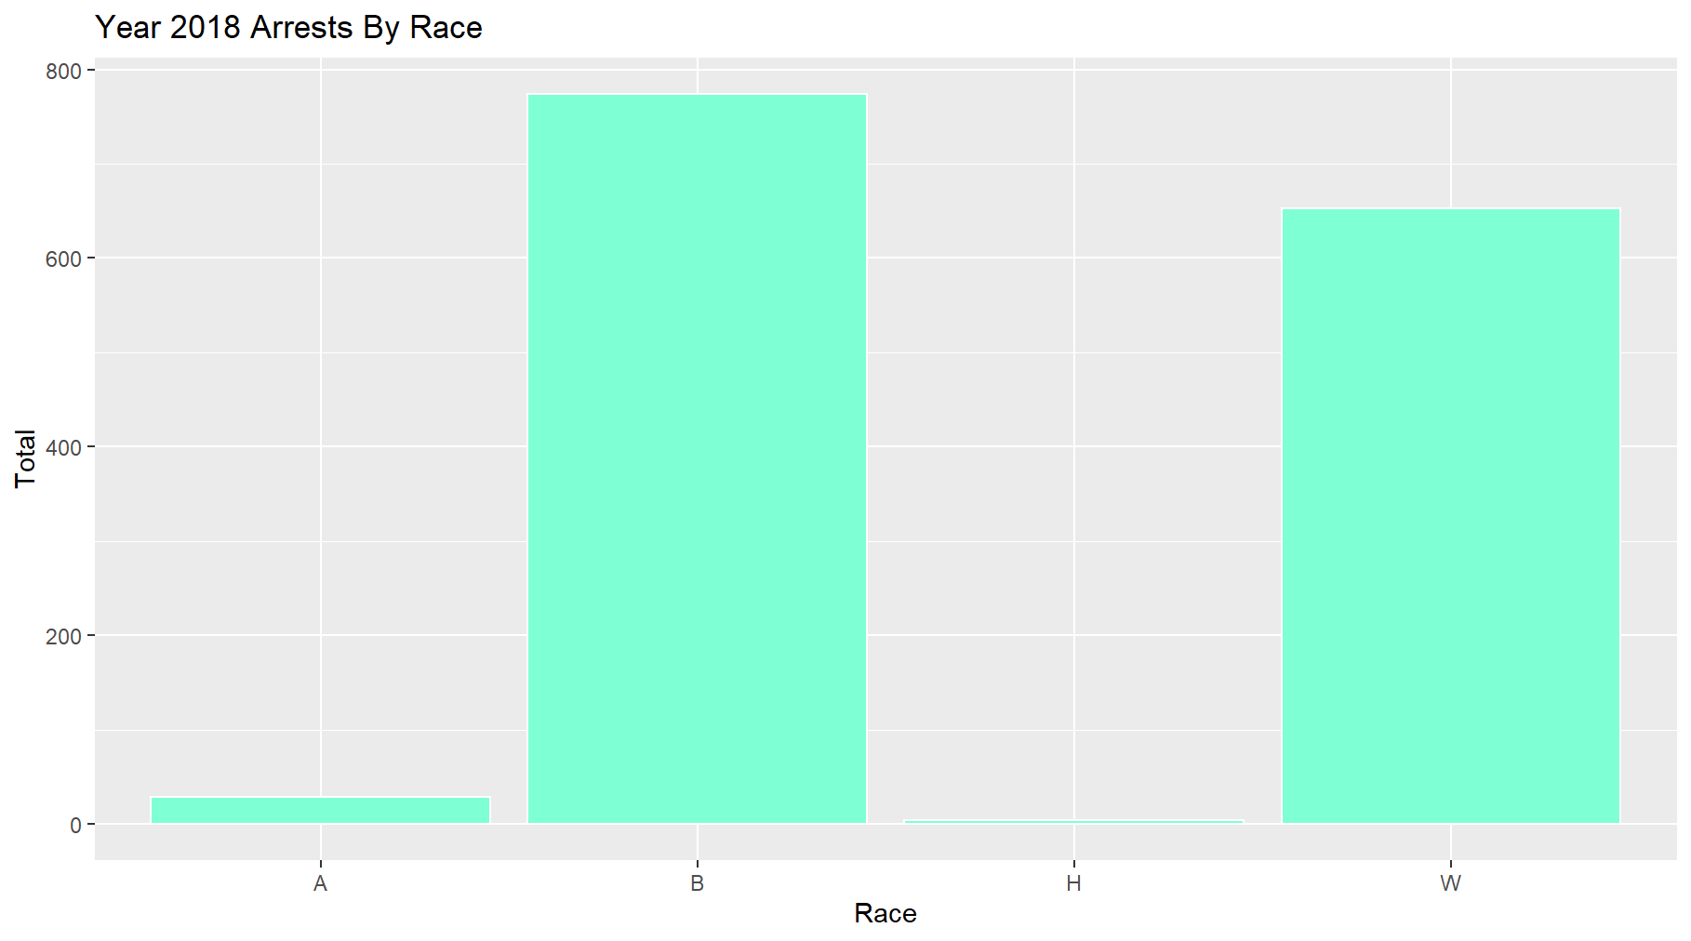
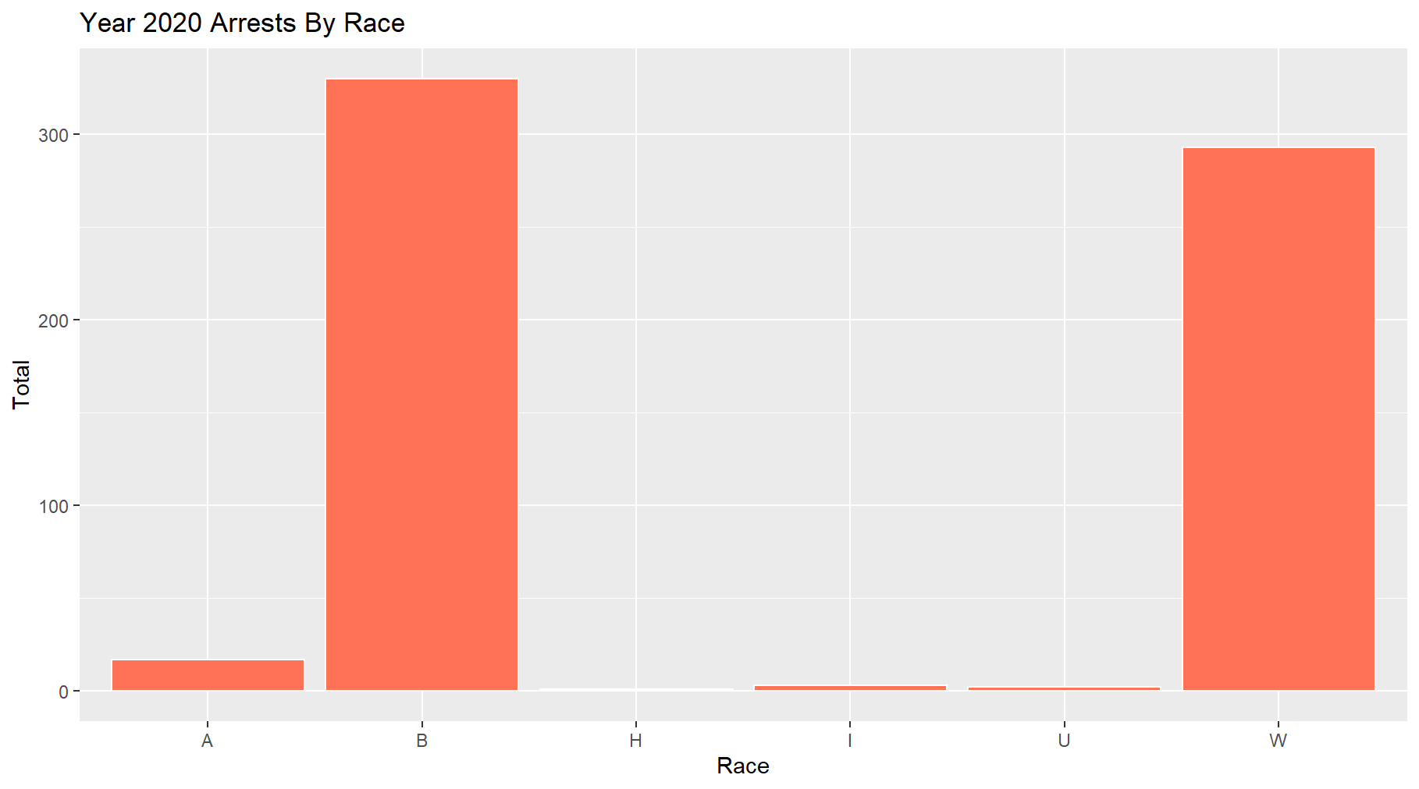
Arrests by Race
A - Asians
B - Black
H - Hispanics
I - Islanders
O - Others
U - Unknown
W - Whites

Slide 9
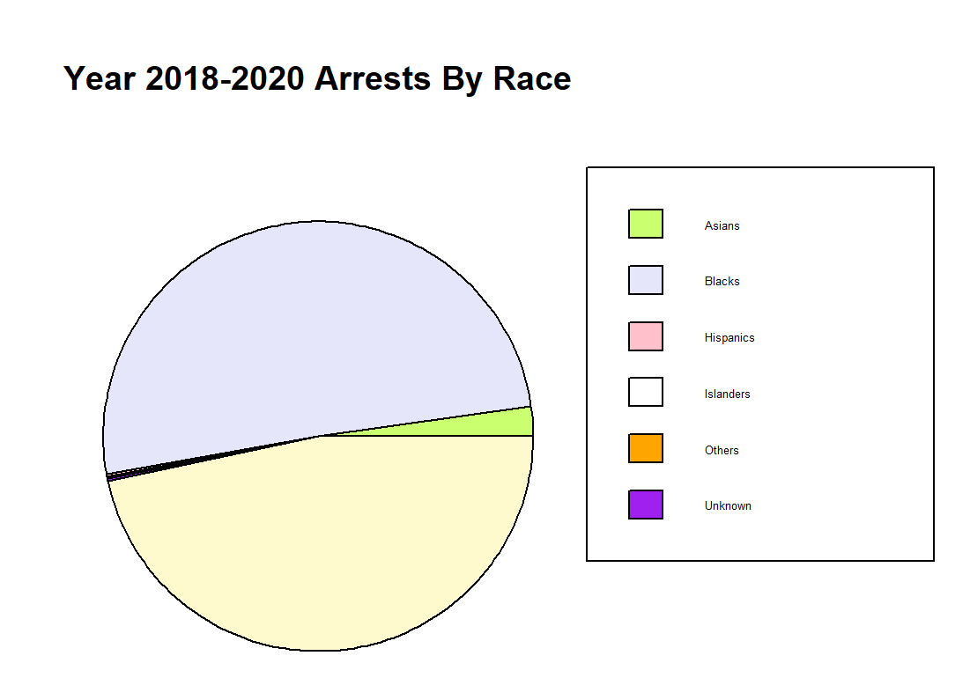
Demographics of Chapel Hill:
White: 71.74%
Asian: 13.03%
Black or African American: 10.89%
Two or more races: 2.87%
50.5%
2.25%
46.7%

Slide 10
Age Analysis by Race and Gender (2018-2020)
Race | Average | Maximum | Minimum | Median
A | 30.48 | 71.00 | 18.00 | 25.00
B | 38.51 | 79.00 | 18.00 | 35.00
H | 28.00 | 46.00 | 18.00 | 27.00
I | 32.00 | 65.00 | 20.00 | 21.50
O | 34.00 | 34.00 | 34.00 | 34.00
U | 32.17 | 45.00 | 18.00 | 34.00
W | 37.19 | 87.00 | 18.00 | 35.00
Average: | 33.19 | 61.00 | 20.57 | 30.21
Gender | Average | Maximum | Minimum | Median
F | 34.26 | 79.00 | 18.00 | 31.00
M | 38.60 | 87.00 | 18.00 | 36.00
Average: | 36.43 | 83.00 | 18.00 | 33.50

Slide 11
Weapon Analysis (2018-2020)
Weapon_Present | Total
CLUB/BLACKJACK/BRASS KNUCKLES | 8
FIREARM (TYP NOT STATED) | 8
HANDGUN | 64
LETHAL CUTTING INSTRUMENT | 29
OTHER FIREARM | 1
RIFLE | 1
SHOTGUN | 2
UNARMED | 3105

Slide 12
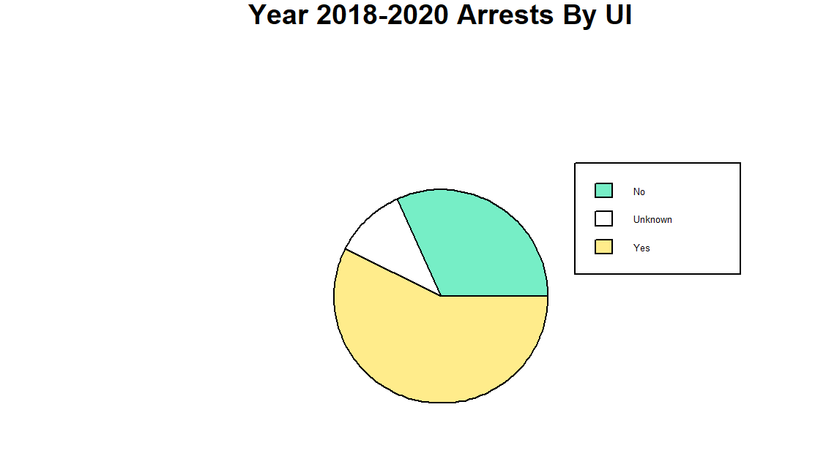
UI = Under the Influence of Drugs or Alcohol
10.9%
31.8%
57.3%

Slide 13
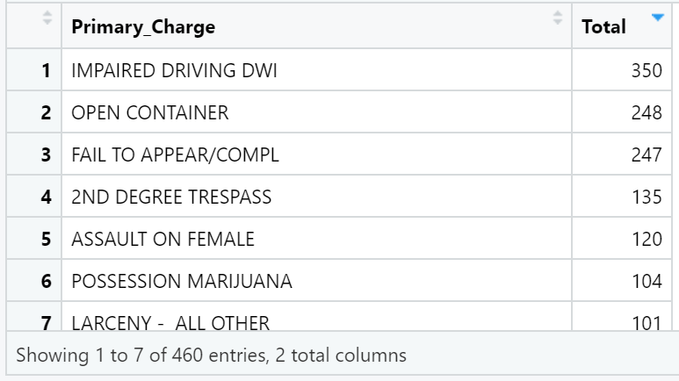
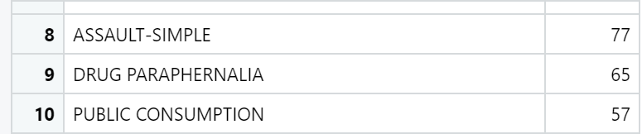
Crime Type and COUNT

Slide 14
POLICY IMPLICATION
Predicting crimes in an area
Resource Allocation
Education and law and rule enforcement

Slide 15
CONCLUSION
Most crimes committed in Chapel Hill are within the UNC region
Crimes occur the most during the hot months
Black people are the most arrested despite being a minority
Young people get arrested more than old people
Most of crimes in Chapel Hill are Drug and Alcohol related

