Slide 1
Consumer Scoring
Approach Note
Srimoyee Joardar

Slide 2
The Premise
PRM has collected close to 140Mil consumer records through various touchpoints across brands and channels
  Contact Information
  Demographic Data
  Date/Time stamp of interactions
  Brand/Variant/SKU interacted with
  The combination of big data and advanced analytics offers HUL countless opportunities across the marketing funnel. The objective is to use PRM data to move from mass marketing efforts to mass personalisation

Slide 3
Business Objective : Moving towards Mass Personalisation
  Consumer interactions with existing brands, overlaid with consumer brand basket framework from IMRB can improve marketing context, build relationships, drive repeat purchase and identify brand and category opportunities.
IMRB Consumer Panel Data
PII Data (mobile no/Email ID)
Consumer Segment 1
Advanced Analytics
LSM prediction algorithm
Purchase Basket Analysis
Response Rate Modelling
Attribution Modelling
Consumer Scoring
Offering 1
Demographic data
Consumer Segment 2
Offering 2
PRM
Brand/Variant/SKU data
Offering 3
Consumer Segment 3
Behavioral and Campaign data
Data Layer
This layer takes care of collection, standardization, aggregation and maintenance of data from multiple sources
Analytics Layer
Stitches data together, and translating data into actionable insights
Mass personalization
Knowing what consumers want and do not want, we can now match the right audience to the right offering

Slide 4
Consumer Scoring
Score
Profile
Brand/
Category
Psychographic
Behavioral
Campaign
At its core, the customer engagement score is a single number that is used to measure how engaged your customers are
Each customer has their own score based on profiling information available for that customer, activity and interaction with the brands, and usage of your product and services
The higher the score, the more engaged the customer

Slide 5


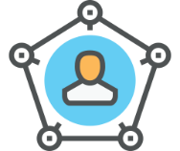


Why use Consumer Scoring?
Allows you to look at just one number, instead of many different data points
Identify the most potential customers, for a specific marketing activity, including sampling
Effective and Efficient Targeting to the right people, with the right offer at the right channel
Tailoring offers/communications basis consumer score
Identifying the next set of data points/actions needed to move consumers to a higher score

Slide 6
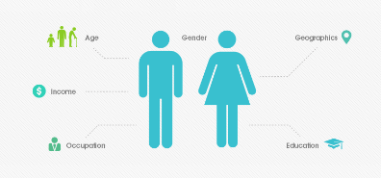
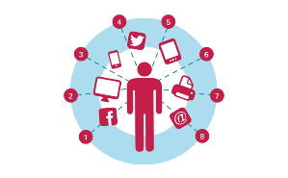
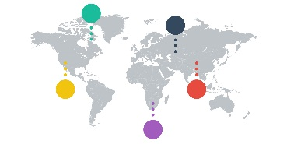
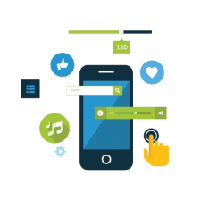


Scoring Attributes
Demographic
Age, Gender,LSM
Region/City
Occupation , Education
Religion, Ethnicity
Behavioral
Campaign
Usage
Purchase Behavior
Benefits Sought
Patterns
Organic/Paid
Engagement Level Campaign type
Campaign Channel
Campaign ncentive
Psychographic
Brand/Category
Social Class
Personality
Lifestyle & Activities
Attitude
Frequency
Recency
Monetary
Engagement Channel

Slide 7
Scoring Methodology
Best in Class
>0.95
Profile Index (Pr_{i})
Campaign Index (Ca_{i})
Brand Index (Br_{i})
Psychographic Index (Psy_{i})
Behavioral Index (Bh_{i})
Highly Engaged
0.75-0.95
5
[∑Pr_{i}+ Ca_{i} + Psy_{i} + Bh_{i} + Br_{i}]
4
Avg Engagement
0.45-0.75
3
Low Engagement
0.15-0.45
The value of each of the component indices are summed, and then divided by “n to get a very clean value between “0” and “1” that is easily converted to a percentage.
2
1
Disengaged
<0.15

Slide 8
Data Available in PRM
Score | KPI | Description | Be Be | Btone | Careline | Digital | H2H | KKT | Lakme | Pure It
Demographics | Age | Age of the consumer | ü | ü |  |  |  | ü | ü
 | Gender | Gender of the consumer | ü |  |  |  |  | ü | ü
 | Region/City | Region/City of the consumer | ü |  |  |  | ü |  | ü | ü
 | Email Id | Email id of consumer | ü |  | ü |  |  |  | ü
 | Name | Name of consumer | ü |  | ü |  |  |  | ü
 | LSM | LSM of the consumer | ü | ü | ü | ü | ü | ü | ü | ü
Brand/Category | Frequency/Engagement Channel | How many times has the consumer interacted with the brand. Is it above or below the average number: --For Brands like KKT/lakme/Pureit we will consider the visits and engagement. -- For providers like brandtone/digital we can consider the campaign wise avg engagement count and map it |  | ü |  | ü |  | ü | ü | ü
 | Recency | How recently the consumer interacted with the brand. We will create buckets of 0-3 Months 3-6 Months etc. the lowest will get highest score and highest will get least score | ü | ü | ü | ü | ü | ü | ü | ü
Campaign | Responded | Whether consumer responded to the campaign |  | ü |  | ü
 | Campaign Type | Whether consumer completed the entire campaign flow |  | ü |  | ü
 | Campaign Channel | Channel of campaign i.e. SMS, OBD etc. |  | ü |  | ü
 | Campaign Incentive | Reward mechanic of the campaign |  | ü |  | ü
*** IMRB Market basket can be used for cross brand engagement
*** LSM can be used to assess Income level
*** Email Id can be used to assess Education level
*** Consumers Name can be used to derive Ethnicity and religion
*** City/Region of consumer in tandem with city can be used to derive consumer buying power

Slide 9
Consumer Scoring for PRM
[∑Pr_{i}+ Ca_{i} + Br_{i}]
Profile Index (Pr_{i})
Campaign Index (Ca_{i})
Brand Index (Br_{i})
The value of each of the component indices are summed, and then divided by “n to get a very clean value between “0” and “1” that is easily converted to a percentage
Data Caveats and Assumptions
Most of the demographic KPI’s are restricted to very small number.
All tier 3 digital and Brandtone data will be considered as interacted
Reached to responded cannot be done for existing campaign data
Lakme Salon and KKT campaign data is not considered for scoring due to unavailability
In order to map consumer response, going forward the data which is uploaded for campaigns need to be saved

Slide 10
Additional Possibilities
With consumer scoring:
Integrating to overall PRM dashboard
Further drill on overall scoring parameters (With Tier 4 data)
  For e.g.: Campaign score can be drilled further into channel level score, campaign type level score etc.
Dynamic selection of profiling questions basis customer data
Embrace relationships as a core aspect of its data using Graph DB
Requires additional Data Points:
Assigning weights to individual KPI’s using statistical techniques
Implementing machine learning algorithms like Collaborative filtering
Expanding the scope to include newer parameters like
  Psychographic
  Behavioral
  Social
  Competitor
Process Mining of campaigns and Triggering Mechanism for campaigns on customer movement across scoring spectrum

Slide 11
Let’s discuss!

