Slide 1
IMPROVEMENTS IN PARALLEL JOB SCHEDULING ALGORITHM USING MIGRATION AND CONSOLIDATION IN THE CLOUD ENVIRONMENT
Project Associates
13381A0509 P. Sai Sree Keerthana
13381A0503 P. Hema
13381A0515 G. Vanitha
13381A0512 G. Sujitha
13381A0514 A. Uday kumar
Under the Guidance of
Sri P. Ravi Kiran

Slide 2
overview
Abstract
Cloud computing
Problem Statement
Existing System
Limitations of Parallel Scheduling Schemes
Idea Behind Proposed Approach
Proposed Algorithms
FCFS with KEASY Backfilling and Consolidation
The Scheduling Progress of FCFS With KEASY
Limitations of KEASY
REASY Algorithm
MEASY Algorithm
System Requirements
Design and Implementation
Conclusion

Slide 3
Abstract
An increasing number of high performance computing parallel applications leverages the power of the cloud for parallel processing.
Scheduling of parallel applications is key to success in improving QoS while hosting parallel applications
A more popular parallel job scheduling algorithm is Extensible Argonne Scheduling sYstem (EASY).
The project proposes Migration and Consolidation EASY (MEASY) algorithm that enhances EASY.

Slide 4
Cloud Computing
Provides easy-to-use and cost-effecting solutions for running HPC parallel applications
Low utilisation of computing resources is a major issue in Data Centres.
Reasons for low utilization:
Processor fragmentation
Idle CPU cycles
Consequences of low utilization of computing resources:
Increases the cost of running HPC parallel applications in the cloud
Reduces the benefit of Data centres

Slide 5
Cloud Computing (contd...)
We adopt FCFS algorithm, the basic variable partitioning scheme to overcome low utilization.
The algorithm is simple and straightforward, but it suffers from processor fragmentation.
So we adopt FCFS with backfilling ,which was developed as the Extensible Argonne Scheduling System(EASY).

Slide 6
Problem Statement
The main objective of the project is to propose parallel job scheduling algorithms named KEASY, REASY and MEASY an enhancement to EASY that uses migration and consolidation.

Slide 7
Existing System
Extensible Argonne Scheduling System(EASY)
A more popular parallel job scheduling algorithm
EASY allows short or small jobs to use idle processors.
EASY makes reservation to the head job in the queue.
In addition, SJF is often employed to assist parallel job scheduling.

Slide 8
Existing System (Contd....)
The goals of EASY algorithm are simplicity and efficient usage of the available resources.
This algorithm allows users to queue both interactive job and batch job access.
When resources are available the user is notified by the scheduler.

Slide 9
Existing System (Contd....)
Other parallel job scheduling algorithms are:
Dynamic partition
Gang Scheduling
These algorithms are not widely accepted because of their limitations in practice.

Slide 10
Limitations of Parallel Scheduling Schemes
Existing parallel scheduling schemes tries to improve utilization caused by processor fragmentation but not taking idle CPU cycles into account.

Slide 11
Idea Behind Proposed Approach
Parallel workload consolidation for better utilization of computing resources is well supported by Virtualization Technology.
In order to improve cpu utilization we partition each processesor into two-tier virtual machines(fg and bg).
Idea is to employ migration and consolidation to enhance the existing parallel scheduling algorithms.

Slide 12
Proposed Algorithms
The project proposes three parallel scheduling algorithms that adopt migration and consolidation
The basic Algorithm – FCFS with KEASY(job kill bases on EASY)
Two improved Algorithms
Reservation based EASY (REASY)
– using reservation instead of job kill
Migration based on EASY (MEASY)
– using migration instead of job kill

Slide 13
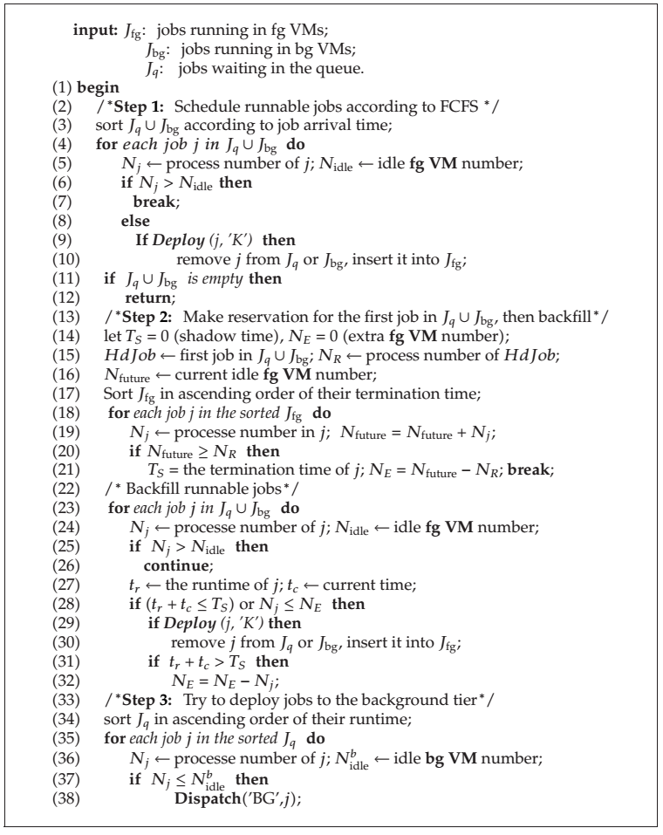
FCFS with KEASY Backfilling and Consolidation

Slide 14
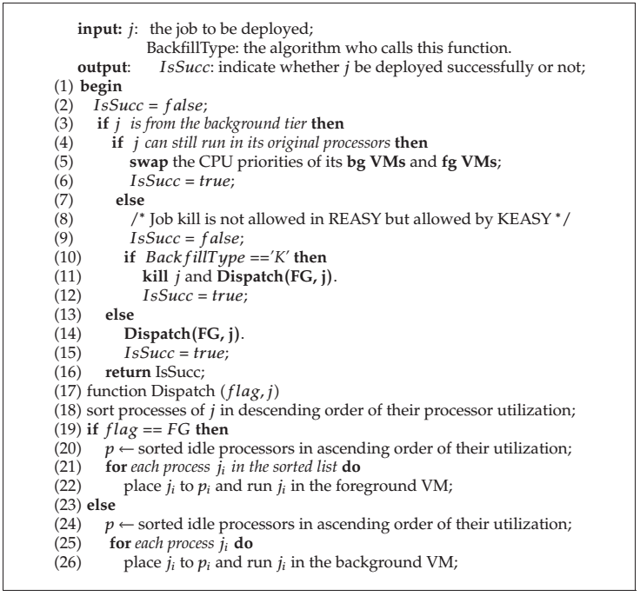
Algorithm for Deploy & Dispatch (contd....)

Slide 15
The Scheduling Progress of FCFS With KEASY
Step1: Use FCFS to schedule all possible jobs to foreground VMs.
Step2: Use EASY to make reservation to the currently head job of the fg-running job list ,and then backfilling all possible jobs to foreground VMs.
Step3: Use SJF to deploy all possible jobs into background VMs. The following four points needs to be emphasized.
KEASY is called to schedule jobs to run in foreground VMs when job arrives or job departs the foreground tier; SJF is called to schedule jobs to run in background VMs when job departs the background tier.
When selecting jobs to run in foreground VMs, jobs both waiting in the queue and running in the background VMs are candidates.
Only the background VM whose corresponding foreground VM’s CPU utilization is less than a threshold 96% can accommodate process.
Jobs’ execution time estimates are used whenever this information is needed for the scheduling decision making.

Slide 16
An Illustrative example of KEASY
Consider the following:-
5 processors - (P1,P2,P3,P4,P5)
12 jobs – (J1–J12) at the initial time
Each job is denoted by (n, t), ‘n’ is the processor requirement ‘t’ is the execution time
Each processor has two tier VMs denoted as fg and bg

Slide 17
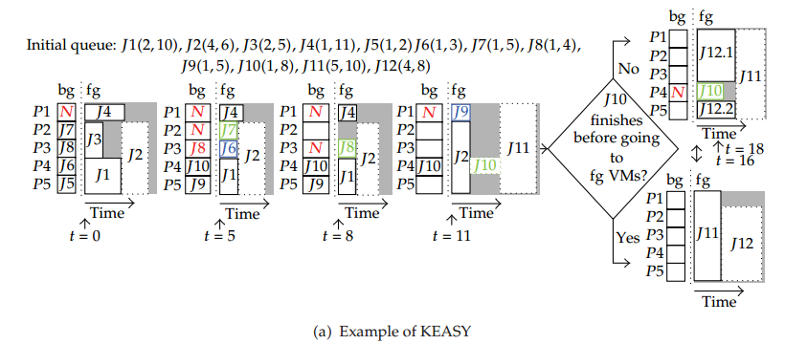
An Illustrative Example Of KEASY (contd...)

Slide 18
An Illustrative Example of KEASY(contd....)
In the previous illustrative example
(●) Mark represents - a job can run on its original nodes.
(●) Mark represents -a job should be killed first and then restart from the very beginning on other nodes.
(●) Mark represents – Processor is busy in executing some other job.

Slide 19
Limitations of KEASY
The basic algorithm described above adopts job kill during the scheduling. This leads to a waste of computing resource.
So we try to remove job kill and present two refined algorithms.
REASY
MEASY

Slide 20
REASY
In REASY, job kill is not allowed while scheduling.
Once a job deployed onto background vm’s of a set of processors, it’s run is pinned onto this set of processors.
Thus it prevent job kill during execution.

Slide 21
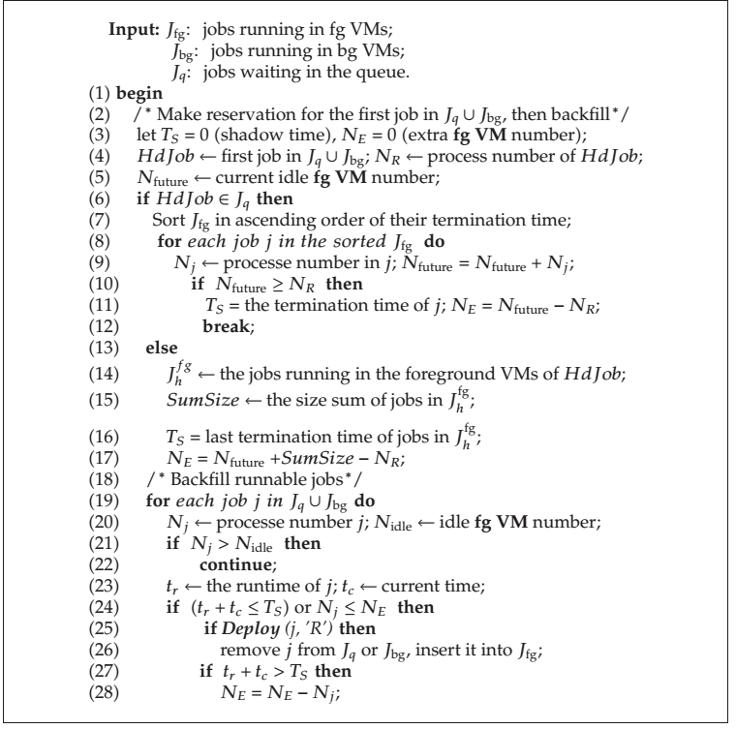
REASY Algorithm

Slide 22
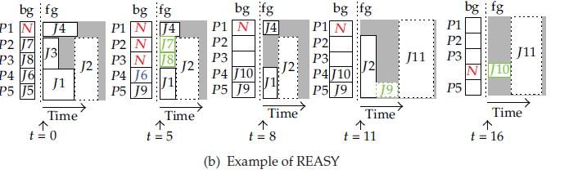
An Illustrative Example Of REASY

Slide 23
MEASY Algorithm
The only difference between KEASY and MEASY
exists in the Deploy.
MEASY does not kill a selected job but uses migration instead.

Slide 24
MEASY Algorithm(contd....)

Slide 25
System Requirements
Software Requirements:
Language used – C language
Operating system support – Windows XP and above
Integrated Developing Environment (IDE) – Dev C++
Hardware Requirements:
PC with configuration of Quad Core processor or above with 2 GB of RAM and 500 GB of HDD

Slide 26
Design and Implementation
Structure designed for Job Queues:
struct jobqueue{
int job_id;
int num_of_procs;
int execution_time;
int pending_time;
int shadow_time;
int status;
struct jobqueue *ptr;
};

Slide 27
Design and Implementation
Requires three job queues with the designed jobqueue structure:
jobq – A job queue that contains jobs that are waiting for execution.
fgq – A job queue that contains jobs that are executing in foreground.
bgq – A job queue that contains jobs that are executing in background.
Requires two linked lists with the designed jobqueue structure:
joblist – A linked list that contains the list of jobs to be executed.
Unionlist – A linked list that contains union of list of jobs executing in bgq background queue and jobs waiting in jobq job queue.

Slide 28
Operations on Job Queues
List of operations on jobq job queue:
Void enqueue_jobq(int j_id,int no_procs,int ex_time);
Void delete_jobq(int j_id,int no_procs,int ex_time);
Void display_jobq();
List of operations on fgq foreground queue:
Void enqueue_fgq(int j_id,int no_procs,int ex_time,
int pend_time);
Void delete_fgq(int j_id);
Void sort_fgq();
Void display_fgq();

Slide 29
Operations on Job Queues(contd….)
List of operations on bgq background queue:
Void enqueue_bgq(int j_id,int no_procs,int ex_time ,int pend_time);
Void delete_bgq(int j_id,);
Void display_bgq();
Void sort_bgq();

Slide 30
List of Operations on Linked list
List of operations on joblist linked list:
void addnode_joblist(int j_id,int no_procs,int ex_time);
void display_joblist();
List of operations on unionlist linked list:
void union_list();
bool isPresent (int j_id);
void delete_unionlist(int j_id);
void union_sort(char s);
void display_unionlist();

Slide 31
Design of Virtual Machine
Designed a two dimensional array for Virtual Machine to display jobs executing in background, foreground and jobs in reservation.
Int vm[5][3];

Slide 32
Design of Virtual Machine(contd….)
Operations performed on Virtual Machine:
bool dispatch_fg(int j_id,int no_procs);
void delete_fg(int j_id);
void update_fg();
bool dispatch_bg(int j_id);
void delete_bg(int j_id);
void update_bg();
bool insert_rsrv(int j_id,int no_procs);
int deploy(int j_id,int p_id);
int job_pid_bg(int j_id);
bool status();

Slide 33
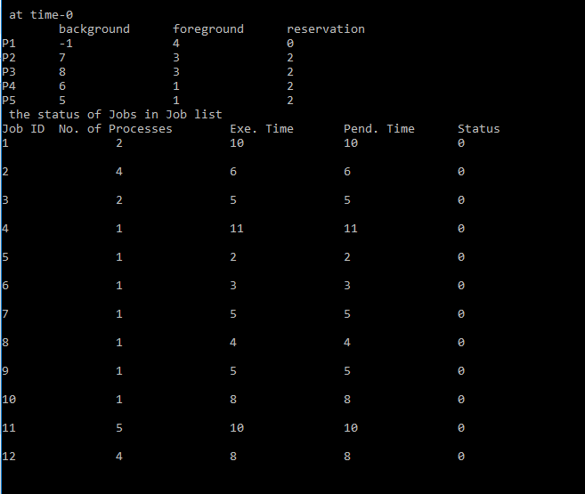
Output Screens
0-incomplete
1-complete

Slide 34
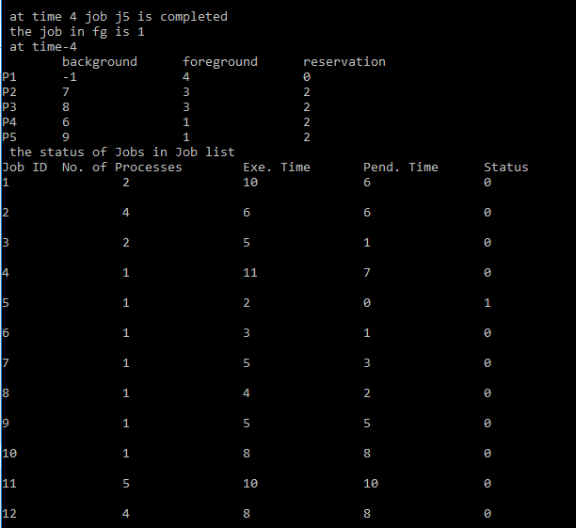

Slide 35
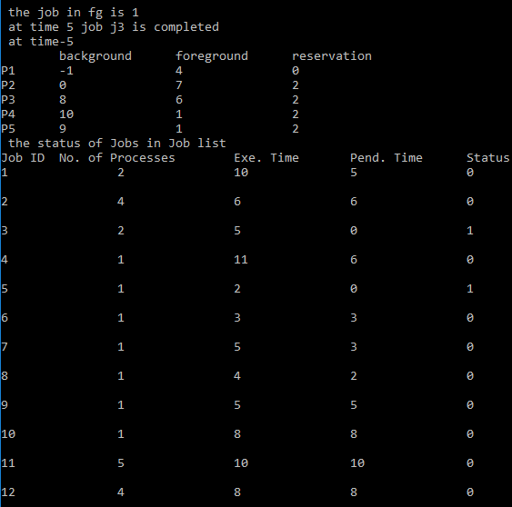

Slide 36
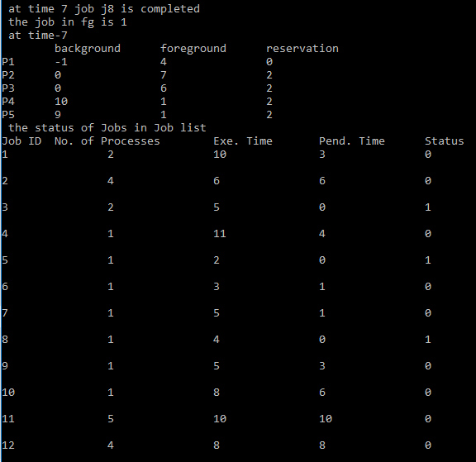

Slide 37
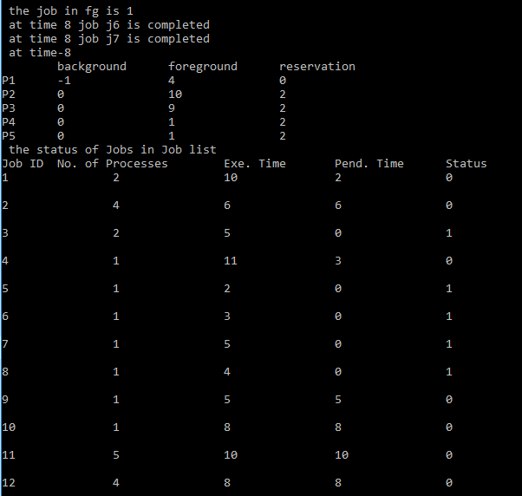

Slide 38
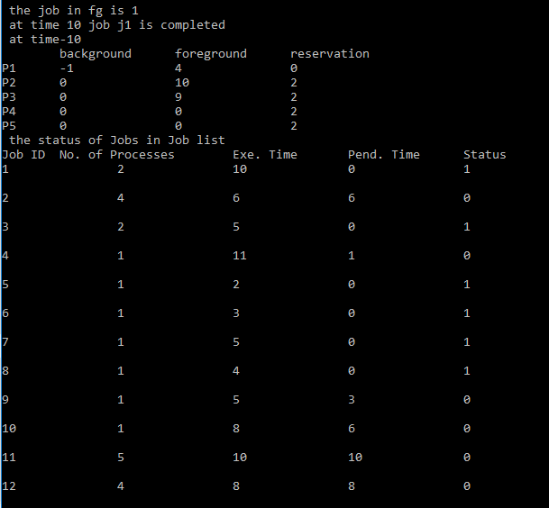

Slide 39
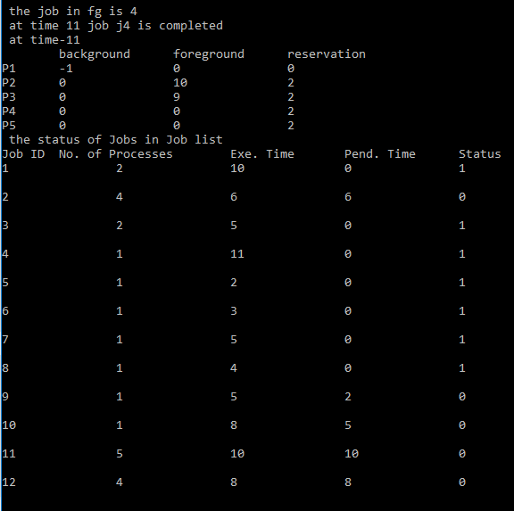

Slide 40


Slide 41
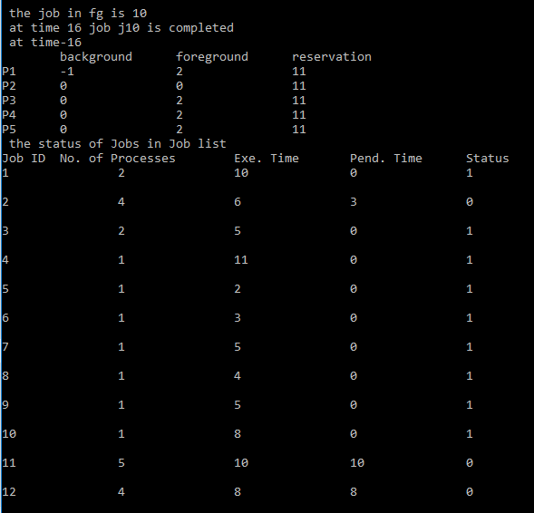

Slide 42
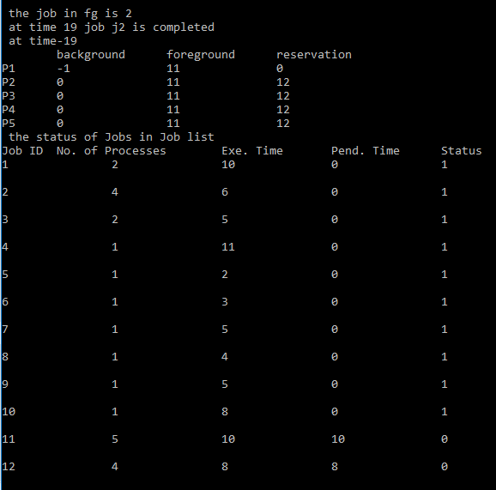

Slide 43
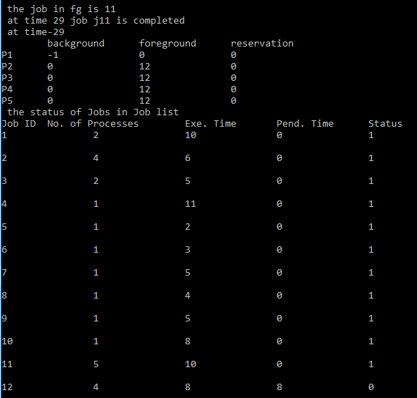

Slide 44
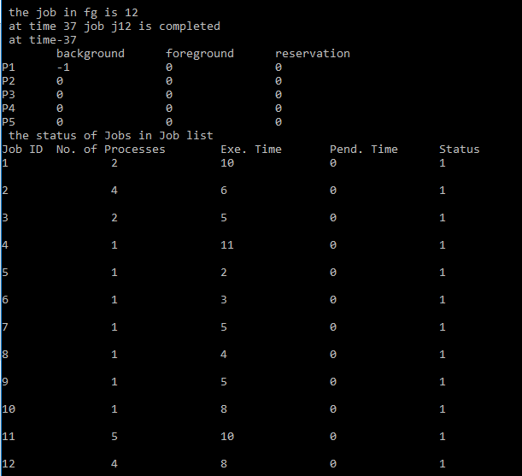

Slide 45
Conclusion
Parallel job scheduling algorithm KEASY, an enhancement to EASY has been achieved successfully.
Next, we going to work on algorithms REASY and MEASY an enhancement to EASY that uses migration and consolidation.

Slide 46
References
1. A. Iosup, S. Ostermann, N. Yigitbasi, R. Prodan, T. Fahringer, and D. Epema, “Performance analysis of cloud computing services for many-tasks scientific computing,” IEEE Transactions on Parallel and Distributed Systems, vol. 22, no. 6, pp. 931–945, 2011.
2. A.W. Malik, A. Park, and R.M. Fujimoto, “Optimistic synchronization of parallel simulations in cloud computing environments,” in Proceedings of IEEE International Conference on Cloud Computing (CLOUD ’09), pp. 49–56, September 2009.
3. R. Fujimoto, A. Malik, and A. Park, “Parallel and distributed simulation in the cloud,” Simulation Magazine, Society for Modeling and Simulation, no. 3, 2010.
4. G. D’Angelo, “Parallel and distributed simulation from many cores to the public cloud,” in Proceedings of the International Conference on High Performance Computing and Simulation (HPCS ’11), pp. 14–23, IEEE, Istanbul, Turkey, 2011.
5. Amazon, “High performance computing HPC on AWS,” 2011, http://aws.amazon.com/hpc-applications/.

Slide 47


Slide 48


