Slide 1
Adapters for Machine Translation
Aditya Kurniawan

Slide 2
Objectives and motivations
Integrating BERT (MLM) to Machine Translation task
Fine-tuning BERT with Adapters
Understand the impact of pre-training LM training volume to the adapters
Understand the impact of the pre-trained LM weights to the adapters

Slide 3
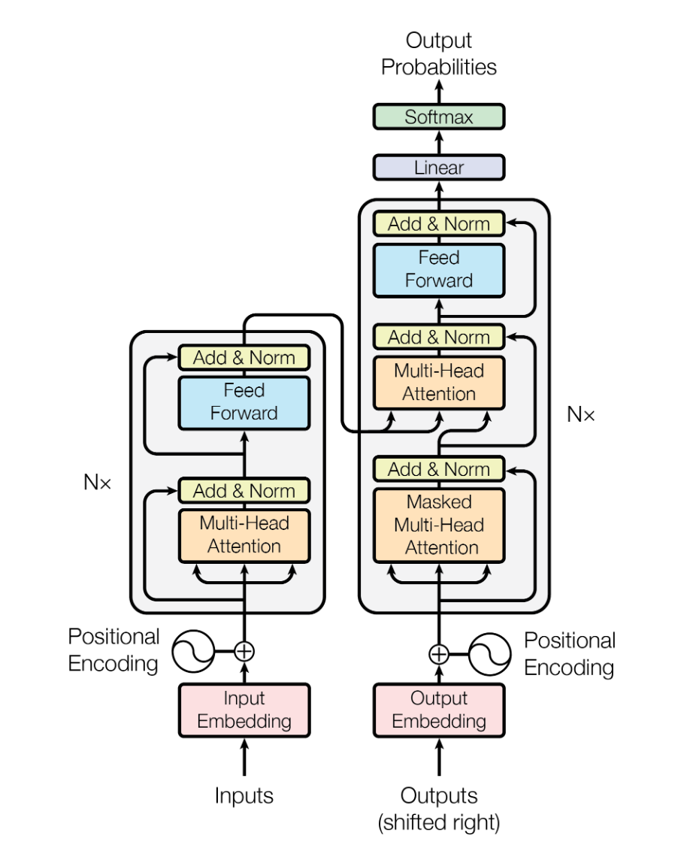
Transformer (Vaswani et al. 2017)
Transformer architecture diagram from Vaswani et al. 2017

Slide 4
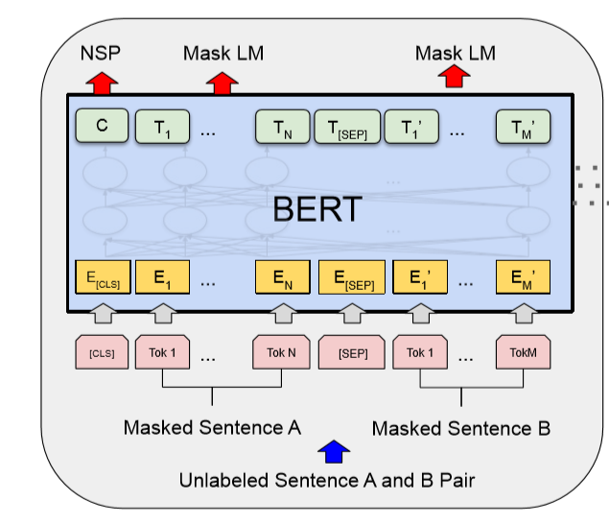
BERT (Devlin et al 2018)
BERT diagram from Devlin et al. 2018

Slide 5
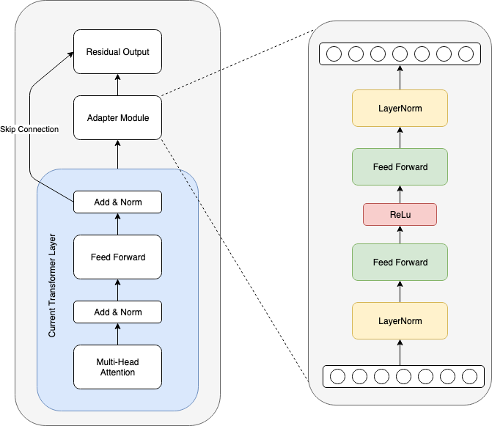
Adapter Module (Pfeiffer et al. 2020)
Adapters are small parametrized modules introduced into a pre-trained Transformer model that can be used for parameter and cost-efficient model adaptation.
Seed model is firstly pre-trained on source domain data / source task.
During fine-tuning stage only adapter parameters are trained, while pre-trained model parameters are frozen, that helps to efficiently overcome catastrophic forgetting problem and perform simultaneous model adaptation towards different tasks / domains by training adapters in parallel.

Slide 6
BLEU Test Scores
Adapters Models | BLEU | Steps
IWSLT | 22.5619 | 234k
IWSLT + WMT (total 500k) | 23.7127 | 590k
IWSLT + WMT (total 2m) | 25.4734 | 394k
IWSLT BERT | 27.643 | 200k
Baseline Models | BLEU | Steps
IWSLT | 22.9773 | 120k
IWSLT + WMT (total 500k) | 22.6145 | 236k
IWSLT + WMT (total 2m) | 21.5499 | 556k

Slide 7
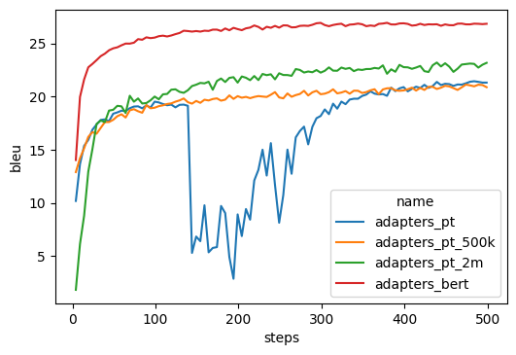
Adapters comparison

Slide 8
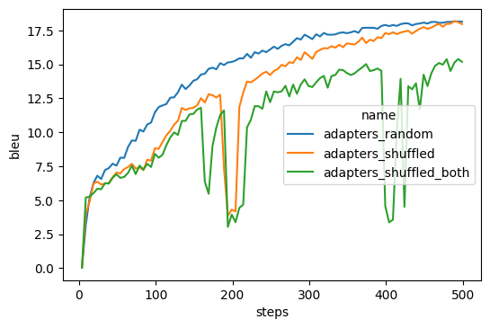
Random & shuffled adapters

Slide 9
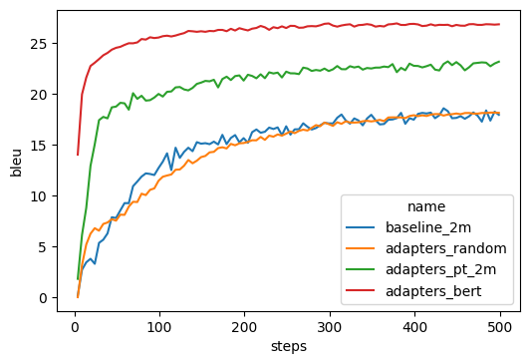
Random adapters

