Slide 1
Steganography

Slide 2
Agenda
What is Steganography?
Historical Techniques
RSA Encryption
The LSB Method
The Algorithm Explained
Applications
Advantages & Disadvantages
Credits

Slide 3
What is Steganography ?

Slide 4
Steganography is the art and science of writing hidden messages in such a way that no-one, apart from the sender and intended recipient, suspects the existence of the message, a form of security through obscurity. The word steganography is of Greek origin and means "concealed writing". The first recorded use of the term was in 1499 by Johannes Trithemius in his Steganographia, a treatise on cryptography and steganography disguised as a book on magic. Generally, messages will appear to be something else: images, articles, shopping lists, or some other cover-text and, classically, the hidden message may be in invisible ink between the visible lines of a private letter.
The advantage of steganography, over cryptography alone, is that messages do not attract attention to themselves. Plainly visible encrypted messages—no matter how unbreakable—will arouse suspicion, and may in themselves be incriminating in countries where encryption is illegal. Therefore, whereas cryptography protects the contents of a message, steganography can be said to protect both messages and communicating parties.
Steganography includes the concealment of information within computer files. In digital steganography, electronic communications may include steganographic coding inside of a transport layer, such as a document file, image file, program or protocol. Media files are ideal for steganographic transmission because of their large size. As a simple example, a sender might start with an innocuous image file and adjust the color of every 100th pixel to correspond to a letter in the alphabet, a change so subtle that someone not specifically looking for it is unlikely to notice it.

Slide 5
Historical Techniques

Slide 6
Hidden messages on messenger's body.
Use of Invisible Ink during WWII.
Use of Microdots for typing the message.
Null ciphers (unencrypted messages) were also used.
Fishing freshwater bends and saltwater coasts rewards anyone feeling stressed. Resourceful anglers usually find masterful leapers fun and admit swordfish rank overwhelming anyday.
“Send lawyers, guns, and money” .

Slide 7
The RSA Encryption

Slide 8
Sender A does the following:-
Obtains the recipient B's public key (n, e).
Represents the plaintext message as a positive integer m.
Computes the ciphertext c = m^{e} mod n.
Sends the ciphertext c to B.
Summary
n = pq, where p and q are distinct primes.
phi, φ = (p-1)(q-1) e < n such that gcd(e, phi)=1
d = e⁻¹ mod phi.
c = m^{e} mod n, 1<m<n.
m = c^{d} mod n
Recipient B does the following:-
Uses his private key (n, d) to compute m = c^{d} mod n.
Extracts the plaintext from the message representative m

Slide 9
The LSB Method

Slide 10
Consider a 24 bit picture
Data to be inserted: character ‘A’: (10000011)
Host pixels: 8 pixels will be used to store one character of 8-bits at LSB of blue color.
The pixels which would be selected for holding the data are chosen on the basis of the key which can be a random number {Stego Key}.
Ex:
00100111 11101001 11001000 00100111 11001000 11101001 11001000 00100111 11101001 Embedding ‘A’ 00100111 11101000 11001000 00100110 11001000 11101000 11001001 00100111 11101001
According to researchers on an average only 50% of the pixels actually change from 0-1 or 1-0.

Slide 11
The Algorithm Explained

Slide 12
The main algorithm behind the project is to first encrypt the data and then hide it behind the image such that even if the steganography is cracked, the data still remains encrypted. The algorithm follows the following approach:
The data is encrypted using the 32 bit RSA Encryption algorithm. The cipher text thus obtained is used in the next step.
The cipher text from step 1 is hidden behind an Image( .jpg, .png, .bmp, .gif) using the LSB Algorithm of Steganography.
This image can now be sent to the destination user who will first extract the cipher text out of the image and then decrypt using his private key for the RSA Decryption.

Slide 13
Algorithm to write in image file:
Get the width and height of image.
Calculate incer_w = coprime of width(lowest) and incer_h = coprime of height(lowest).
First write the length of message on 1st pixel i.e., pixel[0][0].
Now write length of PIN in pixel[incer_h][incer_w]
To write the data:
k=k+incre_w;
l = l+ incre_h;
For i=0 to length of message
if(k>=width)
k-=width;
if(l>=height)
l-=height;
p=pixels[l*w+k];
Set thvalue of pixel accordingly
k=k+incre_w;
l=l+incre_h;
The pattern is shown as:

Slide 14
1 |  |  |  |  |  |  |  |  |  |  |  |  | 16
 |  |  |  |  |  |  |  | 9
17 |  |  | 2
 |  |  |  |  |  |  |  |  |  |  | 10
 |  |  | 18 |  |  | 3
 |  |  |  |  |  |  |  |  |  |  |  |  |  | 11
 |  |  |  |  |  | 19 |  |  | 4
 | 12
 |  |  |  |  |  |  |  |  | … |  |  | 5
 |  |  |  | 13
 |  |  |  |  |  |  |  |  |  |  |  |  |  |  | 6
 |  |  |  |  |  |  | 14
 |  | 7
 |  |  |  |  |  |  |  |  |  | 15
 |  |  |  |  | 8

Slide 15
Applications

Slide 16
Watermarking.
Defense Purpose.
Business Field.
Areas where information hiding is an integral part.
Secure data transfer through internet.
Banking.

Slide 17
Advantages & Disadvantages

Slide 18
Advantages
Secure transfer of data.
Large number of applications.
Negligible chance of decoding when caught.
Disadvantages
Trade-off between distortion and efficiency.
Chances of misuse.

Slide 19
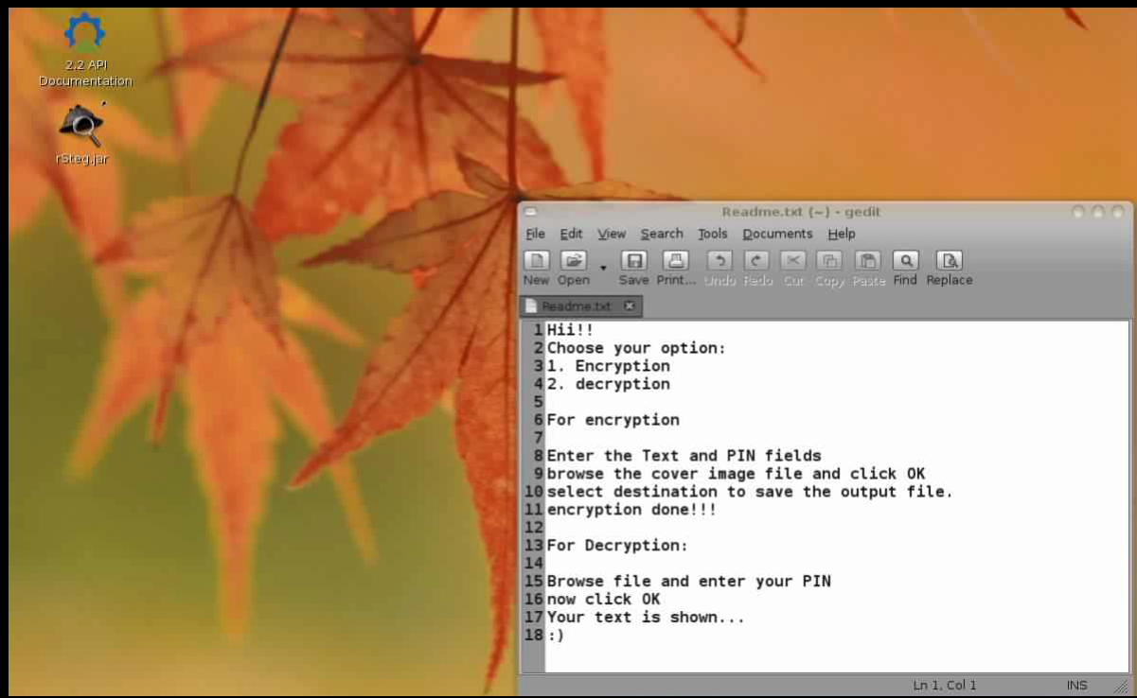

Slide 20
Credits

Slide 21
Saurabh Gupta
Abhinav Kumar Kushwaha
Alok Ranjan

Slide 22
Thanking you…

