Slide 1
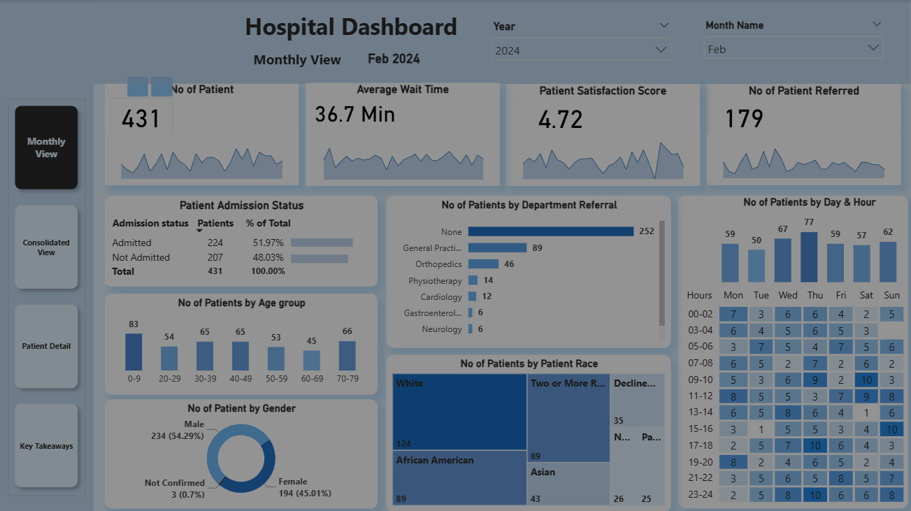
Hospital Analysis Project
STEPS IN PROJECT :
Requirement Gathering/ Business Requirements
Data Walkthrough
Data Connection
Data Cleaning / Quality Check
Data Modeling
Data Processing
DAX Calculations
Dashboard Lay outing
Charts Development and Formatting
Dashboard / Report Development
Insights Generation
By. Akanksha Walde

Slide 2
Hospital Analysis Project
DASHBOARD - 4 :
Monthly View
Consolidated View
Patient Details
Key Takeaways

Slide 3
Hospital Analysis Project
BUSINESS REQUIREMENTS:
KPI’s Requirements
To enhance operational efficiency and provide actionable insights into Hospital performance, we need to create a Hospital Analysis Dashboard in Power BI. This solution will enable stakeholders to track, analyze, and make data-driven decisions regarding patient management and service optimization.
Number of Patients:
Measure the total number of patients visiting the Hospital daily.
Display a daily trend using an area sparkline to understand patterns over time, such as peak days or seasonal trends.
Average Wait Time:
Calculate the average time patients wait before being attended to by a medical professional.
Use an area sparkline to show daily fluctuations and identify days with higher wait times that may require operational adjustments.
Patient Satisfaction Score:
Analyze the average satisfaction score of patients on a daily basis to evaluate the quality of service provided.
Present a daily trend using an area sparkline to identify dips in satisfaction and correlate them with operational challenges or peak times.
Number of Patients Referred:
Count the number of patients referred to specific departments from the Hspital each day.
Use an area sparkline to track daily trends and identify departments with high referral rates, which may require additional resources.

Slide 4
Hospital Analysis Project
BUSINESS REQUIREMENTS:
Dashboard 1: Monthly View
Objective: Monitor key metrics and trends on a month-by-month basis to identify patterns and areas for improvement.
Charts to Develop:
  Patient Admission Status: Track admitted vs. non-admitted patients.
  Patient Age Distribution: Group patients by 10-year age intervals.
  Department Referrals: Analyze referral trends across different departments.
  Gender Analysis: Visualize patient distribution by gender.
  Racial Demographics: Analyze patient data by race.
  Time Analysis: Assess patient volume by day and hour.

Slide 5
Hospital Analysis Project
BUSINESS REQUIREMENTS:
Dashboard 2: Consolidated View
Objective: Provide a holistic summary of hospital performance for a selected date range.
Charts to Develop:
  Similar metrics as the Monthly View, but aggregated over a customizable date range for broader insights and trend analysis

Slide 6
Hospital Analysis Project
BUSINESS REQUIREMENTS:
Dashboard 3: Patient Details
Objective: Offer granular insights into patient-level data to enable detailed analysis and troubleshooting.
Charts to Develop: A grid displaying essential fields:
  Patient ID
  Patient Full Name
  Gender
  Age
  Admission Date
  Patient Race
  Wait Time
  Department Referral
  Admission Status

Slide 7
Hospital Analysis Project
BUSINESS REQUIREMENTS:
Dashboard 4: Key Takeaways
Objective: Summarize the findings from all dashboards to provide clear and actionable insights for stakeholders.
Charts to Develop:
  Descriptive analysis of each metric and visualization, including patterns, anomalies, and actionable recommendations to optimize Hospital operations and patient care.

Slide 8
Hospital Analysis Project
Insights:
Descriptive Analysis
(April 2023 October 2024)
The Hospital dataset, covering a period of 19 months, records a total of 9,216 unique patients.
Patient Satisfaction:
The average satisfaction score was 4.99 out of 10, suggesting moderate satisfaction and highlighting areas for improving patient experiences.
Departmental Referrals:
A significant number of Patients (5400) did not required referrals. Among those referred, the most common were General Practice (1540 cases) and Orthopedics (995 Cases), followed by Physiotherapy (276 Cases) and Cardiology (248 Cases)
Peak busy Periods:
The busiest day were Mondays (1377 Patients), Saturdays (1322 Patterns), and Tuesdays (1318 Patients). The busiest hours were 11 AM, 7PM, 01 PM, and 11 PM indicating need of ample staffing during these periods.
Patient Demographics:
Age Groups: Adults (30-39 years) formed a large group (1200 Patients), followed by young adults (20-29 Years) with 1188 Patients. Other significant groups included middle aged as well (40-50 Years).
Race Distribution:
The largest racial group was White (2571), followed by African American (1951), multi racial (1557), and Asian (1060) patients. A significant number of patients (1030) declined to Identify their race.
Admission Patterns:
Nearly half of the patients (4612) wars admitted, while the rest (4604) wars treated and released,
Summary:
The dataset reveals high patient volumes, moderate satisfaction levels, and common referrals to General Practice and Orthopedics. Mondays and late night to early mornings hours are particularly busy. The patient demographics show a diverse age and racial composition, with nearly equal numbers of admitted and non admitted patients. These Insights can help optimize resource allocation and improve patient care in the Hospital.

Slide 9
Hospital Analysis Project
  Thank You…
By. Akanksha Walde

