Slide 1

MISM 6213 - Business Information Design, Quality, and Strategy
New Quality Information Product
Final Project Presentation
Presented by:
Group 7
Akash Valathappan, Riha Sindhe, Tarunya Daga,

Slide 2
Information Product
Inventory Management Review

Slide 3
How is it Useful?
Optimise Inventory Levels
Cut Waste, Boost Profits
Make Data-Driven Decisions
Control Over Inventory Cost
Increase overall efficiency and profitability
Provides insights into inventory levels, sales data, trends and patterns

Slide 4
Who is it Useful For?
Inventory Managers
Stakeholders
Marketing Team
Operations Team
Supply chain management Team
Finance and Sales Team
Senior Management

Slide 5
Data Methodology
9648 Rows, 13 Columns
No Null Values
Dropped Retailer ID column
No Duplicates

Slide 6
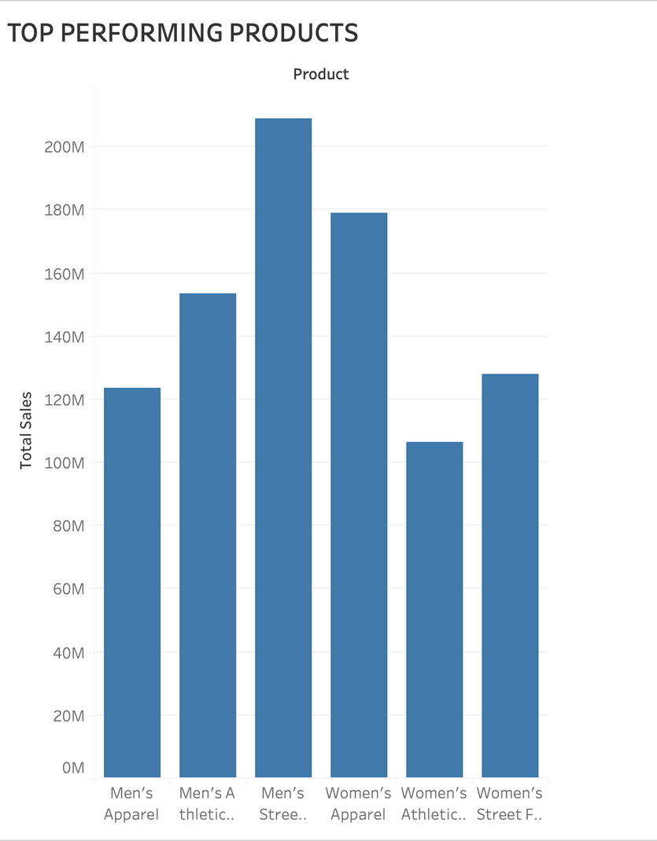
Top Performaning Products

Slide 7
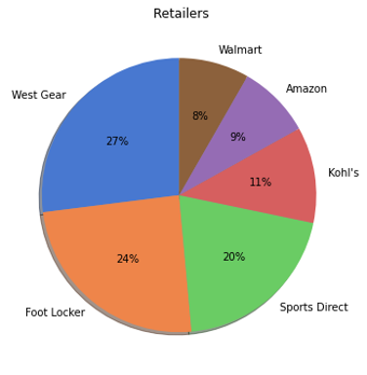
Total Sales by Retailers

Slide 8
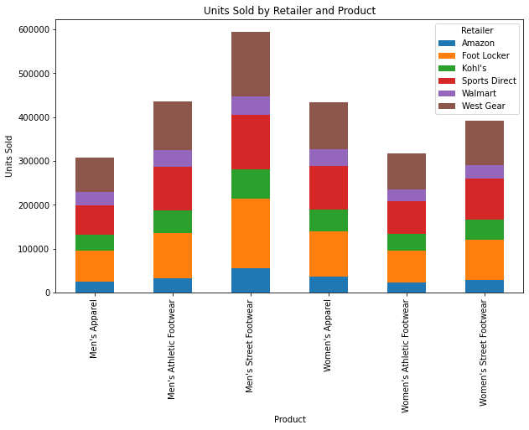
Units Sold By Retailer And Product

Slide 9
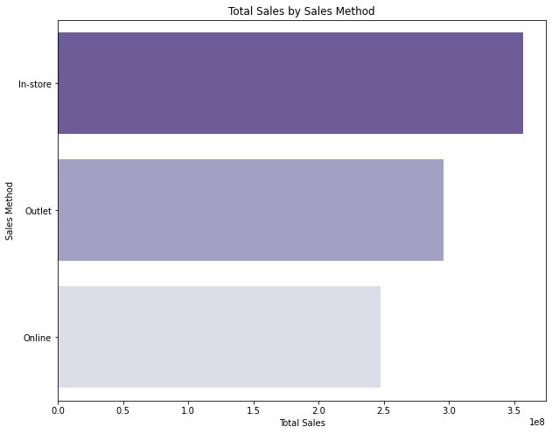
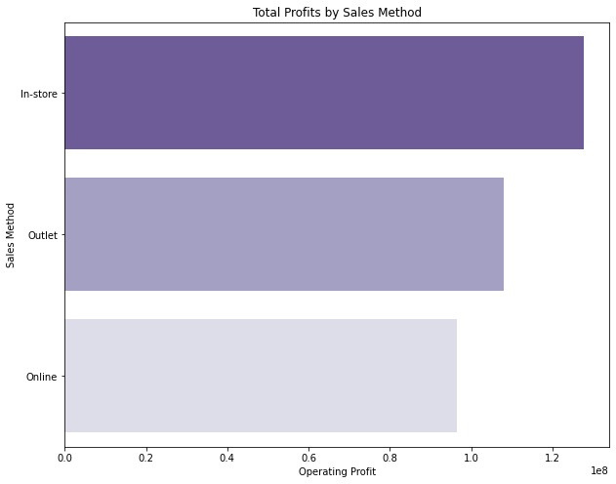
Total Profits, Total Sales by All Three Sales Methods

Slide 10
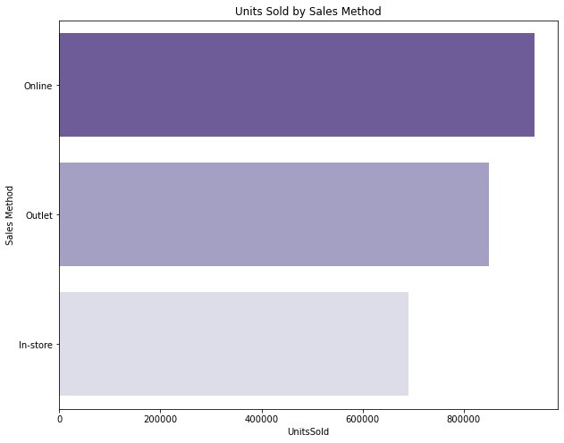
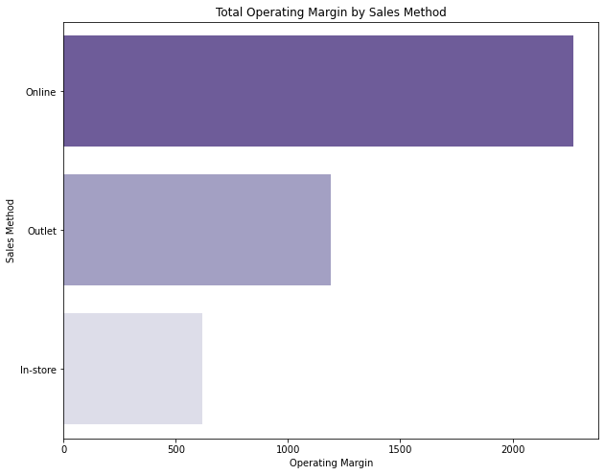
Total Units Sold, Total Operating Margin by All Three Sales Methods

Slide 11
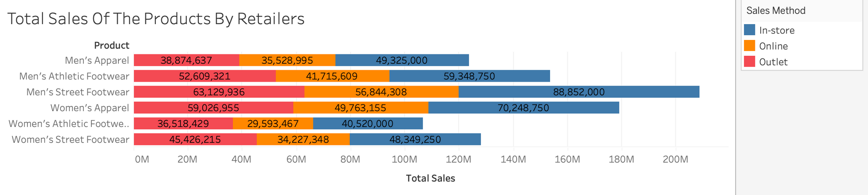
Total Sales Of The Products By Retailers

Slide 12

Identifying Products With Zero Total Sales

Slide 13
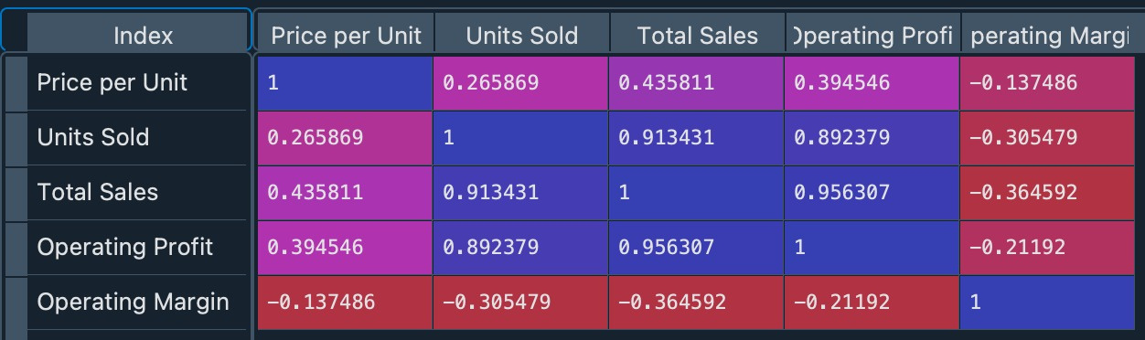
Correlation Matrix
Operating Profit and Units Sold have Positive Correlation with Total Sales

Slide 14
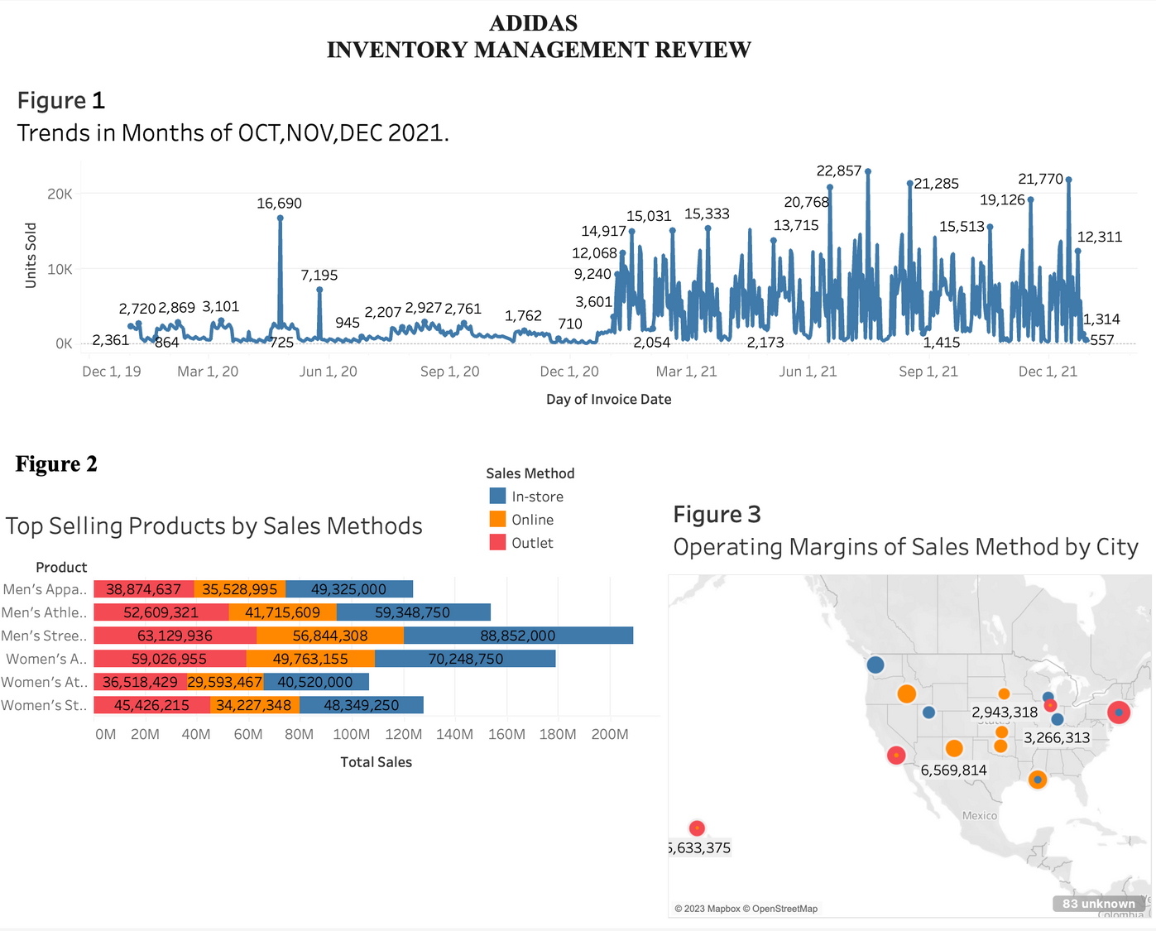
INFORMATION PRODUCT

Slide 15
Conclusion
Effective inventory management Information Product can assist Adidas' supply chain to be optimized while also reducing waste and increasing revenues.
The information product can counteract Porter's Five Forces such as the threat of new entrants and the bargaining power of buyers.
The new information product of inventory management is strategic for Adidas as it can help them fulfill customer demand, save money, and spot trends and patterns.

Slide 16
Recommendations
Adidas should use the information product to aid in data-driven inventory management choices
The sales teams may benefit from the product to ensure that in-demand goods are always available, lowering the possibility of stockouts.
Adidas should continue to gather and analyze data to refine its inventory management strategy and stay competitive in the market.

Slide 17
THANK YOU
FOR YOUR
ATTENTION

