Slide 1

Hotel Booking Cancellation Prediction
MIS 637 A - Data Analytics & Machine Learning
Team Members - (Group 3):
Tejal Rajendra Kuwar
Bhawna
Akshay Vanaparthi
Nithin Reddy Venna

Slide 2

Problem Statement
Hotel cancellations create major financial losses for hotels and make it difficult to manage room availability, staffing, and revenue forecasting.
Project Goal
The goal of this project is to predict whether a hotel booking will be canceled using various reservation and customer-related features.
By analyzing booking patterns and applying machine learning classification models, we aim to identify the main factors that contribute to cancellations and build a model that can accurately classify incoming bookings as "Canceled" or "Not Canceled." This analysis can help hotels prepare better strategies for managing cancellations.

Slide 3



Dataset Overview
Hotel Booking Demand Dataset from Kaggle
https://www.kaggle.com/datasets/jessemostipak/hotel-booking-demand
Dataset Characteristics
Total Records
Hotels Covered
Target Variable
119,390 booking records
City Hotel and Resort Hotel
is_canceled (1 = canceled, 0 = not canceled)
Key Features Analyzed
lead_time
arrival_date (year, month, week)
adults, children, babies
deposit_type
customer_type
market_segment
previous_cancellations
total_of_special_requests
Note: The dataset is clean, widely used in research, and highly suitable for classification tasks. We may work with a cleaned or filtered subset if needed for analysis.

Slide 4
Algorithms (Expected to Use)
We plan to apply and compare:
1
Logistic Regression
2
Decision Tree (CART)
3
K-Nearest Neighbors (KNN)
4
Random Forest
5
Simple Neural Network (MLP)
Reason:
These models handle classification problems well and are taught in class or accepted for ML projects.

Slide 5





Software and Tools
Development Environment
Data Processing Libraries
Python
Jupyter Notebook
pandas
numpy
Interactive development and code execution
Data manipulation, analysis, and numerical computing
Visualization Tools
Machine Learning Framework
matplotlib
seaborn
scikit-learn
Static plotting and statistical data visualization
Model training, evaluation, and preprocessing
All tools are industry-standard and widely used in data analytics and machine learning projects

Slide 6
Methodology / Algorithms
We will follow the CRISP-DM process:
A
Business Understanding
B
Data Understanding
Understand how cancellations impact hotel revenue and why it is important to predict them early.
Explore data distribution. Identify cancellation trends. Analyze categorical and numerical features. Understand the relationship between variables.
C
Data Preparation
D
Modeling
Remove missing values. Encode categorical features (One-Hot or Label Encoding). Handle outliers (if necessary). Normalize/scale features (for KNN, Neural Networks).
We will build and compare multiple classification algorithms: Logistic Regression, Decision Tree (CART), K-Nearest Neighbors (KNN), Random Forest Classifier, Neural Network (Simple MLP).
E
Evaluation
F
Deployment / Output
We will evaluate each model using: Accuracy, Precision, Recall, F1-score, Confusion Matrix, ROC-AUC curve (optional). The best-performing model will be selected based on evaluation metrics.
(Conceptual only, no real deployment needed.) Show predicted cancellation probability. Provide feature importance analysis. Suggest how hotels can use the model.

Slide 7

Team Roles and Responsibilities
Collaborative approach with flexible task distribution
Data Collection & Preparation
1
Exploratory Data Analysis (EDA)
2
Download and clean dataset, handle missing values, encode categorical variables, and prepare the final cleaned dataset for analysis.
Visualize patterns, analyze cancellation trends, identify correlations between features, and understand the relationships within the data.
Machine Learning Model Development
3
Results, Interpretation & Presentation
4
Split data into training and testing sets, train multiple classification models, tune hyperparameters, and compare model performance.
Explain model outputs, interpret key findings, document the complete workflow, and prepare final report and presentation slides.
Note:
Roles will be confirmed as the project progresses to ensure balanced workload.

Slide 8

Expected Results
We expect to:
Identify major factors influencing cancellation (lead time, deposit type, special requests, customer type, etc.)
Build a model that can predict cancellation with high accuracy
Compare the performance of different ML models
Provide insights hotels can use for planning and reducing losses

Slide 9
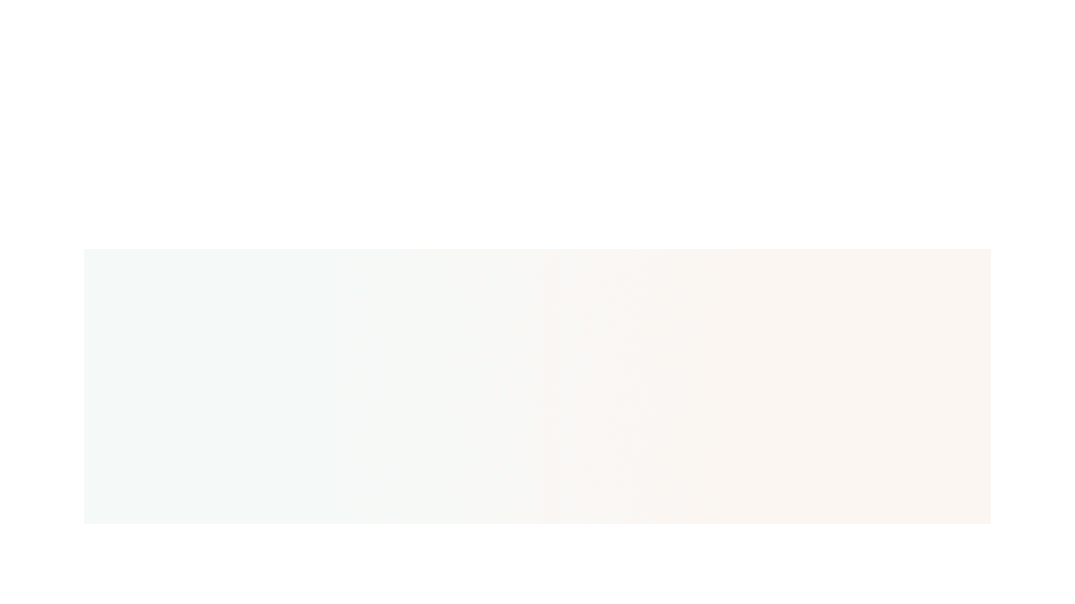
Completed Project Proposal (CPP)
The dataset, algorithms, and tools for the project were already fully included in the Initial Project Proposal (IPP).
Therefore, the same project details from the IPP are confirmed for the Completed Project Proposal (CPP).
We will proceed with the Hotel Booking Demand dataset, the planned ML models, and the selected Python tools/environment.

Slide 10

Thank You

