Slide 1
Finding Landmarks: Overview

Slide 2
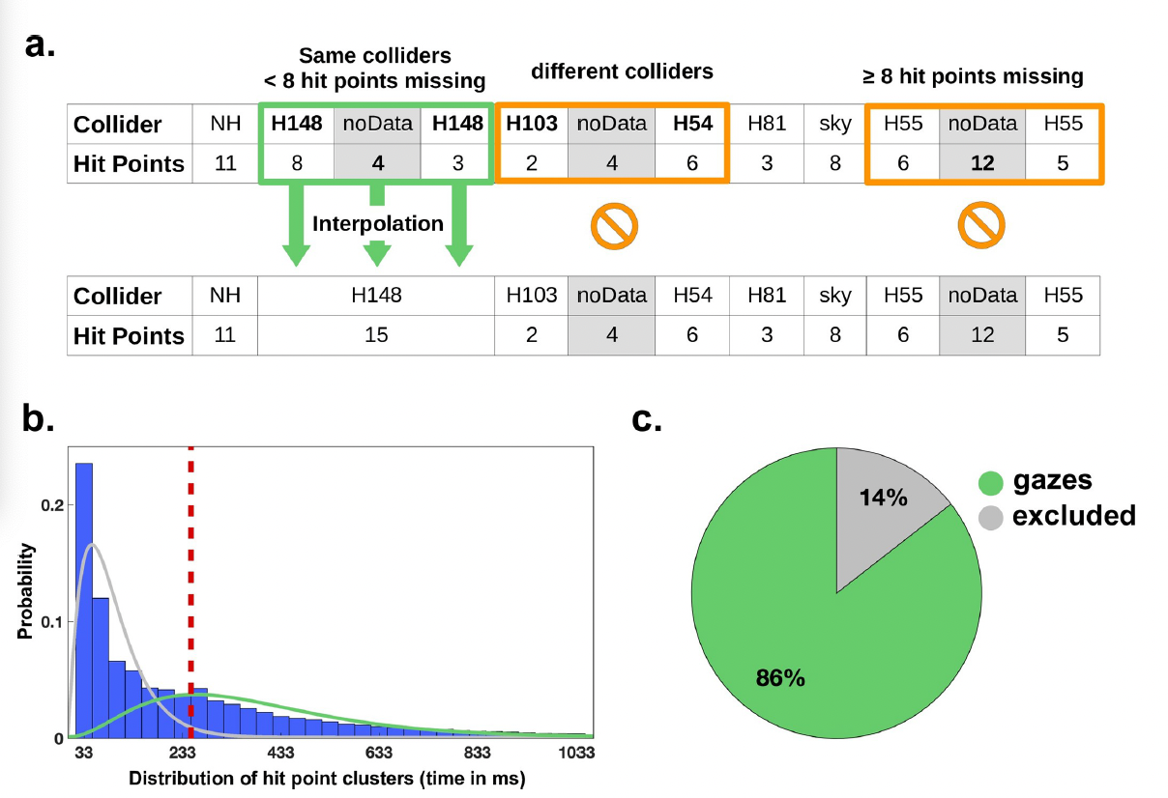
Pre-Processing: Gaze Analysis
Interpolation of missing data
Consider only gaze fixations
  8 consecutive data points (~266 ms)
  larger gaps considered to be missing data
Fig.1. Gazes analysis.

Slide 3
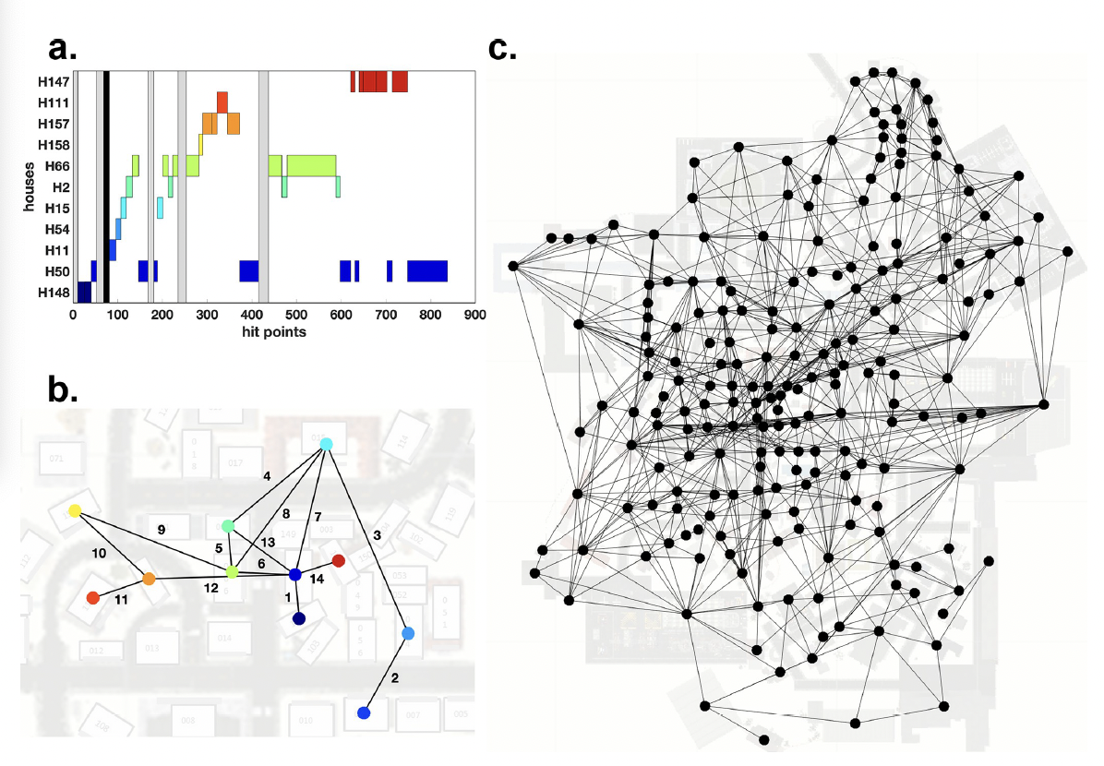
Graph Creation
Based on participants’ gaze fixations on the regions of interest (ROI)
  fixations on regions of no-house (NH) or “sky” is not considered
The graph plots the nodes (house fixation points) and edges (the subsequent gaze succade to another ROI)
  undirected and unweighted, i.e. edges show no direction and no frequency of occurence
Fig.2. Graph Creation.

Slide 4
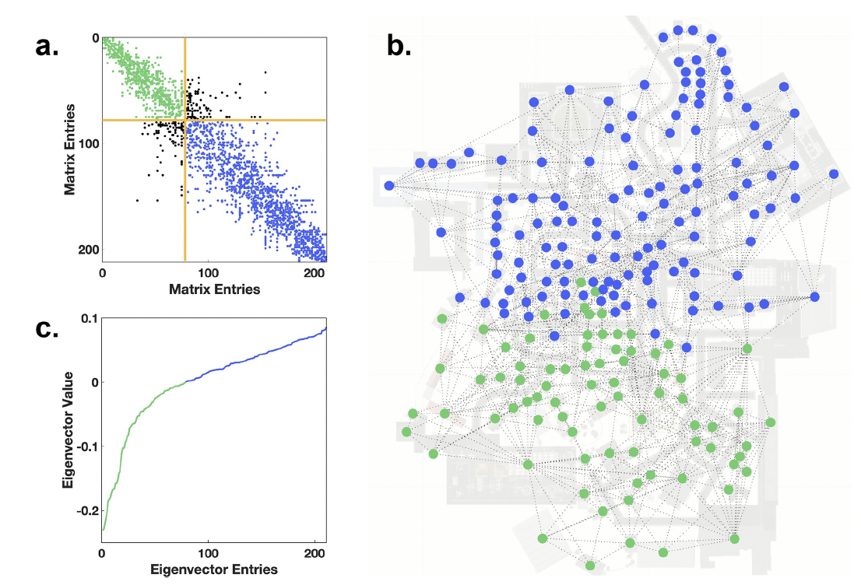
Graph Partitioning
Can the graph-map be cut into two or more mutually independent graphs?
Focus on: the number of edges between nodes.
  within-cluster and between-cluster connections
The spectral graph analysis
Fig.3. Graph partitioning. Potential clusters of nodes on the map.

Slide 5
Graph Partitioning
The spectral graph analysis
The adjacency matrix - a binary square matrix with each entry indicating whether the edge connects two nodes.
The degree matrix - a square matrix containing a degree of each node (number of connections) on its diagonal and 0 otherwise.
Laplacian matrix = the adjacency matrix - the degree matrix
Smallest eigenvalue = 0 → take 2nd smallest eigenvalue
the larger the value, the higher the overall connectivity of the network is.
Fiedler vector - eigenvector of 2nd smallest eigenvector; the further the value from 0, the higher the connectivity of the particular node within its cluster.
Fig.4. The spectral graph analysis. (a) The sparsity pattern of the graph’s adjacency matrix sorted by the entries in second smallest eigenvector. (c) Many entries of the Fiedler vector are around 0, indicating the connection of these nodes to the nodes from another cluster, i.e. the absence of separate clusters.

Slide 6
Graph Partitioning: Investigate quality of the partitioning
Consider the intra-cluster density and the inter-cluster density
  Density - the ratio of instantiated edges to the number of possible edges.
→ on average, each participant has ~883 edges per graph; mean density = 0.041 ± 0.006; 4.1% of all possible edges instantiated
→ dividing the graph in two parts, cuts at least 9,3% of the edges
→ after partitioning, the mean intra-cluster density = 0.079 ± 0.012;
the mean inter-cluster density = 0.0083 ± 0.0020
→ the graph can not be easily partitioned

Slide 7
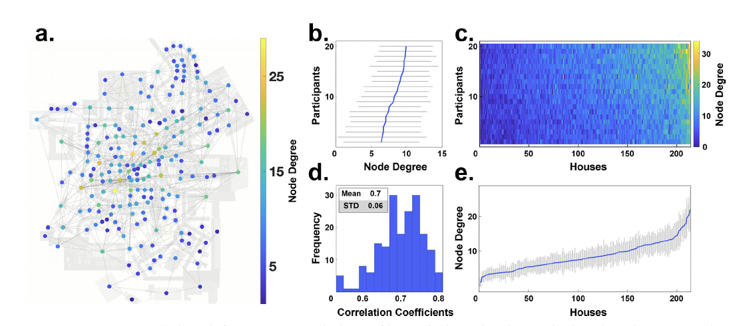
Node Degree Centrality
The number of edges connecting a node
A few houses reach rather high values (up to 33).
Calculate the mean node degree iterated over all participants, all houses, and both.
Correlation Coefficient - how consistent the participants in their gazes between each other in relation to the mean node degree.
  Mean = 0.7; STD = 0.06
Fig.5. Node degree centrality.

Slide 8
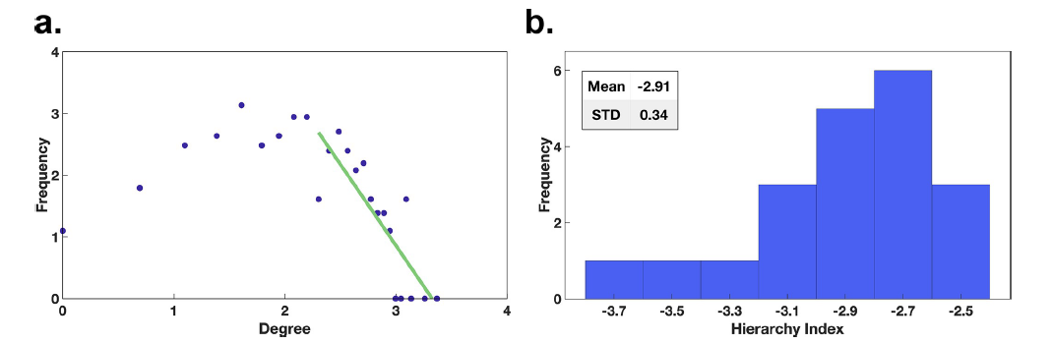
Hierarchy Index
Characterizes hierarchical configurations within networks.
Shows the tendency of the frequency of nodes of certain degree over increasing degree.
individual degree values are plotted against their frequency of appearance on a double logarithmic plot
the data points above the median of the degree distribution are linearly fitted
Strong hierarchical configurations with many low degree nodes and few high degree nodes have a slope of below -2 or above 2.
→ Slope smaller than -2.00; Mean = 2.92; STD = 0.34
→ “the hierarchy index reveals a clear hierarchical structure of the gaze graphs and emphasizes the importance of the few exceptionally high node degree centrality houses”
Fig.6. The Hierarchy Index.

Slide 9
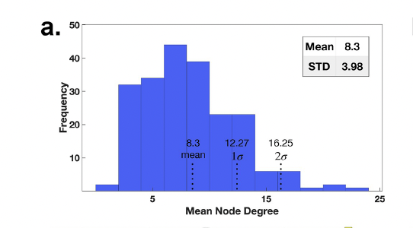
Threshold for gaze-graph-defined landmarks
The mean ND distribution over all participants to identify the high ND houses → plotting the mean node degree of houses averaged across participants
Mean ND across all houses and all participants = 8.3; STD = 3.98
Threshold to identify high node degree houses: 2-sigma distance → 16.25
→ a set of 10 houses with the ND centrality values exceeding the threshold.
Fig.7. The mean ND distribution across all participants with mean,1-sigma- and 2-sigma thresholds.

Slide 10
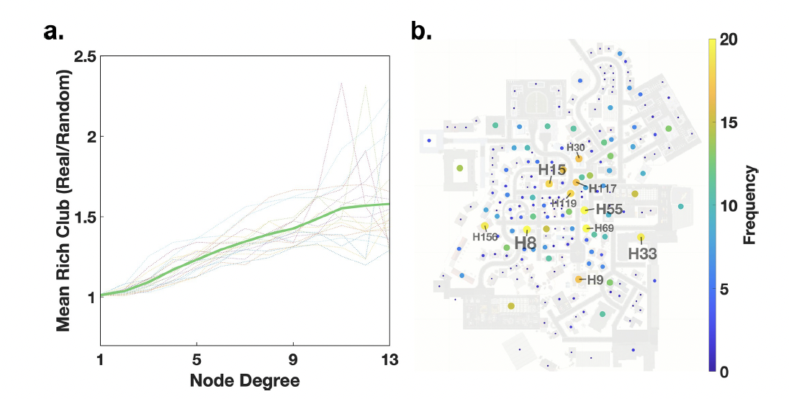
The Rich Club Coefficient
Are the high node degree nodes preferentially connected and form a network?
“The rich club coefficient is based on the relation of edges in the graph in comparison to the number of possible edges that could be instantiated”.
how many edges of nodes with a ND of at least 1 (all edges of the graph)
divided by the max possible number of edges
apply the baseline - random graph that has the same degree distribution as the graph of interest
A value of 1.0 - no bias in connectivity
Higher values indicate a preferential connectivity within the considered set of nodes.
Fig.8. The Rich Club Coefficient.

