Slide 1
Violence Detection using Adapted DenseNet with Convolutional LSTM
Mohammed abdulsatar-89082
YousSef Ghoneim - 87523
Said Iqelan - 86701
Ahmed Alabd Aljabar - 92885

Slide 2
Introduction
Objective:
Adapt and enhance a pre-trained computer vision model for real-time violence detection, focusing on temporal feature detection and model robustness in dynamic environments.
Convert a TensorFlow-based CNN and a ConvLSTM to PyTorch, optimizing for dynamic graphing and computational efficiency.
Deploy on a recognized violence dataset to ensure adaptability and effectiveness.
Demonstrate model's effectiveness by achieving set metrics, emphasizing real-time processing and operational feasibility

Slide 3
Problem Statement
Importance of Violence Detection:
Violence detection systems are critical in enhancing public safety and security. They serve as an early warning mechanism in crowded areas like schools, shopping malls, and public transport systems, potentially preventing escalations and facilitating timely interventions
Challenges in Automatic Detection:
Variability in scenes can mislead systems not trained on diverse datasets; differing lighting conditions require robust models that perform consistently across scenarios; distinguishing between violent and non-violent actions demands high-accuracy classification to avoid false positives

Slide 4
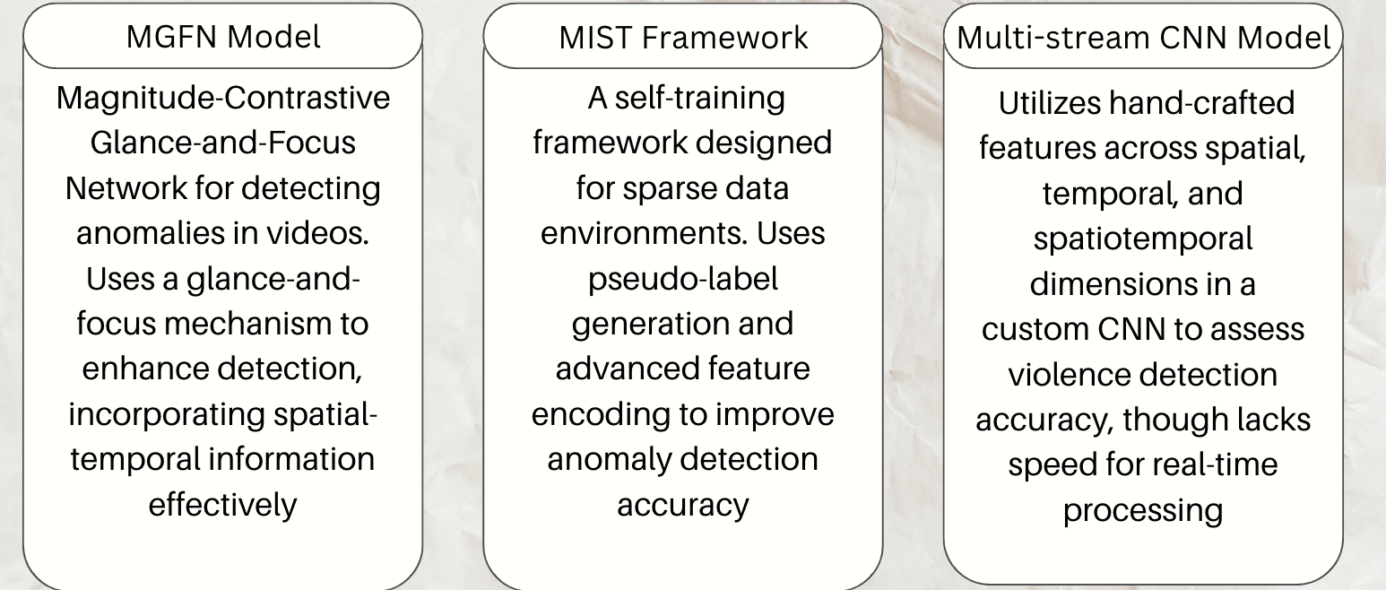
Literature Review

Slide 5
Methodology
Implemented an architecture inspired by ViolenceNet
Implemented a DenseNet and Convolutional-LSTM based architecture to detect violence
Adapted the DenseNet architecture for videos instead of pictures (2D -> 3D)
Preprocessed videos to obtain the Optical Flow Field and used that to improve the model’s perception of the video clip

Slide 6
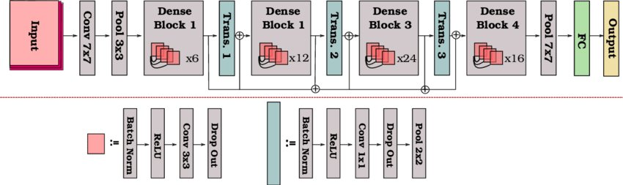
Methodology

Slide 7
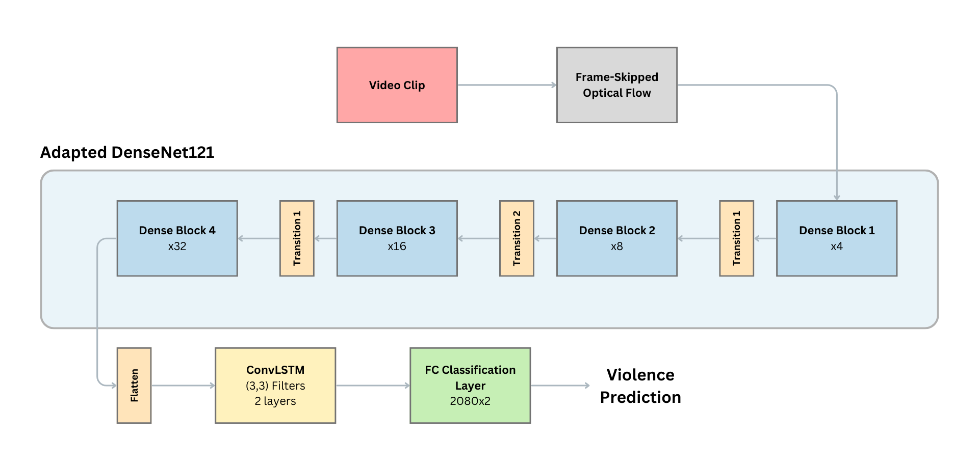
Implementation

Slide 8
Implementation
Details:
Used frame skipping due to computation and memory constraints, went from 40 frames per clip to 20 frames -> 50% less memory.
Adapted & Customized state-of-the-art CNN model: DenseNet
Training for 50 epochs
Adam Optimizer
L2 Regularization
CrossEntropyLoss Criterion

Slide 9
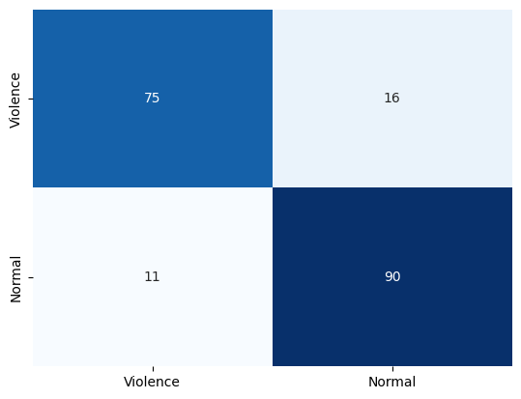
Your Results
Testing Metrics:
Accuracy: 86%
Weighted precision: 86%
Weighted recall: 86%
Weighted F-score: 86%

Slide 10
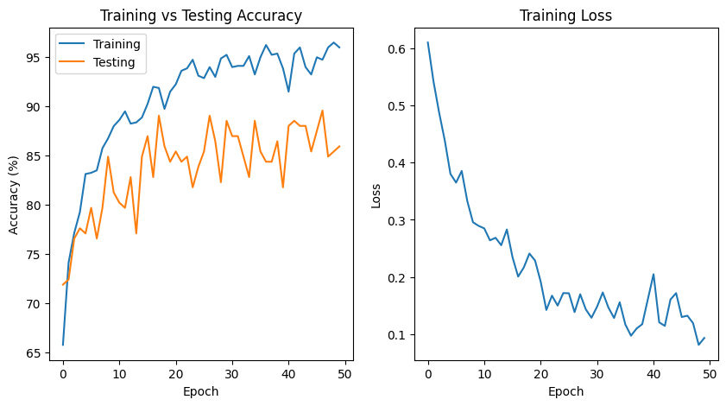
Your Results

Slide 11
Performance evaluation
ViolenceNet Performance:
On Hockey Fights Dataset:
Test Accuracy: 99.5%
Our Model's Performance:
On Hockey Fights Dataset:
Test Accuracy: 86%
The drop in performance can be attributed to:
Oversimplifying the model (2-frame skip and reducing size of the model)
No validation (dev) set
Not using k-fold cross validation
Not employing an attention mechanism

Slide 12
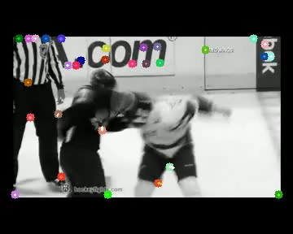
Discussion
The results suggest that our approach of using an adapted Densenet121 model with optical flow as input, and implementing frame skipping due to memory and computation constraints, is a viable strategy for violence detection in video sequences
Since the proposed modifications did not have any significant impact on the results of the original inspired work (i.e., ViolenceNet), it could potentially be viewed as an enhancement to their work

Slide 13
Work Division
Mohammed - Data preprocessing, setting up the video data pipeline and ensuring efficient data handling
Ahmed - Managed the training process, including parameter tuning and performance evaluation metrics
Saeed - Led the implementation of the model conversion from TensorFlow to PyTorch, optimized for GPU usage
Youssef - Oversaw model architecture adjustments, and led testing and validation processes

Slide 14
Demonstration

