Slide 1
A PART OF JAVA FOUNDATION CLASSES (JFC) FOR CREATING WINDOW-BASED APPLICATIONS - MUSIC PLAYER
JAVA SWING

Slide 2
INTRODUCTON TO JAVA SWING
Java Swing is a part of Java Foundation Classes (JFC) that is used to create window-based applications. It is built on the top of AWT (Abstract Windowing Toolkit) API and entirely written in java. Unlike AWT, Java Swing provides platform-independent and lightweight components. The javax.swing package provides classes for java swing API such as JButton, JTextField, JTextArea, JRadioButton, JCheckbox, JMenu, JColorChooser etc.
Here specifically, we can also use AWT (Absbtract window tool) but comparison to AWT , Java swing is more effective and along with advanced features which you can’t find AWT like…,
Java swing components are platform-independent but Awt is not.
Swing components are lightweight but AWT’s are heavyweight.
Swing supports pluggable look and feel but Awt doesn’t.
Swing provides more powerful components such as tables, lists, scrollpanes, colorchooser, tabbedpane etc. but that feature are not available int AWT.
Swing follows MVC(Model View Controller) where model represents data, view represents presentation and controller acts as an interface between model and view, but Awt doesn’t.

Slide 3
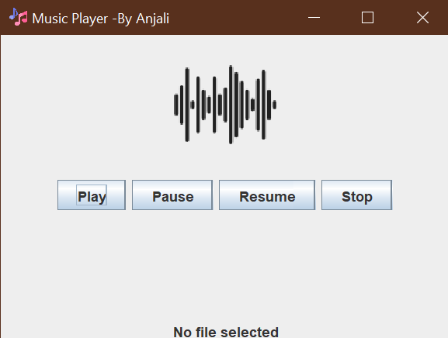
ABOUT THIS MUSIC PLAYER
Here, we have implemented java swing to create a Musical Player software.
This Music player allows you to play your favourite music in one go, here you can also pause, resume and stop your music in just one click.

Slide 4
SimpleMP3Player.java
import javax.swing.*; import java.awt.*; import java.awt.event.ActionEvent; import java.awt.event.ActionListener; import java.io.File; import java.io.FileInputStream; import java.io.FileNotFoundException; import javazoom.jl.decoder.JavaLayerException; import javazoom.jl.player.Player; public class SimpleMP3Player { private final JFrame frame; private final JPanel controlPanel; private final JButton playButton; private final JButton pauseButton; private final JButton stopButton; private final JButton resumeButton; private final JLabel statusLabel;

Slide 5
private final JLabel fileNameLabel; private Player filename Label; private FileInputStream fileInputStream; private boolean playing; private boolean paused; private String currentFileName; private long pausedAt; private File selectedFile; public SimpleMP3Player() { frame = new JFrame("Music Player -By Anjali"); frame.setSize(400, 300); // Increased frame height Image imageIcon = Toolkit.getDefaultToolkit().getImage("Java Projects/images/musical-note.png"); frame.setIconImage(imageIcon); frame.setDefaultCloseOperation(JFrame.EXIT_ON_CLOSE); // Load image ImageIcon icon = new ImageIcon("Java Projects/images/graphic.png"); Image get Image = icon.getImage().getScaledInstance(100, 120, Image.SCALE_SMOOTH); // Set size ImageIcon scaledIcon = new ImageIcon(image); JLabel imageLabel = new JLabel(scaledIcon);

Slide 6
fileNameLabel = new JLabel("No file selected"); // Initialize file name label fileNameLabel.setHorizontalAlignment(SwingConstants.CENTER); // Center align file name label controlPanel = new JPanel(); controlPanel.setLayout(new FlowLayout()); playButton = new JButton("Play"); pauseButton = new JButton("Pause"); stopButton = new JButton("Stop"); resumeButton = new JButton("Resume"); statusLabel = new JLabel(); playButton.addActionListener(new ActionListener() { public void actionPerformed(ActionEvent e) { if (!playing) { play(); } else if (paused) { resume(); } } });

Slide 7
controlPanel.add(playButton); controlPanel.add(pauseButton); controlPanel.add(resumeButton); controlPanel.add(stopButton); // Add components to frame frame.getContentPane().setLayout(new BorderLayout()); frame.getContentPane().add(BorderLayout.NORTH, imageLabel); // Add image label frame.getContentPane().add(BorderLayout.CENTER, controlPanel); frame.getContentPane().add(BorderLayout.SOUTH, fileNameLabel); // Add file name label frame.setVisible(true); } private void play() { JFileChooser fileChooser = new JFileChooser(); int result = fileChooser.showOpenDialog(frame); if (result == JFileChooser.APPROVE_OPTION) {
try { stop(); // Stop any previous playback selectedFile = fileChooser.getSelectedFile(); fileInputStream = new FileInputStream(selectedFile);

Slide 8
player = new Player(fileInputStream); currentFileName = selectedFile.getName(); new Thread() { public void run() { playing = true; paused = false; try { player.play(); } catch (JavaLayerException e) { e.printStackTrace(); } finally { if (player != null) { playing = false; player.close(); try { fileInputStream.close(); } catch (Exception ex) { ex.printStackTrace(); } }
} } }.start(); updateUI(currentFileName); } catch (FileNotFoundException ex) { ex.printStackTrace(); } catch (JavaLayerException e) { throw new RuntimeException(e); } } } private void pause() { if (player != null) { paused = true; pausedAt = player.getPosition(); player.close(); statusLabel.setText("Paused"); } }

Slide 9
private void resume() { if (paused) { new Thread() { public void run() { playing = true; paused = false; try { fileInputStream = new FileInputStream(selectedFile); player = new Player(fileInputStream); fileInputStream.skip(pausedAt); player.play(); } catch (Exception e) { e.printStackTrace(); } finally { if (player != null) { playing = false; player.close(); } } } }.start(); statusLabel.setText("Playing"); } }
private void stop() { if (player != null) { playing = false; player.close(); statusLabel.setText("Stopped"); try { fileInputStream.close(); } catch (Exception ex) { ex.printStackTrace(); } } }
private void updateUI(String fileName) { SwingUtilities.invokeLater(() -> { fileNameLabel.setText("Playing: " + fileName); statusLabel.setText("Playing"); }); }
public static void main(String[] args) { SwingUtilities.invokeLater(new Runnable() { public void run() {

Slide 10
new SimpleMP3Player(); } }); } }
// **************************************************The end****************************************
-- THANK YOU --

