Slide 1
Tkinter built-in Python library
- paint
By Anjali
DPL Student

Slide 2
INTRODUCTION TO TKINTER
Tkinter is a built-in Python library (which means you don't need to install anything extra) that lets you create GUI applications.
Widgets: These are the building blocks of your GUI. Buttons, labels, text boxes—you name it. You can place and customize these widgets to design your app.
Geometry Managers: These help you arrange your widgets within the window. Tkinter has three main geometry managers: pack, grid, and place. Each has its own way of organizing widgets.
Event Handling: Just like web development, Tkinter lets you respond to user actions like button clicks or mouse movements. You can define functions that get triggered when these events happen.
Main Loop: Every Tkinter app has a main loop that keeps it running. It continuously listens for events and updates the GUI accordingly.
Cross-Platform: Tkinter works on most platforms, including Windows, macOS, and Linux, so you don't have to worry about compatibility.

Slide 3
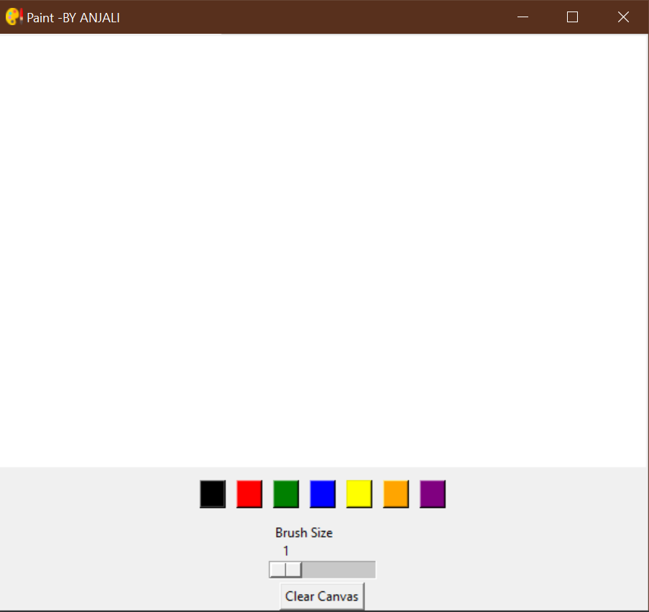
ABOUT PAINT
This paint lets you draw in different color even you can clear the canvas and increase the Brush size here.
Here we have implemented tkinter to build up this paint software.

Slide 4
paint.py
import tkinter as tk class PaintApp: def __init__(root): root.root = tk.Tk() root.root.title("Paint -BY ANJALI") root.root.iconbitmap("images/paint.ico") root.canvas = tk.Canvas(root.root, bg="white", width=600, height=400) root.canvas.pack() root.draw_mode = False root.start_x = None root.start_y = None root.brush_color = "black" root.brush_size = 2
root.canvas.bind("<Button-1>", root.start_draw) root.canvas.bind("<B1-Motion>", root.draw) root.canvas.bind("<ButtonRelease-1>", root.stop_draw)

Slide 5
root.color_palette = tk.Frame(root.root) root.color_palette.pack(pady=10) colors = ["black", "red", "green", "blue", "yellow", "orange", "purple"] for color in colors: button = tk.Button(root.color_palette, bg=color, width=2, command=lambda c=color: root.change_color(c)) button.pack(side="left", padx=5) root.size_scale = tk.Scale(root.root, from_=1, to=10, orient="horizontal", label="Brush Size", command=root.change_size) root.size_scale.pack() clear_button = tk.Button(root.root, text="Clear Canvas", command=root.clear_canvas) clear_button.pack() def start_draw(root, event): root.draw_mode = True root.start_x = event.x root.start_y = event.y
def draw(root, event): if root.draw_mode: x, y = event.x, event.y

Slide 6
root.canvas.create_line(root.start_x, root.start_y, x, y, width=root.brush_size, fill=root.brush_color) root.start_x = x root.start_y = y def stop_draw(root, event): root.draw_mode = False def change_color(root, color): root.brush_color = color def change_size(root, size): root.brush_size = int(size) def clear_canvas(root): root.canvas.delete("all") app = PaintApp() app.root.mainloop()

Slide 7
- Thank you -

