Slide 1

CHANDIGARH UNIVERSITY, GHARUAN
PRESENTATION on
“SENTIMENT ANALYZER USING PYTHOn "
Submitted by:- Aakash kumar vatsa(17BCS2790)

Slide 2
Introduction to the project:
Project Title : Twitter Sentiment Analyzer
Project Duration : 3-4 months
Brief Description of project:
Sentiment Analysis, also called opinion mining or emotion AI, is the process of determining whether a piece of writing is positive, negative, or neutral. A common use case for this technology is to discover how people feel about a particular topic. Sentiment analysis is widely applied to reviews and social media for a variety of applications . Sentiment analysis can be performed in many different ways. Many brands and marketers use keyword-based tools that classify data (i.e. social, news, review, blog, etc. as positive/negative/neutral . Automated sentiment tagging is usually achieved through word lists. For example, mentions of ‘hate’ would be tagged negatively.

Slide 3
Field of project
The new proposed system will affect the users in the following areas:-
Provide facility to analyze the question according to the views of tweeter users.
Reduce efforts of users to find out view about the trending topics
Provides pie charts and graphs related to views of multiple users of tweeter which are easily understandable.
It can also be used as poll for audience.
It also shows percentage of people’s sentiments.

Slide 4
Project Requirements:
Software: - The software packages are used
Operating System: - Windows 10
Front End :- Pycharm , python IDLE mode, SQL.
Operating System:-
Factors that would influence the choice of an operating system
Support for the programming language
Feature like multitasking, backup and recovery
Performance related issue
Open system or patented
Support for disk mirroring
Data communication
Availability of hardware
Single user/ multi-user/ network operating system

Slide 5
Feasibility Study of Project
A proposed system is twitter sentiment analyzer .
The new proposed system affects the users in the following areas:-
Provide facility to analyze the trending topics.
Reduce efforts of users to find out summarized reaction about anything.
Technology Used:
Language Used: Python
Framework Used: Pycharm , python IDLE mode
Operating System Used: Windows 10 / 8

Slide 6
Modules used
1 . Matplotlib:
Matplotlib is a Python 2D plotting library which produces publication quality figures in a variety of hardcopy formats and interactive environments across platforms. Matplotlib can be used in Python scripts, the Python and IPython shells, the Jupyter notebook, web application servers, and four graphical user interface toolkits. Matplotlib tries to make easy things easy and hard things possible. You can generate plots, histograms, power spectra, bar charts, errorcharts, scatterplots, etc., with just a few lines of code.
2. Tweepy:
Twitter is a popular social network where users share messages called tweets. Twitter allows us to mine the data of any user using Twitter API or Tweepy. The data will be tweets extracted from the user. The first thing to do is get the consumer key, consumer secret, access key and access secret from twitter developer available easily for each user. These keys will help the API for authentication.

Slide 7
1. Textblob
TextBlob is a Python (2 and 3) library for processing textual data. It provides a simple API for diving into common natural language processing (NLP) tasks such as part-of-speech tagging, noun phrase extraction, sentiment analysis, classification, translation, and more
Noun phrase extraction
Part-of-speech tagging
Sentiment analysis
Classification (Naive Bayes, Decision Tree)
Language translation and detection powered by Google Translate
Tokenization (splitting text into words and sentences)
Word and phrase frequencies

Slide 8
Functionality of Project:
Understand the Problem Statement
Tweets Preprocessing and Cleaning
Story Generation and Visualization from Tweets
Extracting Features from Cleaned Tweets
Model Building: Sentiment Analysis
Future Scope:
Vidoes can be added.
Detailed analysis can be provided.

Slide 9
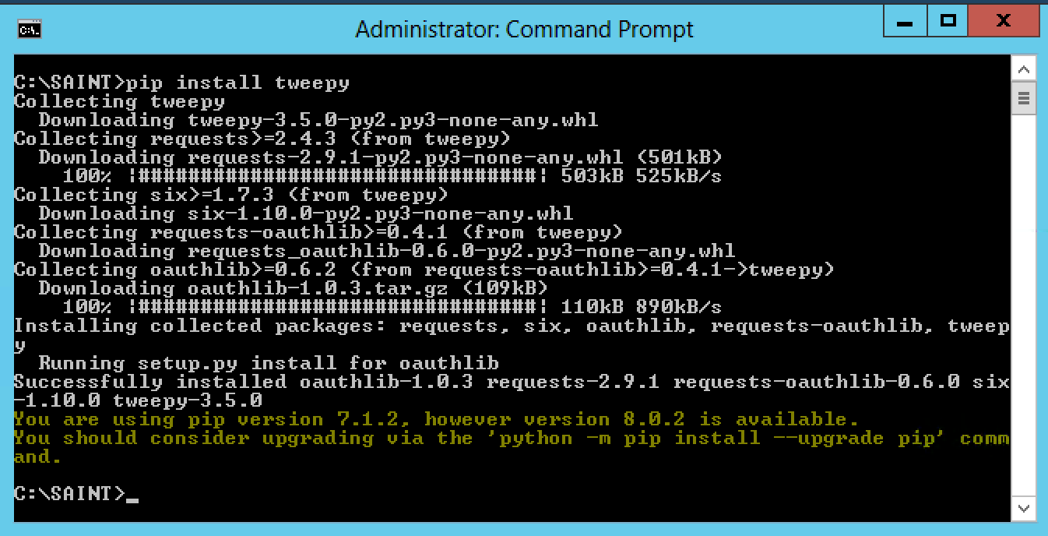
Screenshots :
Installing tweepy through command prompt:

Slide 10
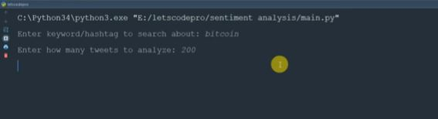
Searching statement:

Slide 11
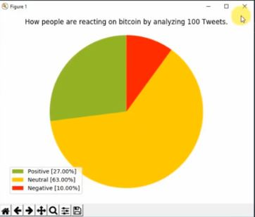
Analysis

Slide 12
Conclusion of Project:
It is fully working twitter sentiment analyzer , which can perform task in online condition as we given her local modules . In online condition it gets more resources to work with. Also, any peripheral can be control with the sentiment analyzer, just by giving the command. The local modules can be added or removed by user as he sees fit. Also, there is simple option for conversation with it, where it learns further.

Slide 13
Internship
Company name:-Volkswagen It services India
Department:-D2(L-10)
Position:-Software engineer Trainee
Duration:3 months

Slide 14
What I have done during my internship journey?
Being a part of Delivery-II Team, I have learnt and worked on several Tools and Technologies in past 3 months, which includes:
HTML,CSS,JS,Asp.net,React,angular,C#
Solving bugs related to business Logic.
Learnt about several tools used for development and testing such as VS CODE,VISUAL STUDIO,Postman,Fiedler,JIRA.

Slide 15
Learning Takeaways
Collaborate and communicated with the team.
Design Patterns for writing code.
Corporate culture.
Using tools like Postman,Fiedler,Jira.

Slide 16
THANK YOU

