Slide 1
AI-Powered Food Classification and Calorie Estimation Using the Food-101 Dataset
Abdallah Waked
Dr. Mohammed Yousefhussien
Apr 12, 2025
INFO-6147 Deep Learning with PyTorch

Slide 2
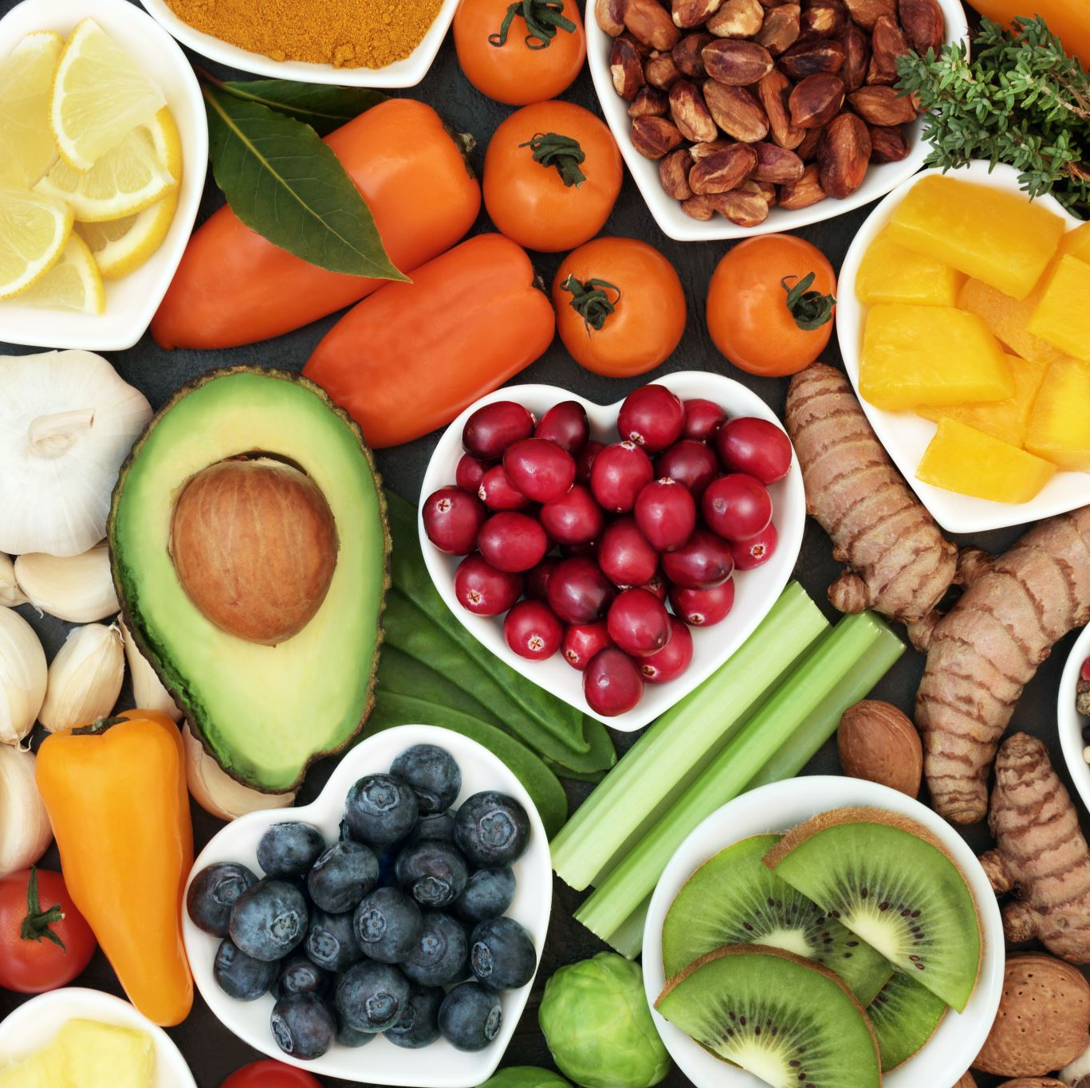
Project Overview
Goal: Classify food images and estimate caloric value
Dataset: Food-101
API Integration: Spoonacular API for recipe and nutrition details
Output: Fast food classification and calorie estimation through web app

Slide 3
Why is this project valuable?
Simplifies food identification and calorie tracking
Useful for health-conscious users and diet tracking
Provides instant results using image input
No manual search for nutritional info needed

Slide 4

Approach & Methodology
Train a Convolutional Neural Network (CNN)
Use ResNet18 pretrained model to improve accuracy
Integrate with JSON nutrition database and Spoonacular API
Deploy model using Streamlit web application

Slide 5
Dataset
Food-101 Dataset
Total images: 101,000 (101 categories)
Split:
70% Training
15% Validation
15% Testing
Preprocessing:
Resize: 224×224
Augmentation: Horizontal flip, rotation
Normalization: ImageNet mean and std

Slide 6
Model Architecture (ResNet18)
Pretrained on ImageNet
Frozen initial layers, fine-tuned Layer4 and FC
Custom classifier for 101 food classes
Efficient for small-to-medium datasets

Slide 7
Baseline Model Flowchart
Training Loop
Forward pass
Compute loss
Backpropagation
Update weights
Load Food-101 Dataset
Preprocess Images
Resize to 224x224
Normalize (ImageNet stats)
Split: Train / Val / Test
Validation Step
Check Accuracy
Monitor Loss
Checkpoint Saving
Save "Best Model"
Save "Final Model"
Save training history (JSON)
Build ResNet18 Model (Baseline)
• Random initialization
• No pretrained weights
Test on Unseen Data
• Use saved checkpoint
Define Training Settings
• Loss: CrossEntropy
• Optimizer: Adam
• LR: 0.001
Evaluate Model
• Accuracy
• Classification Report
• Confusion Matrix

Slide 8
Pretrained Freeze Flow
Pretrained Unfreeze Flow
Load Food-101 Dataset
Load Food-101 Dataset
Preprocess Images
Preprocess Images
Load Pretrained ResNet18
Load Pretrained ResNet18
Trainable Layers
Layer 1
Layer 2
Layer 3
Layer 4
Fully Connected Layer (FC)
Freeze Early Layers
Layer1
Layer2
Layer3
Trainable Layers
Layer4
Fully Connected Layer (FC)
Trainable Loop
Checkpoint Saving
Evaluate Model

Slide 9
Training Process
Device: GPU (if available), fallback to CPU
Epochs: ~10 with early stopping
Batch Size: 32 → 8 (due to device limits)
Learning Rate:
Started: 0.001
Planned: 0.0003 (but limited by Colab quota and hardware)
Features:
Checkpoint saving
Best model saving
Training history logged

Slide 10
Hyperparameter Tuning
Experiments:
Learning rates: 0.001, planned 0.0003
Batch sizes: 32 → 8
Model modes:
Pretrained Freeze
Pretrained Unfreeze
Observations:
Pretrained models outperformed baseline
Freezing sped up training
Unfreezing all layers achieved higher accuracy

Slide 11
Deployment Application
Web App: Streamlit Link
Auto-downloads model from Google Drive
User uploads image → Model predicts category
Click on prediction → Spoonacular API fetches:
Recipes
Nutritional information
Code available on GitHub: GitHub Repository

Slide 12
Challenges & Limitations
Google Colab quota limits GPU usage
Local device performance is limited
Large model size (~5 GB) requires external storage
API rate limits from Spoonacular
Time constraints limited fine-tuning
Complex dataset with varied image conditions

Slide 13
Results & Evaluation
Model accuracy: (Insert your number here)
Classification report: (Add sample screenshot or table)
Confusion matrix visualization: (Optional screenshot)
Efficient web deployment achieved

Slide 14
Conclusion
Successfully classified food images and estimated calories
Integrated external API for dynamic recipe and nutrition data
ResNet18 pretrained model improved accuracy and efficiency
Deployed as an interactive Streamlit web application

Slide 15
Thank You!

