Slide 1
NOVELty
Project #2 - Group-01
Full Stack Web Development Bootcamp - University of Toronto – Jan 30, 2021

Slide 2
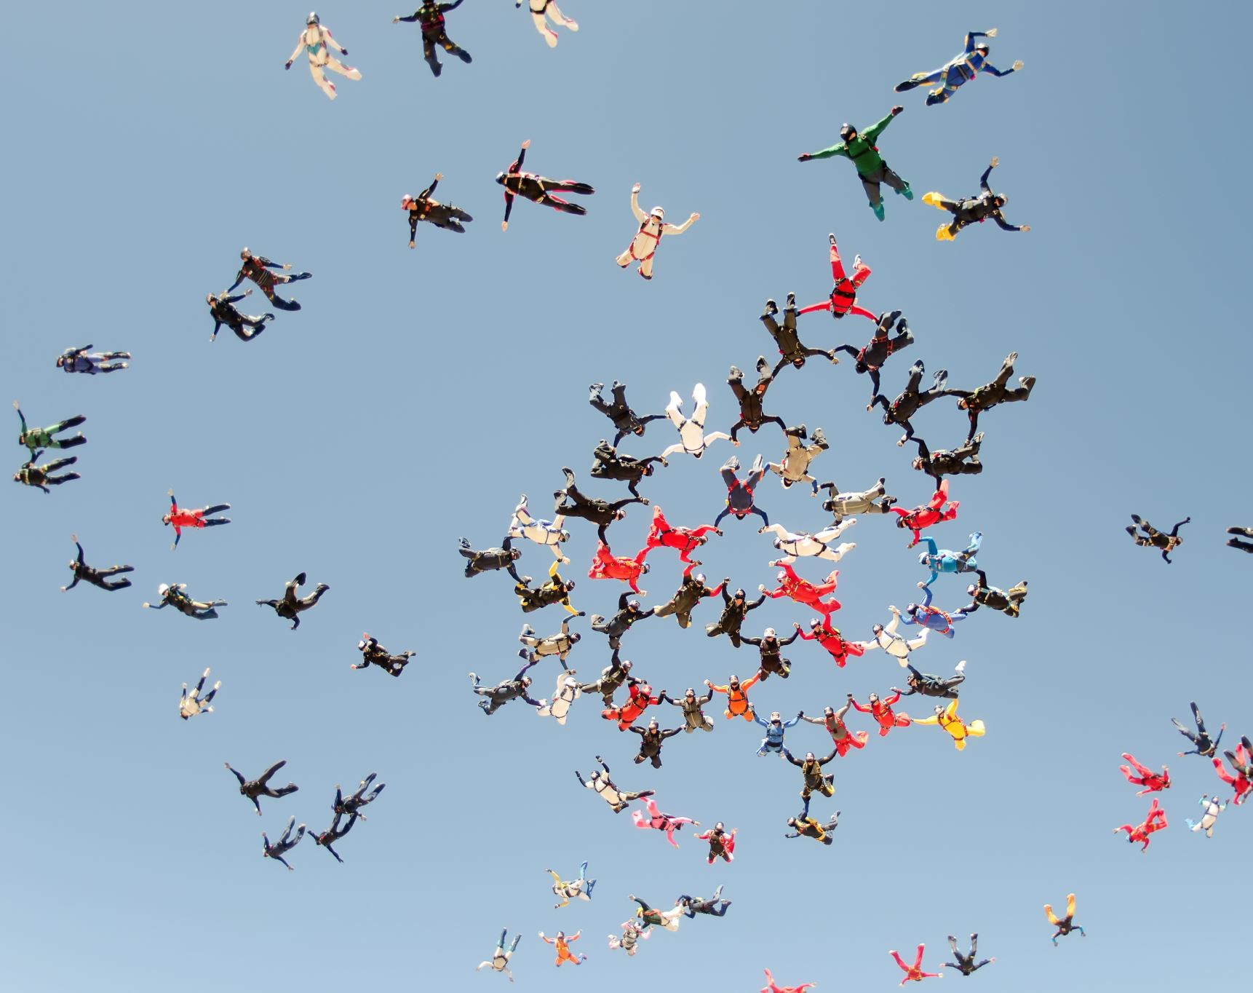
The NOVELty team
Annie Kwan
Héctor García Millares
Ivan Đuranić
Nagesh Kalegowda
Natasha Fray

Slide 3
The concept

Slide 4

NOVELty
Have you ever read a book and thought to yourself?
“I need to share this book with someone”
YOU HAVE COME TO THE RIGHT PLACE!!
NOVELty is the one-stop shop for book lovers. Here, you can keep track of all the books you are reading or have read, get personalized book recommendations from fellow literary enthusiasts, and share book reviews in our growing and vibrant community.

Slide 5

User Story
As someone always looking for new book recommendations based on my preferences,
I want to have an app to track whether I finish reading a book or not,
So that I can have books recommended to me based on similar interests and the ratings given by the API.
As a user of the app,
I want a clean dashboard interface to easily view and update my reading lists and recommendations,
So that I can easily use and navigate the app and spend more time reading.
As a fan of books,
I want to be able to share my literary preferences, list of books read, and books I’m reading,
So that I can receive recommendations from other users with similar tastes.
As a user of the app,
I want to be able to share personal ratings of books to others,
So that others can find out whether or not users with similar book preferences recommend them or not.

Slide 6
Technologies
Node.js, Express
JavaScript, CSS,
HTML
MySQL database
MVC
Handlebars
JQuery lightSlider
APIs
NPM packages:
Passport
bcryptjs
Node-fetch
Request
Moment
Sequelize
Jest
Nodemon

Slide 7
APIs Used
TasteDive
Google Books
OpenLibrary
The New York Times Books API

Slide 8
Styling
Bootstrap CSS Framework
Handlebars
JQuery lightSlider - a lightweight responsive Content slider with carousel thumbnails navigation

Slide 9
Tasks/Roles
Annie Kwan
Controller, Routes, APIs,
Code reviews/merge
Héctor García Millares
View - UI, Handlebar, Bootstrap
Code reviews/merge
Ivan Đuranić
Authentication, Handlebar
Code reviews/merge
Nagesh Kalegowda
Model - MySQL, CRUD, Sequelize,
GitHub/Heroku configuration/deployment, Code reviews/merge
Natasha Fray
View – UI, Handlebar, Bootstrap
Testing
Idea for the project!

Slide 10

Demo
Website:
https://novelty.herokuapp.com/
GitHub Repository:
https://github.com/nagck/NOVELty

Slide 11
Challenges/ Successes
Great Teamwork and Collaboration
Minor Git challenges leading to duplicate code and some conflicts to be resolved. Handling more than one pull request at a time and merging became a little more challenging
API Challenges:
Limit on calls and slow request
Inconsistencies in the data retrieved -> Required multiple guards
OpenLibrary suddenly stopped working with API calls on the client side -> Changed code to backend

Slide 12
Challenges/ Successes (part 2)
Testing challenges:
Needed to find a convenient way to test jQuery
Figuring out how to test front-end functions on the back-end
Testing ever-evolving code
Experience a few Heroku crashes when testing the deployed app. We diligently found some workarounds and solutions to stabilize the app

Slide 13
Future Development
Prompt user for literary preferences and provide even more personalized recommendations.
Partner with Book Affiliate Programs – Amazon, Indigo, etc. for books purchase.
Enable collaboration with local book reading clubs – connect local book lovers and go virtual book clubs based on reader

Slide 14
Q&A

