Slide 1
NOVELty
Project #2 - Group-01
Full Stack Web Development Bootcamp - University of Toronto – Jan 30, 2021

Slide 2
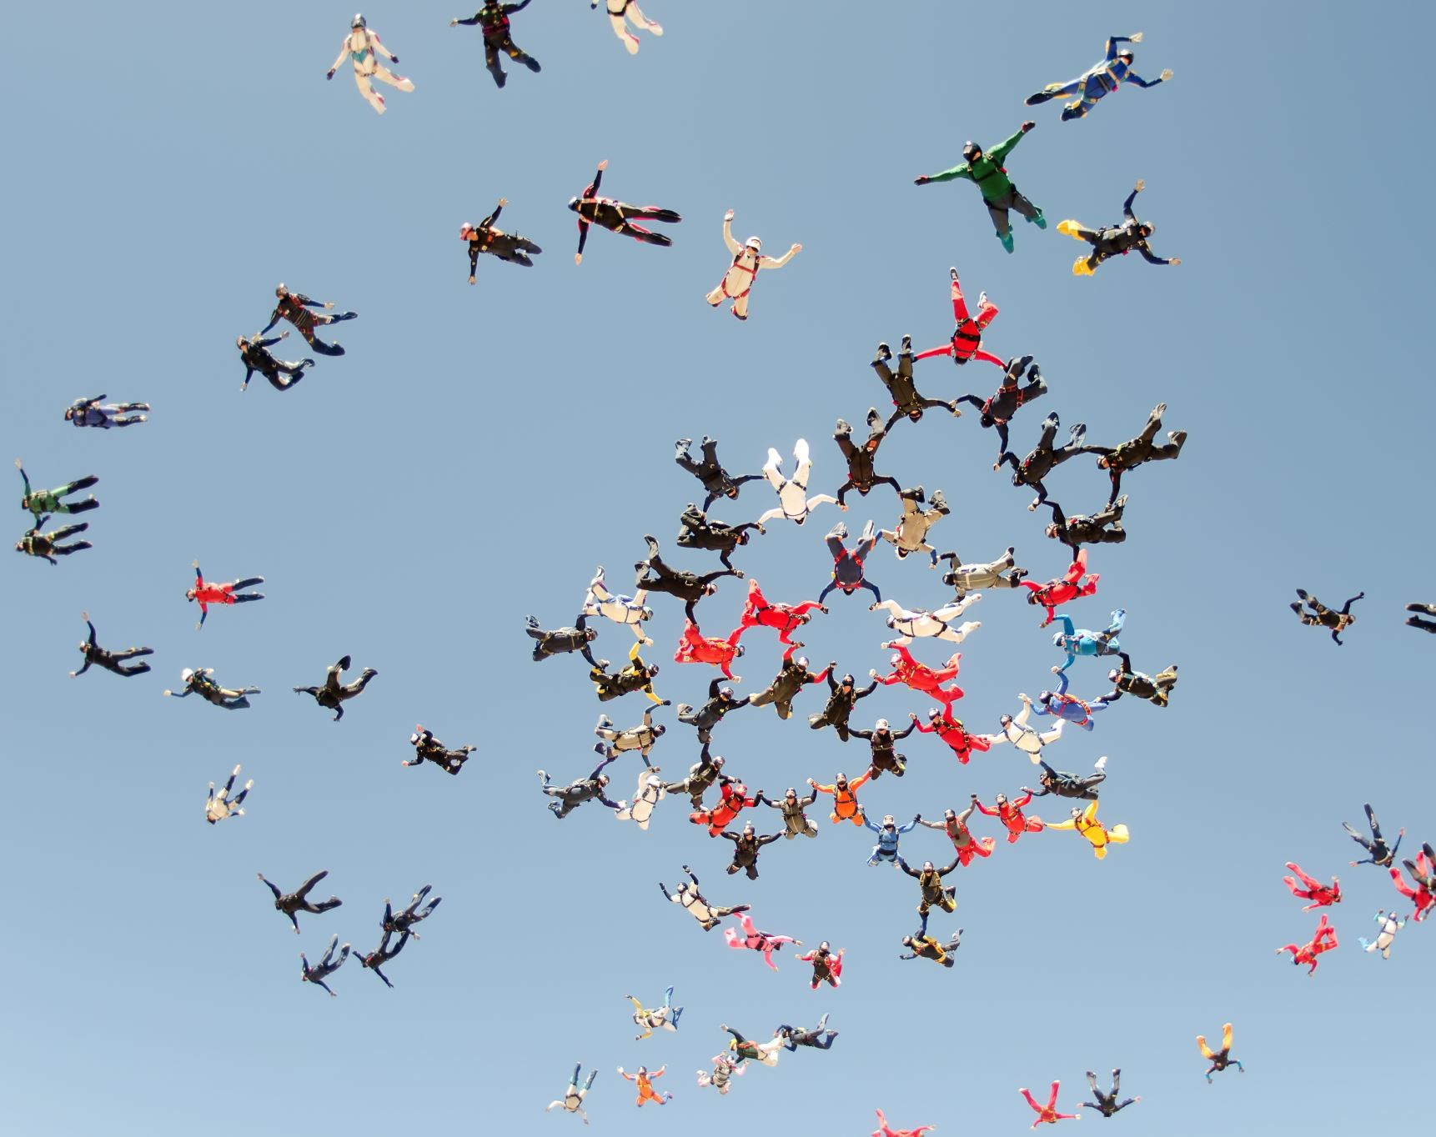
Team
Annie Kwan
Héctor García Millares
Ivan Đuranić
Nagesh Kalegowda
Natasha Fray

Slide 3
The concept

Slide 4

NOVELty
Have you ever read a book and thought to yourself?
“I need to share this book with someone”.
YOU HAVE COME TO THE RIGHT PLACE!!.
NOVELty is one-stop shop for keeping track of all the books you are reading or read, get personalized book recommendations and participate in your book reading community by sharing the book that you like and participate in book reviews.

Slide 5

User Story
As someone always looking to recommend new books based on my preferences,
I want to be able to have the app track whether I finish reading it or not,
So that I can have books recommended to me based on similar interests and the ratings given by the API.
As a user of the app,
I want a clean dashboard interface to easily view and update my preferences, books and recommendations,
So that I can easily use and navigate the app and spend more time reading.
As a fan of books,
I want to be able to share my literary preferences, list of books read, and books I’m reading,
So that I can receive recommendations from other users with similar tastes.
As a user of the app,
I want to be able to share personal ratings of books to others,
So that others can find out whether or not users with similar book preferences recommend them or not.

Slide 6
Technologies
Node.js, Express
JavaScript, CSS, HTML
npm
MySQL database
ORM
Handlebars
JQuery lightSlider
APIs
Passport
bcryptjs
Node-fetch
Squelize
Jest

Slide 7
APIs Used
TasteDive
Google Books
OpenLibrary
The New York Times Books API

Slide 8
Styling
Bootstrap Framework
Handlebars
JQuery lightSlider - a lightweight responsive Content slider with carousel thumbnails navigation

Slide 9
Tasks/Roles
Annie Kwan
Controller, Routes, APIs,
Code reviews/merge
Héctor García Millares
View - UI, Handlebar, Bootstrap
Code reviews/merge
Ivan Đuranić
Authentication, Handlebar
Code reviews/merge
Nagesh Kalegowda
Model - MySQL, CRUD, Sequelize,
GitHub/Heroku configuration/deployment, Code reviews/merge
Natasha Fray
View – UI, Handlebar, Bootstrap
Testing
Idea for the project!

Slide 10

Demo
Website:
https://novelty.herokuapp.com/
GitHub Repository:
https://github.com/nagck/NOVELty

Slide 11
Challenges/ Successes
Great Teamwork and Collaboration
API Challenges – keys, slow performance

Slide 12
Future Development
Prompt user for literary preferences and provide even more personalized recommendations.
Partner with Book Affiliate Programs – Amazon, Indigo, etc. for books purchase.
Enable collaboration with local book reading clubs – connect local book lovers?

Slide 13
Q&A

