Slide 1
HeartTrialTwin
Model-release readiness review for a selected clinical trial
CS 5588 Challenge 2
Human–AI Co-Design
Challenge 2 / verified safe-failure workflow
Final delivery · September 2026
Notes:
Project materials: Human Design, AI Design, frozen cohort HTT-P1-AACT-20260905, validation_metrics.json, and the finalized Streamlit application.

Slide 2
Human Design, AI Design, and Co-Design
The scope changed when evidence exposed a data constraint
HUMAN DESIGN
Predict risk
Identify model factors
Explain with verified evidence
AI DESIGN
Logistic Regression
SHAP on log-odds
Exact-NCT evidence
Deterministic explanation
HUMAN–AI CO-DESIGN
Historical retrieval failed
One safe predictor remained
Validation failed
The application blocked output
Working task: Model-release readiness review for a selected clinical trial.
HeartTrialTwin | CS 5588 Challenge 2
2
Notes:
Sources: week 4/human design/HeartTrialTwin_Challenge2_Human_Design.pptx; p1_app/feature_audit.md; historical_retrieval_pilot/pilot_report.md.

Slide 3
Human–AI workflow
Model-release readiness review for a selected clinical trial
Implemented path
Select NCT ID
Retrieve verified
submission metadata
Check model
validation
Read model
release status
Display grounded
BLOCKED result
Human review
and revision
No probability, SHAP attribution, or risk explanation leaves the gate after failed validation.
Exact provenance, uncertainty, and a deterministic readiness explanation remain available for review.
HeartTrialTwin | CS 5588 Challenge 2
3
Notes:
Source: p1_app/app.py and p1_app/core.py. Runtime uses deterministic application logic, not an autonomous agent.

Slide 4
Application architecture
Frozen data, reproducible model artifacts, and an explicit safety gate
Frozen manifest
2,824 NCT IDs
Feature builder
submission_year only
Development fit
1999–2017
Validation gate
2018–2020
Exact-NCT provenance cache
No outcome fields
Release-readiness result
Risk output BLOCKED
Deterministic explanation
Session-only review log
Final test: 456 labels masked, no automatic evaluation
HeartTrialTwin | CS 5588 Challenge 2
4
Notes:
Sources: p1_app/feature_build.py, train_model.py, score_all.py, evidence_fetch.py, app.py. Final-test labels are masked in features.parquet.

Slide 5
Data and AI capability
Trained-but-rejected ML remains separate from the operational safety output
2,824 frozen trials
587 discontinued
ML baseline
Trained and evaluated
Release status: FAIL
Operational output
Deterministic readiness result
No probability or SHAP
Verified predictor: submission_year
Final-test outcomes remained locked
HeartTrialTwin | CS 5588 Challenge 2
5
Notes:
Source: step3_manifest/HeartTrialTwin_first_p1_cohort_manifest_HTT-P1-AACT-20260905.audit.json and p1_app/feature_build_audit.json. Chart uses complete literal values.

Slide 6
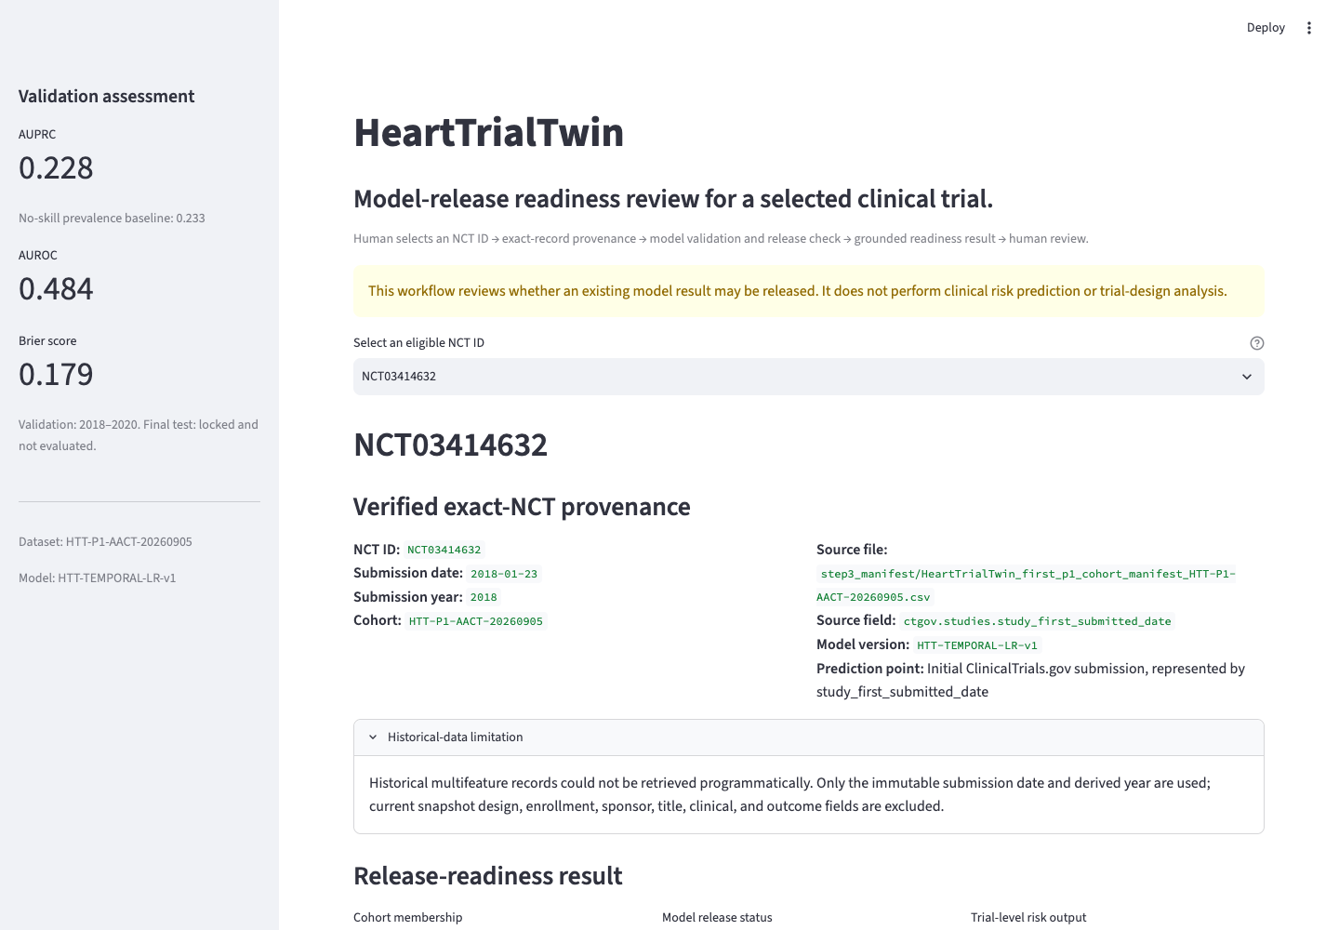
Release-readiness result in Streamlit
Model-release readiness review for NCT03414632
Visible safeguards
Exact NCT ID and submission date
Frozen cohort and source field
Validation metrics and uncertainty
BLOCKED model release status
No selected-trial probability or SHAP
HeartTrialTwin | CS 5588 Challenge 2
6
Notes:
Actual screenshot captured from the local Streamlit app on 2026-09-20. Source image: p1_app/screenshots/01_failure_state.png.

Slide 7
Validation evidence blocked the prediction
The one-feature baseline performed below its no-skill checks
AUPRC
0.484
validation AUROC
FAIL
Below 0.5 random ranking
Brier score 0.178645
Validation-derived threshold classified every trial positive: recall 1.0, precision 0.233.
HeartTrialTwin | CS 5588 Challenge 2
7
Notes:
Source: p1_app/artefacts/validation_metrics.json. AUPRC 0.228136; prevalence baseline 0.232759; AUROC 0.484108; Brier 0.178645. Final test not evaluated.

Slide 8
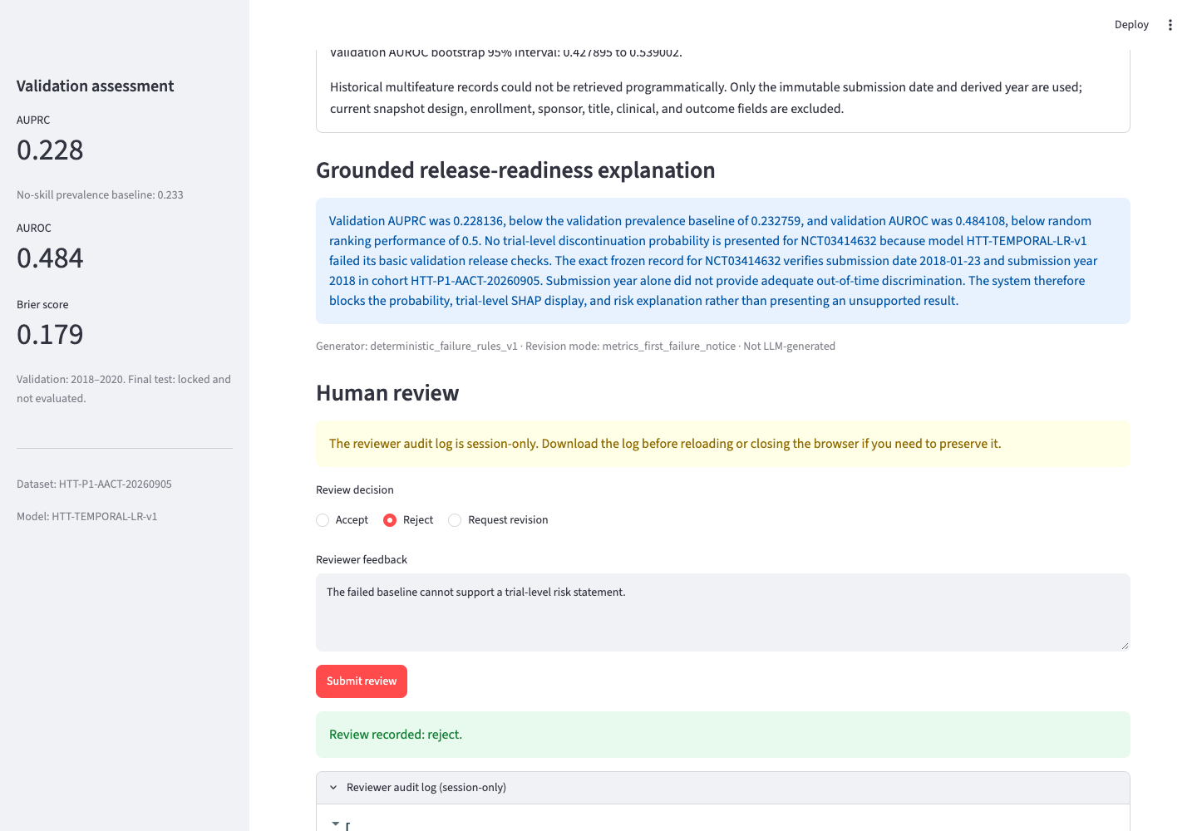
Human review and revision
Session-only review with a downloadable audit record
Implemented controls
Accept records approval
Reject requires a reason
Revision changes emphasis
Stored facts remain fixed
Log clears after reload or close
Session-only log
Download before reloading
HeartTrialTwin | CS 5588 Challenge 2
8
Notes:
Actual screenshot captured from the local Streamlit app on 2026-09-20. The browser workflow verified accept, request revision, reject, and audit-log display.

Slide 9
Codex-assisted implementation
Human approval governed development. Runtime remains deterministic.
Human authority
Codex contributions
Runtime behavior
Approved task and constraints
Protected the final test
Reviewed validation evidence
Required blocked outputs
Authorized publication
Audited files and provenance
Implemented scoped code
Debugged and ran tests
Verified UI and screenshots
Prepared and validated slides
No autonomous runtime agent
No LLM or RAG
Deterministic safety output
Explicit human review
Published GitHub repository
github.com/akwasianing/HeartTrialTwin
Credentials and raw course files excluded
HeartTrialTwin | CS 5588 Challenge 2
9
Notes:
Sources: README.md, p1_app/app.py, test evidence, screenshot verification, presentation validation, and published repository https://github.com/akwasianing/HeartTrialTwin. Codex assisted development; the project owner approved scope, constraints, validation evidence, blocked outputs, and publication.

Slide 10
Tests, limitations, and next steps
8 software tests passed; model validation failed.
8 / 8
Test coverage
Evidence and review
Valid and invalid NCT selection
Development-only fit and split integrity
Probability consistency and output blocking
SHAP additivity
Exact-NCT provenance
Explanation fidelity and claim safety
Missing-evidence failure
Functional revision
software tests passed
0 failed / 0 skipped
MODEL VALIDATION
FAILED
Implemented
Safe failure application, provenance, deterministic explanation, human review, tests
Unfinished
A validated trial-level risk predictor and multifeature SHAP explanation
Next
Obtain verified historical predictors and add durable review storage before operational use
10
Notes:
Source: p1_app/TEST_RESULTS.md and p1_app/artefacts/pytest_results.xml. Current result: 8 passed, 0 failed, 0 skipped. Final test remains locked.

